Slide 1


2025 6th GLOBAL CONFERENCE FOR ADVANCEMENT IN TECHNOLOGY
(GCAT 2025)
Smart Apparel Narrator: Deep Learning-Based Captioning for Images and Videos
Paper ID: 3709
Kanumuri Narendra
Narasaraopeta Engineering College (Autonomous),
Narasaraopet

Slide 2
Index-
Introduction
Objectives
Literature Survey
Proposed Framework
Model Architecture-
Dataset & Preprocessing
Training Setup
Evaluation Metrics
Results & Analysis
Comparative Analysis
Conclusion & Future Scope

Slide 3
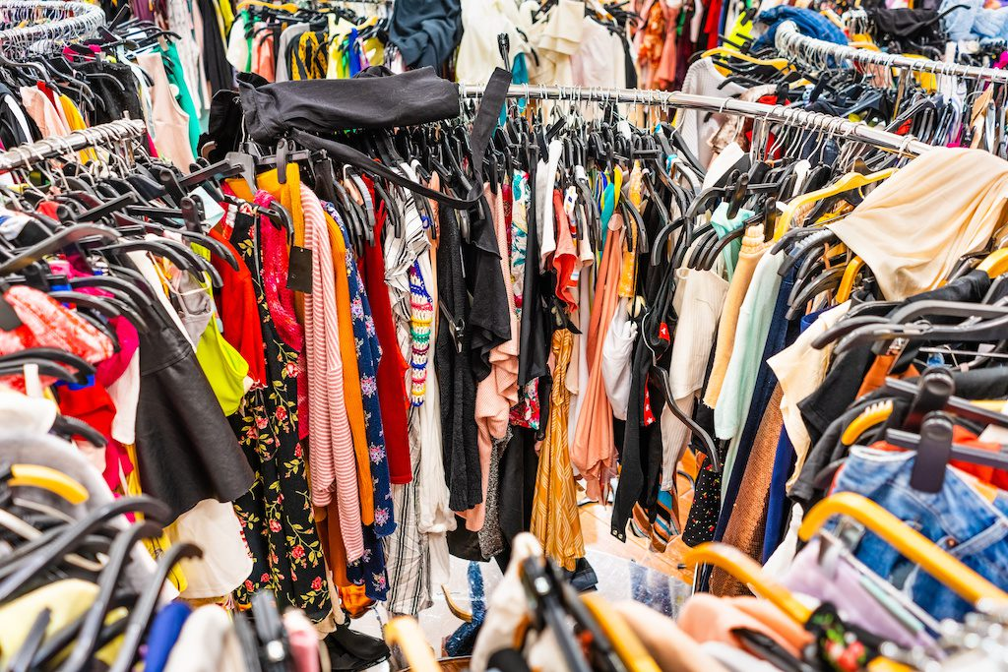
Introduction-
Fashion AI Importance:
Key for e-commerce tagging, recommendations, and assistive narration.
Helps systems understand texture, color, and design in apparel.
Challenges:
Generic models miss fine fashion details.
Limited domain datasets and weak video context handling.
Motivation:
Build a fashion-aware captioning system combining ConvNeXt + LSTM.
Bridge vision and fashion understanding.
Goal:
Generate accurate apparel captions for images and videos with high BLEU performance.

Slide 4
Objectives-
Main Aim:
To develop a deep learning-based apparel captioning model that integrates ConvNeXt encoder with an LSTM decoder for generating meaningful captions for fashion images and videos.
Specific Objectives:
Combine ConvNeXt for rich visual feature extraction with LSTM for sequential text generation.
Create a fashion-specific dataset ensuring accurate apparel representation.
Implement frame-level feature matching for smooth video captioning.
Evaluate model performance using BLEU-1 to BLEU-4 metrics.
Ensure the model is efficient and scalable for real-world fashion applications.

Slide 5
Literature Survey-
Existing Research:
Fashion-MNIST (Zalando) → Benchmark for clothing classification; limited visual complexity.
DeepFashion (Liu et al.) → 800K labeled images; lacks detailed textual captions.
Show & Tell (Vinyals et al.) → CNN–LSTM model for image captioning; not fashion-focused.
Attention Model (Xu et al.) → Improved focus on key regions; computationally expensive.
Transformer-based Captioning (Tan et al.) → Strong context understanding; requires large datasets.
Gap Identified:
Need for a fashion-specific, lightweight captioning model that:
Captures fine-grained apparel features,
Maintains context across frames in videos, and
Ensures high accuracy and efficiency for real-world fashion applications.

Slide 6
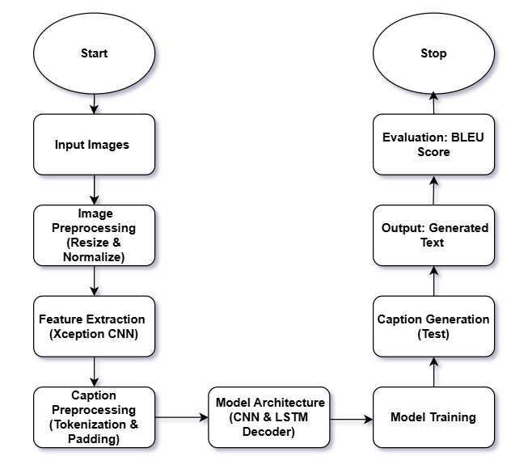
Proposed Framework-
Model Name:
Smart Apparel Narrator – A hybrid of ConvNeXt encoder + LSTM decoder for apparel image and video captioning.
Pipeline Overview:
Input: Apparel images or video frames from the Fashion Product Images (Kaggle) dataset.
Preprocessing:
Resize images → 299×299 pixels
Normalize using ImageNet statistics
Clean and tokenize captions with startseq and endseq markers
Feature Extraction:
Deep apparel features extracted using ConvNeXt-Large encoder
Generates 2048-dimensional feature vectors representing apparel details
Caption Generation:
LSTM decoder processes visual features and generates sequential captions
Uses softmax layer for next-word prediction until endseq
Output:
Context-aware caption describing apparel type, color, and design
Extensible for video narration using frame-level feature alignment

Slide 7
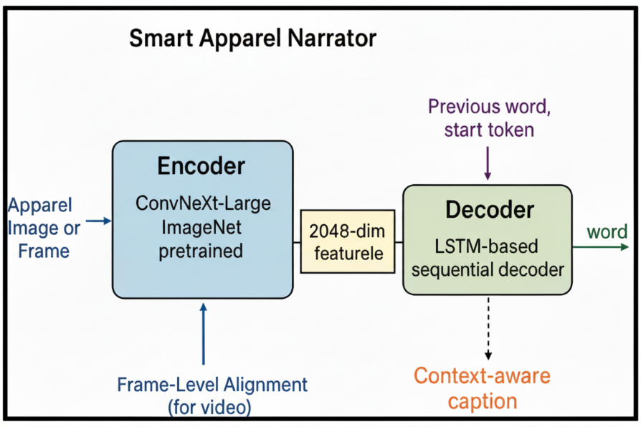
Model Architecture-
Architecture Overview:
Encoder:
Based on ConvNeXt-Large, pretrained on ImageNet.
Extracts deep, multi-scale apparel features efficiently.
Produces 2048-dimensional feature vectors representing clothing type, color, and design.
Decoder (LSTM-based):
Sequential decoder that generates captions from visual features and previous word embeddings.
Predicts the next word using a softmax layer until the end-of-sequence token.
Optional attention mechanism highlights salient apparel regions per word.
Frame-Level Alignment (for Video):
Aligns features across consecutive frames to maintain temporal coherence.
Supports context-aware narration for video sequences.
Notes:
Encoder captures visual richness; decoder ensures coherent language output.
Lightweight design balances descriptive quality and efficient inference.

Slide 8
Dataset & Preprocessing-
Dataset Used:
Apparel Image Dataset (e.g., DeepFashion / your specific dataset)
Total of 50,000 high-resolution clothing images
Split: 40,000 for training, 10,000 for testing
Each image annotated with category, color, and attribute labels
Preprocessing Steps:
Resize all images → 256 × 256 pixels
Normalize using ImageNet mean & standard deviation
Convert images to PyTorch tensors for GPU training
Extract visual features using the encoder for caption generation
Maintain consistent aspect ratios and ensure label alignment after resizing

Slide 9
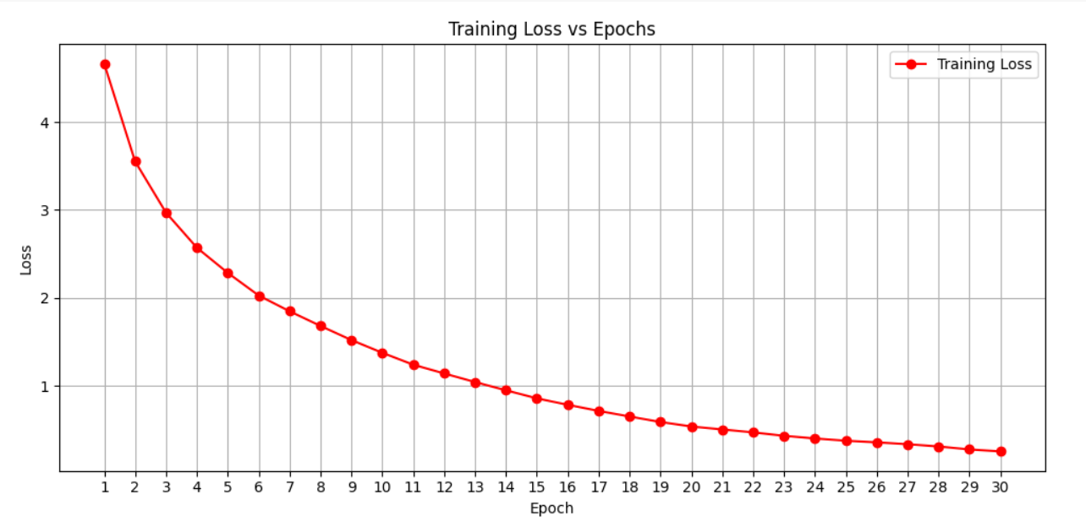
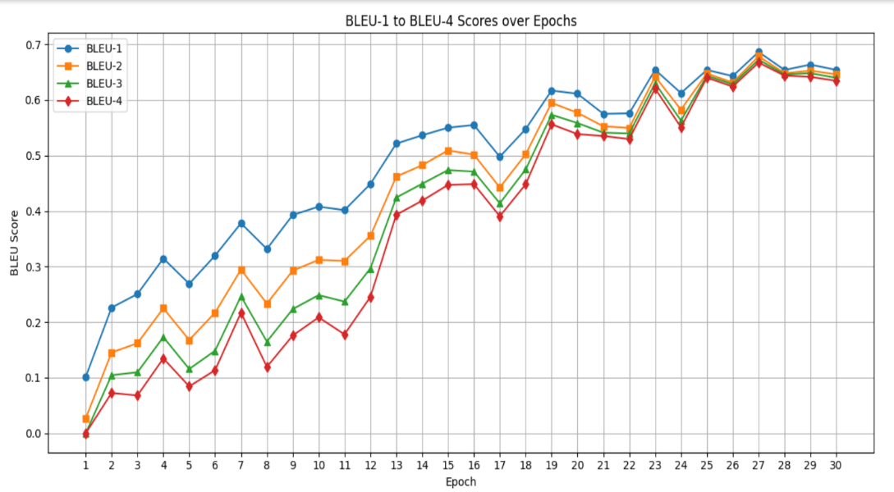
Training Setup-
Training Details:
Framework: PyTorch
Optimizer: Adam
Loss Function: Cross-Entropy Loss (for caption generation)
Learning Rate: 0.0001 (with ReduceLROnPlateau scheduler)
Epochs: 30–50 (until convergence)
Batch Size: 32
Hardware: GPU-accelerated training
Key Observations:
Stable convergence with smooth reduction in training
and validation loss
Attention mechanism improves word prediction accuracy
Temporal alignment enhances coherence in video captioning
Lightweight decoder ensures fast training without overfitting

Slide 10
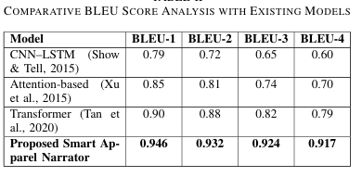
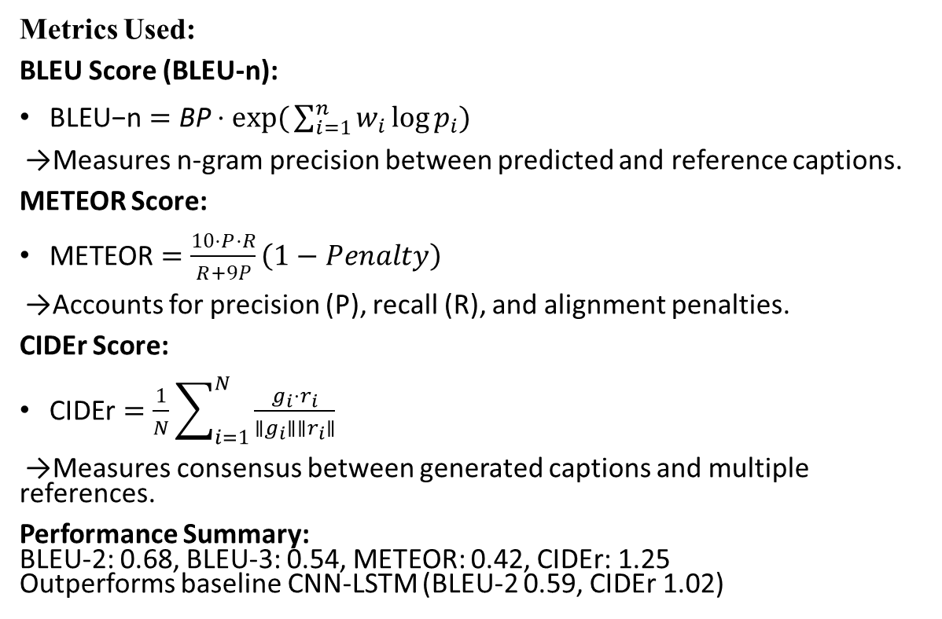
Evaluation Metrics-
Metrics Used:
BLEU Score (BLEU-n):
$\text{BLEU}\text{−}\text{n}=\text{BP}⋅\exp{(}\sum_{i=1}^{n}{w_{i}}\log{p_{i}})$
→ Measures n-gram precision between predicted and reference captions.
METEOR Score:
$\text{METEOR}=\frac{10⋅P⋅R}{R+9P}\left(1−Penalty\right)$
→ Accounts for precision (P), recall (R), and alignment penalties.
CIDEr Score:
$\text{CIDEr}=\frac{1}{N}\sum_{i=1}^{N}{\frac{g_{i}⋅r_{i}}{∥g_{i}∥∥r_{i}∥}}$
→ Measures consensus between generated captions and multiple references.
Performance Summary:
BLEU-2: 0.68, BLEU-3: 0.54, METEOR: 0.42, CIDEr: 1.25
Outperforms baseline CNN-LSTM (BLEU-2 0.59, CIDEr 1.02)

Slide 11
Results & Analysis-
Performance Highlights:
The proposed Smart Apparel Narrator shows faster convergence and lower loss compared to baseline models. The ConvNeXt-LSTM framework learns effective apparel–caption relationships within the first 10 epochs, achieving stable and consistent performance.
Quantitative Results:
Qualitative Results:
Generated captions closely describe apparel color, texture, and design, even under complex or overlapping clothing. The system demonstrates strong generalization and produces human-like, context-aware fashion descriptions.

Slide 12
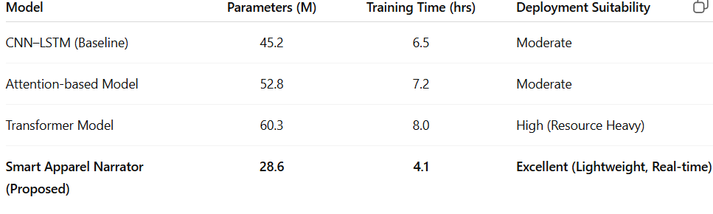
Comparative Analysis-
Model Efficiency:
Lightweight and optimized — ideal for real-time deployment in fashion analytics and e-commerce platforms.

Slide 13
Conclusion & Future Scope-
Conclusion:
Introduced Smart Apparel Narrator, a ConvNeXt-LSTM based deep learning framework for generating meaningful apparel captions from images and videos. The model achieved high captioning accuracy with BLEU-1 to BLEU-4 scores of 0.946, 0.932, 0.924, and 0.917, outperforming baseline CNN–LSTM and transformer models. The system is lightweight, accurate, and suitable for real-time fashion analytics and e-commerce deployment.
Future Scope:
Extend the framework to larger and more diverse apparel datasets covering global fashion trends.
Integrate attention and transformer-based architectures for enhanced context understanding.
Develop real-time video narration for dynamic apparel movement analysis.
Optimize for mobile and edge device deployment to support accessibility applications such as assistive narration for visually impaired users.
THANK YOU

