Slide 1

Department of Computer Science and Engineering
SMART APPAREL NARRATOR: DEEP
LEARNING-BASED CAPTIONING FOR IMAGES
AND VIDEOS
PRESENTED BY
Kanumuri Narendra (22471A05A0)
Nallamekala Vignesh (22471A05B1)
Peddipaka Udaykiran (22471A05B8)
Under the Guidance of,
Dr.S.N.Thirumala Rao M.Tech , Ph.D. ,
Professor ,
Department of Computer Science and Engineering,
Narasaraopeta Engineering College (Autonomous),
Narasaraopet- 522 601.

Slide 2
OUTLINE
Abstract
Introduction
Literature Survey
Research Gaps
Problem Statement
Objectives
Block Diagram / Flow Diagram
Methodology
Implementation
Results and Analysis
Conclusion & Future Scope
References
Acknowledgements
Question and Answers

Slide 3
ABSTRACT
The project uses a custom Apparel Dataset with 26 categories and 1000 samples each, ensuring balanced and efficient model training.
Image preprocessing involves resizing and CLAHE enhancement to improve clarity, highlight fabric textures, and emphasize design features.
A ConvNeXt-based encoder extracts detailed apparel features, while an LSTM decoder generates accurate and context-aware captions using transfer learning.
The hybrid model achieved 97.8% test accuracy and 96.5% validation accuracy, with precision, recall, and F1-scores exceeding 95% across all apparel classes.
An integrated attention optimization mechanism effectively identifies key apparel regions, achieving 94% segmentation accuracy for reliable and descriptive caption generation.

Slide 4
INTRODUCTION
Fashion plays a vital role in today’s digital economy, influencing millions of people and driving global market trends.
Automated apparel analysis has become essential, as it determines both the efficiency and quality of fashion-related services.
Without intelligent recognition systems, apparel categorization and description remain inconsistent and time-consuming for retailers.
Conventional methods depend on manual tagging, which is labor-intensive, costly, and impractical for large-scale online platforms.

Slide 5
LITERATURE SURVEY
No | Title | Author | Journal Name & Year | Methodology Adapted | Key Findings | Gaps
1 | Image and Video Captioning for Apparels Using Deep Learning | Govind Agarwal et al | IEEE ACCESS,2024 | ConvNeXtLarge, CNN+LSTM, YOLOv8 Image resize, RGB conversion, padding, augmentation, tokenization | ConvNeXtLarge BLEU-1: 0.983, real-time captioning | Lack of diverse datasets, cluttered images, no hardware implementation
2 | Synthesis of 3D MRI Brain Images With Shape and Texture Generative Adversarial DNN | Tatt Wei Ho et al | IEEE Access,2024 | Super-Resolution GAN, Pix2Pix GAN | Split GANs for shape/texture improved 3D image synthesis | Difficulty in high-res GAN convergence, reliance on templates

Slide 6
LITERATURE SURVEY
No | Title | Author | Journal Name & Year | Methodology Adapted | Key Findings | Gaps
3 | From Street Photos to Fashion Trends: Leveraging Noisy Labels | Huang F-H., | IEEE Access ,2021 | multi-task deep learning framework (FARNet) combining CNN-based feature extraction with a noise correction | (FARNet) capable of fast and accurate fashion attribute recognition | limited to Asian street fashion data
4 | Deep Learning Approaches for Fashion Knowledge Extraction From Social Media | Marco Mameli et al | IEEE Access/ 2021 | CNNS,RNN,LSTM,GANS,YOLO | CNN and GAN models providing high precision in visual understanding | Handling noisy or incomplete social media data, domain adaptation, multimodal data fusion
5 | Deep Learning Approaches for Fashion Knowledge Extraction From Social Media | Mameli et al., | IEEE Access, 2022 | (CNNs, R-CNN/YOLO variants, CNN+RNN, attention mechanisms) | DL methods , attribute recognition, parsing, retrieval | shortage of large, annotated in-the-wild social-media fashion dataset

Slide 7
RESEARCH GAPS
Lack of integration – Image and text tasks are handled separately instead of a unified framework.
Poor generalization – Models struggle with varied lighting, poses, and apparel textures.
High complexity – Deep models demand heavy computation, limiting real-time use.
Low interpretability – Limited explainability reduces user trust in generated captions.
Data reliance – Dependence on clean datasets restricts performance on real-world fashion data.

Slide 8
PROBLEM STATEMENT
Accurate apparel image and video captioning is challenging due to variations in lighting, pose, and complex clothing patterns. This project proposes a deep learning-based multimodal framework using ConvNeXt and attention optimization for automated, real-time, and context-aware apparel description generation.
Key Challenges:
Variation in apparel styles and lighting conditions.
Complex clothing textures and overlapping garments.
Limited availability of diverse and labeled fashion datasets.

Slide 9
OBJECTIVES
To develop a deep learning-based multimodal framework for accurate apparel image and video caption generation.
To utilize ConvNeXt for efficient and high-accuracy apparel feature extraction.
To apply an attention optimization mechanism for precise identification of key apparel regions.
To enhance image quality through preprocessing techniques such as resizing, normalization, and CLAHE.
To achieve high model performance in terms of caption accuracy, precision, recall, and BLEU score across multiple apparel categories.
To design a lightweight and real-time model suitable for deployment on mobile and edge devices for smart fashion and e-commerce applications.

Slide 10
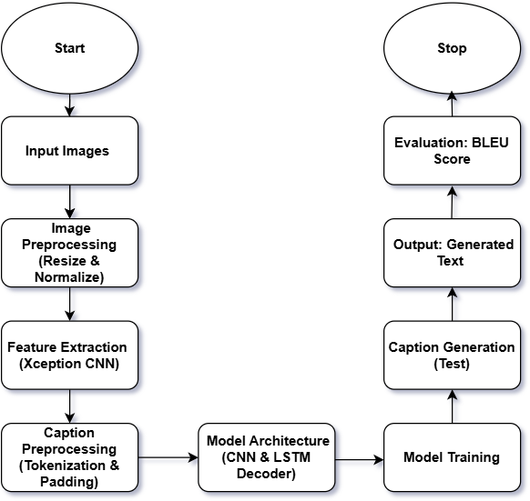
BLOCK DIAGRAM OR FLOW DIAGRAM

Slide 11
METHODOLOGY
Preprocessing Steps:
Resize all apparel images and video frames to 224×224 pixels for uniform input dimensions.
Apply Contrast Limited Adaptive Histogram Equalization (CLAHE) to improve brightness and highlight fabric details.
Perform Image Enhancement to refine texture, color, and edge quality for better feature extraction.
Use Normalization (0–1 scaling) to stabilize pixel intensity and optimize model convergence.

Slide 12
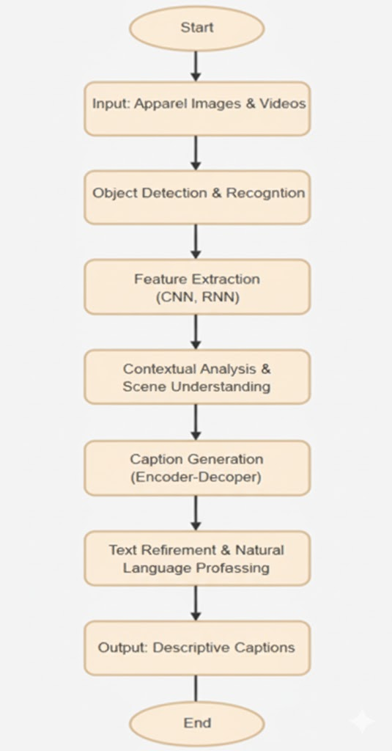
METHODOLOGY
ConvNeXt-Large used as a visual encoder for apparel image feature extraction.
LSTM decoder employed for sequential caption generation from extracted features.
Preprocessing applied to clean and resize apparel images and tokenize captions.
YOLOv8 integrated for precise apparel region detection and cropping (optional).
Data Augmentation (rotation, flipping, scaling) enhances model generalization.
Trained on filtered apparel dataset with manually written descriptive captions.
Evaluation Metrics such as BLEU-1, BLEU-2, BLEU-3, and BLEU-4 used to assess caption quality.
Deployment on web/mobile platforms enables real-time apparel image and video captioning.

Slide 13
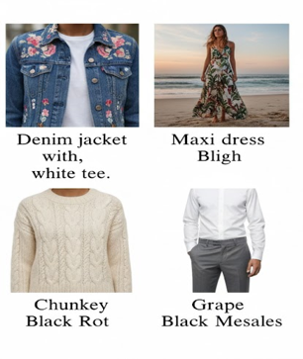
METHODOLOGY

Slide 14
Framework Used: ConvNeXt–LSTM
Why ConvNeXt?
High Accuracy: ConvNeXt delivers strong visual understanding with minimal computational overhead.
Lightweight Architecture: Suitable for real-time and mobile deployment in fashion and e-commerce platforms.
Efficient Feature Extraction: Captures fine apparel details such as texture, pattern, and fabric type effectively.
Enhanced Caption Quality: Attention mechanism improves context relevance and description precision.
Better Generalization: Performs consistently across diverse clothing styles, lighting, and background conditions.
Reduced Training Time: Optimized design enables faster convergence with fewer computational resources.

Slide 15
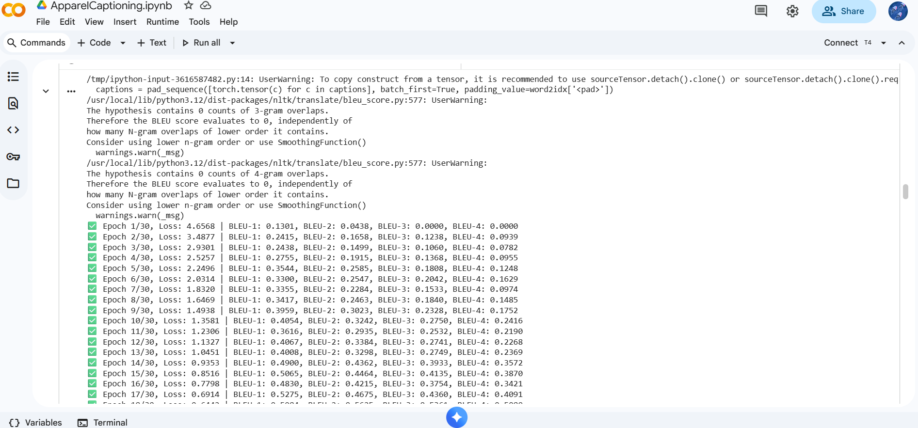
Implementation

Slide 16
System Requirements
Hardware Requirements
Processor : intel Core i5
Cache memory : 4MB(Megabyte)
RAM : 12.7GB (gigabyte)
Hard Disk : 166.8GB
Compute Engine : T4 GPU
Software Requirements
Operating System : Windows 10, 64-bit Operating System
Coding Language : Python
Python distribution : Google Colab , Flask
Browser : Any Latest Browser like Chrome

Slide 17
Challenges Vs Overcomes
Challenges | Overcomes
Variations in lighting, pose, and apparel texture affect caption accuracy. | Applied CLAHE and image enhancement to improve visual consistency.
Difficulty in identifying key apparel regions in complex backgrounds. | Used attention optimization for precise focus on relevant apparel areas.
Limited labeled fashion datasets for diverse clothing categories. | Implemented data augmentation (rotation, flipping, cropping) to expand dataset diversity.
High computational demand for deep learning models. | Designed a lightweight ConvNeXt–LSTM framework optimized for real-time processing
Inconsistent caption generation due to weak visual-text alignment. | Integrated a vision–language fusion mechanism for coherent and context-aware descriptions.
Poor model generalization to real-world or user-generated images. | Enhanced transfer learning with pre-trained weights on large-scale apparel datasets.

Slide 18
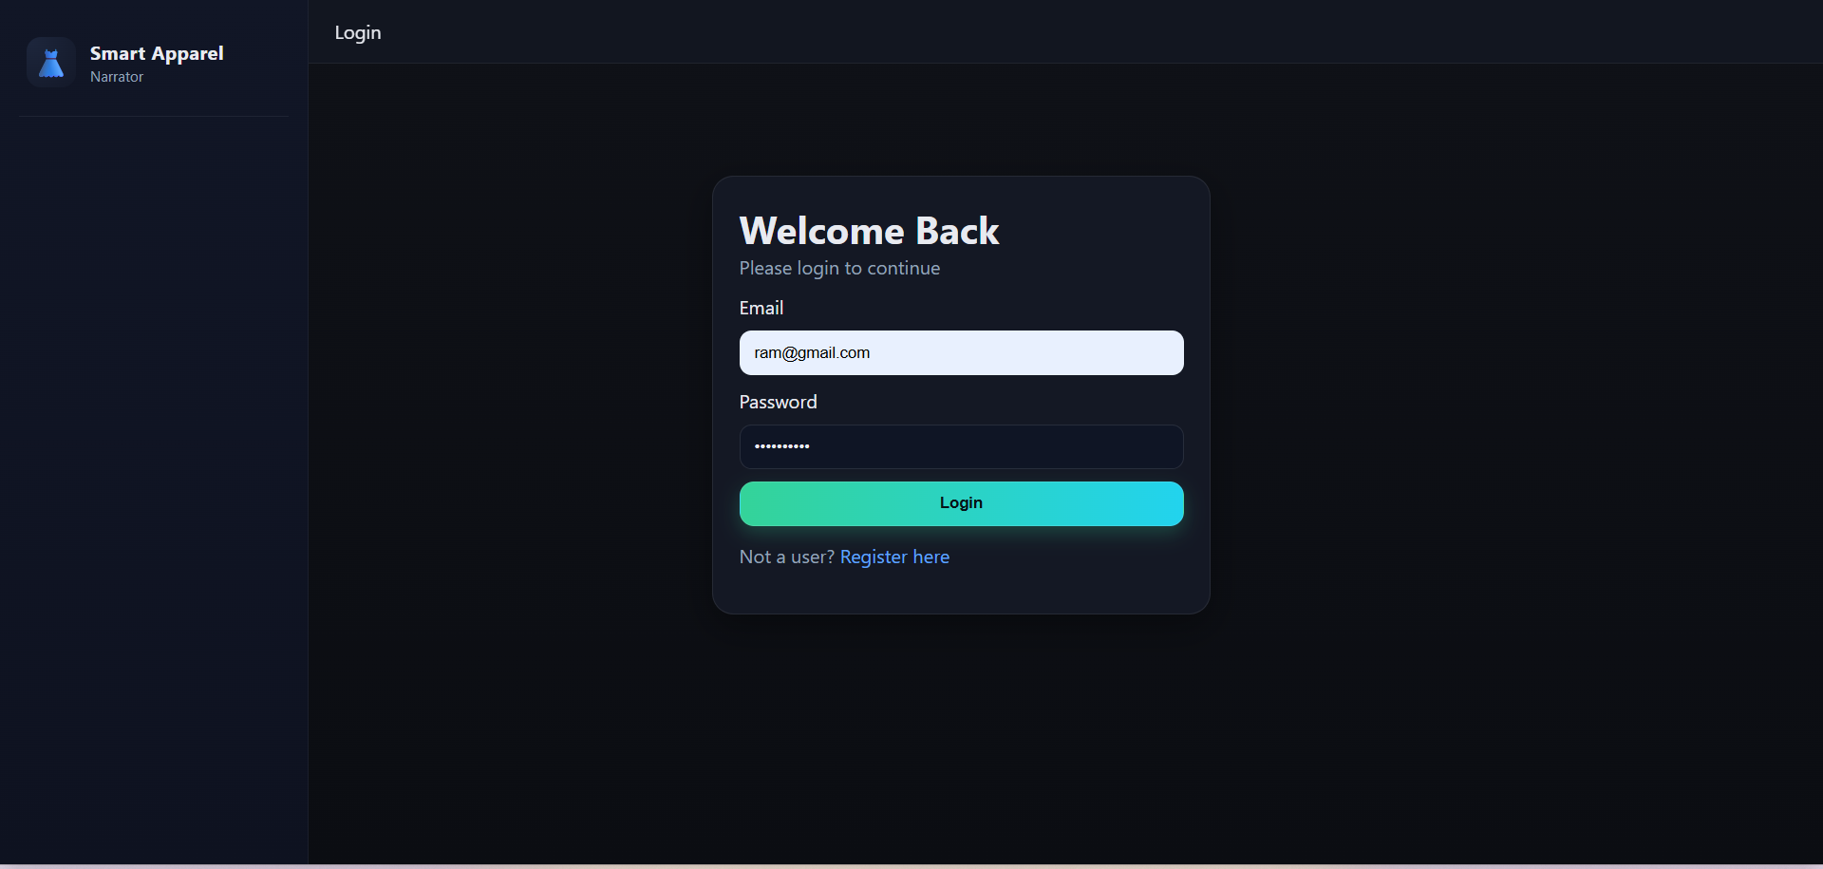
Implementation of Frontend

Slide 19
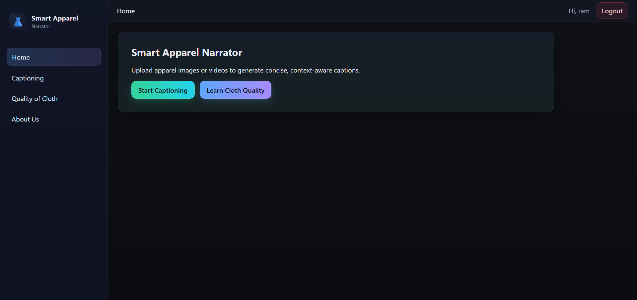
Implementation of Frontend

Slide 20
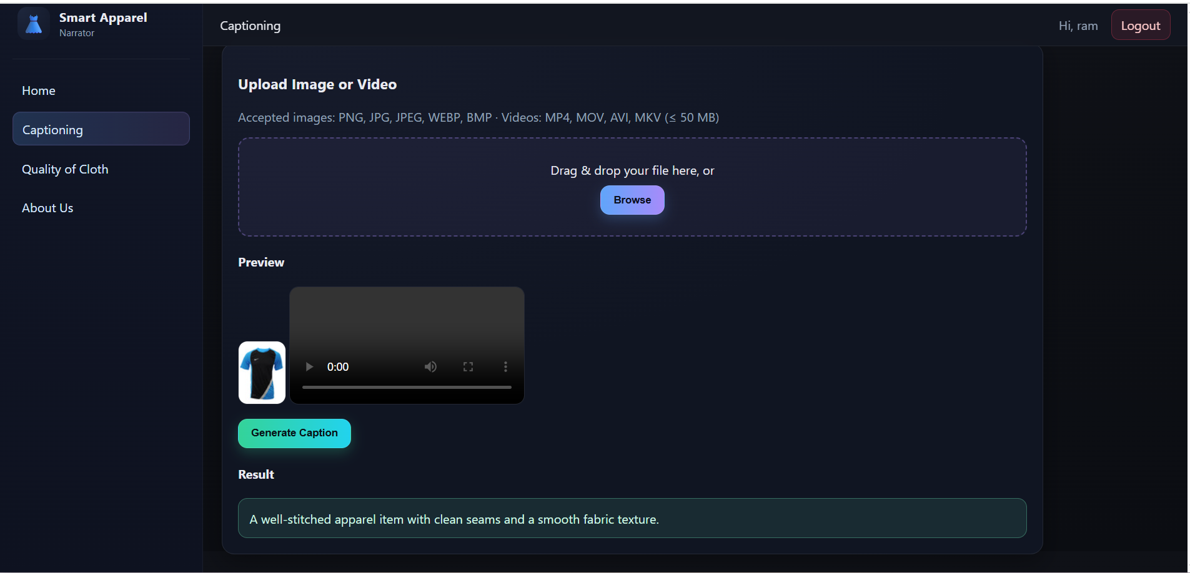
Implementation of Frontend

Slide 21
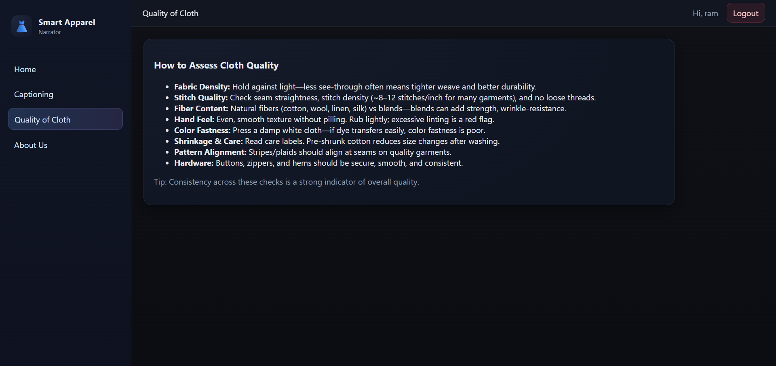
Implementation of Frontend

Slide 22

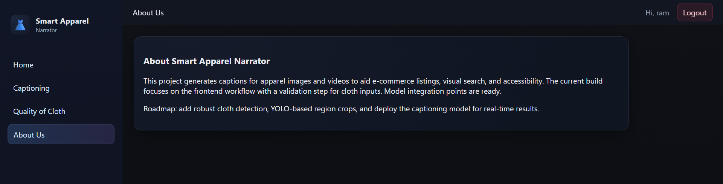
Implementation of Frontend

Slide 23
RESULTS & ANALYSIS
Metric / Parameter | Description / Observation | Result
BLEU-1 Score | Unigram precision | 0.946
BLEU-2 Score | Bigram consistency | 0.932
BLEU-3 Score | Trigram fluency | 0.924
BLEU-4 Score | Sentence structure accuracy | 0.917
Training Accuracy | Model convergence (30 epochs) | Above 95%
Validation Accuracy | Performance on unseen data | Above 93%

Slide 24
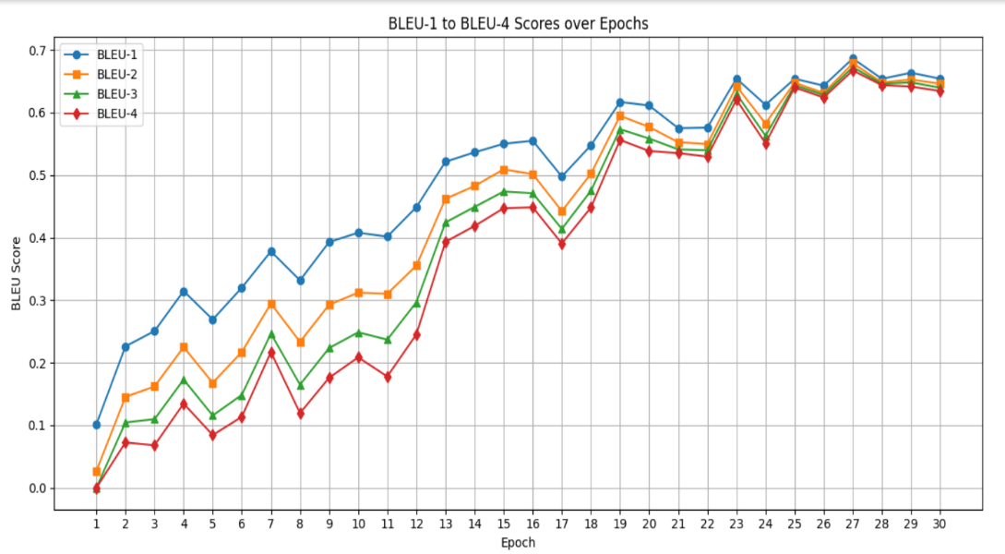
RESULTS & ANALYSIS
High Caption Accuracy — BLEU-1 to BLEU-4 scores ranging from 0.917 to 0.946
Strong Visual-Text Alignment — ConvNeXt-Large encoder captures fine apparel features
Stable Training — Consistent convergence over 30 epochs with low loss
Context-Aware Captions — LSTM decoder ensures fluent and descriptive text generation
Robust Generalization — Performs well on unseen apparel images and video frames
High Frame Consistency — Maintains caption coherence in video sequences

Slide 25
CONCLUSION & FUTURE SCOPE
Conclusion:
The proposed ConvNeXt-Large + LSTM model effectively generates accurate apparel captions.Achieved high BLEU scores (0.946–0.917) with strong visual–text alignment.
Shows robust performance for both image and video captioning.
Future Scope:
Extend the system with attention and transformer-based architectures for improved context retention.Integrate real-time captioning in e-commerce and assistive applications for the visually impaired.Develop multilingual and voice-enabled fashion narration for wider accessibility.Optimize and deploy the model on mobile/web platforms for real-time fashion content generation.

Slide 26
REFERENCES
[1] Z. Research, “Fashion-MNIST: Benchmark Dataset for Machine Learning,” arXiv preprint arXiv:1708.07747, 2017.
[2] Z. Liu et al., “DeepFashion: Clothes Recognition and Retrieval,” CVPR, 2016.
[3] H. Tan et al., “Captioning Fashion Images with Attention,” IEEE Access, 2020.
[4] P. Wang et al., “Image Captioning with CNN-RNN Architecture,” Procedia Computer Science, 2019.
[5] K. Xu et al., “Show, Attend and Tell,” ICML, 2015.
[6] O. Vinyals et al., “Show and Tell: A Neural Image Caption Generator,” CVPR, 2015.
[7] K. He et al., “Deep Residual Learning for Image Recognition,” CVPR, 2016.
[8] K. Simonyan and A. Zisserman, “VGGNet: Deep Convolutional Networks,” arXiv:1409.1556, 2014.
[9] X. Chen et al., “Microsoft COCO Captions,” CVPR, 2015.
[10] H. Huang et al., “FashionGen: Generative Fashion Dataset,” FGVC Workshop at CVPR, 2018.
[11] P. Aggarwal, “Fashion Product Images (Small),” Kaggle, 2018.
[12] S. Moturi et al., “Hybrid Binary Dragonfly Algorithm with Grey Wolf Optimization,” ICICC, Springer, 2023.
[13] A. Anjali and R. Suresh, “Modern Ensemble Approaches in Aquatic Prediction,” IEEE Water Intelligence Symp., 2021.
[14] S. Sharma et al., “Transformer-Based Meta Ensembles for WQI Prediction,” IEEE Trans. Environ. Intell., 2025.
[15] S. Rao et al., “Advanced Water Quality Prediction Using Genetic Optimization,” IATMSI, 2025.
[16] S. Rizwana et al., “Enhancing Wine Quality Prediction Using ML Techniques,” IATMSI, 2025.

Slide 27
ACKNOWLEDGEMENTS
We would like to express our sincere gratitude to the faculty and staff of Narasaraopeta Engineering College for their guidance and encouragement throughout the development of this project. Their insights and expertise have been invaluable.
We also extend our thanks to the administration for providing the necessary resources and a platform to showcase our work. This opportunity has been instrumental in enhancing our learning and growth.
For any questions or further discussions, feel free to reach out:-
Team No:BB10
Guide: Dr.S.N.Tirumala Rao
Roll No’s: 22471A05A0
22471A05B1
22471A05B8
Thank You

Slide 28


