Slide 1


2025 6th GLOBAL CONFERENCE FOR ADVANCEMENT IN TECHNOLOGY
(GCAT 2025)
TransAugNet: Transformer-Aware Cyclic Augmentation for Biomedical Image Analysis
Paper ID: 2438
Ashok Nimmala
Narasaraopeta Engineering College (Autonomous),
Narasaraopet

Slide 2
Index-
Introduction
Objectives
Literature Survey
Proposed Framework
Model Architecture
Dataset & Preprocessing
Training Setup
Comparison with other works
Conclusion & Future Scope

Slide 3
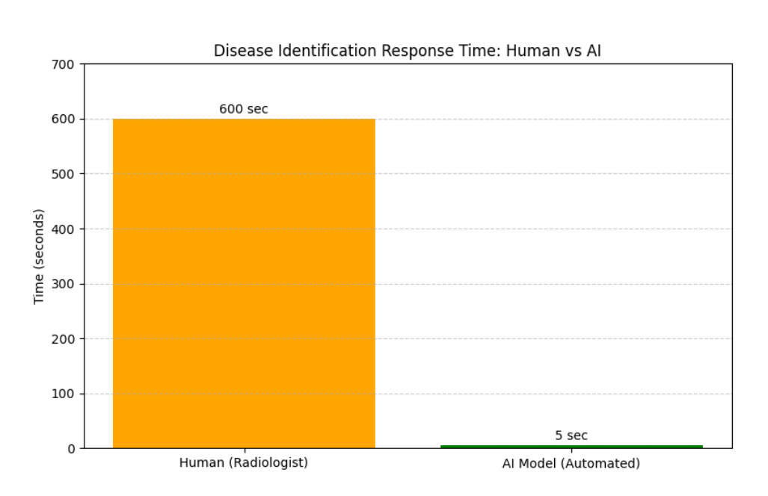
Introduction-
Medical Imaging Importance:
Medical imaging (like X-ray, MRI, CT) plays a vital role in diagnosing diseases.
Early and accurate detection can save lives and improve treatment planning.
Challenges in Traditio
nal Methods:
Manual interpretation by specialists is time-consuming and subjective.
Early-stage diseases are often missed due to complex imagery and human limitations.
Delayed or incorrect diagnosis can lead to life-threatening situations.
Motivation:
To overcome human limitations, automated diagnosis using Deep Learning is essential.
Traditional 2D models fail to capture complex 3D medical structures effectively.

Slide 4
Objectives-
Main Aim:
To develop an deep learning model that accurately identifies and classifies diseases using Cyclic Augmentation through ResNet3D-50 for efficient medical image analysis.
Specific Objectives:
Automate disease diagnosis for 3D medical imagery to reduce human error and response time.
Convert 3D medical images into stacked 2D slices for better learning and classification.
Integrate Transformer Attention with ResNet3D-50 for improved spatial and contextual understanding of images.
Use MedMNIST 3D datasets (Adrenal and Vessel) to verify the model’s robustness and adaptability.

Slide 5
Literature Survey-
Existing Research:
Microscopic(Wanying Li) –→ Improved microscopic image augmentation but failed to handle large-scale datasets.
GraphRNN (VALENTINA SÁNCHEZ) → Proposed GraphRNN for fMRI image graphs, limited to time-series data only.
DuCo-Net (Zahid ur Rahman) → Developed DuCo-Net, a Dual-Contrastive Learning Network for medical reports. Faced issues with limited contrastive learning.
PRCNet (Ahmeed Suliman Farham) → Introduced PRCNet for brain MRI augmentation. Improved feature extraction but suffered from low data diversity
VGG and cGAN (Hafsa Laçi) → Used VGG and cGAN for X-ray and MRI classification. Effective for 2D data but lacked multimodal 3D analysis.
Gap Identified:
Need for a deep learning model that:
Is not limited to 2D medical images and can effectively capture the spatial depth of 3D data.
that can generalize well even with limited and diverse training data, and
that supports real-time and clinically deployable diagnosis.

Slide 6
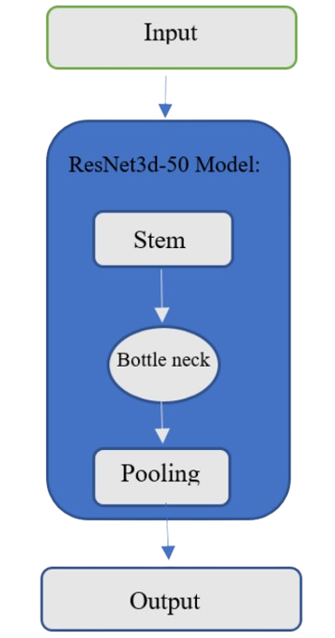
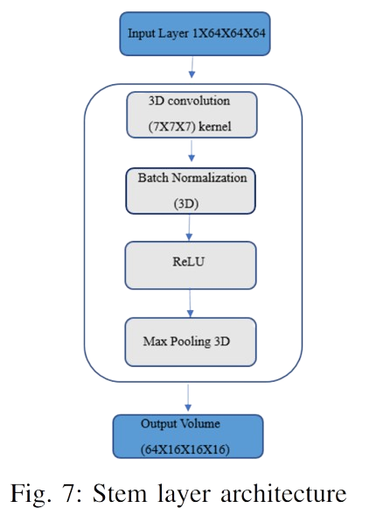
Proposed Framework-
Model Name:
TransAugNet- Transformer-Aware Cyclic Augmentation for Biomedical
Image Analysis
Pipeline Overview:
Input: High-resolution 3D medical images
Preprocessing:
  Resize images → 256×256
  Convert 3D images to single-channel grayscale 2D slices.
  Applies Transormer-Aware Cyclic Augmentation.
Feature Extraction:
  The ResNet3D-50 model extracts volumetric features.
  The encoder consists of a Stem Layer followed by four Residual
  Block Groups.
Classification Head:
  Global Average Pooling (GAP) converts 3D feature maps into a
  concise vector summary.
Output:
  Predicted class probabilities for disease presence or absence.
ResNet3D-50 and STEM architecture

Slide 7
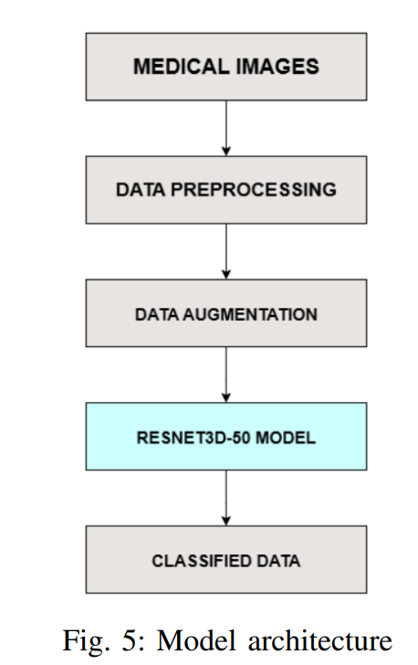
Model Architecture-
The overall model architecture follows a sequential flow for disease diagnosis:
Medical Images(Input): The flow begins with medical images as the input.
Data Preprocessing: The images first undergo preprocessing steps, such as Grayscale conversion, Normalization, and Resizing.
Data Augmentation: The preprocessed images enter the data augmentation phase, where they are transformed using different techniques, including the primary Cyclic Augmentation
ResNet3D-50 Model: The augmented data then enters the ResNet3D-50 model phase.
  This model is the core component that extracts the volumetric features from the images.
  It uses a 3D variant of ResNet-50, converting 2D operations to their 3D counterparts.
Classified Data (Output): The final output is the classified image or prediction of the disease.

Slide 8
Dataset & Preprocessing-
Dataset Used:
The proposed model was trained using the MedMNIST dataset — a benchmark collection for biomedical image analysis.
Contains 12 two-dimensional subsets and 6 three-dimensional subsets of medical imagery
Major 3D Datasets Used: AdrenalMNIST and VesselMNIST
Preprocessing Steps:
Resizing: All images were resized to 224 × 224 to match model input requirements.
Normalization: Applied ImageNet normalization for consistent pixel intensity distribution.
Grayscale Conversion: 3D images were converted to single-channel grayscale format.
Slicing: 3D volumetric images were split into 2D cross-sectional slices to feed into the ResNet3D-50 model efficiently.

Slide 9
Training Setup-
Parameter | Configuration/Description
Input Size | 1 × 64 × 64 × 64
Batch Size | 16
Epochs | 20
Optimizer | Adam
Learning Rate | 0.0001
Loss Function | Cross Entropy
Spatial Dimensions | 3
Smoothing Techniques | Gaussian Blur
Regularization | Applied to prevent overfitting
Output Channels | 2

Slide 10
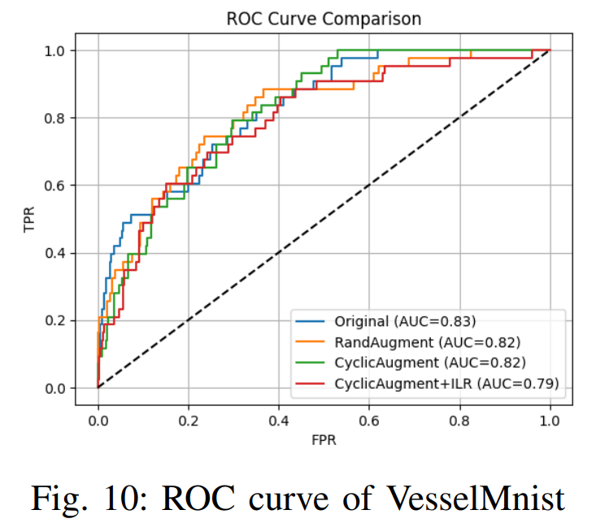
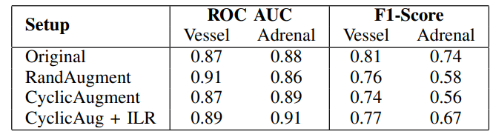
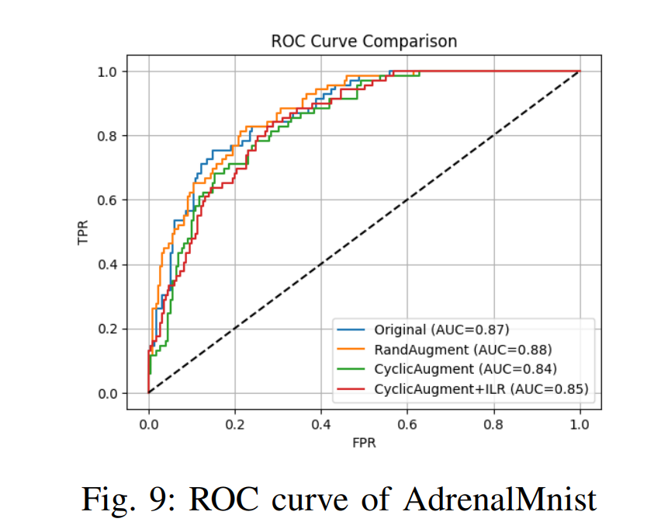
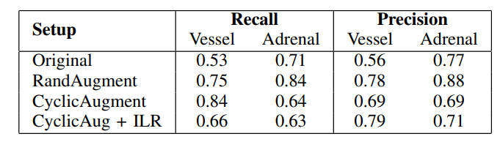
Results & Analysis-

Slide 11
Comparison with Other Works
Handling 3D Data: TransAugNet uses the ResNet3D-50 backbone to overcome the limitation of models like MIN-JUN KIM's approach, which primarily focused on 2D datasets.
Feature Enrichment: The approach integrates transformer attention into the ResNet3D-50 backbone , which helps the model understand spatial patterns better and improves diagnostic accuracy. Existing methods sometimes lacked this transformer-based segmentation.
The CyclicAug + ILR setup provided superior or competitive results, achieving the highest ROC-AUC of 0.91 and the highest F1-Score of 0.77.

Slide 12
Conclusion & Future Scope-
Conclusion:
TransAugNet was introduced as a deep learning technique for accurate identification of diseases through medical images.
The model uses the ResNet3D-50 backbone with Transformer-Aware Cyclic Augmentation for precise monitoring and diagnosis of diseases.
The model demonstrated robust performance across Adrenal and Vessel-related diseases.
Future Scope:
Further Exploration of multi-model data Augmentation for fMRI images, as it was a limitation in related work.
Specialized surveys on Diffusion Models (DMS) in augmentation could be used to further improve the data augmentation step.

Slide 13


