Slide 1

TransAugNet : Transformer-Aware Cyclic Augmentation for Biomedical Image Analysis

Slide 2
Department of Computer Science and Engineering
TransAugNet : Transformer-Aware Cyclic Augmentation for Biomedical Image Analysis
PRESENTED BY
Nimmala Ashok 22471A05B2
Chenna Reddy Sudheer Reddy 22471A0582
Yamarthy Venkata Krishna 22471A05D9
Under the Guidance of,
DR. S. N. Tirumala Rao,M.Tech, Ph.D.,
Professor ,
Department of Computer Science and Engineering,
Narasaraopeta Engineering College (Autonomous),
Narasaraopet- 522 601.

Slide 3
OUTLINE
Abstract
Introduction
Literature Survey
Research Gaps
Problem Statement
Objectives
Block Diagram / Flow Diagram
Methodology
Implementation
Results and Analysis
Conclusion & Future Scope
References
Question and Answers
Acknowledgements

Slide 4
ABSTRACT
Accurate identification of medical conditions is an important aspect of disease diagnosis. Over time, the doctors themselves need to analyze the disease of the patient. Doctors might not be able to detect the exact disease quite often. This leads to major damage to the patient, like delaying of diagnosis of the disease. In the worst case, this may lead to life-threatening conditions. To overcome these scenarios a deep learning technique named TransAugNet was introduced for accurate monitoring of disease through medical images. In recent times, due to advancements in AI, we can detect the disease accurately by using these deep learning techniques. It uses an approach of Cyclic Augmentation through the ResNet3D-50 model for precise monitoring and helps in diagnosing the disease. This ResNet3D-50 model mainly converts the three-dimensional image to a stack of two-dimensional image slices. These slices are being worked together and help in the prediction of the disease. By using this deep learning technique, the response time will be low, and it supports the doctor in identifying the disease faster. The response time was much lower when compared to older methods, which were introduced earlier. Our model uses Transformer-Aware Cyclic Augmentation, combining attention with cyclic intensity to better understand biomedical images and improve classification accuracy.

Slide 5
INTRODUCTION
Medical imaging (X-ray, MRI, CT) is vital for disease diagnosis but manual interpretation by specialists is time-consuming, subjective, and often misses early-stage symptoms.
Such delayed or inaccurate detection can lead to severe or life-threatening outcomes.
To overcome this, we propose TransAugNet — Transformer-Aware Cyclic Augmentation, a deep learning framework using ResNet3D-50 for automated and accurate disease identification.
The model converts 3D medical images into 2D slices, preserving spatial context for efficient training.
Cyclic Augmentation adaptively varies data intensity, improving generalization and reducing overfitting.
Integrated Transformer Attention enhances spatial understanding, leading to faster and more precise predictions compared to traditional 2D models.
Applied on VesselMNIST3D and AdrenalMNIST3D, the model achieves high diagnostic accuracy and low response time, supporting doctors in real-time disease analysis.

Slide 6
LITERATURE SURVEY
No | Title | Author | Journal Name & Year | Methodology Adapted | Key Findings | Gaps
1 | Advances in Diffusion Models for Image Data Augmentation | Panagiotis Alimisis, Ioannis Mademlis, Panagiotis Radoglou-Grammatikis, Panagiotis Sarigiannidis, Ge | Artificial Intelligence Review, 2025 | Systematic review of diffusion models (DMs) for image augmentation; comparison with GANs and classical methods. | DMs effectively enhance data diversity and realism in augmentation tasks. | Lack of domain-specific benchmarks and limited exploration in medical imaging.
2 | AI in Motion: Impact of Data Augmentation on MRI Motion Artifacts | Simon D. Westfechtel et al. | European Radiology, 2025 | nnU-Net trained with baseline, default, and MRI-specific augmentations. | MRI-specific augmentations improved segmentation under severe artifacts. | Limited to specific body parts and controlled environments.
3 | An Effective Microscopic Image Augmentation Approach (MIAA-FSL) | Wanying Li, Linhe Yang, Guangyao Pang, Zhenming Yu, Xiaoying Zhu | Scientific Reports, 2025 | Combines Conditional DDPM-based generation (CGMIGM) and semi-supervised SSLDAM for few-shot learning. | Improved identification accuracy by 24%, especially for rare microscopic features. | Needs evaluation on larger real-world datasets and generalization tests.

Slide 7
LITERATURE SURVEY
No | Title | Author | Journal Name & Year | Methodology Adapted | Key Findings | Gaps
4 | Combined Oriented Data Augmentation for Brain MRI | Ahmeed S. Farhan, Muhammad Khalid, Umar Manzoor | IEEE Access, 2025 | Oriented Combination MRI (OCMRI) using image fusion and mean squared error thresholds. | Accuracy improved by 5–8% after augmentation across four datasets. | Applicability to multi-modal MRI not explored.
5 | CyclicAugment: Optimized Medical Image Analysis via Adaptive Augmentation Intensity | Min-Jun Kim, Jung-Woo Chae, Hyun-Chong Cho | IEEE Access, 2025 | Introduced cyclic intensity variation in augmentations during training to maintain balance between weak and strong augmentations. | Improved accuracy up to 8.8% across diverse medical datasets. | Need for real-time adaptive augmentation systems and domain-specific validations.
6 | Data Augmentation Techniques for fMRI Data: A Technical Survey | Valentina Sánchez, Çiçek Güven, Gonzalo Nápoles, Marie Šafář Postma | IEEE Access, 2025 | Survey of image-, time-series-, and graph-based augmentation techniques | Provides structured taxonomy for augmentation in fMRI analysis. | Lacks comparative empirical evaluation across techniques.

Slide 8
LITERATURE SURVEY
No | Title | Author | Journal Name & Year | Methodology Adapted | Key Findings | Gaps
7 | Deep Learning Approaches for Medical X-ray, MRI, and Ultrasound Images | Hafsa Laçi, Kozeta Sevrani, Sarfraz Iqbal | BMC Medical Imaging, 2025 | Scoping review using PRISMA-ScR on deep learning for classification using X-ray, MRI, and Ultrasound. | Identified best-performing DL architectures and data augmentation impacts. | Missing standardized benchmarking and reproducibility across datasets.
8 | DuCo-Net: Dual-Contrastive Learning Network for Medical Report Retrieval | Zahid Ur Rahman et al. | IEEE Access, 2025 | Dual contrastive learning using DenseNet121 & BioBERT for vision-text alignment with augmented training.. | Achieved significant improvement on IU-Xray and MIMIC-CXR datasets. | Limited interpretability and applicability to multimodal non-text data.
9 | HsMix: Hard and Soft Mixing Data Augmentation for Medical Image Segmentation | D. Sun, F. Dornaika, N. Barrena | Information Fusion, 2025 | Introduces hybrid hard (superpixel-based) and soft (brightness/saliency-based) augmentation. | Preserves contour and saliency better than Mixup/CutMix; improves segmentation. | Computationally intensive; needs optimization for 3D data.

Slide 9
LITERATURE SURVEY
No | Title | Author | Journal Name & Year | Methodology Adapted | Key Findings | Gaps
10 | Toward General Text-Guided Multimodal Brain MRI Synthesis (TUMSyn) | Yulin Wang, Honglin Xiong, Qian Wang, Qian Liu, Dinggang Shen | Cell Reports Medicine, 2025 | Developed text-guided MRI synthesis framework using CLIP-based multimodal learning. | Generates realistic multimodal MRI aiding diagnosis and analysis. | Limited to textual metadata input; real-time synthesis efficiency untested.

Slide 10
RESEARCH GAPS
Existing models mostly handle 2D images, missing crucial 3D spatial details.
Limited data diversity and static augmentation reduce model generalization.
Lack of Transformer-aware mechanisms to capture spatial and contextual patterns.
No adaptive cyclic control for augmentation intensity.
Current systems show slow response time and poor clinical scalability.

Slide 11
PROBLEM STATEMENT
Manual diagnosis of diseases from complex 3D medical images is time-consuming, error-prone, and often fails in early detection.
Existing deep learning models are limited to 2D imagery, lacking the ability to fully capture volumetric spatial features.
There is a need for an automated deep learning framework that can efficiently analyze 3D biomedical images with high accuracy, low response time, and robust generalization.

Slide 12
OBJECTIVES
To automate disease diagnosis using deep learning on 3D medical imagery for faster and more reliable results.
To implement Cyclic Augmentation that adaptively varies data intensity to enhance model generalization.
To integrate Transformer-aware attention with ResNet3D-50 for improved spatial and contextual understanding.
To convert 3D medical volumes into 2D slice stacks for efficient feature extraction and classification.
To evaluate performance using metrics such as Accuracy, F1-Score, Recall, Precision, and ROC-AUC on MedMNIST 3D datasets (VesselMNIST, AdrenalMNIST).

Slide 13
BLOCK DIAGRAM OR FLOW DIAGRAM
Input 3D Medical
Pre - Processing
Image Resizing
Normalization
3D-to-2D Slice Conversion
Data Augmentation
Cyclic Augmentation
Intensity Level Regularization
Feature Extraction (Encoder)
ResNet3D-50 Backbone
Transformer-Aware Attention Module
Classification Network
Global Average Pooling(GAP)
Output
Brightness/Contrast Adjustments
Volumetric Feature Extraction
Fully Connected Layer
Softmax Activation

Slide 14
METHODOLOGY
Dataset: MedMNIST3D (VesselMNIST & AdrenalMNIST subsets).
Preprocessing: Image resizing (224×224), normalization, 3D-to-2D slice conversion.
Augmentation: Cyclic Augmentation + Intensity Level Regularization (ILR) to enhance diversity.
Model: ResNet3D-50 backbone integrated with Transformer-Aware Attention.
Training: Optimizer – Adam, LR – 1e-4, Batch Size – 16, Loss – Cross Entropy.
Evaluation: Metrics – Accuracy, Precision, Recall, F1-Score, ROC-AUC.

Slide 15
METHODOLOGY
Dataset Selection
The MedMNIST3D dataset was used, which contains multiple biomedical subsets. For this study, VesselMNIST3D and AdrenalMNIST3D were chosen as they provide high-resolution 3D medical images representing healthy and diseased conditions. These datasets are ideal for evaluating volumetric disease classification.

Slide 16
METHODOLOGY
Data Pre-Processing
All input volumes were resized to 224×224×224 to maintain uniform dimensions and normalized to the range [0,1]. Each 3D image was converted into a stack of 2D grayscale slices, enabling the network to process volumetric data efficiently. The dataset was split in a 70:15:15 ratio for training, validation, and testing to ensure balanced evaluation.

Slide 17
METHODOLOGY
Data Augmentation
To address limited data diversity and overfitting, Cyclic Augmentation and Intensity Level Regularization (ILR) were applied. Cyclic Augmentation adaptively varies brightness, contrast, and rotation intensity over time, while ILR improves robustness under different illumination levels. These augmentations simulate real-world variations in medical imaging.

Slide 18
METHODOLOGY
Model Architecture
The proposed framework employs a ResNet3D-50 backbone integrated with Transformer-Aware Attention for efficient 3D spatial feature extraction. The ResNet3D layers extract volumetric features, while the Transformer module enhances contextual understanding across 2D slice sequences, improving diagnostic accuracy.

Slide 19
METHODOLOGY
Classification and Evaluation
Extracted features are passed through Global Average Pooling (GAP) and a Fully Connected Layer with a Softmax classifier to predict the disease category (Healthy / Diseased). The model was trained using the Adam optimizer (LR = 1e-4) and evaluated using Accuracy, Precision, Recall, F1-Score, and ROC-AUC metrics to assess its performance.

Slide 20
System Requirements
Hardware Specifications:
Processor : Intel Core i7Gen or above
RAM : 8GB (4 GB usable)
System Type : 64-bit operating system
Software Specifications:
Operating System : Windows 11 or above
Coding Language : Python
Python Distribution: Google COLAB

Slide 21
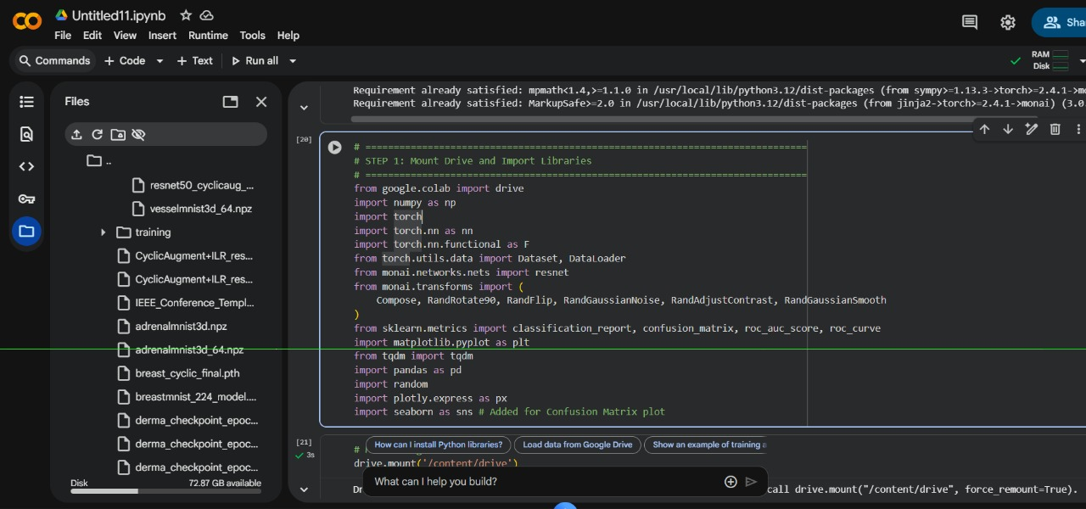
IMPLEMENTATION

Slide 22
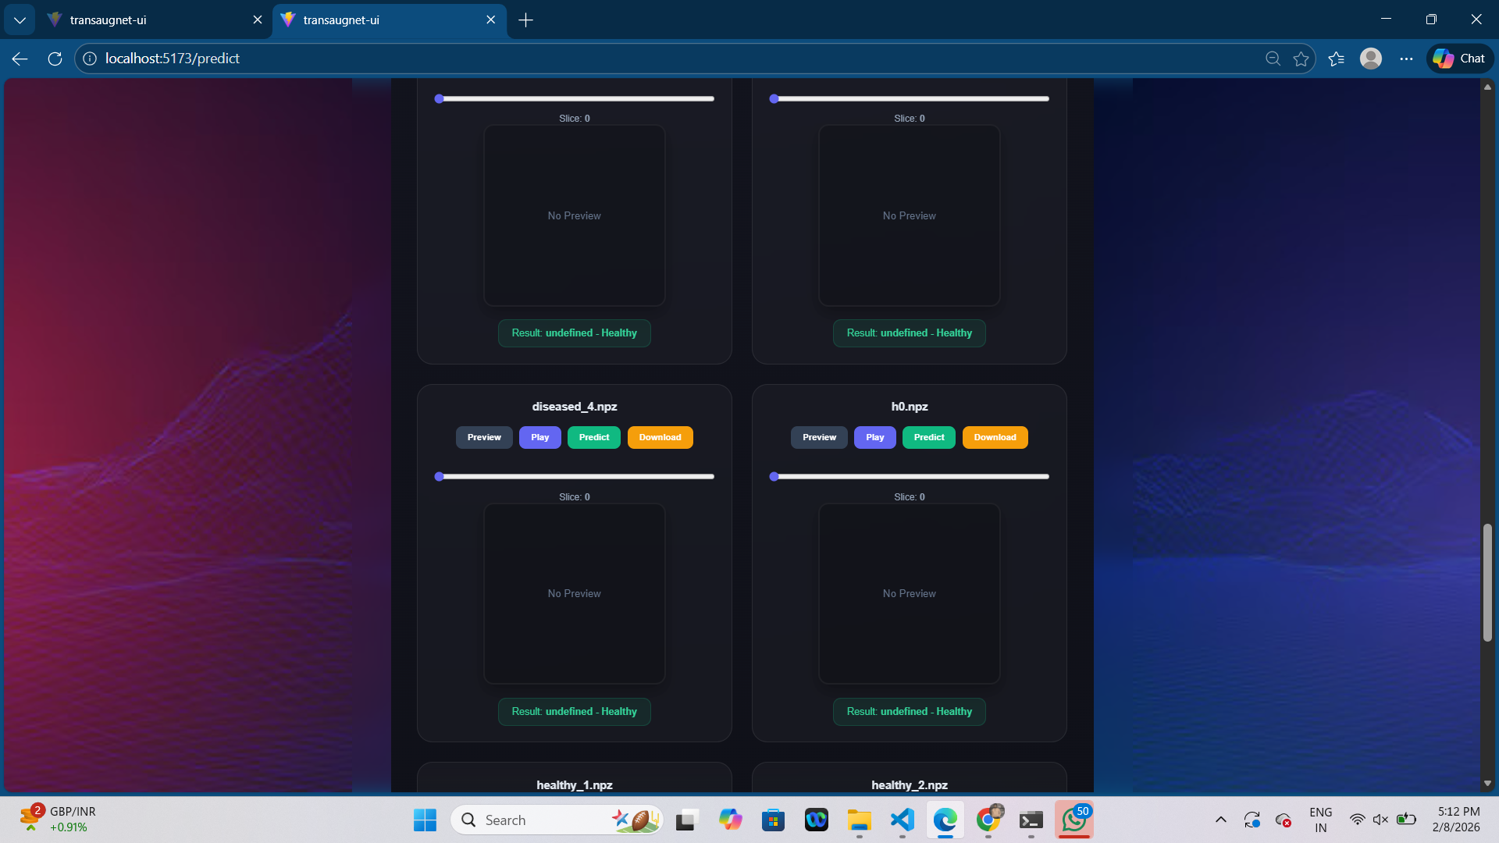
IMPLEMENTATION OF FRONTEND

Slide 23
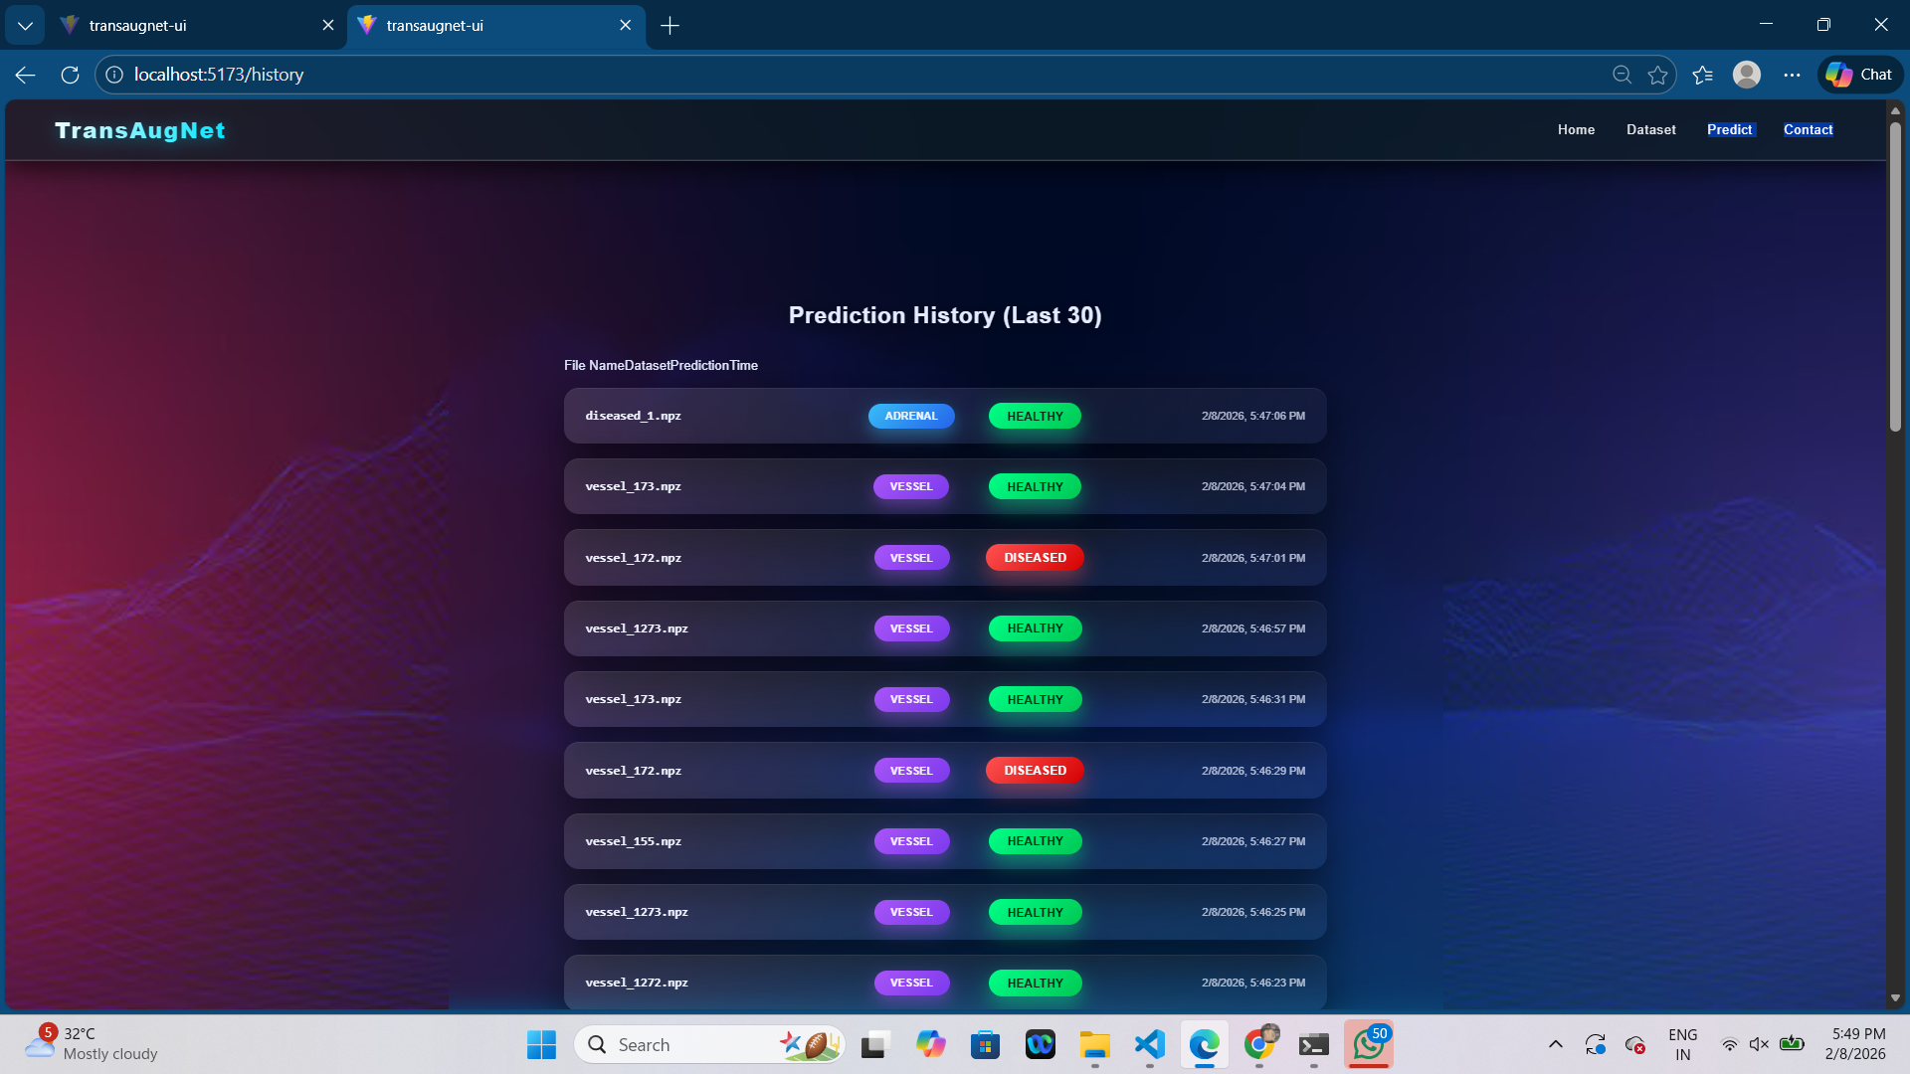
IMPLEMENTATION OF FRONTEND

Slide 24
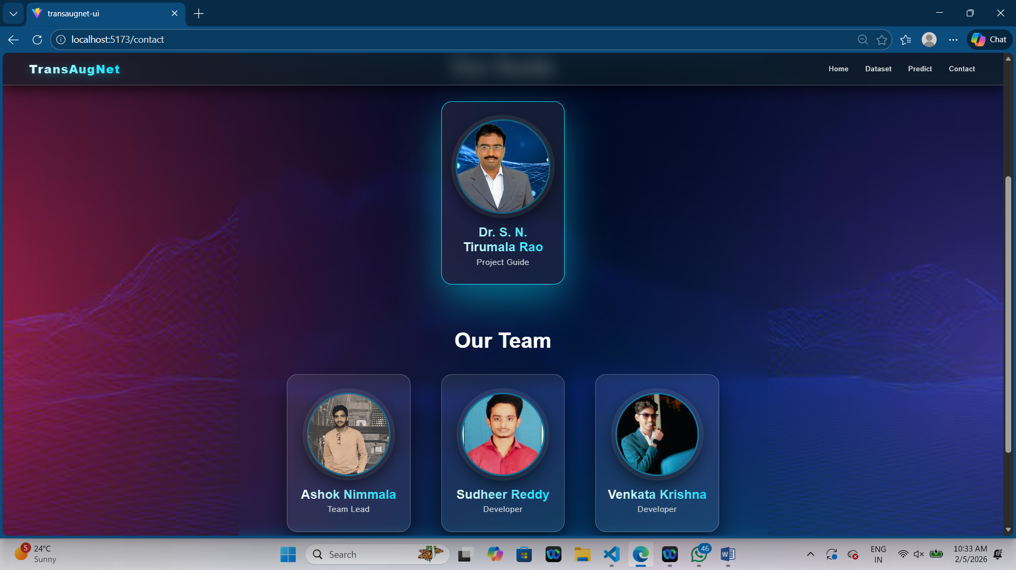
IMPLEMENTATION OF FRONTEND

Slide 25
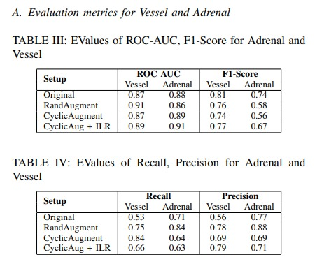
RESULTS & ANALYSIS

Slide 26
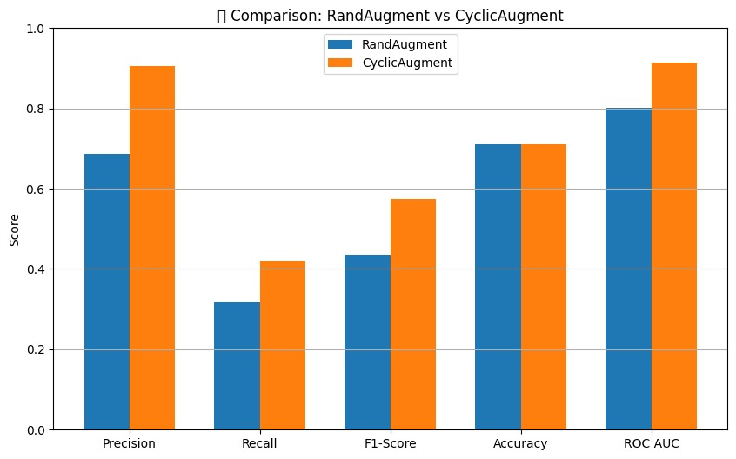
RESULTS & ANALYSIS
Comparison – RandAugment vs CyclicAugment
This chart compares RandAugment and CyclicAugment in different performance metrics.
CyclicAugment gives better precision, recall, and F1-score, meaning it learns patterns more effectively.
Accuracy is similar for both, but CyclicAugment has higher ROC AUC, showing it predicts more confidently.
In short — CyclicAugment improves model quality and generalization over RandAugment.

Slide 27
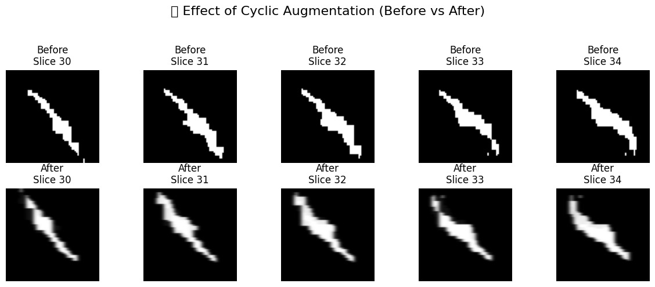
RESULTS & ANALYSIS
Effect of Cyclic Augmentation (Before vs After)
These are image slices before and after applying CyclicAugment.
After augmentation, the images become smoother and clearer, with less noise and distortion.
It improves feature quality while keeping the main structure the same.
So, CyclicAugment helps the model see better and learn more accurately.

Slide 28
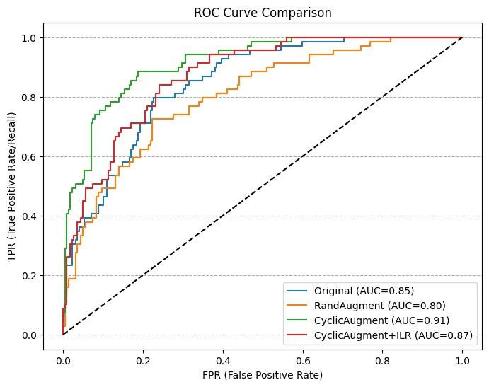
RESULTS & ANALYSIS
ROC Curve Comparison
This ROC graph shows the performance difference among models.
CyclicAugment (AUC = 0.91) gives the best detection accuracy, better than the original and RandAugment.
Adding ILR also performs well (AUC = 0.87).
Overall, CyclicAugment provides the most reliable and accurate predictions.

Slide 29
CONCLUSION and FUTURE SCOPE
The proposed TransAugNet model efficiently classifies 3D medical images using ResNet3D-50 with
Transformer-Aware Cyclic Augmentation.
Integrating Cyclic Augmentation and Intensity Level Regularization (ILR) improved
accuracy (ROC-AUC: 0.91, F1-Score: 0.77) and reduced overfitting.
The model delivers fast, reliable, and high-precision disease predictions, outperforming
conventional augmentation methods.
Future Scope:
Extend to multi-modal datasets (MRI, CT, PET, fMRI).
Incorporate Diffusion Models (DDPM) for advanced data augmentation.
Add explainable AI and real-time deployment for clinical diagnosis.

Slide 30
REFERENCES
V. Sánchez et al., “Data Augmentation Techniques for fMRI Data: A Technical Survey,” IEEE Access, vol. 13, pp. 66,529–66,556, 2025.
S. D. Westfechtel et al., “AI in Motion: The Impact of Data Augmentation Strategies on Mitigating MRI Motion Artifacts,” European Radiology, in press, 2025.
W. Li et al., “An Effective Microscopic Image Augmentation Approach,” Scientific Reports, vol. 15, no. 1, p. 10247, 2025.
P. Alimisis et al., “Advances in Diffusion Models for Image Data Augmentation,” Artificial Intelligence Review, vol. 58, no. 11, pp. 1–56, 2025.
S. Moturi et al., “Enhanced Lung Cancer Detection Using Deep Learning Ensemble Approach,” IEEE InCoWoCo 2024 Proceedings, IEEE, 2024.
S. Rao et al., “Deep Learning-Based Tomato Leaf Disease Identification: Enhancing Classification with AlexNet,” IEEE IATMSI 2025 Proceedings, IEEE, 2025.

Slide 31
ACKNOWLEGEMENTS
We would like to express our sincere gratitude to the faculty and staff of Narasaraopeta Engineering College for their guidance and encouragement throughout the development of this project. Their insights and expertise have been invaluable.
We also extend our thanks to the administration for providing the necessary resources and a platform to showcase our work. This opportunity has been instrumental in enhancing our learning and growth.
For any questions or further discussions, feel free to reach out:-
Team No:BB4
Guide: DR. S. N. Tirumala Rao
Roll No’s: 22471A05B2
22471A0582
22471A05D9

Slide 32

QUESTIONS and ANSWERS

