Slide 1





2025 IEEE iSSSC
2025 IEEE 3rd International Symposium on Sustainable Energy, Signal Processing & CyberSecurity
Paper Title: HFS-VAE: A Hierarchical Feature-Splitting Variational Autoencoder for Interpretable and Robust Network Intrusion Detection
Paper ID: ISSSC-790
Presenter Name: Shaik Mohammad Thaheer
Authors: Munnangi Suresh , Shaik Mohammad Thaheer , Derangula Durga Rao , Shaik Mannepalli Mastanvali , Panduri Bharathi , Vavilala Divya Raj , Dr. Sireesha Moturi
Affiliation: Student, Department of CSE, Narasaraopeta Engineering College, Andhra Pradesh, India

Slide 2
Outline
Introduction (try to answer what it is, why it is, and what is (are) existing problems, why the problem is so important to discuss; may cite in the footer)
Motivation & Contributions
Proposed System Model
Results and Discussion
Conclusion
Reference

Slide 3
Introduction
The rapid growth of networks and smart devices has increased the risk of cyberattacks.
NIDS play a key role in detecting abnormal or malicious network activity.
Traditional signature-based NIDS fail to detect new or zero-day attacks.
Existing systems struggle to handle large-scale and complex network data.
Deep learning–based NIDS improve detection but lack interpretability and robustness.
Models are often vulnerable to adversarial inputs and fail to generalize across datasets.
The proposed HFS-VAE enhances clarity, robustness, and detection accuracy through hierarchical feature-splitting.

Slide 4
Motivation & Core Contribution
Existing intrusion detection models often act as black boxes, giving little insight into their decision process.
Many current systems are not robust, becoming unstable under noisy or adversarial network traffic.
Most approaches are dataset-dependent and fail to adapt to large or changing network environments.
There is a growing need for interpretable, scalable, and modular intrusion detection solutions.
The proposed HFS-VAE divides network traffic into flow, packet, and protocol groups for parallel encoding.
It employs XGBoost classifier fusion to improve both accuracy and explainability of detections.
Evaluated on CICIDS2017 and NSL-KDD, HFS-VAE achieved high precision, strong latent separation, and robust performance for real-world NIDS.

Slide 5
Literature Review
Shone et al. (2018) and Vinayakumar et al. (2019) used deep autoencoders for intrusion detection but lacked interpretability and robustness.
Pang et al. (2021) highlighted that most deep anomaly detectors fail to explain latent behavior and are sensitive to noise.
He et al. (2024) – NIDS-Vis improved interpretability using feature-space partitioning but had limited scalability and no robustness handling.
Ren et al. (2023) and Li et al. (2024) proposed hybrid VAEs but missed hierarchical feature understanding across flow, packet, and protocol levels.
Prior models showed low recall and metric inconsistency, focusing mainly on precision without balancing detection trade-offs.
The proposed HFS-VAE fills these gaps through hierarchical feature-splitting, robustness loss, and XGBoost fusion, achieving better scalability, stability, and interpretability on large datasets.

Slide 6
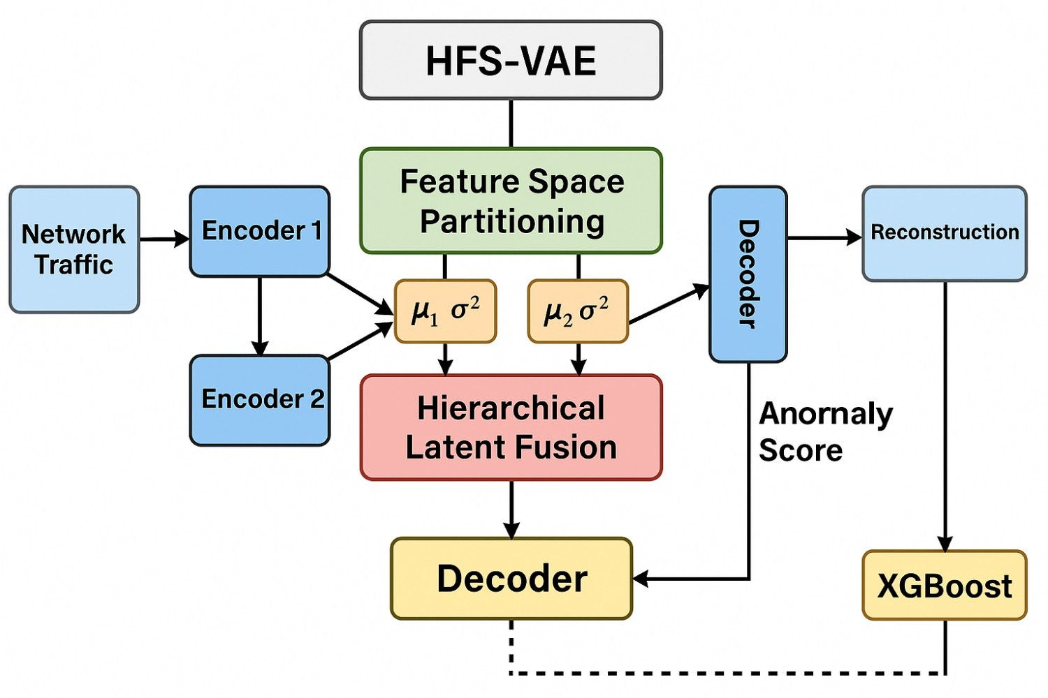
Proposed System Model
Network traffic data is divided into Flow, Packet, and Protocol features.
Each feature group is processed through separate encoder branches for independent latent learning.
The encoded outputs (μ, σ²) are passed into Feature Space Partitioning for structured latent distribution.
Latent features are fused hierarchically in the Hierarchical Latent Fusion layer to form a unified representation.
The decoder reconstructs inputs and generates an anomaly score based on reconstruction loss.
The XGBoost classifier uses fused latent vectors and anomaly scores for final attack detection.

Slide 7
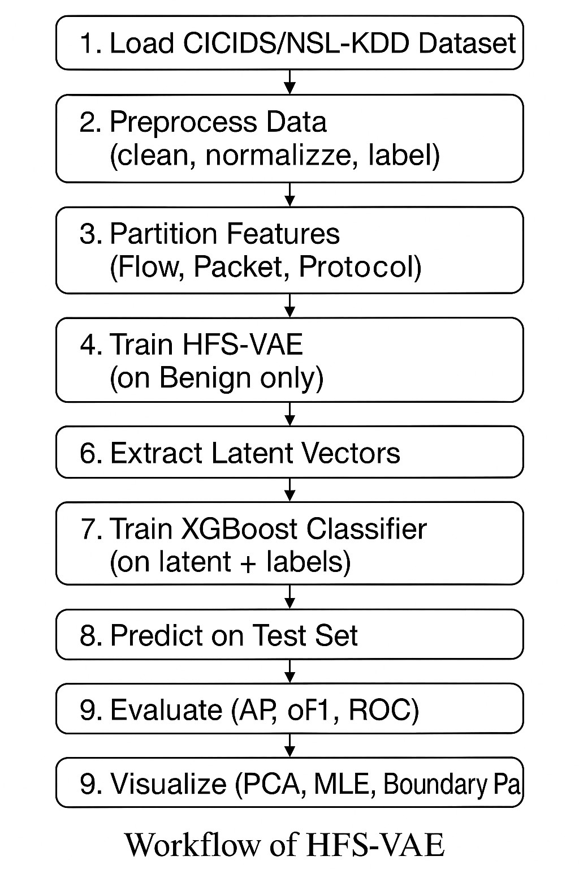
Workflow of HFS-VAE
Load Datasets: Import benchmark datasets — CICIDS2017 and NSL-KDD — for training and evaluation.
Preprocess Data: Clean missing values, normalize features (0–1), and label samples as benign or attack.
Partition Features: Split input features into Flow, Packet, and Protocol groups for hierarchical learning.
Train HFS-VAE: Train the model on benign data only to learn normal traffic representations.
Train XGBoost Classifier: Use latent vectors from HFS-VAE with labels to detect intrusions.
Evaluate & Visualize: Test on unseen data, compute metrics (F1, AP, AUC), and visualize latent space using PCA, MLE, and boundary plots.

Slide 8
Simulation Setup
System Configuration: Windows 11 OS, Intel Core i7 Processor, 32 GB RAM, NVIDIA RTX 3060 GPU
Development Tools: Python 3.10 with PyTorch and XGBoost frameworks (NumPy, Pandas, Scikit-learn libraries)
Datasets Used: CICIDS2017 (3 M records, 80 features) and NSL-KDD (125 K samples, 41 features)
Preprocessing: Missing value removal, feature normalization (0–1), and label binarization (benign = 0, attack = 1)
Training Setup: 100 epochs, batch size 256, learning rate 1×10⁻³ using Adam optimizer
Evaluation Metrics: F1-Score, AP, AUC, Reconstruction Loss, and MLE Score

Slide 9
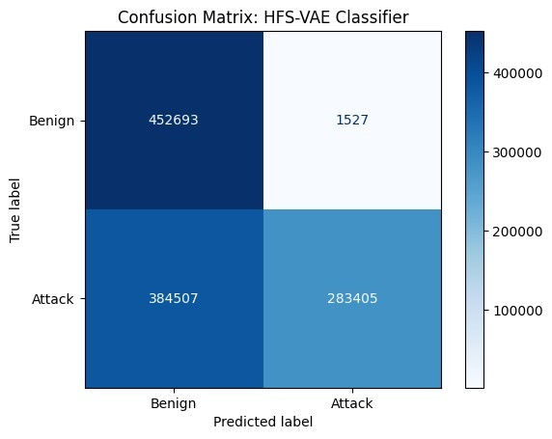
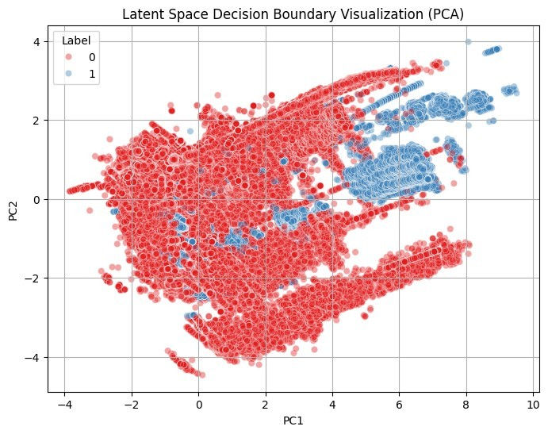
Result and Discussion
The HFS-VAE model was evaluated on CICIDS2017 and NSL-KDD datasets for performance and interpretability.
Achieved F1-score = 0.74, AP = 0.84, and AUC = 0.88, showing balanced detection capability.
Confusion matrix highlights high precision with minimal false alarms.
PCA visualization shows clear separation between benign and attack samples, ensuring interpretability.
Overall, the model provides robust detection, improved transparency, and strong adaptability for enterprise-scale NIDS.
Model / Source | Dataset | AP | F1 | AUC
NIDS-Vis | UQ-IoT-IDS | 0.802 | 0.69 | 0.84
HFS-VAE (Ours) | CICIDS2017 | 0.8412 | 0.7463 | 0.88
HFS-VAE (Ours) | NSL-KDD | 0.9234 | 0.7371 | 0.88

Slide 10
Conclusion & Future Work
Conclusion
Proposed HFS-VAE, a hierarchical feature-splitting variational autoencoder for NIDS.
Enhances interpretability, robustness, and modularity in intrusion detection systems.
Combines multi-branch encoders and classifier fusion (XGBoost) for better accuracy.
Achieved F1 ≈ 0.74, AP ≈ 0.84–0.92, and AUC = 0.88 across benchmark datasets.
Outperforms prior works like NIDS-Vis by scaling to enterprise-level data.
Demonstrates clear latent separation and stable detection performance.
Future Work
Extend HFS-VAE for real-time or streaming intrusion detection.
Apply model compression, pruning, and quantization for IoT and edge devices.
Integrate adversarial training to further improve robustness and recall.
Develop threshold-adaptive mechanisms for better precision–recall balance.
Expand validation using additional datasets for broader generalization.
Explore fine-grained attack classification using latent feature embeddings.

Slide 11
References
K. He, D. D. Kim, and M. R. Asghar, “NIDS-Vis: Improving the Generalized Adversarial Robustness of Network Intrusion Detection Systems,” Computers & Security, vol. 145, p. 104028, 2024.
M. Farhan et al., “Network-Based Intrusion Detection Using Deep Learning Technique,” Scientific Reports, vol. 15, p. 25550, 2025.
Y. Xue, C. Kang, and H. Yu, “HAE-HRL: A Network Intrusion Detection System Utilizing a Novel Autoencoder and a Hybrid Enhanced LSTM-CNN Residual Network,” Computers & Security, vol. 151, p. 104328, 2025.
Y. Ren et al., “A Lightweight Unsupervised Intrusion Detection Model Based on Variational Auto-Encoder,” Sensors, vol. 23, p. 8407, 2023.
H. Huang et al., “Self-Organizing Maps-Assisted Variational Autoencoder for Unsupervised Network Anomaly Detection,” Symmetry, vol. 17, p. 520, 2025.
A. Kumar et al., “A Scalable Hybrid Autoencoder–Extreme Learning Machine Framework for Adaptive Intrusion Detection,” Future Internet, vol. 17, p. 221, 2025.
Z. Li, C. Huang, and W. Qiu, “An Intrusion Detection Method Combining Variational Auto-Encoder and Generative Adversarial Networks,” Computer Networks, vol. 253, p. 110724, 2024.
Y. Zhang, R. C. Muniyandi, and F. Qamar, “A Review of Deep Learning Applications in Intrusion Detection Systems,” Applied Sciences, vol. 15, p. 1552, 2025.

Slide 12
Reviewer Comments Addressed
Addressed recall limitations by discussing the precision–recall trade-off and threshold optimization.
Clarified evaluation consistency between confusion matrix (F1 = 0.665) and PR-curve results (F1 = 0.7463).
Expanded comparative analysis explaining dataset differences with NIDS-Vis (UQ-IoT) vs HFS-VAE (CICIDS2017).
Enhanced mathematical clarity by refining loss equations and architecture explanation.
Improved English writing and grammar for readability and technical accuracy.
Added details on practical considerations and limitations to strengthen real-world applicability.
Highlighted model novelty in feature-splitting architecture and interpretability over existin VAEs.
Confirmed no major modifications required as per Reviewer, only refinements in presentation and clarity.

Slide 13
Thank You

