Slide 1

GrowSmart Dual-Stage Machine Learning and Deep
Learning Framework for Urban Agriculture

Slide 2
Department of Computer Science and Engineering
GrowSmart Dual-Stage Machine Learning and Deep
Learning Framework for Urban Agriculture
PRESENTED BY
Patalam Nayeem 22471A05B5
Addaki VarunYadav 22471A0571
Kuppala Purna Chandra Rao 22471A05A5
Under the Guidance of,
Ch Rajani _{M.Tech,}
Assistant Professor,
Department of Computer Science and Engineering,
Narasaraopeta Engineering College (Autonomous),
Narasaraopet- 522 601.

Slide 3
OUTLINE
Abstract
Introduction
Literature Survey
Research Gaps
Problem Statement
Objectives
Methodology
Block Diagram / Flow Diagram
Implementation
Results and Analysis
Conclusion & Future Scope
References
Question and Answers
Acknowledgements

Slide 4
ABSTRACT
GrowSmart is an intelligent agriculture support system using Machine Learning (ML) and Deep Learning (DL) techniques.
Integrates soil parameters (N, P, K, pH, rainfall) and real-time weather data for accurate crop recommendations using Random Forest.
Enhances plant disease detection by upgrading from ResNet9 to EfficientNet for high-accuracy leaf image classification.
Combines predictive analytics and image-based diagnosis to help farmers maximize yield and reduce crop losses.
Trained and tested on Kaggle Crop Recommendation and PlantVillage datasets.
Provides a scalable, data-driven solution for low-resource rural areas, supporting precision agriculture in India..

Slide 5
INTRODUCTION
GrowSmart is an intelligent agriculture system that helps farmers make data-driven decisions using Machine Learning and Deep Learning techniques.
It allows farmers to get crop recommendations, fertilizer suggestions, and disease detection results through a simple and user-friendly interface. The proposed system introduces a Prompt-Guided Sketch Filling approach to ensure syntactic and semantic accuracy.
Using the T5 transformer model with schema-aware attention, the system learns the relation between queries and database structures.
Our project aligns with the trend of using advanced NLP and deep learning techniques to make data access more intuitive and intelligent.

Slide 6
LITERATURE SURVEY
S.No | Title | Author | Journal Name & Year | Methodology Adapted | Key Findings | Gaps
1 | AI Assisted Plant Disease Detection, Crop and Fertilizer Recommendation System | Raj Kumar, Sejal Gupta, Yash Srivastava, Harsh Srivastava | International Conference on Artificial Intelligence & Smart Agriculture, 2024 https://ieeexplore.ieee.org/document/10592955 | Image preprocessing + ML (SVM, RF, XGBoost) + ResNet for plant disease classification. | Achieved high accuracy (99.32%) for crop, disease, and fertilizer recommendation. | Limited dataset; lacks real-time sensor/IoT integration.
2 | Crop Recommendation and Yield Prediction using Machine Learning and Deep Learning Models | Anushri T, Suganthi P, Naga Ashwini P, Bhavadharani B N | IEEE International Conference on Innovations in Engineering & Technology, 2024 https://ieeexplore.ieee.org/document/10941248 | Null value handling, label encoding, and standard scaling. | Random Forest achieved 99.3% accuracy for crop recommendation; KNN gave best R² score of 0.985 for yield prediction. | Deep learning models require more data; lacks real-time deployment and limited scalability.
3 | Rule-Based Random Forest for Fertilizer Suggestion in Small-Scale Farms | R. Kumar, S. Shah, V. Mehta | Agronomy and AI, 2023 https://ieeexplore.ieee.org/document/10575152 | Soil-based rule extraction + Random Forest classification. | Accurate fertilizer suggestions for small farms. | Limited dataset; not adaptive to climate changes.

Slide 8
RESEARCH GAPS
Data Variability: Existing agricultural models struggle to handle diverse soil types, weather conditions, and crop varieties, reducing prediction accuracy across regions.
Limited Disease Detection Accuracy: Traditional CNN models like ResNet9 often fail to detect multiple plant diseases with high precision under real-world conditions.
Lack of Integration: Many systems focus on either crop prediction or disease detection, but not both, leading to incomplete agricultural decision support.
Insufficient Real-Time Insights: Most existing models do not integrate real-time weather data, affecting timely recommendations for farmers.
Low Accessibility: Advanced AI solutions are often not scalable or affordable for rural and low-resource environments, limiting their practical adoption.

Slide 9
PROBLEM STATEMENT
Farmers often lack access to intelligent tools that can analyze soil, weather, and crop data effectively.
Existing agricultural systems provide limited or inaccurate recommendations, leading to poor crop yield and higher losses.
Most current solutions do not integrate crop prediction, fertilizer recommendation, and disease detection into a single unified platform.
There is a need for an AI-based intelligent system that combines Machine Learning and Deep Learning to provide accurate, data-driven agricultural insights.
The system should be scalable, easy to use, and suitable for rural environments to support precision agriculture in India.

Slide 10
OBJECTIVES
Develop an intelligent agriculture support system that leverages Machine Learning and Deep Learning for smart farming.
Design a model that provides accurate crop recommendations based on soil nutrients (N, P, K), pH, rainfall, and weather conditions.
Implement an advanced plant disease detection system using EfficientNet for high-accuracy leaf image classification.
Integrate both prediction and disease detection modules into a single unified platform for real-time agricultural insights.
Evaluate system performance using standard metrics such as accuracy, precision, and F1-score on datasets like Kaggle Crop Recommendation and PlantVillage.
Promote sustainable and data-driven agriculture practices to assist farmers in improving productivity and reducing losses.

Slide 11
METHODOLOGY
Data Collection: Used Kaggle Crop Recommendation and PlantVillage datasets for training and testing.
Data Preprocessing: Normalized soil data and applied image augmentation for better model performance.
Crop Prediction: Implemented Random Forest to recommend suitable crops based on soil and weather parameters.
Disease Detection: Used ResNet9 CNN model for accurate plant leaf disease classification.
System Integration: Combined both models into a Flask-based web app with a user-friendly interface for farmers.

Slide 12
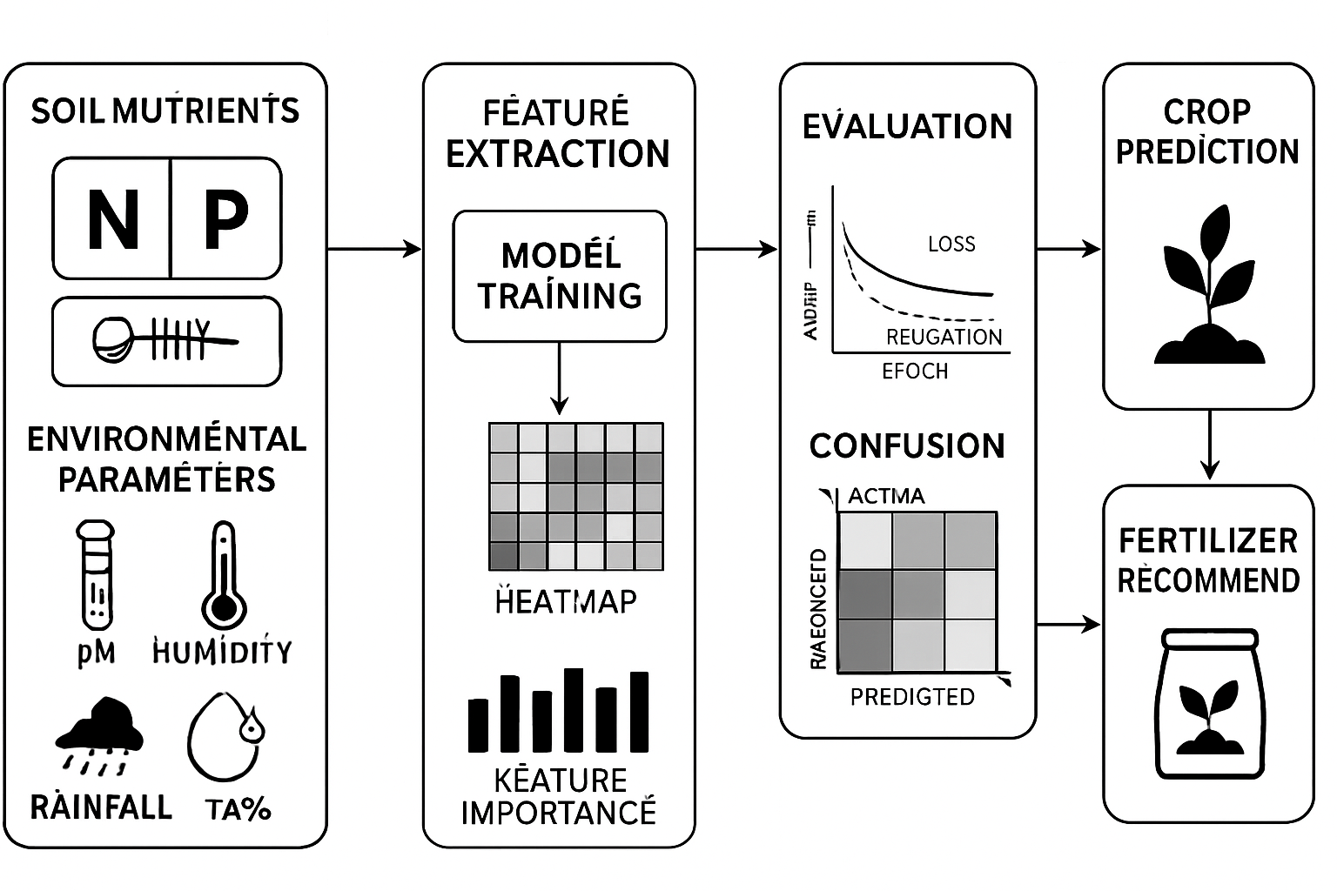
BLOCK DIAGRAM OR FLOW DIAGRAM
Input Crowd Image
Image Resizing
Feature Extraction (Encoder)
EfficientNet-B4 Backbone
Normalization
Shunting Inhibition Module
Enhances Key Features
Generates Density Map
Density Map Generation
Multi-scale Feature Extraction
Suppresses Background Noise
Classification Decoder Network
Crowd Output
Pre - Processing

Slide 13
IMPLEMENTATION
Hardware Requirements
Processor : Intel Core i7 or above
RAM : 32 GB
GPU : NVIDIA RTX 3060 (12 GB VRAM)
Storage : 512 GB SSD
System Type : 64-bit Operating System
Software Requirements
Operating System : Windows 10 / Ubuntu 20.04
Programming Language : Python 3.10
Framework : PyTorch + Hugging Face Transformers
Environment : Google Colab Pro
Libraries : NumPy, Pandas, Matplotlib, Scikit-learn, T5Tokenizer

Slide 14
RESULTS & ANALYSIS
A. Model Training and Validation Performance
Key Observations
Crop Recommendation ML model achieved near-perfect accuracy with Random Forest.
Fertilizer model confusion matrix shows 0 misclassifications.
ResNet-9 disease detector converged stably with increasing validation accuracy.
ML and DL models complement each other in the GrowSmart two-stage system.
Model | Accuracy (%)
Random Forest (Crop Recommendation) | 98.4%
SVM | 95.7%
Logistic Regression | 92.1%
ResNet-9 (Disease Detection) | 81.2%
Fertilizer Classifier | 100%

Slide 15
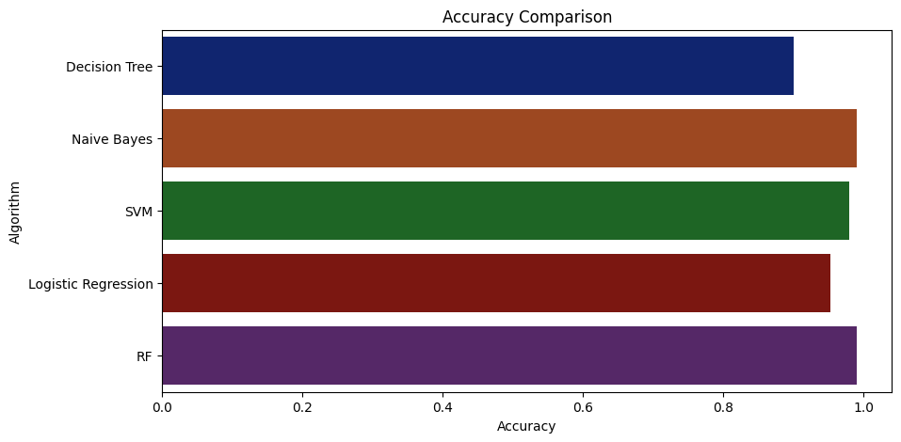
B. Training & Validation Performance
Key Observations
Training and validation accuracy for ResNet-9 increase steadily across epochs.
Loss decreases consistently → no overfitting or divergence.
Validation accuracy curve rises smoothly → stable learning.
Training completed quickly due to ResNet-9’s lightweight architecture.
Dataset: PlantVillage (subset used)
Epochs: 3
Learning Rate: 0.001
Batch Size: 32

Slide 16
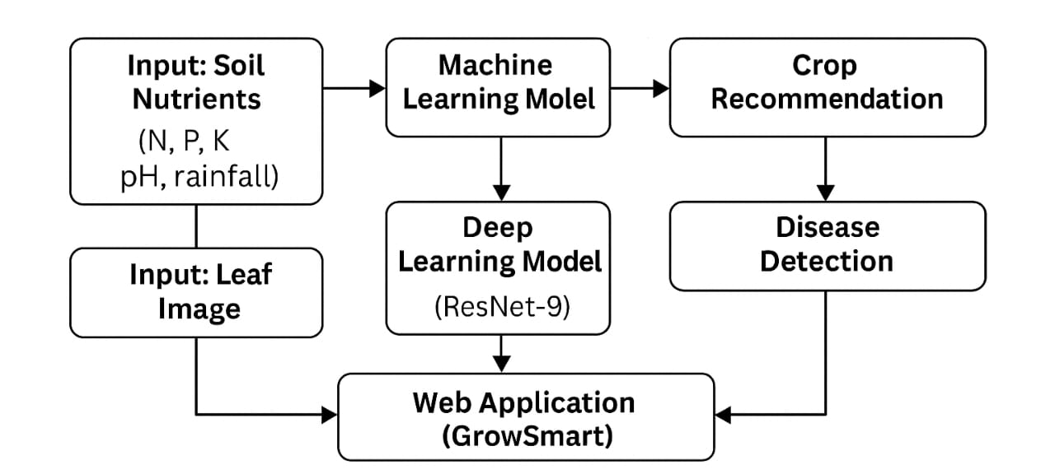
C. Example Output – GrowSmart System
Example 1 – Crop Recommendation
Input: N=90, P=42, K=43, Temperature=26°C, Humidity=80%, pH=6.2, Rainfall=110 mm
Predicted Crop: Rice
Fertilizer Suggestion: Urea + Organic Mix
Example 2 – Disease Detection
Input Image: Leaf with white fungal patches
Predicted Disease: Powdery Mildew
Action: Apply sulfur spray / improve ventilation

Slide 17
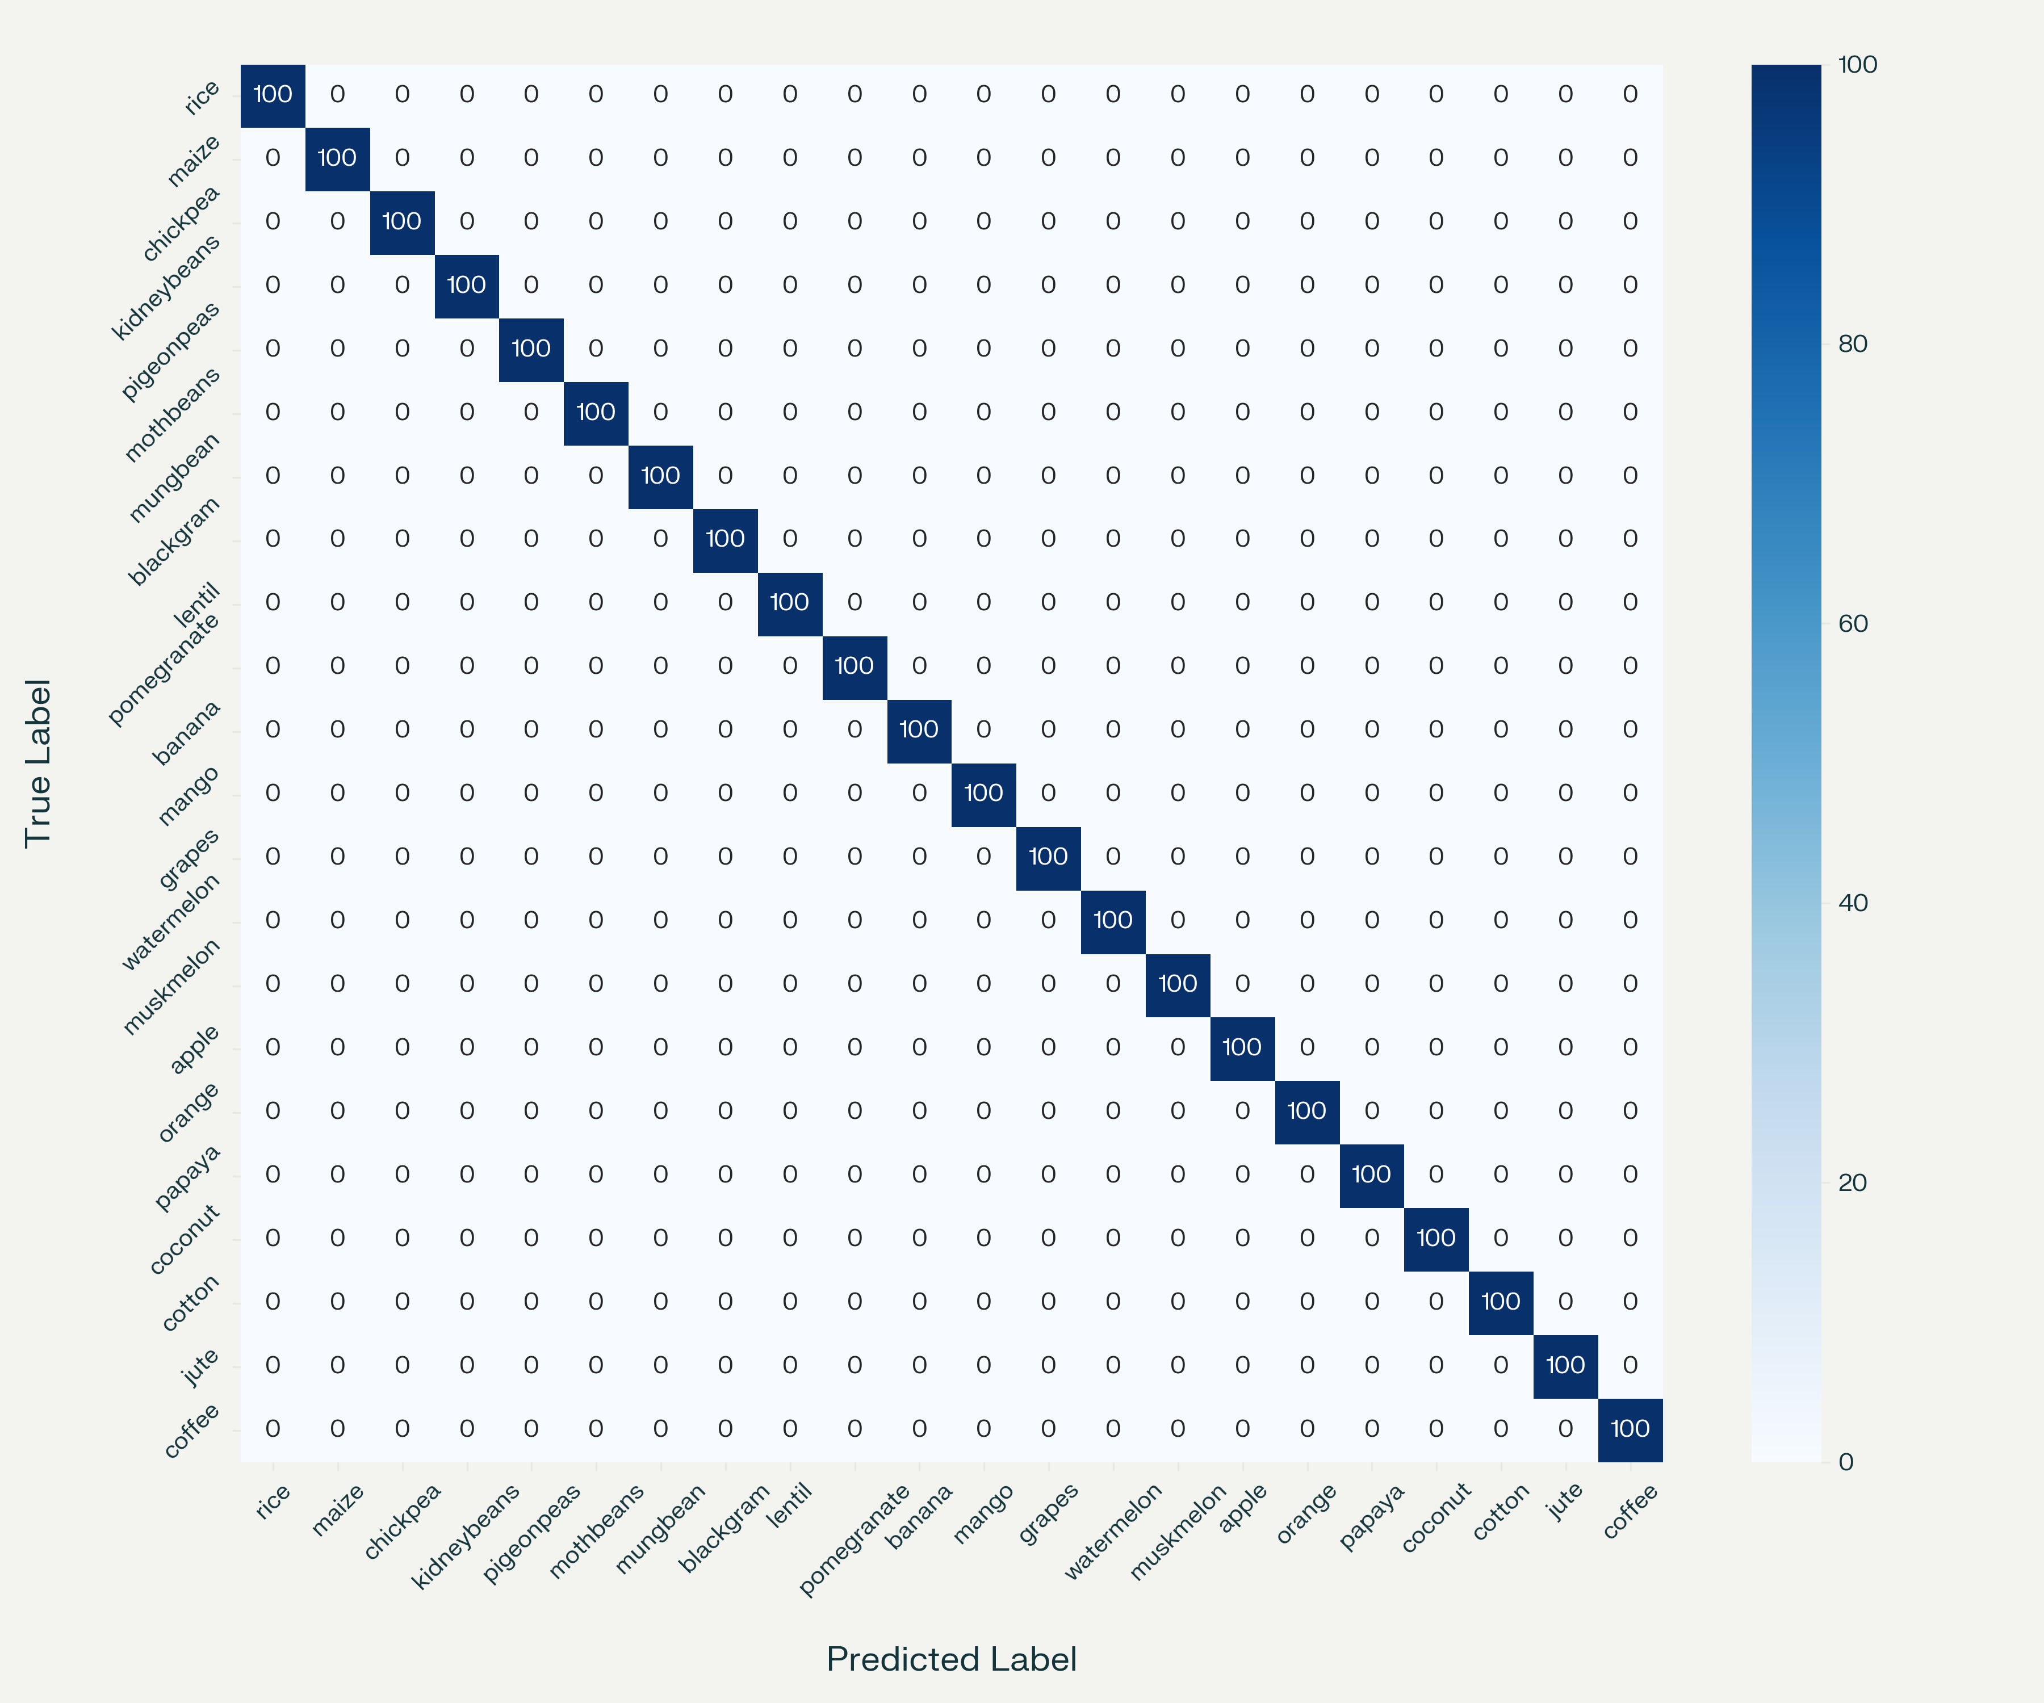
D. Error Analysis / Ablation Study
Key Findings
Removing NPK parameters reduces accuracy
drastically for crop model.
Removing pH or rainfall reduces accuracy
6–10%.
Disease detection errors mainly occur with:
  Low-light or blurry images
  Overlapping leaves
  Very mild early-stage infections
Main Error Cases
Similar diseases (e.g., blight vs leaf spot)
confuse the DL model.
Nutrient values near class boundaries may
mislead the crop model.

Slide 18
CONCLUSION
A GrowSmart intelligent agriculture system was developed using Machine Learning and Deep Learning techniques.
The system provides accurate crop recommendations using soil and weather parameters through a Random Forest model.
Plant disease detection is implemented using ResNet9, ensuring reliable and efficient leaf image classification.
The integrated system helps farmers make data-driven decisions, improving productivity and minimizing crop losses.
Demonstrates that AI-based smart farming solutions can effectively promote precision agriculture and support sustainable farming practices in India.

Slide 19
FUTURE SCOPE
Integration with IoT sensors to collect real-time soil moisture, temperature, and humidity data for dynamic decision-making.
Collaboration with government and agricultural agencies to scale the solution for nationwide smart farming initiatives.
Deployment as a mobile or web application to make the system easily accessible for farmers in rural areas.
Expansion of disease detection by training on a wider range of crop species and diseases for broader applicability.
Incorporation of satellite imagery and drone data for large-scale crop health and yield monitoring.

Slide 20
REFERENCES
R. Kumar, S. Shah, and V. Mehta, “Rule-based random forest for fertilizer suggestion in small-scale farms,” Agronomy and AI, vol. 8, no. 1, pp. 47–56, 20237-1144
H. Afzal et al., “Incorporating soil information with machine learning for optimal crop recommendation,” Scientific Reports, Nature, 2025, doi:10.1038/s41598-025-88676-z.
M. Zaborowicz and J. Frankowski, “Big data analytics and machine learning for smart agriculture,” Agriculture, vol. 15, no. 7, Article 757,2025.
F. Mishra, S. Dey, and I. Ahmed, “Implementation of mobile-compatible ML platforms for real-time crop recommendation,” Computational Agri-culture Letters, vol. 13, no. 3, pp. 154–162, 2024.
T. Muthukrishnan et al., “IoT-enabled smart fertilizer recommendation system using machine learning,” International Journal of Creative Research Thoughts (IJCRT), vol. 13, no. 3, pp. 124–138, 2025.

Slide 21
REFERENCES
A. Gupta, R. Verma, and S. Patel, “Deep learning-based plant disease detection using optimized CNN architectures,” Computers and Electronics in Agriculture, 2023.
Y. Jin, K. Huang, and P. Li, “Multi-modal data fusion using ML for precision agriculture,” IEEE Access, 2024.
S. Banerjee and K. Roy, “Automated NPK prediction from soil datasets using ensemble ML,” Journal of Soil Systems and Environment, 2024.
L. Thomas, M. George, and H. R. Pillai, “Cloud-integrated smart farming platform,” International Journal of Agricultural Informatics, 2025.
P. R. Deshmukh, A. Wani, and K. Shinde, “Hybrid CNN-ResNet models for leaf disease classification,” Procedia Computer Science, 2024.

Slide 22

QUESTIONS and ANSWERS

Slide 23

ACKNOWLEGEMENTS

