Slide 1





2025 IEEE iSSSC
2025 IEEE 3rd International Symposium on Sustainable Energy, Signal Processing & CyberSecurity
Paper Title : WasteNet: A Structured-Pruned and EMA-Augmented RepVGG Framework for Real-Time Trash Classification
Paper ID:627
Presenter Name : Kakumanu Sravani
Authors:Yaragani Neelima, Kakumanu Sravani, Kondavarju Ramya, Chinthalanka Poojitha, Akila Venkatraman, Yerrarapu Sravani Devi, Dr.Sireesha Moturi
Affiliation : Student, Department of CSE, Narasaraopeta Engineering College

Slide 2
Outline
Introduction (try to answer what it is, why it is, and what is (are) existing problems, why the problem is so important to discuss; may cite in the footer)
Motivation & Contributions
Proposed System Model
Results and Discussion
Conclusion
Reference

Slide 3
Introduction
Problem Statement:
Urban MSW crisis demands intelligent automation—manual sorting is hazardous and inefficient
Existing models lack optimal accuracy-speed-size balance for edge deployment
Edge-ready deployment for smart bins and mobile waste management systems
Waste classification is crucial for sustainable environmental management and pollution control.
Improper segregation of waste can cause environmental harm, resource depletion, and increased greenhouse gas emissions.
Manual waste sorting is hazardous and inefficient, especially with the rising amount of global waste�.There is an urgent need for intelligent automated solutions to manage waste safely and efficiently.
Deep Learning, particularly Convolutional Neural Networks (CNNs) like RepVGG, enables advanced real-time waste classification and automation�.The RepVGG-MEM model combines advanced techniques such as EMA, mixup data augmentation, and structured pruning for improved accuracy and efficiency.

Slide 4
Motivation & Core Contribution
Improper waste segregation causes pollution, emissions, and resource depletion
Manual sorting: hazardous, inefficient, unable to scale with urban waste growth
Existing models too heavy for edge devices (smart bins, mobile platforms)
Critical need: real-time, lightweight, accurate automated waste classification
Core Contributions:
1. Unified RepVGG-MEM Framework
First holistic integration: EMA + Mixup + Structured Pruning + MSCA (prior works used independently)
2. Superior Performance
95.06% accuracy | 94.5% F1-score (14-class classification)
+1.74% over baseline with 0.55G FLOPs (lightweight design)
3. Edge Optimization
Outperforms ResNet50, MobileNetV3, VGG16, Xception
Handles closely resembling categories effectively

Slide 5
Literature Review State-of-the-Art Waste Classification Models:
Study | Model | Accuracy | Limitation
Sayed et al. [4] | RepVGG-MEM + MSCA | 93.26% | Limited generalization
Hossen et al. [5] | DenseNet201 + MobileNetV2 | 95.01% | Moderate complexity
Tran et al. [6] | Ensemble + HHO | 97.45% | High computational cost
Lapo et al. [7] | RetinaNet + ResNet-50 | 97% | Not edge-friendly
Dipo et al. [8] | YOLOv12 | 78% mAP | Lower accuracy
Sayed et al. [9] | InceptionV3 + MBWO | 97.75% | Complex optimization
Chhabra et al. [10] | Multi-layer CNN | 93.28% | Basic architecture

Slide 6
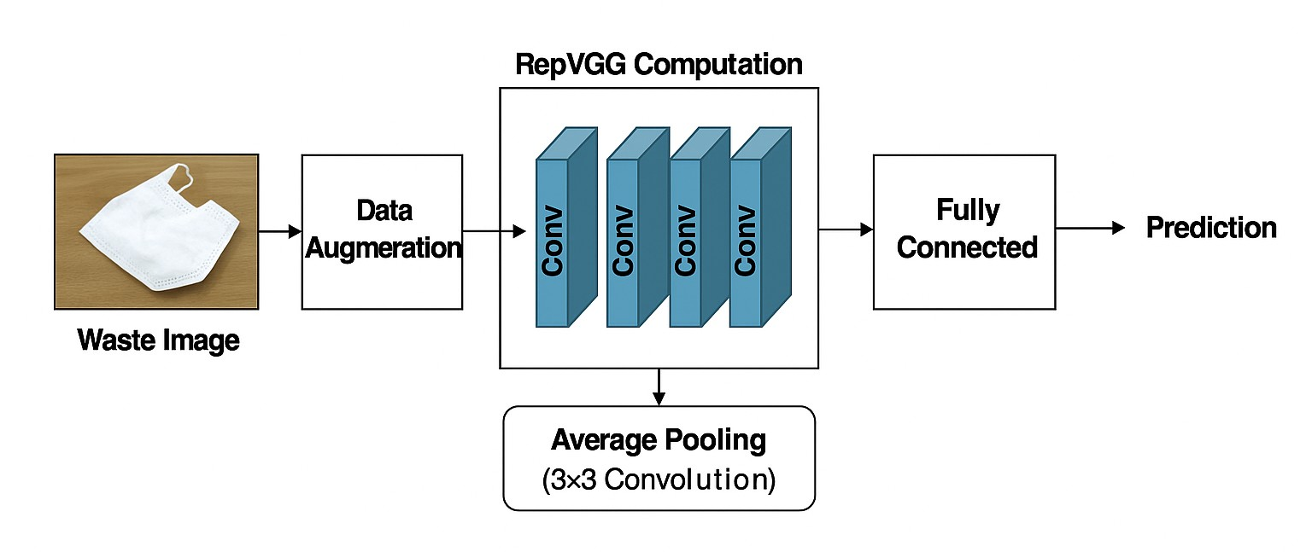
Proposed System Model
Dataset & Preprocessing:
15,000+ images from TrashNet, Kaggle, PublicGarbageNet (14 classes)
Pipeline: Resize 224×224 → Gaussian Blur → CLAHE → Normalization → Augmentation (Flip, Rotation ±15°, Mixup)
RepVGG-MEM Architecture:
Stage 1: Multi-Branch Feature Extraction
Stage 2: MSCA Attention (After Stage 3)
Stage 3: EMA Stabilization
Stage 4: Structured Pruning
Stage 5: Classification
Deployment: Smart bins, mobile apps, edge devices for real-time waste sorting

Slide 7
Simulation Setup
Dataset:
Sources: TrashNet + Kaggle + PublicGarbageNet (15,000+ images, 14 classes)
Resolution: 224×224 pixels
Split: 60% train | 20% validation | 20% test
Hardware & Software:
NVIDIA GPU acceleration
Deep Learning framework (PyTorch/TensorFlow)
Adam optimizer with learning rate 0.001
Training Strategy:
Augmentation: AutoAugment + Mixup
Regularization: EMA (decay=0.999)
Pruning: L1-norm magnitude-based filter removal
Fine-tuning: 15 epochs post-pruning
Evaluation Metrics:
Accuracy, F1-Score, Confusion Matrix
Computational cost: FLOPs analysis

Slide 8
Result and Discussion Performance Metrics: RepVGG-MEM (Pruned): 95.06% Accuracy | 94.5% F1-Score | 0.55G FLOPs Improvement: +1.74% over baseline RepVGG-MEM with reduced computational cost Model Evolution Analysis:
Model Variant | Accuracy (%) | F1-Score (%) | Key Insight
RepVGG (Baseline) | 83.4 | 82.7 | Standard architecture
RepVGG-M (Mixup) | 83.2 | 82.9 | Minimal improvement
RepVGG-ME (Mixup+EMA) | 83.7 | 83.4 | Slight enhancement
RepVGG-MEM (Full) | 91.77 | 92.9 | MSCA drives major gain
RepVGG-MEM (Pruned) | 95.06 | 94.5 | Pruning boosts accuracy

Slide 9
Conclusion & Future Work
Conclusion
Future Work
Developed RepVGG-MEM: Lightweight framework integrating EMA + Mixup + MSCA + Structured Pruning
Achieved 95.06% accuracy | 94.5% F1-score with 0.55G FLOPs (+1.74% over baseline)
Key Innovation: Unified holistic approach outperforms independent technique application
Impact: Edge-ready deployment on smart bins, mobile platforms for real-time automated waste management
Key Achievement:
95.06% accuracy | 94.5% F1-score on 14-class waste dataset
1.74% improvement over baseline with reduced computational cost
Dataset Expansion:
Include more waste categories and real-world conditions (poor lighting, mixed waste, occlusions)
Address class imbalance (Plastic, Battery <6%)
Model Enhancement:
Handle overlapping, damaged, and dusty waste items
Optimize for ultra-low-powered IoT devices with faster inference
System Integration:
Real-time monitoring with sensor fusion (visual + weight + material data)
Hybrid approaches: Computer vision + spectroscopy for improved accuracy
Adaptive learning for new waste categories without full retraining

Slide 10
References
[1] K. Lakshminadh et al., "Pest identification: An efficient deep learning approach using vgg networks," in IEEE International Conference on Interdisciplinary Approaches in Technology and Management for Social Innovation (IATMSI), 2025, pp. 1–6.
[2] K. V. N. Reddy, Y. Narendra, M. A. N. Reddy, A. Ramu, D. V. Reddy, and S. Moturi, "Traffic sign recognition using cnn deep learning," in IEEE International Conference on Interdisciplinary Approaches in Technology and Management for Social Innovation (IATMSI), 2025, pp. 1–6.
[3] S. L. Jagannadham, K. L. Nadh, and M. Sireesha, "Brain tumour detection using cnn," in 5th International Conference on I-SMAC (IoT in Social, Mobile, Analytics and Cloud), 2021, pp. 734–739.
[4] Q. Si and S. Ik Han, "Repvgg-mem: A lightweight model for garbage classification achieving a balance between accuracy and speed," IEEE Access, vol. 13, pp. 36 451–36 469, 2025.
[5] M. M. Hossen, M. E. Majid, S. B. A. Kashem, A. Khandakar, M. Nashbat, A. Ashraf, M. Hasan-Zia, A. K. A. Kunju, S. Kabir, and M. E. H. Chowdhury, "A reliable and robust deep learning model for effective recyclable waste classification," IEEE Access, vol. 12, pp. 13 809–13 821, 2024.
[6] H. M. Tran, T. M. Le, H. V. Pham et al., "An integrated learning approach for municipal waste classification using densenet161 and hho," IEEE Access, 2024. [Online]. Available: https://doi.org/10.1109/ACCESS.2024.3495982
[7] J. R. Lapo and O. M. Cumbicus-Pineda, "Detection of recyclable solid waste using convolutional neural networks and pytorch," IEEE Latin America Transactions, vol. 22, no. 6, pp. 475–483, 2024.

Slide 11
[8] M. H. Dipo, F. A. Farid, M. S. A. Mahmud, M. Momtaz, S. Rahman, J. Uddin, and H. A. Karim, "Real-time waste detection and classification using yolov12-based deep learning model," Digital, vol. 5, no. 2, p. 19, 2025.
[9] G. I. Sayed, M. Abd Elfattah, A.-B. Darwish et al., "Intelligent and sustainable waste classification model based on multi-objective beluga whale optimization and deep learning," Environmental Science and Pollution Research, vol. 31, pp. 31 492–31 510, 2024. [Online]. Available: https://doi.org/10.1007/s11356-024-33233-w
[10] M. Chhabra, B. Sharan, M. Elbarachi, and M. Kumar, "Intelligent waste classification approach based on improved multi-layered convolutional neural network," Multimedia Tools and Applications, vol. 31, pp. 84 095–84 120, 2024. [Online]. Available: https://doi.org/10.1007/s11042-024-18939-w
[11] S. Rafi, A. L. Niharika, S. Neelima, K. Nikhitha, M. S. Reddy, and M. Sireesha, "Detecting sarcasm across headlines and text," in 2025 IEEE International Conference on Interdisciplinary Approaches in Technology and Management for Social Innovation (IATMSI), vol. 3, 2025, pp. 1–6.
[12] S. Moturi, M. Ainavolu, N. R. Dokku, P. Kasula, N. Yaragani, and V. Dodda, "Enhanced lung cancer detection using deep learning ensemble approach," in 2024 First International Conference for Women in Computing (InCoWoCo), 2024, pp. 1–7.
[13] D. Venkatareddy, K. N. Reddy, Y. Sowmya, Y. Madhavi, S. C. Asmi, and S. Moturi, "Explainable fetal ultrasound classification with cnn and mlp models," in 2024 First International Conference on Innovations in Communications, Electrical and Computer Engineering (ICICEC), 2024, pp. 1–7.
[14] S. L. Jagannadham, K. L. Nadh, and M. Sireesha, "Brain tumour detection using cnn," in 2021 Fifth International Conference on I-SMAC (IoT in Social, Mobile, Analytics and Cloud) (I-SMAC), 2021, pp. 734–739.

Slide 12
Thank You

