Slide 1





2025 IEEE iSSSC
2025 IEEE 3rd International Symposium on Sustainable Energy, Signal Processing & CyberSecurity
Paper Title:Deep Stroke Detect: Optimizing Stroke Risk Prediction Using SMOTEENN and Transfer Learning
Paper ID: 633
Presenter Name:Nazeema Shaik
Authors:Nazeema Shaik, Sireesha Moturi, Sai Sarnya Tupakula, Akhila Parella, Sandhya Diddi
Affiliation:Department of CSE, Narasaraopeta Engineering College, Andhra Pradesh, India

Slide 2
Outline
Introduction (try to answer what it is, why it is, and what is (are) existing problems, why the problem is so important to discuss; may cite in the footer)
Motivation & Contributions
Proposed System Model
Results and Discussion
Conclusion
Reference

Slide 3
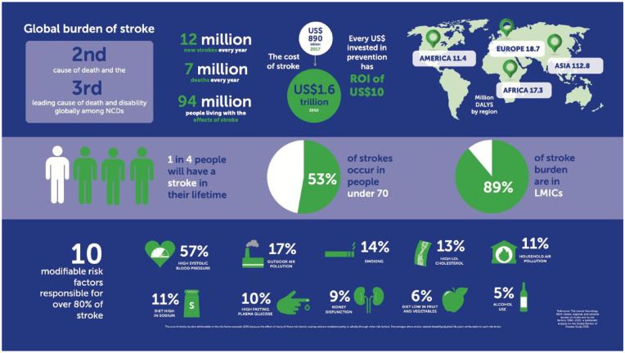
Introduction
Stroke is a severe medical condition that occurs when the brain’s blood supply is disrupted, leading to the death of brain cells within minutes.
It remains one of the top global causes of death and long-term disability, highlighting the urgent need for early risk identification.
Traditional diagnostic systems often fail to predict stroke accurately due to imbalanced and incomplete healthcare datasets.
To overcome this, we propose a hybrid Deep Neural Network integrated with Transfer Learning (TL-DNN) to improve stroke risk prediction using the Kaggle Stroke Dataset containing 43,400 records.

Slide 4
Motivation & Core Contribution
Real-world stroke prediction datasets are often highly imbalanced and noisy, leading to poor performance in traditional diagnostic and machine learning models.
These imbalances cause models to favor non-stroke predictions, resulting in missed early warnings and high false negatives.
Many existing approaches fail to generalize due to missing data, limited training samples, and lack of robust preprocessing.
There is a growing need for an automated, accurate, and early prediction system that can support doctors in identifying high-risk patients.
To address this challenge, our study integrates SMOTEENN, which simultaneously balances and cleans the dataset for improved data quality.
A Transfer Learning–based Deep Neural Network (TL-DNN) is applied to leverage pre-trained healthcare knowledge and enhance model learning.
The proposed system achieves 95.24% accuracy and 95.52% F1-score, demonstrating superior performance and reliability for real-world stroke prediction.

Slide 5
Literature Review
Tanaka et al. (2024): Used LSTM with real-time wearable sensor data and achieved 92% accuracy. However, their work did not handle imbalanced datasets, which reduced its reliability.
Park et al. (2024): Proposed an IoT-based Bi-LSTM model for continuous stroke monitoring with 93% accuracy, but it failed to generalize across different types of patient data.
Ali et al. (2024): Applied XGBoost on the Kaggle Stroke Dataset and achieved 94% accuracy, but the model struggled with data imbalance and limited deep feature learning.
Seva et al. (2024): Used SMOTEENN with a Random Forest classifier for liver disease prediction, proving that balanced data improves accuracy. However, this method was not applied to stroke prediction using deep learning
Research Gaps Identified
Existing models fail to handle imbalanced and noisy medical data, leading to inaccurate stroke predictions.
No previous research has combined SMOTEENN data balancing with Transfer Learning–based Deep Neural Networks (TL-DNN) for stroke prediction.

Slide 6
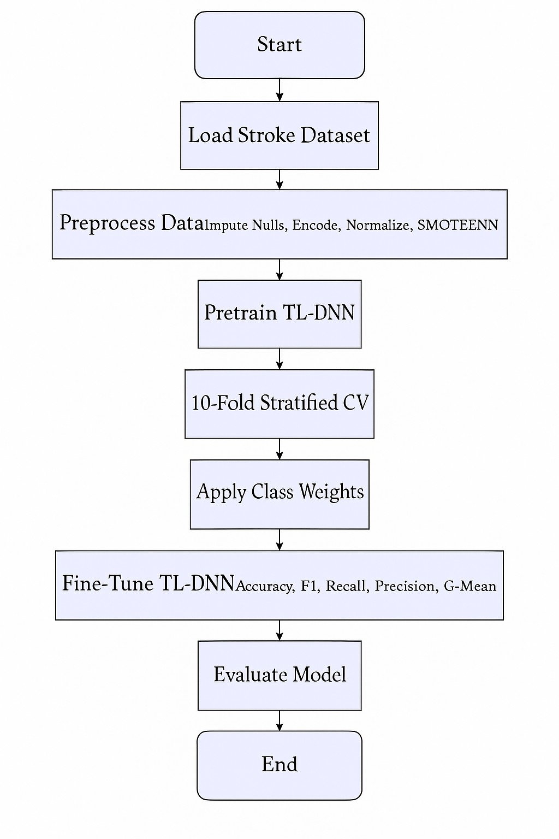
Proposed System Model
Data Preprocessing:
Filled missing BMI values and encoded categorical features (gender, job type).
Applied z-score normalization to maintain consistent data scaling.
Data Balancing:
SMOTE adds synthetic stroke samples to balance the dataset.
ENN removes noisy and overlapping data to improve quality.
Transfer Learning–Based DNN:
Built a Deep Neural Network (128 & 64 neurons, ReLU + Dropout 20%).
Used pre-trained healthcare weights with Adam optimizer and Binary Cross-Entropy loss for efficient learning.
Cross-Validation & Evaluation:
Performed 10-fold stratified cross-validation for stable testing.
Work flow:Dataset → Data Preprocessing → SMOTEENN → TL-DNN Model → Evaluation Metrics

Slide 7
Simulation Setup
🖥️ Hardware Components
Operating System : Windows 10 OS
Processor : Intel Core i5 Processor
RAM : 8 GB
GPU : Not used (CPU mode training)
💾 Software Components
Programming Language : Python 3.x
Frameworks : TensorFlow, Keras
Supporting Libraries : NumPy, Pandas, Matplotlib, Scikit-learn
📈 Performance Focus
Emphasis on high accuracy and low false negatives
Stable model generalization through SMOTEENN and Transfer Learning

Slide 8
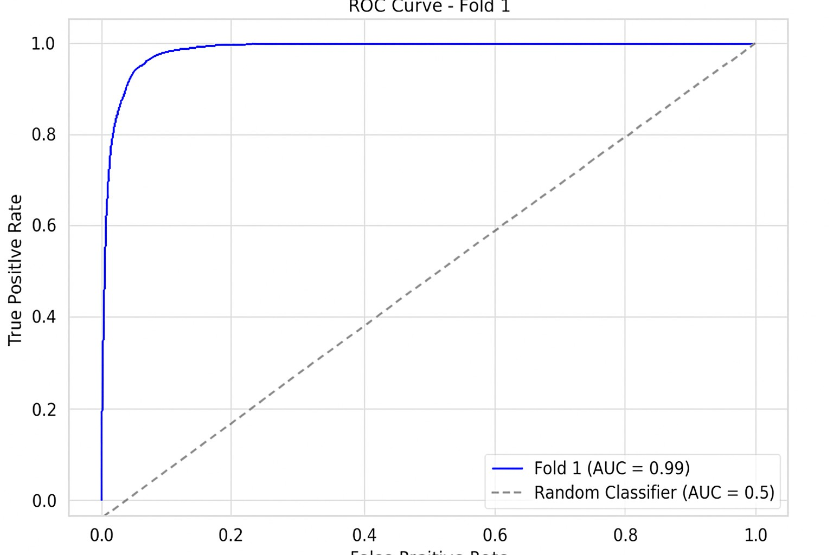
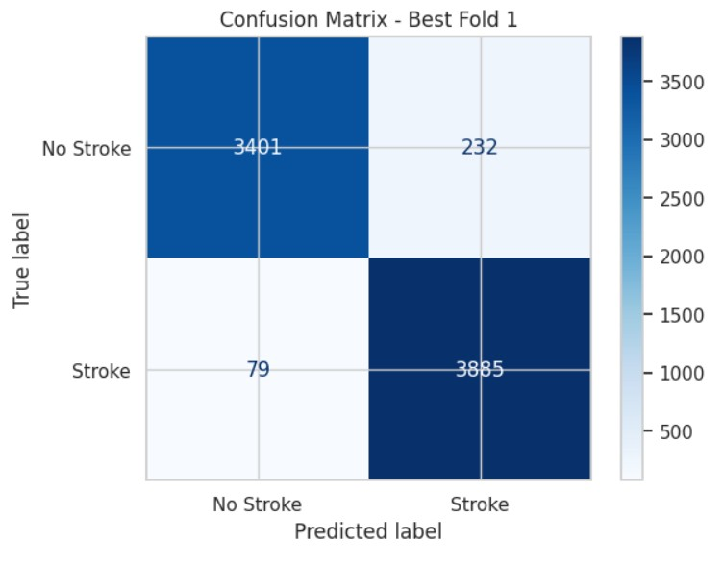
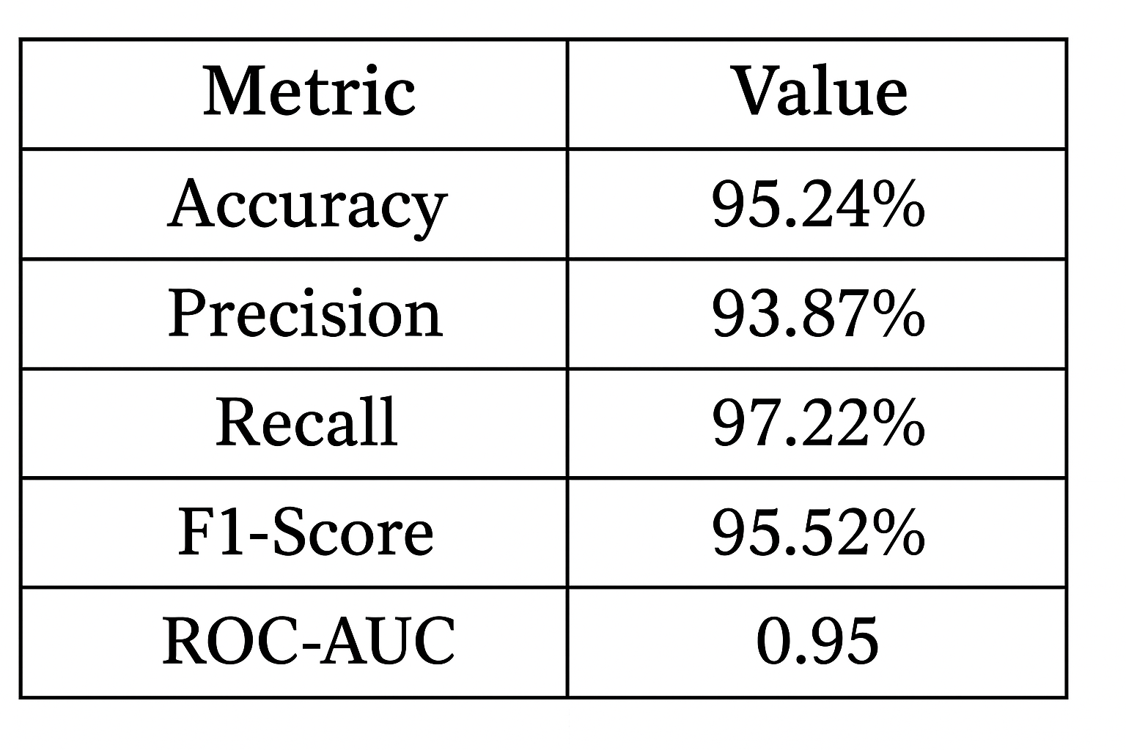
Result and Discussion
1️⃣ Performance Metrics Table:
The proposed TL-DNN achieved 95.24% accuracy, 93.87% precision, 97.22% recall, 95.52% F1-score, and 0.95 ROC-AUC, showing superior predictive performance.
2️⃣ Confusion Matrix:
Demonstrates strong classification capability with high true positives and minimal false negatives, confirming the model’s reliability in identifying stroke cases.
3️⃣ ROC Curve:
The ROC curve area (AUC = 0.95) indicates excellent discrimination ability between stroke and non-stroke classes, proving robust model generalization.

Slide 9
Conclusion & Future Work
Conclusion
The proposed hybrid SMOTEENN + TL-DNN model successfully predicts stroke risk with high accuracy and stability.
It efficiently handles imbalanced healthcare data, reducing false negatives and improving detection of stroke-prone patients.
Achieved 95.24% accuracy outperforming existing CNN, ANN, and DNN models
The integration of SMOTEENN balancing and Transfer Learning proved effective for improving data quality and model generalization.
Future Work
Incorporate MRI and CT imaging data for multimodal stroke prediction (text + image features).
Extend the study to multi-hospital or cross-country datasets for stronger generalization and real-world validation.

Slide 10
References
[11] Y. Tanaka, “Real-time stroke prediction using wearable sensor data and lstm networks,” IEEE Journal of Biomedical and Health Informatics, 2024.
[12] M. Park, “Iot-enabled stroke monitoring and prediction using bi-lstm model,” IEEE Access, 2024.
[13] S. Ali, “Stroke prediction using feature selection and xgboost on kaggle dataset,” in Proceedings of the International Conference on Health Informatics (ICHI), 2024.
[14] S. L. Jagannadham, K. L. Nadh, and M. Sireesha, “Brain tumour detection using cnn,” in 2021 Fifth International Conference on I-SMAC (IoT in Social, Mobile, Analytics and Cloud) (I-SMAC), Palladam, India, 2021, pp. 734–739.
[15] A. Seva, S. N. Tirumala Rao, and M. Sireesha, “Prediction of liver disease with random forest classifier through smote-enn balancing,” in 2024 IEEE 13th International Conference on Communication Systems and Network Technologies (CSNT), Jabalpur, India, 2024, pp. 928–933.

Slide 11
Reviewer Comments Addressed
General Improvements
Enhanced English and grammar throughout the paper
Technical Improvements
Replaced all figures and tables with high resolution, readable version
Added comprehensive evaluation using Accuracy, Precision, Recall, F1-Score, and ROC-AUC, with detailed comparison to CNN, ANN, and DNN models.
Improved results and discussions with clearer visuals and metric tables.
Additional improvements
Trimmed the redundant content and refined with equations for the clarity

Slide 12
Thank You

