Slide 1

Department of Computer Science and Engineering
INTELLIGENT PEST CLASSIFICATION AND REMEDY RECOMMENDATION SYSTEM USING VISION TRANSFORMERS AND DOMAIN-AWARE SUMMARIZATION
PRESENTED BY
Satwika Jahnavi Chakka : | 22471A0580
Thrisony Gayam : | 22471A0590
Jahnavi Kappa : | 22471A05A1
Under the Guidance of,
M. Mounika Naga Bhavani _{Mtech},
Assistant Professor,
Department of Computer Science and Engineering,
Narasaraopeta Engineering College (Autonomous), Narasaraopet- 522 601.
Review No.1
Department of CSE

Slide 2
OUTLINE
Abstract
Introduction
Literature Survey
Research Gaps
Problem Statement
Objectives
Block Diagram / Flow Diagram
Methodology
Implementation
Results and Analysis
Conclusion & Future Scope
References
Question and Answers
Acknowledgements
Review No.
Department of CSE

Slide 3
ABSTRACT
Farmers lose up to 40% of their crops yearly due to pests, often because they can’t identify the problem in time. Pest identification in rice farming remains a challenge, leading to delayed control and extensive damage. To address this, we developed a deep learning system using Vision Transformers (ViT) to identify 40 classes of rice pests by capturing detailed spatial and structural features. Unlike traditional classifiers, our system acts as a pest assistant, providing concise, farmer-friendly summaries with descriptions, recommended pesticides, and preventive measures. Designed for farmers, agricultural workers, students, and researchers, it combines deep learning with agricultural insight for accurate classification and practical advice. our simpler ViT-based model handles 40 classes and achieving 96% accuracy
Review No.
Department of CSE

Slide 4
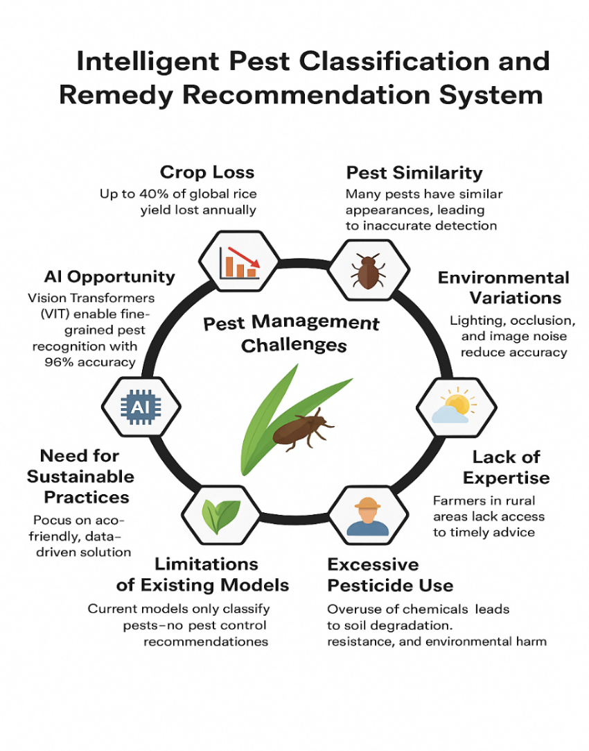
INTRODUCTION
The present work introduces the Intelligent
Pest Classification System that designed to assist
farmers in pest management.
It employs Vision Transformers (ViT) for accurate
identification of 40 rice pest species from crop images.
The system goes beyond classification by providing
pest descriptions, recommended pesticides, and
preventive measures through domain-aware summarization.
Review No.
Department of CSE

Slide 5
Motivation & Core Contribution
Farmers face huge yield losses due to delayed or incorrect pest identification.
Limited access to experts and excessive pesticide use cause environmental damage.
Existing AI models only classify pests without offering control or prevention guidance.
Proposed an Intelligent Pest Classification System using Vision Transformers (ViT) for 40 rice pest species.
Introduced a domain-aware recommendation layer giving pest description, pesticide, and preventive tips.
Integrated deep learning + agricultural knowledge for accurate, practical, and farmer-friendly outputs.
Achieved 96% classification accuracy, outperforming existing CNN and YOLO-based models.
Review No.
Department of CSE

Slide 6
LITERATURE SURVEY
No | Title | Author | Journal Name & Year | Methodology Adapted | Key Findings | Gaps
1 | Rice Pest Recognition Method Based on Improved YOLOv8 | Yang Yang; Juxing Di; Guisuo Liu; Jiali Wang | https://xplorestaging.ieee.org/document/10504248 | YOLOv8 + GAM Attention | Enhanced detection of small pests; ~91.3% accuracy | Needs validation on more diverse datasets
2 | Research on Natural Scene Rice Pest Detection Method Based on YOLOv5 | Yujie Zhuang, Hui Deng, Mengmeng Lv IEEE, 2024 | https://ieeexplore.ieee.org/document/10270124 | YOLOv5 with scene optimization | YOLOv5 adaptation performs well in unstructured natural environments | Drops in accuracy under poor lighting conditions
3 | TP-YOLO: A Lightweight Attention-Based Architecture for Tiny Pest Detection | A. Ali, B. Sardar, P. K. Singh, D. Kumar, 2023, IEEE ICIP | https://ieeexplore.ieee.org/document/10255819 | TP-YOLO with attention-enhanced heads | Efficient detection of very small pests; suitable for mobile/edge devices | Model generalization across crops not studied
4 | A Lightweight Rice Pest Detection Algorithm Using Improved Attention Mechanism and YOLOv8 (2024) | Yin et al., 2024, Agriculture | https://www.mdpi.com/2077-0472/14/7/1052 | YOLOv8 + M‑CBAM + MPDIoU loss | Achieved 95.8% AP with just 2.15 M parameters—ultra-lightweight | Needs validation on larger field-scale datasets
Review No.
Department of CSE

Slide 7
LITERATURE SURVEY
No | Title | Author | Journal Name & Year | Methodology Adapted | Key Findings | Gaps
5 | Innovative lightweight deep learning architecture for enhanced rice pest identification (2024) | Song et al., 2024, Physica Scripta | https://ui.adsabs.harvard.edu/abs/2024PhyS...99i6007S | YOLOv8‑SCS (SPD‑Conv + CG block + Slide Loss) | Improved mAP by 5.7% (to 87.9%); 44% fewer parameters | Tested only on proprietary dataset—public generalization unclear
6 | MobileNet-CA-YOLO: Improved YOLOv7 for Rice Pest & Disease Detection | Q. Wang et al., 2023, MDPI | https://plantmethods.biomedcentral.com/articles/10.1186/s13007-025-01381-w | YOLOv7 + MobileNetV3 + Channel Attention | Introduces MobileNet-CA for rice pest/disease detection with high precision and reduced size | Limited to rice leaf blight; generalization to other pests/diseases untested
7 | Improved Lightweight YOLOv8 Model for Rice Disease Detection in Multi-Scale Scenarios (RGC-YOLO) | S. Zhang et al., 2025, MDPI | https://doi.org/10.3390/agronomy15020445 | YOLOv8 + RepGhostConv + CBAM | Boosts mAP (93.2%) with efficient feature fusion | Focuses only on diseases, not insects; no comparison with multi-task models
8 | Advanced Pest Detection Using MobileNetV2-YOLOv4 | M. Hussain et al., 2023, IEEE | https://ieeexplore.ieee.org/document/10054894 | MobileNetV2 + YOLOv4 | Combines low-resource feature extraction with accurate detection | Lacks detailed ablation study; dataset size and diversity are not mentioned

Slide 8
LITERATURE SURVEY
Hussain et al., 2023 – Advanced Pest Detection Using MobileNetV2-YOLOv4
  Key Finding:
  Combined MobileNetV2 for lightweight feature extraction with YOLOv4 detection head.
  Relation to Our Work:
  Inspired the efficient feature extraction approach used in our hybrid Vision Transformer model.
Chen et al., 2024 – Rice Pest Recognition Method Based on Improved YOLOv8
Key Finding: Integrated GAM attention with YOLOv8 for improved detection of small rice pests, achieving ~91.3% accuracy.
Relation to Our Work: Inspired our model’s attention-driven enhancement for better local feature extraction in complex pest images.
Review No.
Department of CSE

Slide 9
Zhuang et al., 2024 – Natural Scene Rice Pest Detection Based on YOLOv5
Key Finding: Adapted YOLOv5 for unstructured natural environments, improving real-field pest recognition accuracy.
Relation to Our Work: Motivated the field-level robustness of our preprocessing pipeline under variable lighting and background conditions.
Ali et al., 2023 – TP-YOLO: Tiny Pest Detection via Attention Architecture
Key Finding: Proposed a lightweight attention-based TP-YOLO, enabling efficient detection of tiny pests on mobile and edge device.
Relation to Our Work: Inspired our parameter-efficient design with Vision Transformer layers for scalable inference in real-time applications.

Slide 10
Yin et al., 2024 – Lightweight Rice Pest Detection Using Improved YOLOv8
Key Finding: Introduced M-CBAM attention and MPDIoU loss to achieve 95.8% AP with minimal model size.
Relation to Our Work: Guided our model compression and optimization strategy for efficient ViT-based classification.
Song et al., 2024 – Lightweight Deep Learning Architecture for Pest Identification
  Key Finding: Presented YOLOv8-SCS (SPD-Conv + CG block) achieving 87.9% mAP with 44% fewer parameters.
Relation to Our Work: Encouraged integration of lightweight transformer backbones for efficient pest classification.

Slide 11
RESEARCH GAPS
Limited validation on diverse, real-field pest datasets.
Lack of domain-specific contextual or semantic understanding.
Poor performance under varying lighting and background conditions.
Insufficient exploration of transformer-based architectures in pest detection.
Limited focus on connecting classification with actionable agricultural insights.
Review No.
Department of CSE

Slide 12
RESEARCH GAPS
Absence of hybrid visual–knowledge-based reasoning models.
Minimal integration of lightweight models for mobile or edge deployment.
Lack of interpretability and explainability in deep learning predictions.
Insufficient ablation and comparative analysis for model optimization.
Inconsistent use of standardized open datasets for benchmarking.
Neglect of multi-task learning combining detection and recommendation.
Review No.
Department of CSE

Slide 13
PROBLEM STATEMENT
Existing pest detection models struggle to achieve consistent accuracy across varied pest species, crop types, and environmental conditions.
Most deep learning models focus solely on image classification without providing actionable, domain-aware agricultural recommendations.
Current CNN and YOLO-based approaches lack scalability, interpretability, and efficiency for real-time field deployment.
There is a need for an integrated, intelligent system that combines visual recognition with expert-driven knowledge to support farmers in timely pest management decisions.
Review No.
Department of CSE

Slide 14
OBJECTIVES
Develop a Vision Transformer (ViT)-based pest classification model capable of accurately identifying multiple pest species from crop images.
Integrate a Domain-Aware Summarization layer that links each detected pest to relevant expert knowledge, including descriptions, pesticides, and preventive measures.
Enhance model performance through advanced preprocessing and augmentation techniques to improve robustness under diverse field conditions.
Implement an end-to-end intelligent framework that supports real-time pest detection, classification, and recommendation for precision agriculture applications.
Review No.
Department of CSE

Slide 15
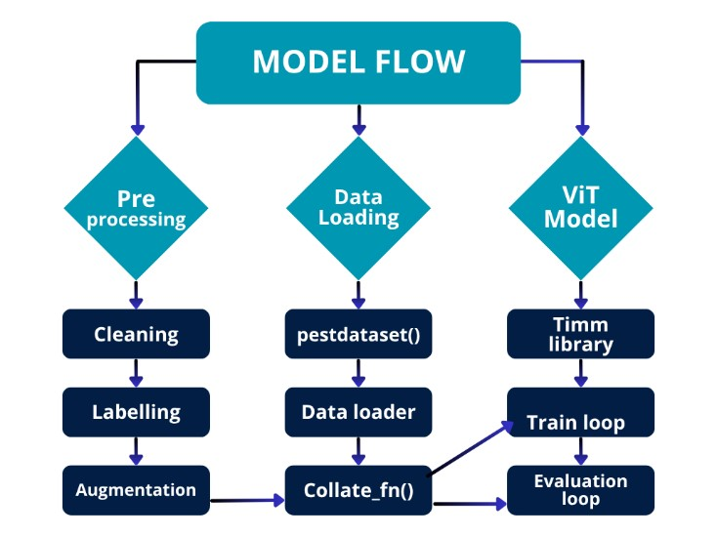
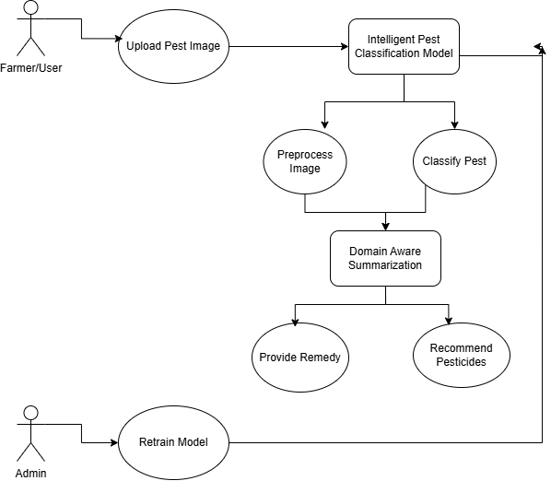
BLOCK DIAGRAM OR FLOW DIAGRAM
Review No.
Department of CSE

Slide 16
METHODOLOGY
Input (Pest Images):
Collects raw pest images from agricultural datasets like IP102 for analysis.
Preprocessing:
Cleans, labels, and augments images to enhance quality and model readiness.
Data Loading:
Organizes images into batches using pestDataset(), DataLoader, and Collate_fn() for efficient training.
ViT Model Training & Evaluation:
Utilizes Vision Transformer to extract deep visual features and classify pest species accurately.
Review No.
Department of CSE

Slide 17
METHODOLOGY
Knowledge Base Lookup:
Fetches detailed pest information from the domain-specific JSON knowledge repository.
Context Adaptation (Crop Stage, Environment):
Adjusts recommendations based on the crop’s growth stage and environmental factors.
Severity Level Analysis:
Determines the pest damage level as low/moderate or severe to guide actions.
Preventive / Chemical Control:
Suggests eco-friendly preventive methods or chemical treatments (GAPs) as per severity.
Farmer-Friendly Summary:
.
Review No.
Department of CSE

Slide 18
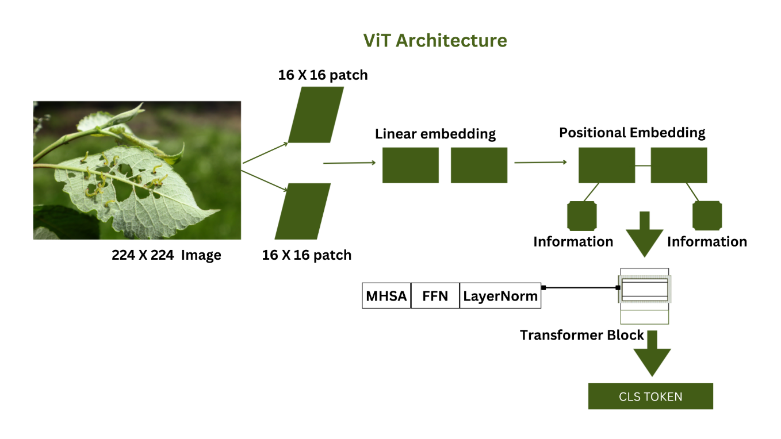
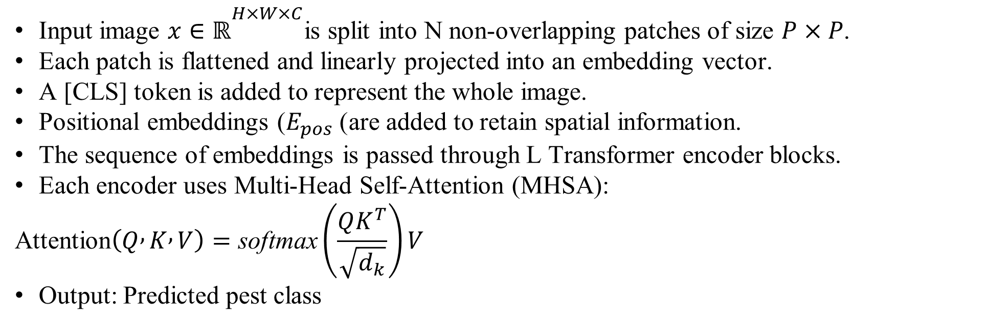
MODEL ARCHITECTURE
Vision Transformer Workflow
Input image $x∈ℝ^{H×W×C}$is split into N non-overlapping patches of size $P×P$.
Each patch is flattened and linearly projected into an embedding vector.
A [CLS] token is added to represent the whole image.
Positional embeddings ($E_{pos}$) are added to retain spatial information.
The sequence of embeddings is passed through L Transformer encoder blocks.
Each encoder uses Multi-Head Self-Attention (MHSA):
$$\text{Attention}\left(Q , K , V\right)=\text{softmax}\left(\frac{QK^{T}}{\sqrt{d_{k}}}\right)V$$
Output: Predicted pest class

Slide 19
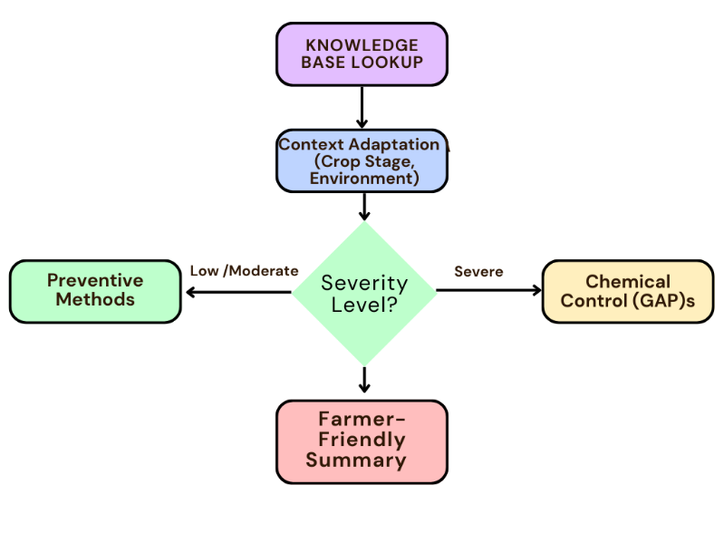
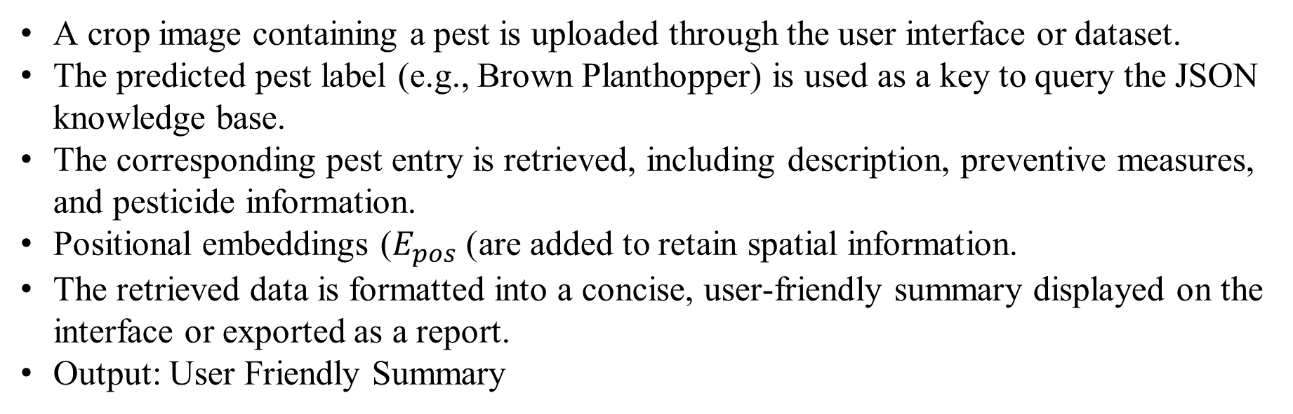
MODEL ARCHITECTURE
Domain Aware Summarisation Workflow
A crop image containing a pest is uploaded through the user interface or dataset.
The predicted pest label (e.g., Brown Planthopper) is used as a key to query the JSON knowledge base.
The corresponding pest entry is retrieved, including description, preventive measures, and pesticide information.
Positional embeddings ($E_{pos}$) are added to retain spatial information.
The retrieved data is formatted into a concise, user-friendly summary displayed on the interface or exported as a report.
Output: User Friendly Summary

Slide 20
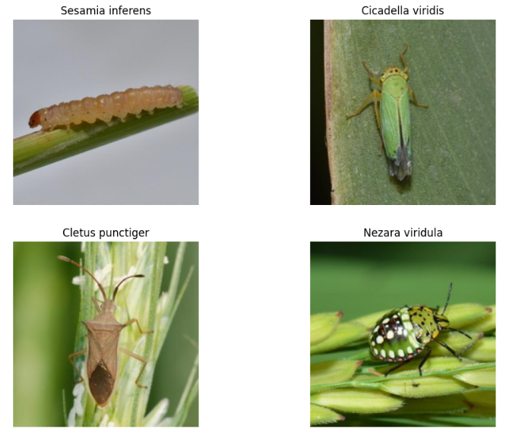
DATASET
The dataset contains diverse pest images collected from open agricultural sources like IP102(link) covering multiple pest species across various crops and environments.
Each image represents real-field conditions, ensuring variability in lighting, background, and pest orientation for robust model training.
Sample Code for Data loading and Data Splitting
from torchvision.datasets import ImageFolder
from torchvision import transforms
from torch.utils.data import DataLoader
train_dir = '/content/train'
val_dir = '/content/valid'
test_dir = '/content/test’
train_loader = DataLoader(ImageFolder(train_dir, transform), batch_size=16, shuffle=True)
val_loader = DataLoader(ImageFolder(val_dir, transform), batch_size=16)
test_loader = DataLoader(ImageFolder(test_dir, transform), batch_size=16)
.
Fig. Sample Images In Dataset

Slide 21
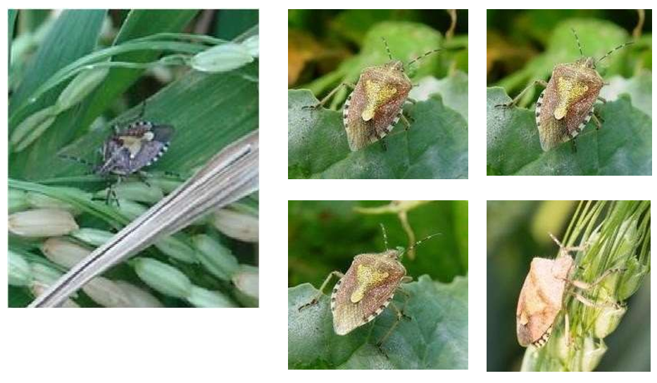
DATA PREPROCESSING
TIn this project, all images undergo systematic pre-processing to enhance image quality and ensure accurate pest classification. The key techniques applied are as follows: Image Resizing, Normalization, Data Cleaning, Data Augmentation
Sample Code for Data Preprocessing
import albumentations as A
from albumentations.pytorch import ToTensorV2
train_tf = A.Compose([
A.HorizontalFlip(),
A.RandomRotate90(),
A.RandomBrightnessContrast(),
A.Resize(224, 224),
ToTensorV2()
])
valid_tf = A.Compose([
A.Resize(224, 224),
ToTensorV2()
Fig. BEFORE AND AFTER APPLYING THE PREPROCESSING TECHNIQUE.

Slide 22
IMPLEMENTATION
💻 System Configuration:
  Windows 10 OS
  Intel® Core™ i5 Processor
  8 GB RAM
  No dedicated GPU (CPU-based training)
🧠 Development Environment:
  Language: Python
  Framework: PyTorch
  Libraries: timm, Albumentations, OpenCV
🗂️ Dataset:
  IP102 rice pest dataset (40 classes)
  Includes image normalization and data augmentation (flips, rotations, brightness)
⚙️ Performance Focus:
  Batch and data-loading optimized for CPU efficiency
  Evaluated lightweight ViT model for low-resource environments
Review No.
Department of CSE

Slide 23
RESULTS & ANALYSIS
Training Performance
Model: Vision Transformer (ViT) trained for 50 epochs using AdamW optimizer.
Validation Accuracy: ≈ 96%
Training Trend: Smooth decline in loss — strong generalization and no overfitting.
Model effectively adapted to diverse and challenging pest images.
Metric | Score (%)
Accuracy | 96.0
Precision | 95.4
Recall | 94.7
F1-Score | 95.0
Review No.
Department of CSE

Slide 24
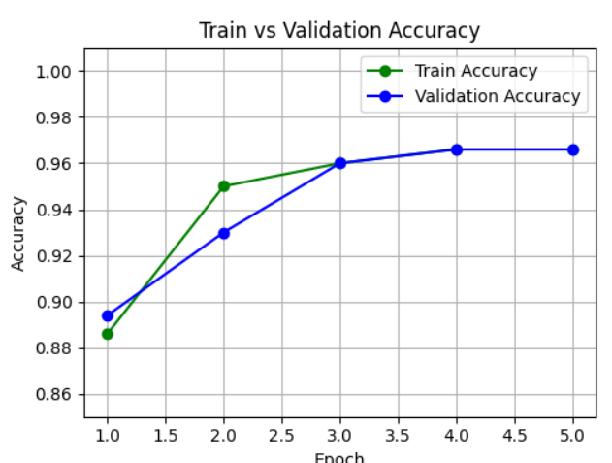
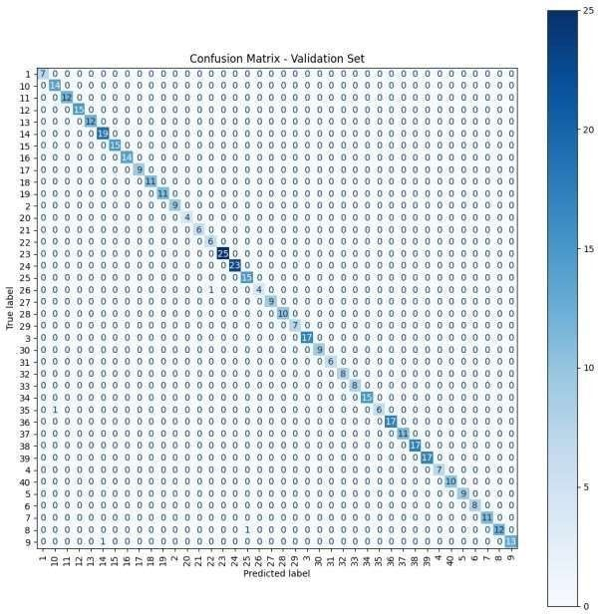
Confusion matrix shows high class-wise accuracy and consistent recognition across all 40 pests.
Outperforms existing CNN and YOLO-based models in both accuracy and robustness.

Slide 25
CONCLUSION and FUTURE SCOPE
Conclusion
  Proposed PestVision+, an intelligent pest detection and remedy system.
  Uses Vision Transformers (ViT) to classify 40 rice pest species with 96% accuracy.
  Integrates a domain-aware layer for pesticide and preventive recommendations.
  Acts as a smart assistant supporting accurate and sustainable pest management.
Review No.
Department of CSE

Slide 26
CONCLUSION and FUTURE SCOPE
Future Scope
  Extend to multi-crop pest datasets.
  Develop regional language & voice interfaces.
  Integrate drone-based pest monitoring for early detection.
  Using drones to capture crop images can help farmers spot pests early, target affected areas efficiently
Review No.
Department of CSE

Slide 27
REFERENCES
[3] R. Mehta and D. Rao, “FasterPest: An efficient framework for pest detection and leaf condition assessment,” Computers and Electronics in Agriculture, vol. 208, p. 107785, 2024.
[5] C. Wang, X. Li, and Y. Huang, “Rice pest and disease detection using MobileNet-CA-YOLO,” Applied Sciences, vol. 13, no. 9, p. 4881, 2023.
[6] H. Zhang, L. Chen, and F. Sun, “RGC-YOLO: Lightweight model for multi-scale rice disease detection,” Sensors, vol. 25, no. 1, p. 135, 2025.
[8] P. Sharma and R. Kumar, “PestNet: An end-to-end deep learning approach for large-scale multi-class pest detection and classification,” Computers and Electronics in Agriculture, vol. 212, p. 108195, 2024.
[9] S. Li and Y. Tan, “RiceShield: Robust detection of subtle rice pest features using channel-spatial attention,” Computers and Electronics in Agriculture, vol. 209, p. 107893, 2024.
Review No.
Department of CSE

Slide 28
[4] M. Tan and Q. Le, “Efficientnetv2: Smaller models and faster training,” in Proceedings of the International Conference on Machine Learning (ICML). PMLR, 2021.
[5] C. Wang, X. Li, and Y. Huang, “Rice pest and disease detection using mobilenet-ca-yolo,” Applied Sciences, vol. 13, no. 9, p. 4881, 2023.
[6] H. Zhang, L. Chen, and F. Sun, “Rgc-yolo: Lightweight model for multi scale rice disease detection,” Sensors, vol. 25, no. 1, p. 135, 2025.
[7] A. Hussain, M. A. Raza, and A. R. Javed, “Deep mobilenetv2-yolov4 for intelligent pest detection in low-resource settings,” IEEE Access, vol. 11, pp. 12345–12356, 2023.
[8] P. Sharma and R. Kumar, “Pestnet: An end-to-end deep learning approach for large-scale multi-class pest detection and classification,” Computers and Electronics in Agriculture, vol. 212, p. 108195, 2024.

Slide 29
QUESTIONS and ANSWERS
1. Problem & Motivation
Q: Why did you choose pest classification as your problem?
A: Pest attacks cause significant crop loss. Early AI-driven pest recognition helps reduce yield and economic loss.
Q: How is your approach different from existing systems?
A: Most stop at classification. Ours adds domain-aware summarization that provides actionable remedies for farmers
2. Model & Methodology
Q: Why ViT over CNNs?
A: ViT captures global context via self-attention, ideal for subtle pest differences
Q: What dataset did you use?
A: IP102 dataset with 75,000+ pest images across 102 categories. Q: How did you handle class imbalance? A: Applied augmentation and class-weighted loss.
Review No.
Department of CSE

Slide 30
QUESTIONS and ANSWERS
3. Performance & Results
Q: What metrics did you use?
A: Accuracy, Precision, Recall, and F1-score with confusion matrix analysis.
Q: What results did you achieve?
A: Achieved 96% accuracy, outperforming CNN baselines like ResNet or EfficientNet.
4. Remedy Recommendation Module
Q: How do you ensure reliability?
A: Summaries are curated and validated against agricultural data; no generative hallucination.
Q: Is your system real-time? A: Yes, it classifies and provides remedies within seconds per image
Q: How does it help farmers?
A: Offers instant pest ID and trusted remedies, cutting pesticide misuse and improving yield.
Review No.
Department of CSE

Slide 31
ACKNOWLEGEMENTS
I sincerely thank our Head of Department, Project Guide, and Faculty Members for their continuous support and guidance throughout this project.
Review No.
Department of CSE

Slide 32
Thank you!
.

