Slide 1

Ultrasound-Based Breast Cancer Detection Using a Segmentation-Guided Deep Learning Framework
287
Authors : Karuna Kumar Valicharla, Badina Chandana Priya, Bandi Srilakshmi, Kolisetty Sri Varsha,
Ashlin Deepa R N, M Aparna, Dr. Sireesha Moturi

Slide 2
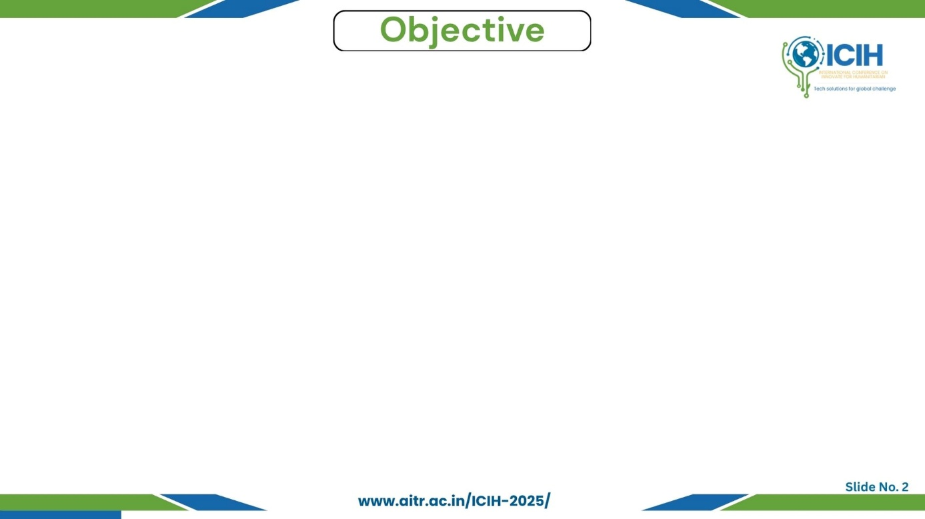
Paper_id : 287
Problem
Manual ultrasound diagnosis is inconsistent due to low contrast, speckle noise, and irregular tumor shapes.
Motivation
Need for an accurate, automated, and explainable breast-cancer detection system.
Scope & Goal
Build a segmentation-guided deep-learning model using U-Net++ + CNN for region-aware diagnosis.
Expected Outcomes
~99 % segmentation accuracy and >96 % classification accuracy.
Enhanced transparency and clinical reliability.

Slide 3
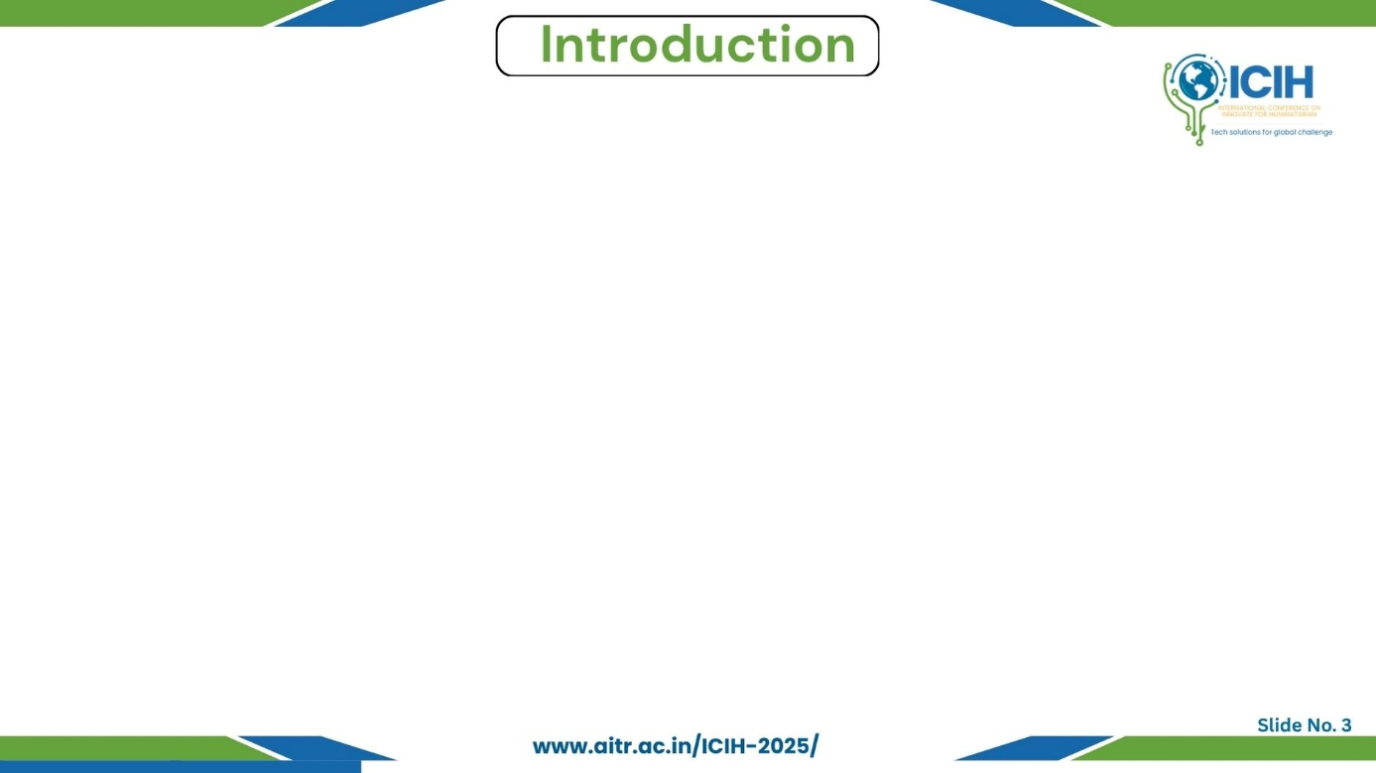
Paper_id : 287
Background Context
Breast cancer is one of the leading causes of death among women worldwide.
Early detection plays a vital role in improving survival rates.
Importance of the Problem
Ultrasound imaging is safe, affordable, and widely used for screening, but its interpretation is subjective and error-prone.
Overview of Technology Involved
Deep learning, especially CNNs, automates tumor detection and classification.
U-Net++ is used for accurate lesion segmentation, guiding the CNN for classification.
Key Challenges
Low contrast and speckle noise in ultrasound images.
Difficulty in identifying irregular tumor boundaries.
Lack of explainable and clinically interpretable AI models.

Slide 4
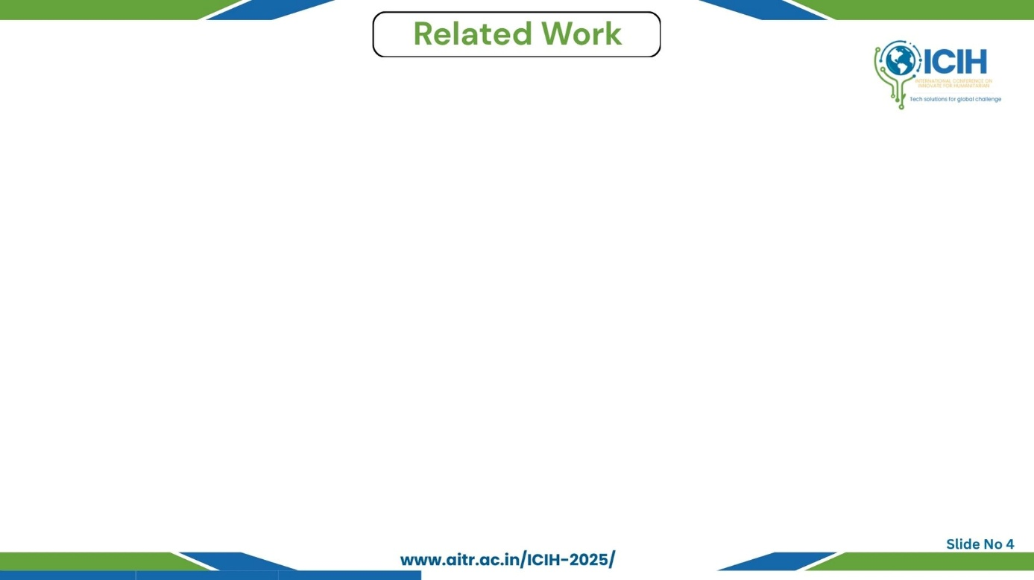
Paper_id : 287
Short Review of Similar Research
Zhang et al. (2021): Domain-guided CNN for ultrasound classification.
Ronneberger et al. (2015): Introduced U-Net for biomedical segmentation.
He et al. (2016): ResNet improved deep feature learning.
Abdelhafiz et al. (2020): Transfer learning with adaptive fusion for small datasets.
Existing Approaches
CNNs used for tumor detection and classification.
Segmentation and classification handled separately.
Limitations
Inaccurate tumor boundary detection.
Weak link between segmentation and classification.
Limited clinical interpretability.
Novelty of Proposed Work
Segmentation-guided dual-stage model (U-Net++ + CNN).
Follows radiologists’ process — locate, then classify.
Includes domain-aware enhancement for explainable diagnosis.

Slide 5
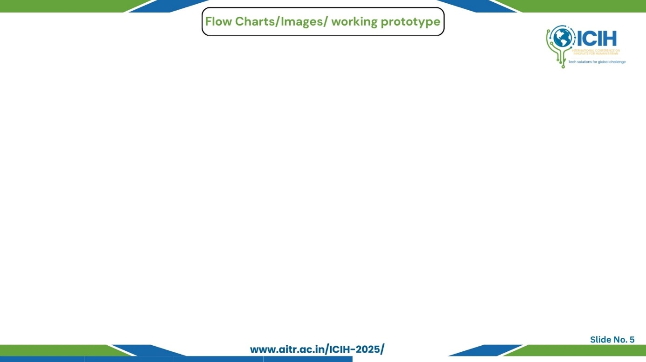
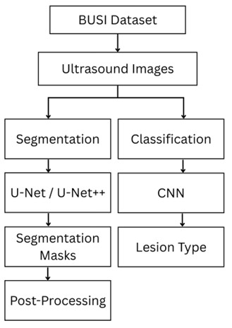
Paper_id : 287
Workflow Explanation
BUSI dataset provides ultrasound inputs.
Images are resized, normalized, and augmented.
Segmentation: U-Net / U-Net++ generate tumor masks.
Classification: CNN uses image + mask to predict benign or malignant.
Post-processing: Combines both results for final diagnosis.
Key Highlights
Dual-stage design improves accuracy and interpretability.
Region-aware segmentation enhances classifier focus.
Works efficiently even on CPU setups.
Fig: Segmentation-guided framework for breast-cancer detection

Slide 6
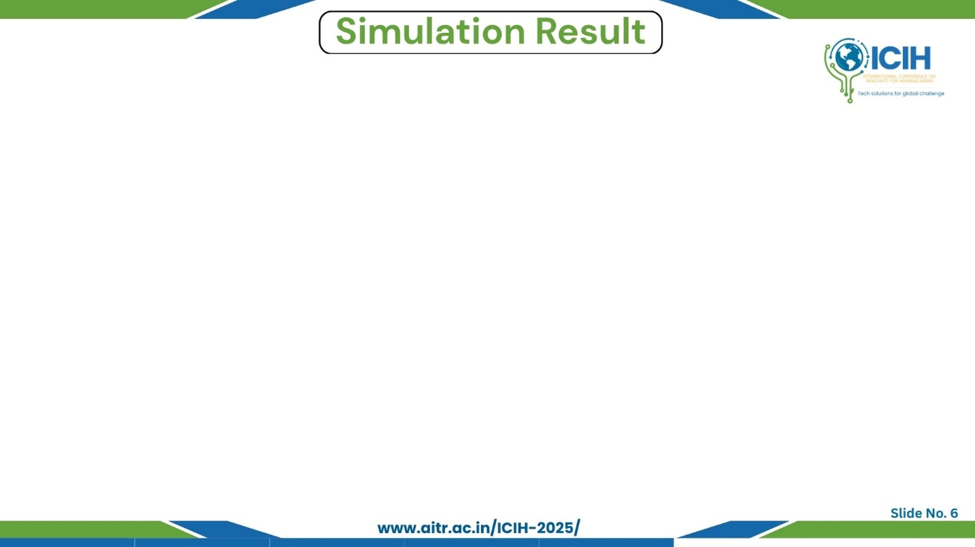
Paper_id : 287
S.NO | Model | Accuracy | Precision | Recall | F1-Score
1 | U-Net | 96.86 % | 0.89 | 0.88 | 0.89
2 | U-Net++ | 99.07 % | 0.97 | 0.96 | 0.97
3 | CNN | 91.03 % | 0.90 | 0.91 | 0.91
4 | U-Net++CNN | 96.04 % | 0.88 | 0.84 | 0.86
Table–Performance metrics of different models
Test Results Summary
U-Net++ achieved highest segmentation accuracy (99.07 %).
CNN alone: 91.03 %, while U-Net++ + CNN reached 96.04 %.
Demonstrates advantage of segmentation-guided design over standalone models.
Insights
Enhanced tumor localization and classification accuracy.
Stable convergence with minimal overfitting.
Effective even on standard CPU hardware.

Slide 7
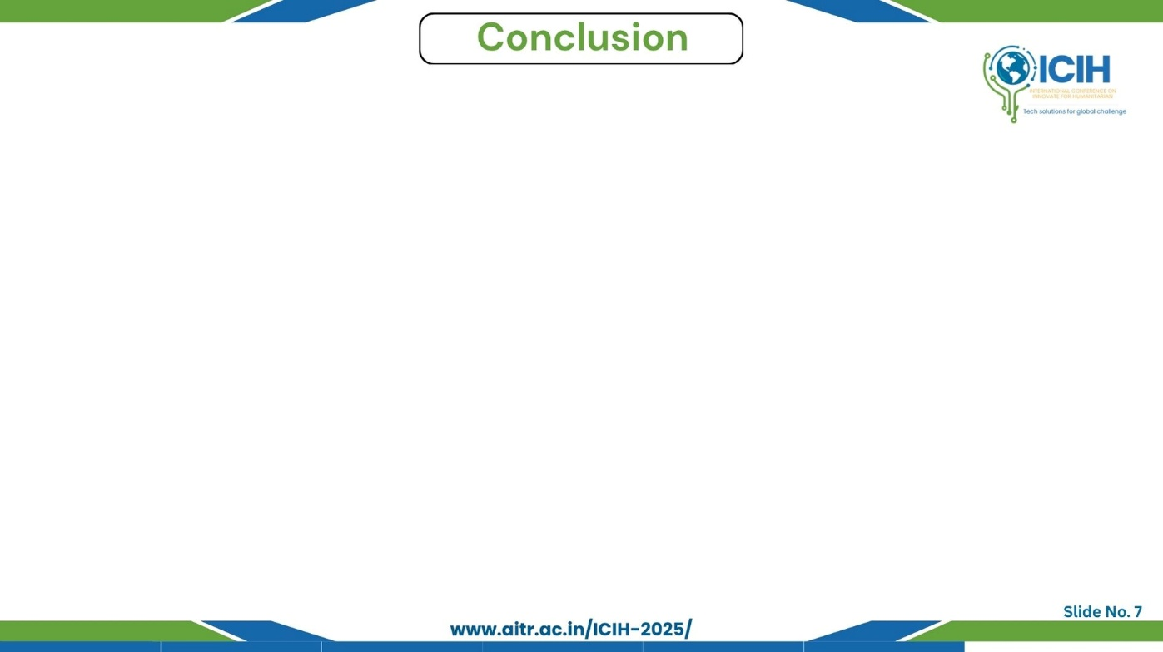
Paper_id : 287
Main Findings
Segmentation-guided model detects and classifies tumors effectively.
Achieved 99.07% segmentation and 96.04% classification accuracy.
Advantages
Region-aware and explainable (Grad-CAM).
High accuracy with CPU-efficient performance.
Key Contributions
Dual-stage U-Net++ + CNN design.
Segmentation-guided classification with stable results.
Limitations
Single dataset evaluation.
Higher training time.
Future Scope
Add attention layers and dilated convolutions.
Test on larger, multi-dataset setups.
Develop real-time end-to-end system.

Slide 8
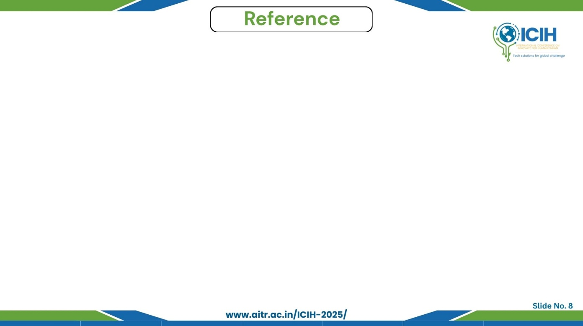
Paper_id : 287
Y. Zhang et al., “Ultrasound breast image classification through domain knowledge integration into deep neural networks,” IEEE Trans. Image Process., vol. 30, pp. 6745–6757, 2021.
O. Ronneberger et al., “U-Net: Convolutional networks for biomedical image segmentation,” Proc. MICCAI, 2015.
K. He et al., “Deep residual learning for image recognition,” Proc. CVPR, pp. 770–778, 2016.
D. Abdelhafiz et al., “Breast cancer detection using transfer learning and adaptive decision fusion,” Sensors, vol. 20, no. 3, pp. 1–15, 2020.
L. Alzubaidi et al., “Review of deep learning: Concepts, CNN architectures, challenges, applications, and future directions,” J. Big Data, vol. 8, no. 1, pp. 1–74, 2021.
S. Moturi et al., “CNN-driven detection of abnormalities in PCG signals using Gammatonegram analysis,” IEEE InCoWoCo, 2024.

