Slide 1

Department of Computer Science and Engineering
Ultrasound-Based Breast Cancer Detection Using a Segmentation-Guided Deep Learning Framework
PRESENTED BY
Badina Chandana Priya
Bandi Srilakshmi
Kolisetty Sri Varsha
(22471A0573)
(22471A0574)
(22471A05A2)
Under the Guidance of,
V.Karuna Kumar_{M.Tech},
Assistant Professor,
Department of Computer Science and Engineering,
Narasaraopeta Engineering College (Autonomous), Narasaraopet- 522 601.
Review No.
Department of CSE

Slide 2
OUTLINE
Abstract
Introduction
Literature Survey
Research Gaps
Problem Statement
Objectives
Block Diagram / Flow Diagram
Methodology
Implementation
Results and Analysis
Conclusion & Future Scope
References
Question and Answers
Acknowledgements
Review No.
Department of CSE

Slide 3
ABSTRACT
Breast cancer remains a major health concern for women, where timely and accurate diagnosis is crucial. Ultrasound imaging is widely used due to its safety and low cost but is limited by speckle noise, low contrast, and tumor variability. This study proposes a segmentation-guided deep learning framework using a U-Net++ model for precise lesion localization, achieving 99.07% accuracy with strong Dice and IOU scores. The generated segmentation masks guide a CNN classifier to distinguish benign from malignant tumors, enhancing interpretability and clinical reliability. The two-stage system shows practical utility for breast cancer diagnosis, especially in resource-limited settings, with potential for integration into clinical workflows for improved robustness.
Review No.
Department of CSE

Slide 4
INTRODUCTION
Breast cancer is a major health concern requiring early and accurate detection.
Ultrasound imaging is preferred for being safe, affordable, and widely accessible.
Manual diagnosis is often inconsistent due to noise and low contrast in scans.
This project proposes a segmentation-guided deep learning framework to automate diagnosis.
The model uses U-Net++ for tumor segmentation and CNN for classification, achieving 99.07% accuracy on the BUSI dataset.
Review No.
Department of CSE

Slide 5
MOTIVATION & RELEVANCE
Existing models struggle with precise lesion localization and interpretability.
The proposed system focuses on region-aware learning, mimicking how radiologists analyze scans.
Enhances diagnostic transparency and reliability in ultrasound-based detection.
Designed for resource-limited clinical environments, supporting early and accurate breast cancer screening.
Review No.
Department of CSE

Slide 6
LITERATURE SURVEY
No | Title | Author | Journal Name & Year | Methodology Adapted | Key Findings | Gaps
1 | Ultrasound Breast Image Classification Through Domain Knowledge Integration Into Deep Neural Networks | Y. Zhang et al., 2021, IEEE Transactions on Image Processing | https:// ieeexplore.ieee.org/ document/10634159 | U-Net extracts segmentation masks; resized inputs feed a dual-stream CNN with multiscale fusion for classification. | Achieved 7.5% higher accuracy with better interpretability and region-focused learning. | Performance limited by small data, poor generalization, and reliance on precise segmentation masks.
2 | Breast Cancer Detection Using Transfer Learning and Decision Fusion | D. Abdelhafiz et al., 2020, Frontiers | https://paultimothymooney/chest-xray-pneumonia | Patch-wise augmented and normalized inputs are processedtransfer learning with adaptive fusion. Resized and normalized images are segmented using an encoder–decoder CNN with skip connections for biomedical precision. | Achieved ~94% accuracy on limited data model fusion, strong generalization. | Cross-device dataset variability and limiting broader applicability.
3 | U-Net: Convolutional Networks for Biomedical Image Segmentation | O. Ronneberger, P. Fischer, T. Brox | https://link.springer.com/article/10.1007/s11263-015-0816-y |  | Achieved state-of-the-art medical image segmentation with effective preservation of fine spatial details. | No classification or adaptation.
Review No.
Department of CSE

Slide 7
LITERATURE SURVEY
No | Title | Author | Journal Name & Year | Methodology Adapted | Key Findings | Gaps
1 | Ultrasound Breast Image Classification Through Domain Knowledge Integration Into Deep Neural Networks | Y. Zhang et al., 2024, IEEE Transactions on Image Processing | https:// ieeexplore.ieee.org/ document/10634159 | U-Net extracts segmentation masks; resized inputs feed a dual_x0002_stream CNN with multiscale fusion for classification. | Achieved 7.5% higher accuracy with better interpretability and region-focused learning. | Performance limits by small data, poor generalization, and reliance on precise segmentation mask..
2 | Breast Cancer Detection Using Transfer Learning and Decision Fusion | D. Abdelhafiz et al., Frontiers | https://paultimothymoo ney/chest-xray_x0002_pneumonia | Patch-wise augmented and normalized inputs are processed transfer learning with adaptive fusion. | Achieved ~94% accuracy on limits data model fusion, strong generalization. | Cross-device dataset variability and limiting broader applicability.
3 | U-Net: Convolutional Networks for Biomedical Image Segmentation | O. Ronneberger, P. Fischer, T. Brox | https://link.springer.com/article/10.1007/s112 63-015-0816-y | Resized and normalized images are segmented using encoder–decoder CNN with skip connections for biomedical precision. | Achieved state-of_x0002_the-art medical image segmentation with effective preservation of fine spatial details. | No classification or adaptation.
Review No.
Department of CSE

Slide 8
LITERATURE SURVEY
No | Title | Author | Journal Name & Year | Methodology Adapted | Key Findings | Gaps
4 | Very Deep Convolutional Networks for Large-Scale Image Recognition | K. Simonyan, A. Zisserman | https:// ieeexplore.ieee.org/ document/10634159 | VGGNet with 16–19 layers using small convolutional filters. | Depth improved accuracy; set new ImNet benchmark. | Heavy computation, largememory, poor fit for small medical datasets.
5 | DeepResidual Learning for Image Recognition | K. He, X. Zhang, S. Ren, J. Sun | https://paultimothymooney/chest-xray-pneumonia | ResNet with residual connections enabling ultra-deep training. An encoder–decoder convolutional neural network (CNN) with skip connections, optimized for biomedical image segmentation, enabling accuracy. | A breakthrough accuracy; solved vanishing gradient problem. | Complex architecture; needs massive labeled data; limited biomedical adaptation initially.
6 | U-Net: Convolutional Networks for Biomedical Image Segmentation | O. Ronneberger, P. Fischer, T. Brox | https://link.springer.com/article/10.1007/s11263-015-0816-y |  | Achieved state-of-the-art medical image segmentation with effective preservation of fine spatial details. | Focused only on segmentation; no classification or model adaptation.
Review No.
Department of CSE

Slide 9
LITERATURE SURVEY
No | Title | Author | Journal Name & Year | Methodology Adapted | Key Findings | Gaps
4 | Very Deep Convolutional Networks for Large-Scale Image Recognition | K. Simonyan, A. Zisserman | https:// ieeexplore.ieee.org/ document/10634159 | VGG Net with 16–19 layers using small convolutional filters. | Depth improved accuracy; set new Image Net benchmark. | Heavy computation, largememory, poor fit for small medical datasets.
5 | U-Net: Convolutional Networks for Biomedical Image Segmentation | O. Ronneberger, P. Fischer, T. Brox | https://link.springer.com/article/10.1007/s112 63-015-081 | Optimized for biomedical image segmentation, enabling accuracy. | Achieved state-of_x0002_the-art medical image segmentation with effective preservation of fine spatial details. | Focused only on segmentation; no classification or model adaptation.

Slide 10
LITERATURE SURVEY
Zhang et al. (2021) — Domain-guided deep learning for ultrasound
  Summary: Combines raw ultrasound images with segmentation masks to focus the classifier on lesion regions.
  Key finding: Region-aware training improves accuracy and interpretability.
  Relation to our project: Validates the segmentation-guided approach (we adopt U-Net++ masks to guide classification).
Ronneberger et al. (2015) — U-Net for biomedical segmentation
  Summary: Introduced encoder–decoder architecture with skip connections for precise pixelwise segmentation.
  Key finding: Excellent retention of spatial details for medical images.
  Relation to our project: Underpins our choice of U-Net++/U-Net variants for robust tumor mask generation.
Review No.
Department of CSE

Slide 11
LITERATURE SURVEY
Abdelhafiz et al. (2020) — Transfer learning + adaptive decision fusion
  Summary: Uses pretrained CNNs and fusion strategies to improve detection on small datasets.
  Key finding: Transfer learning + fusion yields reliable accuracy with limited data.
  Relation to our project: Informs use of pretrained backbones and fusion of segmentation features to strengthen classifier performance.
Huang et al. (2020) — CNN classification on ultrasound images
  Summary: Direct CNN-based classification of ultrasound scans without segmentation.
  Key finding: Achieves decent accuracy but misses region-specific cues, causing misclassifications.
  Relation to our project: Motivates adding explicit segmentation masks to focus the classifier on tumor regions.
Review No.
Department of CSE

Slide 12
RESEARCH GAPS
CNN models lack focus on lesion boundaries and region-aware learning.
Manual diagnosis remains subjective and inconsistent.
Existing methods show poor generalization on real ultrasound data.
Limited integration of segmentation with classification.
High data and hardware requirements hinder clinical use.
Need for a lightweight, explainable, and accurate deep learning framework.
Review No.
Department of CSE

Slide 13
PROBLEM STATEMENT
Breast cancer diagnosis from ultrasound images is often inaccurate due to noise and low contrast.
Manual interpretation leads to inconsistent and subjective results.
Existing CNN models ignore lesion boundaries, reducing diagnostic reliability.
Lack of integrated segmentation and classification limits model performance.
There is a need for an automated, accurate, and interpretable system for early breast cancer detection using ultrasound images.
Review No.
Department of CSE

Slide 14
OBJECTIVES
To develop a segmentation-guided deep learning framework for breast cancer detection using ultrasound images.
To use U-Net++ for accurate lesion segmentation and region localization.
To train a CNN classifier guided by segmentation masks for benign/malignant classification.
To achieve high accuracy, interpretability, and efficiency suitable for clinical applications.
Review No.
Department of CSE

Slide 15
DATASET DESCRIPTION
Dataset: BUSI (Breast Ultrasound Images) from Baheya Hospital, Egypt, with 780 grayscale images.
Categories: 133 normal, 210 benign, 437 malignant; masks provided for benign/malignant, empty for normal.
Preprocessing: Images resized to 128×128 pixels and normalized for training.
Augmentation: Flipping, rotation, translation, and zooming applied to improve generalization and balance classes.
Review No.
Department of CSE

Slide 16
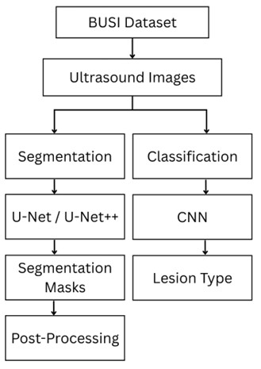
BLOCK DIAGRAM OR FLOW DIAGRAM
Review No.
Department of CSE

Slide 17
METHODOLOGY
The proposed system follows a two-stage deep learning approach:
  Segmentation Stage using U-Net++
  Classification Stage using CNN
Dataset used: BUSI (Breast Ultrasound Images Dataset)
Workflow includes:
  Data collection & preprocessing
  Segmentation mask generation
  Mask-guided classification
  Evaluation and post-processing
Framework implemented using Python, TensorFlow, and Keras in Google Colab.
Review No.
Department of CSE

Slide 18
METHODOLOGY
Data Preprocessing
All ultrasound images resized to 128 × 128 pixels and converted to grayscale.
Applied normalization to scale pixel intensity between 0 and 1.
Used data augmentation (rotation, flip, zoom, shift) to increase dataset variability.
Split dataset into training, validation, and testing sets (70:20:10).
Preprocessing ensured better generalization and minimized overfitting.
Review No.
Department of CSE

Slide 19
METHODOLOGY
Segmentation Phase
Used U-Net++ architecture for accurate tumor segmentation.
Input: preprocessed ultrasound image.
Output: binary segmentation mask highlighting the lesion region.
Features:
  Encoder–decoder structure with skip connections.
  Nested skip pathways improve boundary precision.
Evaluated using Dice Coefficient and IoU metrics for segmentation accuracy.
Review No.
Department of CSE

Slide 20
METHODOLOGY
Classification Phase:
The CNN classifier receives both the original image and its segmentation mask.
Learns region-focused features for benign vs malignant tumor classification.
Implemented Adam optimizer, Binary Cross-Entropy loss, and EarlyStopping.
Performance measured by Accuracy, Precision, Recall, and F1-score.
Review No.
Department of CSE

Slide 21
METHODOLOGY
Parameter Settings:
Parameter | Value
Image Size | 128 × 128
Batch Size | 32
Epochs | 50
Learning Rate | 0.001
Metrics | Accuracy, Dice, IoU
Review No.
Department of CSE

Slide 22
IMPLEMENTATION
Software: Python, TensorFlow, Keras, OpenCV, NumPy, Google Colab
Hardware: Intel Core i5 CPU, 8 GB RAM, 256 GB SSD (no GPU)
Process: Model trained on BUSI dataset using U-Net++ for segmentation and CNN for classification.
Challenges & Solutions:
  Limited data → handled by data augmentation
  Overfitting → controlled with early stopping
  Low-contrast images → improved by normalization and preprocessing
  Long training time → reduced using optimized architecture and batch processing
Review No.
Department of CSE

Slide 23
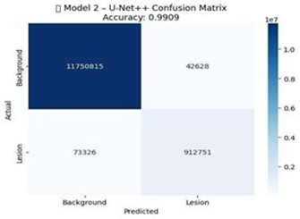
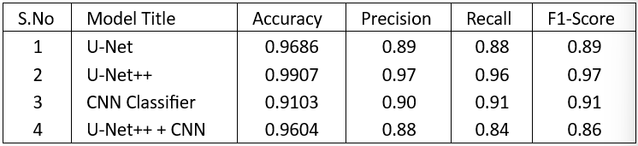
RESULTS & ANALYSIS
Segmentation Phase
U-Net++ outperformed U-Net with higher Dice and IoU, achieving 99.07% segmentation accuracy.
Review No.
Department of CSE

Slide 24
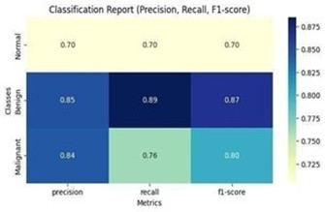
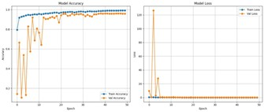
RESULTS & ANALYSIS
Classification Phase
The proposed U-Net++ + CNN framework achieved 96.04% accuracy, offering improved interpretability and lesion-focused learning.
Review No.
Department of CSE

Slide 25
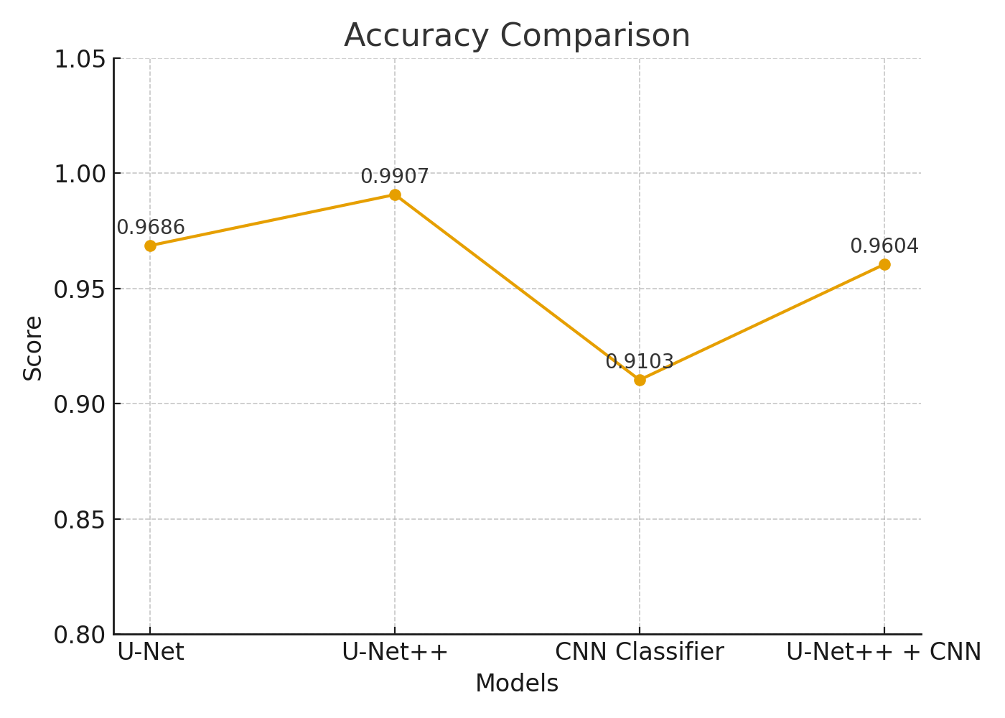
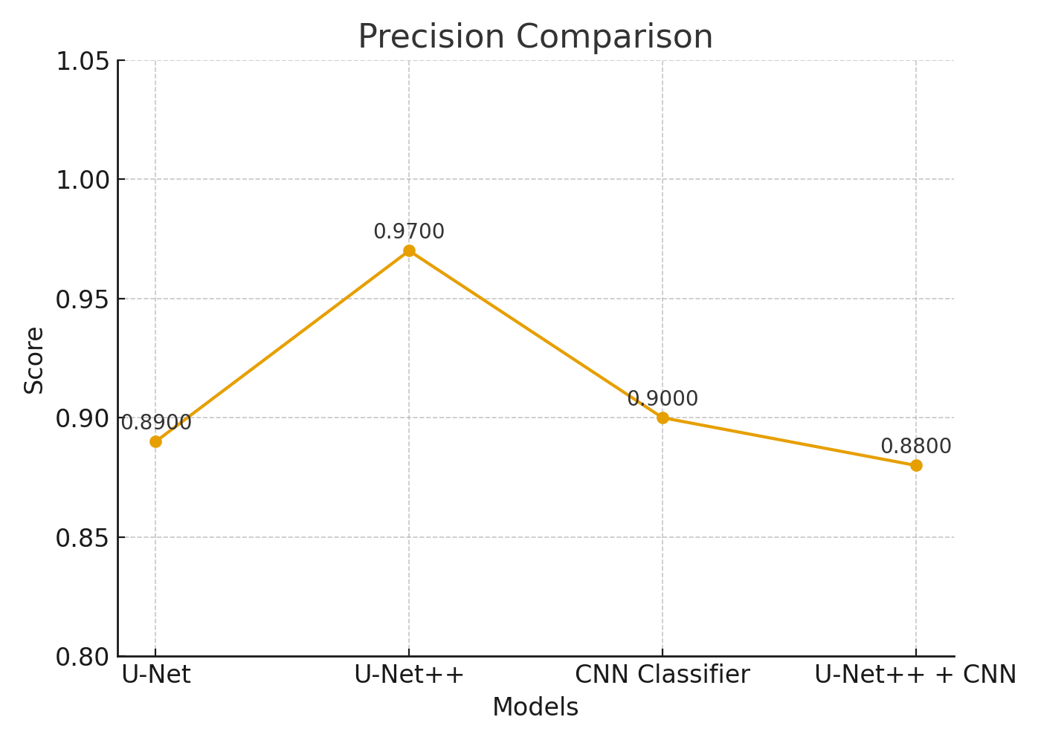
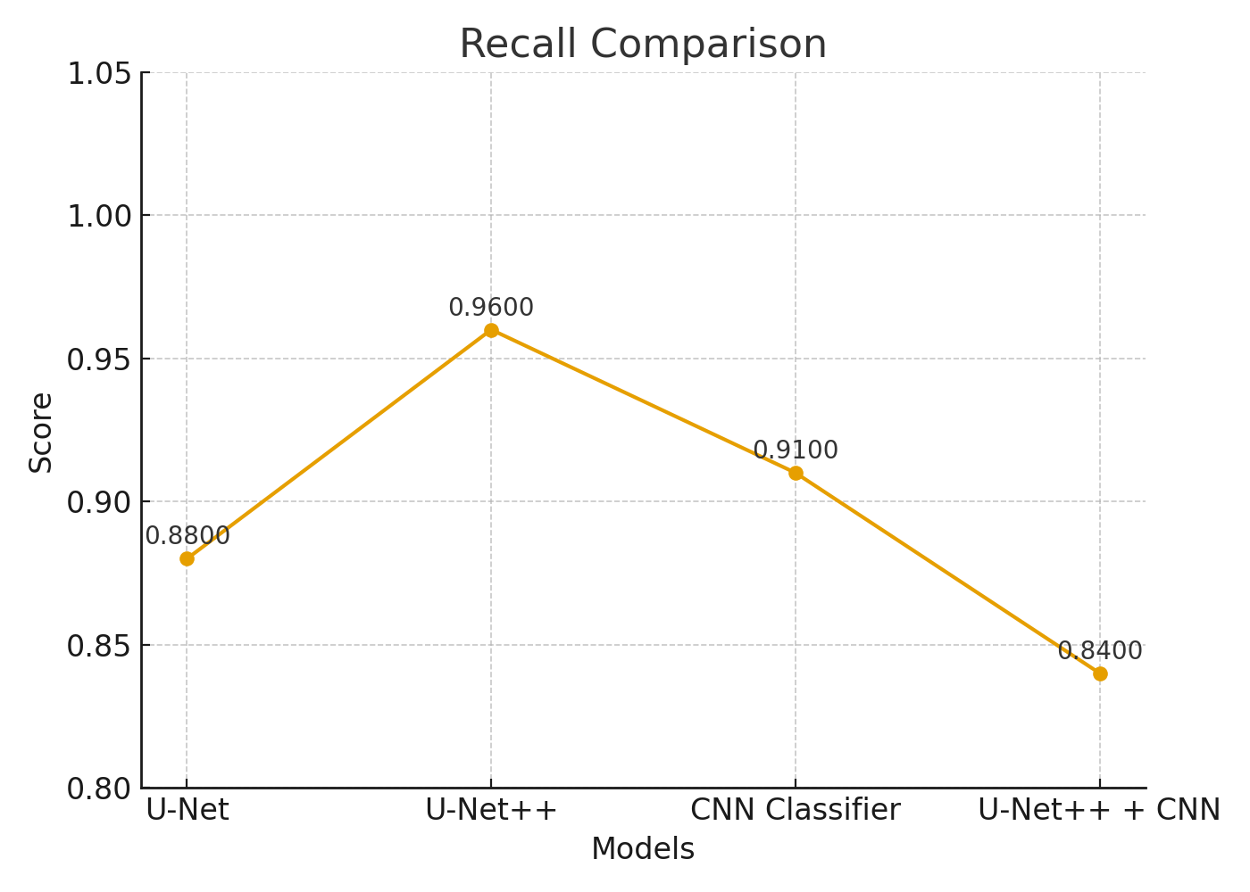
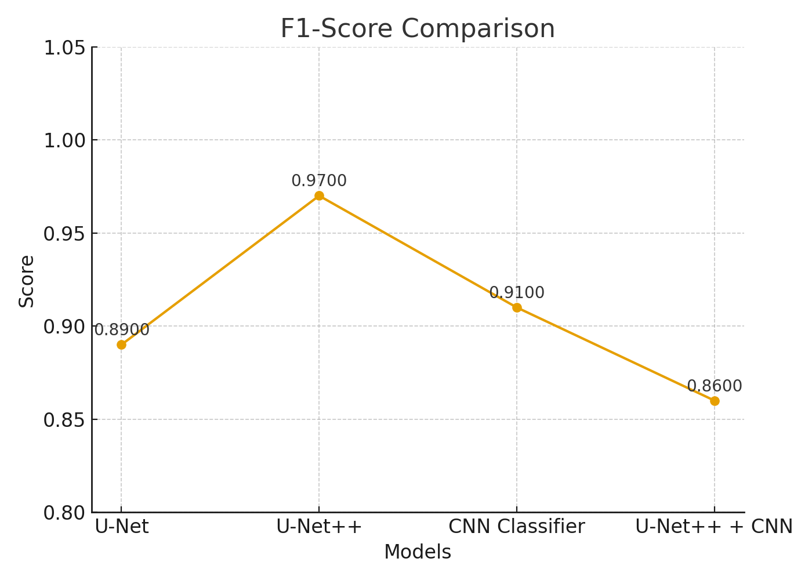
RESULTS & ANALYSIS

Slide 26
CONCLUSION and FUTURE SCOPE
Proposed a segmentation-guided deep learning model for breast cancer detection using ultrasound images.
U-Net++ + CNN achieved high accuracy with improved interpretability and lesion focus.
Demonstrated potential for clinical decision support in early cancer diagnosis.
Future Work:
  Train on larger, diverse datasets.
  Develop real-time clinical integration.
  Enhance precision using attention or hybrid models.
  Improve robustness against noise and imbalance.
Review No.
Department of CSE

Slide 27
REFERENCES
Y. Zhang, X. Sun, L. Chen, and Y. Zhang, “Ultrasound Breast Image Classification Through Domain Knowledge Integration into Deep Neural Networks,” IEEE Trans. Image Process., vol. 30, pp. 8719–8731, 2021.
O. Ronneberger, P. Fischer, and T. Brox, “U-Net: Convolutional Networks for Biomedical Image Segmentation,” in Proc. MICCAI, 2015, pp. 234–241.
K. He, X. Zhang, S. Ren, and J. Sun, “Deep Residual Learning for Image Recognition,” in Proc. IEEE CVPR, 2016, pp. 770–778.
G. Litjens et al., “A Survey on Deep Learning in Medical Image Analysis,” Med. Image Anal., vol. 42, pp. 60–88, 2017.
J. Long, E. Shelhamer, and T. Darrell, “Fully Convolutional Networks for Semantic Segmentation,” in Proc. IEEE CVPR, 2015, pp. 3431–3440.
A. Krizhevsky, I. Sutskever, and G. Hinton, “ImageNet Classification with Deep Convolutional Neural Networks,” Commun. ACM, vol. 60, no. 6, pp. 84–90, 2017.
D. P. Kingma and J. Ba, “Adam: A Method for Stochastic Optimization,” in Proc. ICLR, 2015.
Review No.
Department of CSE

Slide 28
REFERENCES
S. Ioffe and C. Szegedy, “Batch Normalization: Accelerating Deep Network Training by Reducing Internal Covariate Shift,” in Proc. ICML, 2015, pp. 448–456.
C. Szegedy et al., “Going Deeper with Convolutions,” in Proc. IEEE CVPR, 2015, pp. 1–9.
Q. Huang, Z. Huang, and S. Chen, “Diagnosis of Breast Tumors with Ultrasound Images Based on Deep Learning,” J. Healthcare Eng., 2020.
D. Abdelhafiz et al., “Breast Cancer Detection Using Transfer Learning and Adaptive Decision Fusion,” Sensors, vol. 20, no. 20, p. 5785, 2020.
G. Campanini, E. Dongiovanni, and D. Iampieri, “A Novel Featureless Approach to Breast Lesion Characterization Based on Sonographic Texture Analysis,” Med. Phys., vol. 41, 2014.
J. Cheng et al., “Computer-Aided Diagnosis with Deep Learning Architecture: Applications to Breast Lesions in Ultrasound Images,” Ultrasound Med. Biol., vol. 42, no. 4, pp. 990–1004, 2016.
T.-Y. Lin et al., “Focal Loss for Dense Object Detection,” in Proc. IEEE ICCV, 2017, pp. 2980–2988.
Review No.
Department of CSE

Slide 29
QUESTIONS and ANSWERS
Q1. What is your project about?
→ Detecting and classifying breast tumors from ultrasound images using a segmentation-guided deep learning model.
Q2. Why did you use U-Net++?
→ It gives more accurate tumor boundary detection than basic U-Net.
Q3. What accuracy did you achieve?
→ 99.07% for segmentation and 96.04% for classification.
Q4. What are your future improvements?
→ Use larger datasets, add attention mechanisms, and develop real-time clinical integration.
Review No.
Department of CSE

Slide 30
ACKNOWLEGEMENTS
I sincerely thank my project guide, department faculty, and Narasaraopeta Engineering College for their constant guidance and support throughout this work.
I am grateful to the review panel for giving me the opportunity to present my project and for their valuable feedback.
Special thanks to my teammates and peers for their collaboration and encouragement.
For further inquiries or collaboration, please contact:
📧 Email: chandanapriyabadina@gail.com
Review No.
Department of CSE

