Slide 1

Combining Deformable CNNs and Transformers for Real-time Multi-Task Dense Prediction.
Paper Id : 165
Authors : Suresh Munnangi, Anitha Ambati, Kathyayani Muthayla,
Harshini Sanagala, Srinivas Varanasi,
Sai Niranjan Kumar Pathakota,
Sireesha Moturi

Slide 2
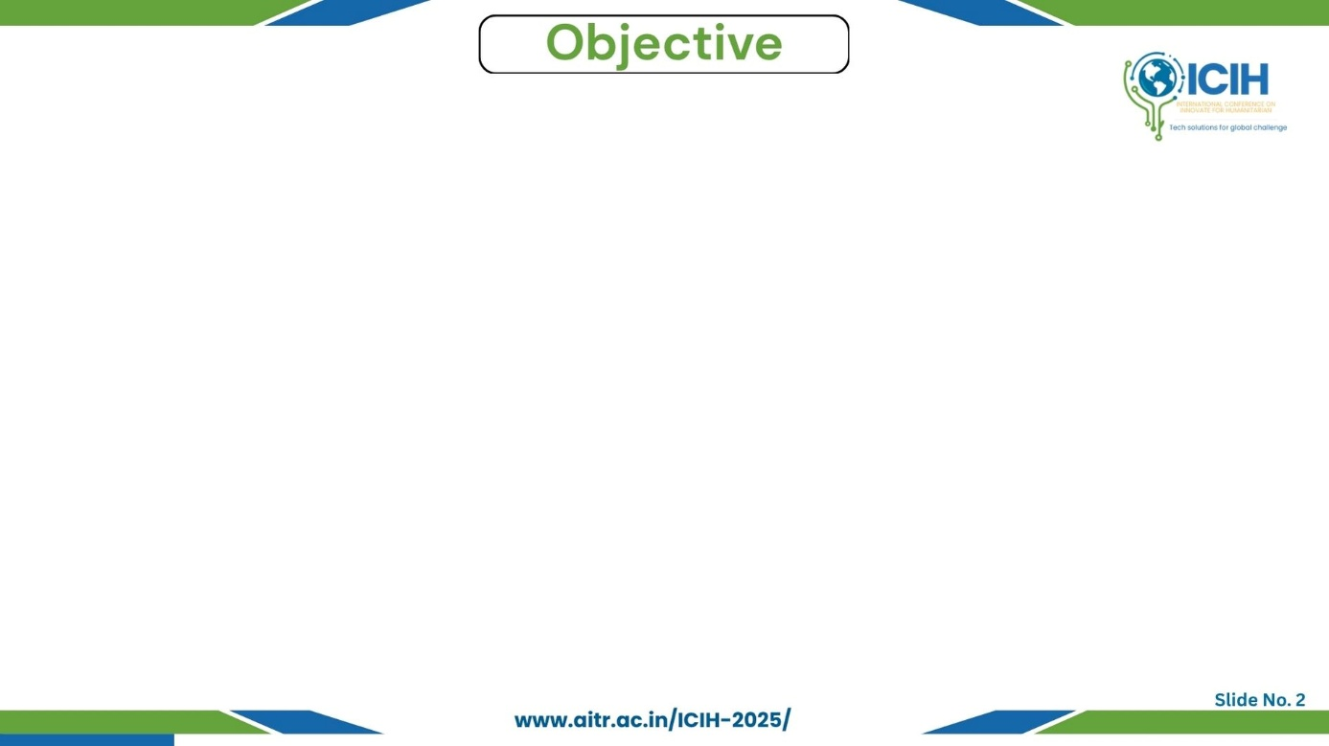
Paper_id : 165
Problem to solve / motivation
Research goal
Expected outcomes
A single RGB image must be used to predict multiple dense outputs — segmentation, boundaries,depth, and surface normals — each requiring different levels of spatial and semantic understanding.
Traditional CNNs capture only local features, while transformers capture global dependencies, making it difficult to efficiently perform all tasks in one unified model.
There is a need for a hybrid model that maintains accuracy, adaptability, and real-time performance for dense scene understanding
To design and implement a Deformable Mixer Transformer (DeMT) that integrates deformable convolutions with transformer-based task decoding.
A unified architecture that predicts segmentation, depth, surface normals, and boundaries simultaneously.
Improved accuracy and computational efficiency over traditional models.

Slide 3
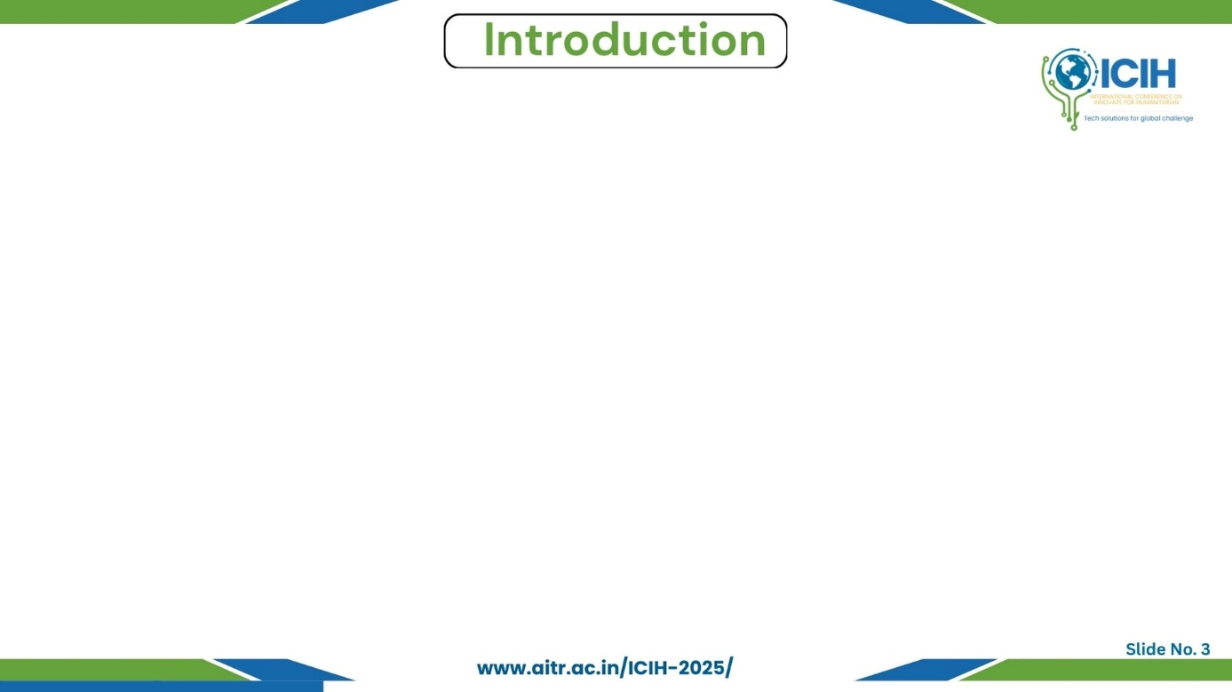
Paper_id : 165
Background context
Importance of the problem
Basic overview of technology
Key challenges
Dense prediction tasks such as segmentation, depth, and boundary detection are critical in computer vision for robotics, AR/VR, and smart vision systems.
Each task requires understanding both local textures and global structures.
Multi-task learning reduces computation cost and memory usage while improving generalization.
Semantic Segmentation – classifies each pixel in the image.
Depth Estimation – predicts distance from the camera for each pixel.
Surface Normal Prediction – identifies object orientation and geometry.
Boundary Detection – locates object edges and shape transitions.
CNNs lack long-range reasoning
Transformers are computationally heavy.
Balancing multiple losses and tasks is difficult.

Slide 4
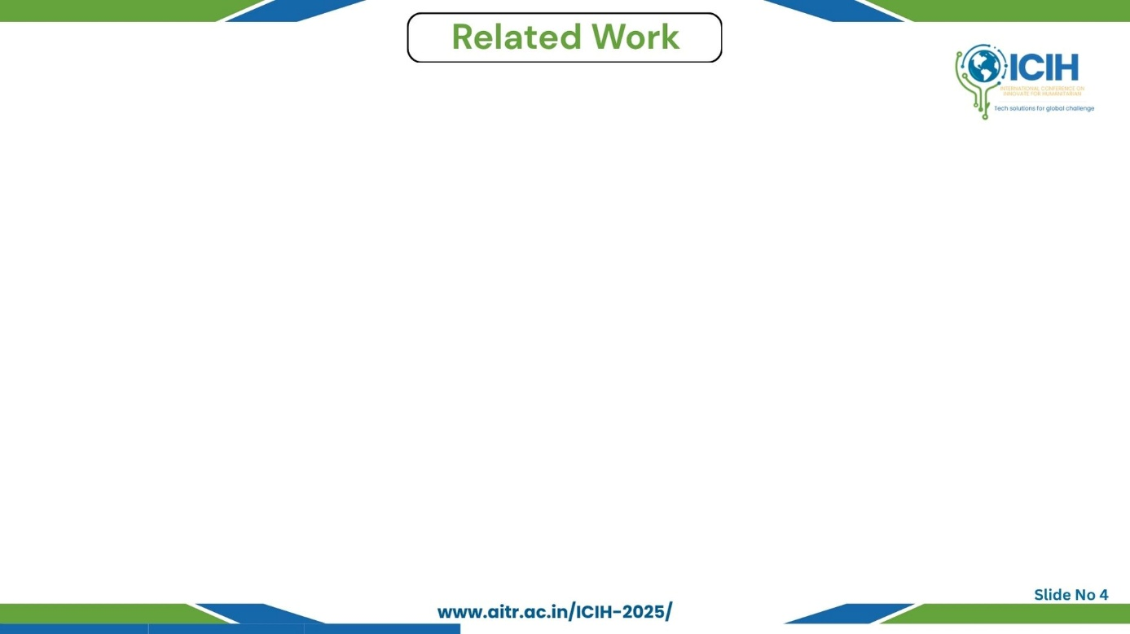
Paper_id : 165
Short review of similar technologies/research
Limitations of current works
Novelty of our approach
Cross-Stitch Networks (Misra et al.) – flexible parameter sharing, limited scene context.
MTI-Net (Vandenhende et al.) – multi-scale CNN, lacked global reasoning.
MulT (Bhattacharjee et al.) – transformer-based multi-task model, computation-heavy.
CNN-based models fail to capture long-range global context.
Transformer models are computationally heavy and less practical for real-time systems.
No unified framework efficiently processes segmentation, depth, normals, and boundaries simultaneously.
DeMT uses Deformable Convolutions to adapt sampling locations → improves fine local feature understanding.
Introduces Task Query–based Transformer Decoder for global contextual reasoning across tasks.
Provides a balanced multi-task architecture that predicts segmentation, depth, normals, and boundaries in a single forward pass.
Achieves high accuracy + real-time efficiency, overcoming limitations of both CNN-only and Transformer-only models.

Slide 5
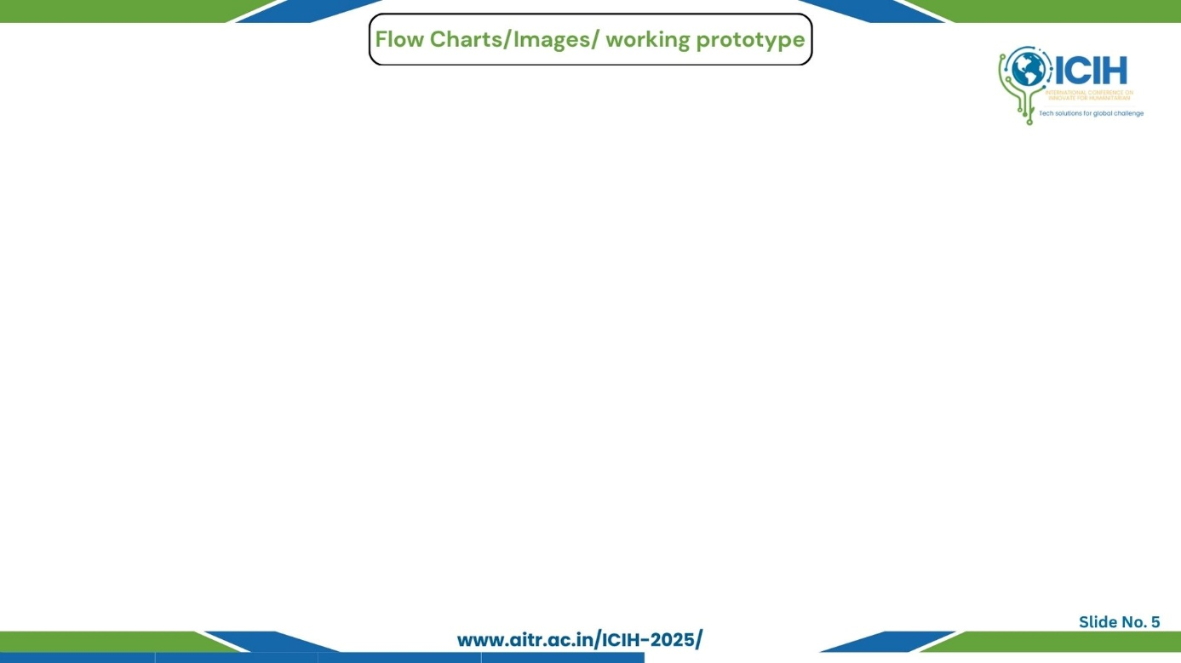
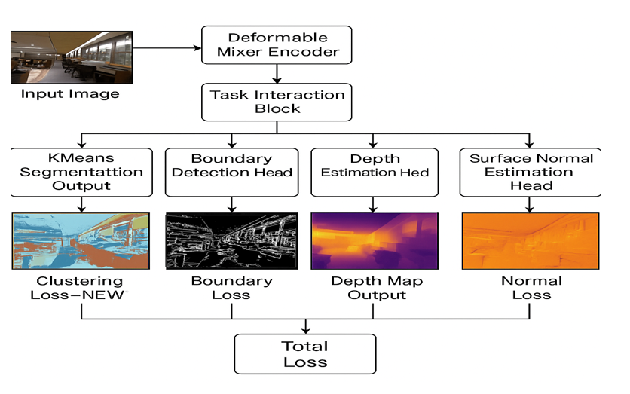
Paper_id : 165
System workflow
Architecture diagram
Load NYUD-v2 Dataset (RGB + Depth).
Preprocessing: Resize → Normalize → Generate Segmentation (K-means), Normals (gradient), and Boundaries (Canny).
Feature Extraction: DeepLabV3 + ResNet-101 backbone extracts semantic and spatial features.
Deformable Mixer Encoder: Learns local adaptive sampling.
Transformer Decoder: Enhances inter-task feature sharing.
Task Heads: Outputs Segmentation, Depth, Normals, and Boundaries.
Loss Calculation: Weighted sum of all task losses.
Evaluation: Quantitative (metrics) and qualitative (visual results).

Slide 6
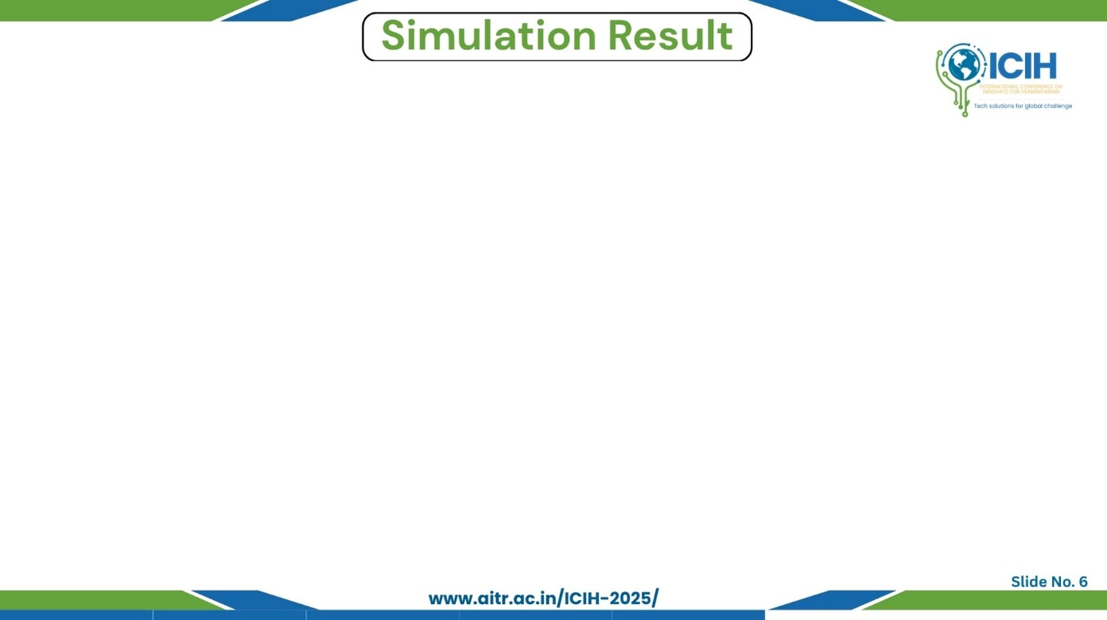
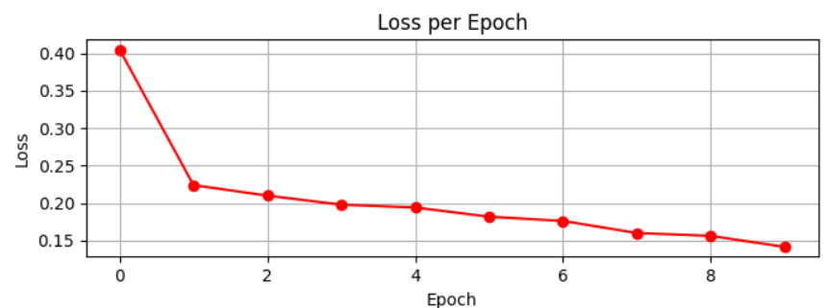
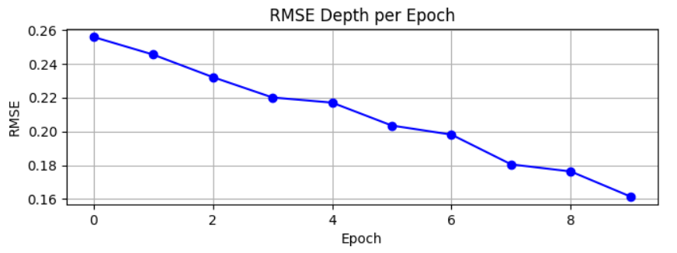
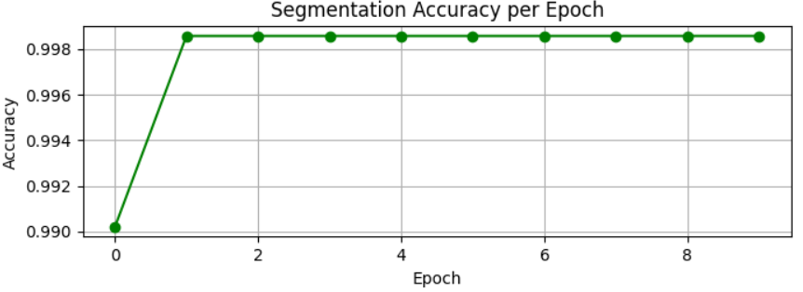
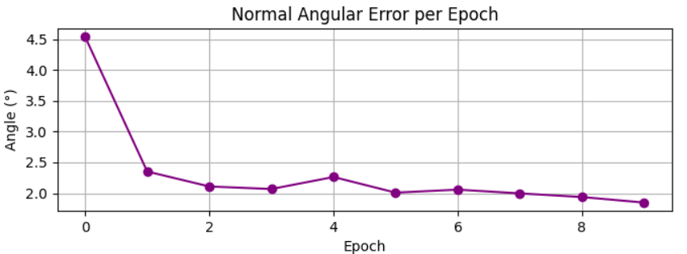
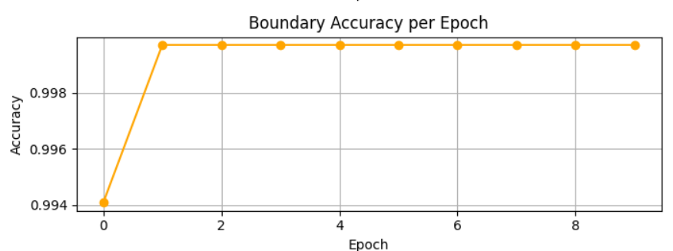
Paper_id : 165
Graphs
  Test results
  Brief observations & insights
Task | Metric | Result
Semantic Segmentation | Pixel Accuracy | 99.8%
Depth Estimation | RMSE | 0.16
Surface Normal Estimation | Mean Angular Error | 0.5
Boundary Detection | Accuracy | 99.9%
Overall Loss | Loss | 0.14
DeMT achieves superior performance in multi-task learning compared to single-task baselines.
Training converges smoothly with stable task balance.

Slide 7
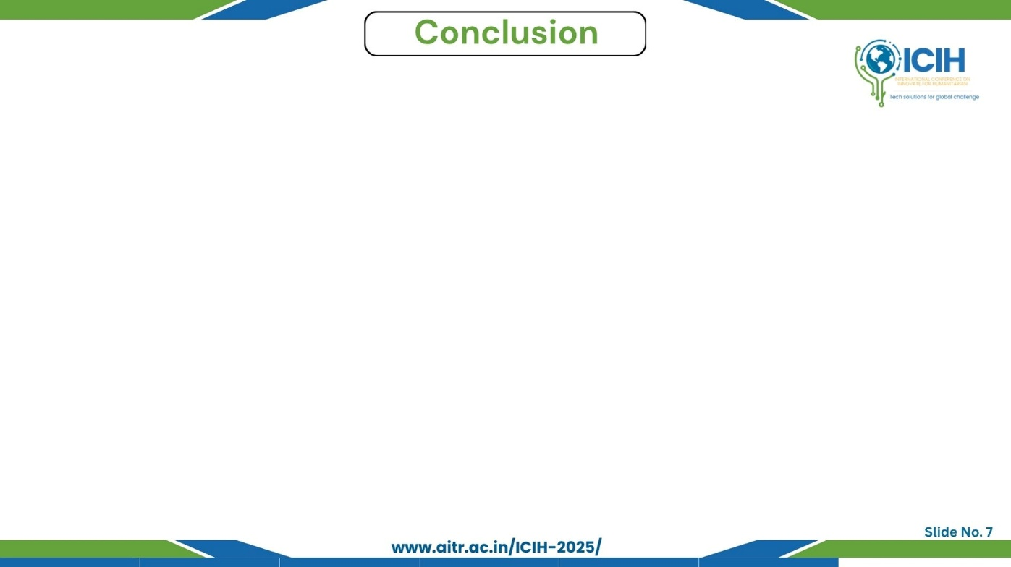
Paper_id : 165
  Main findings
  Advantages of our solution
  Limitations
DeMT successfully integrates local adaptability and global reasoning.
Produces accurate, detailed outputs across multiple dense tasks.
Real-time efficient, High accuracy and stability, Unified model for all dense tasks.
Key contributions
Hybrid Deformable + Transformer model, Custom preprocessing pipeline for NYUD-v2.
Balanced multi-task loss mechanism.
High training time on large datasets, Requires GPU for efficient performance.
Future scope
Apply to outdoor datasets (Cityscapes, PASCAL).
Optimize for edge deployment.
Add instance segmentation and object detection heads.

Slide 8
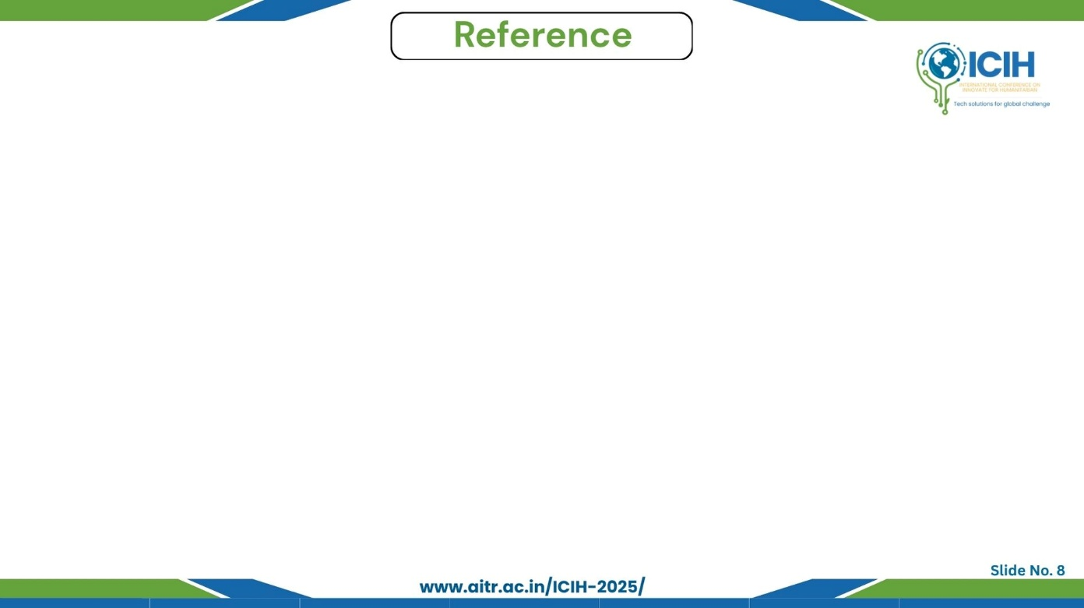
Paper_id : 165
  References
H. Zhang, Y. Wang, G. Wang, and Y. Shan, “Deformable Mixer Transformer for Multi-Task Dense Prediction,” IEEE Transactions on Pattern Analysis and Machine Intelligence (TPAMI), 2023.
S. Vandenhende, M. Brabandere, and L. Van Gool, “MTI-Net: Multi-Task Learning Through Multi-Scale Task Interaction,” in Proc. IEEE/CVF Conf. on Computer Vision and Pattern Recognition (CVPR), 2020, pp. 4824–4833.
D. Bhattacharjee, S. N. Rai, and V. Gandhi, “MulT: Transformer for Multi-Task Learning,” in European Conf. on Computer Vision (ECCV), 2022.
O. Sener and V. Koltun, “Multi-Task Learning as Multi-Objective Optimization (GradNorm),” in Proc. Int. Conf. on Machine Learning (ICML), 2018, pp. 4423–4432.
A. Kendall, Y. Gal, and R. Cipolla, “Multi-Task Learning Using Uncertainty to Weigh Losses,” in Proc. IEEE/CVF Conf. on Computer Vision and Pattern Recognition (CVPR), 2018, pp. 7482–7491.
D. Xu, W. Ouyang, E. Ricci, and N. Sebe, “ATRC: Attention to Relational Context for Multi-Task Learning,” in IEEE/CVF Conf. on Computer Vision and Pattern Recognition (CVPR), 2021, pp. 4031–4041.

