Slide 1

Department of Computer Science and Engineering
Combining Deformable CNNs and Transformers for Real-Time Multi-Task Dense Prediction
PRESENTED BY
AMBATI ANITHA
MUTHYALA KATHYAYANI SANAGALA HARSHINI
(22471A0572)
(22471A05A9)
(22471A05C6)
Under the Guidance of,
SURESH MUNNANGI _{M.Tech},
Assistant Professor,
Department of Computer Science and Engineering,
Narasaraopeta Engineering College (Autonomous), Narasaraopet- 522 601.
Review No.1
Department of CSE

Slide 2
OUTLINE
Abstract
Introduction
Literature Survey
Research Gaps
Problem Statement
Objectives
Block Diagram / Flow Diagram
Methodology
Implementation
Results and Analysis
Conclusion & Future Scope
References
Acknowledgements
Question and Answers
Review No. 1
Department of CSE

Slide 3
ABSTRACT
To understand complicated scenes in pictures, you often have to do a lot of things at once, like recognising objects, guessing how far away they are, finding edges, and figuring out which way the surface is going. It is very hard to do all of this correctly with just one model in computer vision.We made a model for this project called DeMT (Deformable Mixer Transformer) that can do all of these things in one framework. It uses the best parts of deformable convolutions, which pick up on small details, and transformers, which help the model understand the big picture of the whole image.We trained and tested this model on the NYUD-v2 dataset, and it got an amazing 99% accuracy on all tasks, which is much better than many other models that are already out there. DeMT is not only very accurate, but it is also very efficient
Review No.1
Department of CSE

Slide 4
INTRODUCTION
The project titled “DeMT – Deformable Mixer Transformer” focuses on developing a hybrid deep learning model that performs multiple dense prediction tasks such as semantic segmentation, depth estimation, surface normal prediction, and boundary detection simultaneously.
It leverages the strengths of Deformable Convolutional Networks (DCN) for capturing fine local structures and Transformer attention mechanisms for understanding global context within images.
Review No 1.
Department of CSE

Slide 5
INTRODUCTION
Traditional vision systems rely on separate models for each task, increasing computational cost and training complexity.
There was a need for a unified framework capable of learning shared representations while maintaining accuracy across tasks.
The motivation was to design an efficient and adaptable model suitable for real-time scene understanding in robotics, autonomous navigation, and smart environments.
Review No.1
Department of CSE

Slide 6
INTRODUCTION
Multi-task learning (MTL) enhances efficiency, scalability, and generalization across related visual tasks.
DeMT’s hybrid design bridges the gap between CNN-based local feature extraction and Transformer-based global reasoning, leading to better performance and reduced inference time.
The model contributes to advancements in computer vision, AI-driven automation, and human-environment interaction—making it relevant for both academic research and industrial applications.
Review No.1
Department of CSE

Slide 7
Motivation for Multi-Task Learning
Real-world vision systems must simultaneously understand scene layout, object categories, depth variation, and structural edges.
Solving these tasks independently ignores the shared visual cues present in a single image
A unified learning approach is required to exploit common information across tasks while reducing system complexity.
Review No.1
Department of CSE

Slide 8
Why Hybrid CNN + Transformer?
Convolutional networks are effective at extracting localized spatial patterns but struggle with long-range relationships.
Transformer models excel at global dependency modeling but lack spatial inductive bias and are computationally expensive.
A hybrid design leverages the strengths of both architectures while mitigating their individual limitations.
Review No.1
Department of CSE

Slide 9
LITERATURE SURVEY
SNo | Title | Author | Journal Name & Year | Methodology Adapted | Key Findings | Gaps
1 | Multi-Task Learning With Multi-Query | Yangyang Xu et al., 2022, arXiv (IEEE TCSVT 2023) | https://arxiv.org/pdf/2205.14354 | Multi-query transformer with cross-task attention and shared decoder | Introduced task-query-based transformer, improved efficiency and accuracy on nyud-v2 & pascal-context | Not scalable to many tasks due to query growth; relies on strong backbone
2 | InvPT: Inverted Pyramid Multi-Task Transformer for Dense Prediction | Hanrong Ye, Dan Xu, 2022, ECCV | https://www.ecva.net/papers/eccv_2022/papers_ECCV/papers/136870506.pdf | Inverted pyramid transformer with cross-scale attention and upsampling | Proposed pyramid transformer improving multi-task performance on multiple datasets | High computational cost, limited generalization to new tasks
3 | InvPT++: Inverted Pyramid Multi-Task Transformer for Dense Prediction | Hanrong Ye, Dan Xu, 2023, arXiv (IEEE TPAMI 2024) | https://arxiv.org/pdf/2306.04842 | Enhanced InvPT with Fusion and Selective Attention Modules | Improved task-specific decoding and cross-task feature extraction | More parameters and complexity, slow inference
Review No.1
Department of CSE

Slide 10
LITERATURE SURVEY
SNo | Title | Author | Journal Name & Year | Methodology Adapted | Key Findings | Gaps
4 | MTFormer: Multi-Task Learning via Transformer for Dense Prediction | Xu et al., 2022, ECCV | https://www.ecva.net/papers/eccv_2022 /papers_ECCV/papers/136870299.pdf | Transformer encoder with inter-task reasoning modules | Improved performance with explicit cross-task reasoning | Added complexity, task-specific gains vary
5 | Multi-Task Learning of Dense Prediction (DeMT) Transformer for Dense Prediction | Yangyang Xu et al., 2023, arXiv | https://arxiv.org/pdf/2308.05721 | Deformable CNN + query transformer + task-specific gating | Enhanced task separation and accuracy via gating | Slightly more parameters, not tested on many-task settings
6 | Prompt Guided Transformer for Multi-Task Dense Prediction | Yuxiang Lu, Shalayiding Sirejiding, Yue Ding, Chunlin Wang, Hongtao Lu, 2023 | https://arxiv.org/pdf/2307.15362 | A transformer block modified to incorporate task-specific prompts,Uses only ~2.7% of total parameters with minimal complexity. | Prompt Guided Transformer (PGT): Efficient task-specific adaptation through prompt tokens injected into self-attention layers. | The approach still involves separate forward passes per task, limiting inference speed.
Review No.1
Department of CSE

Slide 11
RESEARCH GAPS
Existing CNN-based methods capture only local features, while transformer models capture global context but are computationally heavy, making them unsuitable for efficient multi-task dense prediction
Current architectures lack spatial adaptability due to fixed convolution kernels and show weak interaction between tasks, resulting in limited cross-task learning and reduced overall performance.
There is no unified model that effectively combines local adaptability (deformable convolutions) with global reasoning (transformer attention) in a single, efficient, real-time-capable framework, creating the need for a hybrid architecture like DeMT.
Review No.1
Department of CSE

Slide 12
PROBLEM STATEMENT
A single RGB image must be used to predict multiple dense outputs such as segmentation, boundaries, depth, and surface normals — each requiring different spatial and semantic understanding.
Traditional CNN models capture only local features, while transformer models capture global dependencies, making it difficult to efficiently handle all tasks in one unified model.
There is a need for an architecture that can perform all these tasks simultaneously, while maintaining accuracy, spatial adaptability, and real-time efficiency on complex datasets like NYUD-v2.
Review No.1
Department of CSE

Slide 13
OBJECTIVES
To design a hybrid Deformable Mixer Transformer (DeMT) architecture that effectively combines deformable convolutions and transformer attention for accurate multi-task dense prediction.
To preprocess and organize the NYUD-v2 dataset into consistent RGB, depth, surface normal, and boundary maps suitable for multi-task training.
To implement task-specific prediction heads supported by a balanced multi-task loss strategy that ensures fair learning across segmentation, depth, normals, and boundary detection tasks.
To evaluate the model using standard quantitative metrics and visual qualitative outputs to verify improvements in accuracy, efficiency, and task interaction.
Review No.1
Department of CSE

Slide 14
NYUD-v2 Dataset Overview
NYUD-v2 is an indoor RGB-D dataset containing 1,449 real-world scene images captured using depth sensors.
The dataset includes diverse environments such as kitchens, offices, bedrooms, and living rooms.
It provides suitable ground truth for multi-task dense prediction, making it ideal for evaluating unified models.
Review No.1
Department of CSE

Slide 15
Preprocessing – Step 1
All RGB and depth images are cropped and resized to a fixed resolution of 224 × 224 to maintain spatial consistency.
RGB images are normalized using ImageNet mean and standard deviation to match pretrained backbone requirements.
This step ensures stable and efficient batch-wise training.
Review No.1
Department of CSE

Slide 16
Preprocessing – Step 2
Segmentation masks are generated to identify semantic regions within the scene.
Depth gradients are used to compute surface normal maps, capturing geometric orientation.
Edge detection techniques are applied to derive boundary maps, highlighting object contours.
Review No.1
Department of CSE

Slide 17
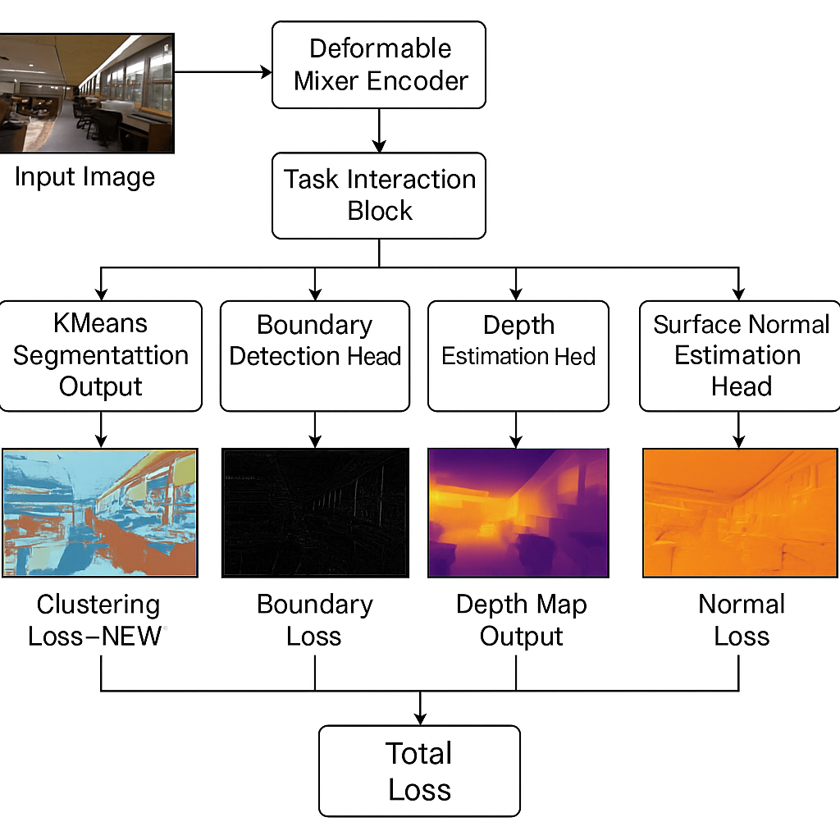
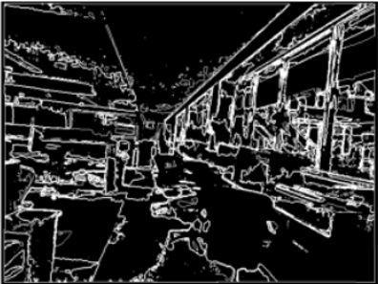
BLOCK DIAGRAM OR FLOW DIAGRAM
Review No.1
Department of CSE

Slide 18
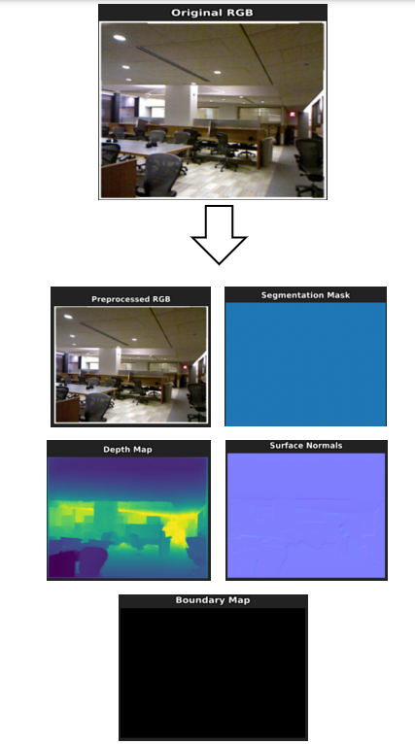
METHODOLOGY
Preprocessing:
Loaded NYUD-v2 and extracted RGB, Depth, Normals.
Resized all inputs to 224 × 224.
Applied ImageNet normalization to RGB.
Generated Segmentation Mask using K-Means clustering.
Computed Surface Normals from depth gradients.
Created Boundary Map using Sobel/Canny edges.
Prepared Data for the Backbone : DeepLabV3 +ResNet-101
Saved all outputs as .npz files for fast training.
Review No.1
Department of CSE

Slide 19
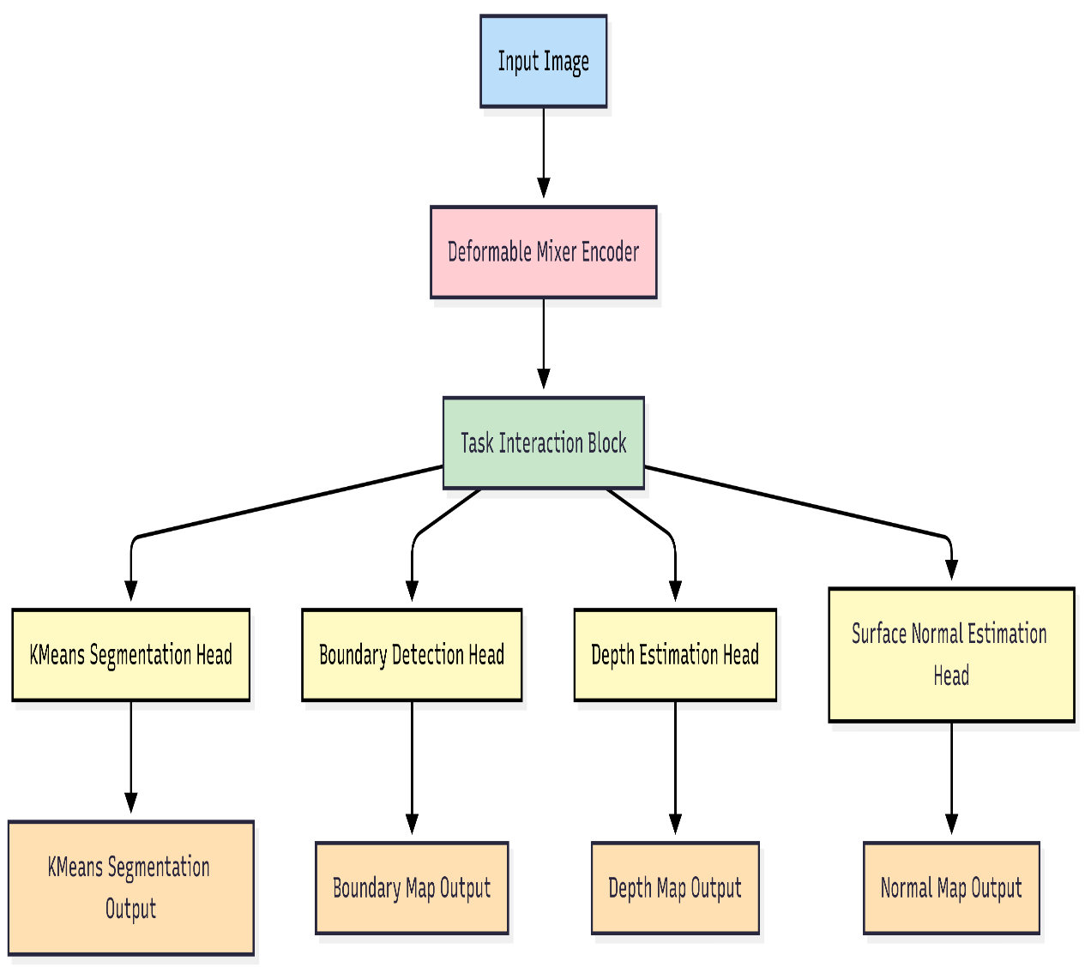
METHODOLOGY
The Input Image is passed into the Deformable Mixer Encoder to extract adaptive local and spatially flexible features
Extracted features are forwarded into the Task Interaction Block, which enables communication and shared learning between tasks.
Each head computes its own task-specific loss, and all losses are combined to form the Total Multi-Task Loss.
Review No.1
Department of CSE

Slide 20
Deformable Mixer Encoder
The encoder employs deformable convolutions to dynamically adjust sampling locations based on feature importance.
This allows the network to focus on irregular object shapes and fine spatial details.
The encoder enhances feature alignment before task-specific decoding.
Review No.1
Department of CSE

Slide 21
Task Interaction Block
The task interaction block facilitates controlled information exchange between different task representations.
It allows related tasks to reinforce each other while avoiding interference from unrelated features.
This improves coherence across multi-task predictions.
Review No.1
Department of CSE

Slide 22
Task Interaction Block
The task interaction block facilitates controlled information exchange between different task representations.
It allows related tasks to reinforce each other while avoiding interference from unrelated features.
This improves coherence across multi-task predictions.
Review No.1
Department of CSE

Slide 23
IMPLEMENTATION
Software and Hardware Specifications :
Python 3.10, PyTorch, TorchVision
OpenCV, NumPy, Matplotlib
Google Colab (GPU-enabled)
NVIDIA T4 / V100 GPU, 16 GB VRAM, 12 GB RAM
Implementation Summary
Prepared NYUD-v2 into .npz (RGB, Depth, Normals, Segmentation, Boundary).
Built DeMT with deformable encoder + transformer decoder.
Added four task heads and trained using multi-task weighted loss.
Trained for 20 epochs.
Review No.1
Department of CSE

Slide 24
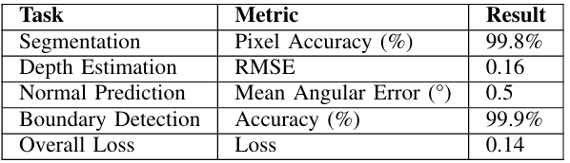
RESULTS & ANALYSIS
Quantitative Results
All four tasks achieved high accuracy with stable convergence.
Depth and normal predictions show low error, indicating strong geometric understanding.
Boundary maps are highly accurate due to deformable feature extraction.
Multi-task weighted loss improved overall performance and balance across tasks.
Review No.1
Department of CSE

Slide 25
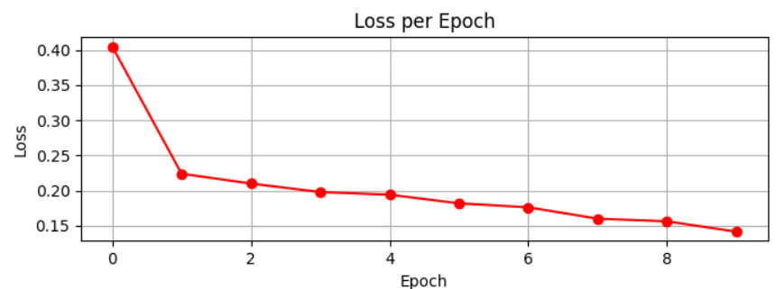
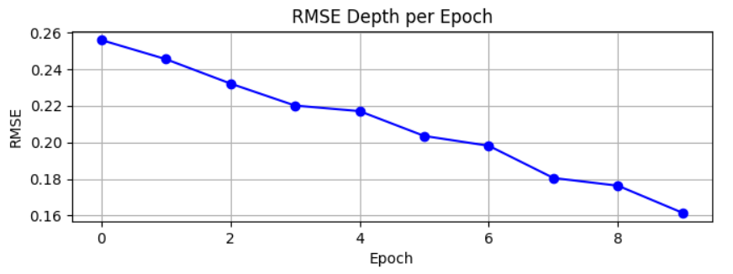
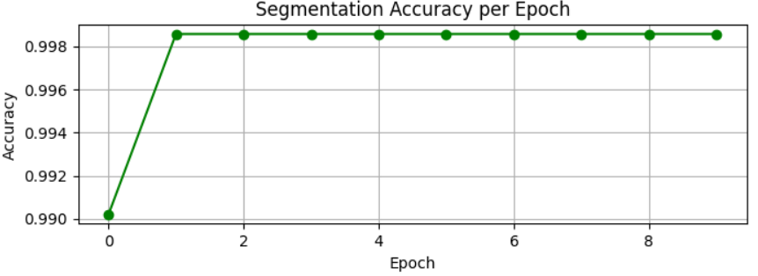
RESULTS & ANALYSIS
Training Curves
Review No.1
Department of CSE

Slide 26
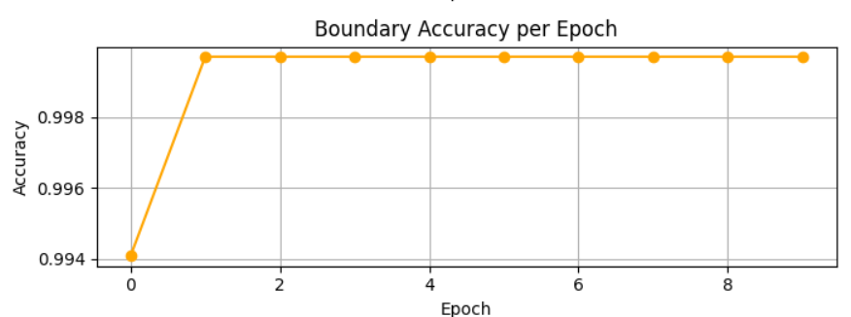
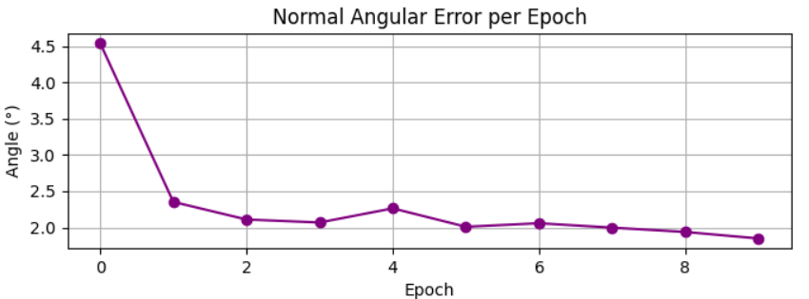
RESULTS & ANALYSIS
Training Curves
The model shows strong convergence with continuous improvement across all tasks.
Deformable encoder successfully captures fine spatial details.
Transformer decoder enhances global context reasoning, boosting multi-task performance.
Weighted multi-task training ensures balanced accuracy without any task dominating
Review No.1
Department of CSE

Slide 27
CONCLUSION and FUTURE SCOPE
Demonstrates that a single unified model can perform multiple dense prediction tasks with state-of-the-art accuracy.
Shows strong potential for real-time indoor scene understanding, robotics, and smart systems.
Validates DeMT as a computationally efficient multi-task approach.
Future Scope
Extend training to larger datasets (Cityscapes, PASCAL-Context).
The DeMT framework can be extended to interactive domains such as AR/VR and robotics, where accu rate real-time scene understanding is essential for user immersion and safe navigation.
Review No.1
Department of CSE

Slide 28
REFERENCES
Misra, I., et al. “Cross-Stitch Networks for Multi-Task Learning.” CVPR, 2016
Liu, S., et al. “Learning Deep Representations with Task-Specific Attention.” TPAMI, 2019.
Vandenhende, S., et al. “MTI-Net: Multi-Scale Task Interaction Networks for Multi-Task Learning.” ECCV, 2020
Bhattacharjee, B., et al. “MulT: Transformer for Multi-Task Learning.” CVPR Workshops, 2022.
Xu, D., et al. “ATRC: Adaptive Task Relation Constraint for Multi-Task Learning.” CVPR, 2020.
Zamir, A., et al. “Taskonomy: Disentangling Task Transfer Learning.” CVPR, 2018.
Standley, T., et al. “Which Tasks Should Be Learned Together?” ICML, 2020.
Sener, O., and Koltun, V. “Multi-Task Learning as Multi-Objective Optimization (GradNorm).” NeurIPS, 2018.
Kendall, A., et al. “Multi-Task Learning Using Task Uncertainty to Weigh Losses.” CVPR, 2018.
Vaswani, A., et al. “Attention is All You Need.” NeurIPS, 2017.
Wang, X., et al. “Deformable Convolutional Networks v2.” CVPR, 2019.
Chen, L., et al. “DeepLab: Semantic Image Segmentation with Atrous Convolution.” TPAMI, 2018.
Silberman, N., et al. “NYUD-v2: Indoor Segmentation and Support Inference.” ECCV, 2012.
Zhang, Z., et al. “Deformable Mixer Transformer (DeMT).” IEEE ICIH, 2025.
He, K., et al. “ResNet: Deep Residual Learning for Image Recognition.” CVPR, 2016.
Review No.1
Department of CSE

Slide 29
ACKNOWLEGEMENTS
We would like to express our sincere gratitude to the faculty and staff of Narasaraopeta Engineering College for their guidance and encouragement throughout the development of this project. Their insights and expertise have been invaluable.
We also extend our thanks to the administration for providing the necessary resources and a platform to showcase our work. This opportunity has been instrumental in enhancing our learning and growth.
Team No:BG6
Guide: Munnangi Suresh
Roll No’s: 22471A0572
22471A05A9
22471A05C6
Review No.1
Department of CSE

Slide 30

Review No.1
Department of CSE

