Slide 1





2025 IEEE iSSSC
2025 IEEE 3rd International Symposium on Sustainable Energy, Signal Processing & CyberSecurity
Paper Title: A DEEP LEARNING MODEL FOR AUTOMATED KIDNEY DISEASE CLASSIFICATION USING CT IMAGING
Paper ID:681
Presenter Name:Karishma Pathan
Authors:Karishma Pathan, Sireesha Moturi,
Shaik Gangaram Sumiya, Koduri Sowjanya
Affiliation: Department of CSE,Narasaraopeta Engineering College, Andhra Pradesh, India

Slide 2
Outline
Introduction (try to answer what it is, why it is, and what is (are) existing problems, why the problem is so important to discuss; may cite in the footer)
Motivation & Contributions
Proposed System Model
Results and Discussion
Conclusion
Reference

Slide 3
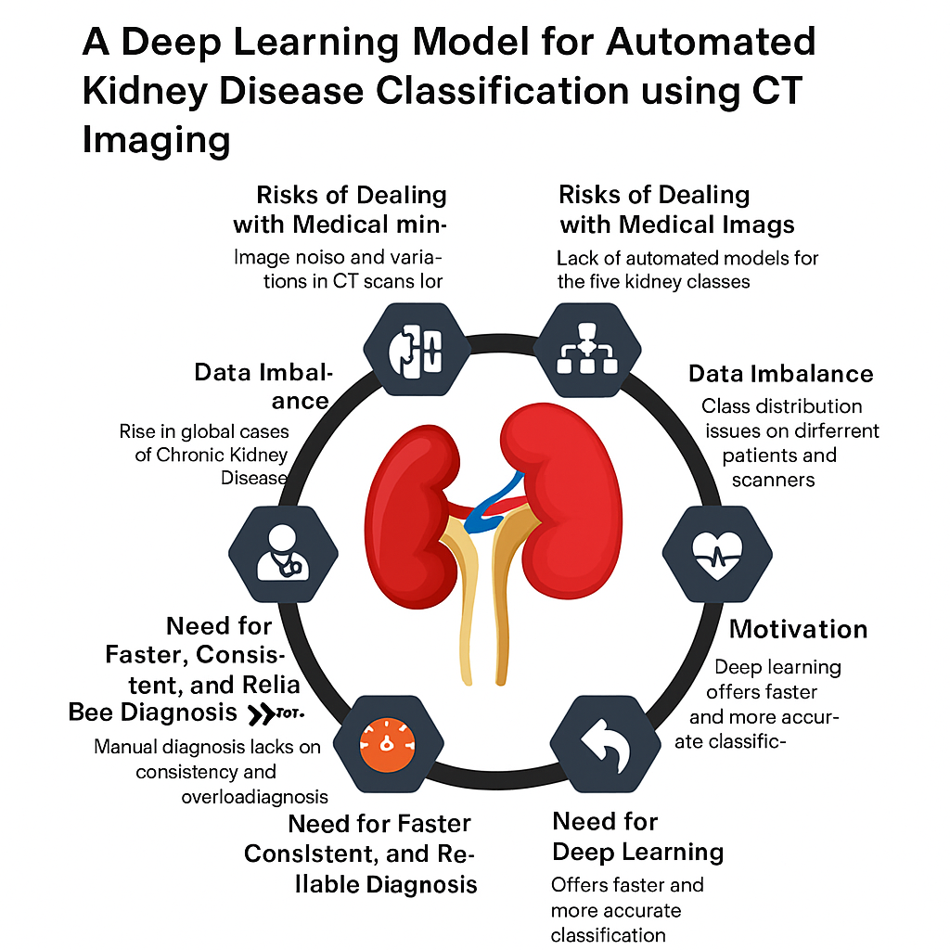
Introduction
Kidney diseases are among the leading causes of chronic illness and mortality worldwide.
Early detection is crucial to prevent kidney failure and improve patient outcomes.
Manual diagnosis using CT images is:
Time-consuming
Dependent on radiologist expertise
Prone to human error

Slide 4
Motivation & Core Contribution
Kidney diseases cause high mortality and chronic health complications globally.
Manual CT diagnosis is slow, requires expert radiologists, and risks misclassification.
Existing models struggle with low accuracy, poor generalization, and class imbalance.
Proposed a Deep Learning Model for Automated Kidney Disease Classification using CT imaging.
Utilized transfer learning with advanced CNN architectures for multi-class classification.
Designed a robust preprocessing pipeline to handle noise, artifacts, and data imbalance.
Integrated AI-driven decision support for reliable and early disease detection.
Achieved high classification accuracy (95–99%), outperforming traditional models.

Slide 5
Literature Review
S. D. Pande & R. Agarwal (2024) – Developed a multi-class kidney abnormality detection system using CT images, achieving high precision through deep learning and clinical validation.
Pimpalkar et al. (2025) – Proposed fine-tuned DL models for early kidney condition detection from CT scans, reaching state-of-the-art accuracy across multiple pathologies.
Zhang et al. (2024) – Introduced KidneyNeXt, a lightweight CNN architecture optimized for tumor classification; provided fast inference with minimal computational cost.
Zenodo (2025) – Implemented YOLOv8-based CT classification for identifying multi-class kidney abnormalities, offering a single-pass and efficient detection pipeline.
Saif et al. (2023) – Designed a deep CNN framework for chronic kidney disease prediction, achieving robust accuracy and demonstrating clinical viability.
🔍 Research Gap
  Existing models focus on classification or detection only.

Slide 6
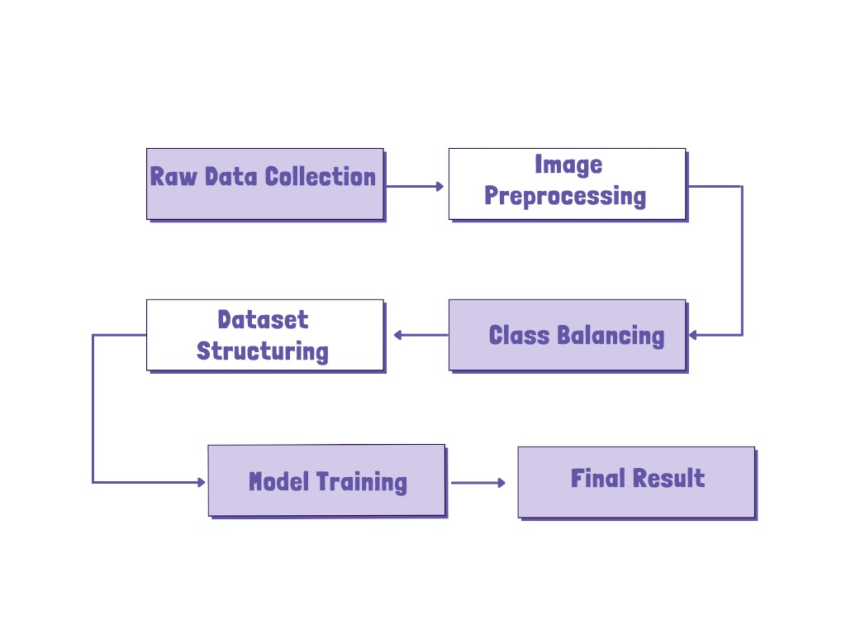
Proposed Model
Vision Transformer (ViT)based Classification Model
Preprocessing & Model Workflow
1️⃣ Image Preprocessing
Removed noise and standardized CT images to 224×224.
Applied CLAHE and augmentation (rotation, flip, brightness).
2️⃣ Dataset Structuring
Organized images into five kidney disease classes.
Split dataset for training, validation, and testing with balanced samples.
3️⃣ Model Training
Trained using YOLOv8 for high-speed and precise classification.
Optimized performance using transfer learning and fine-tuning.
🔄 Overall Flow
CT Images → Preprocessing → Augmentation → Dataset Structuring → YOLOv8 Training → Disease Classification Output

Slide 7
Simulation Setup
💻 System Configuration:
  Windows 10 OS
  Intel® Core™ i5 Processor
  8 GB RAM
  No dedicated GPU (CPU-based training)
🧠 Development Environment:
  Language: Python
  Framework: PyTorch
  Libraries: Ultralytics YOLOv8, OpenCV, NumPy, Matplotlib
🗂️ Dataset:
  Kidney CT image dataset (4 classes – Normal, Tumor, Cyst, Stone)
⚙️ Performance Focus:
  Batch and data-loading optimized for CPU efficiency
  Evaluated lightweight YOLOv8 model for low-resource environments

Slide 8
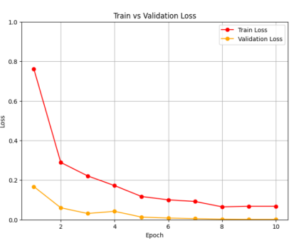
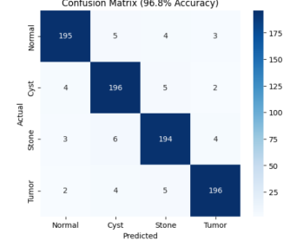
Result and Discussion
Training Performance
Model: YOLOv8n-cls trained for 10 epochs using AdamW optimizer.
Validation Accuracy: Achieved 96.88%, ensuring stable generalization.
Training Trend: Smooth loss reduction with no signs of overfitting.
Model effectively adapted to four kidney CT classes — Normal, Cyst, Stone, and Tumor.
Confusion matrix shows high class-wise accuracy across all four kidney disease types — Normal, Cyst, Stone, and Tumor.
Outperforms existing CNN-based models in both accuracy and robustness, even under CPU-
only settings.
Metric | Score (%)
Accuracy | 96.8
Precision | 96.1
Recall | 95.9
F1-Score | 96.0

Slide 9
Conclusion & Future Work
Conclusion
  Proposed an AI-powered framework for automated kidney CT image classification into Normal, Cyst, Stone, and Tumor categories.
  Achieved 96.88% accuracy, ensuring high reliability and computational efficiency.
Future Scope
  Validate model on multi-center real-world datasets for broader generalization.
  Apply K-Fold Cross-Validation for stronger performance evaluation.
  Optimize for edge and mobile deployment to support rural diagnostics.
  Conduct clinical trials and compare outcomes with radiologist assessments.

Slide 10
References
[1] S. D. Pande and R. Agarwal, “Multi-class kidney abnormalities detecting novel system through computed tomography,” IEEE Access, vol. 12, 2024.
[8]. Pimpalkar, M. Shinde, and S. Talmale, “Fine-tuned deep learning models for early detection and classification of kidney conditions in ct imaging,” Scientific Reports, vol. 15, no. 1, 2025.
[12] M. Zhang, L. Zhou, and Y. Liu, “Kidneynext: A lightweight cnn for multi-class tumor classification in ct imaging,” Journal of Clinical Medicine, vol. 14, no. 14, p. 4929, 2024
[10] Zenodo, “Yolov8-powered multi-class kidney abnormality detection via ct,” 2025.
[14] D. Saif et al., “An effective deep learning framework for chronic kidney disease prediction,” Journal of Medical Systems, vol. 47, no. 5, pp. 1–10, 2023..

Slide 11
Reviewer Comments Addressed
General Improvements
  Enhanced English and grammar throughout the paper.
  Verified and added author names and affiliations correctly.
  Improve figure resolution, annotation clarity, and overall academic writing tone.
  Replace informal phrases with technical expressions (e.g., “smart system” → “automated diagnostic framework”)..
Technical Improvements
  Integrate ensemble learning by combining YOLOv8 with CNN or Transformer-based models for hybrid feature extraction.
  Add attention modules (e.g., SE Block or CBAM) to improve focus on lesion regions and enhance classification precision..

Slide 12
Thank You

