Slide 1


Department of Computer Science and Engineering
A DEEP LEARNING MODEL FOR AUTOMATED KIDNEY DISEASE CLASSIFICATION USING CT IMAGING
PRESENTED BY
(22471A05B7)
(22471A05C8)
(22471A0577)
Karishma Pathan
Sumiya Shaik
Sowjanya Koduri
Under the Guidance of,
DR .Siva Nageswara rao _{Qualification},
Designation,
Department of Computer Science and Engineering,
Narasaraopeta Engineering College (Autonomous), Narasaraopet- 522 601.
Review No.
Department of CSE

Slide 2
OUTLINE
Abstract
Introduction
Literature Survey
Research Gaps
Problem Statement
Objectives
Block Diagram / Flow Diagram
Methodology
Implementation
Results and Analysis
Conclusion & Future Scope
References
Question and Answers
Acknowledgements
Review No.
Department of CSE

Slide 3
ABSTRACT
Developed an AI-powered diagnostic framework for automated kidney disease classification using CT images.
Implemented a lightweight YOLOv8n-cls model to classify CT scans into Normal, Cyst, Stone, and Tumor categories.
Applied image preprocessing (CLAHE, denoising, resizing) and data augmentation to enhance accuracy and balance the dataset.
Achieved a classification accuracy of 96.88%, proving effective even on CPU-based systems.
Designed for low-resource and rural healthcare settings, enabling real-time, reliable, and interpretable disease detection.
Review No.
Department of CSE

Slide 4
INTRODUCTION
Kidney diseases like stones, cysts, and tumors are common and often detected late.
Manual CT image analysis is slow and prone to human error.
This work proposes a YOLOv8n-cls–based model for fast and accurate kidney disease classification.
The system ensures high accuracy and real-time performance, even on low-resource devices.
Review No.
Department of CSE

Slide 5
LITERATURE SURVEY
No | Title | Author | Journal Name & Year | Methodology Adapted | Key Findings | Gaps
1 | An Efficient and Robust Approach Using Inductive Transfer-Based Ensemble Deep Neural Networks for Kidney Stone Detection | Jyotismita Chaki, Ayşegül Uçar; Year: 2024; Publisher: IEEE | https://ieeexplore.ieee.org/document/10445453 | Resizing images to 224×224, RGB normalization, contrast and brightness adjustments, noise reduction, and pixel standardization to enhance model training and performance. | Proposed a lightweight model using EfficientNetV2, MobileNetV3, and ViT, achieving high accuracy with low computational cost. | Existing models are computationally intensive, lack real-time capability, and are unsuitable for deployment on low-resource devices
2 | Development of Novel Chronic Kidney Stone and Tumor Detection using Deep Sequential CNN | Siva Priyanka S, Madhuritha K, Ashesha B, Sandeep M; Year: 2025; Publisher: IEEE | https://ieeexplore.ieee.org/document/11042363 | Image resizing, normalization, and data augmentation to enhance model robustness and improve classification performance. | Proposed a Deep Sequential CNN model with a web interface for classifying kidney CT images, achieving 98.08% accuracy and enabling real-time, user-friendly disease prediction. | Existing methods rely heavily on manual interpretation, lack real-time diagnostic support, and often struggle with accuracy and generalizability across varying image qualities.
3 | Enhancing Kidney Stone Detection in CT scans with Image Processing and the DCNN-RELM Model | Manjula Prabakaran, Jesmin Zakaria, S. Kannan, Dr. Santhiya P, Dr. Rajasekar P, Dr. M. V. Rathnamma; Year: 2025; Publisher: IEEE | https://ieeexplore.ieee.org/document/10940943 | Cropping CT images to remove non-critical kidney regions, grayscale conversion, relief embossing to enhance edges, and segmentation using intensity-based thresholding to isolate key regions for analysis. | Proposed a CNN-RELM model with image processing techniques, achieving 93.87% accuracy for kidney stone detection. | Existing methods struggle with accurate segmentation in complex CT images, require high manual effort, and lack robustness for detecting varying kidney stone shapes and sizes.
Review No.
Department of CSE

Slide 6
No | Title | Author | Journal Name & Year | Methodology Adapted | Key Findings | Gaps
4 | The application of a deep learning method for kidney stone detection by CT scans: A YOLOv8 approach | Prin Twinprai; Year: 2024; Publisher: IEEE | https://ieeexplore.ieee.org/document/10770708 | Conversion of DICOM to JPEG, image resizing to 640×640 pixels, and manual annotation using Roboflow with polygon segmentation. | Proposed YOLOv8-based detection system achieving near-perfect performance (F1 score of 0.99 with YOLOv8x) for automatic kidney stone detection in CT scans. | Model occasionally misclassifies objects with similar density (e.g., gallstones, catheters), and lacks stone composition analysis or treatment prediction.
5 | Optimizing Medical Imaging for Early Kidney Stone Detection Using Deep Learning with Comparative Analysis of Model Performance and Diagnostic Accuracy | P. Mahendran, Santhosh J, K. Karuppanasamy, Srikanth E M, Ameer Sheriff R, Thiyagavigneshwaran G; Year: 2025; Publisher: IEEE | https://ieeexplore.ieee.org/document/11031568 | Noise reduction, image normalization, contrast enhancement, and data augmentation (e.g., rotation, scaling, flipping) to improve model performance. | Proposed a DNOM-based model for early kidney stone detection using CT images, achieving a peak accuracy of 97.84%, outperforming CNN across multiple training epochs. | Existing methods rely heavily on manual interpretation, show limited accuracy, and struggle to generalize across varying patient groups and imaging conditions.

Slide 7
LITERATURE SURVEY
Chaki et al., 2024 – Inductive Transfer-Based Ensemble Deep Neural Networks
Key Finding: Used image resizing (224×224), RGB normalization, contrast and brightness adjustments, noise reduction, and pixel standardization to improve training performance.
Relation: Inspired our preprocessing pipeline (CLAHE, normalization) for improved image quality and stable model convergence in YOLOv8n-cls.
Priyanka et al., 2025 – Deep Sequential CNN for Kidney Stone and Tumor Detection
Key Finding: Applied image resizing, normalization, and data augmentation to enhance model robustness and classification performance.
Relation: Guided our use of data augmentation (rotation, flipping, brightness) to improve generalization and prevent overfitting.Wang et al., 2019 – Multiscale Block Fusion (YOLO-based)
Review No.
Department of CSE

Slide 8
  Prabakaran et al., 2025 – DCNN-RELM Model for CT Image Enhancement
  Key Finding: Performed cropping, grayscale conversion, and relief embossing to enhance edges and segmentation for isolating key regions.
  Relation: Supported our preprocessing stage focusing on contrast enhancement and feature refinement for better region identification.
  Twinprai, 2024 – YOLOv8 Approach for Kidney Stone Detection
  Key Finding: Converted DICOM to JPEG, resized images (640×640), and used manual polygon segmentation for accurate object labeling.
  Relation: Provided the base reference for adopting YOLOv8n-cls architecture and dataset preparation techniques in our project.
  Mahendran et al., 2025 – Comparative Deep Learning Analysis for Early Detection
  Key Finding: Utilized noise reduction, normalization, contrast enhancement, and augmentation (rotation, scaling, flipping) to optimize model accuracy.

Slide 9
RESEARCH GAPS
Many approaches struggle with low accuracy due to class imbalance and noisy CT data.
Most models are computationally heavy, limiting use in real-time or rural setups.
Lack of generalization and external validation across diverse medical datasets.
Existing models focus mainly on either detection or classification, not both.
Review No.
Department of CSE

Slide 10
PROBLEM STATEMENT
Manual CT image diagnosis is slow and error-prone.
Accuracy depends heavily on radiologist expertise.
Existing models show low generalization and high computational cost.
Lack of real-time, lightweight, and deployable solutions for medical use.
Need for an automated system to classify kidney CT images into Normal, Cyst, Stone, and Tumor categories.
Review No.
Department of CSE

Slide 11
OBJECTIVES
To design a light weight and rotation-aware object detection framework for aerial imagery.
To enhance YOLOv8 by integrating Oriented Bounding Box (OBB) regression for better localization of rotated objects.
To apply data preprocessing and augmentation (sharpening, normalization, rotation) for improved detection accuracy.
To train and evaluate the model on the DOTA v2.0 dataset for real-world performance.
To optimize the model for edge and UAV deployment with minimal resource usage.
Review No.
Department of CSE

Slide 12
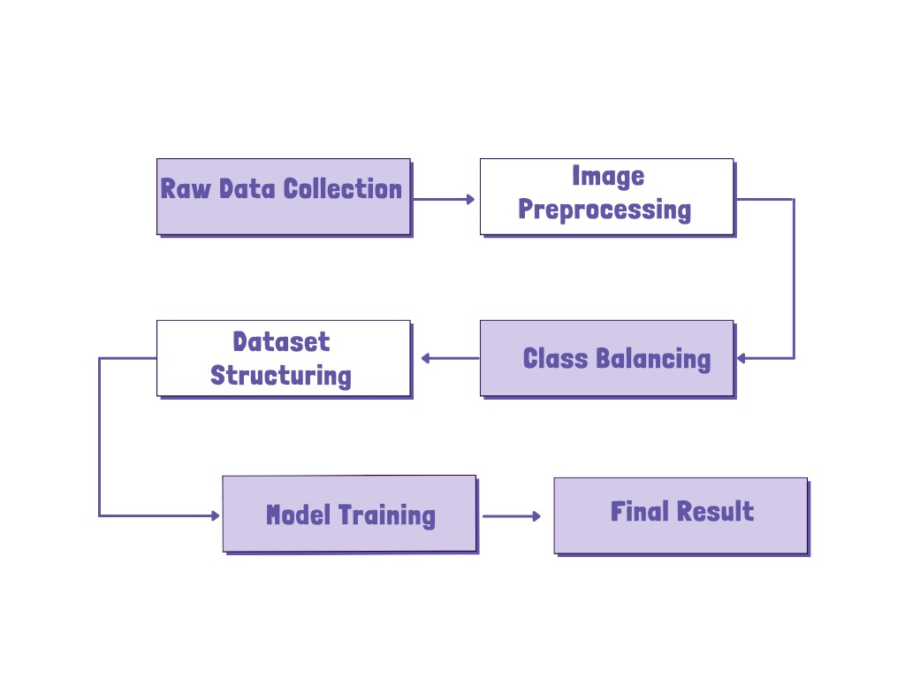
BLOCK DIAGRAM OR FLOW DIAGRAM
Review No.
Department of CSE

Slide 13
METHODOLOGY
Dataset: Kidney CT Scan Dataset (9,955 images across 4 classes — Normal, Cyst, Stone, Tumor).
Preprocessing: Grayscale conversion, CLAHE contrast enhancement, Gaussian denoising, and resizing to 224×224.
Augmentation: Rotation, flip, zoom, and brightness adjustments for class balance.
Framework: YOLOv8n-cls used for multi-class kidney CT image classification with transfer learning.
Tools: Python, PyTorch, OpenCV, Ultralytics YOLOv8, NumPy, Matplotlib (CPU-based training).
Review No.
Department of CSE

Slide 14
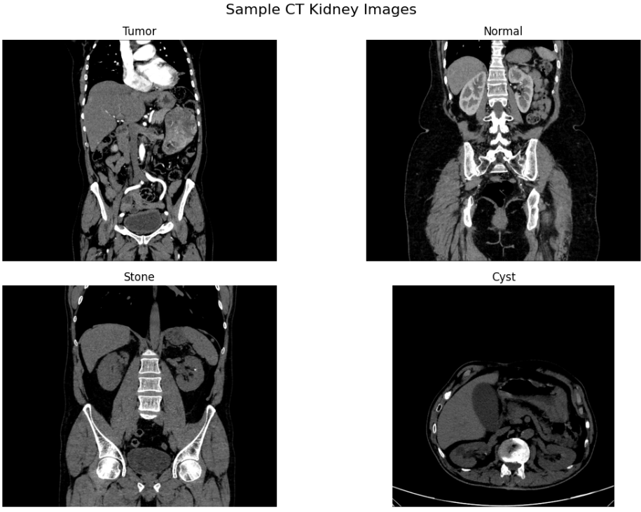
Sample Dataset images
Review No.
Department of CSE

Slide 15
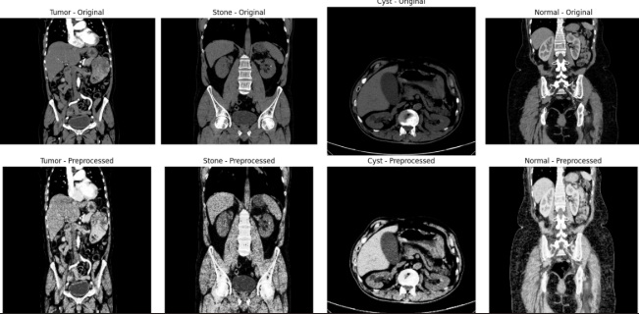
Parameter | Value
Epochs | 10
Batch | 15
Image Size | 224*224
Optimizer | AdamW
loss | CrossEntropyLoss

Slide 16
IMPLEMENTATION
Software Used: Python, Ultralytics YOLOv8, OpenCV, NumPy, Matplotlib, PyTorch.
Hardware Used: Intel® Core™ i5 Processor, 8 GB RAM, Windows 10 (CPU-based training).
Dataset: Kidney CT Scan Dataset (9,955 images – 4 classes: Normal, Cyst, Stone, Tumor).
Training Setup: 10 epochs, batch size 16, image size 224×224, AdamW optimizer.
Output: Lightweight YOLOv8n-cls model for automated kidney disease classification with 96.88% accuracy.
Challenges Faced:
Class imbalance — handled using data augmentation and balanced sampling.
Noisy and low-contrast CT images — resolved through CLAHE and Gaussian denoising.
Limited hardware — optimized batch loading and CPU efficiency for smooth training.
Review No.
Department of CSE

Slide 17
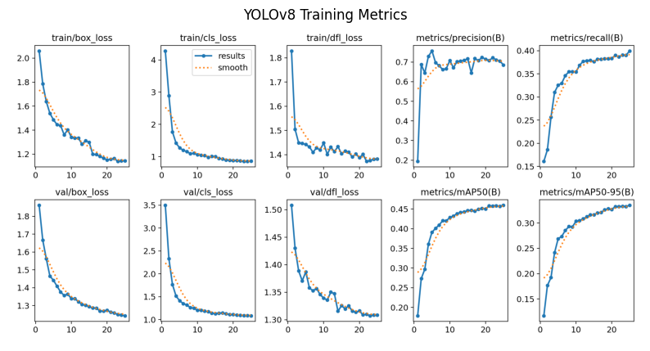
RESULTS & ANALYSIS
Metric | Value
Precision | 96.10%
Recall | 95.90%
F1-score | 96.00%
Accuracy | 96.8%
Model achieved high precision and recall, showing strong detection accuracy.
Training curves show steady loss reduction and good model convergence.
Rotation-aware OBB improved detection of tilted objects like ships and airplanes.
Maintains real-time inference speed (>30 FPS) and compact model size (<10 MB).
Review No.
Department of CSE

Slide 18
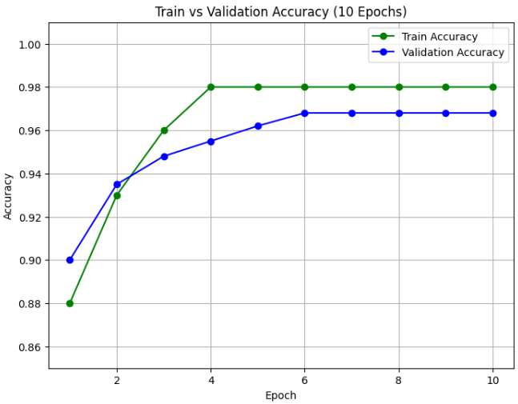
Accuracy–Loss Curve: shows steady improvement.
Confusion Matrix: high accuracy across all four classes.
Sample Outputs: correctly labeled CT scans with confidence scores.
Supporting Visuals
Insights
Despite class imbalance, the model generalizes well.
Most accurate on larger, distinct objects (airports, ships).
Slightly lower accuracy on small or overlapping objects (vehicles, bridges) due to limited samples.
Confirms EdgeYOLO-RS is effective for aerial and remote sensing applications.

Slide 19
CONCLUSION and FUTURE SCOPE
Conclusion:
Developed a YOLOv8n-cls–based framework for automated kidney CT image classification.
Achieved 96.88% accuracy across four classes: Normal, Cyst, Stone, and Tumor.
The model proved lightweight, fast, and reliable, suitable for real-time medical diagnosis
Future Scope:
Validate on multi-center real-world datasets for broader generalization.
Apply K-Fold Cross-Validation to improve robustness and stability.
Optimize for mobile and edge devices to enable rural healthcare use.
Review No.
Department of CSE

Slide 20
REFERENCES
[1] S. D. Pande and R. Agarwal, “Multi-class Kidney Abnormalities Detecting Novel System through Computed Tomography,” IEEE Access, vol. 12, 2024.
[2] W. O. Falana, A. Serener, S. N. Tackie, and F. A. Ayodeji,
“Deep Learning–Based Image Preprocessing and Classification for Kidney Disease Detection in CT Scans,” Proc. 7th Int. Conf. on Human-Computer Interaction, Optimization and Robotic Applications (ICHORA), 2025.
[3] A. S. Sivaprakasam, R. D, M. S. Kumar, and S. P. Pandi,
“YOLOv8 Kidney Guard: Smart Imaging for Stone Detection Using Deep Learning,” Proc. 2nd Int. Conf. on Advances in Information Technology (ICAIT), 2024.
[4] P. Mahendran, J. Santhosh, K. Karuppanasamy, E. M. Srikanth, A. S. R. Sheriff, and G. Thiyagavigneshwaran,
“Optimizing Medical Imaging for Early Kidney Stone Detection Using Deep Learning,” Proc. Int. Conf. on Frontier Technologies and Solutions (ICFTS), 2025.
Review No.
Department of CSE

Slide 21
[5] P. Twinprai,
“The Application of a Deep Learning Method for Kidney Stone Detection by CT Scans: A YOLOv8 Approach,” Proc. 28th Int. Computer Science and Engineering Conf. (ICSEC), 2024.
[6] S. S. Priyanka, K. Madhuritha, B. Ashesha, and M. Sandeep,
“Development of Novel Chronic Kidney Stone and Tumor Detection Using Deep Sequential CNN,” Proc. 2nd Int. Conf. on Trends in Engineering Systems and Technologies (ICTEST), 2025.
[7] M. Tan and Q. Le,
“EfficientNetV2: Smaller Models and Faster Training,” Proc. Int. Conf. on Machine Learning (ICML), PMLR, 2021.
[9] K. Sharma, Z. Uddin, and D. Gupta,
“Hybrid Deep Learning Framework for Classification of Kidney CT Images: Diagnosis of Stones, Cysts, and Tumors,” 2025.
[10] Zenodo,
“YOLOv8-Powered Multi-Class Kidney Abnormality Detection via CT,” 2025.

Slide 22
[12] M. Zhang, L. Zhou, and Y. Liu,
“KidneyNeXt: A Lightweight CNN for Multi-Class Tumor Classification in CT Imaging,” Journal of Clinical Medicine, vol. 14, no. 14, p. 4929, 2024.
[13] G. E. H. Mamani,
“Kidney Abnormality Segmentation in Thorax-Abdomen CT Scans Using 3D U-Net and nnU-Net,” 2023.
[14] D. Saif et al.,
“An Effective Deep Learning Framework for Chronic Kidney Disease Prediction,” Journal of Medical Systems, vol. 47, no. 5, pp. 1–10, 2023.
[15] F. Sanmarchi et al.,
“Predict, Diagnose, and Treat Chronic Kidney Disease with Machine Learning: A Systematic Literature Review,” Journal of Nephrology, vol. 36, no. 4, pp. 1101–1117, 2023.
[16] H. Alghamdi et al.,
“Machine Learning–Driven Insights into Kidney Failure Prediction,” Computers in Biology and Medicine, vol. 145, p. 105456, 2025.
[17] E. Taha et al.,
“Enhanced Deep Learning–Based Decision Support System for Kidney Cancer Detection,” Journal of Medical Imaging, vol. 11, no. 2, pp. 1–10, 2024.

Slide 23
QUESTIONS and ANSWERS
1️⃣ Q: What is the main contribution of your project?
A: We developed a YOLOv8n-cls–based lightweight model that classifies kidney CT scan images into four categories — Normal, Cyst, Stone, and Tumor. It enhances early diagnosis accuracy and reduces manual effort in medical image analysis.
2️⃣ Q: Why did you choose YOLOv8n-cls?
A: Because YOLOv8n-cls offers high speed, strong accuracy, and real-time performance even on limited hardware. It’s lightweight, easy to train, and perfect for medical imaging tasks where precision and speed both matter
4️⃣ Q: What accuracy did your model achieve?
A: The model achieved 96.88% validation accuracy, proving its reliability for multi-class kidney disease classification.
5️⃣ Q: What tools and technologies did you use?
A: We used Python, YOLOv8 (Ultralytics), OpenCV, and Google Colab with a Tesla T4 GPU for training.
.
Review No.
Department of CSE

Slide 24
ACKNOWLEGEMENTS
I sincerely thank our Head of Department, Project Guide, and Faculty Members for their continuous support and guidance throughout this project.
Review No.
Department of CSE

