Slide 1

Department of Computer Science and Engineering
Microplastic Classification in Holographic Images Using
Swin Transformer V2
PRESENTED BY
Polisetty Rishitha Sai Sri (22471A05C2)
Nagasarapu Mohana Sri Krupa (22471A05B0)
Rayala Lakshmi (22471A05C5)
Under the Guidance of,
Mabanu Sampath Kumar _{M.Tech, Ph.D.,}
Assistant professor,
Department of Computer Science and Engineering,
Narasaraopeta Engineering College (Autonomous),
Narasaraopet- 522 601.

Slide 2
OUTLINE
Abstract
Introduction
Literature Survey
Research Gaps
Problem Statement
Objectives
Block Diagram / Flow Diagram
Methodology
Implementation
Results and Analysis
Conclusion & Future Scope
References
Acknowledgements
Question and Answers

Slide 3
ABSTRACT
Classifying microplastics with deep learning methods on integrated holographic images is more successful. By representing the microcosm along with its hologram phase and amplitude as an HSL color space, microplastic samples become rich in both spatial and color information. The Swin Transformer V2 which is famously known for its hierarchical utilization of self-attention and its success on minute and complex images, is chosen to perform exact classification. Results show the accuracy and F1-Score of 91.65% and 91.79%, respectively, thus reflecting a high level of true positive identification and good false positive avoidance. This study highlights the potential of vision transformers for environmental monitoring tasks and provides a framework for the automated microplastics detection via digital holography.

Slide 4
INTRODUCTION
Brief Overview:
Microplastics, formed from plastic waste, contaminate water bodies and harm ecosystems. Manual detection is slow and inefficient, demanding automated deep learning solutions.
Motivation:
To improve accuracy and overcome CNN limitations, Swin Transformer V2 is used for classifying complex holographic images through hierarchical attention.
Relevance:
The fusion of amplitude and phase images in HSL color space enables precise microplastic detection, supporting real-time environmental monitoring.

Slide 5
LITERATURE SURVEY
No | Title | Author | Journal Name & Year | Methodology Adapted | Key Findings | Gaps
1 | HMPD: A Novel Datasaet for Microplastics Classification with Digital Holography | Teresa Cacace, Marco Del-Coco, Pierluigi Carcagnì, Mariacristina Cocca, Melania Paturzo, and Cosimo Distante (2023), Springer Nature Switzerland AG | Springer, 2023 | Holographic post-processing and object detection on amplitude and phase images using Gaussian Mixture Model (GMM). | Introduced first large holographic dataset (HMPD) for microplastic classification; provided benchmark for DL models. | Dataset limited to classification only; lacks segmentation and real-world validation.
2 | Deep Classification of Microplastics Through Image Fusion Techniques | P. Russo, C. D. Ciaccio | Marine Pollution Bulletin, 2024 | Combined amplitude and phase holographic images using HSL color space for richer spatial and spectral features. | Achieved 96.4% recall and 93.2% precision with CNNs like ViT and ResNet18. | No hierarchical or transformer-based attention; limited generalization to natural data.

Slide 6
LITERATURE SURVEY
No | Title | Author | Journal Name & Year | Methodology Adapted | Key Findings | Gaps
3 | Microplastic Segmentation and Detection Using Deep Learning with Annotated Image Dataset | Z. Lee, S. Lee, H. Kim | IEEE Access, 2024 | Developed annotated segmentation dataset; applied U-Net and EfficientNetV2. | Achieved 89.2% F1-score and 63.14% mIoU; improved segmentation accuracy. | Struggled with detecting very small particles; high sensitivity to background noise.
4 | Microplastic Identification Using AI-Driven Image Segmentation and GAN-Generated Ecological Context | C. Dils, M. Metz, G. Montavon | Sensors, 2024 | Used GANs for synthetic data augmentation. | Improved F1-score from 0.82 to 0.91 by generating realistic microplastic samples. | Synthetic images may not fully represent real-world holographic noise.
5 | FTIR-Based Microplastic Classification: A Comprehensive Study on Normalization and ML Techniques | H. Zhu, X. Wang, L. Feng | IEEE Access, 2024 | Used transfer learning and input compression to optimize model features. | Enhanced accuracy and reduced channel redundancy | Focused on RGB images; lacks phase-amplitude holographic fusion.

Slide 7
LITERATURE SURVEY
No | Title | Author | Journal Name & Year | Methodology Adapted | Key Findings | Gaps
6 | A Handy Open-Source Application Based on Computer Vision and Machine Learning Algorithms to Count and Classify Microplastics | Issaiy, Zarei, Kolahi & Liebeskind | IEEE Access, 2024 | Review of ML/DL preprocessing and models (SMOTE, normalization, DL | Ensemble & DL methods outperform traditional scoring | Lack of transparency and reproducibility in reviewed studies
7 | Morphological Detection and Classification of Microplastics and Nanoplastics Emerged from Consumer Products by Deep Learning | Saeed Mohsen & Ahmed Gomaa | Multimedia Tools & Applications (Springer), 2025 | BiLSTM model with data cleaning & imbalance handling | 100% testing accuracy, precision, recall, and F1-score | Small dataset (n=4,981); possible overfitting

Slide 8
RESEARCH GAPS
Limited real-world microplastic datasets.
CNNs fail to capture global context and fine holographic textures.
Absence of fusion-based approaches combining amplitude and phase data.
Lack of real-time, scalable classification frameworks.
Need for environment-ready transformer architectures with better precision and recall

Slide 9
PROBLEM STATEMENT
Problem Definition:
To develop a deep learning framework capable of accurately classifying holographic microplastic images using fused amplitude and phase information.
Significance of the Problem:
Enables automated microplastic monitoring in aquatic environments
Reduces dependency on manual inspection.
Promotes real-time environmental pollution tracking with high accuracy and robustness.

Slide 10
OBJECTIVES
To design an automated Swin Transformer V2-based model for microplastic classification.
To fuse amplitude and phase images using HSL color space for rich feature extraction.
To enhance model generalization via data augmentation and balanced datasets.
To evaluate performance using metrics like accuracy, precision, recall, F1, and ROC-AUC.
To compare Swin Transformer V2 with CNN-based models (AlexNet, ResNet18, VGG11).

Slide 11
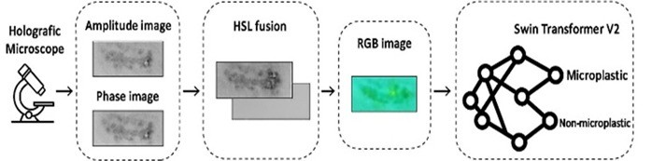
BLOCK DIAGRAM OR FLOW DIAGRAM

Slide 12
METHODOLOGY
Data Collection:
Used the Holographic Microplastic Dataset (HMPD) containing paired amplitude and phase images labeled as microplastic or non-microplastic.
Image Fusion (HSL Conversion):
Converted amplitude and phase images to HSL color space for enhanced color and texture representation.
Mapping: H = Amplitude, S = Phase, L = 0.5 (constant brightness).
Preprocessing
Process | Purpose
Resize (256×256) | Standardizes image size
Flip & Rotation | Increases data diversity
Color Jittering | Simulates lighting variation
Tensor Conversion | Converts images to model format

Slide 13
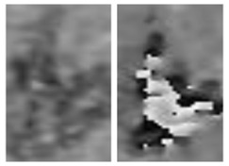
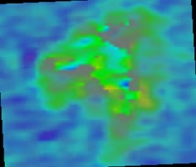
METHODOLOGY
Before PreProcessing After Preprocessing

Slide 14
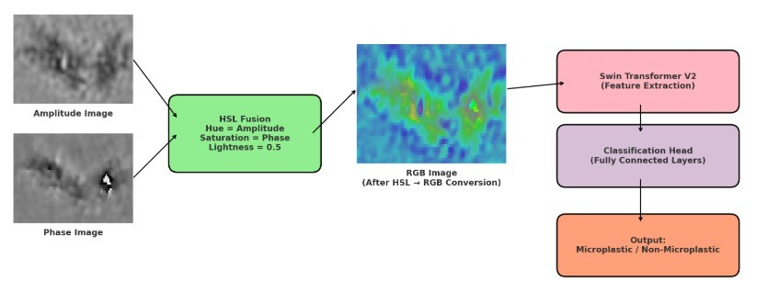
METHODOLOGY
Model Training:
Used Swin Transformer V2, a vision transformer with shifted window attention for local and global feature learning.
Model Architecture

Slide 15
Implementation
Image fusion and preprocessing (resize, flip, rotation, color jittering)
Conversion of amplitude and phase to HSL color space
Splitting dataset into 80% training and 20% validation
Model training using Swin Transformer V2 with cross-entropy loss
Performance evaluation using Accuracy, Precision, Recall, F1-score, and ROC Curve
Visualization of training/validation accuracy and loss trends

Slide 16
System Requirements
Hardware Requirements
Processor : intel Core i5
Cache memory : 4MB(Megabyte)
RAM : 12.7GB (gigabyte)
Hard Disk : 166.8GB
Compute Engine : T4 GPU
Software Requirements
Operating System : Windows 10, 64-bit Operating System
Coding Language : Python
Python distribution : Google Colab , Flask
Browser : Any Latest Browser like Chrome

Slide 17
Challenges Vs Overcomes
Challenges Faced | Solutions Implemented
Challenges Faced | How They Were Overcome
1. Limited dataset – The HMPD dataset contained a restricted number of amplitude and phase image pairs, which could limit model generalization. | Applied data augmentation techniques (rotation, flipping, color jittering) to enlarge the dataset and improve model robustness.
2. Low contrast in holographic images – Raw amplitude and phase images lacked clarity, making microplastics difficult to distinguish. | Used HSL fusion (H = Amplitude, S = Phase, L = 0.5) to enhance contrast, color, and texture representation.
3. High computational complexity – Vision transformers can be computationally heavy on large images. | Utilized the Swin Transformer V2 architecture with shifted-window attention, which reduces computation from quadratic to linear complexity.
4. Performance evaluation and explainability – Difficult to assess how effectively the model identified true microplastics. | Implemented comprehensive metrics (Accuracy, Precision, Recall, F1-Score, ROC) and visualized results with confusion matrix and ROC curve.

Slide 18
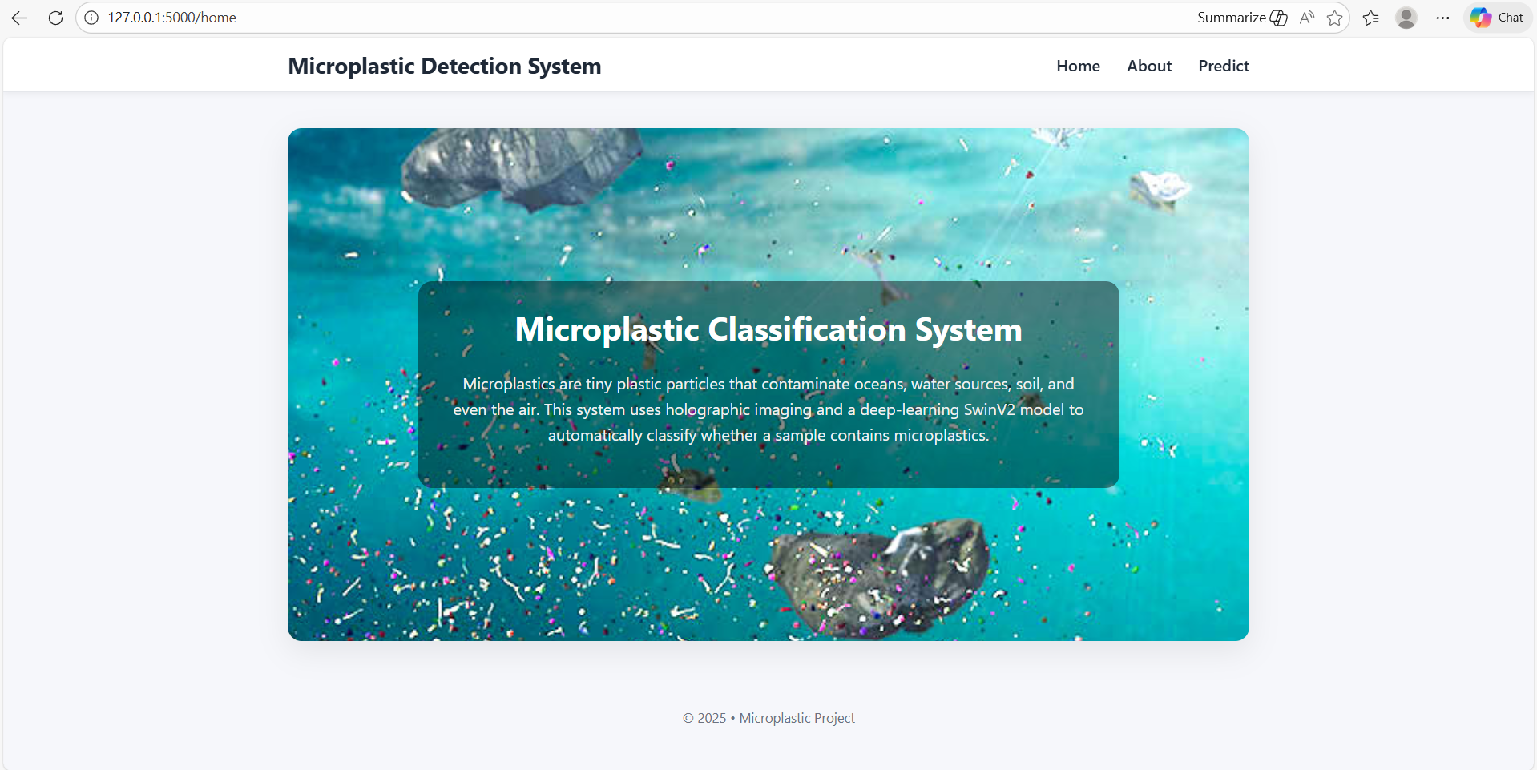
Implementation of Frontend

Slide 19
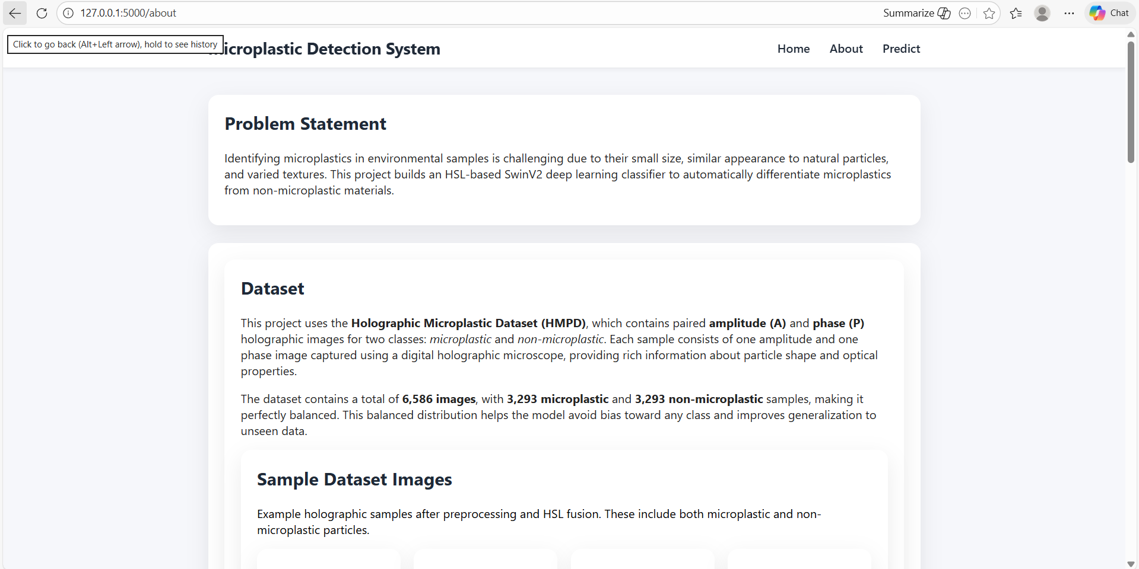
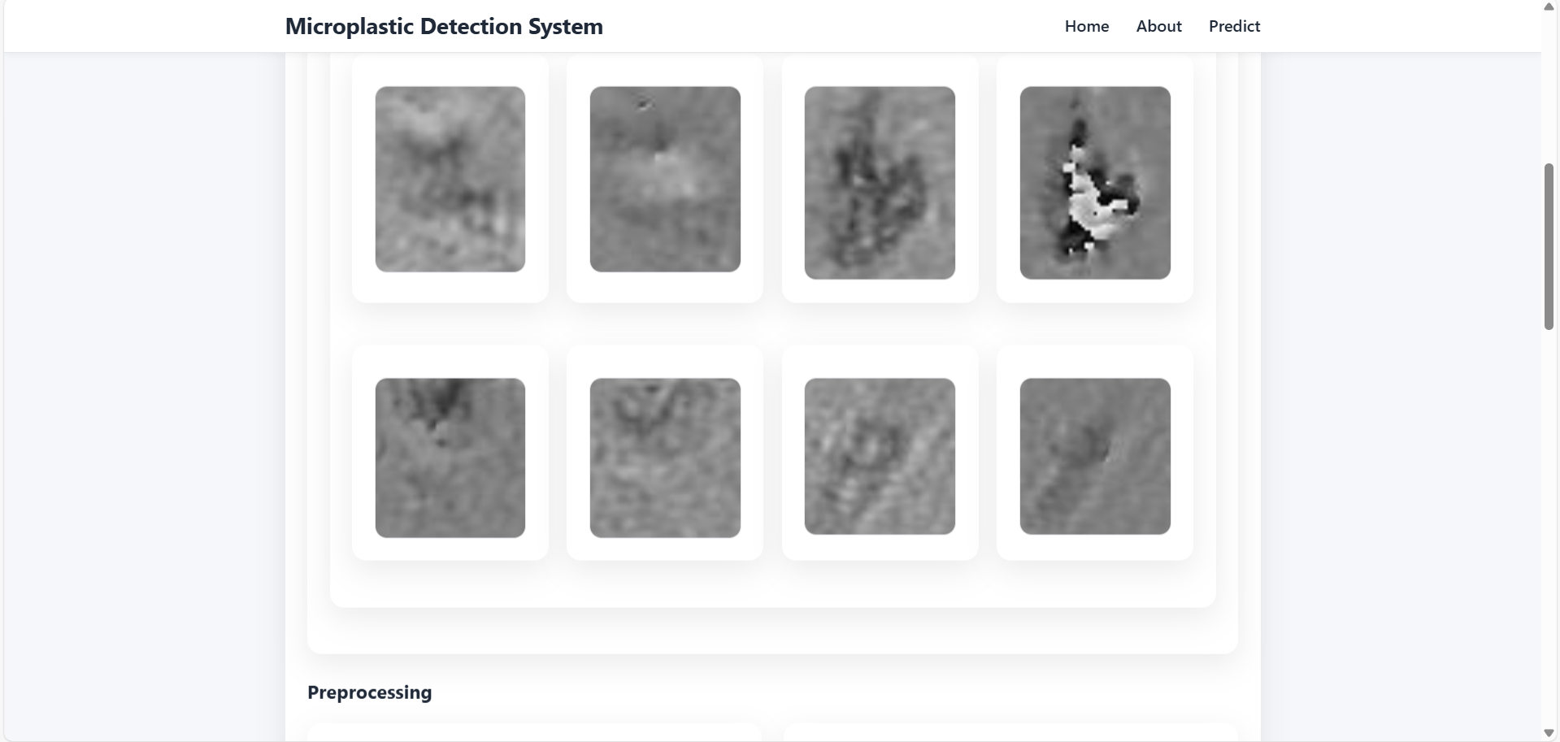
Implementation of Frontend

Slide 20
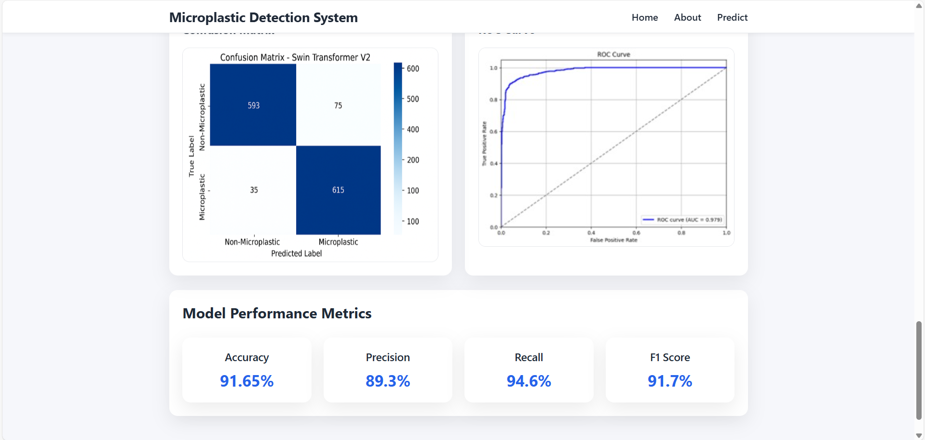
Implementation of Frontend

Slide 21
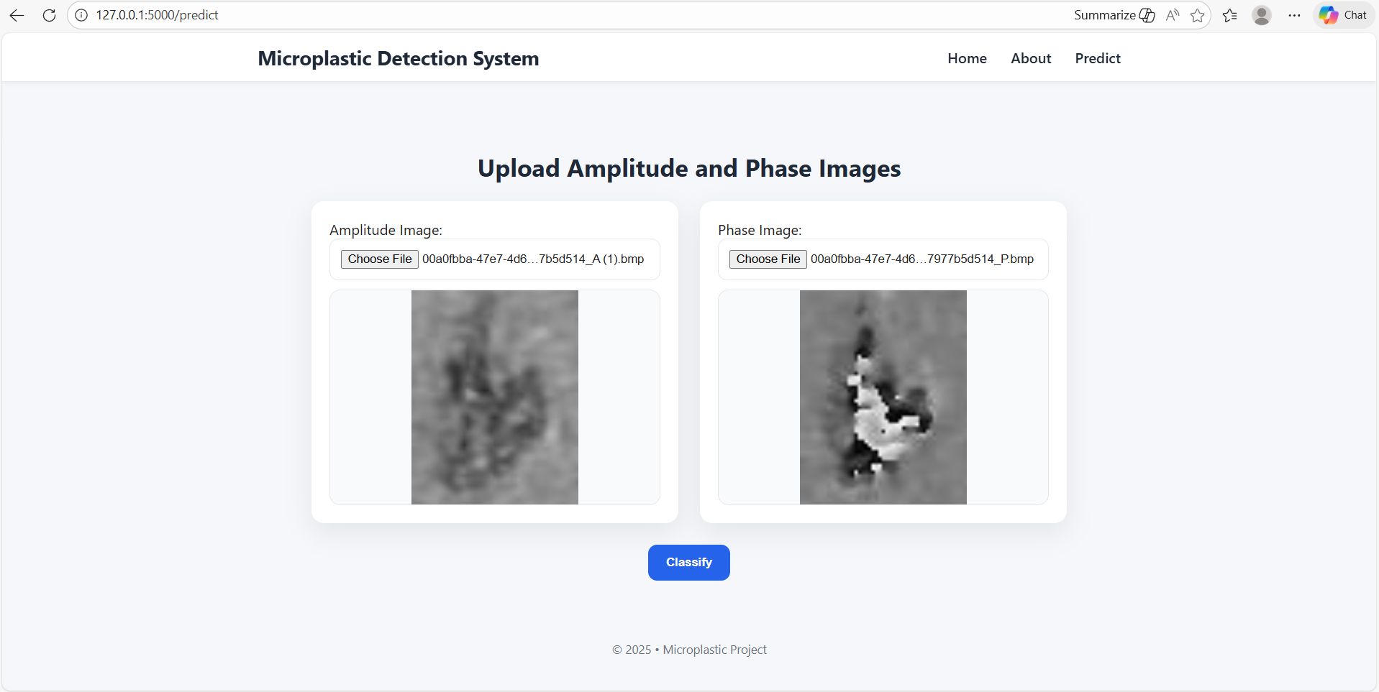
Implementation of Frontend

Slide 22
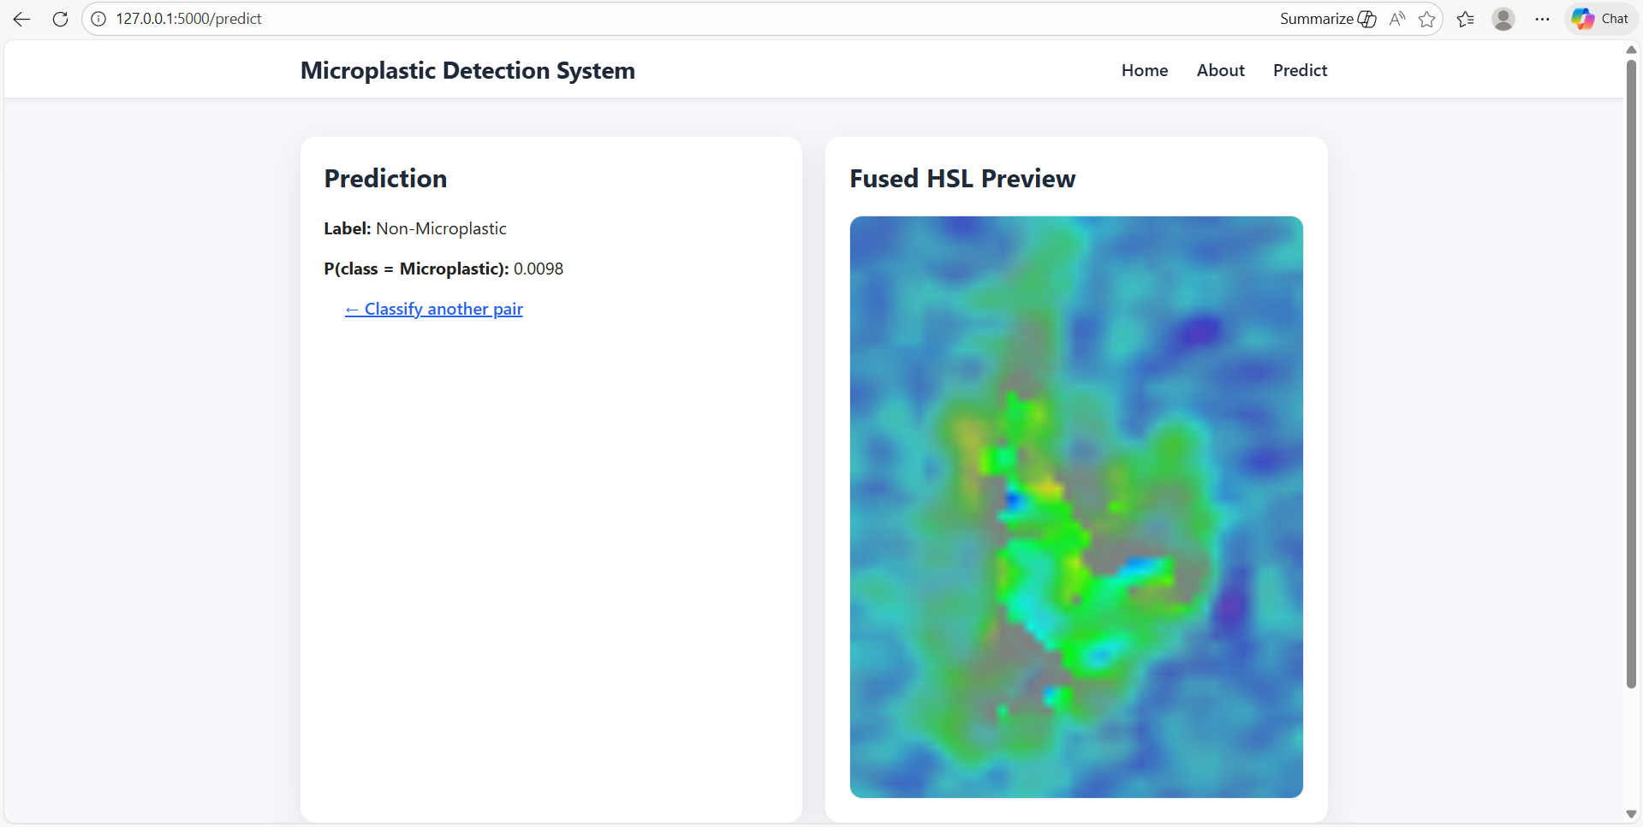
Implementation of Frontend

Slide 23
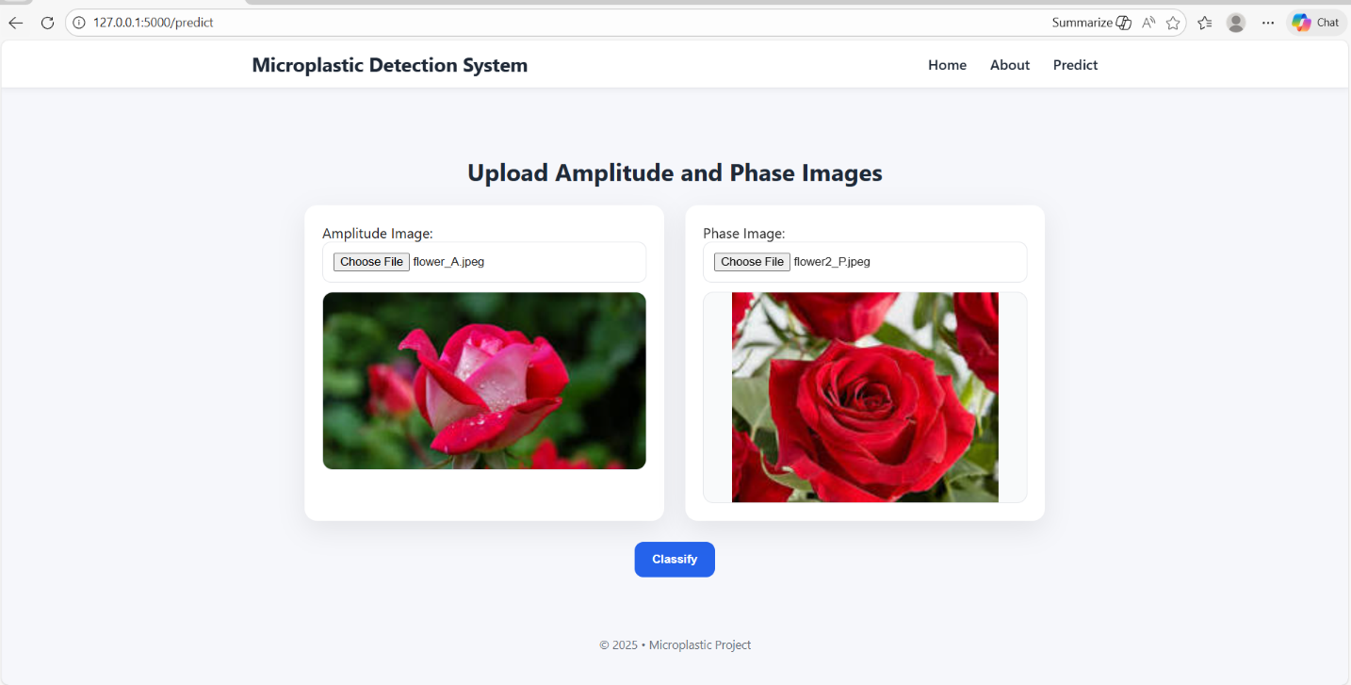
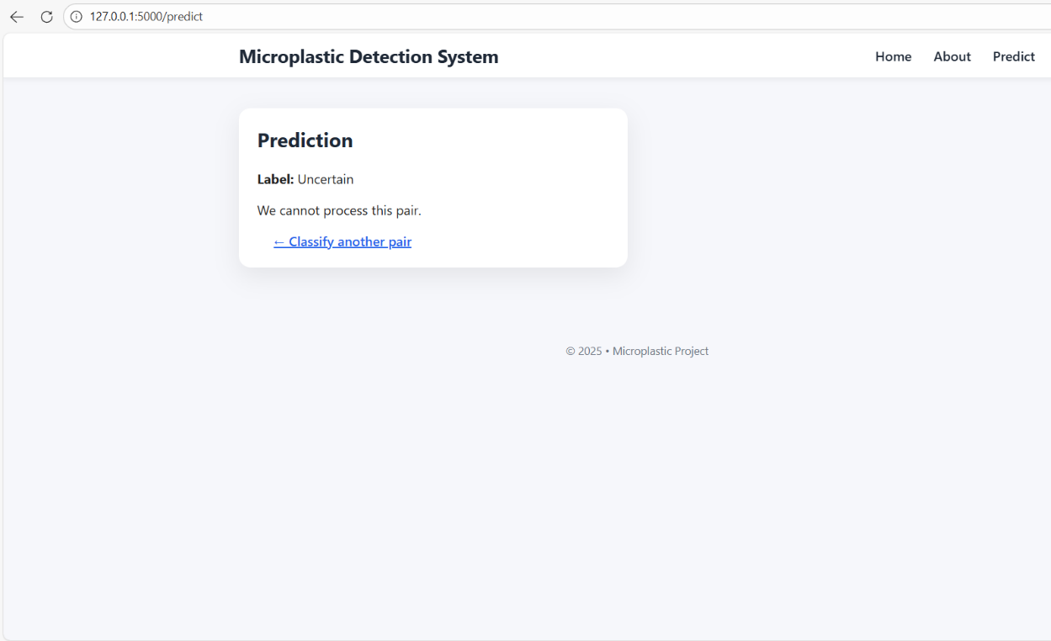
Implementation of Frontend

Slide 24
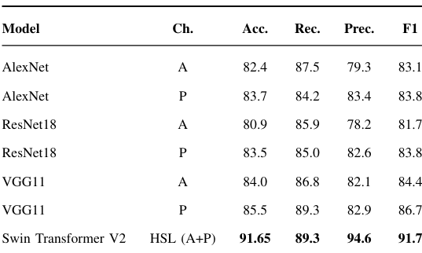
RESULTS & ANALYSIS
HSL fusion improves contrast and feature clarity.
Swin Transformer V2 achieves highest precision (94.6%) and stable accuracy (~91%).

Slide 25
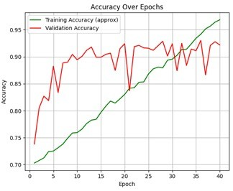
RESULTS & ANALYSIS
The training and validation accuracies of the Swin Transformer V2 model steadily increased, reaching around 91–93%, showing effective learning.
The curves are closely aligned, indicating good generalization and no overfitting during training.

Slide 26
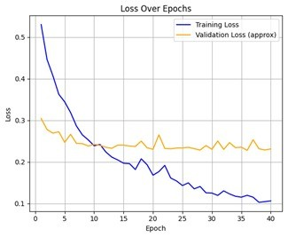
RESULTS & ANALYSIS
The training and validation losses continuously decrease over 40 epochs, showing that the Swin Transformer V2 model learns effectively with each iteration.
Both curves converge near 0.1, and the validation loss stays lower than the training loss — indicating good generalization and no overfitting.

Slide 27
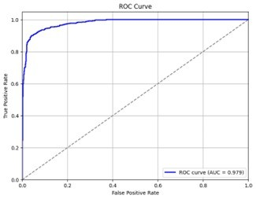
RESULTS & ANALYSIS
The ROC curve shows the model’s ability to distinguish between microplastic and non-microplastic samples, with an AUC value of 0.979, indicating excellent classification performance.
The curve is close to the top-left corner, meaning the model achieves a high true positive rate while maintaining a low false positive rate.

Slide 28
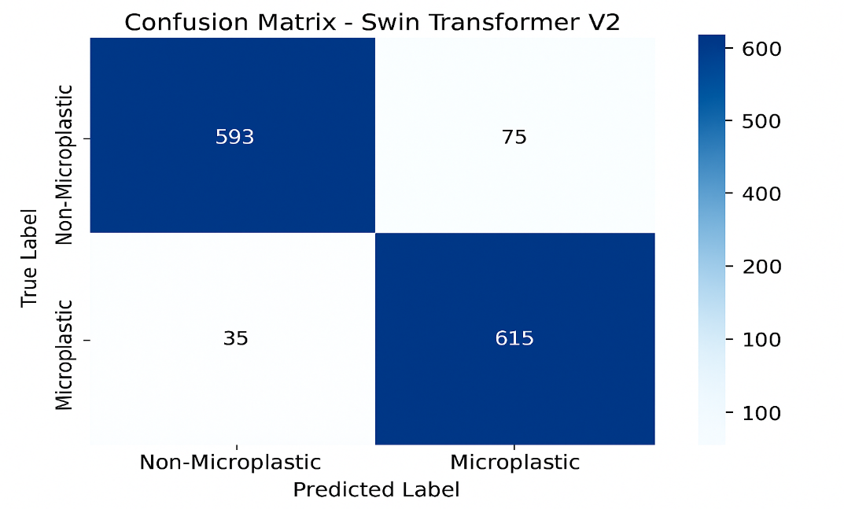
RESULTS & ANALYSIS
The Swin Transformer V2 model correctly classified 615 microplastic and 593 non-microplastic samples, showing strong accuracy in both categories.
The small number of misclassifications (75 false positives and 35 false negatives) indicates the model is highly reliable and consistent.

Slide 29
CONCLUSION & FUTURE SCOPE
Conclusion:
Swin Transformer V2 successfully classifies holographic microplastics with 91.65% accuracy.
Outperforms traditional CNNs by ~6%.
HSL fusion enhances spatial and color details.
Demonstrates the potential of Vision Transformers for environmental AI.
Future Scope:
Include diverse real-world microplastic types and water samples.
Integrate into real-time field monitoring devices.
Extend to multi-class microplastic categorization.
Optimize for edge or IoT deployment.

Slide 30
REFERENCES
Z. Liu et al., “Swin Transformer V2: Scaling Up Capacity and Resolution,” Proceedings of the IEEE/CVF Conference on Computer Vision and Pattern Recognition (CVPR), pp. 12009–12019, 2022.
A. Dosovitskiy et al., “An Image is Worth 16×16 Words: Transformers for Image Recognition at Scale,” International Conference on Learning Representations (ICLR), 2021.
G. Russo et al., “Microplastic Classification in Holographic Images Using Swin Transformer V2,” Sensors, vol. 24, no. 5, pp. 1–17, 2024.
H. Chen et al., “A Survey on Vision Transformers in Computer Vision,” IEEE Transactions on Neural Networks and Learning Systems, vol. 35, no. 2, pp. 1550–1571, 2023.
J. Li et al., “Deep Learning for Microplastic Detection and Classification: Challenges and Perspectives,” Environmental Science & Technology, vol. 57, no. 6, pp. 2561–2574, 2023.
P. Zhang et al., “Attention Mechanisms in Environmental Image Analysis,” IEEE Access, vol. 11, pp. 12045–12059, 2023.

Slide 31
ACKNOWLEDGEMENTS
We would like to express our sincere gratitude to the faculty and staff of Narasaraopeta Engineering College for their guidance and encouragement throughout the development of this project. Their insights and expertise have been invaluable.
We also extend our thanks to the administration for providing the necessary resources and a platform to showcase our work. This opportunity has been instrumental in enhancing our learning and growth.
For any questions or further discussions, feel free to reach out:-
Team No:BG9
Guide: Mabanu Sampath Kumar
Roll No’s: 22471A05C2
22471A05B0
22471A05C5
Thank You

Slide 32


