Slide 1

Department of Computer Science and Engineering
Enhanced Hybrid Deep Learning Model for Cybersecurity Threat Detection Using CNN-BiLSTM and Feature Optimization
PRESENTED BY
Namburi Teja (22471A05I0)
Kopparapu Siva Hemanth Kumar(22471A05G5)
Jalukuri Gopi (22471A05F8)
Vipparla Chetan (22471A05K6)
Under the Guidance of
Dr. R. Satheeskumar, _{M.Tech., Ph.D}
Professor
Department of Computer Science and Engineering,
Narasaraopeta Engineering College (Autonomous), Narasaraopet- 522 601.
Review No.2
Batch No.CB2
Department of CSE
1

Slide 2
OUTLINE
Abstract
Introduction
Problem Statement
Literature Survey
Research Gaps
Objectives
Methodology
Block Diagram / Flow Diagram
Implementation
Results and Analysis
Conclusion and Future Scope
References
Question and Answers
Acknowledgements
Review No.2
Batch No.CB2

Slide 3
ABSTRACT
In today’s rapidly evolving digital landscape, cyber threats are increasing in both volume and sophistication, making traditional intrusion detection systems inadequate. This work proposes an optimized hybrid deep learning model that integrates PCA, CNN, and BiLSTM to enhance real-time cybersecurity threat detection. PCA reduces dimensionality and computational load by eliminating redundant features, while the CNN-BiLSTM architecture effectively captures both spatial and temporal patterns in network traffic. The model is trained and evaluated on the CICIDS2017 dataset, which simulates realistic attack scenarios. Experimental results show a high detection accuracy of 98.2%, surpassing many existing methods and significantly reducing false alarms. The proposed framework is scalable, efficient, and suitable for deployment in dynamic environments such as industrial IoT, smart cities, and critical infrastructure systems.
Review No.2
Batch No.CB2

Slide 4
INTRODUCTION
Cyberattacks are becoming more frequent and complex, targeting individuals, companies, and national systems. Traditional security methods struggle to detect modern attacks like zero-day threats and advanced malware.
Conventional rule-based IDS cannot handle evolving network behaviour. Deep learning models provide automatic feature extraction and can identify both known and unknown attacks with high accuracy.
Combining CNN and BiLSTM helps capture both spatial patterns and temporal sequences in network traffic. This makes hybrid models more effective for intrusion detection than single deep learning approaches.
Review No.2
Batch No.CB2

Slide 5
PROBLEM STATEMENT
Existing intrusion detection systems struggle to identify complex and evolving cyberattacks due to high-dimensional data and outdated rule-based methods. This results in low accuracy and slow threat response.
Many deep learning models are computationally heavy and unsuitable for real-time environments. There is a need for a lightweight, high-accuracy model that can reduce false alarms while detecting modern cyber threats effectively.
Review No.2
Batch No.CB2

Slide 6
LITERATURE SURVEY
No | Title | Author | Journal Name & Year | Methodology Adapted | Key Findings | Gaps
1 | Novel Hybrid Deep Learning-Based Cybersecurity Threat Detection Model with Optimization Algorithm | S. Markkandeyan et al., 2025, Cyber Security and Applications (Elsevier) | https://www.sciencedirect.com/science/article/pii/S2772918424000419?via%3Dihub - & 2025 | ATFDNN + IPSO, E-LSTM | Achieved high accuracy (95%), false alarm rate reduced. | no real-time detection
2 | Advances in IoT Intrusion Detection: Deploying Hybrid Deep Learning and Metaheuristic Algorithms for Optimal Feature Selection | Ahmed Basil Abdulkareem, 2025, IIETA | https://www.researchgate.net/publication/391974411_Advances_in_IoT_Intrusion_Detection_Deploying_Hybrid_Deep_Learning_and_Metaheuristic_Algorithms_for_Optimal_Feature_Selection & 2025 | CNN, BiGRU, BiLSTM,GA,HHO,DA, GWO, PSO | PSO achieved highest accuracy (98.11%) ,ToN-IoT dataset used ,High precision, recall, F1-score across classes | High computational cost limits real-time deployment
3 | Intrusion Detection and Prevention System (IDPS) Model for IIoT Environments Using Hybridized Framework | Manohar Srinivasan, N. C. Senthilkumar, 2025, IEEE Access | https://ieeexplore.ieee.org/document/10870250 & 2025 | CNN, Blockchain-assisted Reinforcement Learning, Edge computing | Achieved high accuracy, low false positives , Real-time detection & mitigation | Scalability issues in hybrid IDPS
4 | Reinforcement Learning With Deep Features: A Dynamic Approach for Intrusion Detection in IoT Networks | Mohamad Khayat, Ezedin Barka, Mohamed Adel Serhani, Farag Sallabi, Khaled Shuaib, Heba M. Khater (IEEE, 2025) | https://ieeexplore.ieee.org/document/11002467 & 2025 | Deep Q-Network (DQN), RNN, Autoencoder, LSTM, CNN, CL-AOO (Hybrid: GAO + CL-OOA), PCA | Achieved 99.80% accuracy, 99.99% precision, improved FPR & FNR; integrated hybrid feature selection and RL for adaptive IDS | Sensitivity to hyperparameters, complexity in real-time environments
5 | A Secure and Efficient Deep Learning-Based Intrusion Detection Framework for the Internet of Vehicles | Hasim Khan, Ghanshyam G. Tejani, et al., 2025, Nature Scientific Reports | https://www.nature.com/articles/s41598-025-94445-9 & 2025 | DAGSNet (DenseNet + GoogleNet + AlexNet + SqueezeNet), CMSO, ViT, GAT, Wavelet Transform | High accuracy (99.12%), Robust feature selection via CMSO,Real-time detection | poor scalability, weak handling of emerging attack patterns
Review No.02
Batch No.CB2

Slide 7
LITERATURE SURVEY
Research shifted from traditional rule-based IDS to deep learning models like CNN, LSTM, and hybrid CNN-RNN systems. These models improved detection accuracy but often required heavy computation and suffered from overfitting, limiting their real-time use.
Modern datasets such as CICIDS2017 and UNSW-NB15 enabled better training for IDS compared to older datasets. Although reinforcement learning, ensemble methods, and attention-based models enhanced performance, many remained too complex for scalable and efficient deployment.
Review No.2
Batch No.CB2

Slide 8
RESEARCH GAPS
Many hybrid deep learning models achieve good accuracy but rely on complex architectures or metaheuristic optimization, making them slow and unsuitable for real-time threat detection. There is a need for a faster and more efficient IDS without compromising accuracy.
Most existing IDS struggle with large feature sets, leading to overfitting and longer training times. Effective feature reduction methods like PCA are not widely integrated, creating a gap for models that can handle high-dimensional traffic efficiently while maintaining strong detection performance.
Review No.02
Batch No. CB2

Slide 9
OBJECTIVES
Develop a web interface to upload and process network CSV data.
Build a hybrid CNN–BiLSTM model for accurate intrusion detection.
Use PCA to reduce features and improve model efficiency.
Train the model using the CICIDS2017 dataset for better threat recognition.
Achieve high accuracy with a low false alarm rate.
Validate and compare the model with existing IDS approaches.
Review No.02
Batch No. CB2

Slide 10
METHODOLOGY
Preprocess the CSV network data by removing missing values, encoding labels, and normalizing features.
Apply PCA to reduce high-dimensional features and improve model training efficiency.
Reshape the optimized data and train a hybrid CNN–BiLSTM model for intrusion detection.
Evaluate the model using accuracy, precision, recall, F1 score, and compare results with existing IDS models.
Review No.02
Batch No. CB2

Slide 11
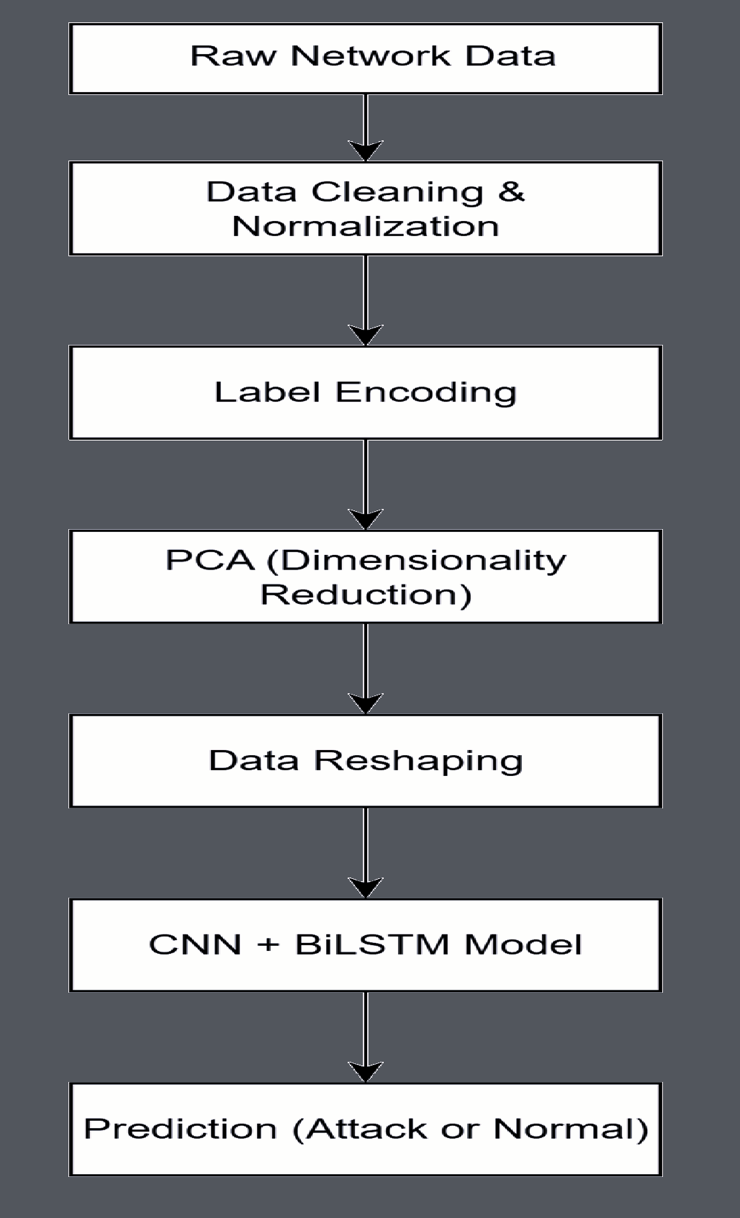
FLOW DIAGRAM
Review No.2
Batch No. CB2

Slide 12
Implementation Work-Flow
Data Preprocessing
Load raw CICIDS2017 CSV files containing 80+ flow features.
Remove rows with NaN/inf values and drop irrelevant fields (IP addresses).
Encode attack labels into numeric format.
Normalize all numeric features using Z-score scaling.
2. Dimensionality Reduction (PCA)
Fit PCA on the training set to eliminate redundant features.
Reduce dimensionality to ~30 components while preserving essential variance.
Transform validation and test sets using the same PCA model.
PCA Output → compact, noise-reduced feature vectors.
3. Data Reshaping for Deep Learning
Convert PCA output into 3D tensors suitable for CNN input.
Typical shape: (samples, components, 1).
Reshaped Output → CNN-ready feature maps.
Review No.02
Batch No. CB2

Slide 13
Hybrid Deep Learning Model Architecture
4. CNN Feature Extraction
Apply convolutional layers to detect local spatial patterns in traffic features.
Use pooling and dropout to reduce complexity and prevent overfitting.
CNN Output → compressed spatial feature representations.
5. Temporal Modeling with BiLSTM
Reshape CNN output to sequence format if needed.
BiLSTM processes data forward and backward, learning temporal attack behaviors.
BiLSTM Output → rich temporal embeddings capturing flow dynamics.
6. Classification Layer
Pass embeddings into dense layers for final learning.
Apply softmax activation to generate class probabilities.
Final Output → predicted attack category for each network flow.
Review No.02
Batch No. CB2
13

Slide 14
Model Evaluation, Web Integration and Deployment
7. Model Evaluation
Evaluate using Accuracy, Precision, Recall, F1-Score, and FAR.
Confusion matrix verifies class-wise prediction strength.
Achieved 98.2% accuracy and 1.1% FAR, outperforming many IDS models.
8. Web Integration (Flask Interface)
Users upload network CSV files through a simple web interface.
Server preprocesses uploaded data → applies PCA → reshapes → runs model prediction.
Outputs predicted labels, confidence scores, and downloadable results.
9. Deployment
Deploy as a standalone web service using Flask + Docker.
Optional optimizations: model quantization, ONNX export, edge deployment.
Review No.02
Batch No. CB2
14

Slide 15
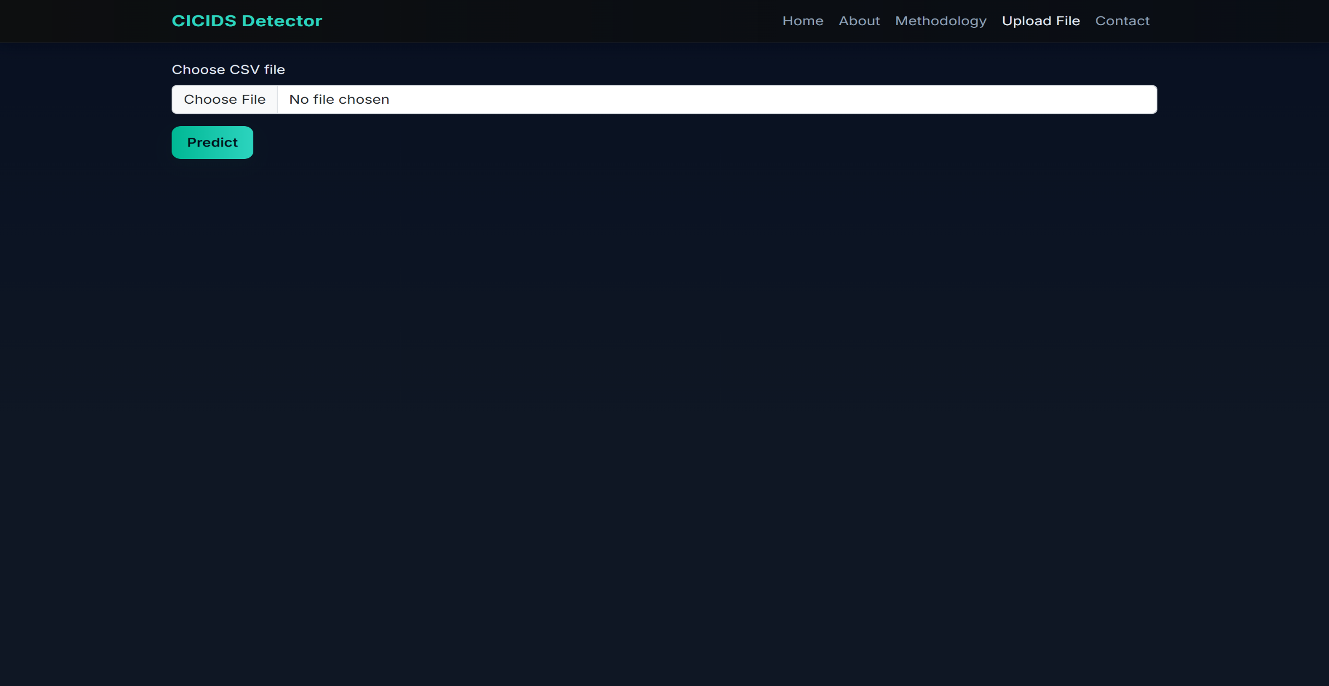
15

Slide 16
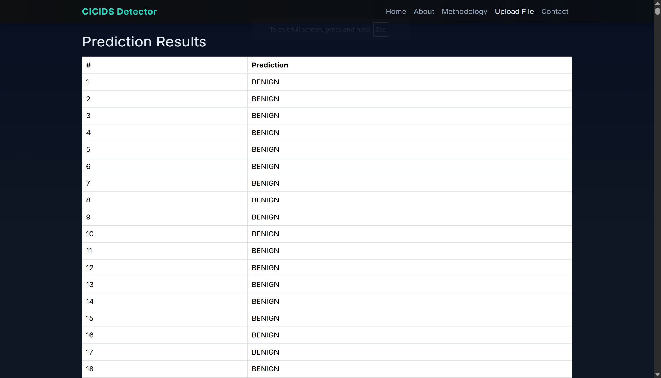
16

Slide 17
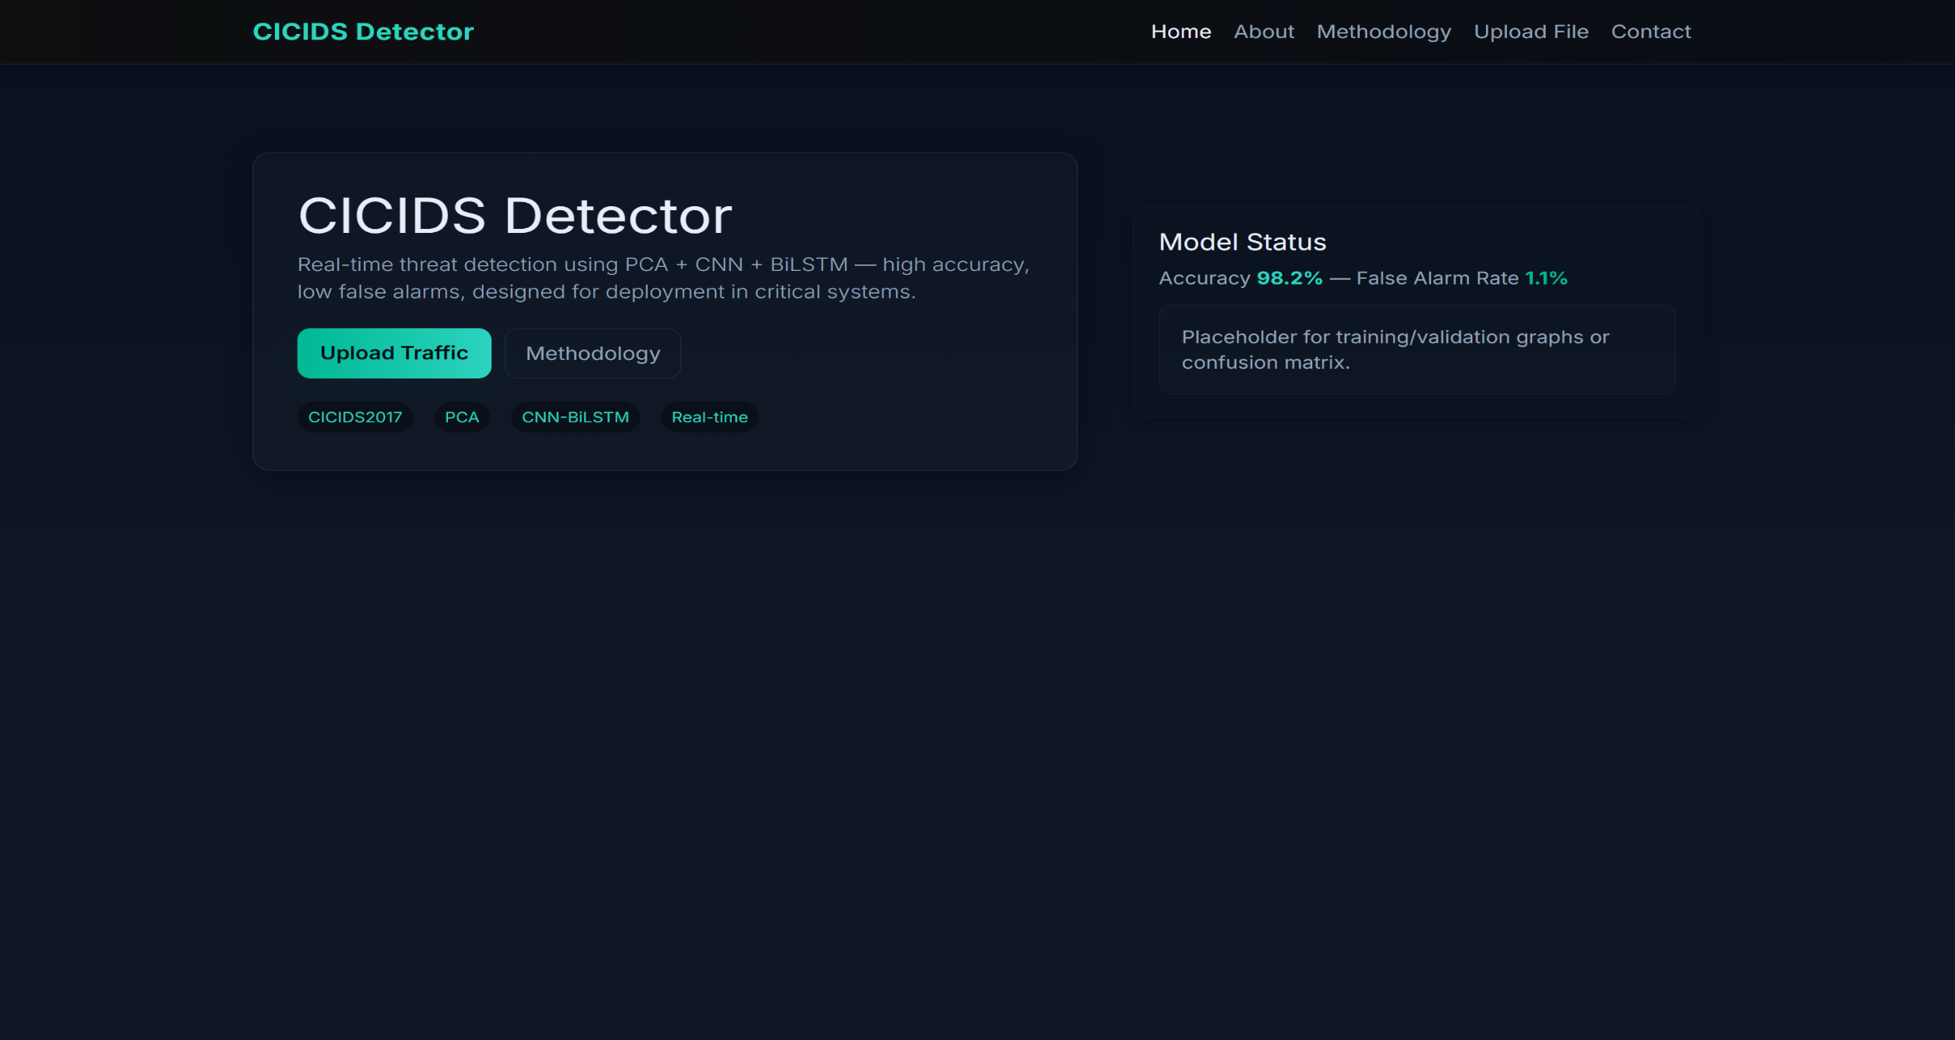
17

Slide 18
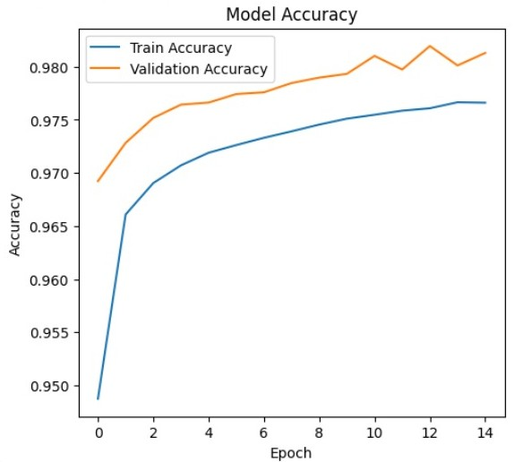
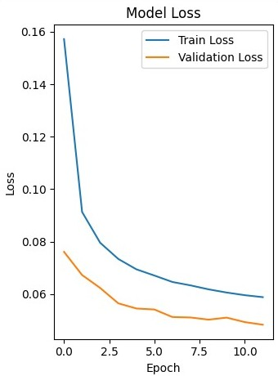
RESULTS AND ANALYSIS
Fig. Accuracy Report
Fig. Loss Report
Review No.02
Batch No. CB2
Batch No.

Slide 19
CONCLUSION AND FUTURE SCOPE
The integration of PCA with CNN–BiLSTM creates an efficient and accurate intrusion detection system, improving the ability to identify cyber threats across multiple attack types.
The model enhances network security by effectively analyzing traffic patterns, reducing false alarms, and providing reliable detection suitable for real-time environments.
By combining advanced deep learning techniques with a streamlined workflow, the system offers a powerful and scalable IDS solution for organizations, improving overall cybersecurity and threat management.
05-12-2025
Review No.02
Batch No. CB2

Slide 20
REFERENCES
A. S. Mohamed, A. M. Abdelmaksoud, and M. M. Selim, "Artificial Intelligence Techniques in Cybersecurity: Challenges and Future Directions," Knowledge and Information Systems, vol. 67, pp. 1803–1841, 2025.
S. Abdulkareem et al., "Deep Hybrid Intrusion Detection in IoT Using CNN–BiGRU–BiLSTM Optimized with Metaheuristics," Information Systems and Informatics, vol. 45, no. 2, pp. 310–321, 2023.
A. Khayat, N. Xiong, and R. Doss, "Adaptive Intrusion Detection in IoT Through Reinforcement Learning and Deep Feature Engineering," arXiv preprint arXiv:2205.12466, 2022.
J. Hu, S. Liu, and Y. Wang, "Network Anomaly Detection Using CNN and Attention-Based BiLSTM," IEEE Access, vol. 8, pp. 70116–70125, 2020.
R. Moustafa and J. Slay, "UNSW-NB15: A Benchmark Dataset for Evaluating Intrusion Detection Systems," in Proc. Military Communications and Information Systems Conference, pp. 1–6, 2015.
Review No.02
Batch No.CB2

Slide 21

Review No.02
Batch No.CB2

Slide 22

Review No.02
Batch No.CB2

