Slide 1

Department of Computer Science and Engineering
SignSight : A Robust Deep Vision Framework for Real-Time Perception of Traffic Sign Under Adverse Weather Conditions
PRESENTED BY
Nallamothu Vinay (22471A05H9)
Eerlapati Lakshmaiah (22471A05F5)
Yepuri Teja Naga Anil Kumar (22471A05L0)
Under the Guidance of
Marella Venkata Rao, M.Tech, Asst. Professor
Department of Computer Science and Engineering,
Narasaraopeta Engineering College (Autonomous), Narasaraopet- 522 601.
Review No.2
Batch No.CB3
Department of CSE
1

Slide 2
OUTLINE
Abstract
Introduction
Problem Statement
Literature Survey
Research Gaps
Objectives
Methodology
Block Diagram / Flow Diagram
Implementation
Results and Analysis
Conclusion & Future Scope
References
Question and Answers
Acknowledgements
Review No.2
Batch No.CB3

Slide 3
ABSTRACT
Accurate recognition of traffic signs is a foundation of contemporary autonomous driving systems, and it is an important factor in road safety, lawful driving, and informed vehicle control. However, developing high reliability in opera_x0002_tional environments is still a significant challenge. Poor weather conditions, partial occlusion by other cars or obstacles, and the small appearance of traffic signs tend to face many challenges and fail to provide consistent detection. Such issues may reduce system performance and undermine safety-critical decisions. This model introduces SignSight, a strong deep learning framework for real time perception of traffic sign and recognition frame_x0002_work to address and direct these challenges through a hybrid deep learning architecture. The approach combines conventional CNNs with Keras for initial classification complemented with a YOLOv8 detection pipeline for accurate spatial localization and real-time prediction. Compared to state-of-the-art models, SignSight includes weather-robust preprocessing methods and taps into small-object detection improvements. Taking cues from
recent research such as YOLO-BS and MASG-Net, our approach utilizes multiscale feature learning along with context-aware mod_x0002_ules to enhance detection of small sized and blurred traffic signs.Our unified system reached a highest classification accuracy of 97.4%, with real-time performance ensured.
Review No.2
Batch No.CB3

Slide 4
INTRODUCTION
Traffic sign detection and recognition are essential for autonomous driving and road safety.
Real-world challenges such as rain, fog, occlusion, and poor lighting reduce the accuracy of traditional models.
Existing systems often perform well on datasets but fail to generalize in dynamic environments and with small or blurred signs.
To address this, SignSight combines YOLOv8 for fast detection and a CNN for accurate classification.
The hybrid design improves robustness, real-time performance, and reliability for intelligent transportation systems.
Review No.2
Batch No.CB3

Slide 5
PROBLEM STATEMENT
Many standalone CNN or YOLO models perform well on clean datasets but fail in complex, real-time driving environments.
There is a need for a reliable system that can both detect and classify traffic signs accurately under adverse conditions.
The problem is to develop a robust, real-time, and weather-tolerant traffic sign recognition framework suitable for autonomous vehicles.
Review No.2
Batch No.CB3

Slide 6
LITERATURE SURVEY
No | Title | Author | Journal Name & Year | Methodology Adapted | Key Findings | Gaps
1 | A Review of YOLO Algorithm and Its Applications in Autonomous Driving Object Detection | J. Wei, A. A. Azizan, K. A. M. Rezali, M. Z. M. Yusoff, and H. Ma | https://ieeexplore.ieee.org/document/11015428 & 2025 | YOLOv1–YOLOv12, YOLO-MR | YOLO has evolved from v1 to v12 with higher accuracy and faster FPS, achieving real-time performance | Small-object detection Occlusion handling Multi-scale detection
2 | Rectifying Adversarial Examples Using Their Vulnerabilities | F. Morimoto, R. Morita, and S. Ono | https://ieeexplore.ieee.org/document/10918972 & 2025 | Input Transformations, Gradient-Based Filtering, Adversarial Example (AE) Classification | High Rectification Rate, Attack-Agnostic Effectiveness and Superior Performance | Vulnerability to Deep Targeted Attacks, Parameter Tuning Challenges and Limited Modality Generalization
3 | Grounding DINO and distillation-enhanced model for advanced traffic sign detection and classification in autonomous vehicles | H. N. Tran, N. N. N. Nguyen, N. Q. P. Le, and A. D. Nguyen | http://sciencedirect.com/science/article/pii/S2215098625000837 & 2025 | Caption-Text Pairing, Image Caption Fusion and Grounding with DINO & Transformer Distillation | Efficient Model Design, High Detection Performance | Performance on Small or Occluded Signs and Adverse Environmental Conditions
4 | The Bangladesh road traffic sign dataset in real-world images for traffic sign recognition | A. Islam and D. M. Farid | https://www.sciencedirect.com/science/article/pii/S2352340925002550 & 2025 | Data Preparation, Data Augmentation and Model Selection | Real-World Representation and Diverse Environmental Conditions | Limited Geographic Coverage and Insufficient Sign Variants
Review No.2
Batch No.CB3

Slide 7
LITERATURE SURVEY
Qiu et al. (2025) proposed a lightweight DP-YOLO model for detecting small traffic signs, achieving good speed and accuracy; however, performance reduced in cluttered and low-visibility environments.
Zhang et al. (2025) introduced YOLO-BS with BiFPN to improve small-object detection, but their work focused only on detection and lacked fine-grained classification.
Tran et al. (2025) combined Grounding DINO with knowledge distillation to enhance traffic sign detection, though results showed difficulty in distinguishing visually similar sign classes.
Megalingam et al. (2025) developed a CNN-based Indian traffic sign recognition system suitable for real-time use, but their approach struggled under adverse weather and occlusion conditions.
Du et al. (2025) proposed MASG-Net, a lightweight multi-scale network that improved traffic sign detection accuracy and speed, but still showed limitations under harsh lighting and heavy occlusions.
Review No.2
Batch No.CB3

Slide 8
RESEARCH GAPS
Most existing methods focus only on detection or classification separately, lacking an integrated end-to-end system that performs both with high accuracy.
Small traffic sign detection remains unreliable, especially in cluttered scenes and from long distances.
Many models underperform in adverse weather conditions such as rain, fog, low light, and occlusion.
Several high-accuracy approaches have high computational complexity, making them unsuitable for real-time deployment on low-power edge devices.
Review No.2
Batch No.CB3

Slide 9
OBJECTIVES
To develop a hybrid CNN–YOLOv8 framework that performs both real-time detection and fine-grained classification of traffic signs in a single pipeline.
To improve small traffic sign detection accuracy using multi-scale feature learning (BiFPN) and enhanced preprocessing techniques.
To achieve robust performance under adverse weather and low-visibility conditions through advanced data augmentation and normalization methods.
To design a lightweight and efficient model suitable for real-time deployment on edge and low-power devices without sacrificing detection accuracy.
Review No.2
Batch No.CB3

Slide 10
METHODOLOGY
Input & Preprocessing: Collect images/videos, perform noise cleaning, resizing, normalization, and data augmentation.
Detection: Use YOLOv8 with BiFPN to locate traffic signs, including small and distant signs.
Classification: Crop detected signs and classify them using a lightweight CNN into 43 categories.
Output & Evaluation: Display labeled bounding boxes and evaluate using accuracy, precision, recall, and F1-score.
Review No.2
Batch No.CB3

Slide 11
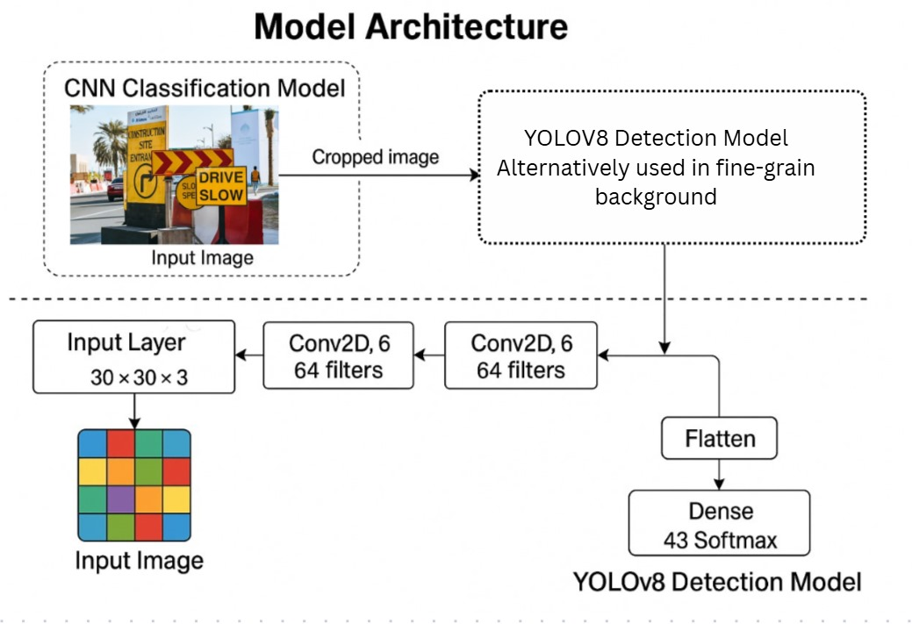
FLOW DIAGRAM
Review No.2
Batch No.CB3

Slide 12
IMPLEMENTATION
Hardware Requirements : Intel Core i5 processor or higher, 8 GB RAM (minimum) and GPU recommended (NVIDIA CUDA-supported) for faster training
Software Requirements : Python 3.9+, Google Colab / VS Code / Jupyter Notebook, PyTorch (YOLOv8 framework), TensorFlow / Keras (CNN classifier), OpenCV, NumPy and Pandas
Preprocessing Techniques: Cleaning, Resizing, Normalization and Augmentation and Rotation
Detection Module (YOLOv8) : YOLOv8 with BiFPN is trained to detect traffic signs from full-frame images, Provides bounding boxes and confidence scores in real time and Optimized for detecting small and distant traffic signs.
Classification Module (CNN) : Cropped traffic sign images are forwarded to a lightweight CNN and
CNN extracts features and assigns each sign to one of the 43 predefined classes using softmax prediction.
BiFPN Integration : To handle blurriness and detect unclear or small traffic signs
Review No.2
Batch No.CB3

Slide 13
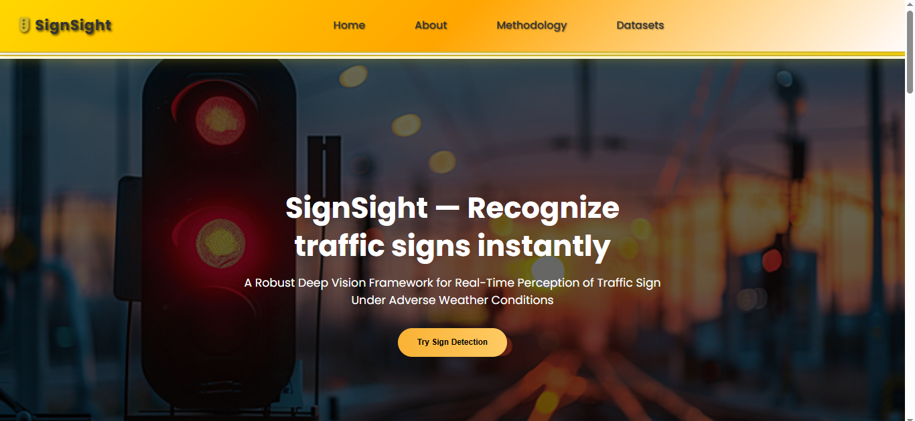

Slide 14
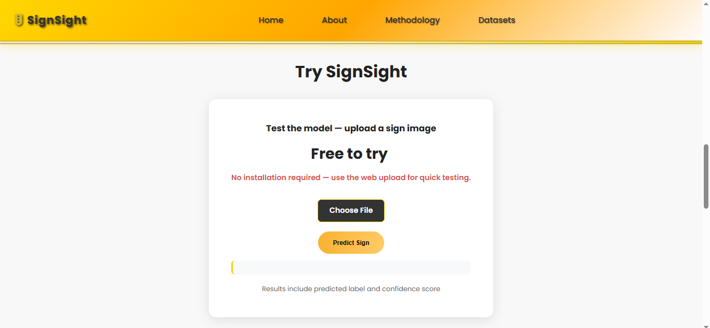

Slide 15
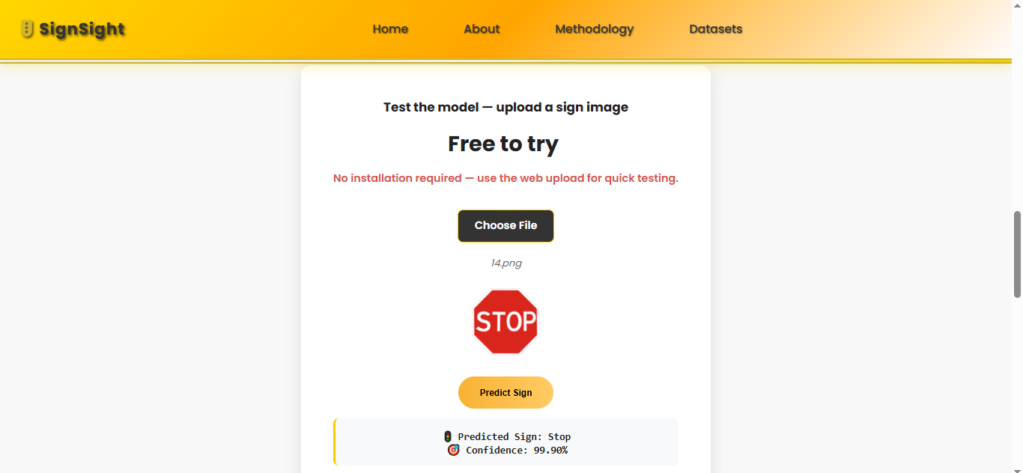

Slide 16
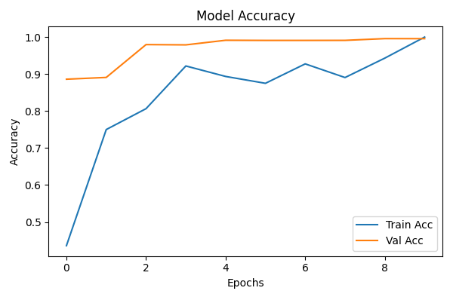
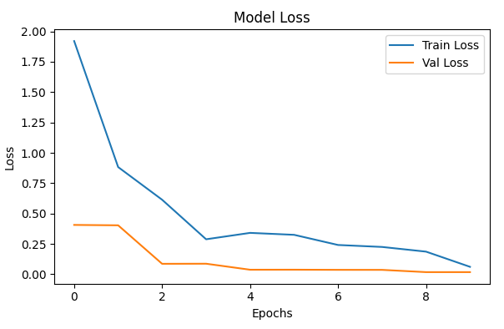
RESULTS & ANALYSIS
Fig. Accuracy Report
Fig. Loss Report
Review No.2
Batch No.CB3

Slide 17
CONCLUSION and FUTURE SCOPE
Conclusion
This work proposed SignSight, a hybrid YOLOv8 + CNN system for accurate real-time traffic sign detection and classification.
The model effectively detects small signs and performs well under challenging weather and lighting conditions.
Experimental results show high accuracy and reliable performance, proving the suitability of the system for intelligent transportation applications.
Future Scope
Training with more severe weather simulations (heavy rain, fog, night scenes) to further improve robustness.
Model optimization using pruning and quantization for deployment on low-power edge devices
Expansion to support multi-country traffic sign datasets for wider global applicability.
Integration with driver assistance systems (ADAS) for real-time alerts and decision support.
Review No.2
Batch No.CB3

Slide 18
REFERENCES
Qiu, J., Zhang, W., Xu, S., and Zhou, H., “DP-YOLO: A Lightweight Traffic Sign Detection Model for Small Object Detection,” Digital Signal Processing, 2025.
Zhang, H., Liang, M., and Wang, Y., “YOLO-BS: A Traffic Sign Detection Algorithm Based on YOLOv8,” Scientific Reports, 2025.
Du, C., Su, S., Lin, C., Yao, Y., Jin, R., and Hong, X., “MASG-Net: A Lightweight Network for Traffic Sign Detection Using Multi-Scale Context Awareness,” Scientific Reports, 2025.
Tran, H. N., Nguyen, N. N. N., Le, N. Q. P., and Nguyen, A. D.,
“Grounding DINO and Distillation-Enhanced Model for Advanced Traffic Sign Detection and Classification,” Pattern Recognition, 2025.
Megalingam, R., Thanigundala, K., Musani, S., and Gadde, L.,
“Indian Traffic Sign Detection and Recognition Using Deep Learning,” Sensors, 2025.
Review No.2
Batch No.CB3

Slide 19

Review No.2
Batch No.CB3

Slide 20

Review No.2
Batch No.CB3

