Slide 1





2025 IEEE iSSSC
2025 IEEE 3rd International Symposium on Sustainable Energy, Signal Processing & CyberSecurity
Paper Title: “SignSight : A Robust Deep Vision Framework for Real-Time
Perception of Traffic Sign Under Adverse Weather Conditions”
Paper ID: 675
Presenter Name: Nallamothu Vinay
Authors: Nallamothu Vinay, Venkata Reddy Dodda, Venkata Rao Marella,
Lakshmaiah Eerlapati, Teja Naga Anil Kumar Yepuri
Affiliation: Department of CSE, Narasaraopeta Engineering College, Narasaraopet, Andhra Pradesh, India

Slide 2
Outline
Introduction (try to answer what it is, why it is, and what is (are) existing problems, why the problem is so important to discuss; may cite in the footer)
Motivation & Contributions
Proposed System Model
Results and Discussion
Conclusion
Reference

Slide 3
Introduction
Traffic signs play a crucial role in ensuring road safety and assisting autonomous vehicles in
decision-making.
However, real-world conditions like rain, fog, poor lighting, and occlusion make detection highly
challenging.
Traditional models often fail under these adverse weather conditions or when signs are small and
blurred.
SignSight is introduced as a robust deep vision framework designed to accurately detect and
recognize traffic signs in real time, even in difficult conditions.
The framework leverages BiFPN-based feature fusion and advanced data augmentation to
enhance detection of blurred or distant signs.

Slide 4
Motivation & Core Contribution
Motivation:
1. Existing detection models (like YOLO, SSD, and R-CNN) show strong results on benchmark datasets
but struggle in real-world, weather-affected environments.
2. There is a need for a lightweight, accurate, and weather-resilient model suitable for edge devices.
Major Contributions:
1. A hybrid CNN + YOLOv8 architecture combining classification and detection for robust performance.
2. Integration of Bidirectional Feature Pyramid Network (BiFPN) for small-object and multi-scale
detection.
3. Advanced data preprocessing and augmentation to simulate real-world weather effects.
4. Achieved 97.4% accuracy with real time performance ensured.

Slide 5
Literature Review
Notable Works:
1. YOLO-BS (Zhang et al., 2025): Added BiFPN for small-object detection.
2. MASG-Net (Du et al., 2025): Context-aware multi-scale detection.
3. Grounding DINO + Distillation (Ma et al., 2025): Model compression with minimal loss.
4. YOLOv8 (Chen et al., 2025): Enhanced with Ghost Convolutions and attention modules.
5. Classification (Pathi et al., 2025): Explored hybrid CNN designs to enhance recognition accuracy
Identified Gaps: Limited validation under adverse weather, Small-sign detection remains inconsistent
and High accuracy v/s real-time performance trade-off unresolved.
Our Focus (SignSight): Integrates YOLOv8 + CNN + BiFPN for weather-robust, real-time perception.

Slide 6
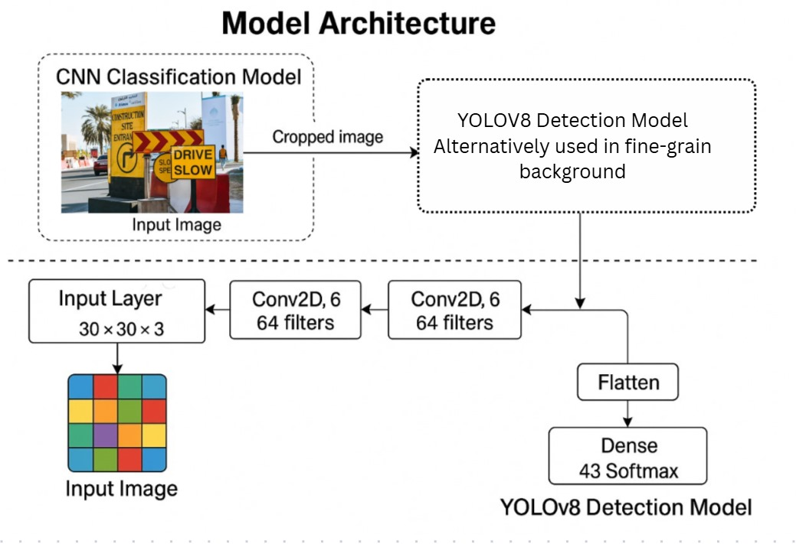
Proposed System Model
The system consists of two main modules:
1. CNN Classifier – Performs fine-grained classification
on cropped sign regions to recognize exact categories.
2. YOLOv8 Detector – Identifies and localizes traffic signs
in real-time using BiFPN for enhanced multi-scale detection
Workflow: Input → Preprocessing (Cleaning,
Normalization, Augmentation) → CNN Classification → YOLOv8 Detection → Output with Labels.
Tools: Python, OpenCV, PyTorch, Keras, Albumentations, LabelImg, Google Colab.

Slide 7
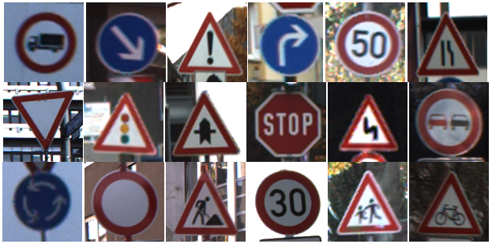
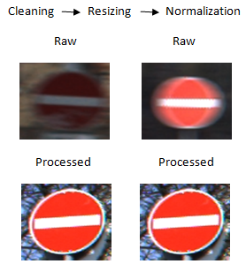
Simulation Setup
Dataset Implemented:
1. German Traffic Sign Recognition Benchmark
(GTSRB) - A widely used benchmark dataset for traffic
sign recognition containing over 50,000 labeled images.
2. Includes 43 distinct classes such as speed limits,
prohibitory signs, direction indicators, and warning signs.
3. Tested on real-world images robustness.
Preprocessing Steps: Cleaning → Resizing (30×30 for CNN,
640×640 for YOLO) → Normalization → Augmentation
(To improve robustness, the dataset is augmented with multiple
transformations of rotation, brightness, blur, occlusion simulation).

Slide 8
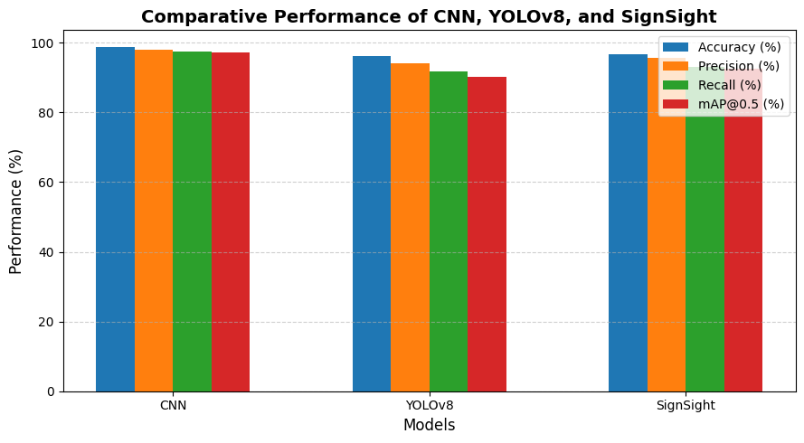
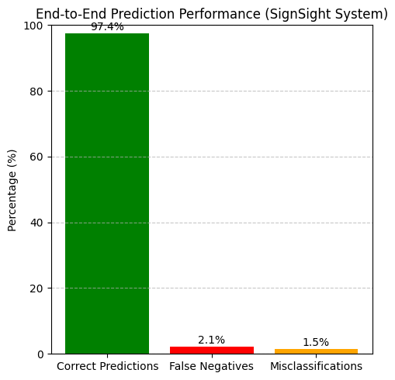
Results and Discussions
CNN Training : The lightweight CNN classifier was trained to achieve a validation accuracy of 97.4%
YOLOv8 Detection : Fine-tuned YOLOv8 on the GTSRB dataset in YOLO format achieved a detection
accuracy of 98.7% when tested on both benchmark and real-world images.
Performance Metrics: Evaluated using Precision, Recall, F1-Score and Confusion Matrix which
collectively confirmed reliable detection and classification.

Slide 9
Conclusion & Future Work
SignSight successfully integrates YOLOv8 for detection and a lightweight CNN for classification,
achieving real-time and weather-resilient traffic sign perception.
The model delivers high accuracy (98.7%) and fast inference speed, ensuring suitability for edge and IoT-
based deployment.
Effectively handles occlusion, blur, and poor illumination, improving the reliability of autonomous and
intelligent transportation systems.
Future Enhancements
1. Weather Simulation: Incorporate synthetic rain, fog, and night-driving conditions
2. Multi-Modal Integration: Combine camera + LIDAR/Radar for improved perception under extreme
weather conditions.
3. Edge Optimization: Apply quantization and pruning for deployment on Jetson NanoRaspberry Pi devices.
4. Regional & Scalable Adaptation: Extend model to regional sign datasets (e.g., Indian traffic signs)

Slide 10
References
[1] J. Qiu, W. Zhang, S. Xu, and H. Zhou: “DP-YOLO: A Lightweight Traffic Sign Detection Model for
Small Object Detection” (Digital Signal Processing, vol. 165, p. 105311, 2025).
[2] H. Zhang, M. Liang, and Y. Wang: “YOLO-BS: A Traffic Sign Detection Algorithm Based on YOLOv8”
(Scientific Reports, vol. 15, no. 1, p. 7558, 2025).
[3] C. Du, S. Su, C. Lin, Y. Yao, R. Jin, and X. Hong: “A Lightweight Network for Traffic Sign Detection
via Multiple Scale Context Awareness and Semantic Information Guidance (MASG-Net)”
(Scientific Reports, vol. 15, no. 1, p. 10110, 2025).
[4] H. N. Tran, N. N. N. Nguyen, N. Q. P. Le, and A. D. Nguyen: “Grounding DINO and Distillation-
Enhanced Model for Advanced Traffic Sign Detection and Classification in Autonomous Vehicles”
(Pattern Recognition, vol. 138, pp. 109245–109256, 2025).
[5] R. Megalingam, K. Thanigundala, S. Musani, and L. Gadde: “Indian Traffic Sign Detection and
Recognition Using Deep Learning” (Sensors, vol. 25, no. 6, pp. 2351–2366, 2025.)

Slide 11
Reviewer Comments Addressed
Enhanced English Proficiency: The manuscript’s language has been thoroughly revised for improved grammar, clarity, and academic tone, ensuring better readability and precision.
Improved Figure Quality: All figures have been updated to high-resolution versions with refined labeling and enhanced visual clarity compared to the previous submission.
Inclusion of Mathematical Equations: Key mathematical formulations and expressions have been incorporated wherever necessary to strengthen the technical depth and theoretical explanation.
Standardized References: The reference list has been reformatted to adhere strictly to IEEE citation standards, ensuring consistency and correctness across all entries.
Added Comparative Analysis: A comparative graph and performance study have been included, clearly illustrating the advantages of the hybrid CNN–YOLOv8 approach over standalone models in terms of accuracy, precision, and robustness.

Slide 12
Thank You

