Slide 1

Department of Computer Science and Engineering
AquaNet-X: A Deep Hybrid Ensemble Model for Accurate Real-Time Water Quality Index Prediction
PRESENTED BY
Adhikari Satish (22471A05E1)
Tullibilli Lakshmi Siva Sai (22471A05G8)
Pallapu Harish (22471A05I1)
Under the Guidance of
Sivaratri Siva Nageswara Rao, _{M.Tech.,}
Professor
Department of Computer Science and Engineering,
Narasaraopeta Engineering College (Autonomous), Narasaraopet- 522 601.
Review No.01
Batch No.CB4
Department of CSE
1

Slide 2
OUTLINE
Abstract
Introduction
Problem Statement
Literature Survey
Research Gaps
Objectives
Methodology
Block Diagram / Flow Diagram
Implementation
Results and Analysis
Conclusion & Future Scope
References
Question and Answers
Acknowledgements
Review No.01
Batch No.CB4

Slide 3
ABSTRACT
Water quality plays a vital role in protecting public health, agriculture, and ecosystems, yet real-time monitoring remains a challenge due to irregular sampling, regional variations, and the limitations of traditional prediction models. To address these gaps, this paper introduces AquaNet-X, a novel deep hybrid ensemble model designed for accurate and scalable Water Quality Index (WQI) prediction. AquaNet-X integrates Bidirectional GRU for sequential dynamics, Transformer layers for capturing long-range feature dependencies, and boosting algorithms (XGBoost and LightGBM) for nonlinear tabular interactions, all unified through a Meta-CatBoost stacked learner. This architecture balances the strengths of deep learning and ensemble methods, reducing variance while enhancing interpretability and robustness. This experiment was conducted using a real-world Indian surface water quality dataset with multivariate parameters such as pH, DO, BOD, and temperature, preprocessed into supervised sequences. The proposed model achieving 99.94% prediction accuracy, thereby setting a new state-of-the-art benchmark, significantly outperforming existing baselines. The novelty of AquaNet-X lies in its meta-layered hybridization strategy, which enables cross-regional adaptability, real-time deployment, and reliable generalization across diverse water sources. It is better way to predict water quality index in different regions based on multivariate features. AquaNet-X is a next-generation tool for intelligent water quality monitoring and sustainable water governance.
Review No.01
Batch No.CB4

Slide 4
INTRODUCTION
Water quality plays a vital role in public health, agriculture, and ecological balance. Continuous monitoring helps detect contamination and maintain sustainable water management systems.
Traditional water quality monitoring methods are slow, manual and time-consuming, while existing machine learning models lack interpretability and adaptability, often failing to handle diverse environmental and sensor data variations across different water conditions.
To overcome these issues, AquaNet-X integrates Bi-GRU, Transformer, XGBoost, and LightGBM within a Meta-CatBoost stacked framework for improved adaptability and robustness.
The Bi-GRU model captures short-to-mid temporal dependencies, the Transformer handles long-range feature interactions, and the boosting models address nonlinear tabular relationships. The Meta-CatBoost layer fuses these insights for improved precision and reliability.
Trained on real Indian surface water data (pH, DO, BOD, Temperature, etc.), the model achieves high accuracy and demonstrates high scalability, adaptability to noisy and regionally diverse data, and readiness for IoT-enabled real-time water quality monitoring.
Review No.01
Batch No.CB4

Slide 5
PROBLEM STATEMENT
Lack of Real-Time Monitoring:
Traditional water quality assessment depends on manual sampling and laboratory testing, which delays detection of contamination and prevents timely action.
Poor Model Generalization:
Existing machine learning models often fail to perform consistently across regions because of variations in environmental factors and sensor data.
Limited Interpretability and Adaptability:
Deep learning models like LSTM or GRU often overfit small or irregular environmental datasets, providing limited interpretability, adaptability and trustworthiness.
Scalability Constraints:
Most predictive frameworks are not optimized for large-scale or real-time data from IoT and sensor networks, limiting their deployment in smart water management systems.
Need for a Robust Hybrid Framework:
There is a growing demand for an ensemble-based model that effectively integrates temporal, spatial, and nonlinear dependencies to deliver accurate, explainable, and real-time Water Quality Index (WQI) forecasts.
Review No.01
Batch No.CB4

Slide 6
LITERATURE SURVEY
No | Title | Author | Journal Name & Year | Methodology Adapted | Key Findings | Gaps
1 | A Hybrid Deep Learning Model for Water Quality Prediction | Qiliang Zhu, Xueting Yu, Liang Zhao, Linjun Xu | https://doi.org/10.1109/ACCESS.2025.3580741 & 2025 | CEEMDAN + LSTM + CNN + Self-Attention | Proposed a novel hybrid model combining CEEMDAN, LSTM, CNN, and Self-Attention. | Less Accuracy and Relatively complex architecture
2 | Recent Trends in the Quality Module of Sustainable Water Management Models – A Systematic Review | C. Subashini, S. Sellamuthu | https://doi.org/10.1109/ACCESS.2025.3560783 & 2025 | Convolutional Neural Network (CNN), ANN, XGBoost | Ensemble trees were top performers and enhance water quality prediction, with high accuracy | lack of real-time predictions, poor generalizability to rare pollutants, high computational cost
3 | Advancing Water Quality Management: An Integrated Approach Using Ensemble Machine Learning and Real-Time Interactive Visualization | Jigna K. Pandya, Suresh S. Khandelwal, Rupesh Kumar Tipu, Kartik S. Pandya | https://doi.org/10.1109/ACCESS.2025.3573589 & 2025 | Decision Tree, Random Forest, GBM, XGBoost, Neural Networks, Transformer-based model; Stacked Ensemble with Logistic Regression meta-learner | Developed a robust ensemble model achieving 96.7% accuracy; introduced a real-time interactive dashboard for stakeholders. | limited dataset size, need for external validation and lack of multivariate modeling in existing threshold based approaches.
4 | Gated-LNN: Gated Liquid Neural Networks for Accurate Water Quality Index Prediction and Classification | Sreeni Chadalavada et al. | https://doi.org/10.1109/ACCESS.2025.3561593 & 2025 | Gated Liquid Neural Network (Gated-LNN) with sigmoid & tanh gates, Adam optimizer | Achieved 0.9995 R² in WQI prediction and 99.74% accuracy in classification and demonstrates real time monitoring | Model is compute-heavy and lacks interpretability
5 | Combining the Improved RGB Water-Filling Algorithm With Penumbra Removal Technique for Shadow Removal From Digitized Images | You-Chang Liu & Cheng-Ta Chuang | https://doi.org/10.1109/ACCESS.2025.3555302 & 2025 | RGB Water-Filling Algorithm, Penumbra Removal, background reconstruction, and post-processing with gamma correction | improve shadow removal efficiency, reducing RMSE and enhancing PSNR and SSIM, | effective shadow removal techniques for improving image quality and document readability.
Review No.01
Batch No.CB4

Slide 7
RESEARCH GAPS
Limited generalization of existing models across different regions and water conditions.
Poor handling of irregular or missing water quality data samples.
Inadequate real-time prediction and deployment capabilities.
Lack of integration between deep learning and ensemble boosting methods.
Insufficient interpretability and robustness under noisy environmental conditions.
Absence of scalable meta-stacked architectures(like Meta-CatBoost) that can intelligently fuse multiple model predictions to improve reliability and cross-regional adaptability.
Review No.01
Batch No.CB4

Slide 8
OBJECTIVES
To develop a robust deep hybrid ensemble model for accurate real-time Water Quality Index (WQI) prediction.
To capture both short- and long-term temporal dependencies and nonlinear feature relationships through the combination of recurrent and attention-based architectures.
To achieve high accuracy, low error, and improve strong generalization and robustness in WQI forecasting.
To enhance model adaptability across diverse regions and varying water conditions.
To evaluate deep hybrid ensemble model and it establish state-of-the-art accuracy.
To design and implement AquaNet-X, a meta-stacked ensemble integrating Bi-GRU, Transformer, XGBoost, and LightGBM models for robust Water Quality Index (WQI) prediction.
Review No.01
Batch No.CB4

Slide 9
METHODOLOGY
Data Sources: Real-world Indian surface water quality dataset with multivariate parameters such as pH, Dissolved Oxygen (DO), Biochemical Oxygen Demand (BOD), Temperature (TEMP), Faecal Streptococci (FS), Total Coliform (TC), Faecal Coliform (FC), Conductivity (COND), and Nitrate(NO₃).
Data Range: 2012–2025.
Preprocessing: clean column names, remove duplicates and fill missing numeric values with sensible imputations., normalization/scale features (StandardScaler).
Modeling: Meta-CatBoost Layer stacks Bi-GRU, Transformer, XGBoost, LightGBM. Bi-GRU learns short-to-mid-term temporal dependencies, Transformer captures long-range feature relationships, XGBoost & LightGBM handles tabular relationships and nonlinear decision boundaries, providing strong feature-level generalization and Meta-CatBoost layer serves as a higher-level learner, combining outputs from all base models.
Evaluation : Evaluate with R², RMSE, MAE, prediction-interval checks and Confusion Matrix.
Review No.01
Batch No.CB4

Slide 10
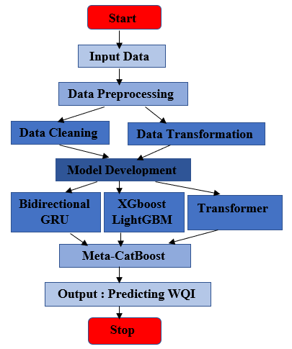
FLOW DIAGRAM
Fig.1: Working Process
Review No.01
Batch No.CB4

Slide 11
IMPLEMENTATION
Install Packages and Import models:
!pip install xgboost lightgbm catboost --quiet
!pip install "scikit-learn<1.7,>=1.2"
!pip install tensorflow --quiet
import pandas as pd # Data Handling
import numpy as np
import matplotlib.pyplot as plt # Visualization
import seaborn as sns
from sklearn.model_selection import train_test_split
from sklearn.preprocessing import StandardScaler
from sklearn.metrics import r2_score, mean_squared_error, mean_absolute_error
import tensorflow as tf # Deep Learning (Keras/TensorFlow)
from tensorflow.keras.models import Model, Sequential
from tensorflow.keras.layers import Input, GRU, Bidirectional, Dense, Dropout, LayerNormalization, MultiHeadAttention,
from xgboost import XGBRegressor # ML Models
from lightgbm import LGBMRegressor
from catboost import CatBoostRegressor
Mounted Google Colab & Load CSV file:
from google.colab import drive
drive.mount('/content/drive’)
data=pd.read_csv('/content/drive/MyDrive/Project/Dataset/Results_MADE.csv')
df=pd.DataFrame(data)
Remove Spaces and Duplicates:
df.columns = df.columns.str.strip().str.replace(r'\s+', '_’,regx=T)
print(df.columns)
df =df.fillna(df.mean(numeric_only=True)).drop_duplicates()
Correlation Heatmap:
plt.figure(figsize=(6, 4))sns.heatmap(df.corr(numeric _only = True), annot=True,cmap='coolwarm', fmt=".2f",linewidths=0.5)
plt.title("Correlation Heatmap of Water Quality Parameters").tight_layout()
plt.show()
Review No.01
Batch No.CB4

Slide 12
IMPLEMENTATION
StandardScaler, Train-Test Split and Reshape:
scaler = StandardScaler()
X_scaled = scaler.fit_transform(X)
X_train, X_test, y_train, y_test = train_test_split(X_scaled, y.values, test_size=0.2, random_state=42)
X_train_seq = X_train.reshape((X_train.shape[0], 1, X_train.shape[1]))
X_test_seq = X_test.reshape((X_test.shape[0], 1, X_test.shape[1]))
Build GRU model:
gru_model = Sequential([Input(shape=(1, X_train.shape[1])), Bidirectional(GRU(256, return_sequences=True)),Dropout(0.3),GRU(128),
Dense(64, activation='relu'),Dense(1)])
gru_model.compile(optimizer='adam', loss='mse')
gru_model.fit(X_train_seq, y_train, validation_split=0.1, epochs=300, batch_size=32, verbose=0)
y_gru_pred = gru_model.predict(X_test_seq, verbose=0).flatten()
XGBoost Model:
xgb_model = XGBRegressor(n_estimators=200, learning_rate=0.05, max_depth=6, random_state=42, verbosity=0).fit(X_train, y_train)
y_xgb_pred = xgb_model.predict(X_test)
Build Meta-CatBoost Model and CatBoost Regressor:
from catboost import CatBoostRegressor
stack_X = np.vstack([y_gru_pred, y_xgb_pred, y_trans_pred,y_lgb_pred]).T
stack_Y = np.vstack([y_gru_pred1, y_xgb_pred1, y_trans_pred1,y_gru_pred1]).T
meta_cat = CatBoostRegressor(iterations=500,Learn ing_rate=0.03,depth=6,verbose=0,random_seed=42)
meta_cat.fit(stack_X, y_test)
y_meta_cat_pred = meta_cat.predict(stack_X)
Evaluation Metrics:
print(f"R:{r2_score(y_test,y_meta_cat_pred):.4f})
print(f"RMSE: {np.sqrt(mean_squared_error(y_test, y_meta_cat_pred)):.2f}")
print(f"MAE:{mean_absolute_e( y_meta_cat_pred)}")
Review No.01

Slide 13
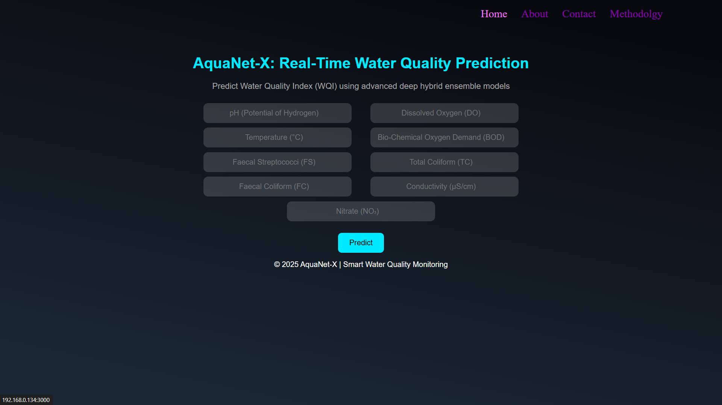

Slide 14
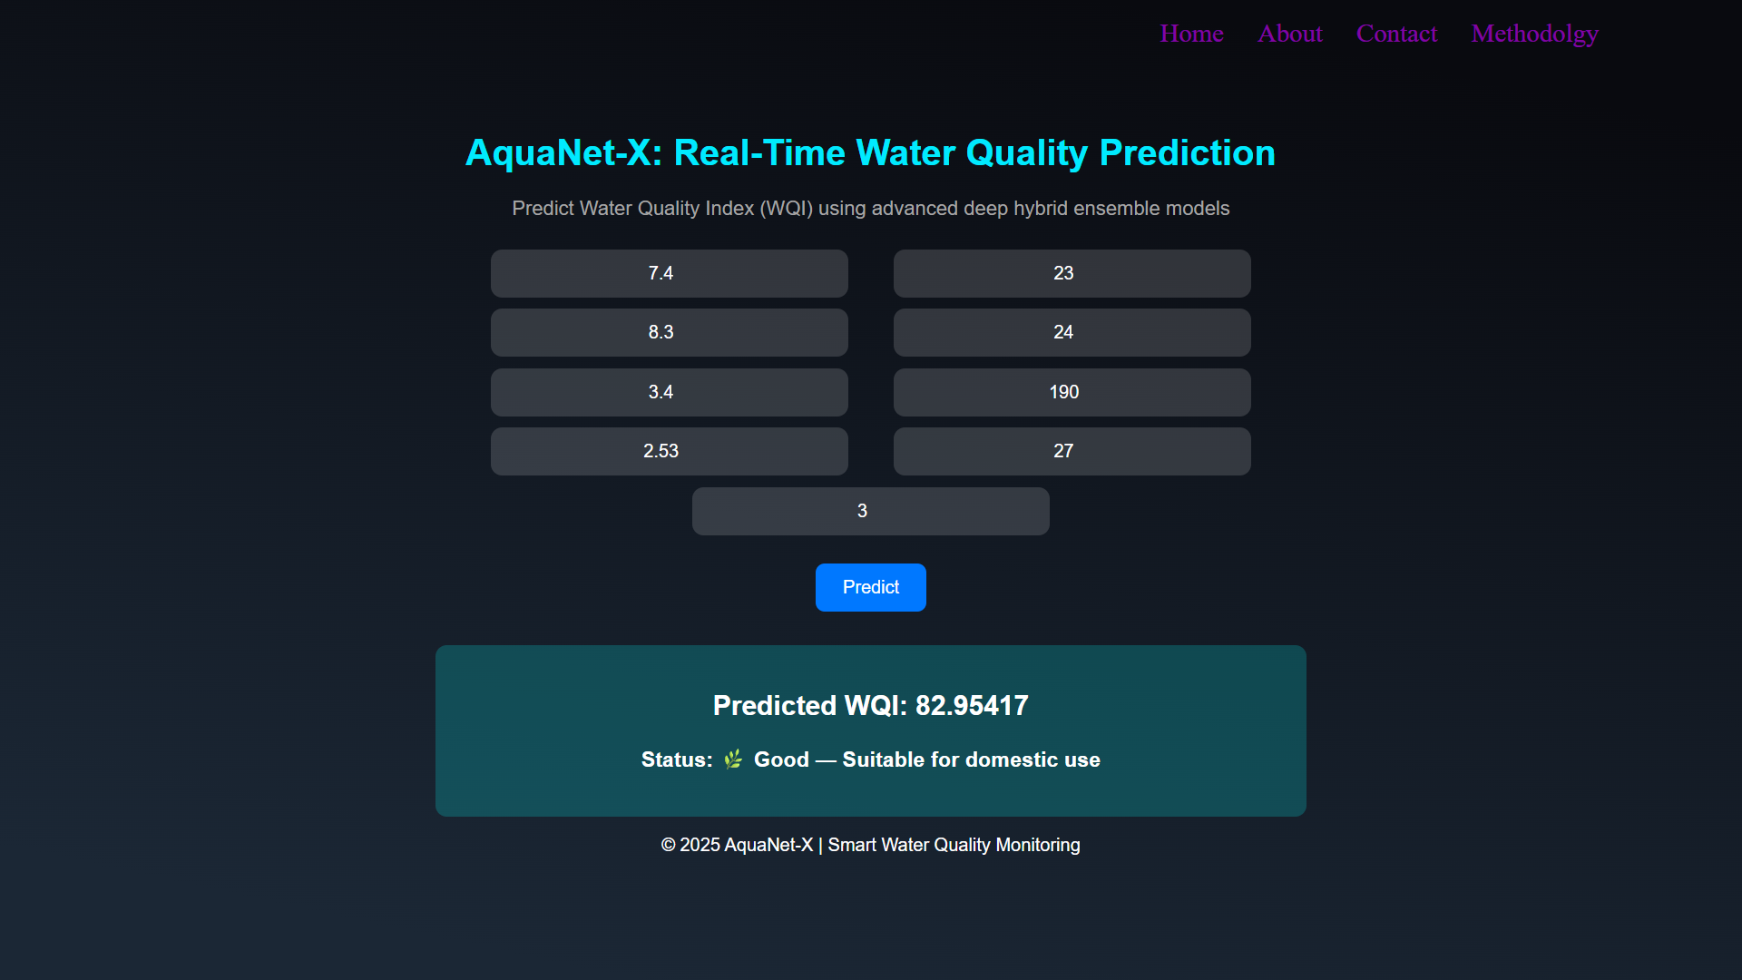

Slide 15
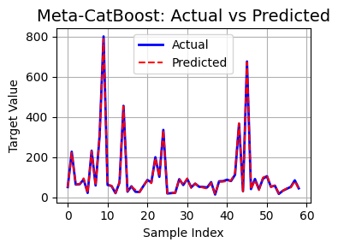
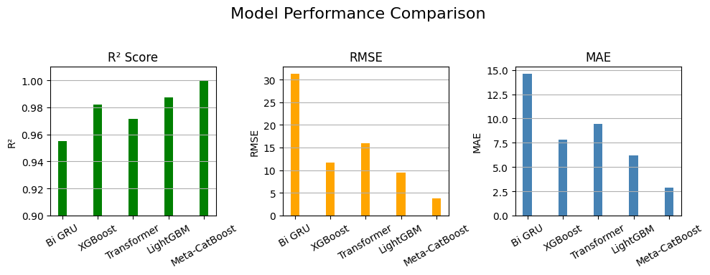
RESULTS & ANALYSIS
Fig.1: Training of Meta-CatBoost Layer
Fig.2: Model Performance Comparison
The AquaNet-X model achieved exceptional predictive accuracy with an R² of 0.9994, RMSE of 3.64, and MAE of 2.83, significantly outperforming individual models like Bi-GRU, Transformer, XGBoost, and LightGBM. The hybrid stacked ensemble effectively captured both temporal and nonlinear feature relationships, leading to stable WQI.
The Meta-CatBoost layer enhanced model generalization by intelligently fusing the base model predictions, reducing residual errors and overfitting.
AquaNet-X demonstrated higher robustness against noisy or region-specific variations, proving its suitability for real-time water quality monitoring and smart environmental management systems.
Review No.01
Batch No.CB4

Slide 16
CONCLUSION & FUTURE SCOPE
Conclusion:
AquaNet-X redefines water quality prediction using a meta-stacked hybrid ensemble model and it effectively captures temporal, spatial, and nonlinear dependencies.
Achieved 99.94% accuracy, outperforming traditional and deep learning baselines.
Its adaptive and interpretable design makes it ready for real-world deployment.
Represents a step toward smart, scalable, and trustworthy water management systems and ensures robustness, interpretability, and scalability.
Future Enhancement:
Expand dataset with multi-national water records for broader generalization.
Integrate IoT sensor and satellite data.
Implement blockchain-based secure reporting.
Extending the model to forecast contaminant-specific predictions.
Review No.01
Batch No.CB4

Slide 17
REFERENCES
Q. Zhu, F. He, and C. Yu, ”CEEMDAN-LSTM-CNN with self-attention for robust water forecasting,” IEEE Trans. Neural Network. Learn. Syst., vol. 36, no. 4, pp. 1234–1245, 2025.
S. Subashini and T. Sellamuthu, ”Intelligent hybrid frameworks for adaptive water quality modeling using IoT and remote sensing,” IEEE Internet Things J., vol. 11, no. 5, pp. 4400–4410, 2025.
S. Pandya, ”Hybrid ensemble dashboards for cross regional water quality prediction,” IEEE Sustain. Comp. Lett., vol. 13, no. 2, pp. 92–99, 2025.
S. Dey and T. Roy, ”Meta-learning ensemble integrator for generalizable basin prediction,” IEEE Trans. Water Compute., vol. 3, no. 2, pp. 101–109, 2025.
Z. Liu and H. Chuang, ”Enhanced water image preprocessing via RGB water-filling with shadow correction,” IEEE Trans. Image Process., vol. 34, no. 6, pp. 2104–2116, 2025.
R. Desai and M. Kulkarni, ”Temporal water quality forecasting using hybrid CNN-GRU architecture,” in Proc. 2023 IEEE Int. Conf. on Sustainable Computing, pp. 58-65, 2023.
Review No.01
Batch No.CB4

Slide 18

Review No.01
Batch No.CB4

Slide 19

Review No.01
Batch No.CB4

