Slide 1
AquaNet-X: A Deep Hybrid Ensemble Model for Accurate Real-Time Water Quality Index Prediction
Authors : Sivaratri Siva Nageswara Rao, Adhikari Satish, Tullibilli Lakshmi Siva Sai, Pallapu Harish, Mallikarjuna Rao Gundavarapu, Patri Venkata Sesha Sudha Arundathi Parimala, Dodda Venkatarededy

Slide 2
Introduction
• Water quality plays a vital role in protecting public health, agriculture, and ecosystems.
• Traditional ML models lack adaptability and fail under irregular or noisy sampling conditions.
• This study introduces AquaNet-X, aims to provide accurate, real-time Water Quality Index (WQI) predictions.
• Combines deep learning and ensemble models for better performance and generalization.

Slide 3
Dataset Description
• Source: Indian Surface Water Quality Dataset from Kaggle.
• Size: 295 samples, 10 key parameters such as: pH(Potential of Hydrogen), Dissolved Oxygen(DO), Temperature(Temp), Bio-Chemical Oxygen Demand(BOD), Faecal Streptococci(FS), Total Coliform(TC), Faecal Coliform(FC), Conductivity(Cond), Nitrate(NO3) and Water Quality Index(WQI).
• Target variable: Water Quality Index (WQI).
• Data includes seasonal, spatial, and temporal diversity for robust generalization.

Slide 4
Proposed Methodology
Model Components:
Bi-GRU: Captures short-to-mid temporal patterns.
Transformer: Learns long-range dependencies using self-attention.
XGBoost & LightGBM: Handle non-linear feature interactions for strong tabular predictions.
Meta-CatBoost: Fuses all model outputs for final prediction.
Implemented in Python using TensorFlow, XGBoost, and LightGBM libraries.

Slide 5
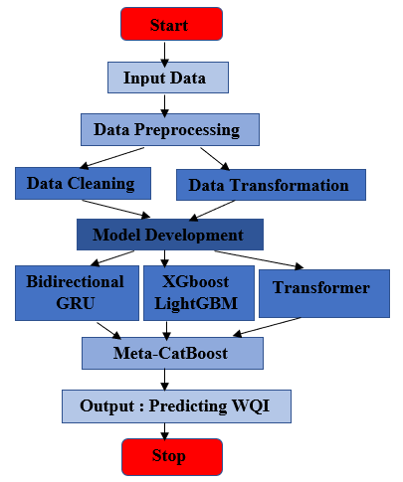
AquaNet-X Model Architecture
• Four specialized base models combined in a stacked architecture.
• Meta-CatBoost acts as a meta-learner that merges all predictions.
• Designed for interpretability, scalability, and high precision.
• Trained using 300 epochs, batch size = 32, learning rate = 0.001 (deep) / 0.05 (boosting).

Slide 6
Results and Comparative Analysis
• AquaNet-X achieved state-of-the-art performance:
R² = 0.9994
RMSE = 3.64
MAE = 2.83
• Outperformed CNN–GRU, BiGRU–CatBoost, Transformer-only, and LightGBM–Deep hybrids.
• Meta-CatBoost reduced variance and enhanced cross-regional adaptability.
• Achieved 99.94% prediction accuracy—new benchmark for WQI prediction.

Slide 7
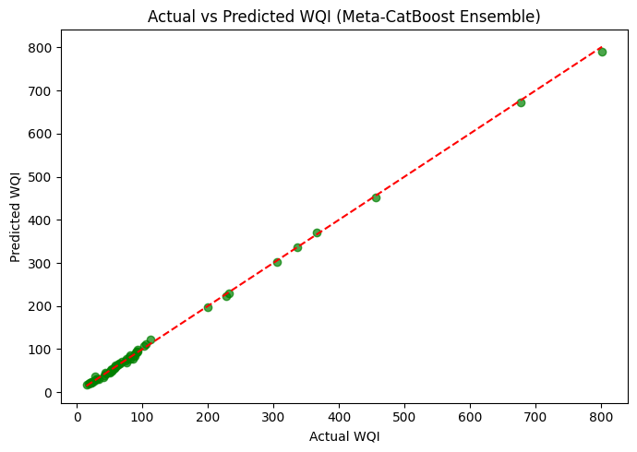
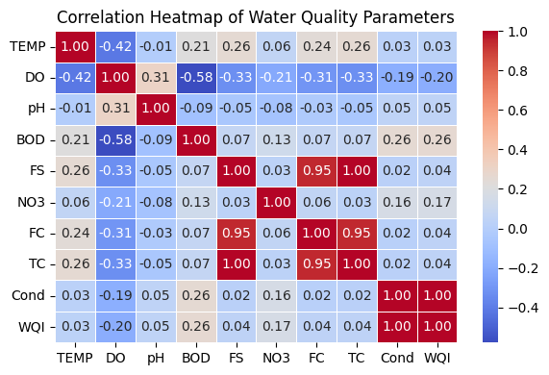
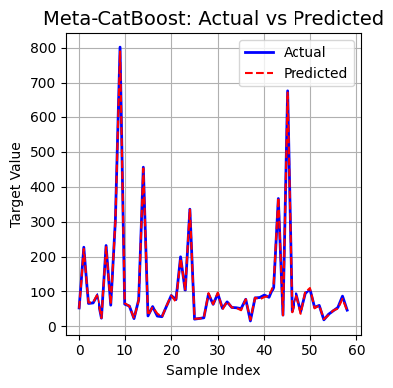
Visual Results
• Figures:
– Actual vs Predicted WQI shows near-perfect alignment.
– Meta-CatBoost training graph demonstrates rapid and stable convergence.
• Heatmap illustrates feature correlation and redundancy avoidance.

Slide 8
Novelty and Key Contributions
Novel meta-layered hybrid ensemble model Combines deep sequential and boosting models.
Superior generalization across regions and noisy data.
High interpretability and scalability.
Ready for IoT-enabled and blockchain-secured real-time monitoring applications.

Slide 9
Future Work and Limitations
Limitation: Small dataset (295 samples) restricts scalability.
Overfitting risk under extreme noise or small sample regions.
Computation cost slightly higher for real-time deployment.
Future Enhancements:
Expand dataset with multi-national water records for broader generalization.
Integrate IoT sensor and satellite data.
Include contaminant-specific prediction modules.
Implement blockchain-backed secure reporting.
Optimize for low-resource devices using pruning/distillation.

Slide 10
Conclusion
AquaNet-X achieved 99.94% accuracy with strong generalization.
Combines GRU, Transformer, and boosting models for robustness.
Meta-CatBoost fusion ensures reliability across conditions.
Provides a foundation for intelligent, real-time water monitoring systems.
Its adaptive and interpretable design makes it ready for real-world deployment.
Represents a step toward smart, scalable, and trustworthy water management systems.

