Slide 1

PrivLogEdu: An Innovative Framework for Real-Time Engagement Recognition in Hybrid Classrooms Using Non-Visual Log Data While Maintaining Privacy
PRESENTED BY
Palutla Venkata Naveen (22471A05I2)
Jonnalagadda Mahesh Babu (22471A05F9)
Under the Esteemed Guidance of
Dr.Sighakolli Naga Tirumala Rao M.Tech , Ph.D ,
Professor & HOD of CSE
Department of Computer Science and Engineering,
Narasaraopeta Engineering College (Autonomous),
Narasaraopet - 522 601.

Slide 2
OUTLINE
Abstract
Introduction
Literature Survey
Research Gaps
Problem Statement
Objectives
Block Diagram
Methodology
Implementation
Results and Analysis
Conclusion & Future Scope
References
Acknowledgement
Q&A

Slide 3

ABSTRACT
This work presents PrivLogEdu, a novel method for real-time engagement detection that supports United Nations Sustainable Development Goal (SDG) 4: Quality Education.
It ensures high prediction accuracy and strong privacy protection by using non-visual log data instead of vision-based methods.
It leverages behavioral logs like problem-solving sequences, time-on-task, and skill-switching patterns to infer engagement levels.
The pipeline uses preprocessing, feature engineering, Skill2Vec embeddings, and a GRU-attention deep neural architecture.
The model classifies engagement into three levels (low, moderate, high).
It achieved an accuracy of 99.91% on the EdNet-KT1 dataset, outperforming baseline LSTM and
Transformer models.

Slide 4
INTRODUCTION
AI integration has significantly altered the interaction between learners and instructors in virtual learning environments.
Effective engagement monitoring is essential for realizing SDG 4 (inclusive and equitable quality education).
The Challenge
Traditional systems use visual indicators like facial expressions and eye-tracking. These visual methods pose major privacy challenges, implementation costs, and adaptability issues. Visual data collection often conflicts with institutional policies and ethical principles.
The Solution
Log-based behavioral data (response times, skill switching) is a credible, non-intrusive source for understanding student engagement.
PrivLogEdu applies a GRU-attention model to these non-visual logs to achieve high accuracy while addressing ethical and privacy concerns.

Slide 5
LITERATURE SURVEY
No | Author / Year | Methodology Adapted | Key Findings
1 | Kumar et al. (2025) | . Clickstream data + temporal modeling | Clickstream data + temporal modeling
2 | Li et al. (2025) | Federated learning framework using interaction logs | Predicted learners' attention spans while adhering to institutional data privacy regulations
3 | Lee et al. (2025) | Analysis of visual models | Showed that lighting, occlusions, and cultural discrepancies drastically lower the accuracy of visual emotion detection

Slide 6
No | Author / Year | Methodology Adapted | Key Findings
4 | Huang et al. (2024) | Graph Neural Networks (GNNs) for inter-skill relationships | Found that contextualized skill embeddings improved model interpretability
5 | Wu et al. (2024) | Attention-enhanced GRUs | Attained a 15% F1-score improvement over baseline RNNs on engagement datasets
6 | Zhang et al. (2024) | Transformer variants for session analysis | Attained state-of-the-art accuracy using the EdNet-KT1 dataset

Slide 7
RESEARCH GAPS
Privacy vs. Precision : Most current solutions either sacrifice precision to preserve privacy or are not robust enough for real-time inference.
Lack of Multi-Class Detection : Multi-class engagement detection (low, medium, high) is not adequately explored; most work focuses on binary classification.
Class Imbalance : Current models (often 80-90% accuracy) have difficulty with class imbalance and session variability.
The Need
There is an urgent need for models that combine high accuracy, privacy protections, advanced feature engineering, and robust sequence modeling.

Slide 8
PROBLEM STATEMENT
Current engagement recognition systems heavily depend on visual indicators (like facial expressions and eye-tracking). This reliance creates significant privacy-related challenges, high implementation costs, and adaptability issues for large-scale hybrid environments. This approach often violates institutional policies and ethical principles regarding personally identifiable information. Therefore, a non-intrusive, privacy-preserving procedure is required to effectively and accurately measure learner engagement.

Slide 9
OBJECTIVES
To design a novel, privacy-preserving framework (PrivLogEdu) for real-time engagement detection using non-visual log data
To apply sophisticated feature engineering and Skill2Vec embeddings to convert raw logs into meaningful behavioral and temporal features
To develop and implement a GRU-attention deep learning architecture tailored for educational sequence modeling
To accurately classify student engagement into three distinct levels: low, moderate, and high
To evaluate the model and demonstrate superior performance over baseline models like LSTM and Transformer on the EdNet-KT1 dataset
To provide a scalable solution that supports UN Sustainable Development Goal (SDG) 4 (Quality Education) by protecting learner privacy

Slide 10
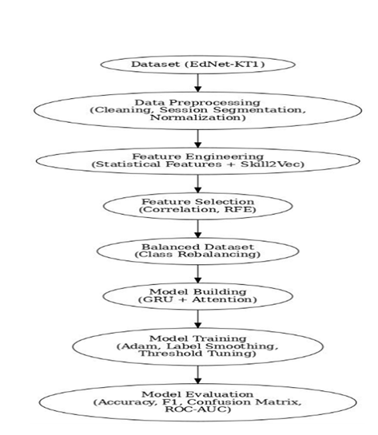
BLOCK DIAGRAM OR FLOW DIAGRAM

Slide 11
METHODOLOGY AND FEATURE ENGINEERING
Dataset: EdNet-KT1 dataset.
Input Data: Behavioral and temporal log data: problem-solving sequences, time-on-task, and skill-switching patterns.
Preprocessing: Sessions were segmented based on 30 minutes of inactivity; used class balancing and label smoothing.
Feature Engineering (Skill2Vec Embeddings):
Purpose: To capture semantic relationships between different skills.
Method: Word2Vec models were trained on sequences of skill IDs.
Result: Skills frequently co-occurring in learning sequences are mapped closer in a dense vector space.

Slide 12
Methodology: GRU-Attention Architecture
The core of the PrivLogEdu model is a GRU network augmented with an attention mechanism.
Component | Function
GRU Network | Effectively captures the temporal dependencies and sequential nature of the student’s log data.
Attention Machanism | Allow the system to pay attention to the most important behavioral features or contextually relevant student actions.
Output | Provides engagemet classification at three levels: low,moderate, and high.

Slide 13
System Requirements
Hardware Requirements
Processor : intel Core i5
Cache memory : 4MB(Megabyte)
RAM : 12.7GB (gigabyte)
Hard Disk : 166.8GB
Compute Engine : T4 GPU
Software Requirements
Operating System : Windows 10, 64-bit OS
Coding Language : Python
Python distribution : Google Colab Pro , Flask
Browser : Any Latest Browser like Chrome

Slide 14
IMPLEMENTATION
import pandas as pd, numpy as npdata = pd.read_csv('EdNet-KT1.csv')data = data.dropna()data['timestamp'] = pd.to_datetime(data['timestamp'])data = data.sort_values(['student_id','timestamp'])Each student’s session sequence is grouped and aggregated:sessions = data.groupby('student_id').apply( lambda x: np.array_split(x, np.where(np.diff(x['timestamp'])>1800)[0]+1))Feature scaling ensures numerical stability:from sklearn.preprocessing import MinMaxScalerscaler = MinMaxScaler()scaled = scaler.fit_transform(data[['time_taken']])data['scaled_time'] = scaled

Slide 15
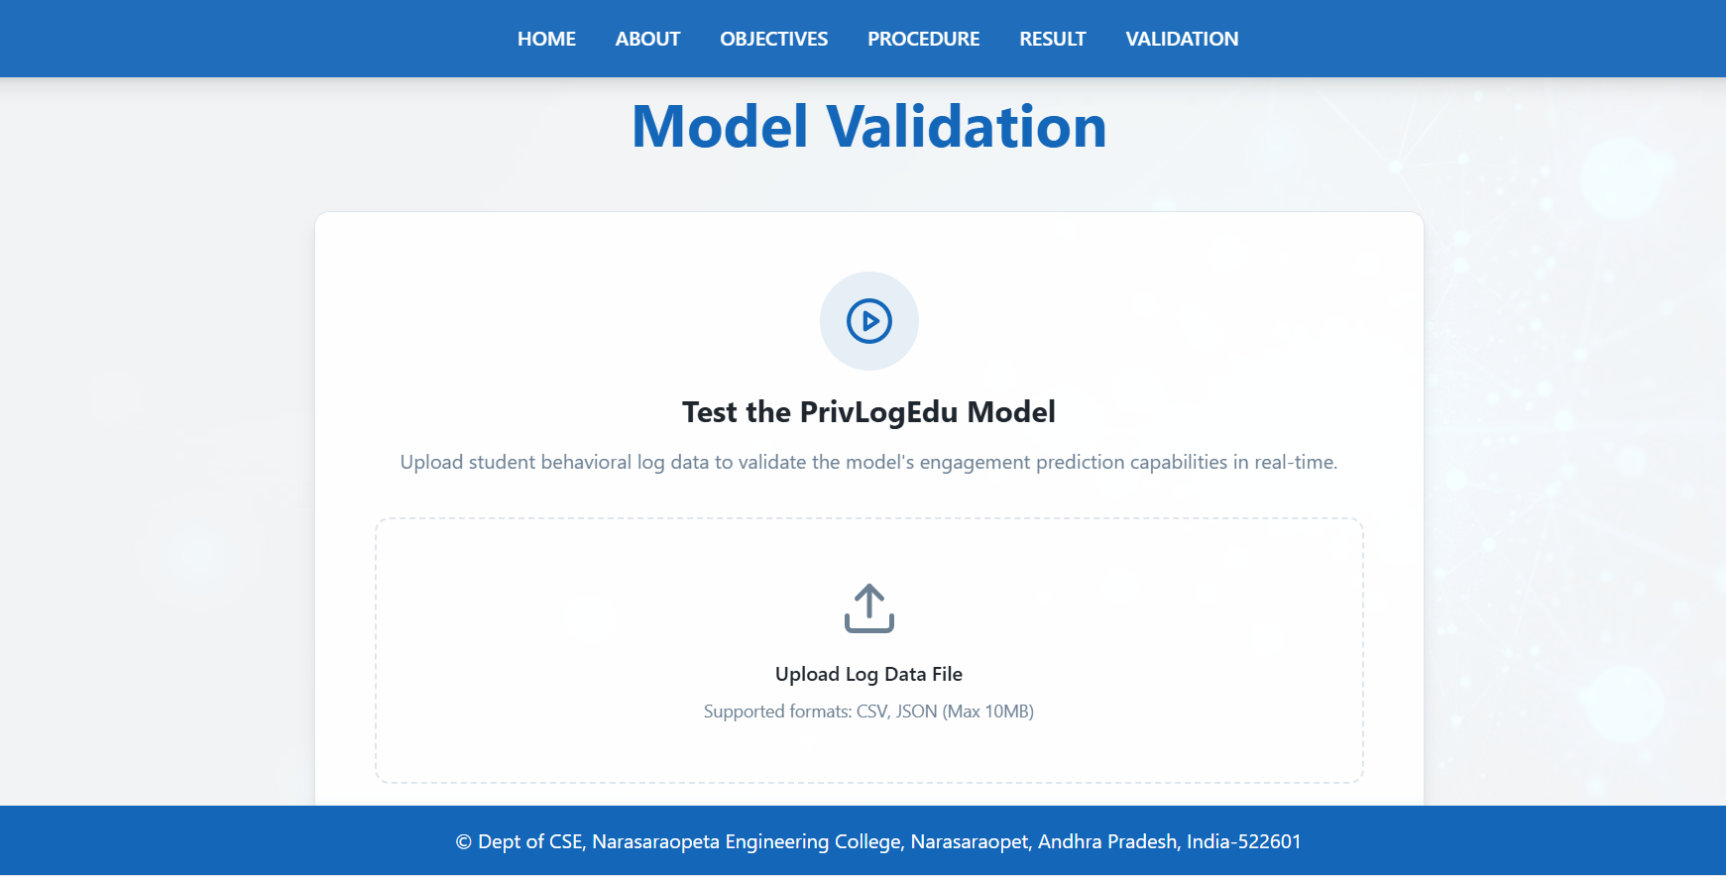
Prediction Page

Slide 16
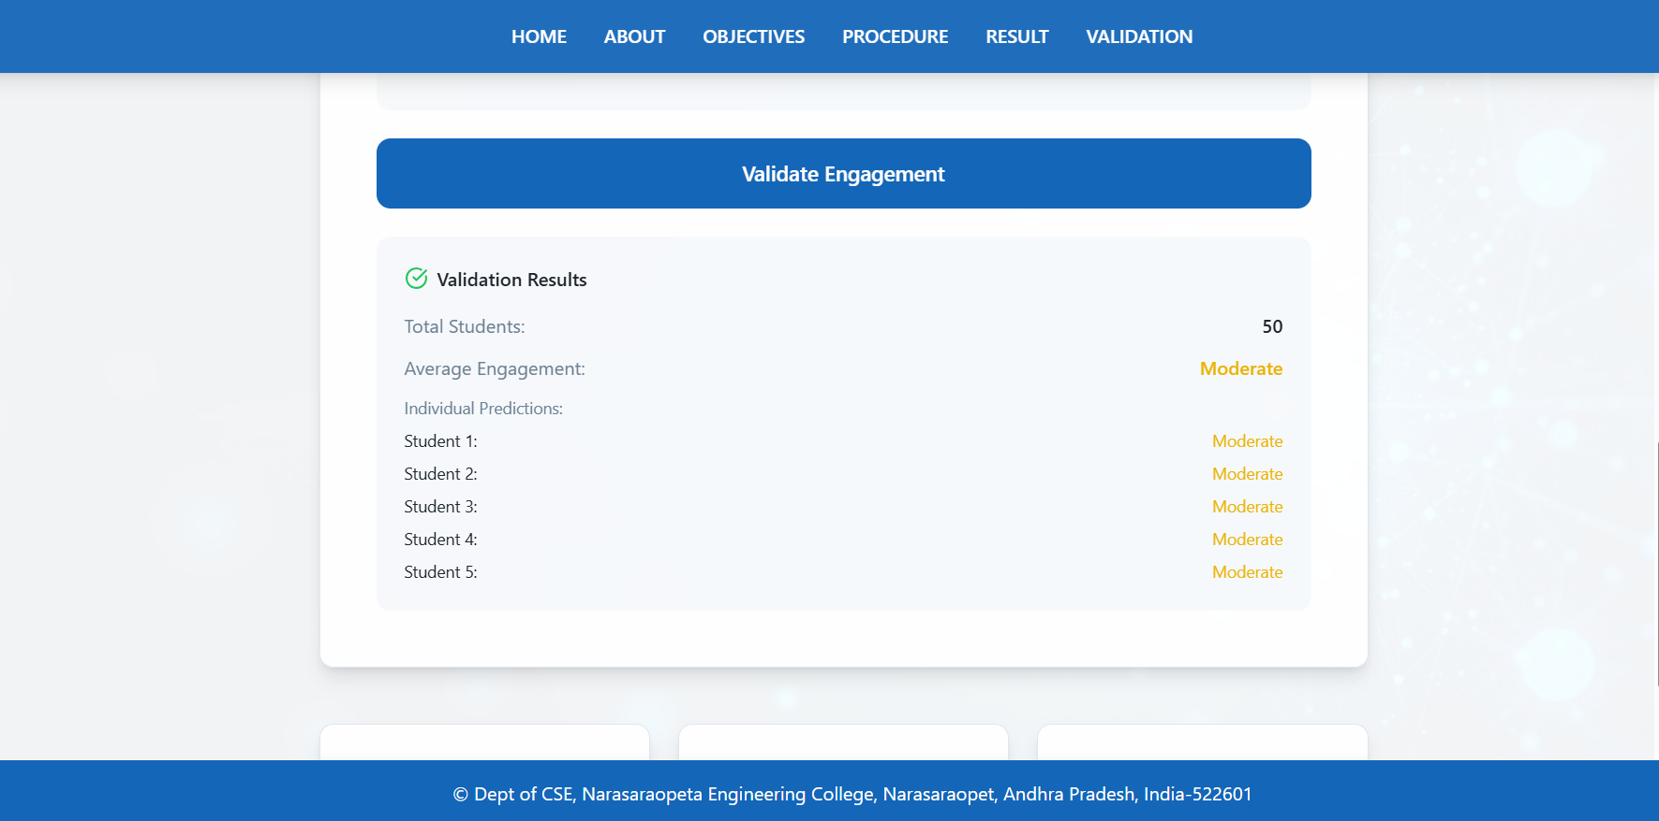
Prediction Results

Slide 17
RESULTS & ANALYSIS
Performance Results
The model's performance was tested using accuracy, F1-score, precision, recall, and confusion matrix analysis. The final model achieved a test set accuracy of 99.91%.
The Classification Report shows Precision, Recall, and F1-scores of 1.00 for the "Disengaged" (0) and "Moderate" (1) classes. The Confusion Matrix confirms extremely low misclassification, with only 138 "Moderate" samples wrongly predicted as "Disengaged" and 12 "Disengaged" samples wrongly predicted as "Moderate" out of over 167,000 samples. The Training vs. Testing Performance graph shows training and testing curves converging smoothly with a minimal gap, confirming excellent stability and no overfitting.

Slide 18
Comparative Analysis
Model | Accuracy(%) | Training Time | Semantic Representation
Vanilla LSTM | 83.5 | Moderate | Basic
Vanilla GRU | 86.7 | Moderate | Basic
Transformed Encoder | 94.1 | High | Contextual
PrivLogEdu (GRU + Attention + Skill2Vec) | 99.91 | Low | Rich

Slide 19
CONCLUSION and FUTURE SCOPE
Conclusion
This study presented PrivLogEdu, a new framework for real-time, privacy-preserving engagement detection from non-visual log data. By using a GRU-attention architecture with Skill2Vec embeddings, the system achieved 99.91% accuracy on the EdNet-KT1 dataset. The model outperformed conventional LSTM, GRU, and Transformer models in both accuracy and ethical alignment. PrivLogEdu directly supports SDG Goal 4 by enabling scalable, effective, and ethical AI in education that protects student privacy.
Future Scope
Extend and validate the model on additional datasets, including K-12 and university-level environments
Integrate multi-modal non-visual data streams, such as keystroke patterns and navigation history
Explore federated learning methods to train models decentrally across institutions without sacrificing privacy
We would like to express our sincere gratitude to the faculty and staff of Narasaraopeta Engineering College for their guidance and encouragement throughout the development of this project. Their insights and expertise have been invaluable.

Slide 20
REFERENCES
A. Kumar, R. Patel, and M. Sharma, “Federated engagement prediction in hybrid classrooms using non-visual interaction data,” IEEE Trans. Learn. Technol., vol. 18, no. 3, pp. 452–463, May 2025.
X. Li, H. Chen, and Y. Sun, “Privacy-aware student behavior modeling using sequence-based log analytics,” Comput. Educ., vol. 198, pp. 104–116, Feb. 2025.
J. Lee, S. Choi, and P. Kang, “Challenges of visual emotion detection in online education: Lighting, occlusion, and cultural bias,” IEEE Access, vol. 13, pp. 50122–50134, 2025.
A. Alzahrani, M. Alharthi, and L. Shao, “Non-intrusive behavioral features for scalable engagement detection,” Int. J. Artif. Intell. Educ., vol. 35, pp. 143–160, 2025.
Z. Wang, F. Liu, and C. Zhang, “Transformer-enhanced temporal models for student engagement analysis on EdNet,” Proc. IEEE Int. Conf. AIED, pp. 211–219, 2025.
P. Singh and D. Arora, “Statistical feature engineering for log-based educational data mining,” J. Educ. Data Sci., vol. 12, no. 1, pp. 77–89, 2024.
M. Huang, Y. Zhao, and X. Wu, “Skill graph neural networks for personalized learning analytics,” IEEE Trans. Knowl. Data Eng., vol. 37, no. 8, pp. 920–933, Aug. 2024.

Slide 21
8.Q. Chen, L. Han, and S. Zhou, “Behavioral analytics versus visual analytics: A comparative review for engagement detection,” Comput. Educ. Rev., vol. 64, pp. 29–46, 2024.
9.R. Wu, H. Liu, and J. Park, “Attention-augmented GRU models for educational sequence prediction,” IEEE Access, vol. 12, pp. 102344–102357, 2024.
10.S. Zhang, Y. Tan, and F. Xie, “Improving EdNet engagement prediction using transformer-based self-attention,” Proc. Int. Conf. EDM, pp. 98–107, 2024.
11.M. Zhao, K. Cho, and T. Lee, “Differentially private engagement monitoring for K-12 platforms,” IEEE Trans. Inf. Forensics Secur., vol. 19, pp. 667–681, Jan. 2024.
12.H. Park and Y. Ryu, “Secure aggregation methods for federated learn ing in educational AI,” IEEE Internet Things J., vol. 11, no. 5, pp. 4321–4332, 2024.
13.M. Chen, “Self-supervised skill embeddings for large-scale education datasets,” ACM Learn. Analytics Conf., pp. 12–21, 2023.
14.V. Gupta and S. Banerjee, “Session-level learning analytics for adaptive tutoring,” Proc. IEEE ICALT, pp. 56–63, 2023.
15.M. Johnson, P. D’Silva, and T. Rao, “Multi-class engagement detection for MOOCs: Challenges and solutions,” Comput. Educ., vol. 194, pp. 102–115, 2023.

Slide 22
16.A. Das and R. Kulkarni, “Analyzing log sequence embeddings for stu dent performance prediction,” IEEE Access, vol. 11, pp. 45321–45334, 2023.
17.M. Lee, “Comparative evaluation of RNN, GRU, and transformer architectures for temporal student data,” Proc. Int. Conf. AIED, pp. 210–220, 2023.
18.J. Park, “Bridging accuracy and privacy in engagement recognition models,” IEEE Trans. Learn. Technol., vol. 16, no. 4, pp. 670–683, Oct. 2023.
19.An Iterative Data-Driven Intelligent Multiple-Attribute Decision Making for Football Teaching Quality, 2023.
20.Competency-Based Hybrid Learning: A Modern Approach to Teaching Programming and Digital Technologies, 2023
[

Slide 23
ACKNOWLEDGEMENT
We would like to express our sincere gratitude to the faculty and staff of Narasaraopeta Engineering College for their guidance and encouragement throughout the development of this project. Their insights and expertise have been invaluable.
We also extend our thanks to the administration for providing the necessary resources and a platform to showcase our work. This opportunity has been instrumental in enhancing our learning and growth.

Slide 24
Thank You!!
Any questions?

