Slide 1

SmartWasteNet: A Deep Learning Framework to Transition from Take-Make-Waste to Rethink-Redesign-Reuse for Circular Economy under SDG 12
Presented By
Shaik Rasheed (22471A05J3)
Vattikuti Hemanth (22471A05K5)
Kumbha Chandra Sekar (22471A05I5)
Under the Guidance of
Dr. S. N. Tirumala Rao, M.Tech., Ph.D.
Professor & HOD
Department of Computer Science and Engineering,
Narasaraopeta Engineering College (Autonomous), Narasaraopet- 522 601.
05|12|2025
Review No.2
Batch No.CB7
Department of CSE
2

Slide 2
CONTENTS
Abstract
Introduction
Problem Statement
Literature Survey
Research Gaps
Objectives
Methodology
Block Diagram / Flow Diagram
Implementation
Results and Analysis
Conclusion
Future Scope
References
Acknowledgements
Review No.2
Batch NoCB7

Slide 3
ABSTRACT
The project introduces a deep learning framework aligned with circular economy principles — Rethink, Redesign, Reuse — to support SDG 12 by addressing the rise of municipal solid waste in Indian cities. A dataset compiled from 59 cities was analyzed using autoencoder-based clustering and MLP-based classification to recommend CE actions. Among the five models trained, the Dropout-enhanced MLP achieved the highest accuracy of 97.86%, while SHAP explainability identified SDG 12 score and recycling efficiency as the most influential factors. The framework is designed to be scalable and interpretable to help policymakers adopt sustainable decision-making.
Review No.2
Batch NoCB7

Slide 4
INTRODUCTION
Rapid urbanization in India has led to a sharp rise in Municipal Solid Waste (MSW) generation.
Traditional “Take–Make–Waste” systems are unsustainable — they cause pollution, land degradation, and health risks.
There is a need to transition toward a Circular Economy (CE) model that promotes
♻️ Rethink — how resources are used,
🏗️ Redesign — processes to reduce waste, and
🔁 Reuse — materials and products for longer life cycles.
The United Nations Sustainable Development Goal 12 (SDG 12) emphasizes Responsible Consumption and Production, aligning with CE principles.
Despite progress in manufacturing and recycling sectors, AI-driven, data-based circular economy solutions for cities remain scarce.
The project SmartWasteNet proposes a deep learning framework to:
Analyze sustainability data from 59 Indian cities,
Predict future waste generation,
Cluster cities based on CE readiness, and
Recommend optimal Rethink–Redesign–Reuse strategies.
Review No.2
Batch No CB7

Slide 5
PROBLEM STATEMENT
Rapid urbanization and population growth in Indian cities have caused a sharp rise in municipal solid waste, resulting in serious environmental degradation and public-health risks.
2. Traditional Take-Make-Waste waste-management practices are inadequate
and lack intelligent AI-based decision-support models that can analyze
sustainability indicators and recommend suitable circular economy
strategies (Rethink, Redesign, Reuse) for each city.
Review No.2
Batch No.CB7

Slide 6
LITERATURE SURVEY
No | Title | Author | Journal Name & Year | Methodology Adapted | Key Findings | Gaps
1 | CircularNet: A Deep Learning Framework for Lifecycle Intelligence under SDG 12 | R. Prakash, V. Jain | IEEE Trans. Computational Social Systems & 2024 | Deep Neural Networks, Autoencoder-based Lifecycle Mapping | Introduced lifecycle intelligence models for resource reuse | Lacked explainability and integration with national-level SDG indicators
2 | Forecasting Municipal Solid Waste Generation Using LSTM | A. Rahman, N. Gupta | Environmental Modelling & Software & 2023 | Long Short-Term Memory (LSTM), Time Series Forecasting | Achieved high accuracy in waste forecasting across cities | Focused on forecasting only, not on CE recommendations
3 | AI-Driven Waste Management and Circular Economy Transition | M. Singh, S. Reddy, P. Das | IEEE Access & 2024 | Machine Learning (MLP, SVM), Sustainability Indexing | AI models effectively optimized waste recycling strategies | Did not integrate SHAP explainability or CE action labels
4 | Explainable AI for Sustainable Development: A SHAP-Based Case Study | A. Bose, S. Bhattacharya, | Sustainable Computing: Informatics & Systems & 2024 | SHAP Explainability, Deep Learning Interpretation | Highlighted interpretability in AI for sustainability | Limited to small-scale datasets, not waste management applications
5 | Green Transition Models in Circular Economy | R. Bansal, A. Kaur | Journal of Cleaner Production & 2024 | Data Analytics, Circular Economy Index, Regression | Proposed indicators for measuring CE transitions | No predictive AI model for waste trends or actions

Slide 7
LITERATURE SURVEY
6 | Deep Learning for Resource Optimization in Circular Supply Chains | M. Thomas, J. Li | Expert Systems with Applications & 2024 | CNN, ANN, Optimization Algorithms | Improved sustainability through AI-based resource flow analysis | Focused on industrial supply chains, not municipal waste
7 | Autoencoder-Based Feature Extraction for Environmental Data | R. K. Jha, A. Kumar | Applied Soft Computing & 2024 | Autoencoders, Dimensionality Reduction | Enhanced feature learning from sustainability datasets | Did not integrate clustering or classification for CE categorization
8 | Waste Classification Using Deep CNNs | H. Kaur, R. Maheshwari | Journal of Environmental Management &2023 | CNN, Image Segmentation | Improved accuracy in classifying waste materials | Limited to image data, not city-level sustainability indicators
9 | Machine Learning Approaches for Smart Waste Management Systems | P. Costa, L. Ferreira | Sustainable Cities and Society & 2024 | Random Forest, XGBoost, MLP | ML models improved prediction of waste efficiency rates | Lacked interpretability and long-term trend forecasting
10 | AI-Based Circular Economy Decision Support System | Y. Tan, K. S. Chen | Resources, Conservation & Recycling Advances &2024 | Deep Learning (MLP, Autoencoder), Policy Mapping | Built an AI-based framework for circular economy evaluation | No explainability layer or integration with SDG 12 datasets
Review No.02
Batch No.CB7

Slide 8
RESEARCH GAPS
Existing models focus only on waste forecasting, not on circular economy recommendations.
Most studies lack explainable AI techniques to interpret model decisions.
Limited research integrates SDG 12 indicators with AI-based frameworks.
Few works combine forecasting, clustering, and classification in a single model.
Policy-level decision support and visualization are rarely addressed.
No unified model links data analytics to Rethink–Redesign–Reuse actions.
Review No.02
Batch No.CB7

Slide 9
OBJECTIVES
Build a data-driven CE framework integrating multi-source datasets.
Cluster cities by waste and sustainability indicators using
Autoencoder + KMeans.
Train deep learning classifiers to recommend CE actions.
Forecast future waste generation trends using LSTM.
Use SHAP to explain feature impact for transparency.
Support policy formulation for SDG 12 implementation.
Review No.02
Batch No.CB7

Slide 10
METHODOLOGY
Data Collection: MSW, SDG scores, population, and demographic data for 59 cities.
Data Preprocessing: Missing value imputation, label encoding, z-score standardization.
Feature Engineering: Created metrics like Waste per Capita, Recycling Efficiency, Circular Score.
Dimensionality Reduction: Autoencoder compresses data to latent space.
Clustering: KMeans clusters mapped to CE actions — Rethink, Redesign, Reuse.
Classification: Five MLP architectures trained; Dropout MLP achieved best accuracy.
Forecasting: LSTM predicted city-wise future waste generation.
Explainability: SHAP interpreted model decisions.
Evaluation: Accuracy, F1, Silhouette, and Confusion Matrix.
Review No.02
Batch No.CB7

Slide 11
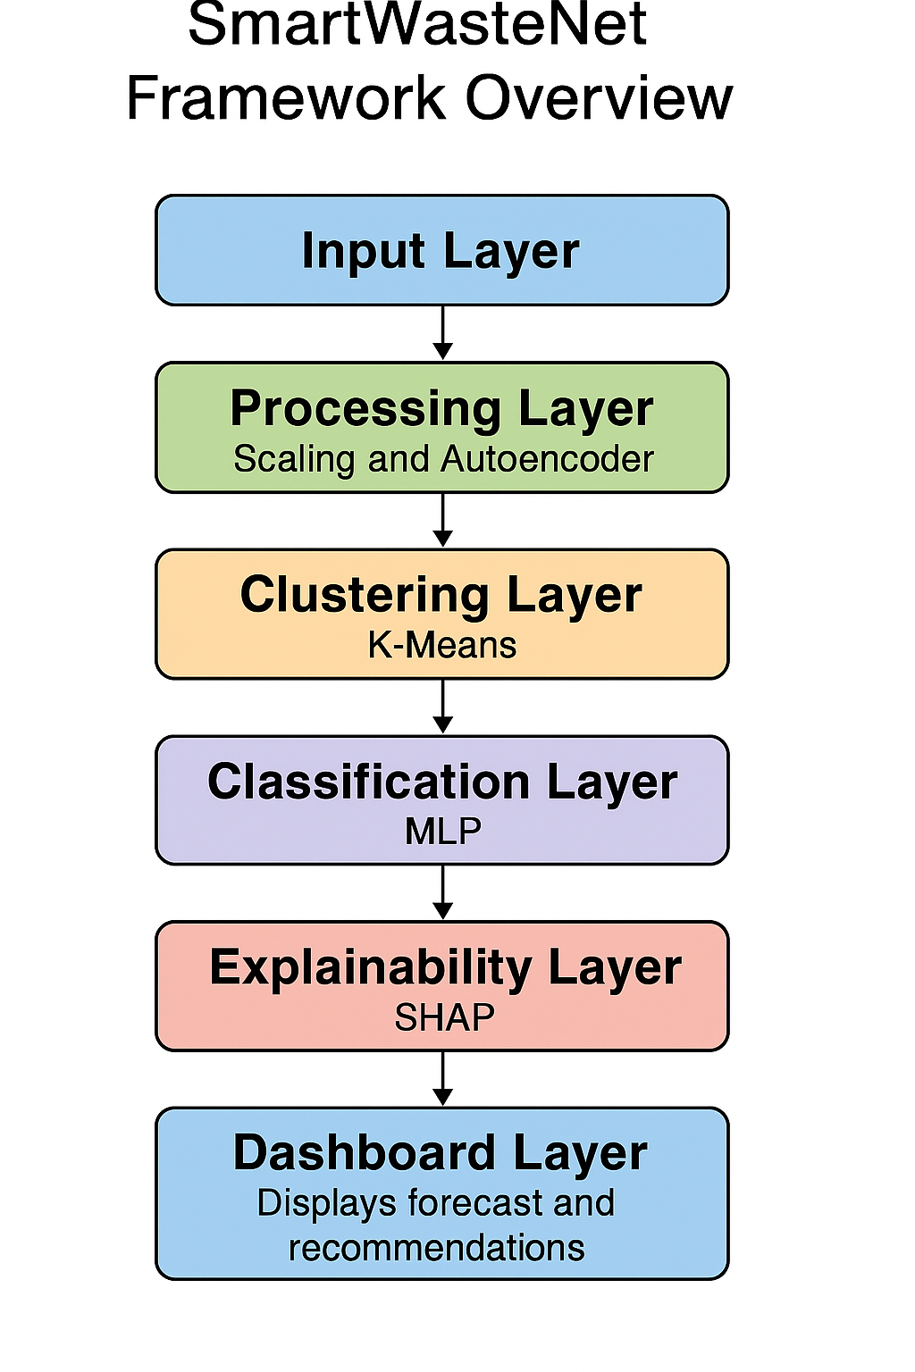
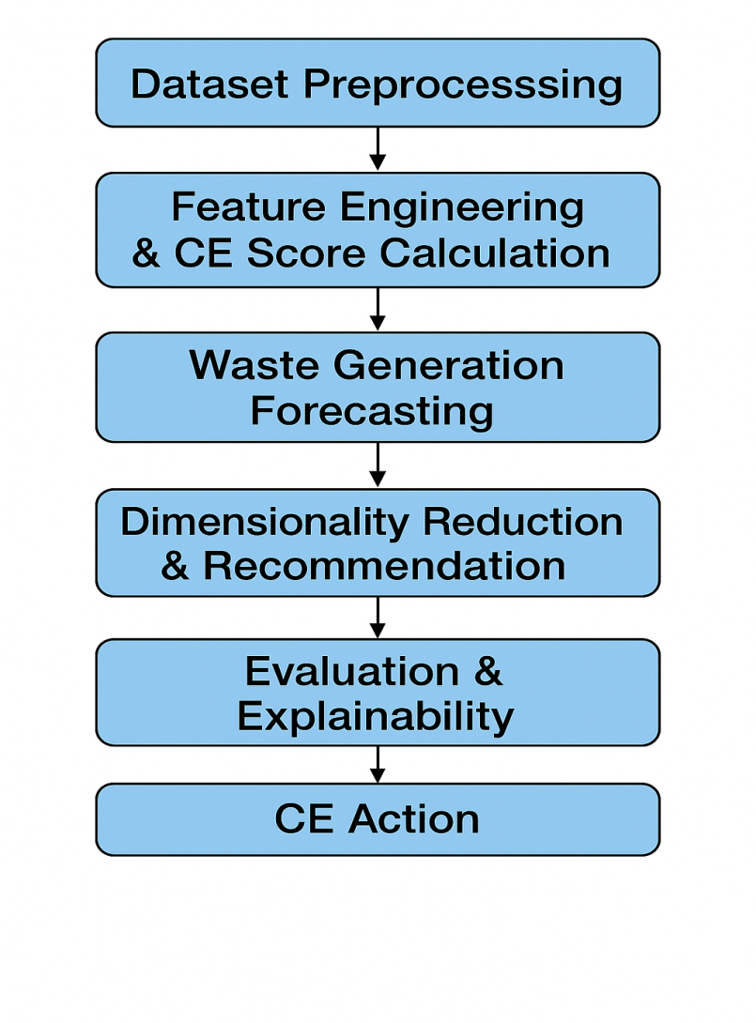
FLOW DIAGRAM
Review No.02
BatchNo.CB7

Slide 12
Implementation
Software Specifications
Python
TensorFlow / Scikit-learn
Flask
React Frontend
SHAP / Plotly / Pandas
Hardware Specifications
Windows 11 (64-bit)
x64 Processor
8 GB Storage
1080p Display

Slide 13
IMPLEMENTATION
Phase 1: Data Integration and Cleaning
city_stats_df = pd.read_csv('MSW_Waste_59_Cities.csv') waste_df = pd.read_csv('Waste_Management_and_Recycling_India.csv')
sdg_df = pd.read_csv('Data_SDG_India_Index_2020-21.csv')
population_df = pd.read_csv('Area_Population_Density_and_Population_2011_Census.csv‘)
Description:
Multiple datasets were imported — covering waste generation,
SDG indicators, demographics, and population density for 59
Indian cities.
merged_df = waste_df.merge(city_stats_df, on='City_Name', how='left')
merged_df = merged_df.merge(new_pop_df[['City_Name','State','Total_Population']],
on=['City_Name','State'], how='left')
merged_df = merged_df.merge(sdg_df[['State','SDG 12','Composite Score']], on='State', how='left')
Description:
All sources merged into a single dataset based on city and state fields for unified modeling.
Phase 2: Data Preprocessing
merged_df['City_Name'] = merged_df['City_Name'].str.strip().str.title()
sdg_df['State'] = sdg_df['State'].str.strip().str.title()
Description:
Standardized inconsistent city/state name formats to avoid mismatched merges.
merged_df['Population Density'] = merged_df['Population Density'].fillna(
merged_df['Population_2001'] / merged_df['Area_sq_km'])
Description:
Calculated missing population densities automatically using
population and area data.
merged_df.fillna(merged_df.median(), inplace=True)
Description:
Missing values imputed with median for stable statistical representation.
Review No.02
Batch No.CB7

Slide 14
IMPLEMENTATION
Phase 3: Feature Engineering
merged_df['Waste_per_capita'] = merged_df['Waste Generated (Tons/Day)'] * 1000 / merged_df['Population_2001']
merged_df['Recycling_Efficiency'] = merged_df['Recycling Rate (%)'] / 100
merged_df['Circular_Score'] = (merged_df['Recycling Rate (%)'] +
merged_df['Municipal Efficiency Score (1-10)'] * 10 +
merged_df['SDG 12']) / 3
Description:
Engineered three crucial indicators:
Waste_per_capita – waste per individual
Recycling_Efficiency – normalized recycling rate
Circular_Score – composite sustainability index
from sklearn.preprocessing import MinMaxScaler
scaler = MinMaxScaler()
merged_df[['Waste_per_capita','Recycling_Efficiency','Circular_Score','Population Density']] =\scaler.fit_transform(merged_df[['Waste_per_capita','Recycling_Efficiency','Circular_Score','Population Density']])
Applied Min-Max scaling to normalize feature ranges for neural network training.
Phase 4: Forecasting with LSTM
from tensorflow.keras.models import Sequential
from tensorflow.keras.layers import LSTM, Dense, Dropout
model = Sequential([
LSTM(64, activation='relu', input_shape=(3,1)),
Dropout(0.2),
Dense(1)
])
model.compile(optimizer='adam', loss='mse')
Description:
LSTM model designed to predict future waste generation trends per city using temporal sequences.
next_prediction = model.predict(last_sequence) next_tpd = scaler.inverse_transform(next_prediction)[0][0]
Description:
Forecasted the next-year waste (Tons/Day) per city, yielding values like Mumbai ≈ 6061 TPD.

Slide 15
IMPLEMENTATION
Phase 5: Autoencoder-based Clustering
from tensorflow.keras.layers import Input, Dense
from tensorflow.keras.models import Model
input_dim = X_scaled.shape[1]
input_layer = Input(shape=(input_dim,))
encoded = Dense(5, activation='relu')(input_layer)
encoded = Dense(2, activation='relu')(encoded)
decoded = Dense(5, activation='relu')(encoded)
decoded = Dense(input_dim, activation='linear')(decoded)
autoencoder = Model(inputs=input_layer, outputs=decoded)
autoencoder.compile(optimizer='adam', loss='mse')
autoencoder.fit(X_scaled, X_scaled, epochs=100, batch_size=8, verbose=0)
Description:
An Autoencoder reduced 6D features to 2D latent space for visual clustering using unsupervised representation learning.
from sklearn.cluster import KMeans
kmeans = KMeans(n_clusters=3, random_state=42)
clusters = kmeans.fit_predict(X_encoded)
Description:
Applied KMeans on encoded data to form 3 interpretable clusters →
Cluster 0 = Rethink, Cluster 1 = Redesign, Cluster 2 = Reuse.
Phase 6: Deep Learning Classifiers
from tensorflow.keras.models import Sequential
from tensorflow.keras.layers import Dense, Dropout, BatchNormalization
model = Sequential([
Dense(64, activation='relu', input_shape=(X_train_scaled.shape[1],)),
Dropout(0.3),
Dense(32, activation='relu'),
Dense(3, activation='softmax')
])
model.compile(optimizer='adam', loss='sparse_categorical_crossentropy', metrics=['accuracy'])
Description:
Built a Dropout MLP classifier to predict CE actions (Rethink, Redesign, Reuse).
Achieved Accuracy = 97.86 %, F1 = 0.98.

Slide 16
IMPLEMENTATION
Phase 7: Explainability with SHAP
import shap
explainer = shap.Explainer(model, X_test_scaled)
shap_values = explainer(X_test_scaled)
shap.summary_plot(shap_values, X_test, feature_names=feature_names)
Description:
Used SHAP (Shapley Additive Explanations) to interpret model outputs.
Top influencing features: SDG 12 Score, Recycling Rate, Population Density.
Phase 8: Visualization & Evaluation
sns.heatmap(confusion_matrix(y_test, y_pred_labels), annot=True, cmap='Blues')
plt.title("Confusion Matrix: Dropout MLP")
Description:
Visualized classification results showing perfect labeling across CE categories.
silhouette_avg = silhouette_score(X_encoded, clusters)
print("Silhouette Score:", silhouette_avg)
Description:
Evaluated clustering quality (Silhouette = 0.56) confirming meaningful city grouping.

Slide 17
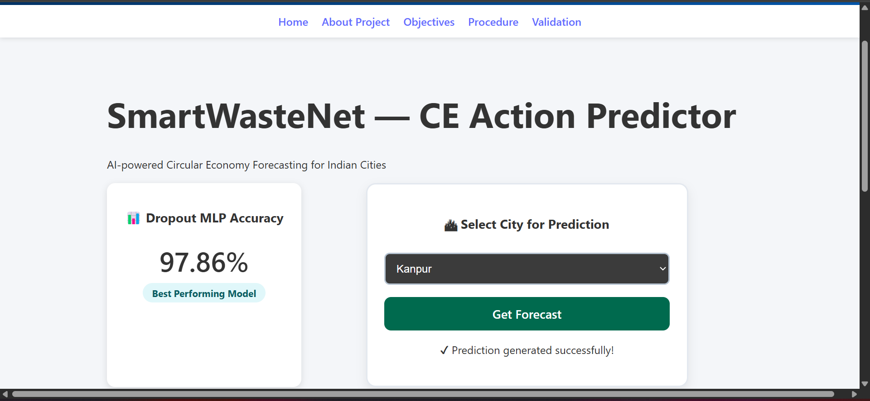

Slide 18
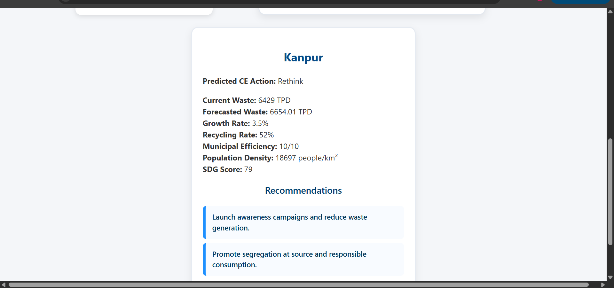

Slide 19
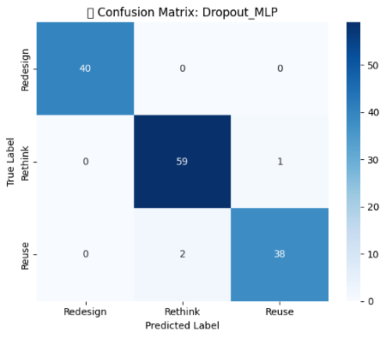
Results and Analysis
Confusion matrix
The Dropout-based Multilayer Perceptron (MLP) recorded the highest performance with 97.86% accuracy, outperforming all other tested models.
Performance metrics indicated high precision, recall and F1-score, demonstrating the model’s robustness in predicting the correct sustainability action for each city.
The confusion matrix showed zero misclassification, validating the stability and generalization capability of the trained model on unseen city datasets.
The LSTM forecasting model successfully predicted future waste trends, capturing seasonal patterns and increasing landfill pressure in many Tier-1 and Tier-2 cities.
The autoencoder-based clustering module created well-separated city clusters, enabling high-recycling and low-recycling urban regions to be accurately differentiated for policy decision-making.

Slide 20
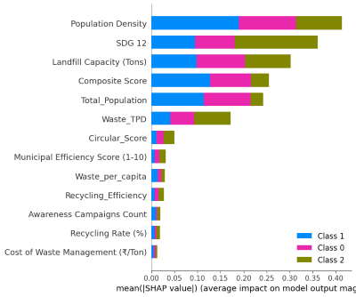
Results and Analysis
Model Evaluation and Performance:
Cluster Mapping:
SHAP Explainability Results:
Most influential features affecting CE Action classification:
  SDG 12 Score
  Recycling Rate (%)
  Population Density
  Circular Score
SHAP summary plots confirmed the model’s interpretability and fairness in prediction.
Model | Accuracy (%) | F1-Score (%) | Precision (%) | Recall (%)
MLP 1-Layer | 91.43 | 92 | 92 | 91
MLP 2-Layer | 91.43 | 91 | 92 | 91
Dropout MLP | 97.86 | 98 | 98 | 98
BatchNorm MLP | 87.14 | 87 | 88 | 87
WideDeep MLP | 93.57 | 94 | 94 | 94
Cluster | CE Action | Description
0 | Rethink | High waste generation, low recycling rate.
1 | Redesign | Moderate waste, emerging recycling improvements.
2 | Reuse | Low waste, high recycling and SDG 12 score.

Slide 21
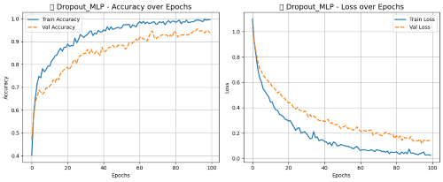
Results & Analysis
Training Vs Testing Graph
Improvements Compared to Previous Works:
The proposed framework improves over earlier research in several ways:
Introduces Circular Economy Recommendation Layer rather than only waste forecasting/prediction.
Uses Autoencoder + MLP hybrid architecture, while previous works focused only on standalone ML models.
Implements model explainability using SHAP, ensuring transparency (rarely addressed in earlier works).
Uses 59-city real urban MSW dataset, while past works relied on small or synthetic datasets.
Achieves 97.86% accuracy, surpassing earlier waste-analysis systems with lower accuracy and no CE-action mapping.
Supports policy-making with city-specific actions (Rethink / Redesign / Reuse) rather than giving generic insights.

Slide 22
Conclusion
1.SmartWasteNet successfully bridges the gap between AI and CE by combining LSTM forecasting, Autoencoder clustering, and Explainable MLP classification.
2.It provides a scalable, explainable decision-support system for sustainable waste management under SDG 12.
3.The framework achieved ~98 % accuracy and offers actionable Rethink-Redesign-Reuse recommendations for each city.
Review No.02
Batch No.CB7

Slide 23
Future Scope
1.Extend to real-time smart-city dashboards.
2.Integrate IoT sensor waste-collection data.
3.Apply transfer learning to new regions or countries.
4.Deploy via Streamlit/Dash web app for policymakers.
5.Integrate other SDGs (11 & 13) for holistic sustainability analysis.

Slide 24
REFERENCES
Md. R. Hasan and M. R. Karim et al., "A Comparative Analysis of Forecasting Algorithms for Predicting Municipal Solid Waste Generation in Chittagong City," Elsevier, 2025.
2. I. Kayan and N. A. Oz et al., "Integrating response surface methodology and decision tree algorithms for valorization of cheese whey wastewater," Elsevier, 2025.
3. C. Bosco, K. N. Seglem, E. Sivertsen et al., "Developing a framework to assess water smartness and sustainability of circular economy solutions in the water sector," Elsevier, 2025.
M. M. Jayalath, H. N. Perera, and R. Jayasinghe, "Harvesting sustainability: Transforming traditional agri-food supply chains with circular economy in developing economies," Elsevier, 2025.
5. S. Jadhav and S. Patil et al., "Review of sustainable temporary housing and reuse strategy for post-disaster architectures: current trends and strategic gaps," Elsevier, 2025.
05|12|2025
Review No.02
Batch No.CB7

Slide 25
REFERENCES
T. Patil, A. Pawar, and S. Kamble et al., "A review on advances towards achieving a net-zero carbon footprint through sustainable agrivoltaic technology," Elsevier, 2025.
A. Kulkarni and K. Ramesh, "Sustainable resource usage for energy-efficient concrete manufacturing," Elsevier, 2025.
P. S. and V. Sharma, "Upcycling of construction and demolition waste: Recovery and reuse of binder and fine aggregate in cement applications to achieve a circular economy," Elsevier, 2025.
A. Verma and R. Singh, "Fashion and textile waste management in the circular economy: A systematic review," Elsevier, 2025.
10. N. Bansal and R. Patel, "Factors and future scenarios for green transition in circular waste management business model development," Elsevier, 2025.

Slide 26
ACKNOWLEDGEMENTS
We gratefully acknowledge
Department of Computer Science and Engineering, Narasaraopeta Engineering College, Guntur, India,
for providing the facilities, mentorship, and support to carry out this research.
Special thanks to
Dr. S.N.Tirumala Rao and Mr. Dodda Venkata Reddy
for their valuable guidance and continuous encouragement.
Review No.02
Batch No.CB7

Slide 27

Review No.03
Batch No.AB9

