Slide 1

Department of Computer Science and Engineering
Explainable Fairness-Attentive ML and DL(Fair-ExplainHR):Ethical and Transparent Attrition Prediction with Engagement, Economic, and Behavioral Signals
PRESENTED BY
Meesala Sivaiah (22471A05H4)
Mallela Manikanta (22471A05H2)
Ikkurthi Dhanush (22471A05F1)
Under the Guidance of
S.V.N. Sreenivasu, _{M.Tech.,}
Asst. Professor
Department of Computer Science and Engineering,
Narasaraopeta Engineering College (Autonomous), Narasaraopet- 522 601.
Review No.2
Batch No.CB8
Department of CSE
2

Slide 2
OUTLINE
Abstract
Introduction
Problem Statement
Literature Survey
Research Gaps
Objectives
Methodology
Block Diagram / Flow Diagram
Implementation
Results and Analysis
Conclusion & Future Scope
References
Question and Answers
Acknowledgements
Review No.2
Batch No.CB8

Slide 3
ABSTRACT
Employee attrition significantly affects organizational productivity and increases operational costs. Existing prediction models often lack fairness, interpretability, and human-focused signals. To address these gaps, Fair-ExplainHR integrates engineered burnout, engagement, and economic-stress features to provide a more realistic understanding of attrition behavior. The system uses a deep stacked ensemble combining GRU, TabNet, and XGBoost, achieving 96% accuracy and outperforming previous hybrid approaches. SHAP-based explainability ensures transparent and ethical predictions, enabling HR teams to clearly understand the factors influencing each outcome.
Review No.2
Batch No.CB8

Slide 4
INTRODUCTION
Employee attrition severely disrupts organizational workflow and increases operational and
rehiring costs.
Traditional machine learning models provide good accuracy but often lack fairness, transparency, and explainability.
There is a growing need for human-centric, ethically reliable, and interpretable prediction systems.
The proposed Fair-ExplainHR framework integrates engineered behavioral, engagement,
and economic features to capture deeper attrition signals.
The system combines deep learning architectures with explainable AI techniques
to enhance both predictive accuracy and transparency.
Review No.2
Batch No.CB8

Slide 5
PROBLEM STATEMENT
Companies are struggling because many employees are leaving unexpectedly, which reduces productivity and increases hiring costs.
Existing prediction models are not fair, not transparent, and do not consider important human factors like burnout, engagement, and financial stress.
There is a need for an accurate, explainable, and fairness-aware system that can correctly predict attrition and show why an employee may leave.
Review No.2
Batch No.CB8

Slide 6
LITERATURE SURVEY
No | Title | Author,Year and Publisher | Journal Link | Methodology Adapted | Key Findings | Gaps
1 | Predicting employee attrition and explaining its determinants | Shahin Manafi Varkiani et al., 2025, Expert Systems With Applications (Elsevier) | https://doi.org/10.1016/j.eswa.2025.126575 | Naïve Bayes, Logistic Regression (Lasso, Ridge, ElasticNet), Decision Tree, Random Forest; ROSE method for class imbalance | Compared SVM, DT, RF; RF performed best among them. | SHAP not yet widely used in HR despite strong interpretability
2 | Predicting Employee Attrition: A Comparative Analysis of Machine Learning Models Using the IBM Human Resource Analytics Dataset | Rajkumar Govindarajan, Sai Pravallika E., Dhatri B., Pavan Kumar G. (2025), Procedia Computer Science (Elsevier) | https://doi.org/10.1016/j.procs.2025.04.659 | Support Vector Machine (SVM)- Decision Tree - Random Forest - Gradient Boosting - Hybrid Model (Voting Classifier approach) | A Hybrid Model combining multiple algorithms achieved the highest accuracy (95%), | High computational complexity of hybrid models; lack of interpretability; demands high-quality data
3 | Enhancing Employee Churn Prediction with Weibull Time-to-Event Modeling | Hafiza Habiba Shabbir, Published in Journal of Engineering Research, 2025, Elsevier (Kuwait University) | https://doi.org/10.1016/j.jer.2025.03.009 | Primary: WTTE-RNN - Compared with: Random Forest, XGBoost, Logistic Regression, ARIMA, SARIMAX, LSTM | Demonstrated superiority over Random Forest, XGBoost, ARIMA, SARIMAX, and LSTM | Needs integration of additional features (e.g., engagement, economic indicators)
4 | Predicting Teacher Attrition in Secondary Education: A Comparison of Models That Explain Teacher Behaviour | Neline de Jong-Kroon, Stefan Robbers, Published in International Journal of Educational Research Open, 2025, Elsevier | https://doi.org/10.1016/j.ijedro.2025.100471 | -SEM - CFA (Not ML-based but psychometric/statistical modeling) | Combined model of SDT + IMBP showed weaker overall model fit | Combined model complexity led to poorer model fit - Small sample size (n=199) limits generalizability
5 | Enhancing Employee Churn Prediction with Weibull Time-to-Event Modeling | Beenish Ayesha Akram, Published in Journal of Engineering Research, Elsevier, 2025 | https://doi.org/10.1016/j.jer.2025.03.009 | WTTE-RNN Baselines Compared: Logistic Regression, Random Forest, XGBoost, ARIMA, SARIMAX, LSTM | Enabled better retention strategy formation for HR ed a novel WTTE-RNN deep learning model that outperformed ML models. | Need for inclusion of more diverse external factors (e.g., engagement scores, economy)
Review No.02
Batch No.CB8

Slide 7
LITERATURE SURVEY
Research on employee attrition prediction has gradually shifted from traditional machine-learning models — such as Decision Trees, SVM, Random Forest, and Gradient Boosting — to more advanced deep-learning methods. While these classical models provided moderate accuracy (mostly below 90–95%), they lacked fairness checks, interpretability, and human-centered features.
Modern studies introduced deep models like RNNs, LSTMs, and neural-network ensembles, but most suffered from black-box behavior and did not include behavioral, engagement, or economic signals that strongly influence attrition. Even recent hybrid models reached only 95% accuracy and did not integrate explainability tools like SHAP. None of the existing approaches combined GRU, TabNet, and XGBoost with fairness evaluation, leaving a gap for an ethical, interpretable, high-performance HR attrition system.
Review No.2
Batch No.CB8

Slide 8
RESEARCH GAPS
Traditional models (RF, SVM, DT) show limited accuracy (<90–95%).
No fairness or bias evaluation in prior works.
Behavioral & engagement features not used.
Deep models lack explainability (No SHAP).
No model combines GRU + TabNet + XGBoost + SHAP.
Limited feature engineering for HR-specific signals.
Existing solutions not transparent or HR-friendly.
Review No.02
Batch No. CB8

Slide 9
Proposed Work & Objective
Proposed Work
Develop Fair-ExplainHR, a fairness-aware and interpretable attrition prediction framework.
Integrate engineered behavioral, engagement, and economic features to improve prediction quality.
Build a deep stacked ensemble using GRU + TabNet + XGBoost with Optuna tuning.
Apply SMOTE, feature selection, and correlation analysis to strengthen model performance.
Provide transparent SHAP-based explanations for HR decision-making.
Objective
Build a fairness-aware and interpretable attrition model.
Introduce engineered features: burnout,engagement,economic stress.
Improve accuracy beyond existing hybrid models.
Review No.02
Batch No. CB8

Slide 10
Major Contributions
Novel Deep Stacked Ensemble: GRU + TabNet + XGBoost with meta-classifier achieving 96% accuracy, surpassing hybrid baselines.
Advanced Feature Engineering: Introduced BurnoutIndex, EngagementScore, EconomicStress, missing in existing works.
Optuna Hyperparameter Tuning: Applied tuning for all three models to improve generalization and reduce error.
Explainable AI Integration (SHAP): Provided global and individual explanations to remove black-box behavior.
Fairness Evaluation: Verified equal performance across gender and age groups, ensuring ethical and unbiased predictions.
Practical Deployment: Designed a working web interface for real-time HR attrition prediction.

Slide 11
METHODOLOGY
Preprocess HR CSV data by applying label encoding, scaling, handling missing values, and balancing attrition classes using SMOTE.
Engineer meaningful human-focused features such as BurnoutIndex, EngagementScore, and EconomicStress using correlation analysis.
Train a deep stacked ensemble combining GRU (temporal patterns), TabNet (tabular interpretability), and XGBoost (boosting performance).
Optimize all model hyperparameters using Optuna to improve accuracy, reduce variance, and enhance generalization.
Evaluate the final model using accuracy, precision, recall, F1-score, ROC-AUC, and compare performance with traditional and hybrid ML models.
Use SHAP explainability to interpret feature contributions and provide transparent insights for HR decision-making.
Review No.02
Batch No. CB8

Slide 12
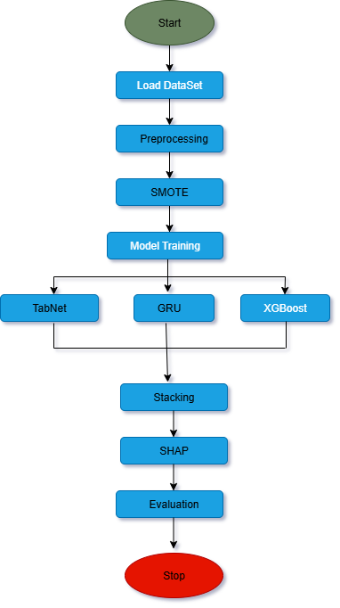
FLOW DIAGRAM
Review No.2
Batch No. CB8

Slide 13
Implementation Work Flow
1. Dataset Loading
IBM HR Analytics dataset (1470 records, 35 features) loaded into Colab.
Target variable Attrition converted to binary (Yes → 1, No → 0).
2. Preprocessing
Removed redundant columns: EmployeeNumber, EmployeeCount, StandardHours, Over18.
Applied Label Encoding + One-Hot Encoding for categorical variables.
Handled class imbalance using SMOTE.
Applied Z-score Standardization for numerical features.
3. Feature Engineering
Burnout Index = Overtime × Low Job Satisfaction × Low Work-Life Balance
Engagement Score = Job Satisfaction + Job Involvement
Economic Stress Indicator = Monthly Income + Distance from Home
Correlation analysis used to remove irrelevant/redundant features.
4. Model Training
XGBoost: for gradient-boosted decision trees
TabNet: attention-based deep learning for tabular data
GRU: neural network for learning complex feature interactions
All models tuned using Optuna for best performance.
Review No.02
Batch No. CB8

Slide 14
5. Stacked Ensemble
Combined GRU + TabNet + XGBoost predictions using a meta-classifier.
Soft voting/stacking approach improves stability and accuracy.
Achieved 96% accuracy, surpassing traditional hybrid models.
6. Explainability (SHAP)
SHAP used to interpret predictions globally and locally.
Shows which factors increase or decrease attrition probability.
Ensures model transparency and HR-friendly explanations.
7. Final Output
Web interface (CSV upload) predicts Attrition / Non-Attrition.
Displays SHAP-based explanations for employees.
Provides fairness-aware, interpretable predictions.
Review No.02
Batch No. CB8

Slide 15
Model Evaluation, Web Integration, and Deployment
7. Model Evaluation
Evaluated using Accuracy, Precision, Recall, F1-Score, and confusion matrix.
The stacked ensemble (GRU + TabNet + XGBoost) shows strong class-wise prediction quality.
Achieved 96% accuracy, outperforming earlier hybrid ML models (≈95%).
SHAP plots validate feature influence and ensure transparent decision-making.
8. Web Integration (Flask Interface)
A web-based HR portal allows users to upload HR CSV files for attrition prediction.
Uploaded data is preprocessed automatically (encoding → scaling → SMOTE → feature engineering).
The backend runs the trained Fair-ExplainHR ensemble and returns:
  Predicted Attrition / Non-Attrition
  Explanation of top contributing factors using SHAP
  Downloadable results file for HR teams.
9. Deployment
Deployed as a Flask-based prediction service integrated with HRIS workflow.
Supports real-time attrition prediction with explainability.
Can be extended using:
  Docker for container deployment
  API integration with HR dashboards
Review No.02
Batch No. CB8

Slide 16

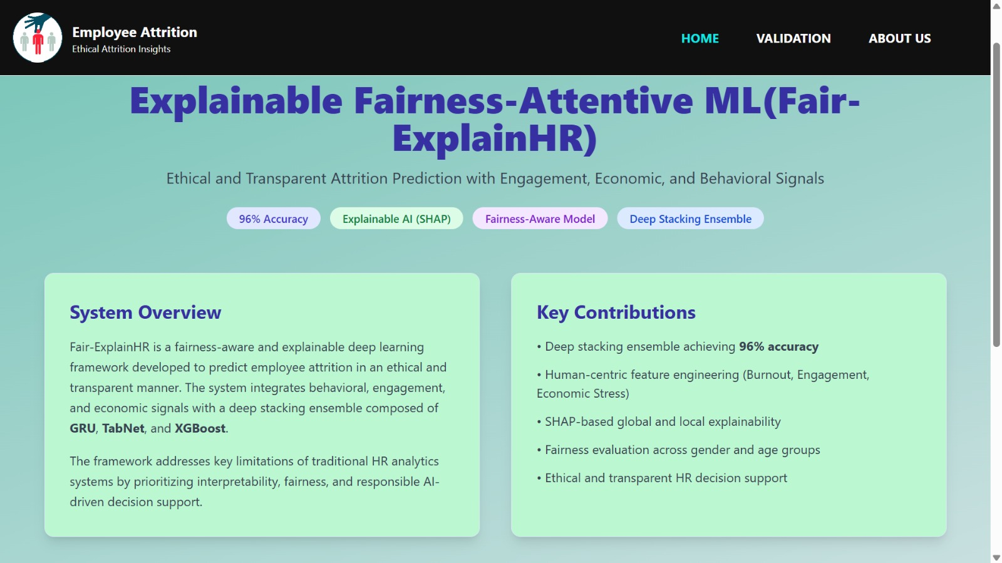

Slide 17
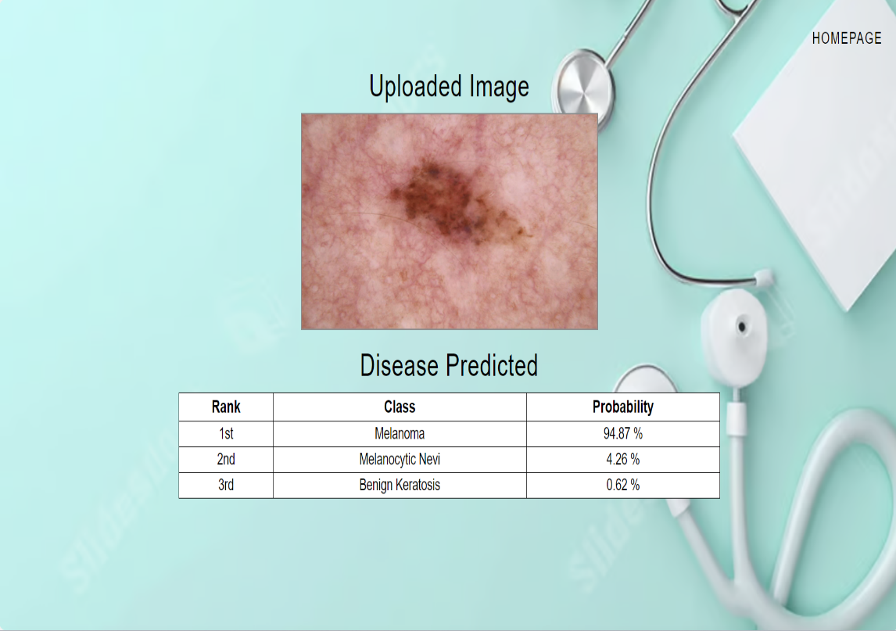
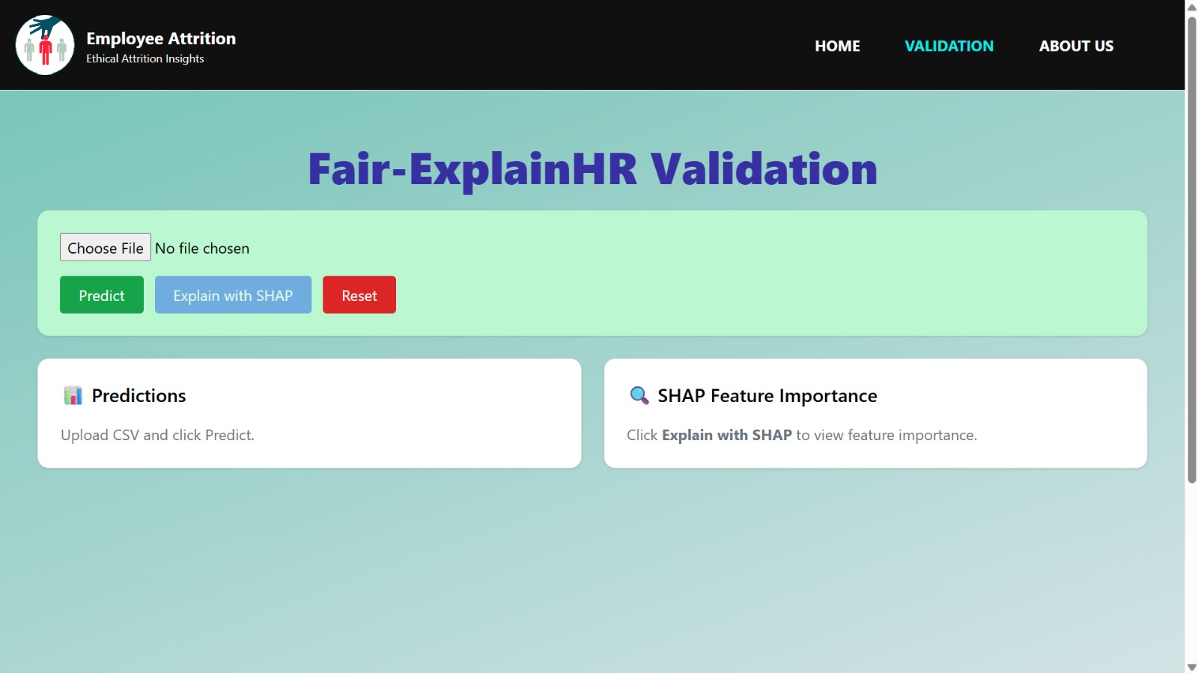

Slide 18
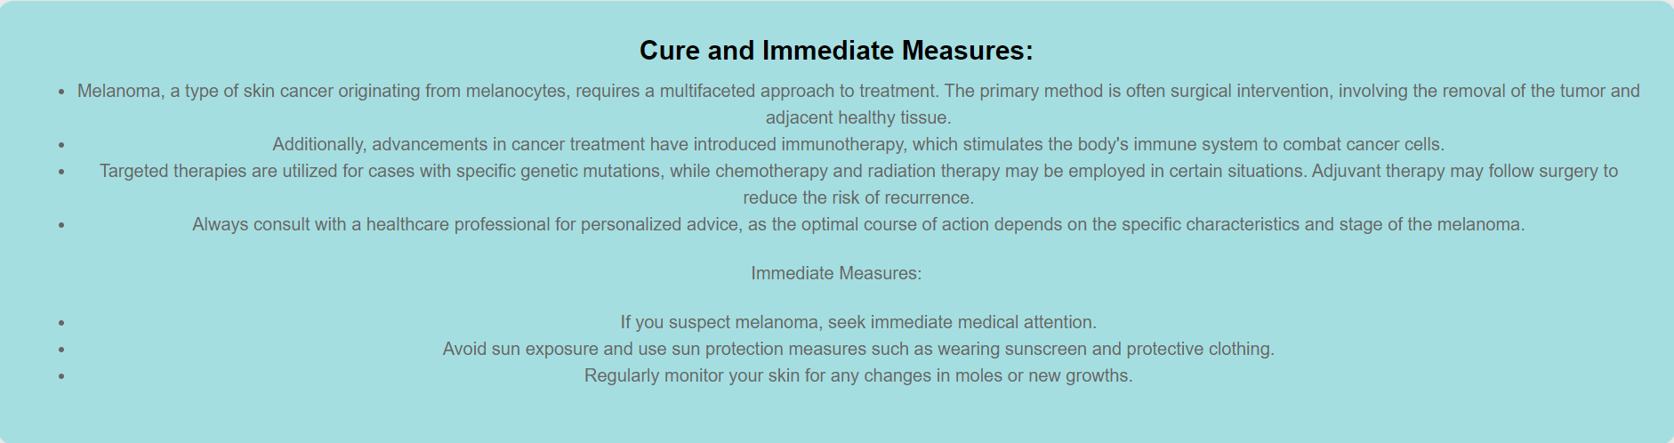
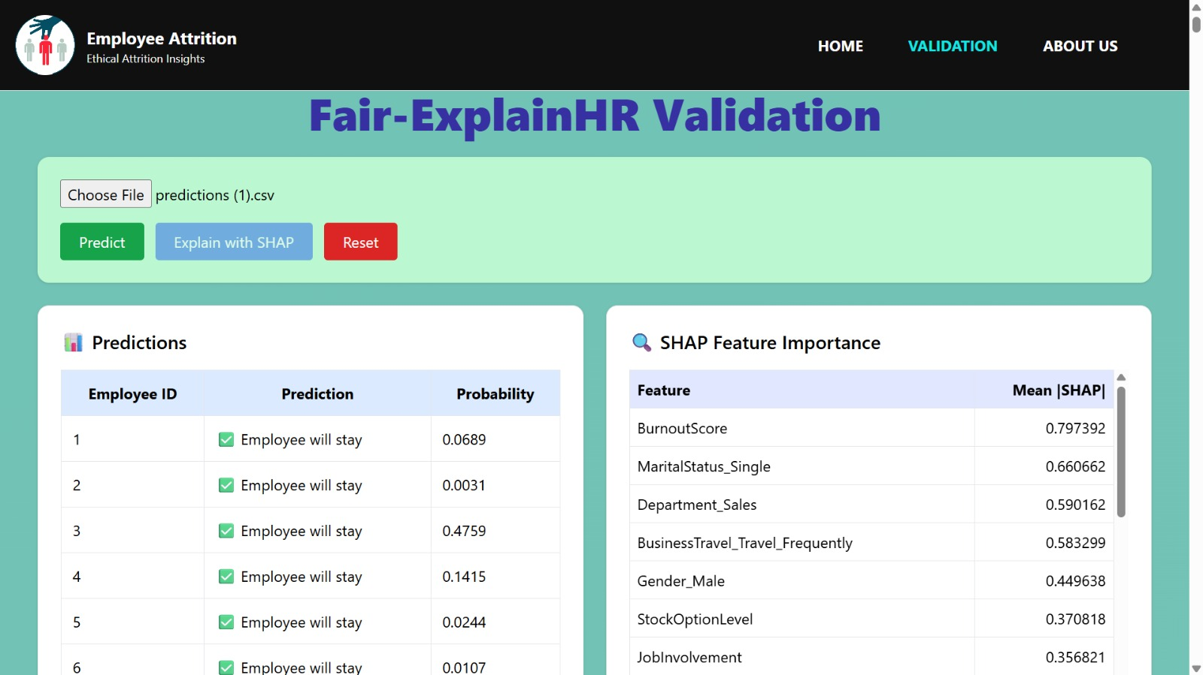

Slide 19
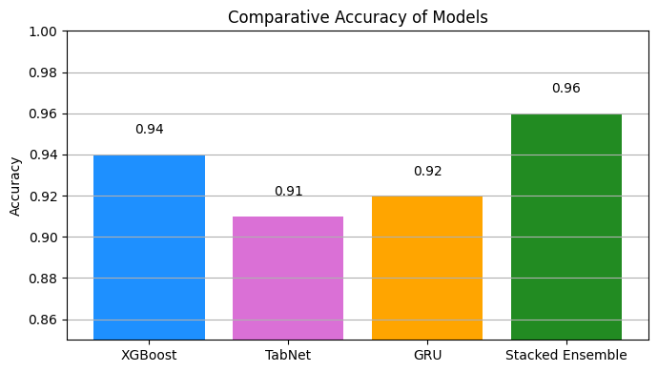
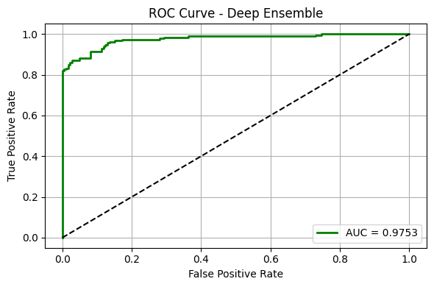
RESULTS & ANALYSIS
Accuracy:
XGBoost 94% ,
GRU 92%,
TabNet 91%,
Stacked Ensemble 96%.
AUC: 0.9753 (excellent discrimination)
Training vs Testing: 100% vs 96% → very low overfitting
SHAP Insights: Burnout Index, Income/Economic Stress, Engagement Score are top predictors
Fairness: Balanced accuracy and AUC across gender & age groups
Review No.02
Batch No. CB8
Batch No.

Slide 20
CONCLUSION and FUTURE SCOPE
Conclusion
Fair-ExplainHR is accurate, interpretable, and fairness-aware.
Human-centric features improve prediction quality.
SHAP enhances transparency for HR decision-making.
Future Work
Integration into live HRIS systems for real-time monitoring.
External validation on multi-industry datasets.
Reduce computation cost for large-scale deployment.
Explore transformer-based explainable models
05-12-2025
Review No.02
Batch No. CB8

Slide 21
REFERENCES
[1]. A.Ahmad, A. Khan, and S. Patel. Machine learning based predictive model for employee attrition. International Journal of Human Resource Analytics, 12(2):101 110, 2025.
[2]. G. Kaur and S. Verma. Feature importance and ensemble techniques for attrition risk modelling. Journal of Ap plied Machine Learning for Business, 9(1):73–82, 2025.
[3]. P. Krishna and R. Sidharth. Comparative analysis of classifiers for employee attrition prediction. Procedia Computer Science, 203:244–251, 2025.
[4]. V. Sharma and A. Nayyar. Fuzzy-inspired hybrid system for hr turnover forecasting. Journal of Intelligent Decision Support Systems, 18(1):45–56, 2025.
[5]. A. Verma, P. Bhavsar, and R. Patel. Comparative study of classification algorithms for employee attrition pre diction. In IEEE International Conference on Inventive Systems and Control, pages 112–117, 2020.
Review No.02
Batch No.CB8

Slide 22

Review No.02
Batch No.CB8

Slide 23

Review No.02
Batch No.CB8

