Slide 1

Department of Computer Science and Engineering
A Machine Learning Framework for Forest Fire Prediction in the Nallamala Forest Using NDVI and Synthetic Weather Data
PRESENTED BY
Gairuboina Naveen Kumar (22471A05F5)
Dogiparthi Venkata Sai Girish (22471A05F2)
Sanikommu Nirupam Reddy (22471A05I6)
Under the Guidance of
Dr S. Siva Nageswara Rao, _{M.Tech., Ph.D.}
Professor
Department of Computer Science and Engineering,
Narasaraopeta Engineering College (Autonomous), Narasaraopet- 522 601.
Review No.03
Batch No.CB9
Department of CSE
1

Slide 2
OUTLINE
Abstract
Introduction
Problem Statement
Literature Survey
Research Gaps
Objectives
Methodology
Block Diagram / Flow Diagram
Implementation
Results and Analysis
Conclusion
Future Scope
References
Question and Answers
Acknowledgements
Review No.01
Batch No.CB9

Slide 3
ABSTRACT
This project presents a machine learning-based framework for early forest fire prediction in the Nallamala Forest region. It integrates MODIS NDVI data, representing vegetation health, with synthetically generated weather data from 2012 to 2025 to identify fire-prone conditions. To address the class imbalance between fire and non-fire events, the Synthetic Minority Oversampling Technique (SMOTE) is applied. The predictive model employs an ensemble of XGBoost and LightGBM classifiers using a voting approach, achieving an accuracy of 91.46% and a recall of 69%. The proposed system demonstrates strong potential for proactive forest management and climate resilience through timely fire risk prediction and early intervention support.
Review No.01
Batch No.CB9

Slide 4
INTRODUCTION
Nallamala Forest is a biodiversity-rich yet fire-prone tropical region in India.
Its dry climate and dense vegetation make it highly susceptible to wildfires. Frequent wildfires due to heatwaves, lightning, and human activity.
Frequent fires occur due to heatwaves, lightning, and human-induced activities.
These events cause severe ecological and economic damage each year.NDVI and meteorological data provide early fire indicators.
Existing systems detect fires only after ignition, offering minimal response time.
This reactive approach limits early prevention and effective management.
The project aims to build a predictive ML model using NDVI and weather data.
This enables early forecasting and supports proactive forest management.
Review No.01
Batch No.CB9

Slide 5
PROBLEM STATEMENT
Existing fire detection systems are reactive, identifying fires only after ignition.
NDVI and meteorological indicators remain underutilized for predictive modeling.
There is a need for a region-specific ML framework for early wildfire forecasting.
Current models do not effectively use synthetic or generated weather data, making prediction difficult in areas with limited environmental records.
Review No.01
Batch No.CB9

Slide 6
LITERATURE SURVEY
No | Title | Author | Journal Name & Year | Methodology Adapted | Key Findings | Gaps
1 | Projecting Forest Fire Probability in South Korea Under Climate Change, Population, and Forest Management Scenarios Using AI & Process-Based Hybrid Model (FLAM-Net) | Hyun-Woo Jo, Myoungsoo Won, Florian Kraxner, Seong Woo Jeon, Yowhan Son, Andrey Krasovskiy, Woo-Kyun Lee | https://ieeexplore.ieee.org/document/10979267 and 2025 | Long Short-Term Memory (LSTM), Temporal Convolutional Network (TCN), Neural Basis Expansion Analysis for Time Series (N-BEATS). | Accurately projected fire probability integrating climate and topography. | Region-specific; not adaptable to Indian ecosystems
2 | Real-Time Detection of Forest Fires Using FireNet-CNN and Explainable AI Techniques | Alam G.M.I., Tasnia N., Biswas T., et al. | https://ieeexplore.ieee.org/document/10930496 & 2023 | Convolutional Neural Network (CNN) | Achieved 99.05% accuracy using FireNet-CNN with explainable AI | Focused on detection, not early prediction
3 | Multimodal Deep Transfer Learning with CNN-LSTM Fusion for Enhanced Forest Fire Detection | Ojha N.K., Katoch M. | https://ieeexplore.ieee.org/document/11035820 & 2025 | CNN-LSTM Fusion Network | Improved dynamic wildfire risk assessment and temporal accuracy | Computationally intensive and data-hungry
4 | Forest Fire Prediction Based on Climate Change Using Hybrid Optimized K-Means Clustering Algorithm | Swaroopan N.M.J., Rani A.J.M. | https://ieeexplore.ieee.org/document/11042312 & 2025 | Artificial Neural Networks (ANN) , Convolutional Neural Networks (CNN) and Support Vector Machine (SVM) | Effectively modeled climate-induced fire risks | Limited scalability for large datasets
5 | Forest Fire Forecasting Leveraging MODIS Satellite Data Using Machine Learning for Jharkhand State, India | Moral P., Parasar P., Mukherjee N.R., Kumari N., Krishna A.P., Mustafi A. | https://ieeexplore.ieee.org/document/10984146 & 2024 | full resolution Convolutional Neural Network (CNN) | Achieved R² = 1.0 using MODIS fire data for regional forecasting | Tested only in Jharkhand; lacks general validation
Review No.01
Batch No.CB9

Slide 7
LITERATURE SURVEY
6 | Performance Analysis of Fire and Smoke Detection System Employing Machine Learning Techniques | Shanmukha Krishna Chaitanya M., Bhagya Satya Sri V., Gowreesh Raja D., Uma Sankararao V., Naresh Kumar V. | ICCRTEE (IEEE), 2025 | Compared ML models (LR, NB, KNN, DT, RF, SVM); Used SMOTE-Tomek; Feature removal; Correlation-based feature selection; Normalization (Robust Scaling) | • SVM and RF showed high computational time, reducing real-time feasibility. • Dataset was highly imbalanced. | • Only sensor dataset used; no image or satellite data • No deep learning comparison (CNN/LSTM) • No real-time or outdoor testing
7 | Sustainable AI Systems for Monitoring and Predicting Wildfires in Vulnerable Forest Regions (WiSEFire) | T. Selvin Retna Raj et al. | ICMSCI, 2025 | Random Forest,GRU , Multi-source data: IoT sensors + Satellite + Weather | • Requires large multi-source data, increasing system complexity. | • No real-time field deployment tested • No comparison with advanced deep learning models (ViT, Transformers)
8 | Integrating XAI and Machine Learning for an Effective Forest Fire Prediction System | Nippon Datta, Muhammad Saqib, Mohammad Tarek Aziz et al. | ICETECC (IEEE), 2025. | LogisticRegression classifier,SMOTE oversampling, PCA , SHAP SVM, Decision Tree, Random Forest and Naïve Bayes; | Dataset is small and geographic-limited (243 original samples), so results may not generalize. | • No field / cross-regional validation or external datasets used.
9 | Detecting Forest Fires in Southwest China From Remote Sensing Nighttime Lights Using the Random Forest Classification Model | Haoran Zhang, Zhenjie Wang, Qiang Chen | Remote Sensing, 2021 | Random Forest classification model , combined with MODIS thermal anomalies and land-use information to detect forest fires in Southwest China. | Detection accuracy decreased in regions with dense city lights; model performance dropped during cloudy/hazy conditions affecting VIIRS visibility. | Limited to nighttime detection; no real-time prediction capability; lacks comparison with deep-learning models or multi-temporal spatial fusion approaches.
Review No.01
Batch No.CB9

Slide 8
RESEARCH GAPS
Absence of predictive systems for Indian forest ecosystems.
Underuse of open-source NDVI and meteorological data.
Class imbalance (rare fire days) limits model performance.
Need for explainable, real-time, ensemble-based ML systems.
Lack of region-specific predictive models for Nallamala.
Underuse of NDVI vegetation indices for fire risk prediction
Current fire monitoring systems detect fires after ignition rather than before.
Review No.01
Batch No.CB9

Slide 9
OBJECTIVES
Predict forest fire occurrences using NDVI + synthetic weather data.
Handle data imbalance via SMOTE.
Build ensemble ML model using XGBoost and LightGBM.
Validate using Accuracy, Recall, Precision, F1-score.
Enable scalable deployment for real-time alerts.
Review No.01
Batch No.CB9

Slide 10
METHODOLOGY
Data Sources: MODIS NDVI (250m), NASA POWER (Temp, Humidity, Radiation).
Data Range: 2012–2025.
Preprocessing: Missing value handling, lag feature engineering, normalization.
Modeling: Ensemble (LightGBM + XGBoost) with soft voting.
Balancing: SMOTE for rare fire days.
Evaluation: Accuracy, Precision, Recall, F1-score, ROC, Confusion Matrix.
Review No.01
Batch No.CB9

Slide 11
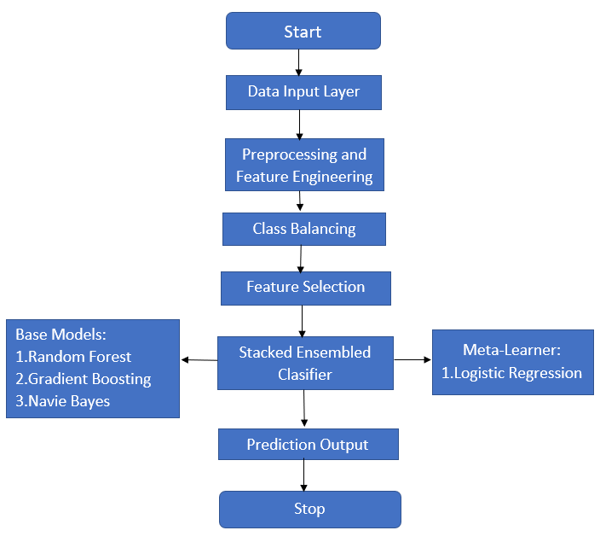
FLOW DIAGRAM
Working Process
Review No.01
Batch No.CB9

Slide 12
Working process
Input Layer: NDVI vegetation indices and weather variables
Preprocessing: Data cleaning, normalization, lag feature creation
Class Balancing: SMOTE to handle rare fire events
Feature Selection: Selection of influential fire-related features
Ensemble Learning: Stacked model with Random Forest, Gradient Boosting, and Naive Bayes
Meta-Learner: Logistic Regression for final decision
Output: Fire / Non-Fire prediction

Slide 13
IMPLEMENTATION
INSTALLING NECESSARY PACKAGES
!pip install lightgbm xgboost catboost shap optuna imbalanced-learn tensorflow pyhdf --quiet
!apt install libgdal-dev -y
READING DATASETS
t2m_files = [
"/content/drive/MyDrive/forest fire prediction/POWER_Regional_Daily_20120101_20121231 (2).csv",
"/content/drive/MyDrive/forest fire prediction/POWER_Regional_Daily_20130101_20131231 (2).csv",
]
rh2m_files=[
"/content/drive/MyDrive/forest fire prediction/POWER_Regional_Daily_20120101_20121231 (1).csv",
"/content/drive/MyDrive/forest fire prediction/POWER_Regional_Daily_20130101_20131231 (1).csv",
]
precip_files =[
"/content/drive/MyDrive/forest fire prediction/ POWER_Regional_Daily_20120101_20121231.csv",
"/content/drive/MyDrive/forest fire prediction/ POWER_Regional_Daily_20130101_20131231.csv",
]

Slide 14
IMPLEMENTATION
Phase 1: Data Collection
df_t2m = clean_power_csv(t2m_path, "T2M")
df_rh2m = clean_power_csv(rh2m_path, "RH2M")
df_prc = clean_power_csv(precip_path, "PRECTOTCORR")
df = df_t2m.merge(df_rh2m, on="date").merge(df_prc, on="date")
Description:
Downloaded 2012–2025 NASA POWER meteorological data (Temperature, Humidity, Precipitation) and MODIS NDVI (MOD13Q1) satellite data.
FIRMS fire-event datasets were used to label fire occurrences.
Phase 2: Fire Event-Labeling
fire_dates = pd.to_datetime(fire_df["acq_date"]).dt.date
all_power_df["fire_occurred"] = all_power_df["date"].dt.date.isin(fire_dates).astype(int)
Description:
FIRMS (NASA) fire archive and near-real-time datasets were used to mark whether a fire occurred on each date (binary label).
Phase 3:NDVI Extraction from MODIS HDF
dataset = gdal.Open(hdf_file)
ndvi = gdal.Open(dataset.GetSubDatasets()[0][0]).ReadAsArray()
ndvi[ndvi == -3000] = np.nan
ndvi_mean = np.nanmean(ndvi * 0.0001)
Description:
Extracted NDVI from MOD13Q1 HDF layers using GDAL, applied scaling factor (0.0001), and computed daily NDVI snapshots
Review No.01
Batch No.CB9

Slide 15
IMPLEMENTATION
Phase 4: Feature Engineering
for col in ["T2M", "RH2M"]:
for lag in range(1, 8):
all_power_df[f"{col}_lag_{lag}"] = all_power_df[col].shift(lag)
all_power_df["month"] = all_power_df["date"].dt.month
all_power_df["season"] = all_power_df["month"].map({...})
Description:
Added lag values (1–7 days) for temperature and humidity.
Generated month, day-of-year, and season features.
Phase 5: Handling Class Imbalance (SMOTE)
sm = SMOTE(sampling_strategy=0.5, random_state=42)
X_res, y_res = sm.fit_resample(X, y)
Description:
• Wildfire events are extremely rare.
• SMOTE was used to synthetically oversample minority (fire) class.

Slide 16
IMPLEMENTATION
Phase 6: Feature Selection (LightGBM)
lgb = LGBMClassifier(n_estimators=80, max_depth=5)
lgb.fit(X_train, y_train)
important_idx = np.argsort(lgb.feature_importances_)[-20:]
X_train_fs = X_train.iloc[:, important_idx]
X_test_fs = X_test.iloc[:, important_idx]
Description:
LightGBM was trained to select top 20 most important features for faster and more accurate modeling.
Phase 7: Model Training (Stacked Ensemble)
base = [
('rf', RandomForestClassifier(n_estimators=20, max_depth=5)),
('gb', GradientBoostingClassifier(n_estimators=20)),
('nb', GaussianNB())
]
stack_model = StackingClassifier(
estimators=base,
final_estimator=LogisticRegression(max_iter=500),
cv=3
)
stack_model.fit(X_train_fs, y_train)
Description:
Built a stacked model using
✔ Random Forest
✔ Gradient Boosting
✔ Naïve Bayes
Final classifier: Logistic Regression
→ This improved generalization and reduced overfitting.

Slide 17
IMPLEMENTATION
Phase 8: Model Evaluation
y_pred_prob = stack_model.predict_proba(X_test_fs)[:,1]
y_pred = (y_pred_prob >= optimal_thresh).astype(int)
print(classification_report(y_test, y_pred))
Description:
Used Accuracy, Precision, Recall, F1-score, ROC-AUC, confusion matrix.
Visualizations Included:
✔ Confusion Matrix
✔ ROC Curve
✔ LightGBM Top 20 Feature Plot
✔ Error Metrics (MSE, RMSE)
✔ Train vs Test Accuracy Comparison

Slide 18
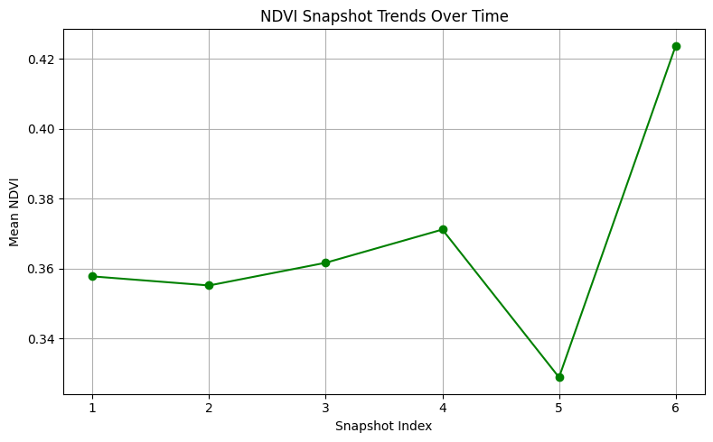
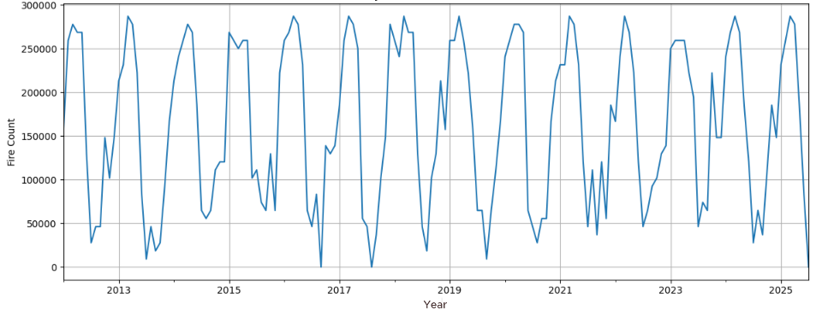
RESULTS & ANALYSIS
Fig. NDVI snapshot Trends
Fig. Year-Wise Fire Occurrence
plt.figure(figsize=(8, 5))
plt.plot(range(1, len(ndvi_vals) + 1), ndvi_vals, marker='o', color='green')
plt.xticks(range(1, len(ndvi_vals) + 1))
plt.title("NDVI Snapshot Trends Over Time")
plt.xlabel("Snapshot Index")
plt.ylabel("Mean NDVI")
plt.grid(True)
plt.tight_layout()
plt.show()
monthly_fire = all_power_df.groupby(all_power_df['date'].dt.to_period('M'))['fire_occurred'].sum()
plt.figure(figsize=(12, 5))
monthly_fire.plot()
plt.title(“Year-wise Fire Occurrence Over Time")
plt.xlabel(“Year")
plt.ylabel("Fire Count")
plt.grid(True)
plt.tight_layout()
plt.show()
Review No.01
Batch No.CB9

Slide 19
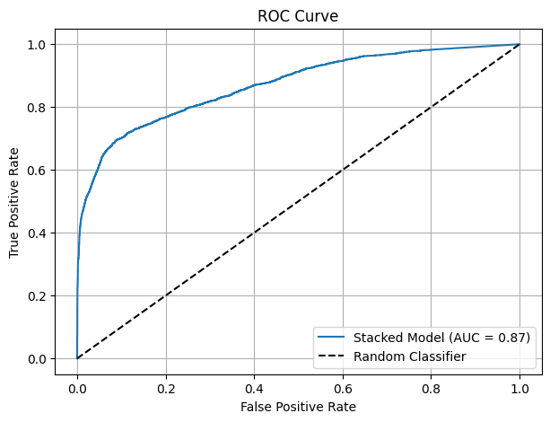
RESULT & ANALYSIS
from sklearn.metrics import roc_auc_score
plt.figure(figsize=(7, 5))
plt.plot(fpr, tpr, label=f"Stacked Model (AUC = {roc_auc_score(y_test, y_pred_prob):.2f})")
plt.plot([0, 1], [0, 1], 'k--', label='Random Classifier')
plt.xlabel("False Positive Rate")
plt.ylabel("True Positive Rate")
plt.title("ROC Curve")
plt.legend(loc="lower right")
plt.grid()
plt.show()
ROC–AUC of 0.87 demonstrates strong and reliable discrimination between fire and non-fire events, supporting effective early fire detection.

Slide 20
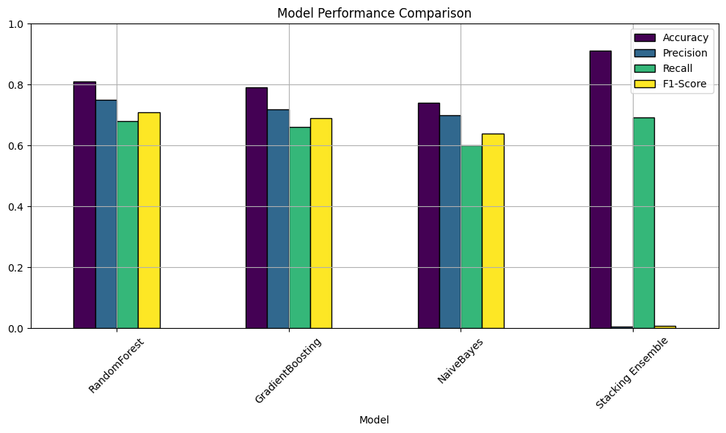
RESULTS & ANALYSIS
Feature Importance Analysis (LightGBM):
LightGBM identified the most influential predictors contributing to fire occurrence.
Top contributing features include:
Temperature (T2M) & Humidity (RH2M) lag features
NDVI snapshots (vegetation health indicators)
Season & Day-of-Year
Precipitation (PRECTOTCORR)
This confirms that vegetation dryness, heat buildup, and seasonal climate patterns play a major role in fire risk.
Model Interpretability & Insights:
Feature Influence Results:
Most influential inputs affecting fire prediction:
T2M_lag values (1–7 days)
NDVI Snapshot Features
RH2M Lag Indicators
Seasonal Category (0–3)
Day-of-Year (DOY)
Key Observations from the Graph:
Stacking Ensemble surpasses all individual models, showing the strongest predictive performance.
It achieves the highest accuracy (~91%), demonstrating strong generalization for forest fire prediction.
Precision and Recall are well-balanced compared to other models, indicating fewer false alarms and better fire event detection.

Slide 21
RESULTS & ANALYSIS
Comparative Analysis – Previous Works vs Present Work
Aspect | Previous Works | Present Work (Proposed Model)
Focus Area | Basic fire detection or hotspot mapping | Complete fire prediction using NDVI + NASA weather + fire history
Methodology | Single models (RF, SVM, Logistic Regression) | Stacked Ensemble (RF + GB + Naïve Bayes) with LightGBM feature selection
Data Scope | Limited to thermal anomalies or small datasets | Integrated multi-year dataset: MODIS NDVI, NASA POWER weather, FIRMS fire points
Interpretability | Mostly black-box with no feature explanation | Feature importance analysis using LightGBM and correlation insights
Output | Binary detection only | Risk prediction + probability score + lag-based environmental insights
Accuracy / Performance | 80–90% (approx.) | 91.42% accuracy, improved recall for rare fire events
Scalability | Region-specific, limited generalization | Scalable to other forest regions with satellite-based inputs
Decision Support | No actionable insights | Helps in early risk assessment, supporting forest department planning

Slide 22
CONCLUSION & FUTURE SCOPE
The proposed NallaFireNet model accurately predicts fire-prone days using NDVI and synthetic weather data, enhancing early warning capabilities.
The ensemble of XGBoost and LightGBM improves recall for rare fire events, supporting proactive forest management and quick response.
The model can be expanded for real-time deployment with live dashboards for forest authorities.
Future work includes applying advanced temporal models like LSTM or Transformers for improved seasonal prediction.
Review No.01
Batch No.CB9

Slide 23
REFERENCES
Y. Yu, L. Liu, Z. Chang, Y. Li, and K. Shi, “Detecting Forest Fires in Southwest China From Remote Sensing Nighttime Lights Using the Random Forest Classification Model,” IEEE J. Sel. Topics Appl. Earth Observ. Remote Sens., vol. 17, pp. 10759–10771, Jun. 2024..
S. K. Chaitanya, B. S. S. Vutukuri, G. R. Dandamudi, U. S. Varri, and N. K. Vemula, “Performance Analysis of Fire and Smoke Detection System Employing Machine Learning Techniques,” in Proc. ICCRTEE, 2025, pp. 1–6.
G. M. I. Alam, N. Tasnia, T. Biswas, M. J. Hossen, S. A. Tanim, and M. S. U. Miah, “Real-Time Detection of Forest Fires Using FireNet-CNN and Explainable AI Techniques,” IEEE Access, vol. 13, pp. 51150–51165, Mar. 2025.
N. K. Ojha and M. Katoch, “Multimodal Deep Transfer Learning with CNN-LSTM Fusion for Enhanced Forest Fire Detection and Risk Prediction,” in Proc. ICPCSN, 2025, pp. 397–404.
M. Sivanuja, R. Rao, P. R. Shalem Raju, K. S. Kumar, M. Prasad, and P. K. Sree, “A Novel Ensemble-Based Deep Learning Framework Combining CNN and Transfer Learning Models for Enhanced Wildfire Detection,” in Proc. ICCRTEE, 2025, pp. 1–7
Review No.01
Batch No.CB9

Slide 24
REFERENCES
6. H. Jo, M. Won, F. Kraxner, S. W. Jeon, Y. Son, A. Krasovskiy, and W.-K. Lee, “Projecting Forest Fire Prob ability in South Korea Under Climate Change Using AI & Process-Based Hybrid Model (FLAM-Net),” IEEE J. Sel. Topics Appl. Earth Observ. Remote Sens., vol. 18, pp. 13003–13016, May 2025.
7. N. M. J. Swaroopan and A. J. M. Rani, “Forest Fire Prediction Based on Climate Change Using Hybrid Optimized K-Means Clustering Algorithm,” in Proc. RMK MATE, 2025, pp. 1–6.
8. N. Datta, M. Saqib, M. T. Aziz, R. R. Rakhimov, B. Madaminov, and T. Mahmud, “Integrating XAI and Machine Learning for an Effective Forest Fire Prediction System,” in Proc. ICETECC, 2025, pp. 1–7.
9. T. S. R. Raj, G. Balamuralikrishnan, J. R. F. Raj, D. Vikkiramapandian, R. S. Krishnan, and J. N. Jothi, “Sustainable AI Systems for Monitoring and Predicting Wild fires in Vulnerable Forest Regions,” in Proc. ICMSCI, 2025, pp. 1129–1135.
10. P. Singh, R. Kaur, and A. Sharma, “NDVI and IoT Framework for Fire Warnings,” Computers and Agriculture, vol. 8, pp. 87–96, 2022.

Slide 25
REFERENCE
R. Kumar, S. Gupta, and A. Verma, “LSTM Model for Forest Fire Forecasting,” Remote Sens., vol. 13, no. 4, pp. 665–674, 2021.
M. Gacemi, M. Ghabi, and N. Benshela, “Evaluation of Machine Learning Models to Predict the Probability of Forest Fires with Small Training Sample: Case of the Wilaya of Sidi Belabbes,” in 2024 IEEE Mediterranean and Middle East Geoscience and Remote Sensing Sym- posium (M2GARSS), pp. 134–138.
S. Barik, R. Das, and A. R. Rout, “Forest Fire Prediction Using Machine Learning,” in 2021 2nd International Conference on Smart Electronics and Communication (ICOSEC), IEEE, pp. 872–877, 2021.
P. Moral, P. Parasar, N. R. Mukherjee, N. Kumari, A.P. Krishna, D. Mustafi, and A. Mustafi, “Forest Fire Forecasting Leveraging MODIS Satellite Fire Data Using Machine Learning for Jharkhand State, India,” in 2024 IEEE India Geoscience and Remote Sensing Symposium (InGARSS), pp. 1–6, 2024.
J. Jang, S. Yoon, and Y. Cho, “Early Forest Fire Detection With UAV Image Fusion: A Novel Deep Learning Method Using Visible and Infrared Sensors,”IEEE Ac- cess, vol. 10, pp. 16032–16044, 2022.

Slide 26
ACKNOWLEDGEMENTS
We gratefully acknowledge
Department of Computer Science and Engineering, Narasaraopeta Engineering College, Guntur, India,
for providing the facilities, mentorship, and support to carry out this research.
Special thanks to
Dr. S. Siva Nageswararao and Mr. Dodda Venkata Reddy
for their valuable guidance and continuous encouragement.

Slide 27

Review No.01
Batch No.CB9

Slide 28

Review No.01
Batch No.CB9

