Slide 1

Department of Computer Science Engineering
Title : ExplaiLiver+: A Multi-Stage Stacking Framework with SHAP-Based Interpretability for Clinical Liver Disease Prediction
PRESENTED BY
Mounica Pulagorla (22471A05H5)
Ramadevi Mahamkali (22471A05G9)
Abhinayasri Valivarthi (22471A05K4)
Under the Guidance of,
G. Saranya, M.Tech., (Ph.D) Assistant Professor,
Department of Computer Science and Engineering,
Narasaraopeta Engineering College (Autonomous),
Narasaraopet- 522 601.

Slide 2
OUTLINE
Abstract
Introduction
Literature Survey
Research Gaps
Problem Statement
Objectives
Flow Chart
Methodology
Implementation
Results & Analysis
Conclusion & Future Scope
References
Question and Answers
Acknowledgements

Slide 3
Abstract
Improving patient outcomes and facilitating early medical intervention depend on timely and accurate liver disease prediction. In this work, we present ExplaiLiver+, a new multi-stage stacking ensemble framework that uses SHAP to combine interpretability of the model with high predictive performance. Robust preprocessing methods such as skewness correction, class balancing with SMOTEENN, feature selection using an ExtraTrees-based approach, and missing value imputation are all integrated into the framework. Four heterogeneous base classifiers—XGBoost, ExtraTrees, LightGBM, and CatBoost—stacked via a logistic regression meta-learner are used in the core ensemble architecture to improve generalization. ExplaiLiver+ outperforms individual baseline models with an AUC of 98.39% and a test accuracy of 94.05%, This study utilizes the ILPD for analysis. SHAP values are employed to illustrate feature importance and provide an explanation of individual predictions in order to guarantee decision-making transparency. The suggested system shows how clinical decision support systems for liver disease detection can be made much more reliable and trustworthy by fusing feature-level explainability with model-level ensemble learning.

Slide 4
Introduction
Project Overview: A machine learning–based stacking ensemble developed for accurate liver disease prediction. Uses clinical parameters from the ILPD dataset.
Core Concept: Combine four strong models (XGBoost, LightGBM, CatBoost, ExtraTrees). Logistic Regression acts as meta-learner to give final prediction.
Motivation: Early detection of liver disease is essential but conventional screening is slow and sometimes inaccurate. Existing ML models struggle with imbalance and poor preprocessing.
Innovation: Multi-stage stacking ensemble framework with SHAP-based interpretability. Feature optimization, SMOTE-ENN balancing, and strong cross-validation ensure robustness.
Significance: Provides reliable, non-invasive liver disease prediction with 94% accuracy. Supports clinical decision-making and can be extended to real-time healthcare systems.

Slide 5
Literature Survey
No | Title | Author | Journal Name & Year | Methodology Adopted | Key Findings | Gaps
1 | Predicting Liver Disease Using Support Vector Machine and Logistic Regression | V. Jyoshita et al., | sciencedirect, 2025 | Label encoding, normalization, cleaning | Simple model; focuses on classical ML; future work mentions Word2Vec | Limited to classical ML; no feature selection; no ensemble or DL
2 | XGBoost-Liver: An Intelligent Integrated Features Approach | Sumaiya Noor et al., | techscience, 2025 | Oversampling, Fisher Score, PCA, LDA | Achieved 92.07% accuracy; hybrid feature engineering; strong performance | High complexity in preprocessing; needs testing on multi-center datasets
3 | Liver Disease Prediction Using Deep Learning | V. Jyoshita et al., | IJRASET, 2025 | Missing values, label encoding, data shuffling | Achieved 73.3% accuracy; RBM improved feature extraction; MLP best-performing model | Moderate accuracy; no ensemble models; limited features; no imaging data

Slide 6
Literature Survey
No | Title | Author | Journal Name & Year | Methodology Adopted | Key Findings | Gaps
4 | Efficient Diagnosis of Liver Disease using Deep Learning | Nosheen Jillani et al. | IEEE Access, 2023 | Null handling, RFE, feature selection | Achieved 93% accuracy; BiLSTM outperformed others; strong feature extraction | No pre-trained embeddings; limited to structured data; needs diverse datasets
5 | Comparative Analysis of Boosting Algorithms for Liver Disease Prediction | Shahid M. Ganie & P.K.D. | Sciencedirect, 2024 | EDA, imputation, SMOTE, scaling | GB achieved 98.29% accuracy; best across 13 metrics | GB is computationally expensive; no deep learning or multimodal data

Slide 7
Literature Survey
Liver Disease Prediction Using Deep Learning (Jyoshita et al., 2024)- Uses MLP and RBM-based feature learning to improve structured clinical parameter classification for liver disease detection
Predicting Liver Disease Using SVM & Logistic Regression - Applies classical ML methods with normalization and label encoding to predict liver disease using basic statistical models.
XGBoost-Liver: Intelligent Feature Integration - Uses hybrid feature engineering (Fisher Score, PCA, ANOVA) with XGBoost to enhance classification performance and highlight discriminative attributes.
Boosting Algorithms for Chronic Liver Disease Prediction -Benchmark analysis showing Gradient Boosting, LightGBM, and CatBoost outperform other boosting models using extensive preprocessing and SMOTE balancing.
Efficient Diagnosis Using Deep Learning Technique - Deep learning-based BiLSTM architecture provides superior accuracy through sequential pattern learning over traditional ML and DL baselines.

Slide 8
Research Gaps
Most existing works lack explainability (no SHAP/LIME). Clinicians cannot understand why a prediction is made.
Many papers use simple oversampling or ignore imbalance . Leads to high false negatives (dangerous in medical prediction).
ML/DL models show accuracy between 70–93%. No stable or robust model across different validation folds.
Papers mostly focus on single models (SVM, XGBoost, BiLSTM). No combined framework to leverage diverse model strengths.
Limited usage of feature ranking, log transformation, or skewness correction. Redundant and noisy features reduce performance

Slide 9
Problem Statements
Clinical data is noisy and imbalanced, causing models to misclassify liver disease cases, especially minority/healthy patients.
Existing ML/DL models show moderate or unstable accuracy, failing to generalize across different validation folds.
Weak preprocessing and limited feature engineering lead to skewed distributions, redundant attributes, and poor predictive power.
Single-model approaches lack robustness, struggling to capture both linear and non-linear patterns in clinical features.
Low interpretability in existing systems, making clinicians unable to trust or understand why a prediction is made.

Slide 10
Objectives
Robust Classification: Build a reliable liver disease prediction model using a multi-stage stacking ensemble for improved accuracy and stability
High-Quality Preprocessing: Correct skewed data, handle missing values, and balance class distribution using SMOTE-ENN for better model performance.
Feature Optimization: Select the most relevant clinical attributes using ExtraTrees feature ranking and log transformation for improved interpretability.
Explainable Predictions: Integrate SHAP-based interpretability to provide clear clinical reasoning behind each prediction.
Generalizable Results: Validate the model with cross-validation to ensure consistency, robustness, and reduced overfitting.

Slide 11
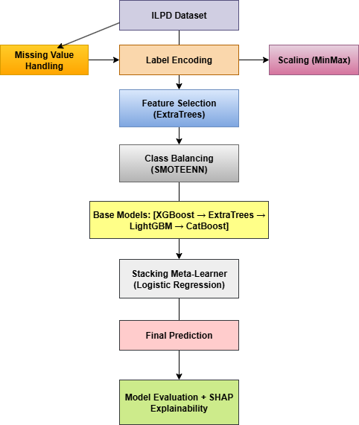
Flow Chart

Slide 12
Methodology
Dataset: Indian Liver Patient Dataset-583 samples, 10 features, 2 output classes(Disease / No Disease)
Preprocessing Steps:
Missing value imputation using median of A/G ratio.
Label encoding for Gender (Male=1, Female=0).
Log transformation to reduce skewness in features like TB, DB, SGOT, SGPT
MinMax normalization to scale features between [0,1].
SMOTE-ENN applied to handle imbalance and remove noise.
ExtraTreesClassifier used for feature importance-based selection.
Model Architecture:
Base learners: XGBoost, LightGBM, CatBoost, ExtraTrees.
Meta learner: Logistic Regression (for final prediction). Trained using 15-fold stratified cross-validation.
Explainability: Integrated SHAP values for feature-level interpretation of model predictions.

Slide 13
Methodology
Category | Description
Framework Used | ExplaiLiver+ multi-stage stacking ensemble combining four base models and a Logistic Regression meta-learner.
Algorithms | XGBoost, LightGBM, CatBoost, ExtraTrees as base learners; Logistic Regression as meta-learner in stacking.
Parameter Settings | XGBoost/LightGBM/CatBoost tuned with optimized learning rate, tree depth, estimators, and regularization; ExtraTrees configured with auto max-features and high estimators. Logistic Regression used as meta-learner with L2 regularization and 15-fold stratified cross-validation for stable training.
Mathematical Equations | Accuracy: (TP + TN) / (TP + TN + FP + FN) F1-Score: 2PR /(P + R), Precision: TP/ (TP+FP), Recall: TP/(TP+FN)​​
Tools Used | Python, Google Colab, Scikit-Learn, XGBoost Library, LightGBM Library, CatBoost Library, Pandas, NumPy, Matplotlib.

Slide 14
Implementation
The project was implemented in Python (Google Colab) using Scikit-learn, XGBoost, LightGBM, CatBoost, Pandas, NumPy, and Matplotlib
The ILPD dataset was preprocessed with median imputation, label encoding, Min–Max scaling, and balanced using SMOTE-ENN to handle class imbalance and noise.
Four Ml models - XGBoost, LightGBM, ExtraTrees, and CatBoost — were trained and stacked using Logistic Regression as the meta-learner with Stratified 15-Fold validation for robust evaluation.
Hardware used: Colab CPU/GPU environment enabling faster training and stable model execution.
Challenges addressed: noisy data, imbalance, skewness, and variance — solved through feature selection, log transformation, SMOTE-ENN, and ensemble stacking for stable performance.

Slide 15
Results & Analysis
Model | Accuracy | F1 Score | Recall | Precision | AUC
XGBoost | 91.09% | 0.8989 | 0.9302 | 0.8696 | 0.9759
ExtraTrees | 91.09% | 0.8916 | 0.8605 | 0.9250 | 0.9824
LightGBM | 93.07% | 0.9195 | 0.9302 | 0.9091 | 0.9840
CatBoost | 93.07% | 0.9195 | 0.9302 | 0.9091 | 0.9840
ExplaiLiver+ (Stacked) | 94.05% | 0.9402 | 0.9384 | 0.9433 | 0.9839

Slide 16
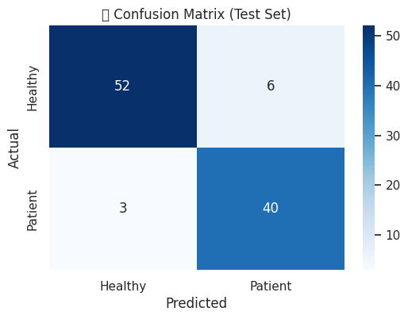
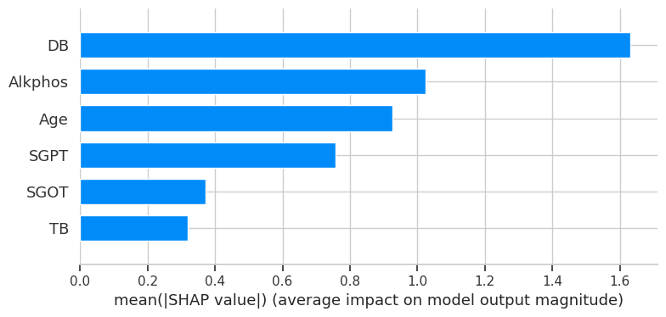
Results & Analysis
Confusion Matrix
Shap Explainability for Stacking model.

Slide 17
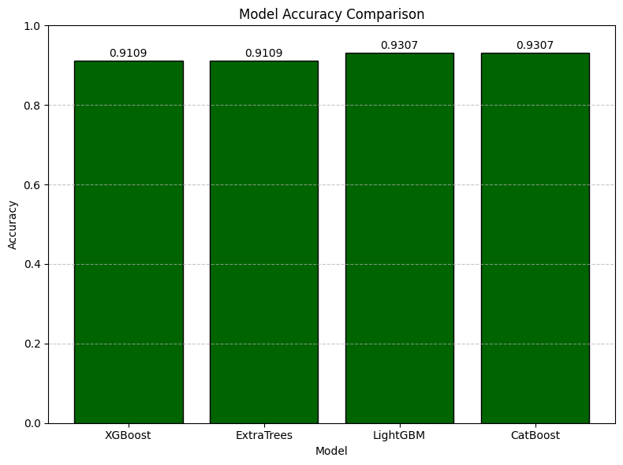
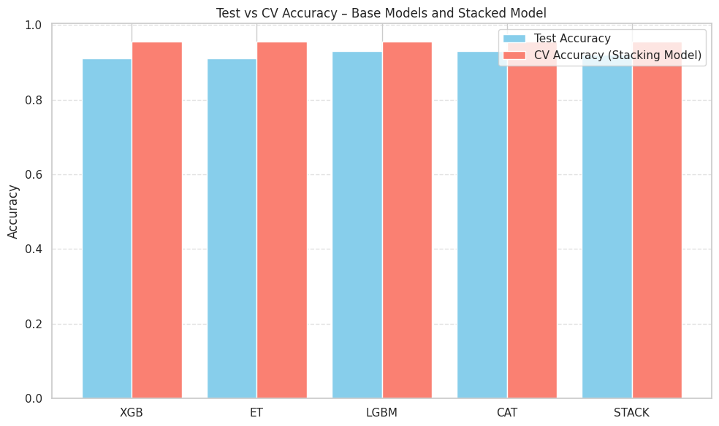
Results & Analysis
Comparison of XGBoost, ExtraTrees, LightGBM, CatBoost
Final Model Evaluation Metrics

Slide 18
Conclusion & Future Scope
ExplaiLiver+ achieved 94% accuracy with strong generalization using a multi-stage stacking ensemble.
Effective preprocessing (SMOTE-ENN, scaling, feature selection) and SHAP explainability improved reliability, transparency, and clinical trust.
The approach reduces noise propagation and enhances semantic alignment in multi-view graph learning.
Integrate with real-time clinical systems or IoT-based health monitoring.
Expand to multi-center datasets and multi-class liver disease prediction for broader applicability.

Slide 19
References
Amin, R., Yasmin, R., Ruhi, S., Rahman, M. H., & Reza, M. S. (2023). Prediction of chronic liver disease patients using integrated projection based statistical feature extraction with machine learning algorithms. Informatics in Medicine Unlocked, 36, 101155.
Noor, S., AlQahtani, S. A., & Khan, S. (2025). Chronic liver disease detection using ranking and projection-based feature optimization with deep learning. AIMS Bioengineering, 12(1).
Ganie, S. M., & Pramanik, P. K. D. (2024). A comparative analysis of boosting algorithms for chronic liver disease prediction. Healthcare Analytics, 5, 100313.
Dritsas, E., & Trigka, M. (2023). Supervised machine learning models for liver disease risk prediction. Computers, 12(1), 19.
Jillani, N., Khattak, A. M., Asghar, M. Z., & Ullah, H. (2023, June). Efficient diagnosis of liver disease using deep learning technique. In 2023 IEEE International Symposium on Medical Measurements and Applications (MeMeA) (pp. 1–6). IEEE.
Noor, S., AlQahtani, S. A., & Khan, S. (2025). XGBoost-Liver: An Intelligent Integrated Features Approach for Classifying Liver Diseases Using Ensemble XGBoost Training Model. Computers, Materials & Continua, 83(1).
Osaseri, R. O., & Usiobaifo, A. R. (2024). Predicting liver Disease Using Support Vector Machine and Logistic Regression classification Algorithm. NIPES-Journal of Science and Technology Research, 6(4).
Rani, R., Jaiswal, G., Nancy, Lipika, Bhushan, S., Ullah, F., ... & Diwakar, M. (2025). Enhancing liver disease diagnosis with hybrid SMOTE-ENNbalanced machine learning models—an empirical analysis of Indian patient liver disease datasets. Frontiers in Medicine, 12, 1502749.

Slide 20
References
Tokala, S., Hajarathaiah, K., Gunda, S. R. P., Botla, S., Nalluri, L., Naga manohar, P., ... & Enduri, M. K. (2023). Liver disease prediction and classification using machine learning techniques. International Journal of Advanced Computer Science and Applications, 14(2).
Rahman, A. S., Shamrat, F. J. M., Tasnim, Z., Roy, J., & Hossain, S. A. (2019). A comparative study on liver disease prediction using supervised machine learning algorithms. International Journal of Scientific & Technology Research, 8(11), 419–422.
Anthonysamy, V., & Babu, S. K. (2023). Multi Perceptron Neural Network and Voting Classifier for Liver Disease Dataset. IEEE Access, 11, 102149–102156.
Hallaji, E., Razavi-Far, R., Palade, V., & Saif, M. (2021). Adversarial learning on incomplete and imbalanced medical data for robust survival prediction of liver transplant patients. IEEE Access, 9, 73641-73650.
Liu, Y., Meric, G., Havulinna, A. S., Teo, S. M., ˚ Aberg, F., Ruuskanen, M., ... & Inouye, M. (2022). Early prediction of incident liver disease using conventional risk factors and gut-microbiome-augmented gradient boosting. Cell Metabolism, 34(5), 719-730.
Kumar, D., Bakariya, B., Verma, C., & Illes, Z. (2025). LivXAI-Net: An explainable AI framework for liver disease diagnosis with IoT based real-time monitoring support. Computer Methods and Programs in Biomedicine, 108950.
Mamun, M., Chowdhury, S. H., Hossain, M. M., Khatun, M. R., & Iqbal, S. (2025). Explainability enhanced liver disease diagnosis technique using tree selection and stacking ensemble-based random forest model. Informatics and Health, 2(1), 17-40.

Slide 21
Questions and Answers
I now open the floor for any questions from the panel and audience.
I would be glad to clarify or discuss any part of my work in more detail.
Your valuable feedback and suggestions are always welcome.

Slide 22
Acknowledgements
I sincerely thank my guide, faculty, and department for their continuous support and guidance throughout this project, and I am thankful for the opportunity to present my work today.

