Slide 1
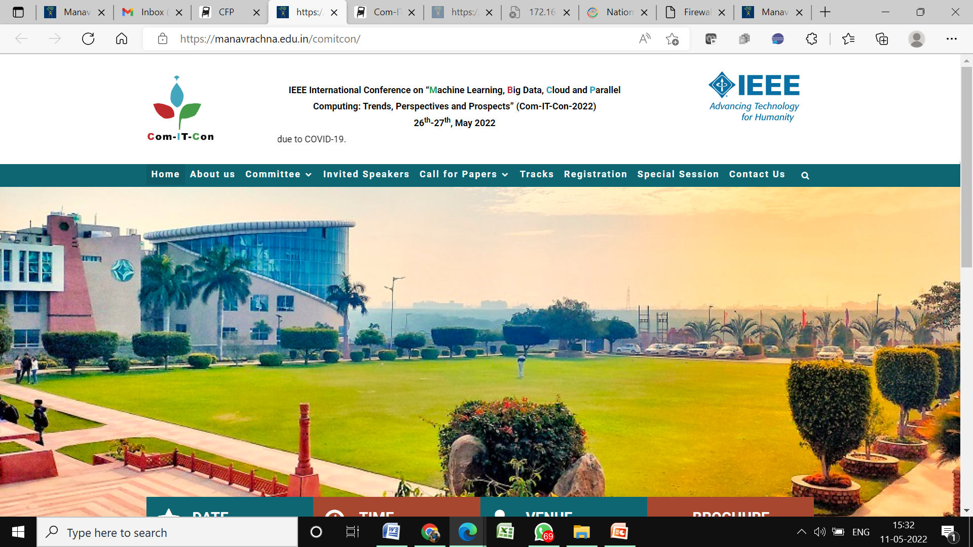


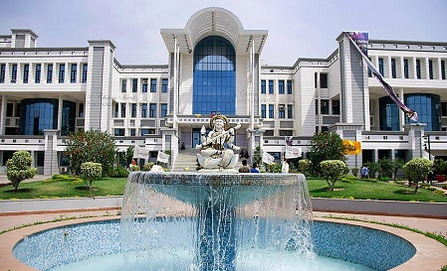

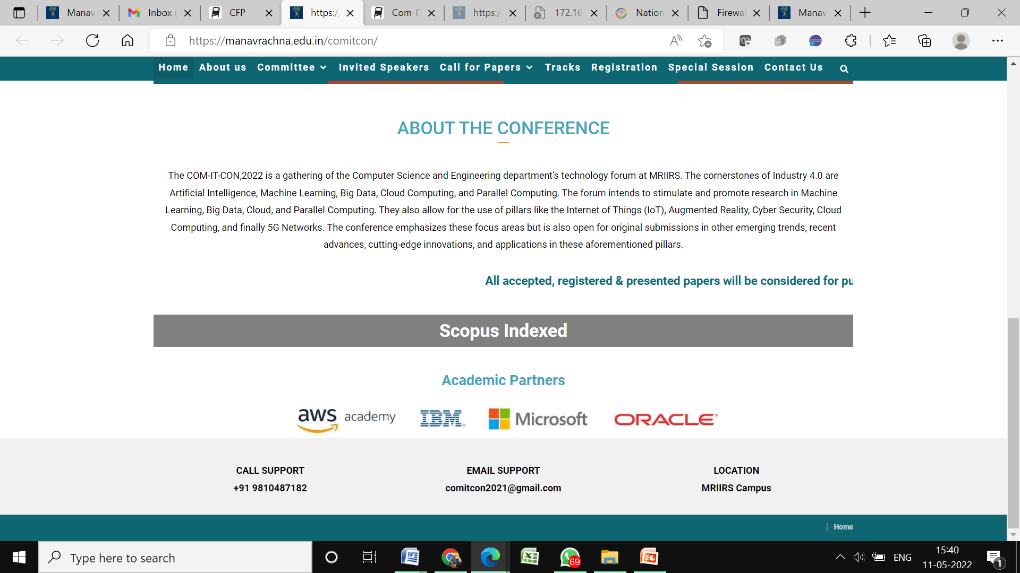


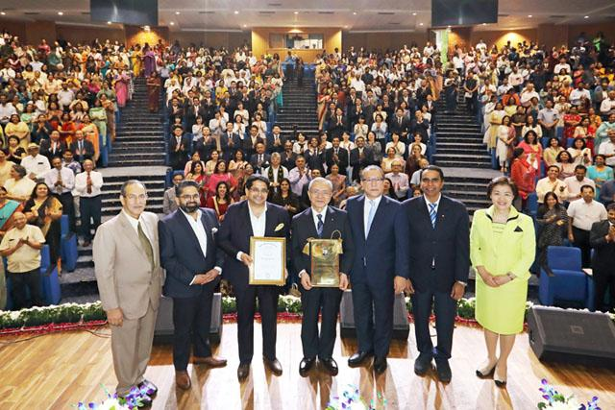
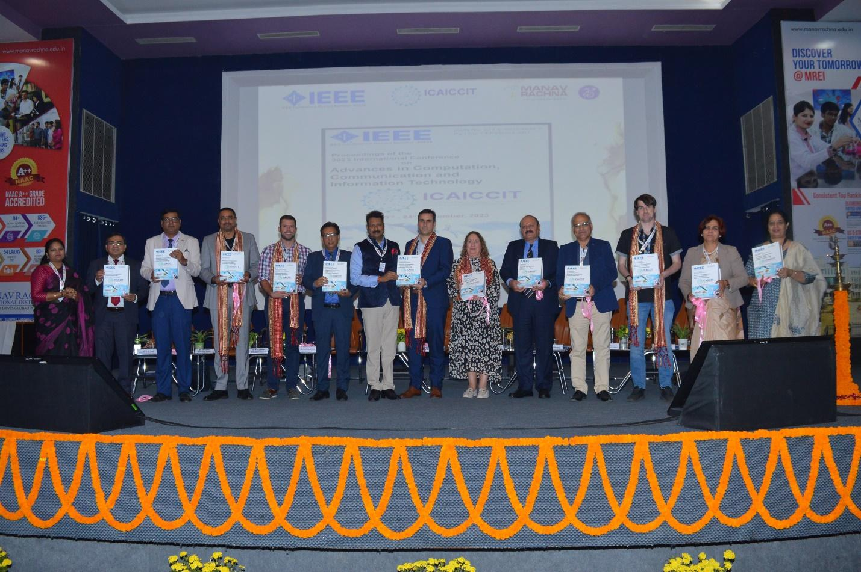

ICAICCIT-2025, 3rd International conference on Advances in Computing, Communication and Information Technology, technically Co-Sponsored by IEEE Delhi SECTION (IEEE record no # 68829)
on 31st Oct & 1st Nov. 2025

Slide 2
Meta-Fusion Ensemble of Transformer Models for Robust Multilingual and Cross-Domain Sentiment Classification
Paper ID - 407
Authors Name & Affiliation :
Vijaya Kumar Nukala, CSE
Prasanna Panchumarthi, CSE
Jayalakshmi Kshatriya, CSE
Apsa Shaik, CSE
Lohitha Mallireddy, CSE
Sushma Brahmadevara, Dept of Humanities and Mathematics
Dodda VenkataReddy, CSE
Presented by
Prasanna Panchumarthi

Slide 3
Introduction
Sentiment Analysis (SA) evolved from binary polarity detection to multilingual and domain-adaptive applications.
Real-world text varies across languages, domains, and contexts, challenging model generalization.
Transformer models like BERT, RoBERTa, DistilBERT, XLM-R revolutionized SA but remain sensitive to domain/language shifts.
Ensemble strategies (e.g., voting, averaging) fail to capture inter-model dependencies.
We propose a Meta-Fusion MLP Ensemble that learns dynamic fusion of transformer logits for robust, multilingual sentiment prediction.

Slide 4
Problem Statements
Existing sentiment models:
  Perform well on single domains but fail under cross-domain or multilingual settings.
  Use static fusion (majority/average voting) which ignores inter-model relationships.
Need for:
  A trainable fusion mechanism that learns inter-logit dependencies.
  A generalized framework effective across multiple languages and data sources.

Slide 5
Objectives
Develop a meta-fusion ensemble integrating multiple transformer models.
Capture non-linear dependencies among base model outputs.
Enhance neutral sentiment detection, the hardest sentiment class.
Achieve cross-domain and multilingual robustness.
Evaluate performance against individual models and traditional baselines.

Slide 6
Literature Review
BERT, RoBERTa, and XLM-R improved SA but struggle in cross-lingual adaptation.
Works (Ouyang et al., 2024; Wu et al., 2025) explored ABSA and multilingual sentiment, yet lacked scalability.
Static ensembles (voting/averaging) underperform on diverse datasets (Zhang et al., 2025).
Learnable ensembles (MLP, stacking) showed promise but were complex or overfit easily.
Our contribution: a lightweight, trainable fusion (MLP) capturing logit-level relationships for multilingual SA.

Slide 7
Methodology Overview
Datasets Used :
Dataset | Samples | Classes | Language | Domain
Sentiment140 | 675 | 2 | English | Twitter
IMDB | 675 | 2 | English | Movie Reviews
ABSA | 675 | 3 | English | Product Reviews
Multilingual Tweets | 675 | 3 | 10+ | Mixed (Blogs, News, Tweets)
Total Evaluation Set: 2,700 balanced samples across all domains.

Slide 8
Preprocessing Pipeline :
Steps:
Text Cleaning → Remove special chars, URLs, whitespace.
Tokenization → BERTTokenizer / XLMRobertaTokenizer.
Padding/Truncation → Fixed 128 tokens.
Dataset Loader → PyTorch tensors for training & inference.
Result:
Consistent, noise-free inputs ensuring stable model convergence.

Slide 9
Proposed Architecture :
Base Models:
BERT – Sentiment140
RoBERTa – IMDB
DistilBERT – ABSA
XLM-RoBERTa – Multilingual Tweets
Fusion:
Concatenate all logits → Feed into Meta-Fusion MLP
MLP (64–32 neurons, ReLU + Softmax)
Learns cross-model dependencies dynamically

Slide 10
Experimental Results :
Model | Dataset | Accuracy (%)
BERT | Sentiment140 | 85.3
RoBERTa | IMDB | 87.0
DistilBERT | ABSA | 83.2
XLM-R | Multilingual | 83.9
Meta-Fusion MLP (Proposed) | Combined | 86.91

Slide 11
Results and Discussion :
Evaluation Metrics
  Accuracy, Precision, Recall, F1-score used to test performance
Comparison with Base Models
  BERT: 85.3% | RoBERTa: 87.0% | DistilBERT: 83.2% | XLM-R: 83.9%
  Meta-Fusion (ours): 86.9%
Against Traditional Models
  SVM: 72.5% | CNN: 75.8% | Shallow ML: 70.1%
  Proposed model performs ~11% better
Key Takeaways
  Works well across different domains & languages
  Low overfitting, stable training
  Dynamic fusion gives better results than static voting

Slide 12
Conclusion :
Proposed a Meta-Fusion Ensemble integrating four transformer models via a trainable MLP fusion layer.
Achieved 86.91% accuracy and strong macro-F1 (85.67%).
Proved effectiveness in multilingual and cross-domain sentiment analysis.
Outperformed individual transformers and traditional ML methods.

Slide 13
Future Scope :
Test under zero-shot & cross-lingual conditions.
Extend to low-resource languages.
Explore multimodal fusion (text + image).
Optimize fusion via attention or NAS (Neural Architecture Search).
Deploy on real-world multilingual social media platforms.

Slide 14
References :
Wu et al., M-ABSA: Multilingual Dataset for Aspect-Based Sentiment Analysis, 2025.
Zhang et al., Sentiment Analysis in the Era of Large Language Models, 2023.
Ouyang et al., ABSA with Explicit Sentiment Augmentations, 2024.
Thakkar et al., M2SA: Multilingual & Multimodal Sentiment Analysis, 2024.
Sinha et al., SEFinBERT for Financial Sentiment, 2023.
Conneau et al., XLM-R Benchmark, 2020.

Slide 15
THANK YOU!!!

