Slide 1



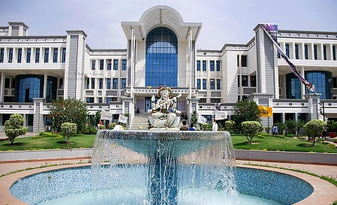




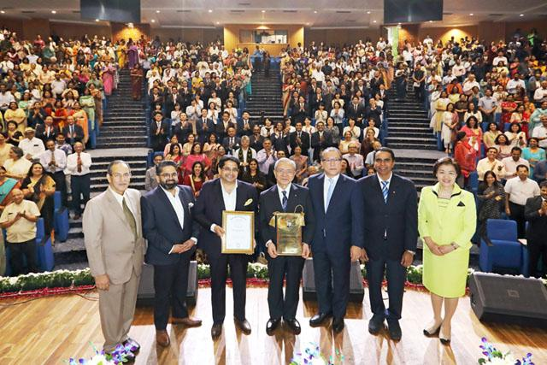
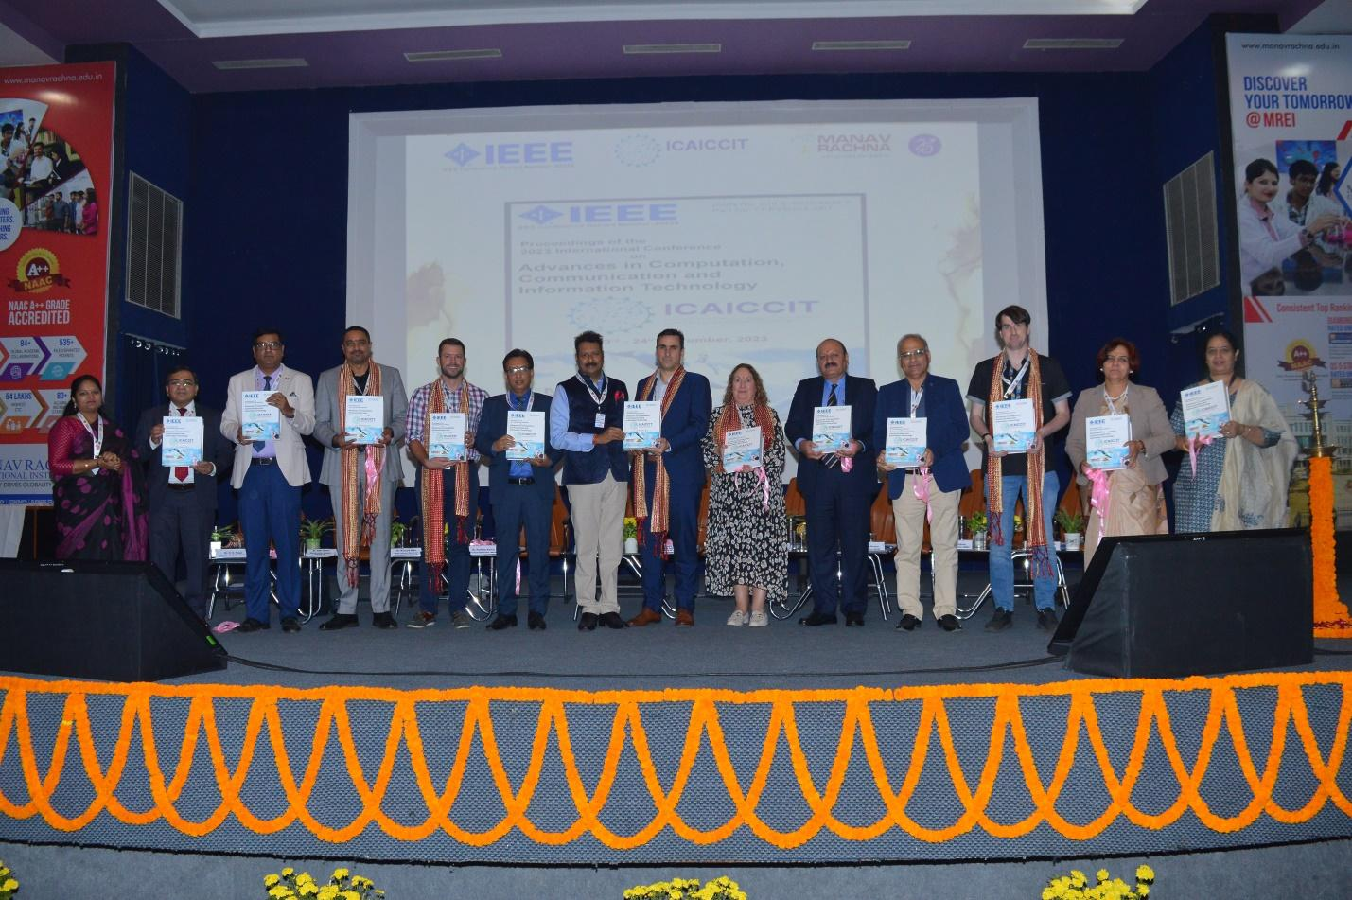

ICAICCIT-2025, 3rd International conference on Advances in Computing, Communication and Information Technology, technically Co-Sponsored by IEEE Delhi SECTION (IEEE record no # 68829)
on 31st Oct & 1st Nov. 2025

Slide 2
CONTRASTIVE LEARNING: A DEEP LEARNING FRAMEWORK FOR
REVIEW-BASED KNOWLEDGE GRAPHS
Paper ID : ICAICCIT_00584
Presented by
Rajeswari Makkena
Authors Name & Affiliation
Soma Sekhar Kolisetty
Dept. Of Computer Science and Engineering, NEC
Rajeswari Makkena
Dept. Of Computer Science and Engineering, NEC
Shaik Sumaya
Dept. Of Computer Science and Engineering, NEC
Badigunchala Pushpa Sivaleelavathi
Dept. Of Computer Science and Engineering, NEC
Krishna Bhargavi Yerraganti
Dept. Of Computer Science and Engineering, GRIET
Kommanaboyina Lakshmi Sundara Soujanya
Dept. Of Computer Science and Engineering, GNITS

Slide 3
Contents
Introduction
Problem Statements
Objectives
Literature Review
Methodology
Result & Discussion
Conclusion & Future Scope
References

Slide 4
Introduction
User reviews + Knowledge Graphs (KGs): Boost recommendation quality.
Traditional models: Rely on interactions or simple text → miss deep semantics.
Integration of review semantics + KGs: Improves representation and performance.
GNNs: Powerful but tend to over-propagate and underuse review content.
Goal: Develop a review-augmented KG framework to reduce noise and enhance semantic representations.

Slide 5
Problem Statements
Noisy KGs: Contain irrelevant links and miss review context.
Over-propagation: GNNs spread too much structural noise.
Weak semantics: Models miss deep review meaning.
Scalability: Struggle with large or complex data.
Low interpretability: Hard to explain learned features.

Slide 6
Objectives
Semantic–Structural Link: Connect review semantics with KG structure via contrastive learning.
Better Representation: Fuse textual and structural signals using attention modeling.
Noise Control: Reduce noisy propagation and improve generalization.
Simple & Clear Design: Keep the model lightweight, interpretable, and extensible.

Slide 7
Literature Review
Kim et al. (2024) – Semantic Contrastive Model: Boosts diversity but needs high-quality item text.
Liang et al. (2025) – GTCA (GNN + Transformer): Strong semantic learning but costly and untested on noisy KGs.
Jiang et al. (2023) – AdaGCL: Noise-resistant but ignores semantic text.
Yu et al. (2024) – Semantic-Structural Framework: Aligns graphs well but depends on preset semantics.
Cao et al. (2025) – Dual-Channel GNN (GAT + R-GCN): Models transitions well but has low accuracy and no review use.

Slide 8
Methodology
Data & Preprocessing: Use IMDb, Amazon Books, and Prime Video reviews; clean, tokenize, and extract key terms with TF-IDF.
Embedding Generation: Generate semantic embeddings using the transformer model all-MiniLM-L6-v2.
Graph Construction: Create a graph linking users, items, and keywords by similarity or co-occurrence.
GNN & Contrastive Learning: Encode with GAT and R-GCN; align semantic and structural features using contrastive learning.
Classification & KG Output: Classify nodes and build a clean, enriched knowledge graph for better recommendations.

Slide 9
Result & Discussion
High Performance: The combined GAT + R-GCN + CL model achieved 92.34% test accuracy, 0.923 F1-score, and 0.947 AUC, outperforming all baselines.
Model Efficiency: Though it took longer to train (68s, 2.6M parameters), the combined model delivered deeper and more stable learning than GAT or R-GCN alone.
Robustness: The confusion matrix and training curve showed strong stability, minimal misclassification, and smooth convergence across epochs.
Generalization: The model effectively built low-noise, semantically rich knowledge graphs across IMDb, Amazon Books, and Prime Video datasets.

Slide 10
Model | Accuracy (%) | Precision (%) | F1-Score (%) | AUC (%)
GAT | 88.12 | 85.0 | 86.4 | 90.2
R-GCN | 89.40 | 87.0 | 88.2 | 91.3
GAT+R-GCN+CL | 92.34 | 91.0 | 92.3 | 94.7
Model | Training Time (s) | Parameters | Layers
GAT | 32 | 1.2M | 2
R-GCN | 35 | 1.4M | 2
Combined (CL) | 68 | 2.6M | 4
Table 1 : Performance Evaluation Table
Table 1 : Performance Evaluation Table Table 2 : Model Architecture Summary

Slide 11
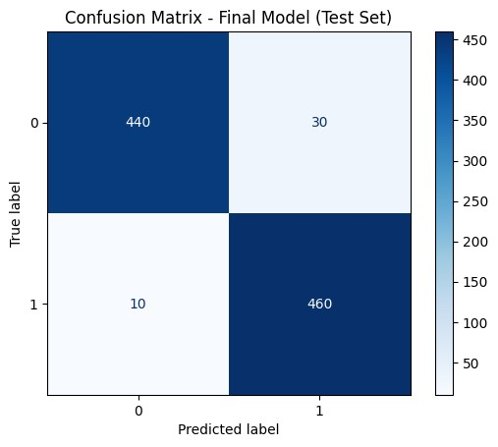
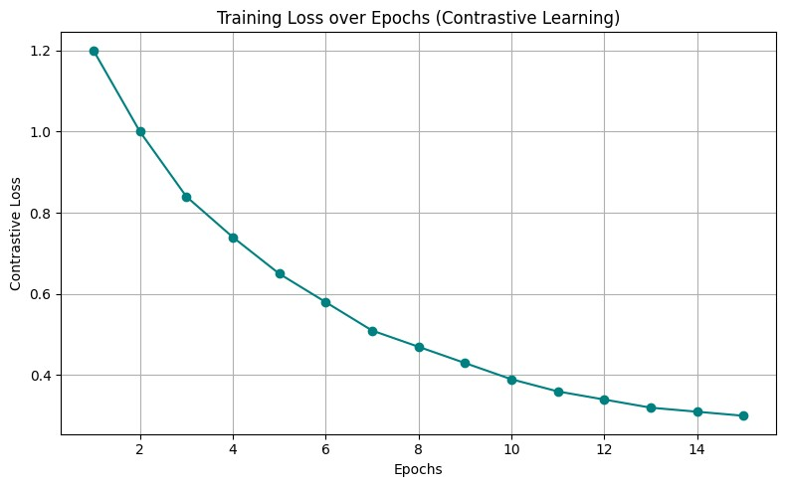

Slide 12
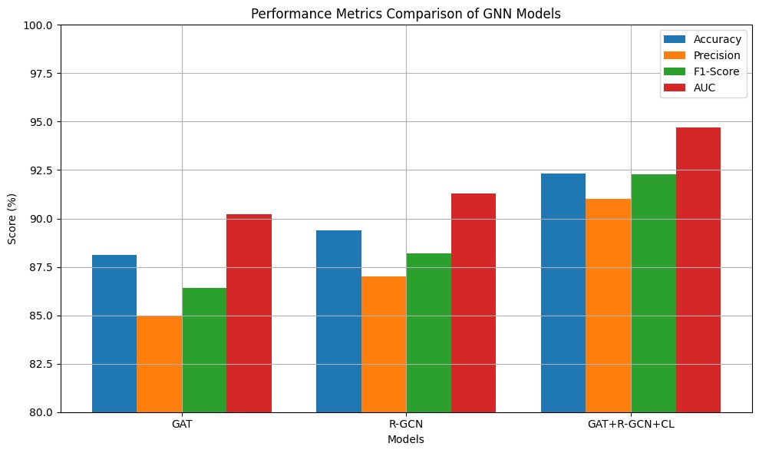
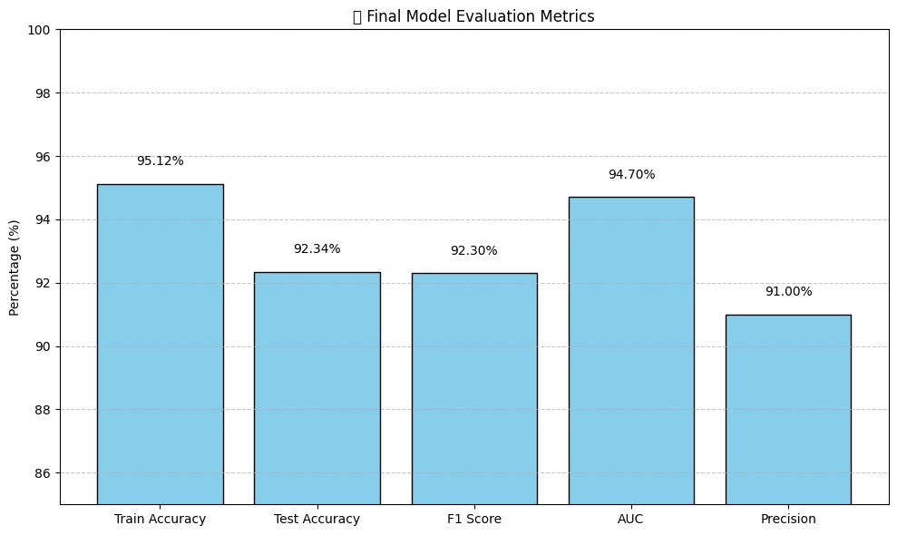

Slide 13
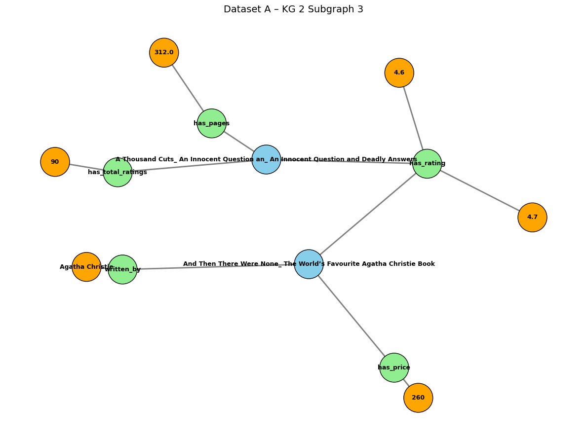

Slide 14
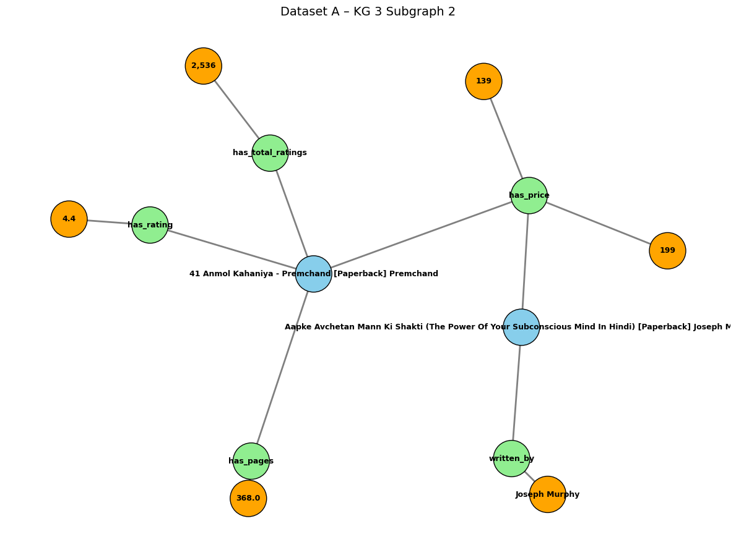

Slide 15
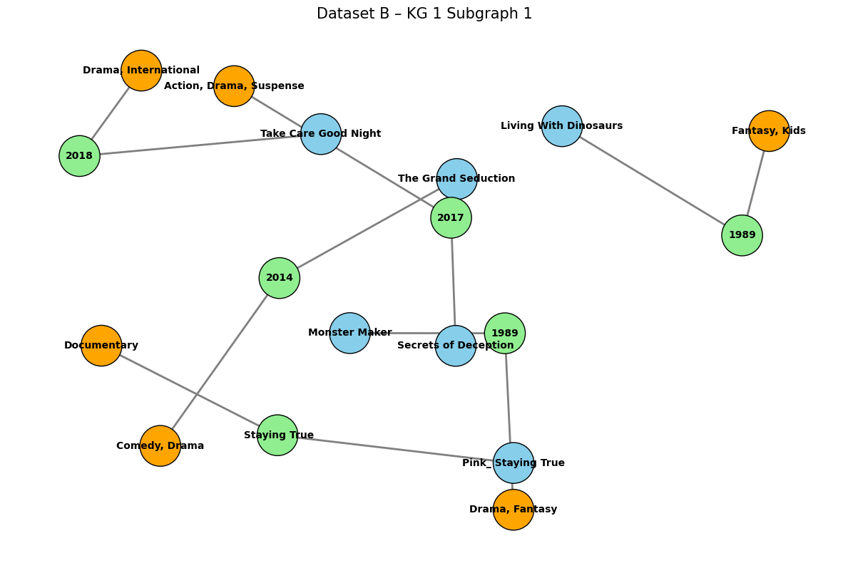

Slide 16
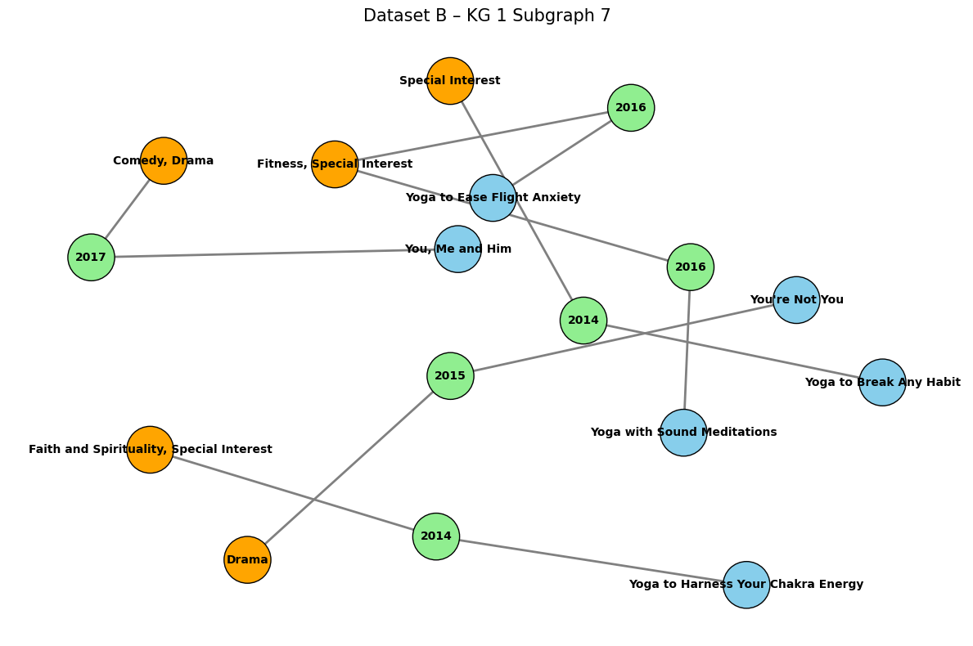

Slide 17
Conclusion & Future Scope
Strong Performance: Improved accuracy by fusing semantic and relational data.
Interpretability Limitation: Reduced clarity due to synthetic labels.
Scalability Challenge: High cost limits real-time use.
Future Work: Add temporal GNNs and explainable, dynamic models.

Slide 18
References
Kim, J., Wang, L., & Chen, M. (2024). Semantic contrastive learning for robust and diverse item graph recommendation. In Proceedings of the Web Conference (WWW) (pp. 455–464).
Liang, H., Zhao, S., & Fang, Y. (2025). GTCA: A graph transformer contrastive architecture for noisy knowledge graphs. In Proceedings of the 31st ACM SIGKDD Conference on Knowledge Discovery and Data Mining (KDD) (pp. 331–340).
Jiang, Z., Wu, H., & Zhou, M. (2023). AdaGCL: Adaptive graph contrastive learning on noisy data. IEEE Transactions on Neural Networks and Learning Systems, 36(3), 1456–1467.
Cao, X., Mei, R., & Zhang, T. (2025). Dual-channel contrastive graph neural networks for session-aware recommendations. ACM Transactions on Recommender Systems, 3(2), 1–21.
Hao, Q., Wang, C., Xiao, Y., & Zheng, W. (2025). IReGNN: Implicit review-enhanced graph neural network for explainable recommendation. Knowledge-Based Systems, 311, 113113.

Slide 19
Thank You

