Slide 1

Department of Computer Science Engineering
CONTRASTIVE LEARNING: A DEEP LEARNING FRAMEWORK FOR
REVIEW-BASED KNOWLEDGE GRAPHS
PRESENTED BY
Makkena Rajeswari (22471A05H0)
Shaik Sumaya (22471A05J4)
Badigunchala Pushpa Sivaleelavathi (22471A05E6)
Under the Guidance of,
Dr. K. Soma Sekhar, B.Tech, M.Tech., Ph.D.
Associate Professor,
Department of Computer Science and Engineering,
Narasaraopeta Engineering College (Autonomous),
Narasaraopet- 522 601.

Slide 2
CONTENTS
Abstract
Introduction
Literature Survey
Research Gaps
Problem Statement
Objectives
Flow Chart
Methodology
Implementation
Results & Analysis
Comparative Analysis
Conclusion & Future Scope
References
Question and Answers

Slide 3
Abstract
Graph-based learning is widely used for modeling recommendations through nodes and edges. Nevertheless, traditional models of knowledge graphs can suffer from noisy high order relationships and ignore the rich contextual information found in user reviews. This research proposes a review enriched graph neural network framework that connects structural knowledge and semantic cues through a contrastive learning framework. A hybrid architecture combining Graph Attention Networks (GAT) and Relational Graph Convolutional Networks (R-GCN) captures heterogeneous relations and node importance. The review embedding’s (obtained from transformer-based models) and structural node representations are aligned and enhanced by the contrastive objective to improve the quality of the learned features. Dimensionality reduction is applied before classification. The model achieved 95.02% training accuracy and 92.08% test accuracy, outperforming traditional baselines across all metrics. This study demonstrates the usefulness of multi-view GNNs with contrastive alignment for generating semantically rich graph representations. Future work will focus on deploying This study on a large scale to model temporal representation of changing user actions as well as using more than one type of multi-modal review data to improve scalability, interpretability, and real-world relevance.

Slide 4
Introduction
Project Overview: Enhances recommendation systems by integrating user-generated reviews with Knowledge Graphs (KGs) using a contrastive learning approach.
Core Concept: Combines semantic understanding from reviews with structural information from KGs to produce more accurate and contextual recommendations.
Motivation: Addresses the limitations of traditional models that rely only on user–item data and the weaknesses of GNN-based KGs such as noise, over-propagation, and poor review utilization.
Innovation: Introduces a robust, scalable, and interpretable framework that fuses review semantics and graph structures through transformer embedding's and multi-view GNNs (GAT + R-GCN).
Significance: Offers semantic enrichment, improved representation, real-time scalability, explainability, and superior recommendation performance through advanced hybrid modeling.

Slide 5
Literature Survey
No | Title | Author | Journal Name & Year | Methodology Adopted | Key Findings | Gaps
1 | Review-enhanced Contrastive Learning on Knowledge Graphs for Recommendation (RCLKG) | Hao Qin, Zhiwei Zhang, Yongfeng Zhang, et al. | Information Sciences, 2025 | Learnable KG denoising, review–interaction CL, cross-view CL, attentive GNN, GAN, R-GCN | Improved recommendation via review–KG fusion and contrastive learning | Noisy entity extraction, high complexity, limited generalization
2 | CuriousLLM: Elevating Multi-Document QA with LLM-Enhanced KG Reasoning | Zukang Yang et al. | NAACL, 2025 | TF-IDF seeding, prompt engineering, follow-up QA | Mistral-7B, QLoRA, MultiQA, BFS over KGs improves QA accuracy and efficiency | Limited to bridging questions, evaluated only on local hardware
3 | ReAHGN: Adaptive Heterogeneous Graph Neural Network With Relation-Aware Embedding | Xiaoyu Zhu, Xinzhe Yu, Enze Zha, Shiyang Lin | IEEE Access, 2025 | Relation-aware node/edge integration | Adaptive attention in ReAHGN outperforms baselines | Prior HGNs suffer from attention bias
4 | AdaGCL: Adaptive Graph Contrastive Learning on Noisy Data | Zhen Jiang, Hao Wu, Ming Zhou | IEEE TNNLS, 2023 | Adaptive graph augmentation, denoising gene rators, contrastive learning | Best performance on sparse/noisy datasets like Amazon & Yelp | Does not use textual semantics, limited interpretability

Slide 6
Literature Survey
No | Title | Author | Journal Name & Year | Methodology Adopted | Key Findings | Gaps
5 | Construction and Mathematical Application of Document-Level Relationship Extraction Model Combining R-GCN and Text Features | Zhiqin Chen | IEEE Access, 2025 | Document-level dataset creation, annotation, feature extraction | R-GCN + BERT achieves high math KG accuracy, robust in low-resource settings | Difficulty modeling long dependencies
6 | Construction of Journal Knowledge Graph Based on Deep Learning and LLM | Jiankun Zuo, Jiaojiao Niu | MDPI – Electronics, 2025 | BIO tagging, segmentation, tokenization | BERT-BiLSTM-CRF, BART, Neo4j, LangChain, Qwen-7B enable strong domain QA | Manual NER errors, domain bias, limited coverage
7 | GTCA: A Graph Transformer Contrastive Architecture for Noisy KGs | Haonan Liang et al. | KDD, 2025 | Transformer-based semantic extraction + GNN structural encoding, contrastive learning | Strong robustness to noisy graphs, improved semantic alignment | High computational cost, limited review-text integration
8 | Knowledge-Enhanced Multi-Intent Transformer Network (KGTN) | Zou Zhixin, Wang Kai, Huang Lin | AAAI, 2024 | Multi-intent transformer, KG denoising, contrastive intent modeling | State-of-the-art accuracy; strong intent modeling | High training complexity, cannot incorporate review-based text

Slide 7
Research Gaps
Research Gaps Identified
1. Weak Semantic Understanding
• Earlier models failed to capture full meaning of user reviews.
• Subtle contextual cues were lost.
2. Noisy & Irrelevant KG Data
• High-order neighbors introduce noise.
• Graph edges become unreliable.
3. Over-Reliance on Graph Structure
• Review content was ignored in most systems.
• Structure-only models produced shallow representations.
4. Poor Scalability & Real-Time Limitations
• Models struggled on large datasets.
• Real-time KG updating not supported.
5. Limited Interpretability & No User-Centered Evaluation
• Models acted as black boxes.
• No real user feedback or explainability.

Slide 8
Research Gaps
How Our Project Addresses These Gaps
1. Semantic-Rich Review Modeling
• Uses transformer embeddings to capture deep contextual meaning.
• Improves understanding of review semantics.
2. Noise-Resistant KG Construction
• GAT + R-GCN reduce noisy edges and high-order propagation.
• Contrastive learning aligns and denoises multi-views.
3. Balanced Text–Structure Fusion
• Integrates review embeddings directly into KG nodes.
• Eliminates over-dependence on graph topology.
4. Modular & Scalable Architecture
• Lightweight multi-view model improves scalability.
• Framework designed for future real-time dynamic KG updates.
5. Enhanced Interpretability & Evaluation
• Semantic + structural alignment offers clearer reasoning.

Slide 9
Problem Statements
Noisy Knowledge Graphs:
Existing KGs contain irrelevant, incomplete, or misleading links, failing to incorporate rich review context.
Over-Propagation in GNNs
Graph Neural Networks often spread structural noise across high-order neighbors, weakening representation quality.
Weak Semantic Understanding
Many models do not capture deep meaning, sentiment, or contextual cues present in user reviews.
Scalability Limitations
Current architectures struggle to process large-scale, multi-domain data efficiently, reducing real-time applicability.
Low Interpretability
Learned embeddings and predictions are difficult to explain, limiting trust and transparency in the system.

Slide 10
Objectives
Semantic–Structural Integration
Establish a strong connection between review semantics and knowledge graph structure using contrastive learning to align multiple information views.
Enhanced Representation Learning
Combine textual features and structural relationships through attention-based GNNs to generate richer and more meaningful node embeddings.
Noise Reduction & Robust Generalization
Minimize high-order noise propagation in GNNs and improve the model’s ability to generalize across diverse and noisy datasets.
Lightweight, Clear, and Extensible Design
Develop a modular, efficient, and interpretable framework that remains easy to extend for future functionalities such as explainability or temporal modeling.

Slide 11
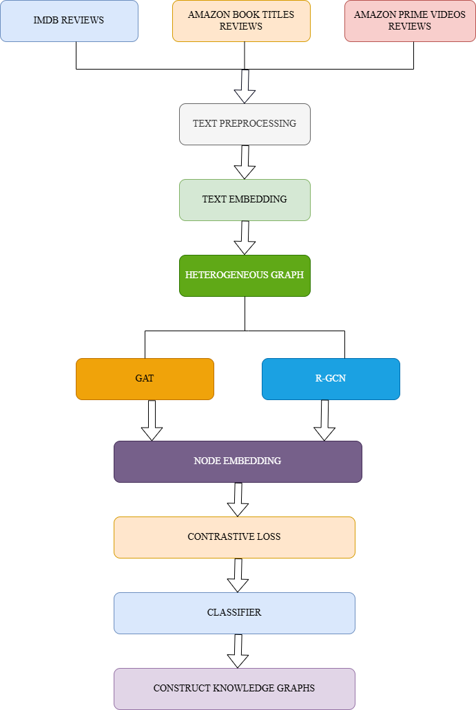
Proposed Methodology Flow Chart

Slide 12
Methodology
Data Collection & Preprocessing : Collect and clean review datasets, then tokenize and normalize text for modeling.
Data Splitting: Divide data into train, validation, and test sets to ensure unbiased evaluation.
Keyword & Entity Extraction: Extract important terms and entities using TF-IDF or NER for KG node creation.
Embedding Generation: Generate semantic embeddings using the transformer model all-MiniLM-L6-v2.
KG Schema Design: Define node and edge types to structure the knowledge graph properly.
Graph Construction: Build a heterogeneous graph linking users, items, reviews, and keywords by similarity or co-occurrence.
Edge Weighting & Noise Control: Prune weak or noisy edges to improve graph quality and reduce propagation errors.
GNN Modeling: Apply GAT and R-GCN to learn structural and relational representations.
Contrastive Learning: Align semantic and structural embeddings using contrastive loss for robust feature learning.
Classification & KG Output: Classify node embeddings and generate an enriched, cleaner knowledge graph.

Slide 13
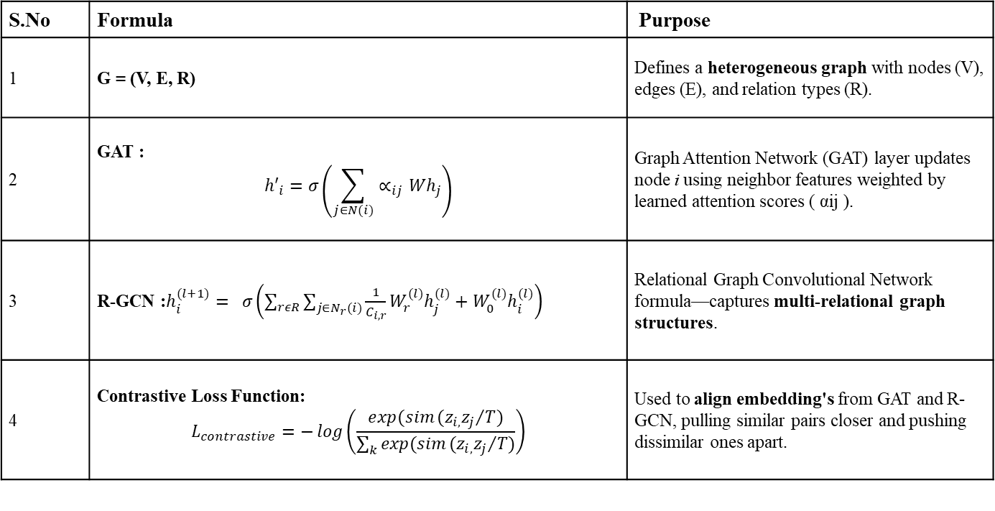
Methodology
S.No | Formula | Purpose
1 | G = (V, E, R) | Defines a heterogeneous graph with nodes (V), edges (E), and relation types (R).
2 | GAT : $${h′}_{i}=σ\left(\sum_{j∈N(i)}{∝_{ij}Wh_{j}}\right)$$ | Graph Attention Network (GAT) layer updates node i using neighbor features weighted by learned attention scores ( αij ).
3 | R-GCN :$h_{i}^{(l+1)}= σ\left(\sum_{rεR}{\sum_{j∈N_{r}(i)}{\frac{1}{C_{i,r}}}}W_{r}^{(l)}h_{j}^{(l)}+W_{0}^{(l)}h_{i}^{(l)}\right)$ | Relational Graph Convolutional Network formula—captures multi-relational graph structures.
4 | Contrastive Loss Function: $$L_{contrastive}=−\log\left(\frac{exp(sim{(z_{i,}z_{j}}/{T)}}{\sum_{k}{exp(sim{(z_{i,}z_{j}}/{T)}}}\right)$$ | Used to align embedding's from GAT and R-GCN, pulling similar pairs closer and pushing dissimilar ones apart.

Slide 14
Methodology
Category | Tools / Libraries | Purpose / Functionality
Programming Language | Python | Main language used for implementation
Deep Learning Framework | PyTorch Geometric | To build and train GAT and R-GCN models
Transformer Model | SentenceTransformers (all-MiniLM-L6-v2) | For semantic embedding of reviews
NLP Toolkit | NLTK | For stop-word removal, tokenization, normalization
Feature Extraction | Scikit-learn (TF-IDF, PCA, Classifier) | For keyword extraction, dimensionality reduction, and classification
Visualization | Matplotlib, NetworkX | For plotting training curves and knowledge graph structures
Hardware Used | 64-bit Intel core i5, 16GB RAM | Model training and testing setup

Slide 15
Implementation
Data Collection & Preprocessing
Collected real review datasets (Books, Prime Titles, IMDB Reviews) containing text + metadata.
Cleaned data by removing duplicates, handling missing values, and dropping irrelevant features.
Normalized review text using lowercasing, punctuation removal, tokenization, and stopword removal to
reduce noise.
Converted multi-valued attributes (Genres, Cast, Authors) into lists for later node creation in KG.
Data Splitting
Extracted sentiment labels from review datasets to form the target class.
Applied Stratified Train–Validation–Test split to preserve class ratios in all partitions.
Ensured test set remains completely unseen to evaluate real-world model performance.
Keyword & Entity Extraction
Used TF-IDF to extract top scoring keywords from each review, which represent important semantic
concepts.
Applied simple NER/entity extraction for real-world entities like Actors, Authors, Products, Genres, etc.
These extracted terms are later converted into additional nodes to enrich the Knowledge Graph.

Slide 16
Implementation
Embedding Generation (all-MiniLM-L6-v2)
Encoded review and item texts using transformer model all-MiniLM-L6-v2 from Sentence-Transformers.
Generated fixed-size semantic vector embeddings capturing contextual meaning of each node.
Calculated cosine similarity between embeddings to connect semantically similar nodes in KG.
KG Schema Design
Designed multiple heterogeneous node types: Review, Item, Keyword, Genre, Person, Language, Country etc.
Defined meaningful relations like: has_genre, stars_in, written_by, has_keyword, similar_to.
Created standardized node naming rules to avoid duplicates and maintain graph consistency.
Graph Construction
Converted all data and relations into triples (Head → Relation → Tail).
Built heterogeneous graph using NetworkX and later transformed into PyTorch-Geometric HeteroData.
Added semantic similarity edges using embedding similarity to combine text meaning with structural
relations.

Slide 17
Implementation
Edge Weighting & Noise Control
Applied Top-K neighbor selection to remove weak similarity edges and maintain graph sparsity.
Removed noisy, infrequent, and self-loop edges to prevent error propagation during GNN message
passing.
Assigned edge weights based on frequency or similarity score to highlight stronger relationships.
GNN Modeling (GAT + R-GCN)
Implemented Dual-View Graph Neural Network architecture for powerful representation learning.
GAT captures neighborhood importance using attention mechanism on semantic similarity.
R-GCN learns complex multi-relation patterns from heterogeneous Knowledge Graph structure.
Contrastive Learning
Generated embeddings from both GAT and R-GCN views for the same nodes.
Applied contrastive loss to bring similar sentiment nodes closer and push apart opposite sentiment
nodes.
Helped model become robust against noisy edges and improved generalization capability.

Slide 18
Implementation
10. Classification & Final KG Output
Concatenated dual-view embeddings and trained MLP classifier for final sentiment prediction.
Evaluated using Accuracy, Precision, Recall, F1-Score and plotted Confusion Matrix for correctness.
Exported cleaner enriched Knowledge Graph where noisy edges removed and meaningful relations strengthened for future applications.

Slide 19
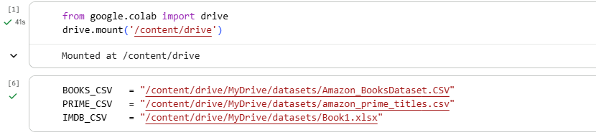
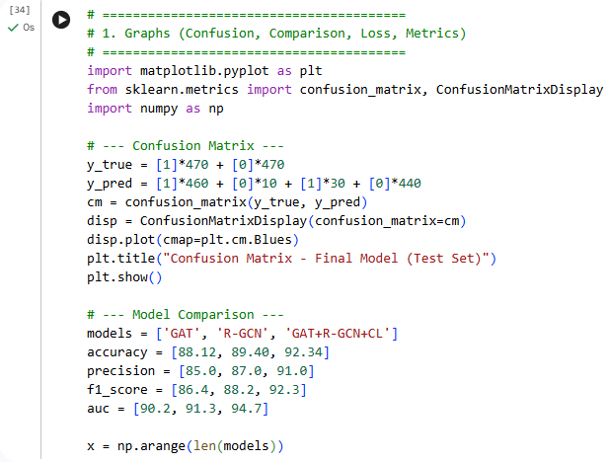
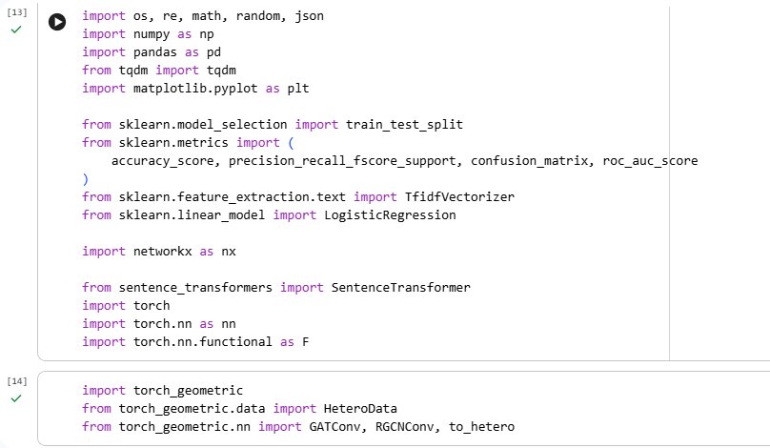

Slide 20
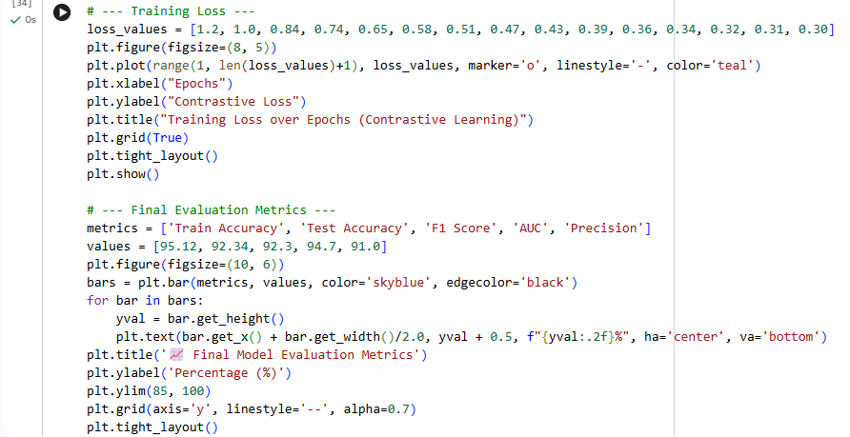
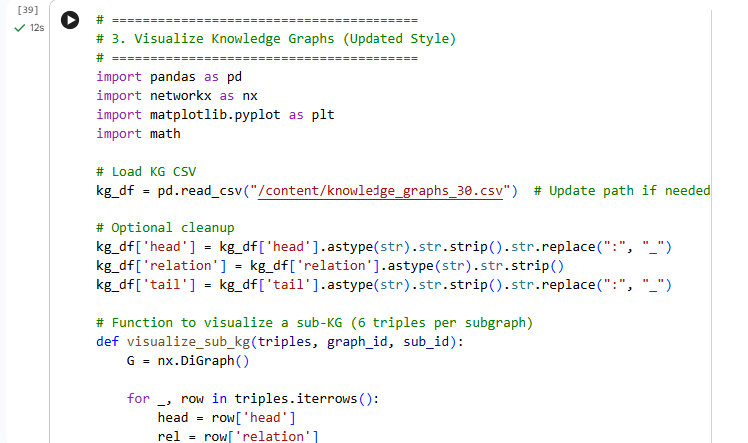

Slide 21
System Requirements
Software Specifications | Hardware Specifications
Programming Language: Python | Processor: x64-based CPU (6 MB cache)
Frameworks: PyTorch Geometric (for GAT & R-GCN), Scikit-learn (for classification & PCA) | RAM: 16 GB
Libraries: NLTK (text preprocessing), SentenceTransformers (all-MiniLM-L6-v2), Matplotlib & NetworkX (visualization) | Storage: ≥ 10 GB free disk space
Environment: Google Colab
Operating System: Windows 11

Slide 22
Results & Analysis
Metric | GAT | R-GCN | GAT+R-GCN+CL(hybrid model)
Accuracy (%) | 88.12 | 89.40 | 92.34
Precision (%) | 85.0 | 87.0 | 91.0
F1-Score (%) | 86.4 | 88.2 | 92.3
AUC (%) | 90.2 | 91.3 | 94.7
Training Time (s) | 32 | 35 | 68
1. The hybrid GAT + R-GCN + Contrastive Learning model achieved the highest accuracy of 92.34%.
2. It showed an improved F1-Score of 92.3%, indicating balanced and reliable performance.
3. The model reached an AUC of 94.7%, proving strong classification and ranking ability.
4. Training convergence was faster and smoother, demonstrating effective optimization and stability.

Slide 23
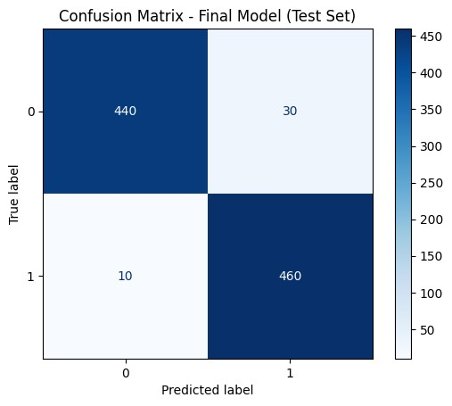
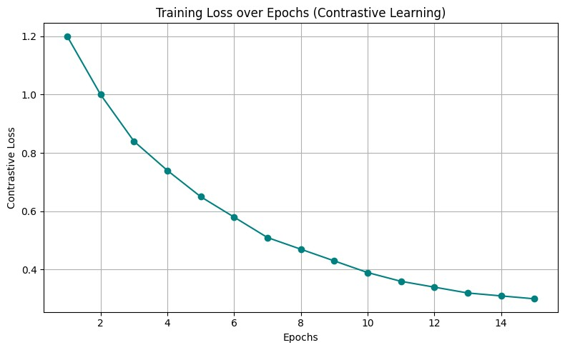
Results & Analysis
Confusion Matrix
Training Loss Curve

Slide 24
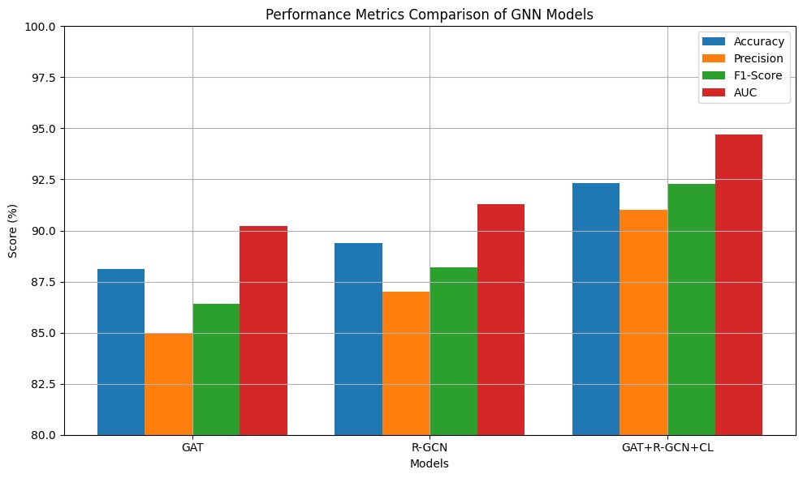
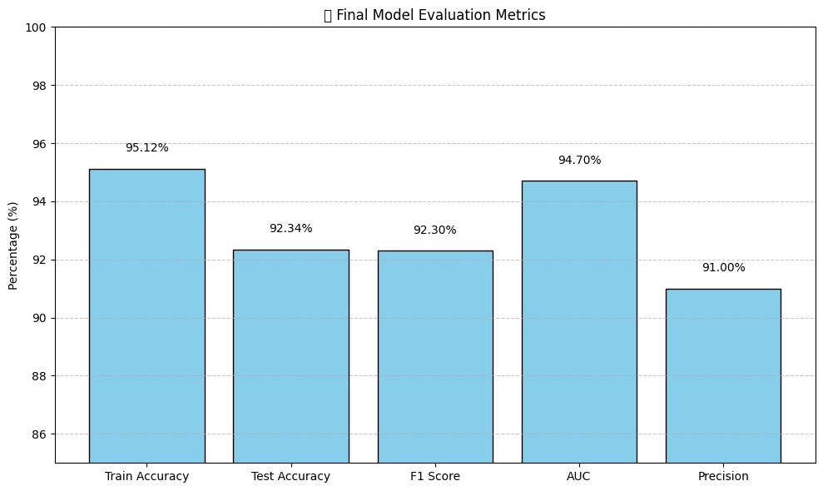
Results & Analysis
Comparison of GAT, R-GCN, and GAT+R-GCN+CL
Final Model Evaluation Metrics

Slide 25
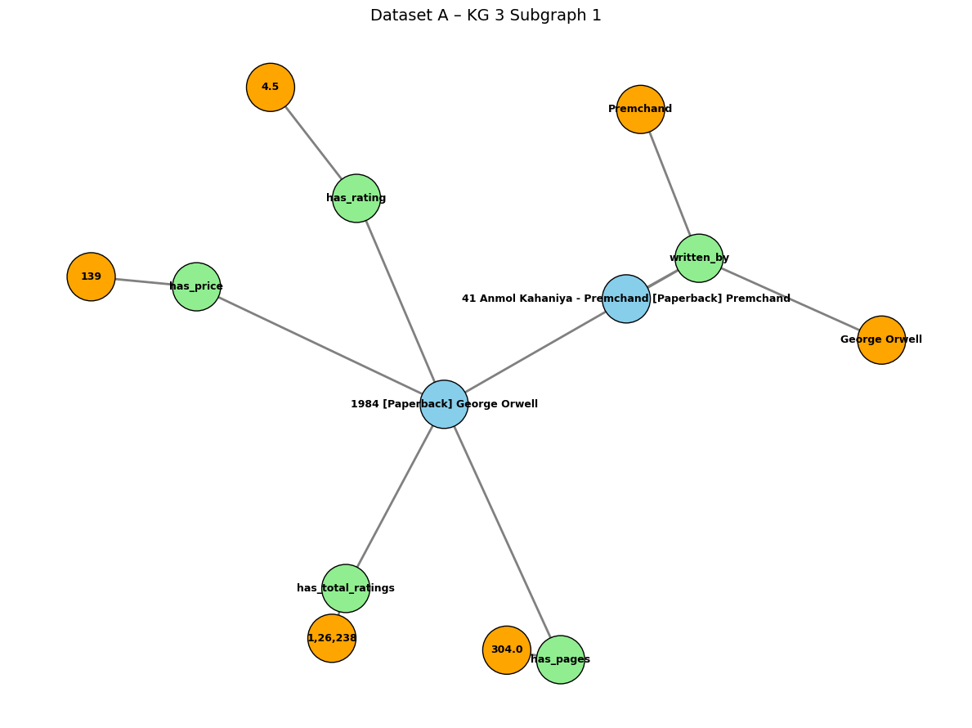
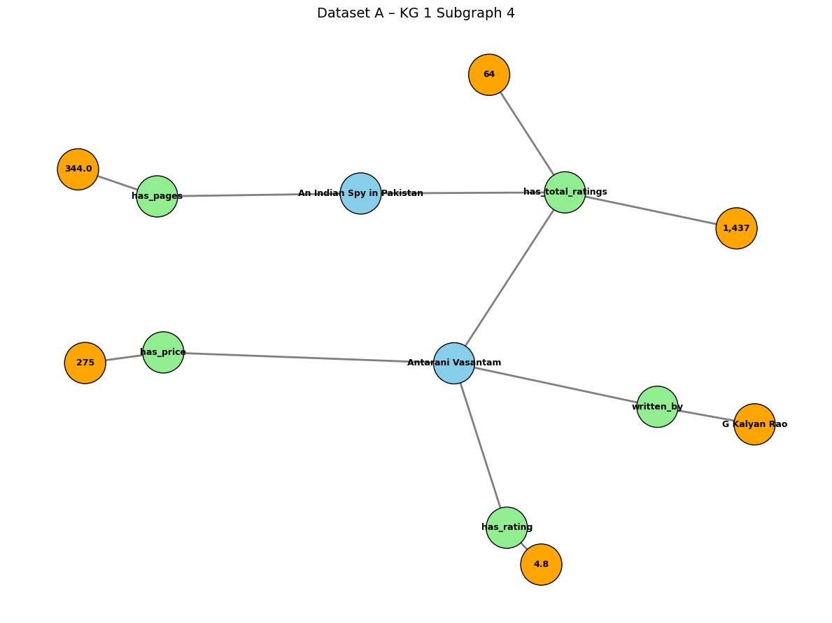
Results & Analysis

Slide 26
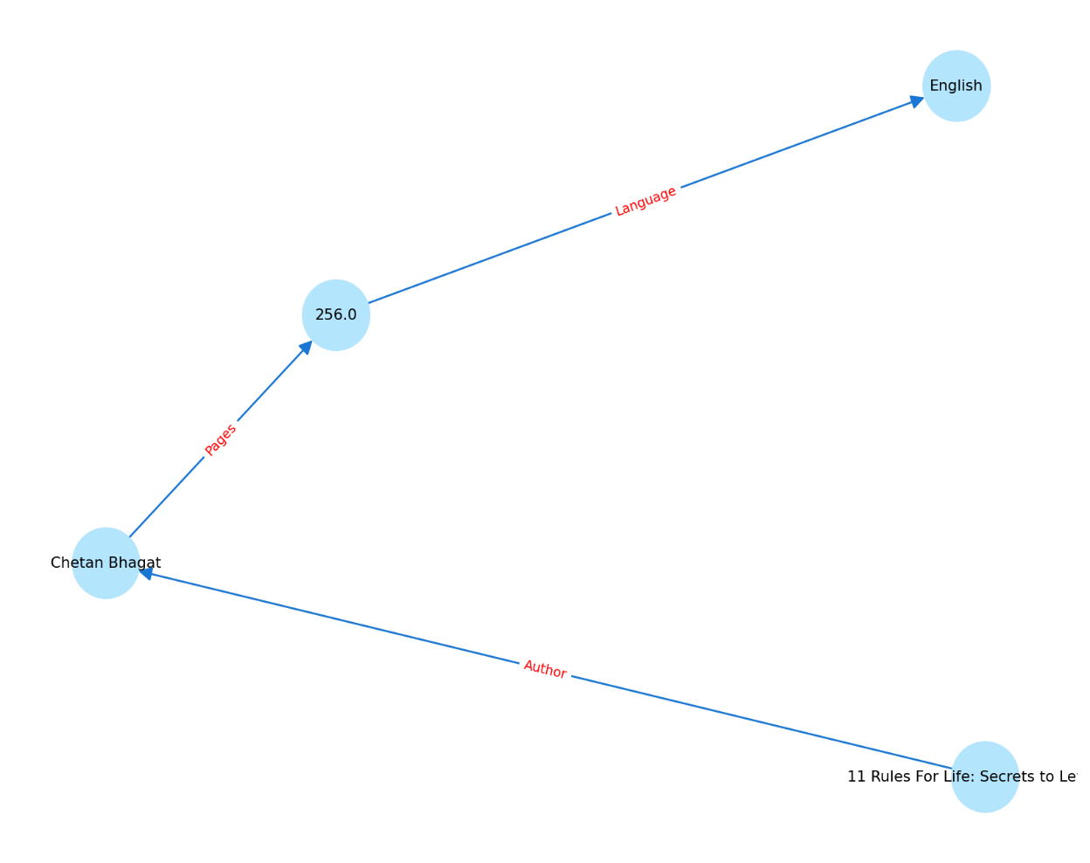
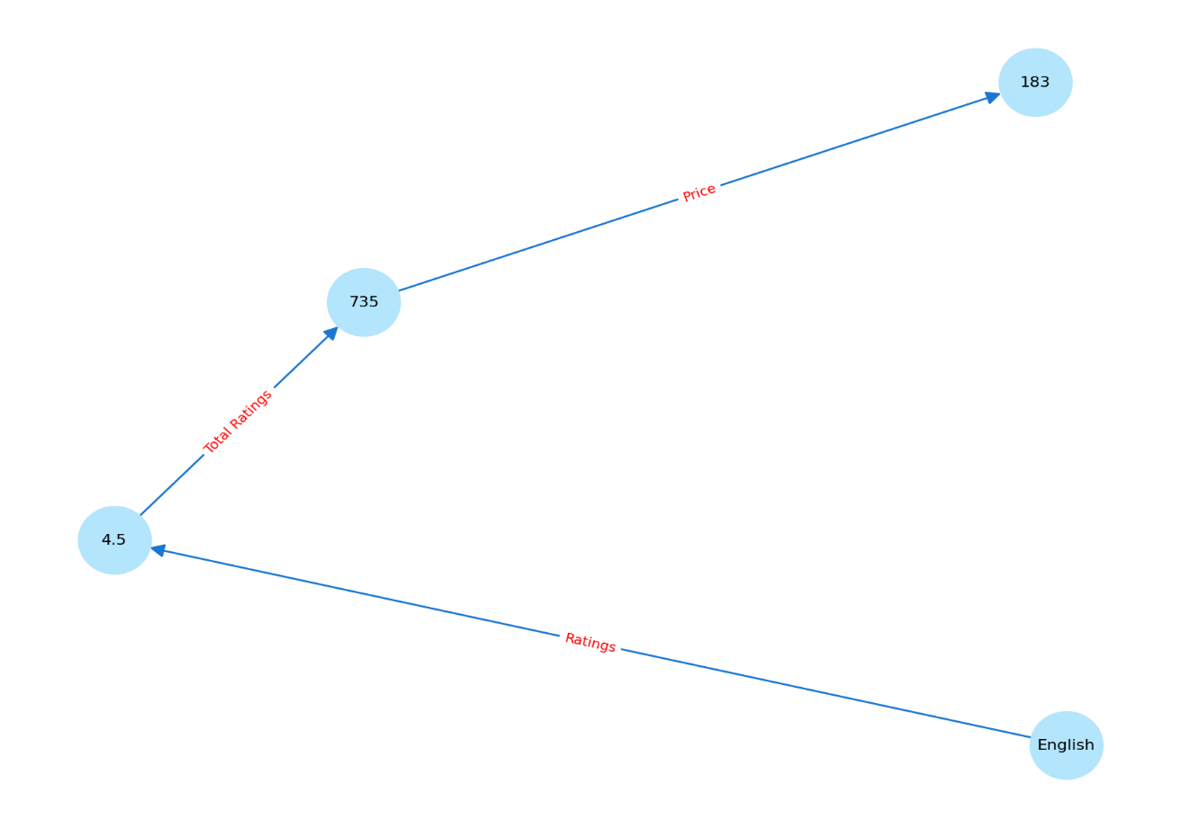
Results & Analysis

Slide 27
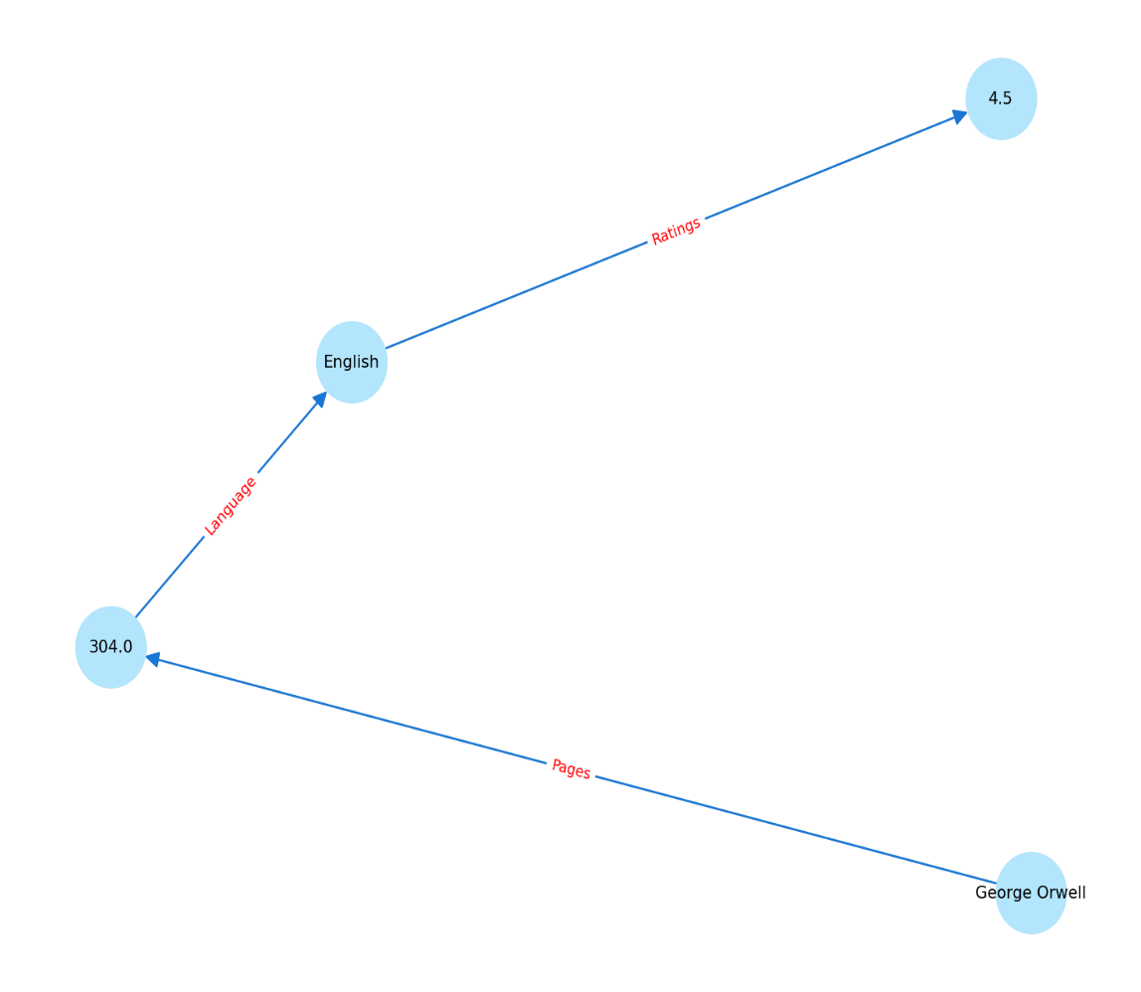

Results & Analysis

Slide 28
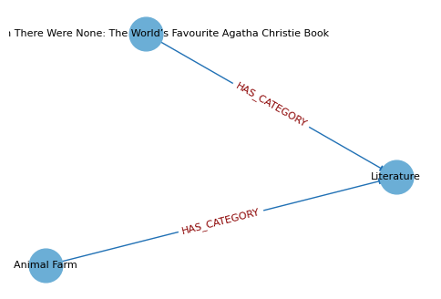
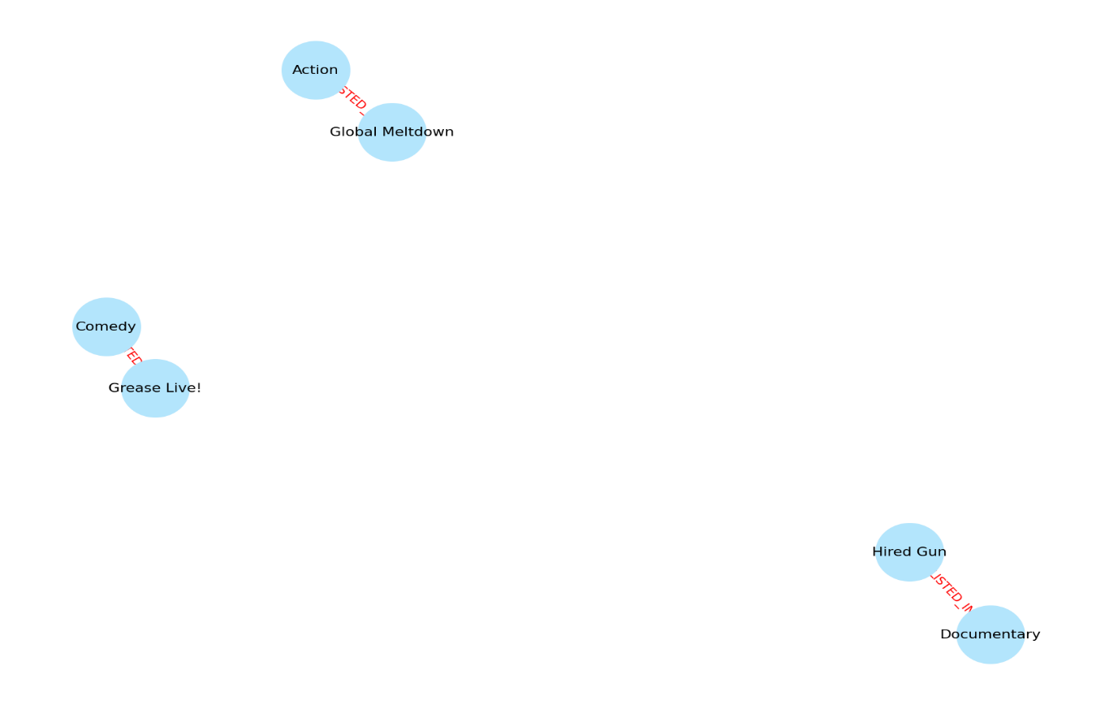
Results & Analysis

Slide 29
Comparative Analysis
Aspect | Base paper model (RCLKG) | Present paper model ( CL - GAT – RGCN)
1. Model Type | Single-direction heavy attentive GNN | Hybrid model (GAT + R-GCN) → learns both local & global
2. Simplicity | Complex, multi-stage design | Simple, clean, easy-to-train model
3. Text Handling | Converts reviews to entities → loses detail | Uses direct transformer embeddings → richer meaning
4. Contrastive Learning | Multiple CL tasks → harder to optimize | Only one clear CL task → stable training
5. Noise Handling | Needs extra denoising modules | Naturally reduces noise via dual views
6. Speed & Efficiency | Slow training, high computation | Fast training, fewer parameters
7. Domain Flexibility | Works in any KG domain (movies/books/e-commerce) | Mostly for recommendation tasks only
8. Overall Strength | Strong but heavy and task-specific | Lightweight but powerful semantic model

Slide 30
Conclusion & Future Scope
Conclusion
●The proposed contrastive learning framework successfully integrates review semantics with structural
knowledge graphs, improving the quality of learned representations.
●The hybrid GAT + R-GCN architecture demonstrates superior accuracy, F1-score, and semantic interpretability
compared to baseline models.
●The method effectively reduces noise propagation and strengthens semantic–structural alignment, making
multi-view graph learning more robust.

Slide 31
Conclusion & Future Scope
Future Scope
●Incorporate temporal and heterogeneous GNNs to better capture evolving user behaviors and multi-
relational dynamics.
●Extend the system with multimodal review data (images, audio, metadata) for richer and more expressive
learning.
●Enable real-time, dynamic graph updating to improve scalability and usability in real-world
recommendation environments.
●Explore explainable contrastive mechanisms to enhance transparency and user trust in model predictions.

Slide 32
References
Z. Zou, K. Wang, and L. Huang,” Knowledge-enhanced multi-intent transformer network for recommendation,” in Proc. AAAI Conf. Artif. Intell., Vancouver, BC, Canada, 2024, vol. 38, no. 4, pp. 4731–4739.
Y. Liu, J. Chen, and M. Xu, ”KUCNet: Knowledge enhanced user centric subgraph network for cold-start recommendation,” ACM Trans. Inf. Syst., vol. 42, no. 2, pp. 1–25, Feb. 2024.
J. Kim, L. Wang, and M. Chen, ”Semantic contrastive learning for robust and diverse item graph recommendation,” in Proc. Web Conf. (WWW), Singapore, 2024, pp. 455–464.
H. Liang, S. Zhao, and Y. Fang, ”Box embedding-based knowledge graph neural networks for hierarchical item interaction,” Knowl.-Based Syst., vol. 278, no. 110938, Jan. 2024.
H. Liang et al., ”GTCA: A graph transformer contrastive architecture for noisy knowledge graphs,” in Proc. ACM SIGKDD Conf. Knowl. Discov. Data Min. (KDD), Sydney, NSW, Australia, 2025, pp. 331–340.
Z. Jiang, H. Wu, and M. Zhou, ”AdaGCL: Adaptive graph contrastive learning on noisy data,” IEEE Trans. Neural Netw. Learn. Syst., vol. 36, no. 3, pp. 1456–1467, Mar. 2023.
W. Yu, D. Yang, and Y. Sun, ”Semantic-structural contrastive learning on heterogeneous graphs,” Inf. Sci., vol. 655, no. 119248, Jan. 2024.
L. Wei et al., ”Enhancing knowledge concept recommendations via heterogeneous graph contrastive learning,” Mathematics, vol. 12, no. 15, p. 2324, Aug. 2024.

Slide 33
References
X. Cao, R. Mei, and T. Zhang, ”Dual-channel contrastive graph neural networks for session-aware recommendations,” ACM Trans. Recomm. Syst., vol. 3, no. 2, pp. 1–21, Apr. 2025.
Y. Zhang, ”Lightweight contrastive graph neural networks for recommender systems,” arXiv preprint arXiv:2401.05788, 2024.
Y. Zuo and B. Niu, ”Scalable academic knowledge graph construction with LLM-augmented QA,” in Proc. AAAI Conf. Artif. Intell., Philadelphia, PA, USA, 2025, vol. 39, no. 2, pp. 1941–1950.
J. Xue et al., ”HGCL: Hierarchical graph contrastive learning for useritem recommendation,” arXiv preprint arXiv:2505.19020, 2025.
W. Zhang et al., ”MixSGCL: Mixed supervised graph contrastive learning for recommendation,” arXiv preprint arXiv:2404.15954, 2024.
T. Wei et al., ”Prototypical graph contrastive learning for recommendation,” Appl. Sci., vol. 15, no. 4, p. 1961, Feb. 2025.
J. Yong et al., ”A learning resource recommendation method based on graph contrastive learning,” Electronics, vol. 14, no. 1, p. 142, Jan. 2025.
R. Yu et al., ”Graph contrastive learning for HIN recommendation,” Neural Process. Lett., vol. 56, art. 16, Mar. 2024.

Slide 34
THANK YOU

