Slide 1

Department of Computer Science Engineering
Title :Cross-Climate Flood Prediction:
A Multi-Regional Deep Learning Approach to Hydrological Diversity
PRESENTED BY
Amireddy Navya (22471A05E4)
Attuluri Pavana Prudula Sri (22471A05E5)
Kadapa Gandhi Kumari (22471A05G0)
Under the Guidance of,
Dr. Rama Krishna Eluri,M.Tech.,Ph.D.
Associate Professor,
Department of Computer Science and Engineering,
Narasaraopeta Engineering College (Autonomous),
Narasaraopet- 522601.

Slide 2
OUTLINE
Abstract
Introduction
Literature Survey
Research Gaps
Problem Statement
Objectives
Flow Chart
Methodology
Implementation
Results & Analysis
Conclusion & Future Scope
References
Question and Answers
Acknowledgements

Slide 3
Abstract
Floods are among the most destructive natural hazards, impacting lives, property, and ecosystems across various climatic regions. This study presents a scalable deep learning–based framework for multi-regional flood prediction using heterogeneous data sources such as rainfall, temperature, soil moisture, and socio-environmental indicators. Data preprocessing ensured consistency through temporal alignment, interpolation, and Min–Max normalization. Five models—Random Forest, XGBoost, CNN, LSTM, and GRU—were developed and evaluated, with deep learning models outperforming traditional machine learning approaches. The GRU model achieved the best results with 99.63% accuracy, R² = 0.8986, RMSE = 0.1555, and MAE = 0.0820, demonstrating strong adaptability across diverse climatic and geographical conditions. This framework offers a robust and transferable solution for flood forecasting and disaster risk reduction.

Slide 4
Introduction
Floods are highly destructive natural disasters, causing major loss of life, property, and infrastructure.
The project develops a Cross-Climate Flood Prediction System using machine learning and deep learning models (Random Forest, XGBoost, CNN, LSTM, GRU).
The system predicts flood occurrences based on key factors like urbanization, climate change, and dam quality.
It uses multi-regional data to improve generalization and adaptability.
The motivation is the increasing frequency of floods due to climate change and rapid urban development.
Traditional forecasting methods struggle with complex non-linear relationships, reducing accuracy.
The proposed deep learning approach improves accuracy and robustness for early flood detection.
The system supports disaster management and planning by enabling timely decisions.
It holds importance for policy makers, researchers, and disaster response agencies.
Overall, the model enhances predictive capability and cross-climate resilience.

Slide 5
Literature Survey
NO | Title | Author | Journal Name & Year | Methodology Adopted | Key Findings | Gaps
1 | A Comprehensive Survey on Deep Learning Solutions for 3D Flood Mapping | Wenfeng Jia, Bin Liang, Yuxi Lu, Muhammad Arif Khan, Lihong Zheng | https://arxiv.org/abs/2506.13201 | Reviewed deep learning models and data used in 3D flood mapping | 3D mapping is more accurate than 2D; end-to-end models perform better | Limited datasets, hard to explain model output, data fusion challenges
2 | FFM: Flood Forecasting Model Using Federated Learning | Muhammad Shoaib Farooq et al. | https://doi.org/10.1109/ACCESS.2023.3252896 | Used federated learning so data stays at local stations and only models are shared | Predicts floods 5 days early with 84% accuracy; protects data privacy | Not tested in many areas, high communication cost, model is less complex

Slide 6
Literature Survey
No | Title | Author | Journal Name & Year | Methodology Adopted | Key Findings | Gaps
3 | Enhanced Flood Prediction using LSTM and Climate Parameters | Vida Atashi & Hamed Taheri Gorji | https://doi.org/10.2166/hydro.2025.236 | Used LSTM with climate data like temperature, humidity, wind, radiation | Very accurate short-term prediction (R² = 0.999 for 6 hours) | Long-term accuracy is lower, only tested in cold region
4 | Intelligent Prediction of Flood Disaster Risk Levels using Knowledge Graph + GNN | Peisheng Yang, Xiaohua Xu, Meilan Shao, Yewei Liu | https://doi.org/10.1109/ACCESS.2025.3525757 | Built knowledge graph and applied graph neural network to predict flood risk | Higher accuracy than SVM, RF, ANN; AUC = 0.84 | Needs high-quality structured data, tested only in one province

Slide 7
Literature Survey
No | Title | Author | Journal Name & Year | Methodology Adopted | Key Findings | Gaps
5 | Flood Detection using Spatiotemporal Fusion + Digital Twin | Se-Jung Lim, K. S. Sankaran, A. Haldorai | https://doi.org/10.1109/JSTARS.2025.3559205 | VGG16 for features → fusion → deep RNN + cloud alerting | 99.89% accuracy and real-time alerts | High computation, limited regional testing

Slide 8
Research Gaps
Earlier models did not capture the full meaning of user reviews, leading to weak semantic understanding.
They struggled with noisy and irrelevant data in knowledge graphs.
Most systems over-relied on graph structure and ignored review content.
Scalability and real-time performance were not well handled in past studies.
There was limited interpretability and lack of user-centered evaluation in older approaches.
Most existing models are region-specific and struggle to generalize across diverse geographic and climatic conditions.
Many studies rely on single-source data, limiting accuracy when multiple hydrological, climatic, and socio-environmental factors are involved.

Slide 9
Problem Statements
-> Data inconsistency:
Missing, noisy, or misaligned data.
-> Poor scalability:
Models fail across regions and climates.
-> Nonlinear patterns:
Hard to capture complex hydrological links.
-> Generalization gap:
Models lack cross-climate adaptability.
-> Need for improvement:
Require a robust deep learning framework.

Slide 10
Objectives
To develop a multi-regional, data-driven flood forecasting framework using diverse climatic, hydrological, and socio-environmental data.
Develop a multi-regional flood forecasting framework using diverse climatic and environmental data.
Handle data inconsistencies such as missing, noisy, and misaligned data using preprocessing techniques.
Evaluate and compare classical ML models (Random Forest, XGBoost) and deep learning models (CNN, LSTM, GRU).
Identify a generalizable model effective across multiple climatic zones.
Provide a scalable deep learning approach for real-time flood early warning and disaster mitigation.

Slide 11
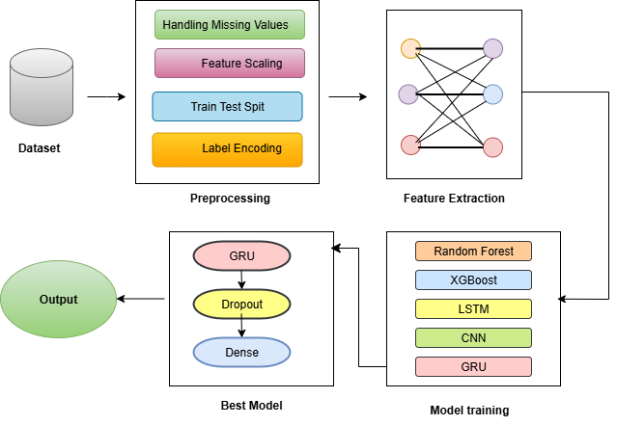
Flow Chart
Fig 1:Architecture for GRU-based Flood Prediction

Slide 12
Table 1:Dataset Description
Source | Type | Features Used | Frequency
NASA POWER | Climate (rainfall, temp) | Rainfall, Temperature | Daily
SMAP | Hydrological | Soil Moisture | Daily
MODIS | Land Cover | Vegetation Type, Urban Cover | Yearly
Socio-Environmental | Infrastructure, Human Factors | 20+ indicators (e.g., Urbanization, Deforestation) | Annual
Flood Label | Target | Binary label (Flood=1, No Flood=0) | Daily

Slide 13
Methodology
Data & Preprocessing:
Collect rainfall, temperature, soil moisture, and land cover data from NASA POWER, SMAP, and MODIS; clean, interpolate missing values, and normalize using Min-Max scaling.
Feature Engineering:
Extract key hydrological and environmental variables — rainfall intensity, soil moisture variation, land use type, and temperature patterns.
Model Development:
Build and train multiple models — Random Forest, XGBoost, CNN, LSTM, and GRU — using an 80:20 train-test split.
Performance Evaluation:
Assess models using Accuracy, RMSE, MAE, and R²; analyze confusion matrices for categorical flood prediction.
Best Model & Framework:
Select GRU with dropout and dense layers as the best model; develop a scalable, transferable flood prediction framework adaptable to multiple climatic zones.

Slide 14
Implementation
Implementation Step | Description
1. Data Collection | Gathered regional datasets including rainfall, temperature, soil moisture, dam condition, and urbanization data.
2. Data Preprocessing | Performed cleaning, normalization, and handling of missing values to ensure uniform data quality.
3. Feature Selection | Identified key attributes influencing floods such as rainfall intensity, urban growth, and dam quality.
4. Data Splitting | Divided the dataset into training (80%) and testing (20%) sets for model evaluation.
5. Model Implementation | Built and trained a GRU-based deep learning model for multi-regional flood prediction.
6. Model Evaluation | Evaluated model performance using Accuracy, RMSE, MAE, and R² metrics.
7. Visualization and Interpretation | Generated graphical outputs to analyze predicted vs. actual flood occurrences.

Slide 15
System Requirements
Software Specifications | Hardware Specifications
Programming Language: Python | Processor: x64-based CPU (6 MB cache)
Frameworks: PyTorch Geometric (for GAT & R-GCN), Scikit-learn (for classification & PCA) | RAM: 16 GB
Libraries: NLTK (text preprocessing), SentenceTransformers (all-MiniLM-L6-v2), Matplotlib & NetworkX (visualization) | Storage: ≥ 10 GB free disk space
Environment: Google Colab
Operating System: Windows 11

Slide 16
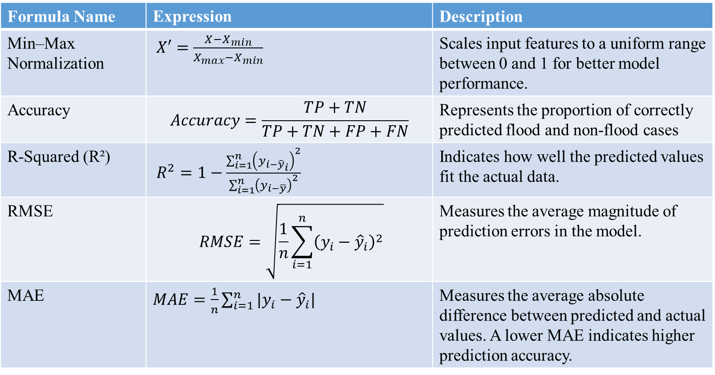
Performance Metrics
Formula Name | Expression | Description
Min–Max Normalization | $X′=\frac{X−X_{min}}{X_{max}−X_{min}}$ | Scales input features to a uniform range between 0 and 1 for better model performance.
Accuracy | $$Accuracy=\frac{TP+TN}{TP+TN+FP+FN}$$ | Represents the proportion of correctly predicted flood and non-flood cases
R-Squared (R²) | $R^{2}=1−\frac{\sum_{i=1}^{n}{{\left(y_{i−{\hat{y}}_{i}}\right)}^{2}}}{\sum_{i=1}^{n}{{\left(y_{i−\overline{y}}\right)}^{2}}}$ | Indicates how well the predicted values fit the actual data.
RMSE | $$RMSE=\sqrt{\frac{1}{n}\sum_{i=1}^{n}{{\left(y_{i}−{\hat{y}}_{i}\right)}^{2}}}$$ | Measures the average magnitude of prediction errors in the model.
MAE | $MAE=\frac{1}{n}\sum_{i=1}^{n}{|y_{i}−{\hat{y}}_{i}|}$ | Measures the average absolute difference between predicted and actual values. A lower MAE indicates higher prediction accuracy.

Slide 17
Results & Analysis
High Accuracy:
The GRU model achieved 99.63% accuracy, outperforming all other models (RF, XGBoost, CNN, LSTM).
Error Metrics:
Recorded RMSE = 0.1555, MSE = 0.0820, and R² = 0.8986, showing high predictive precision.
Model Efficiency:
GRU with dropout and dense layers showed faster convergence and better temporal learning than LSTM or CNN.
Generalization:
The model maintained high accuracy across diverse climatic zones, confirming strong scalability and transferability.

Slide 18
Results & Analysis
Model | Accuracy (%) | R² | RMSE | MAE
Random Forest | 85.62 | 0.4267 | 0.3696 | 0.3380
XGBoost | 88.08 | 0.6465 | 0.2902 | 0.1524
CNN | 98.49 | 0.9301 | 0.1291 | 0.0568
LSTM | 98.49 | 0.8677 | 0.1776 | 0.1061
GRU | 99.63 | 0.8986 | 0.1555 | 0.0820

Slide 19
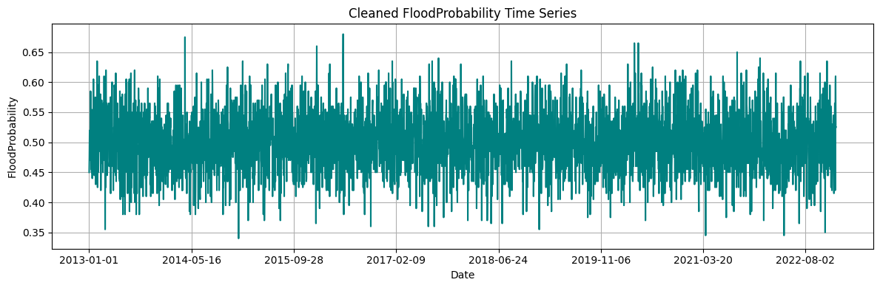
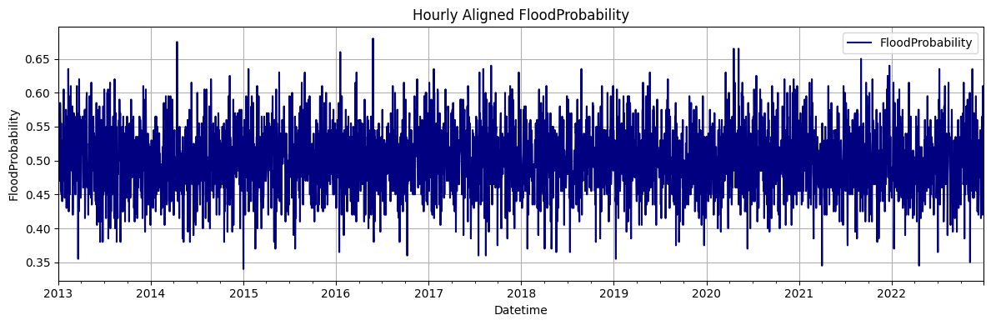
Results & Analysis
Fig 2:Cleaned FloodProbability Time Series
Fig 3: Hourly Aligned FloodProbability

Slide 20
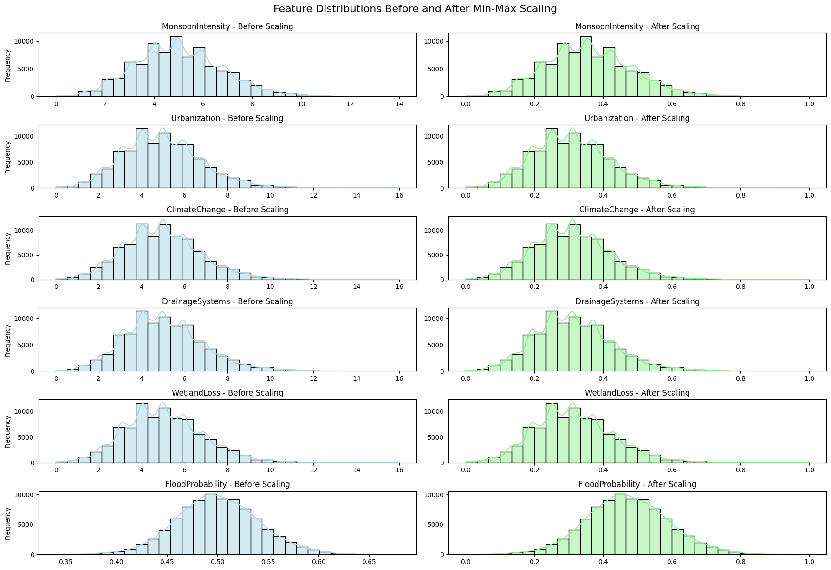
Results & Analysis
Fig 4:Feature Distribution for Before and After Min-Max Scaling

Slide 21
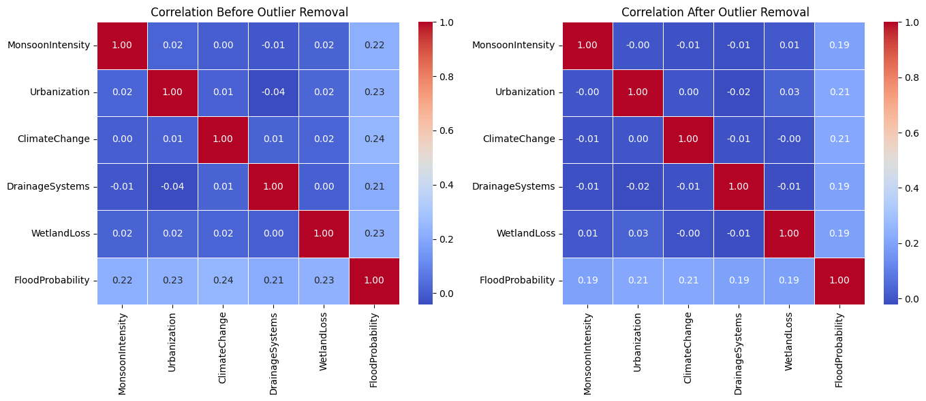
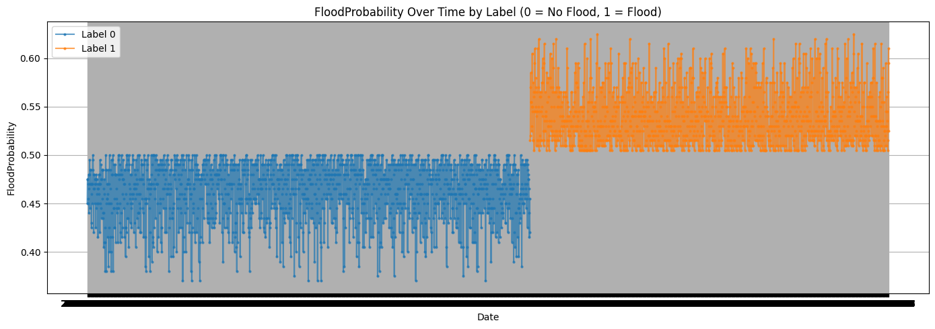
Results & Analysis
Fig 5: Correlation Heatmaps for before and after outlier removal
Fig 6: FloodProbability Over Time Label

Slide 22
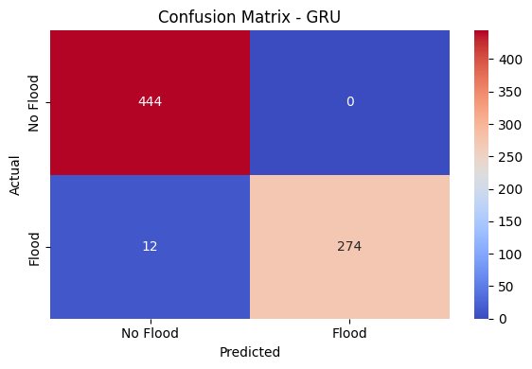
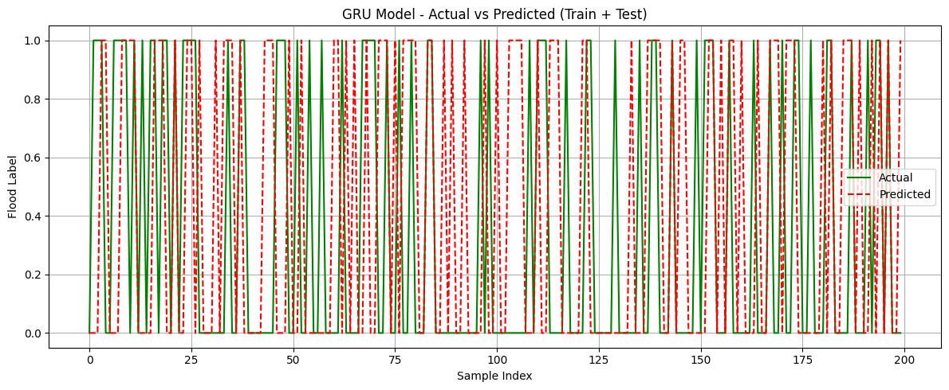
Results & Analysis
Fig 6: GRU-Confusion Matrix Fig 7: GRU Model- Actual vs Predicted

Slide 23
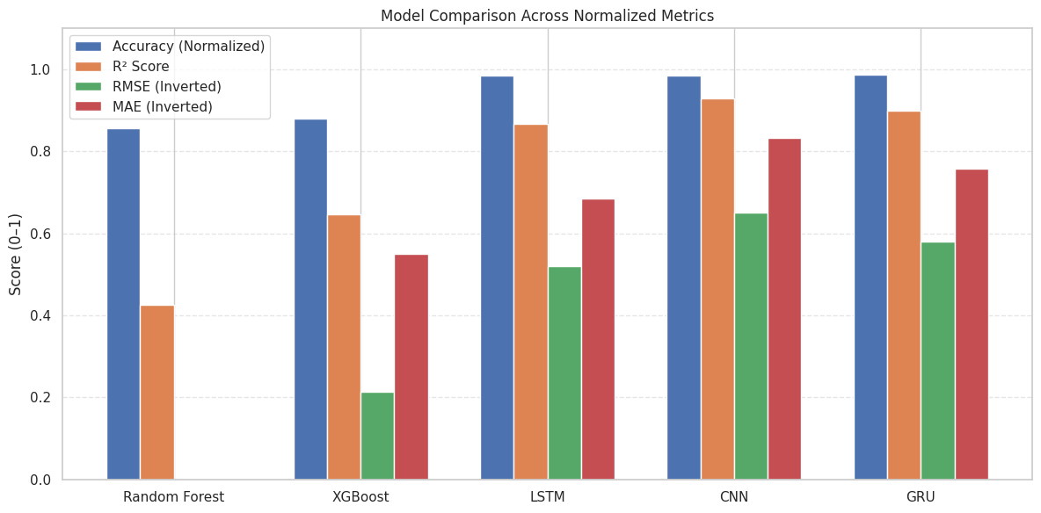
Results & Analysis
Fig 8: Model Performance Comparison

Slide 24
Conclusion & Future Scope
Developed a scalable, multi-regional flood prediction framework integrating heterogeneous datasets.
Deep learning models outperform traditional ML approaches.
GRU model provided the best balance of accuracy and computational efficiency.
Offers a robust solution for operational flood forecasting, disaster risk reduction, and climate adaptation.
Future Scope:
Integrate real-time IoT and satellite data for live prediction.
Explore Conv-GRU / Bi-GRU / Attention-based architectures.
Conduct external validation using STURM-Flood and FloodNet datasets.

Slide 25
References
Jia, W., Liang, B., Lu, Y., Khan, M. A., & Zheng, L. (2025). A
Comprehensive Survey on Deep Learning Solutions for 3D Flood Mapping. In Pacific-Asia Conference on Knowledge Discovery and Data Mining (pp. 21-38). Springer, Singapore.
Atashi, V., & Gorji, H. T. (2025). Enhanced flood prediction using LSTM and climate parameters: multi-station analysis of snowmelt- induced flooding in the Red River of the North. Journal of Hydroin- formatics, 27(2), 245-260.
Yang, P., Xu, X., Shao, M., & Liu, Y. (2025). Intelligent Prediction of Flood Disaster Risk Levels Based on Knowledge Graph and Graph Neural Networks. IEEE Access.
Prihatmanto, A. S., Prasetyadi, A., Yoganingrum, A., Sutriadi, R., & Hadiana, A. (2025). The Digital Twin City in Enhancing Flood Evacuation Systems: Future Opportunities and Challenges. IEEE Access.
Lim, S. J., Sankaran, K. S., & Haldorai, A. (2025). A Framework for Flood Disaster Detection from Remote Sensing Images Using Spatiotemporal Fusion with Digital Twin Technology. IEEE Journal of Selected Topics in Applied Earth Observations and Remote Sensing, 18, 11547-11560.
Saleem, M. A., Javeed, A., Benjapolakul, W., Srisiri, W., Chaitusaney, S., & Kaewplung, P. (2025). Neural-XGBoost: A Hybrid Approach for Disaster Prediction and Management Using Machine Learning. IEEE Access.
Wang, S., & Xu, O. (2025). High perplexity mountain flood level forecasting in small watersheds based on compound Long Short-Term Memory model and multimodal short disaster-causing factors. IEEE Access.

Slide 26
References
Noh, G. H., & Ahn, K. H. (2025). Enhancing multiple precipitation data integration across a large-scale area: a deep learning ResU-Net framework without interpolation. IEEE Transactions on Geoscience and Remote Sensing.
Notarangelo, N., Wirion, C., & van Winsen, F. (2025). STURM- Flood: a curated dataset for deep learning-based flood extent mapping leveraging Sentinel-1 and Sentinel-2 imagery. Big Earth Data, 1-27.
Alkaabi, K., Sarfraz, U., & Al Darmaki, S. (2025). A Deep Learning Framework for Flash-Flood-Runoff Prediction: Integrating CNN-RNN with Neural Ordinary Differential Equations (ODEs). Water, 17(9), 1283.
Farooq, M. S., Tehseen, R., Qureshi, J. N., Omer, U., Yaqoob, R., Tanweer, H. A., & Atal, Z. (2023). FFM: Flood forecasting model using federated learning. IEEE Access, 11, 24472-24483.
Puttinaovarat, S., & Horkaew, P. (2020). Flood forecasting system based on integrated big and crowdsource data by using machine learning techniques. IEEE Access, 8, 5885-5905.
Wu, Z., Zhou, Y., & Wang, H. (2020). Real-time prediction of the water accumulation process of urban stormy accumulation points based on deep learning. IEEE access, 8, 151938-151951.
Liu, Y., Wang, L., Du, S., Zhao, L., & Liu, X. (2022). Flood forecasting method based on improved VMD-FOS-QR-RBL. IEEE Access, 11, 4207-4218.
Khan, T. A., Alam, M. M., Shahid, Z., & Su’Ud, M. M. (2020).
Investigation of flash floods on early basis: A factual comprehensive review. IEEE Access, 8, 19364-19380.

Slide 27
Questions and Answers
Thank you for your attention!
We’d now like to open the floor for any questions or feedback.

Slide 28
Acknowledgements
🙏 Thank You for the Opportunity!
We sincerely express our gratitude to our faculty, mentors, and organizers for their continuous support and guidance throughout this project.

