Slide 1



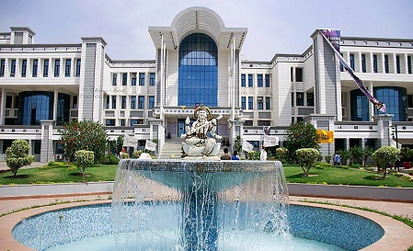




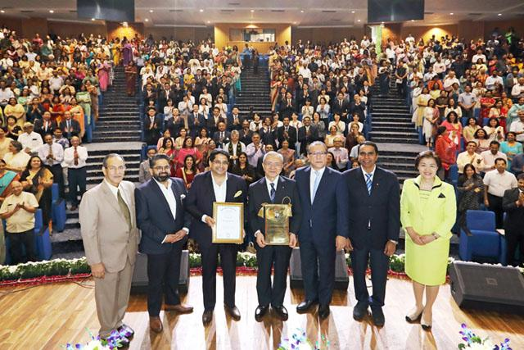
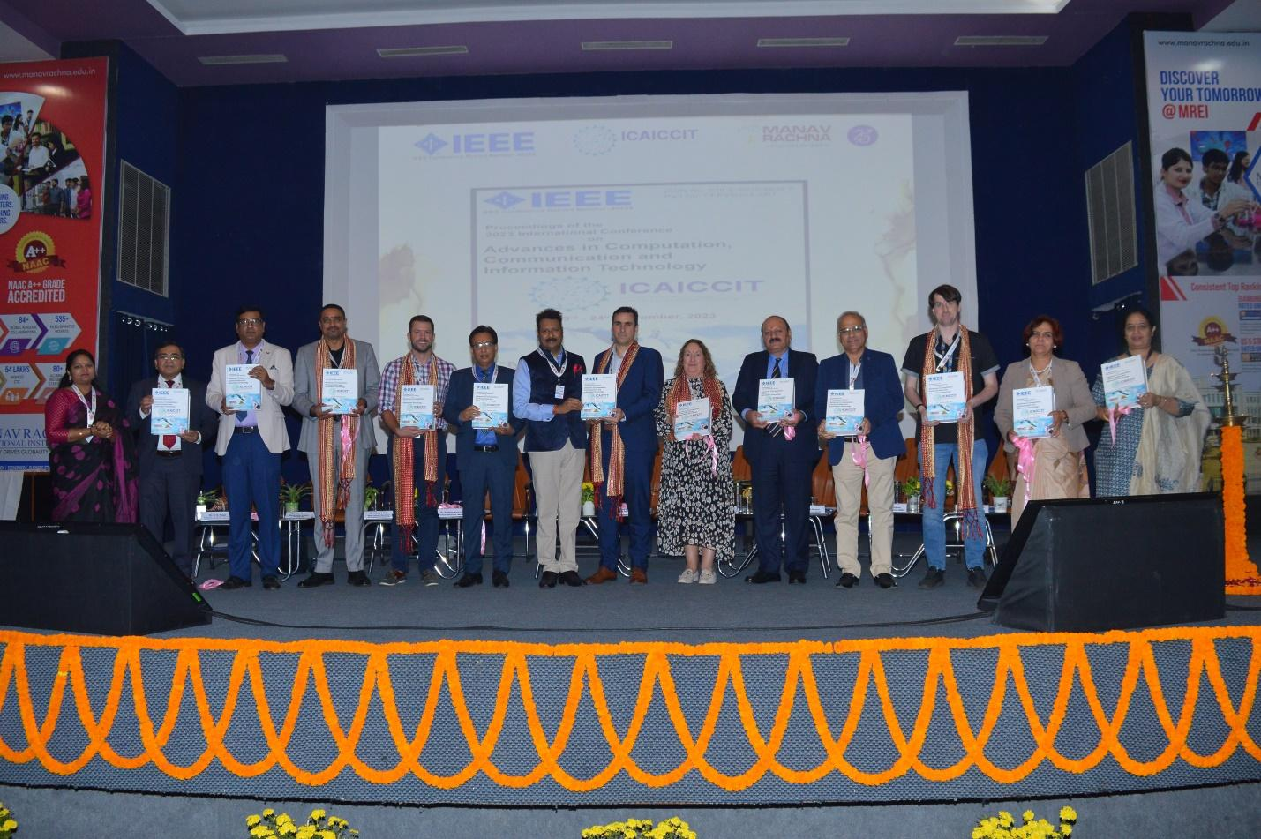

ICAICCIT-2025, 3rd International conference on Advances in Computing, Communication and Information Technology, technically Co-Sponsored by IEEE Delhi SECTION (IEEE record no # 68829)
on 31st Oct & 1st Nov. 2025

Slide 2
Cross-Climate Flood Prediction :A Multi-Regional Deep Learning Approach to Hydrological Diversity
Paper ID : ICAICCIT-0710
Rama Krishna Eluri
Dept. of Computer Science and Engineering
Amireddy Navya
Dept. of Computer Science and Engineering
Attluri Pavana Prudula Sri
Dept. of Computer Science and Engineering
Kadapa Gandhi Kumari
Dept. of Computer Science and Engineering
Pavan Tejaswi Surath
Dept. of Computer Science and Engineering
Vadde Radha Krishna Presented by
Dept. of Electronics & Communication Engineering Amireddy Navya
Authors Name & Affiliation

Slide 3
Contents
Introduction
Problem Statements
Objectives
Literature Review
Methodology
Result & Discussion
Conclusion & Future Scope
References

Slide 4
Introduction
Floods are among the most destructive natural disasters affecting life, infrastructure, and ecosystems.
Increasing climate change, urbanization, and changing rainfall patterns make prediction complex.
Traditional models (empirical or ML) perform well only in localized regions and fail to generalize.
Advanced Deep Learning (DL) approaches like CNN, LSTM, and GRU show strong capability in learning temporal and spatial flood patterns.
Goal: Develop a scalable, transferable deep learning framework for multi-regional flood prediction using heterogeneous data.

Slide 5
Problem Statements
Data inconsistency: Missing, noisy, or misaligned data.
Poor scalability: Models fail across regions and climates.
Nonlinear patterns: Hard to capture complex hydrological links.
Generalization gap: Models lack cross-climate adaptability.
Need for improvement: Require a robust deep learning framework.

Slide 6
Objectives
Develop a multi-regional flood forecasting framework using diverse climatic and environmental data.
Handle data inconsistency (missing, noisy, misaligned data) using preprocessing techniques.
Evaluate and compare classical ML (Random Forest, XGBoost) vs. deep learning models (CNN, LSTM, GRU).
Identify a generalizable model effective across multiple climatic zones.
Provide a scalable, data-driven deep learning approach for real-time flood early warning and disaster mitigation.

Slide 7
Literature Review
Author | Approach | Key Findings / Limitations
Jia et al. (2025) | CNN-LSTM-GNN for 3D flood mapping | High resolution maps, but limited robustness due to simulated data.
Atashi & Gorji (2025) | LSTM for snowmelt flood prediction | High temporal accuracy but region-specific.
Lim et al. (2025) | CNN + Digital Twin | Accurate but computationally expensive.
Saleem et al. (2025) | Neural-XGBoost hybrid | High accuracy (94.8%) but poor scalability.
Alkaabi et al. (2025) | CNN-RNN + Neural ODE | Good performance, but complex computation.
Gap Identified:
Most models are region-specific, computationally heavy, or lack cross-climate adaptability.

Slide 8
Methodology
Data & Preprocessing:
Collect rainfall, temperature, soil moisture, and land cover data from NASA POWER, SMAP, and MODIS; clean, interpolate missing values, and normalize using Min-Max scaling.
Feature Engineering:
Extract key hydrological and environmental variables — rainfall intensity, soil moisture variation, land use type, and temperature patterns.
Model Development:
Build and train multiple models — Random Forest, XGBoost, CNN, LSTM, and GRU — using an 80:20 train-test split.
Performance Evaluation:
Assess models using Accuracy, RMSE, MAE, and R²; analyze confusion matrices for categorical flood prediction.
Best Model & Framework:
Select GRU with dropout and dense layers as the best model; develop a scalable, transferable flood prediction framework adaptable to multiple climatic zones.

Slide 9
Results & Discussion
High Accuracy:
The GRU model achieved 99.63% accuracy, outperforming all other models (RF, XGBoost, CNN, LSTM).
Error Metrics:
Recorded RMSE = 0.1555, MSE = 0.0820, and R² = 0.8986, showing high predictive precision.
Model Efficiency:
GRU with dropout and dense layers showed faster convergence and better temporal learning than LSTM or CNN.
Generalization:
The model maintained high accuracy across diverse climatic zones, confirming strong scalability and transferability.

Slide 10
Model Performance
Model | Accuracy (%) | R² | RMSE | MAE
Random Forest | 85.62 | 0.4267 | 0.3696 | 0.3380
XGBoost | 88.08 | 0.6465 | 0.2902 | 0.1524
CNN | 98.49 | 0.9301 | 0.1291 | 0.0568
LSTM | 98.49 | 0.8677 | 0.1776 | 0.1061
GRU | 99.63 | 0.8986 | 0.1555 | 0.0820

Slide 11
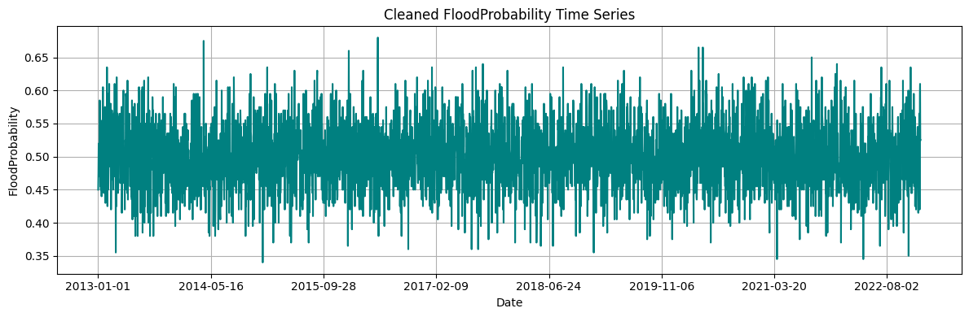
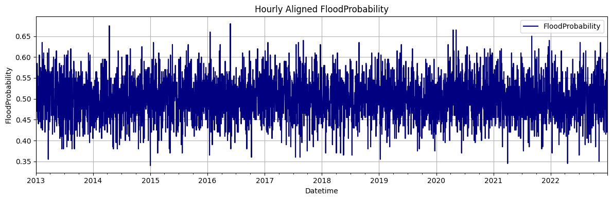

Slide 12
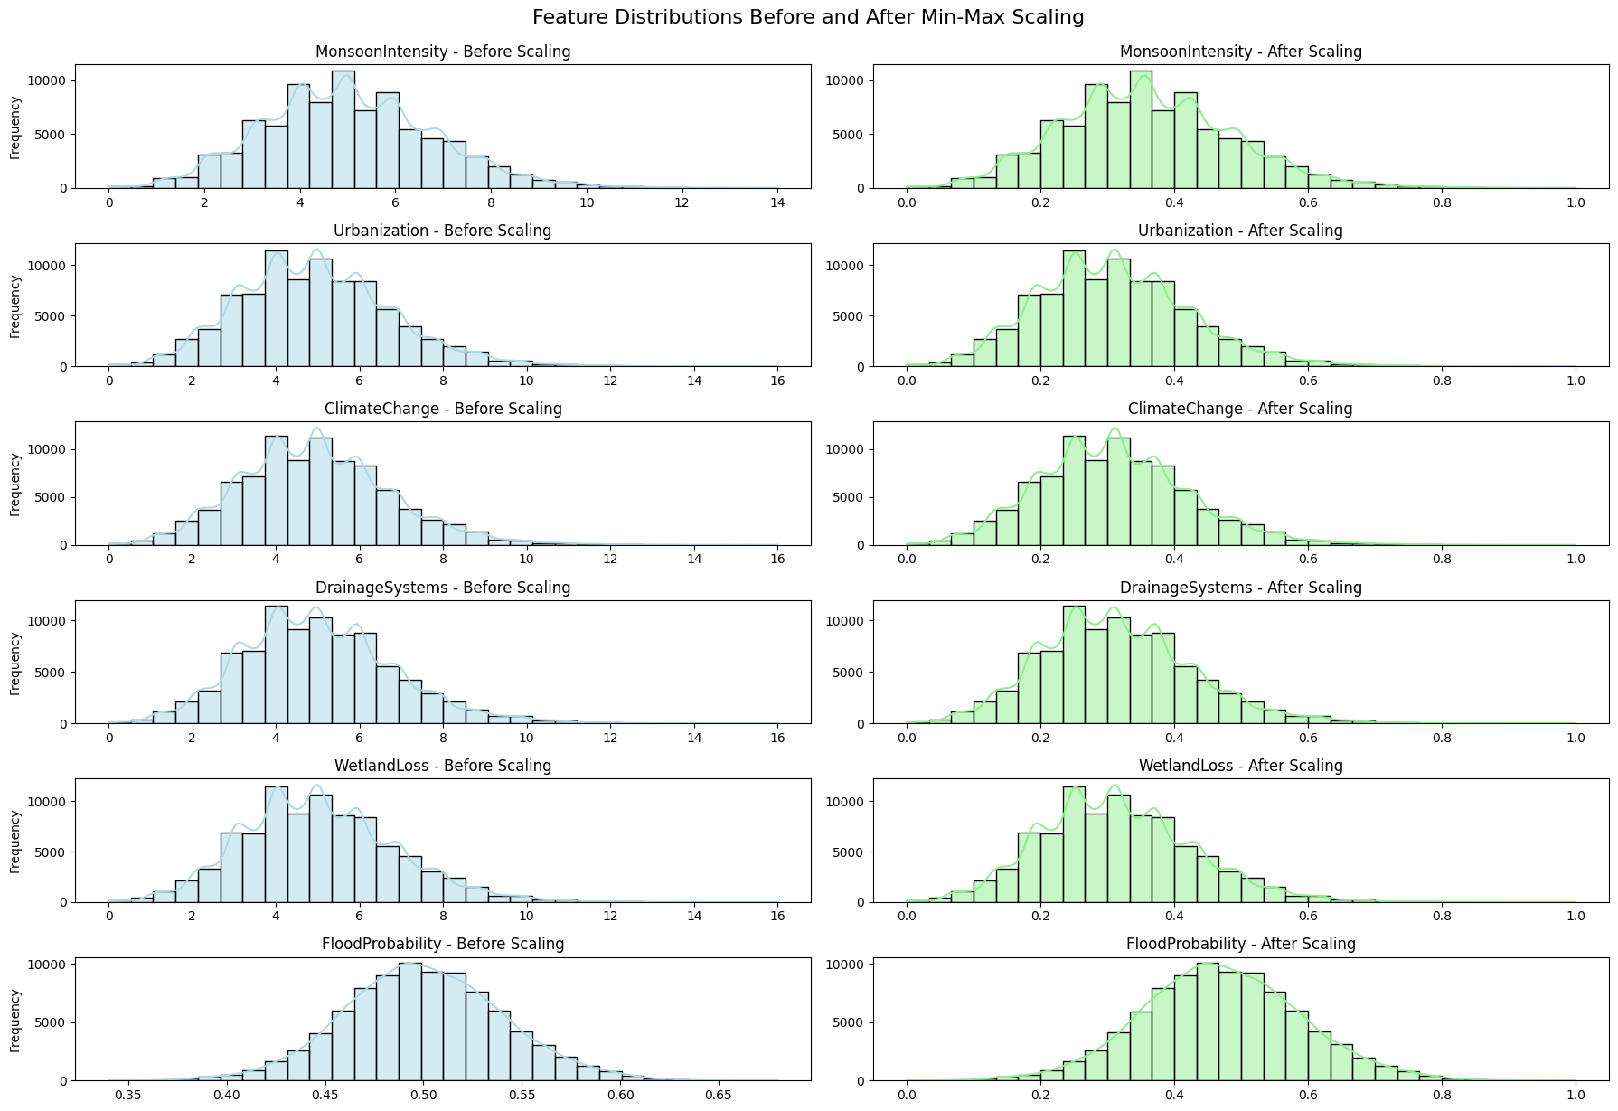

Slide 13
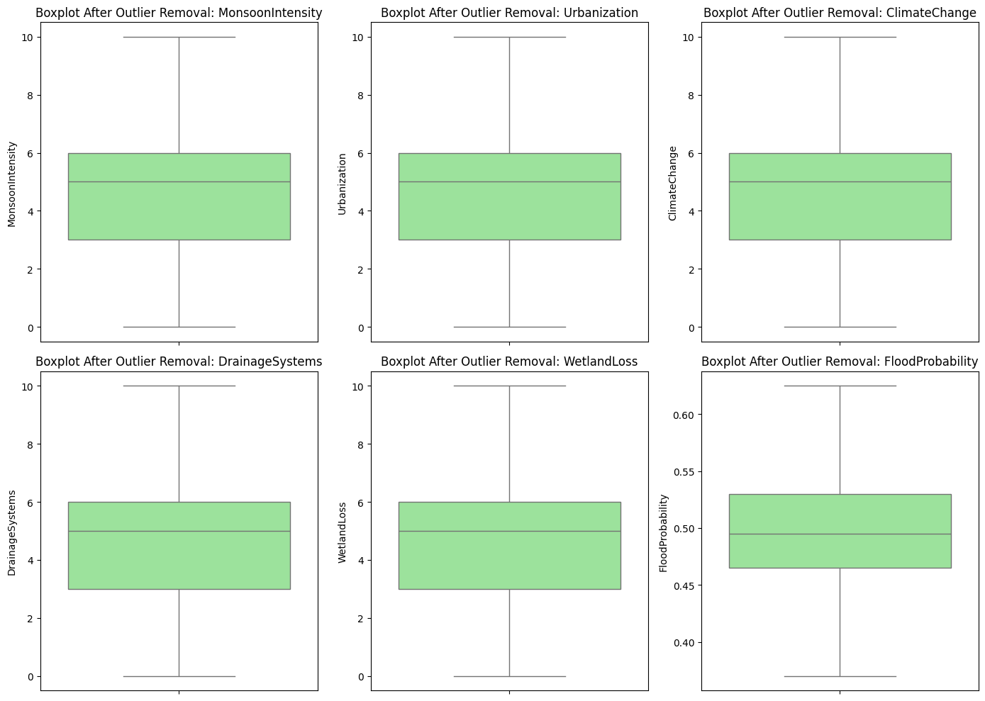

Slide 14
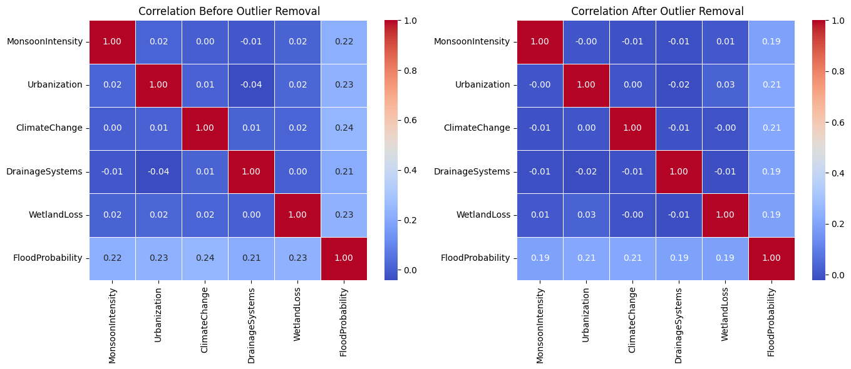

Slide 15
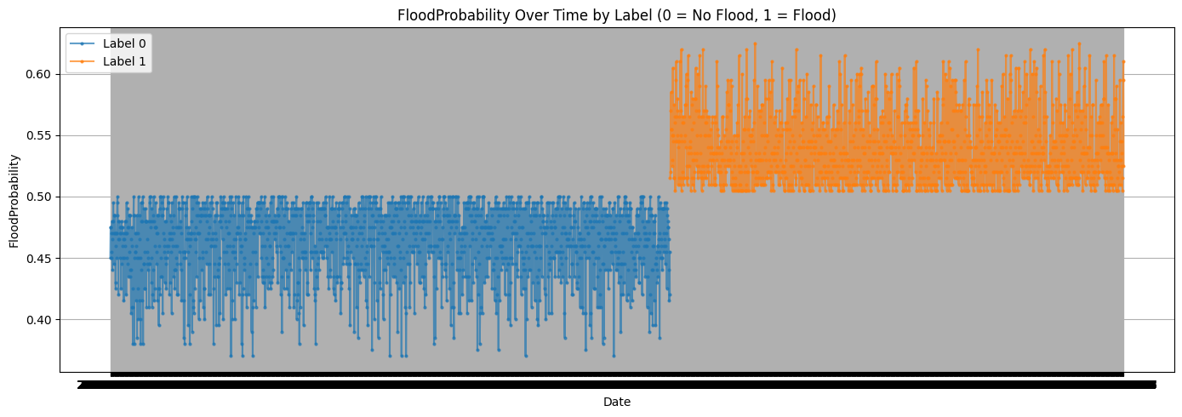

Slide 16
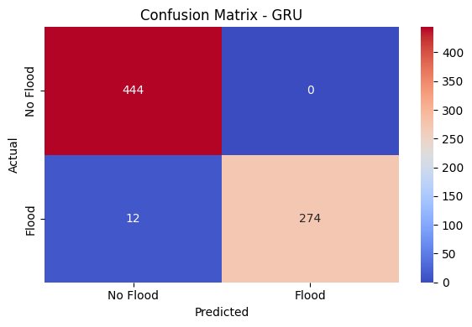
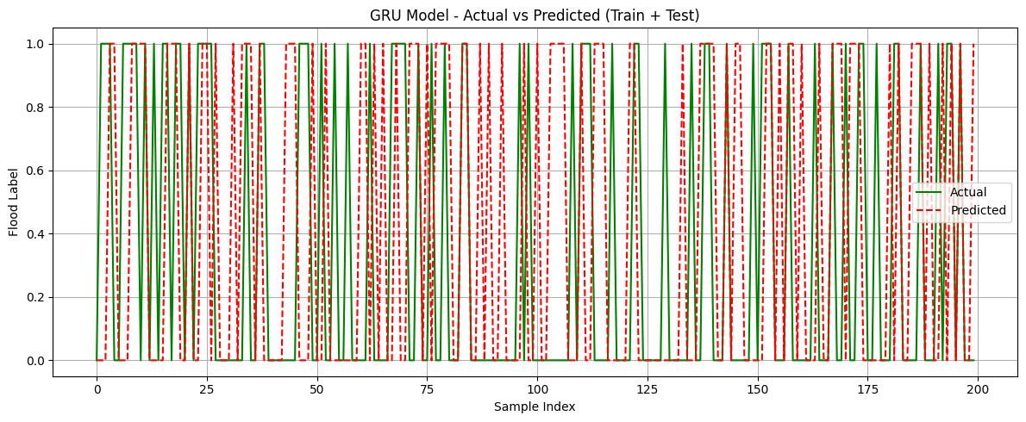

Slide 17
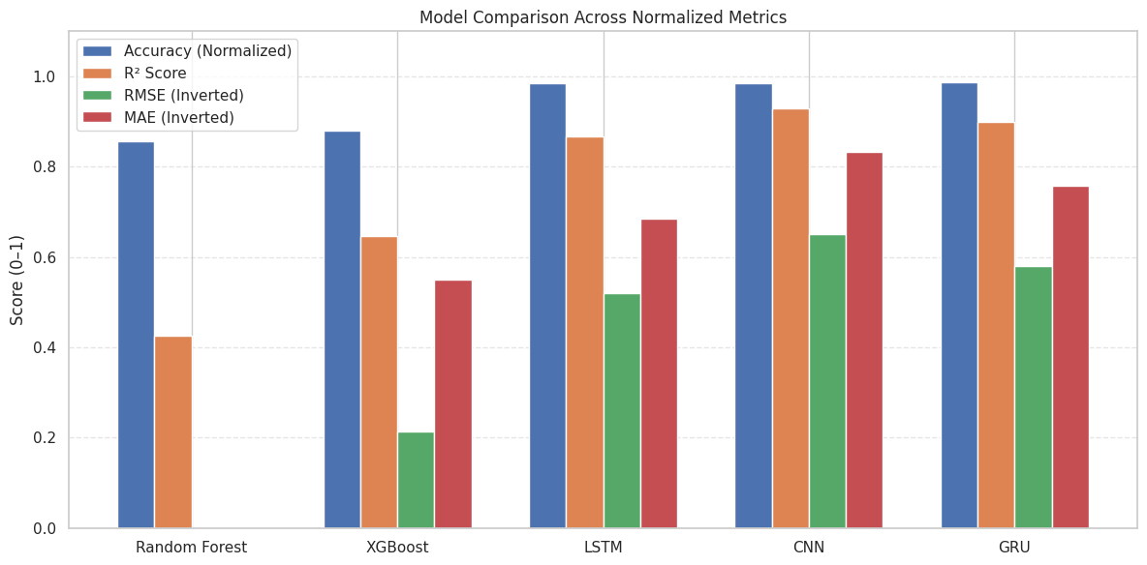

Slide 18
Conclusion & Future Scope
Developed a scalable, multi-regional flood prediction framework integrating heterogeneous datasets.
Deep learning models outperform traditional ML approaches.
GRU model provided the best balance of accuracy and computational efficiency.
Offers a robust solution for operational flood forecasting, disaster risk reduction, and climate adaptation.
Future Scope:
Integrate real-time IoT and satellite data for live prediction.
Explore Conv-GRU / Bi-GRU / Attention-based architectures.
Conduct external validation using STURM-Flood and FloodNet datasets.

Slide 19
References
Jia, W., Liang, B., Lu, Y., Khan, M. A., & Zheng, L. (2025). A Comprehensive Survey on Deep Learning Solutions for 3D Flood Mapping. In Pacific-Asia Conference on Knowledge Discovery and Data Mining (pp. 21-38). Springer, Singapore.
Atashi, V., & Gorji, H. T. (2025). Enhanced flood prediction using LSTM and climate parameters: multi-station analysis of snowmelt- induced flooding in the Red River of the North. Journal of Hydroin- formatics, 27(2), 245-260.
Yang, P., Xu, X., Shao, M., & Liu, Y. (2025). Intelligent Prediction of Flood Disaster Risk Levels Based on Knowledge Graph and Graph Neural Networks. IEEE Access.
Prihatmanto, A. S., Prasetyadi, A., Yoganingrum, A., Sutriadi, R., & Hadiana, A. (2025). The Digital Twin City in Enhancing Flood Evacuation Systems: Future Opportunities and Challenges. IEEE Access.

Slide 20
THANK YOU

