Slide 1

Department of Computer Science Engineering
Title : Hybrid Resampling-Driven Deep Learning Architecture for Cardiovascular Risk Stratification
PRESENTED BY
Thogati Adi Lakshmi (22471A05E2)
Sunkara Harini (22471A05J8)
Sattenapalli Sadarani (22471A05I7)
Under the Guidance of,
D. Venkata Reddy, M.Tech.,
Associate Professor,
Department of Computer Science and Engineering,
Narasaraopeta Engineering College (Autonomous),
Narasaraopet- 522 601.

Slide 2
OUTLINE
Abstract
Introduction
Literature Survey
Research Gaps
Problem Statement
Objectives
Flow Chart
Methodology
Implementation
Results & Analysis
Conclusion & Future Scope
References
Question and Answers
Acknowledgements

Slide 3
ABSTRACT
Cardiovascular diseases (CVD) are a leading cause of global mortality, accounting for nearly 18 million deaths annually.
The study proposes a deep learning-based predictive framework integrating hybrid resampling to address class imbalance in CVD datasets.
Evaluated five architectures — TabNet, CNN–BiLSTM, MLP, Attention-LSTM, and 1D CNN — under a unified pipeline.
Among all models, TabNet achieved the highest accuracy (96.19%), followed closely by MLP and CNN–BiLSTM.
Applied SHAP explainability for model transparency and medical interpretability.
The proposed framework demonstrates potential for inclusion in clinical decision support systems to assist early CVD diagnosis and prevention.

Slide 4
INTRODUCTION
Cardiovascular diseases (CVDs) are the leading global cause of death, claiming over 18 million lives annually.
Traditional risk prediction tools fail to capture the complex nonlinear relationships in clinical data.
Machine learning and deep learning offer data-driven, personalized methods for early CVD detection.
Classical models like Logistic Regression, Decision Trees, and Random Forests show promise but lack explainability and adaptability.
Hybrid architectures like CNN, LSTM, and TabNet effectively model spatial and temporal medical features.
This study develops a SHAP-guided deep learning framework with hybrid resampling for accurate and interpretable cardiovascular risk prediction.

Slide 5
LITERATURE SURVEY
No | Title | Author | Journal Name & Year | Methodology Adopted | Key Findings | Gaps
1 | Predicting Heart Diseases Using Machine Learning and Different Data Classification Techniques | El-Sofany H. F. et al. | IEEE Access, 2024 | Used ensemble ML models (XGBoost, AdaBoost, SVM) with ANOVA and chi-square feature selection. | Achieved 97.57% accuracy and AUC 0.98 on private dataset. | Dataset not publicly available; lacks explainability and reproducibility.
2 | Ischemic Heart Disease Prognosis: Hybrid Residual Attention-Enhanced LSTM (HRAE-LSTM) | Cenitta D. et al. | IEEE Access, 2024 | Proposed attention-based LSTM with residual layers for ischemic heart disease prediction. | Reported 97.7% accuracy on UCI dataset; strong temporal learning. | Evaluated only on ischemic subset; limited generalization across broader CVDs.
3 | Predicting the Prevalence of Cardiovascular Diseases Using ML Algorithms | Sianga B. E. et al. | Intelligence-Based Medicine, 2025 | Applied SMOTE for imbalance handling with XGBoost, SVM classifiers. | Achieved 95.24% accuracy combining clinical and environmental variables. | Dataset limited to specific regions; deep learning and explainability not applied.

Slide 6
LITERATURE SURVEY
No | Title | Author | Journal Name & Year | Methodology Adopted | Key Findings | Gaps
4 | Interactive Cardiovascular Disease Prediction System Using Learning Techniques | Pal P. et al. | Results in Control and Optimization, 2025 | Compared InceptionNet, RF, KNN, and Logistic Regression on 14-feature dataset. | InceptionNet achieved 98.89% accuracy; effective for small datasets. | Lacked explainability and cross-dataset validation.
5 | The Impact of Feature Selection Models on the Accuracy of Tree-Based Classification Algorithms | Efe Y., Demir L. | Procedia Computer Science, 2025 | Feature selection using ReliefF, Boruta; applied Weka preprocessing on Statlog Heart dataset. | ReliefF & Boruta improved accuracy of tree-based models. | Focused only on ML tree models; no deep learning or hybrid methods
6 | Analysis of Machine Learning Techniques for Prediction of Cardiac Diseases | A. Gupta et al., 2025, Elsevier | Procedia Computer Science, 2025 | Standard scaling and data cleaning; tested LR, RF, DT, KNN, SVM | KNN achieved 90.16% accuracy | No DL or ensemble techniques included; limited model diversity

Slide 7
LITERATURE SURVEY
No | Title | Author | Journal Name & Year | Methodology Adopted | Key Findings | Gaps
7 | Machine Learning Methods for Predicting Cardiovascular Diseases Analyzing a Hybrid Dataset | Selvitopi Z., Selvitopi H. | Procedia Computer Science, 2025 | Clean dataset without missing values; used NB, LR, KNN, RFC | Naive Bayes achieved 85.63% accuracy, 84.29% AUC | Dataset small and basic; no DL or advanced ensemble approaches
8 | Comparison of Machine Learning Algorithms for Heart Disease Prediction | Daharwal U. et al. | Procedia Computer Science, 2025 | Basic scaling and feature selection; compared RF and KNN | RF and KNN performed effectively for CVD prediction | No DL, hybrid, or ensemble models included; lacks modern techniques
9 | Feature Selection and Model Evaluation for Heart Disease Prediction Using Ensemble Methods | Sreekumari S. et al. | Procedia Computer Science, 2025 | Feature selection (χ², correlation, IG); ensemble of KNN–DT–NB | Ensemble reached 78.42% accuracy | Lower accuracy; no DL or explainability
10 | Improving CVD Prediction With Deep Learning and Correlation-Aware SMOTE | Trigka M., Dritsas E. | IEEE Access, 2025 | Correlation-Aware SMOTE + normalization; applied DL models | CNN achieved 91% accuracy | No SHAP/interpretability

Slide 8
REASEARCH GAPS & OUR SOLUTIONS
Research Gaps | Our Solutions (Implemented)
G1: Traditional ML used → poor deep feature learning | Implemented 5 deep models (TabNet, CNN+BiLSTM, MLP, Attention-LSTM, 1D CNN)
G2: Small datasets in prior works → poor generalizability | Used Sulianova CVD dataset (70K records) with strict cleaning
G3: Class imbalance ignored → biased predictions | Applied Hybrid Resampling (SMOTE + ENN)
G4: Explainability limited to single models | Applied SHAP on TabNet, MLP, CNN+BiLSTM

Slide 9
PROBLEM STATEMENT
Cardiovascular diseases (CVDs) cause millions of deaths each year, highlighting the need for early and accurate prediction systems.
Many existing models focus only on accuracy and fail to provide clear explanations for their predictions.
Imbalanced medical datasets lead to biased models that perform poorly on minority (disease-positive) cases.
There is a lack of a unified framework combining different deep learning models with effective data balancing and interpretability.
Therefore, there is a need for a reliable and explainable deep learning approach using hybrid resampling and SHAP analysis to predict CVD risk more accurately.

Slide 10
OBJECTIVES
To build an accurate deep learning framework for predicting cardiovascular disease risk using clinical and lifestyle features.
To apply a hybrid resampling method (SMOTE + random undersampling) to handle class imbalance effectively.
To compare five deep learning models — TabNet, CNN–BiLSTM, MLP, Attention-LSTM, and 1D CNN — within a unified pipeline.
To enhance model interpretability using SHAP explainability, making results more understandable for clinicians.
To develop a clinically reliable and interpretable prediction system for early cardiovascular risk assessment.

Slide 11
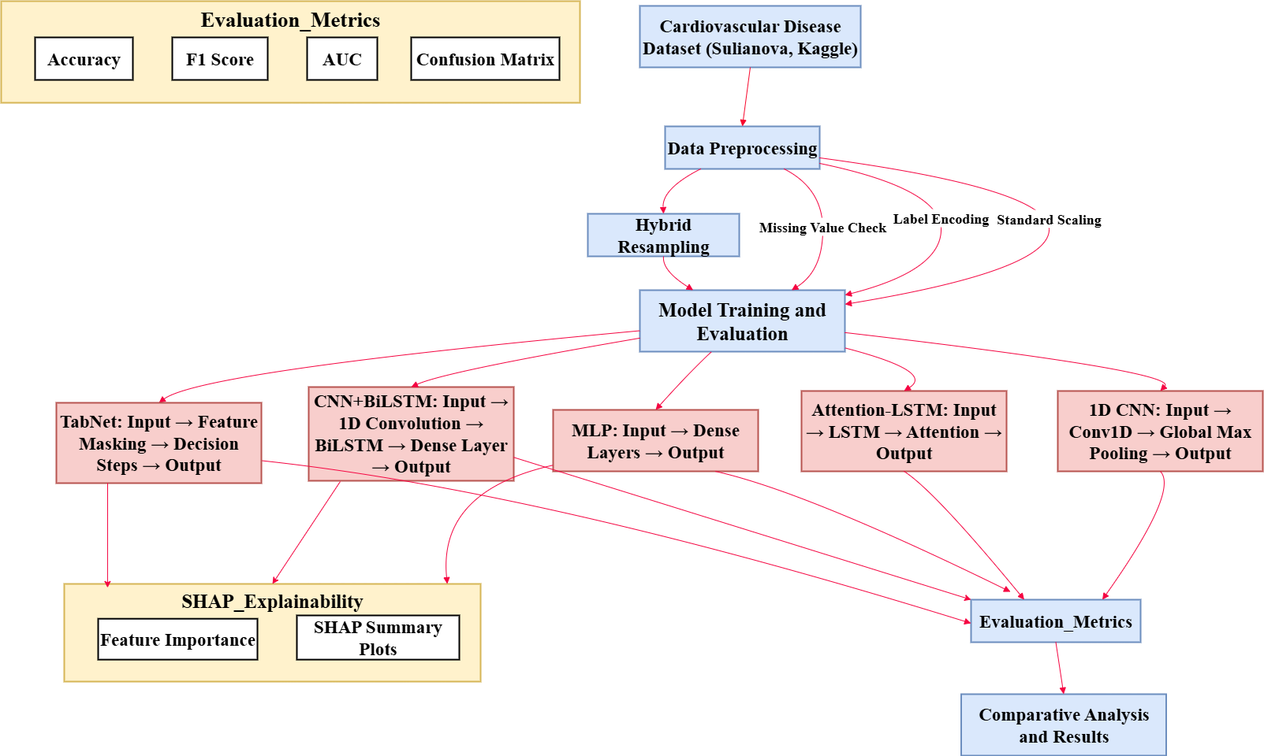
FLOW DIAGRAM

Slide 12
METHODOLOGY
Cleaned the dataset by removing unrealistic values in ap_hi, ap_lo, height, and weight.
Created new clinical features such as Age (years), BMI, and Pulse Pressure for improved representation.
Applied StandardScaler to normalize all numerical features using the saved scaler.pkl.
Selected important features using SelectKBest (Mutual Information) saved as selector.pkl.
Handled class imbalance using a hybrid SMOTE + ENN resampling strategy.

Slide 13
METHODOLOGY
Used frameworks: Python, PyTorch, Scikit-learn, Imbalanced-learn, TabNet, and SHAP for explainability.
Implemented five models: TabNet, CNN–BiLSTM, MLP, Attention-LSTM, and 1D-CNN under a unified pipeline.
Used Adam optimizer (lr = 0.001–0.02), BCE loss, dropout, and batch sizes 128–1024 for stable training.
Applied Mutual Information for feature scoring and StandardScaler mathematical normalization.
Generated SHAP plots to interpret feature contributions in each deep learning model.

Slide 14
IMPLEMENTATION
Loaded the Sulianova CVD dataset and applied preprocessing using the saved scaler (scaler.pkl) and feature selector (selector.pkl).
Balanced the training data using SMOTE + ENN hybrid resampling to fix imbalance and remove noisy samples.
Trained all five deep learning models using a unified training pipeline with metric tracking and evaluation.
Saved models in .pth format for reuse in Flask API and React web application.
Generated SHAP interpretability plots to support clinical decision understanding.

Slide 15
IMPLEMENTATION
Software Used:Python 3.11, PyTorch, Scikit-learn, Imbalanced-learn, SHAP, Optuna, Flask API, React + Vite frontend.
Hardware Used:Intel i5/i7, 8–16 GB RAM, optional GPU support for faster TabNet/CNN/LSTM training (Google Colab).
Challenges & Solutions:
Severe class imbalance → solved using SMOTE + ENN hybrid resampling.
Risk of overfitting → reduced by dropout layers, tuning learning rate, and early stopping.
Preprocessing mismatch during deployment → fixed by reusing the exact saved scaler and selector.
Explaining deep learning outputs → addressed by generating SHAP summary plots.
15

Slide 16
RESULTS & ANALYSIS
Model | Accuracy | F1 Score | AUC
TabNet | 96.19% | 0.9627 | 0.9916
MLP | 96.08% | 0.9613 | 0.9926
CNN+BiLSTM | 95.71% | 0.9580 | 0.9910
Attention-LSTM | 95.65% | 0.9570 | 0.9904
1D CNN | 94.66% | 0.9477 | 0.9870
TabNet outperformed all other models with 96.19% accuracy and high interpretability through SHAP explainability

Slide 17
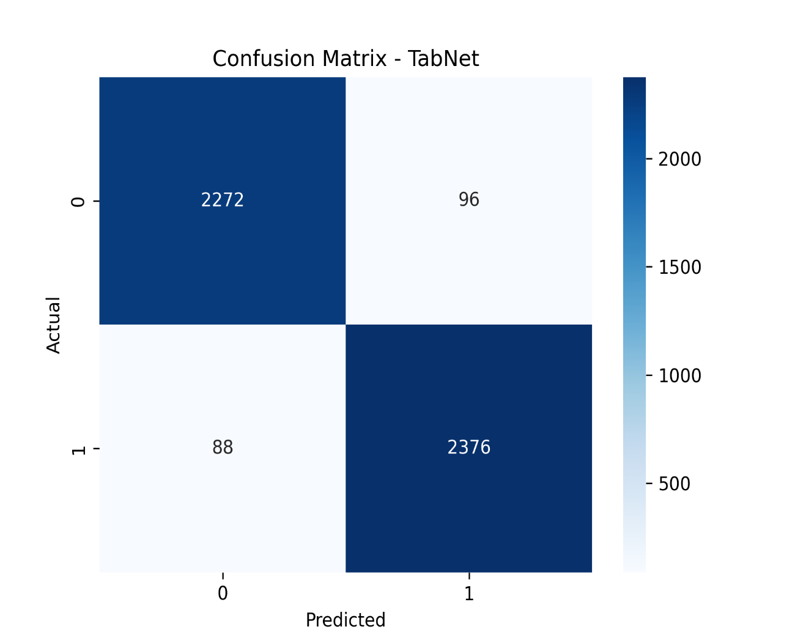
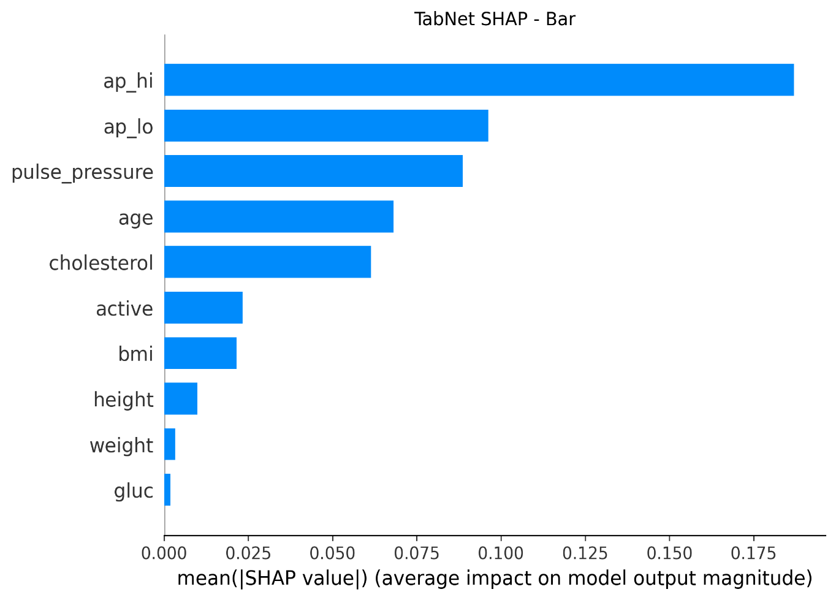
RESULTS & ANALYSIS
Fig.1. Confusion Matrix for tabnet
Fig.2. SHAP explainability for tabnet

Slide 18
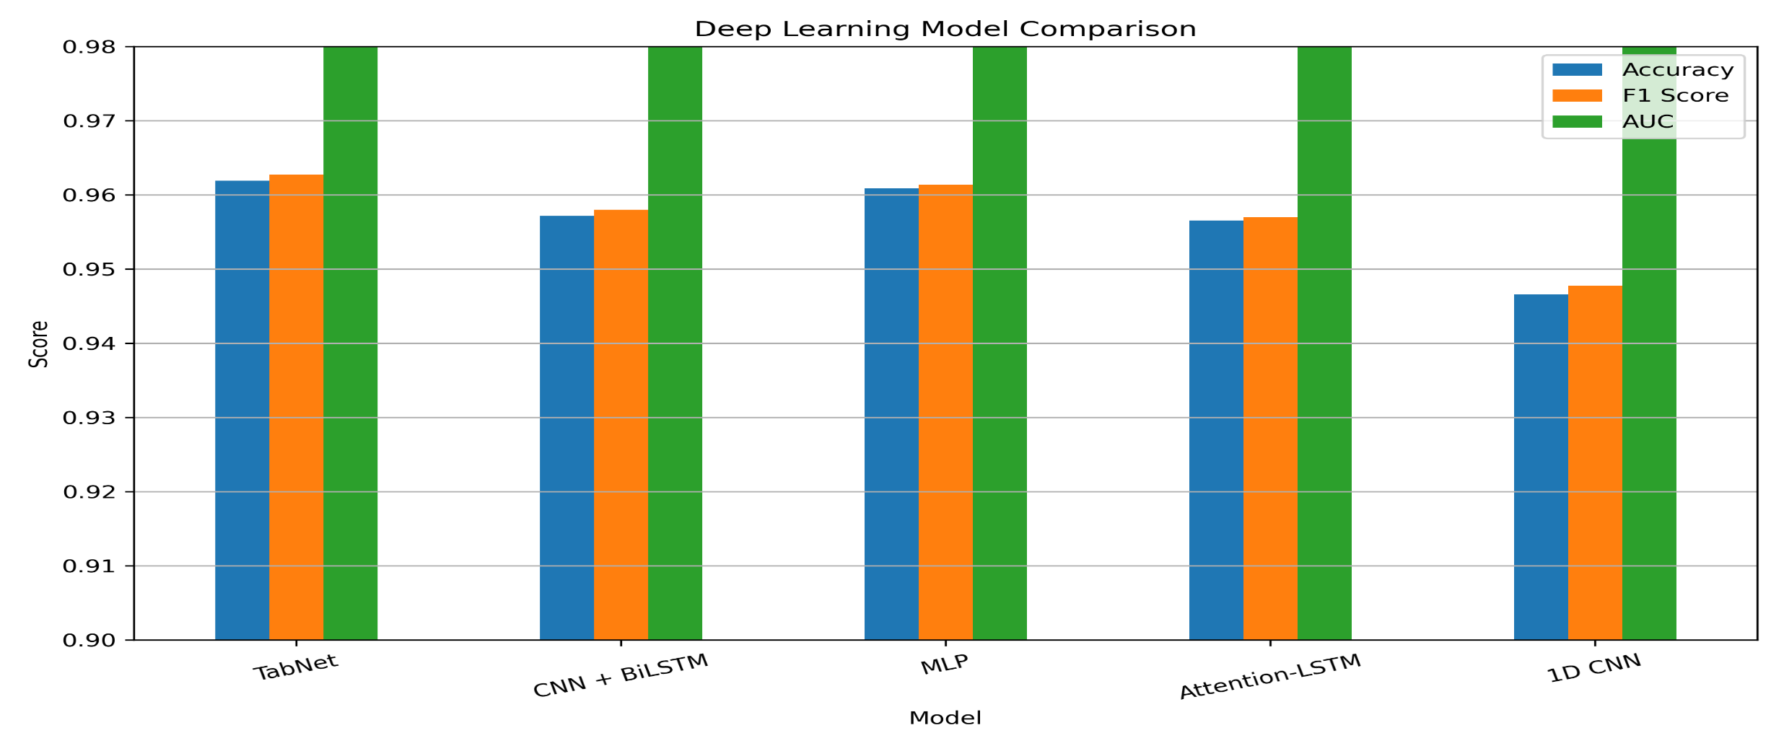
RESULTS & ANALYSIS
Fig.3. Comparison of all deep learning models

Slide 19
CONCLUSION & FUTURE SCOPE
The proposed SHAP-guided hybrid resampling deep learning framework achieved high accuracy and interpretability for cardiovascular risk prediction.
TabNet outperformed other models with 96.19% accuracy, proving effective for tabular clinical data.
The integration of SMOTE and Random Undersampling successfully handled data imbalance, improving model reliability.
SHAP explainability provided clinical insights by identifying key risk factors like age, blood pressure, and cholesterol.
Future work will focus on deploying the model as a real-time web application and exploring larger, multi-center medical datasets for broader clinical use.

Slide 20
REFERENCES
El-Sofany, H. F. (2024). Predicting heart diseases using machine learning and different data classification techniques. IEEE Access.
Cenitta, D., Arjunan, R. V., Paramasivam, G., Arul, N., Palkar, A., & Chadaga, K. (2024). Ischemic Heart Disease Prognosis: A Hybrid Residual Attention-Enhanced LSTM Model. IEEE Access.
Sianga, B. E., Mbago, M. C., & Msengwa, A. S. (2025). Predicting the prevalence of cardiovascular diseases using machine learning algorithms. Intelligence-Based Medicine, 11, 100199..
Pal, P., Singh, H. V., Grover, V., Manikandan, R., Karimi, R., & Khishe, M. (2025). Interactive cardiovascular disease prediction system using learning techniques: Insights from extensive experiments. Results in Control and Optimization, 19, 100560.
Efea, Y., & Demirb, L. (2025). The impact of feature selection models on the accuracy of tree-based classification algorithms: Heart disease case. Proc. Comput. Sci, 253, 757-764.
Gupta, A., Singh, A., Kumar, P., Raj, G., & Tomar, V. (2025). Analysis of Machine Learning Techniques for Prediction of Cardiac Diseases. Procedia Computer Science, 259, 1937-1946.
Selvitopi, Z., & Selvitopi, H. (2025). Machine learning methods for predicting cardiovascular diseases analyzing a hybrid dataset. Procedia Computer Science, 258, 3535-3543.
Daharwal, U., Singh, I., & Khekare, G. (2025). Comparison of Machine Learning Algorithms for Heart Disease Prediction. Procedia Computer Science, 260, 12-21.

Slide 21
REFERENCES
Sreekumari, S., Bhalla, R., & Singh, G. (2025). Feature Selection and Model Evaluation for Heart Disease Prediction Using Ensemble Methods. Procedia Computer Science, 259, 1282-1295.
Trigka, M., & Dritsas, E. (2025). Improving Cardiovascular Disease Prediction With Deep Learning and Correlation-Aware SMOTE. IEEE Access.
Mahajan, A., Kaushik, B., Rahmani, M. K. I., & Banga, A. S. (2024). A hybrid feature selection and ensemble stacked learning models on multi-variant CVD datasets for effective classification. IEEE Access, 12, 87023-87038.
Sinha, N., Kumar, M. G., Joshi, A. M., & Cenkeramaddi, L. R. (2023). DASMcC: Data Augmented SMOTE Multi-class Classifier for prediction of Cardiovascular Diseases using time series features. IEEE Access, 11, 117643-117655.
Chushig-Muzo, D., Calero-D´ ıaz, H., Lara-Abelenda, F. J., G´omez Mart´ ınez, V., Granja, C., & Soguero-Ruiz, C. (2024). Interpretable data driven approach based on feature selection methods and GAN-based models for cardiovascular risk prediction in diabetic patients. IEEE Access, 12, 84292-84305.
Vinay, N. A., Vidyasagar, K. N., Rohith, S., Pruthviraja, D., Supreeth, S., &Bharathi, S. H. (2024). An RNN-Bi LSTM based multi decision GAN approach for the recognition of cardiovascular disease (CVD) from heart beat sound: a feature optimization process. IEEE Access, 12, 65482 65502.
Adhikari, A., DeJesus, S., Swe, N., Vaidean, G., Nahrwold, R., Joshua, J., ... & Gianos, E. (2024). Traditional and non-traditional cardiovascular risk factor profiles in young patients with coronary artery disease. American Heart Journal Plus: Cardiology Research and Practice, 47, 100471.

Slide 22
QUESTIONS & ANSWERS
I now open the floor for any questions from the panel and audience.
I would be glad to clarify or discuss any part of my work in more detail.
Your valuable feedback and suggestions are always welcome.

Slide 23
ACKNOWLEDGEMENTS
I sincerely thank my guide, faculty, and department for their continuous support and guidance throughout this project, and I am thankful for the opportunity to present my work today.
Contact Information:
aadhi0509@gmail.com
harinisunkara2005@gmail.com
sattenapallisada@gmail.com

