Slide 1


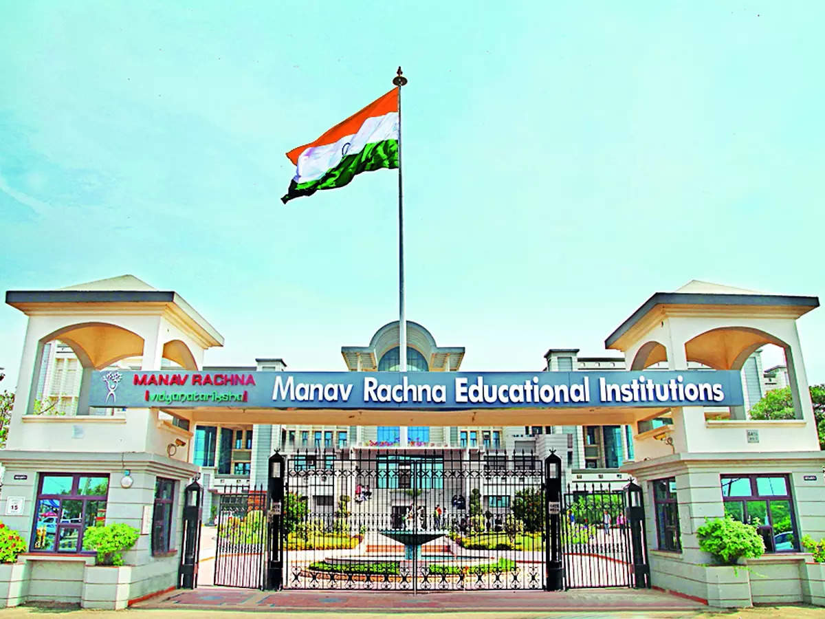
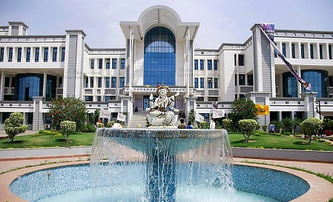
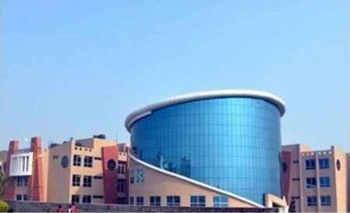



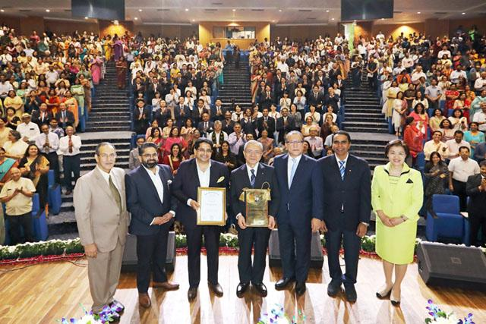
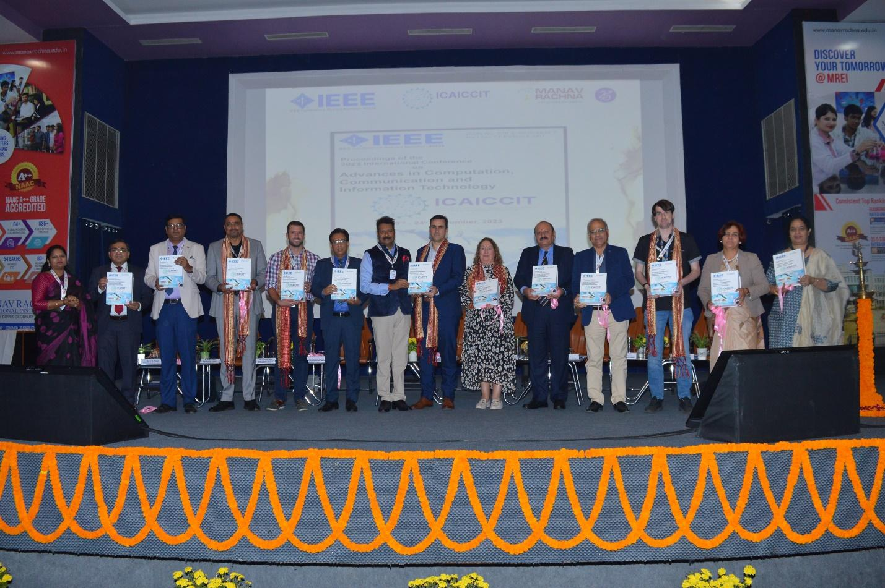

ICAICCIT-2025, 3rd International conference on Advances in Computing, Communication and Information Technology, technically Co-Sponsored by IEEE Delhi SECTION (IEEE record no # 68829)
on 31st Oct & 1st Nov. 2025

Slide 2
pH and Turbidity: Multi-Parameter Water Quality Monitoring Using Edge-Integrated Sensing Platforms
Paper ID : ICAICCIT_00576
Presented by
Keerthisree Alajangi
Authors Name & Affiliation
Suneetha Mothe
Dept. Of Computer Science and Engineering, NEC
Keerthisree Alajangi
Dept. Of Computer Science and Engineering, NEC
Thanmai Katari
Dept. Of Computer Science and Engineering, NEC
Vineela Sonti
Dept. Of Computer Science and Engineering, NEC
Madhavi Karanam
Dept. Of Computer Science and Engineering, GRIET
Reddygari Pallavi Reddy
Dept. Of ECE, G. Narayanamma Institute of Technology & Science

Slide 3
Contents
Introduction
Objectives
Literature Review
Methodology
Result & Discussion
Conclusion & Future Scope
References
Problem Statements

Slide 4
Introduction
    Water pollution is a major global problem affecting health and the environment. Traditional water monitoring systems use costly sensors, making them hard to use in rural areas. This project introduces a software-based system that uses machine learning to check water quality without sensors. It combines parameters like pH and turbidity to create a Pollution Severity Index (PSI). The GRU model gave the best results with 92% accuracy, proving it is an effective and low-cost solution.

Slide 5
Problem Statements
Current water quality systems are hardware-dependent and costly.
Most focus on only a few parameters like pH or turbidity.
Lack of scalability for rural and remote areas with poor connectivity.
Maintenance of sensors and IoT devices is time-consuming.
There is a need for a smart, affordable, and easy-to-deploy solution.
Aim: Develop a sensor-free model that predicts water quality efficiently.

Slide 6
Objectives
To design a multi-parameter water quality classification system.
To develop a Pollution Severity Index (PSI) combining major water indicators.
To train and compare machine learning and deep learning models:
  Random Forest (RF)
  Feedforward Neural Network (FNN)
  Long Short-Term Memory (LSTM)
  Gated Recurrent Unit (GRU)
To identify the best-performing model for accuracy and stability.
To provide a low-cost, scalable, and data-driven solution suitable for all environments.

Slide 7
Literature Review
Xia et al. (2024): Used LSTM for river water analysis but faced poor generalization.
Paneru et al. (2024): Developed CNN–RNN models for Nepal’s river but had limited regional scope.
Sangwan & Bhardwaj (2024): Used ML models for WQI but required hardware input.
Zhang et al. (2025): Applied XGBoost and SHAP for groundwater but lacked low-cost implementation.
Existing models show good accuracy but high cost and limited interpretability.
Our model focuses on sensor-free, low-cost, and scalable analysis using open data.

Slide 8
Methodology
Collected public water datasets (~3000 samples) with parameters like pH, turbidity, chloramines, solids, conductivity, and organic carbon.
Handled missing values, removed outliers, and normalized data using Min–Max Scaling.
Added ratio-based, polynomial, and interaction features for better accuracy.
Applied Principal Component Analysis (PCA) to reduce dimensionality.
Trained RF, FNN, LSTM, GRU using 80:20 train-test split and k-fold validation.
Compared models based on Accuracy, Recall, and F1-score.
Designed for edge-computing and real-time implementation in low-resource areas.

Slide 9
Result & Discussion
GRU Model performed best among all tested models.
Achieved 92% accuracy, 0.89 recall, and 0.895 F1-score.
Low generalization gap – less overfitting, better real-world performance.
Random Forest and LSTM showed good results but higher variance.
GRU captured temporal and nonlinear relations effectively.
The model’s performance proves it can replace expensive sensors with a data-driven approach.
Can be deployed on edge or cloud platforms for real-time water monitoring.

Slide 10
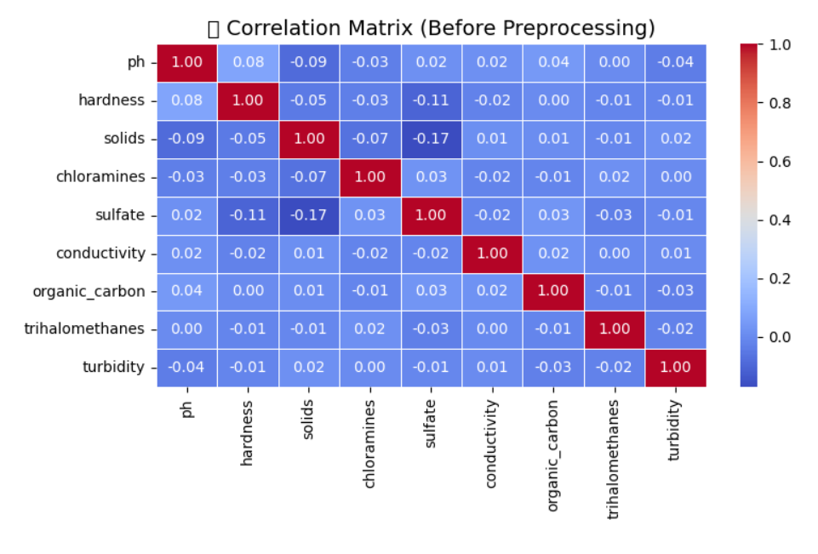
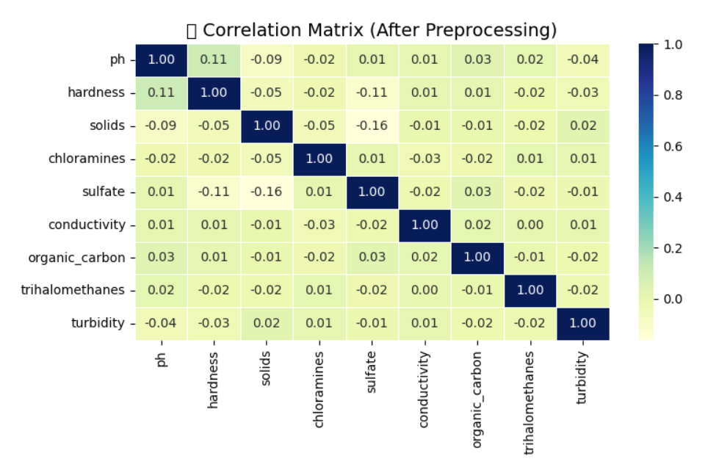

Slide 11
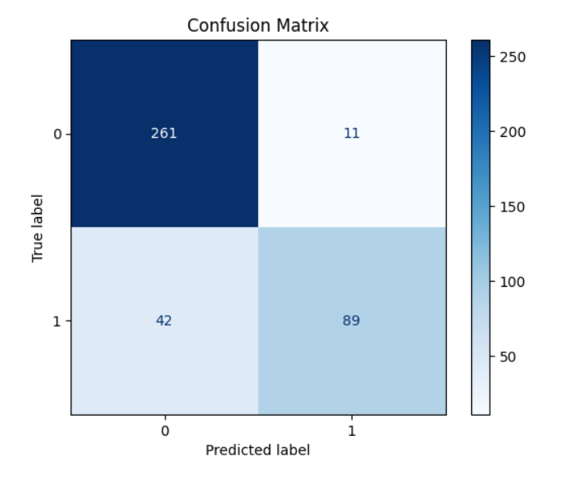
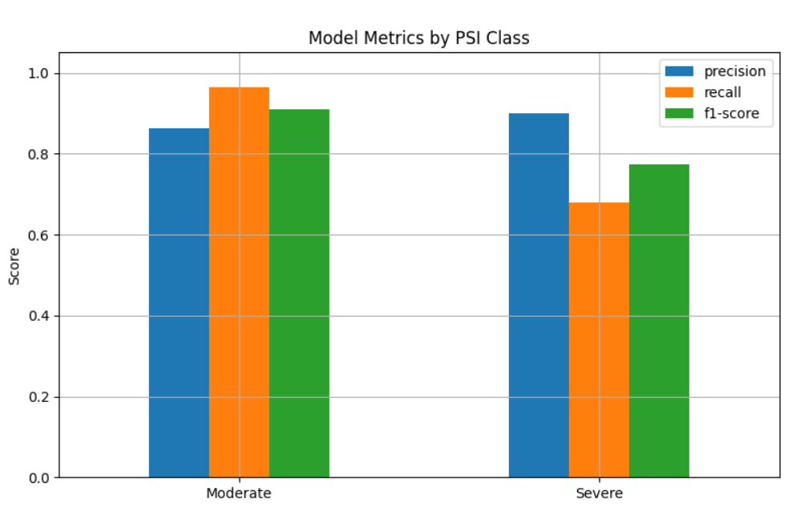

Slide 12
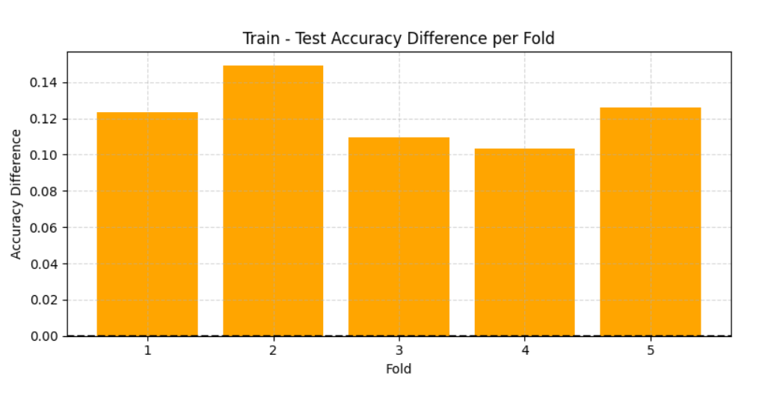
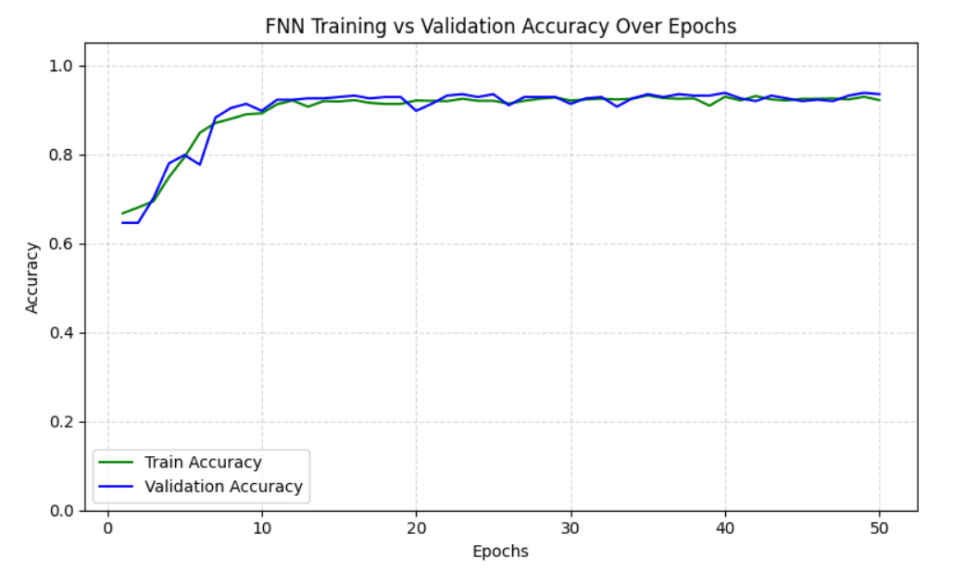

Slide 13
Conclusion & Future Scope
Developed a multi-parameter water quality monitoring framework using ML and open data.
The system works without physical sensors, reducing cost and complexity.
GRU model achieved the best balance between performance and efficiency.
Supports SDG-6 by providing an affordable, scalable solution for clean water access.
Future Scope:
Add biological and microbial water parameters.
Implement real-time monitoring using IoT integration.
Create a mobile/web dashboard for public and government use.
Use transfer learning to adapt the model for different regions and water sources.

Slide 14
References
Chen et al., Machine Learning-Based Water Quality Classification, 2024.
Paneru et al., Hybrid Deep Learning for Seasonal Water Quality, 2024.
Sangwan & Bhardwaj, ML Framework for Predicting Water Quality, 2024.
Zhang et al., Interpretable ML for Groundwater Analysis, 2025.
Quevy et al., Low-Cost Smart Buoy for Water Quality, 2023.
Water Potability Dataset – Kaggle (Aditya Kadiwal, 2020).

Slide 15
Thank You

