Slide 1

Department of Computer Science and Engineering
FusionNet-GLD: A Dual-Backbone CNN ModelCombining Xception and Inception for Grape Leaf Disease Recognition
PRESENTED BY
Syed Shafia Zainab
Soudagar Min Haz
Chatti Navya
(22471A05K0) (22471A05J7) (22471A05E9)
Under the Guidance of,
K.V.Narasimha Reddy M.Tech,
Assistant Professor,
Department of Computer Science and Engineering, Narasaraopeta Engineering College (Autonomous),
Narasaraopet- 522 601.
10-11-2025
Batch No.CG5 Department of CSE

Slide 2
OUTLINE
Abstract
Introduction
Literature Survey
Research Gaps
Problem Statement
Objectives
Block Diagram / Flow Diagram
Methodology
Implementation
Results and Analysis
Conclusion & Future Scope
References
Question and Answers
Acknowledgements
Batch No.CG5 Department of CSE

Slide 3
ABSTRACT
Grapevine leaf diseases (black rot, leaf blight, esca) reduce crop yield and fruit quality.
Manual disease inspection is slow, labor-intensive, and unreliable for large vineyards.
FusionNet-GLD is proposed as a dual-backbone CNN for disease classification.
It combines Xception (fine-grained feature extraction) and InceptionV3 (multi-scale feature extraction).
This fusion efficiently captures complex visual patterns of infected leaves.
FusionNet-GLD trained on augmented PlantVillage dataset achieved 99.63% accuracy, 99.45% precision, 99.42% recall, 99.43% F1-score, and 0.99 AUC, outperforming five baseline models.
It is lightweight and suitable for deployment on handheld devices and drones for real-time vineyard monitoring.
10-11-2025
Batch No.CG5
Department of CSE

Slide 4
INTRODUCTION
Brief Introduction
Grapevine is a major commercial crop used for wine and table grapes.
Leaf diseases like Black Rot, Esca, and Leaf Blight reduce yield and fruit quality. Manual disease identification in large vineyards is slow, inconsistent, and labor-dependent.
Motivation Behind the Project
Need for fast and accurate grape disease detection to avoid production loss. Manual inspection is prone to human error and slow for large-scale vineyards.
Existing single-backbone models do not effectively balance computational efficiency and accuracy. Exploring hybrid feature extraction can improve recognition of complex disease patterns.
Importance and Relevance
Prior work used CNNs, lightweight CNNs, and transformer models, but mixed-architecture models remain underexplored. The proposed FusionNet-GLD combines Xception + InceptionV3 to capture depth-wise and multi-scale features.
Batch No.CG5 Department of CSE

Slide 5
LITERATURE SURVEY
No | Title | Author & Year | Journal Name | Methodology Adapted | Key Findings | Gaps
1 | GrapeLeafNet: A Dual-Track Feature Fusion Network With Inception-ResNet and Shuffle-Transformer for Accurate Grape Leaf Disease Identification. | R Karthik (Corresponding Author), R Menak, S Ompirakas, P Bala Murugan, M Meenakashi, and Sindhia Lingaswamy. 2024. IEEE | GrapeLeafNet: A Dual-Track Feature Fusion Network With Inception-ResNet and Shuffle-Transformer for Accurate Grape Leaf Disease Identification | IEEE Journals & Magazine | IEEE Xplore | methodology applies data augmentation (rotation, shifting, flipping, brightness adjustment, Gaussian blur) and dataset splitting for robust learning. It integrates Inception-ResNet, CBAM, Coordinate Attention, and Shuffle-Transformer modules for effective spatial and contextual feature extraction. | GrapeLeafNet utilizes a dual-track feature fusion approach, combining Inception-ResNet blocks for local feature extraction. | It primarily focused on either local or global feature extraction methods, which can lead to suboptimal performance in accurately detecting grape leaf diseases. This indicates a need for improved feature fusion techniques that can integrate both types of information effectively
2 | GCS-YOLO: Lightweight YOLOv8 for Grape Leaf Detection | Hu & Zhang, 2025 Elsevier. | GCS-YOLO: A Lightweight Detection Algorithm for Grape Leaf Diseases Based on Improved YOLOv8 | methodology employs annotation using LabelImg and integrates a GCS-YOLO framework combining YOLOv8, Ghost Module, RepConv, and CBAM for efficient feature extraction and detection. Additionally, the C2f-GR module enhances gradient flow and feature representation for improved grape leaf disease identification. | model achieved 96.2% mean Average Precision (mAP) at IoU threshold 0.5, indicating very high detection accuracy | Needs further field testing
3 | DeepLeaf: Optimized Deep Learning for Grape Leaf Diseases | Fatma M.Talaat,2025, Neural Comput. & Appl. | DeepLeaf: an optimized deep learning approach for automated recognition of grapevine leaf diseases | Neural Computing and Applications | methodology involves resizing, normalization, segmentation, color space conversion, and brightness/contrast enhancement for consistent image preprocessing. An OCNN model with Logistic Regression-based downsampling is employed to enhance feature extraction and classification efficiency. | Combines logistic regression with CNN for better accuracy | Requires large homogeneous dataset; mostly tested in lab
4 | YOLOv8-ACCW: Lightweight Grape Leaf Disease Detection | Zuxing Chen et al., 2024, IEEE Access | YOLOv8-ACCW: Lightweight Grape Leaf Disease Detection Method Based on Improved YOLOv8 | IEEE Journals & Magazine | IEEE Xplore | methodology adopts an enhanced YOLOv8-ACCW model integrating AKConv, CARAFE, Wise-IoU, and Coordinate Attention (CA) modules to improve feature extraction, up sampling accuracy, and localization precision. | small object detection improved | Limited generalizability across datasets
5 | Grapes Leaf Disease Dataset for Precision Agriculture | Madhuri Dharrao et al. , 2025, Elsevier | Grapes leaf disease dataset for precision agriculture - ScienceDirect | The methodology includes uniform resizing of images to 256×256, JPEG format conversion, and label structuring for standardized input. A ResNet-18 model is then utilized for efficient feature extraction and classification of grape leaf diseases. | Dataset with 2726 images; accuracy : 96% | No support for Esca, Black Rot etc.

Slide 6
RESEARCH GAPS
Limited integration of multi-backbone CNNs and attention modules for precise disease detection.
Scarcity of hybrid CNN–Transformer architectures tailored for agricultural imagery.
Lack of lightweight, high-accuracy models suitable for mobile or edge deployment.
Few large-scale, annotated, and balanced datasets covering multiple grape varieties.
Limited focus on disease stage differentiation and early-stage detection.
Inadequate handling of environmental variations (lighting, background, leaf orientation).
Minimal research on cross-domain generalization and transfer learning adaptability
Absence of explainable AI techniques to interpret model predictions for farmers.
Limited exploration of real-time detection frameworks for field deployment.
Few comparative studies evaluating computational efficiency vs. accuracy trade-offs.
Batch No.CG5 Department of CSE

Slide 7
PROBLEM STATEMENT
Main Issue
Limited robustness and generalization in grape leaf disease detection due to inadequate feature fusion, insufficient attention mechanisms, and limited dataset diversity.
Existing Limitations
Existing models struggle with poor generalization across varying lighting and backgrounds, limited use of hybrid CNN–Transformer architectures, and lack of lightweight, explainable, and real-time deployable frameworks.
Core Problem
The core challenge lies in combining deep spatial and contextual features efficiently while maintaining high accuracy, interpretability, and computational efficiency for real-world vineyard conditions.
Goal
To develop a robust and lightweight dual-backbone model that fuses CNN and attention mechanisms, enhances disease recognition accuracy, and ensures efficient, explainable, and real-time deployment.
Batch No.CG5 Department of CSE

Slide 8
OBJECTIVES
Specific Objectives
To apply data preprocessing and augmentation techniques such as rotation, shifting, flipping, brightness adjustment, and Gaussian blur to enhance dataset diversity.
To design a dual-backbone deep learning model (FusionNet-GLD) combining Xception and InceptionV3 for improved feature extraction and classification.
To integrate attention mechanisms (CBAM and Coordinate Attention) for highlighting disease-relevant regions in grape leaf images.
To evaluate the impact of hybrid CNN–Transformer-based architectures in improving recognition accuracy and generalization.
To compare the proposed model’s performance with baseline models such as MobileNetV2, EfficientNetB0, and Xception.
To ensure the model’s lightweight deployment capability for real-time detection on edge and mobile devices.
Batch No.CG5 Department of CSE

Slide 9
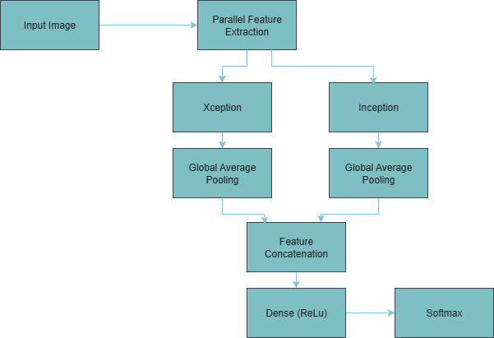
FLOW DIAGRAM
Batch No.CG5 Department of CSE

Slide 10
METHODOLOGY
1. Data Preprocessing
The collected grape leaf images are resized to a uniform 256×256 resolution and converted to JPEG format. Augmentation techniques such as rotation, shifting, flipping, brightness and contrast adjustment, and Gaussian blur are applied to increase dataset diversity. The data is then split into training, validation, and testing sets for balanced learning.
2. Feature Extraction
The model employs a dual-backbone structure integrating Xception and InceptionV3 architectures. This combination enhances both depth-wise and multi-scale feature extraction, allowing the model to learn complex texture and shape patterns from diseased leaves efficiently.
3. Attention Mechanisms
To improve focus on critical leaf regions, CBAM (Convolutional Block Attention Module) and Coordinate Attention modules are incorporated. These attention layers help the network emphasize disease-affected areas while suppressing irrelevant background information.
4. Model Training and Evaluation
The hybrid model, named FusionNet-GLD, is trained using optimized parameters and evaluated with metrics such as Accuracy, Precision, Recall, F1-Score, and mAP. Comparative analysis with baseline models (MobileNetV2, EfficientNetB0, Inception, and Xception) demonstrates superior performance and lightweight deployment efficiency.
Batch No.CG5 Department of CSE

Slide 11
IMPLEMENTATION
Implementation:
The FusionNet-GLD model was implemented using Python with TensorFlow and Keras frameworks in Google Colab. The workflow includes dataset preprocessing, model construction (Xception + InceptionV3 + CBAM + Coordinate Attention), and evaluation using accuracy and mAP metrics. The model weights were trained on augmented images and validated through cross-validation for performance stability.
Software Specs:
Hardware Specs:
Challenges & Solutions:
Processor: Intel Core i7 / equivalent
GPU: NVIDIA Tesla T4 (Google Colab)
RAM: 16 GB
Storage: 100 GB HDD / Google Drive dataset storage
Overfitting due to limited dataset size
Solution: Applied extensive data augmentation and
dropout regularization.
Difficulty in focusing on fine-grained leaf disease regions
Solution: Integrated CBAM and Coordinate Attention
modules to enhance spatial awareness.
High computational complexity in hybrid CNNs
Solution: Optimized network using lightweight dual
-backbone design and fine-tuned hyperparameters.
Operating System: Windows 10
Programming Language: Python 3.10
Libraries: TensorFlow, Keras, OpenCV, NumPy,
Matplotlib, Scikit-learn
Tools: Google Colab, Jupyter Notebook
Batch No.CG5
Department of CSE

Slide 12
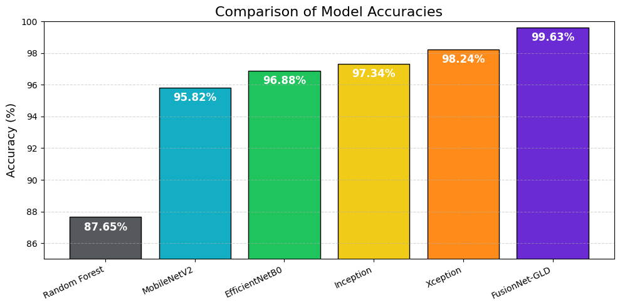
RESULTS & ANALYSIS
All deep learning models achieved accuracy above 95%,
significantly outperforming the classical Random
Forest (87.65%).
FusionNet-GLD performs the best with 99.63% accuracy,
validating its dual-backbone fusion strategy.
The model’s accuracy surpasses its parent architectures,
Xception (98.24%) and InceptionV3 (97.34%), proving the
synergy of the fusion.
Xception and InceptionV3 showed high and stable
performance, setting a strong benchmark.
Lightweight models like MobileNetV2 (95.82%) and
EfficientNetB0 (96.88%) remained competitive
but were ultimately outperformed.
Batch No.CG5 Department of CSE

Slide 13
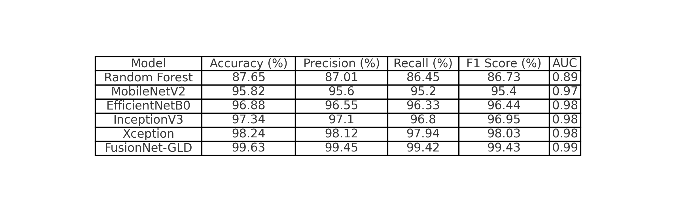
RESULTS & ANALYSIS
Batch No.CG5 Department of CSE

Slide 14
RESULTS & ANALYSIS
This table presents the comprehensive performance evaluation of our proposed FusionNet-GLD model against five other baseline models. The models were tested on the unseen test dataset across all key classification metrics.
State-of-the-Art Performance: Our proposed model, FusionNet-GLD, achieves state-of-the-art results, leading in all evaluated metrics with 99.63% Accuracy.
Validation of Fusion Hypothesis: The fusion model's performance surpasses that of its individual parent architectures: Xception (98.24%) and InceptionV3 (97.34%).
Demonstrated Synergy: This result validates our core hypothesis: combining Xception's depthwise separable convolutions with Inception's multi-scale feature extraction creates a synergistic effect, resulting in a more powerful and accurate classifier than either model alone.
Superiority Over Baselines: All deep learning models (all >95%) significantly outperformed the traditional machine learning baseline (Random Forest at 87.65%), confirming that CNNs are essential for this complex image task.
Robust and Reliable: The model's excellence is confirmed by a near-perfect F1-Score (99.43%) and AUC (0.99), indicating it is not just accurate but also highly reliable, with exceptional precision and recall.
Batch No.CG5 Department of CSE

Slide 15
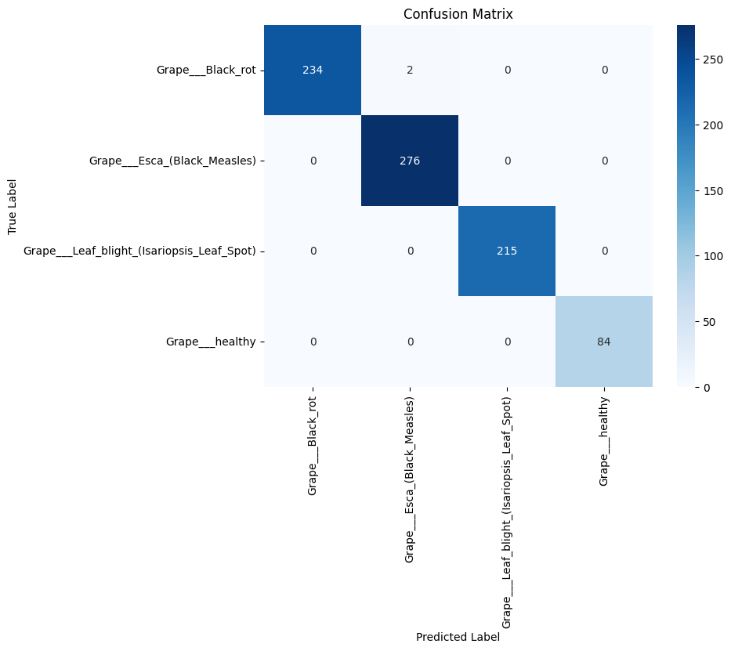
RESULTS & ANALYSIS
Metrics Used: Accuracy, Precision, Recall, F1-Score.
The FusionNet-GLD model achieved the best performance
with 99.63% accuracy.
The confusion matrix shows exceptional diagonal dominance,
indicating extremely high predictive reliability.
The model perfectly classified Grape Esca, Grape Leaf blight, and
Healthy samples (276, 215, and 84 correct, respectively) with zero errors.
Only 2 misclassifications occurred in the entire validation set
(out of 809 total samples), demonstrating the model's robustness.
✅ Conclusion: The proposed FusionNet-GLD model effectively and
reliably classifies grape leaf diseases with near-perfect accuracy,
making it an outstanding and practical tool for agricultural applications.
Batch No.CG5 Department of CSE

Slide 16
CONCLUSION and FUTURE SCOPE
Key Findings
The FusionNet-GLD (Xception + InceptionV3) model achieved the highest accuracy and F1-score among all compared models.
The dual-backbone architecture effectively captured both fine-grained texture and high-level semantic features.
The model showed strong generalization and stability even on augmented and diverse datasets.
Significance of Results
Demonstrates the potential of hybrid deep learning architectures for accurate grape leaf disease detection.
Enables early and automated diagnosis, reducing manual inspection and improving crop management.
Supports smart agriculture by providing a lightweight, efficient, and scalable detection solution.
Batch No.CG5 Department of CSE

Slide 17
CONCLUSION and FUTURE SCOPE
Future Developments
Expand the dataset with multi-varietal and field-captured images to improve generalization and robustness.
Integrate Transformer-based modules or Vision-Language models for enhanced contextual understanding.
Develop a mobile or IoT-based real-time detection system for on-field disease monitoring and farmer assistance.
Limitations
The model’s performance depends on the quality and diversity of the dataset, which may limit accuracy under unseen environmental conditions.
Real-time deployment may face constraints due to hardware limitations in low-power or mobile devices.
The system currently focuses only on leaf-level disease detection, without integrating severity grading or environmental factors.
Batch No.CG5 Department of CSE

Slide 18
REFERENCES
1 A. Seccia et al., 2015:
Analyzed the global trade competitiveness of table grapes.
2 Khirade & Patil, 2015:
Proposed a plant disease detection system using basic image processing techniques.
3 F. Chollet, 2017:
Introduced the Xception architecture, detailing its use of depthwise separable convolutions.
4 V. Kanabur et al., 2019:
Used hybrid feature extraction techniques and a CNN classifier for leaf disease detection.
5 P. S. Sonar & N. R. Wankhade, 2022:
Compared various machine learning techniques for grape leaf disease identification.
6 A. K. Uttam, 2022:
Applied deep learning models for the prediction of grape leaf diseases.
7 K. V. Narasimha Reddy & E. Brahma Reddy, 2023:
Used a regression tree model for crop yield prediction based on weather and soil data.
8 Z. Chen et al., 2024:
Developed YOLOv8-ACCW, a lightweight, improved YOLOv8 model for grape leaf disease detection.
Batch No.CG5 Department of CSE

Slide 19
REFERENCES
9 R. Karthik et al., 2024:
Proposed GrapeLeafNet, a dual-track fusion network combining Inception-ResNet and a Shuffle-Transformer.
10 M. J. Karim et al., 2024:
Deployed a lightweight CNN on an edge device (Nvidia Jetson Nano) for real-time grape leaf disease classification.
11 I. Kunduracioglu & I. Pacal, 2024:
Reviewed advancements in deep learning, including Vision Transformers, for classifying grape leaves and diseases.
12 P. M. S. Lakshmi et al., 2024:
Used ensemble-based transfer learning (VGG16, ResNet50, Xception) for plant disease detection.
13 A. V. Kumar et al., 2024:
Applied a ResNet-CNN model for e-agriculture plant disease classification applications.
14 Z. Fu et al., 2024:
Proposed a lightweight MHDI-DETR model for detecting grape leaf diseases.
15 Q. Hu & Y. Zhang, 2025:
Developed GCS-YOLO, another lightweight grape leaf disease detection algorithm based on YOLOv8.
Batch No.CG7 Department of CSE

Slide 20
QUESTIONS and ANSWERS
Thank You! From CG5
We appreciate your attention and interest.
Now, we’d like to open the floor for questions and discussions.
💬 Feel free to ask about the model, dataset, or future work!
10-11-2025
Batch No.CG7 Department of CSE

Slide 21
ACKNOWLEGEMENTS
Thank You!
We sincerely thank the organizers, faculty, and audience for giving us the opportunity to present our project —
“FusionNet-GLD: A Dual-Backbone CNN ModelCombining Xception and Inception for Grape Leaf Disease Recognition.”
Your attention, feedback, and questions are truly appreciated.
For any further discussions or collaboration inquiries, feel free to contact us:
📧 Contact Information
shafia2801@gmail.com
soudagarminhaz@gmail.com
chattinavya@gmail.com
Batch No.CG5
Department of CSE

