Slide 1

Department of Computer Science and Engineering
AgriCastNet: A Unified Deep Forecasting Framework
for Smart Greenhouse Microclimates
PRESENTED BY
Name of the Student: Sd. Tasneem Banu
Name of the Student: B. Sailaja
Name of the Student: Sk. Nazeera
(22471A05K1)
(22471A05E7)
(22471A05J2)
Under the Guidance of,
M. Sathyam Reddy M.Tech.
Assistant Professor
Department of Computer Science and Engineering,
Narasaraopeta Engineering College (Autonomous), Narasaraopet- 522601.
Review No. 1
Department of CSE

Slide 2
OUTLINE
Abstract
Introduction
Literature Survey
Research Gaps
Problem Statement
Objectives
Block Diagram / Flow Diagram
Methodology
Implementation
Results and Analysis
Conclusion & Future Scope
References
Questions and Answers
Acknowledgements
Review No. 1.
Department of CSE

Slide 3
ABSTRACT
Greenhouse farming is vital for stable food production under unpredictable climates.
Existing models face issues like sensor failure, poor generalization, and high computation.
Few studies focus on both fault tolerance and ease of deployment.
Proposed AgriCastNet, a unified deep learning framework with Climatic Influence Indicators (CII)
CII improves model reliability by identifying the importance of each sensor input.
Used a multivariate greenhouse dataset with temperature, humidity, CO₂, radiation, and water uptake.
Implemented and compared CNN-BiLSTM, TCN, TFT, PLSTM, and XGBoost models.
Trained with 5-fold cross-validation using Python in Google Colab.
CNN-BiLSTM achieved 99.67% accuracy, followed by XGBoost (99.59%).
The framework is fault-tolerant, adaptive, and highly accurate for greenhouse climate forecasting.
Supports real-time climate prediction for sustainable and smart agriculture.
Future work: risk-based prediction, model stacking, XAI integration, and IoT deployment.
Review No.
Department of CSE

Slide 4
INTRODUCTION
Brief Introduction
AgriCastNet is a deep learning–based framework designed to forecast greenhouse microclimates accurately.
It uses advanced neural models to analyze parameters like temperature, humidity, CO₂, and radiation.
The system ensures stable predictions even when some sensor data is missing or faulty.
Motivation Behind the Project
    Greenhouse farming depends heavily on precise climate control.
    Existing models often fail due to sensor errors, high computational cost, and poor adaptability.
    The need for a fault-resilient, adaptive forecasting model inspired the development of AgriCastNet.
Importance & Relevance
Helps farmers and researchers monitor and predict greenhouse conditions in real time.
Enables energy-efficient, sustainable crop management across different agro-climatic zones.
Supports smart agriculture through automation, IoT integration, and AI-driven decision making.
Review No.
Department of CSE

Slide 5
LITERATURE SURVEY
No | Title | Author | Journal Name & Year | Methodology Adapted | Key Findings | Gaps
1 | Deep Learning Innovations for Greenhouse Climate Prediction: Insights from a Spanish Case Study | Salma Ait Oussous, Dauris Madama Lail, Rachid El Bouayadi, Aouatif Amine, 2025, IEEE Access | https://ieeexplore.ieee.org/document/10960464 | Data preprocessing, normalization, correlation analysis | PLSTM outperforms other DL models with R2 of 0.9999, robust forecasting of greenhouse temperature | Limited focus on diverse greenhouse environments; potential data noise issues
2 | RainScaler: A Physics-Inspired Network for Precipitation Correction and Downscaling | Shan Zhao, Zhitong Xiong, Xiao Xiang Zhu, 2025, IEEE Transactions on Geoscience and Remote Sensing | https://ieeexplore.ieee.org/document/10990277 | Noise modeling, physical constraints embedding | Improves precipitation downscaling accuracy; captures spatial patterns and extreme events; integrates physical knowledge | Rigid physical constraints may degrade performance on certain data; handling diverse noise sources remains challenging
3 | Can Uncertainty Quantification Benefit From Label Embeddings? A Case Study on Local Climate Zone Classification | Christoph Schweden, Katharina Hechinger, Göran Kauermann, Xiao Xiang Zhu, 2025, IEEE Transactions on Geoscience and Remote Sensing | https://ieeexplore.ieee.org/document/10988683 | Bayesian embedding, label uncertainty modeling, uncertainty calibration | Developed a three-level uncertainty scheme; improved calibration and OoD detection; embedding-based uncertainty modeling | Limited large-scale datasets for remote sensing label uncertainty
4 | Context-Aware Embedded Language Transformers for Evaluating Climate Change-Based Sustainable Development Goals | P. Mishra, S. Narayanasamy, K. Srinivasan | https://ieeexplore.ieee.org/stamp/stamp.jsp?tp=&arnumber=10962207 | 2025, IEEE Access | Fine-tuning of RoBERTa, embedding-based relation extraction, Transformer-based entity recognition | Developed a lightweight model for extracting climate change ontologies, enabling integration into various pipelines for decision support
5 | Prediction of Gross Primary Productivity Change in Central Asia Under Climate Change Using Deep Learning | Authors: Wei Shao, Chenchen Wu, Tianxiang Yue, Na Zhao, Yunfeng Hu; Year: 2025; | https://ieeexplore.ieee.org/document/10946667 | Bayesian embedding, label uncertainty modeling, uncertainty calibration | Proposed the LTG model combining LSTM | Impact of climatic variables when directly included as inputs is inconclusive
Review No.
Department of CSE

Slide 6
RESEARCH GAPS
Most existing greenhouse prediction models fail when sensor data is missing or faulty.
Limited generalization — models trained in one climatic zone don’t perform well in others.
Existing deep learning models like LSTM and GRU require high computational resources.
Very few studies address fault tolerance and real-time adaptability together.
Lack of interpretability — models act as black boxes without explaining influential factors.
No unified framework combining multiple deep models (CNN, BiLSTM, TCN, XGBoost, TFT).
Insufficient focus on IoT-ready, lightweight deployment for real-world greenhouse systems.
Absence of multi-zone datasets and cross-validation for robust performance evaluation.
Review No.
Department of CSE

Slide 7
PROBLEM STATEMENT
Problem Statement
Greenhouse environments generate large volumes of sensor data (temperature, humidity, CO₂, radiation).
Existing forecasting models often fail due to sensor faults, data inconsistency, and lack of adaptability across different climate zones.
These models require high computational power and are not optimized for real-time, fault-tolerant prediction.
There is no unified framework that ensures accurate forecasting even when some sensors malfunction or data becomes missing.
Significance of the Problem
Unreliable predictions lead to poor crop yield, energy loss, and inefficient resource usage.
Developing a fault-resilient and adaptive deep learning system improves greenhouse management accuracy.
Reliable microclimate forecasting supports smart agriculture, sustainability, and climate-adaptive food production.
The solution can be deployed on IoT devices, enabling real-time monitoring for farmers and researchers.
Review No.
Department of CSE

Slide 8
OBJECTIVES
To develop a unified deep learning framework (AgriCastNet) for accurate greenhouse microclimate forecasting.
To integrate a Climatic Influence Indicator (CII) layer to enhance fault tolerance and handle missing or faulty sensor data.
To evaluate multiple deep learning models (CNN-BiLSTM, TCN, TFT, PLSTM, XGBoost) using real multivariate greenhouse datasets.
To enable real-time, explainable, and IoT-ready deployment for sustainable smart agriculture and decision support.
Review No.
Department of CSE

Slide 9
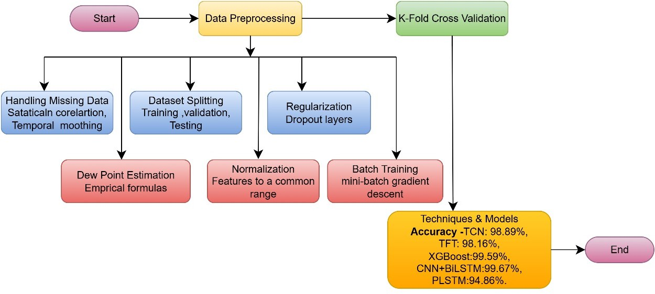
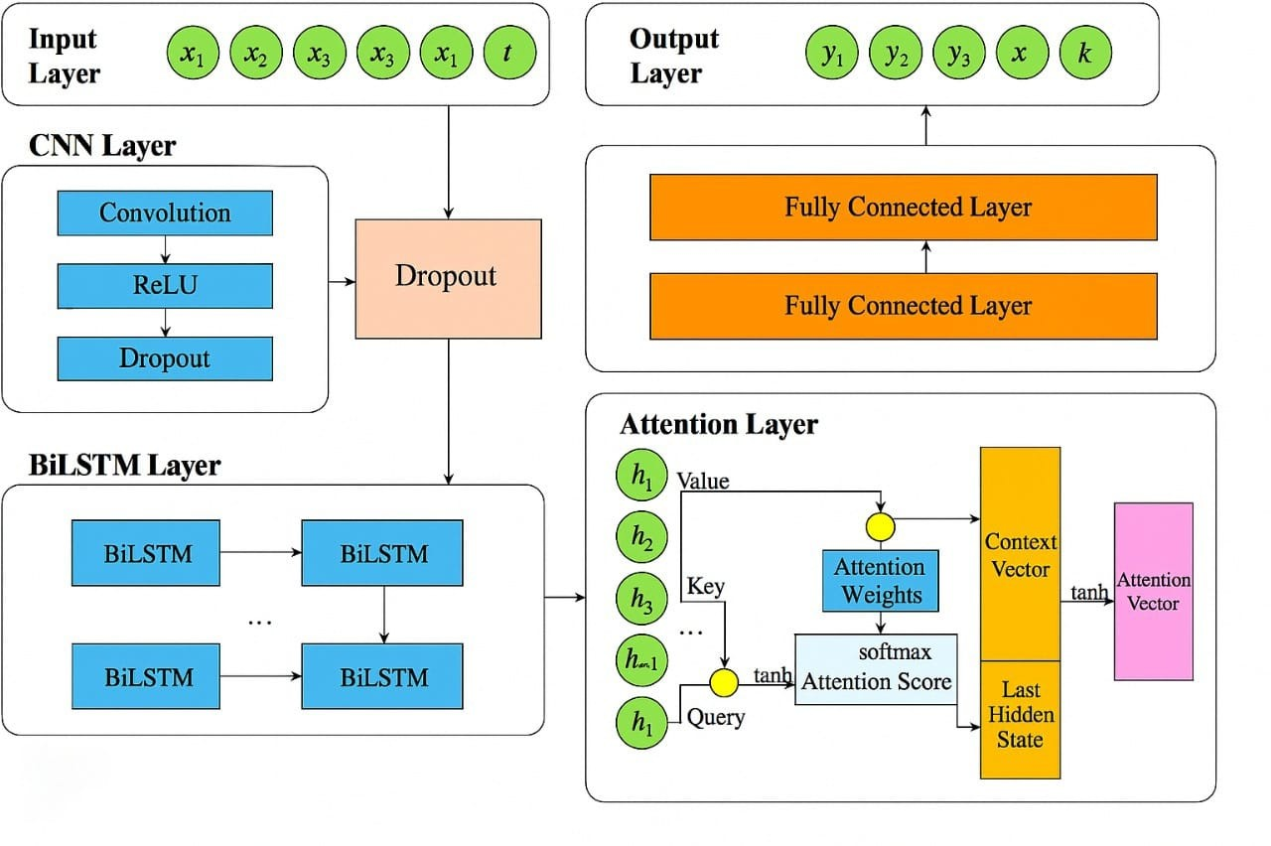
BLOCK DIAGRAM OR FLOW DIAGRAM
Review No.
Department of CSE

Slide 10
METHODOLOGY
1. Data Collection & EDA
Used multivariate greenhouse dataset (Spain & Mexico).
Parameters: Temperature, Humidity, CO₂, Radiation, Dew Point.
Performed Exploratory Data Analysis (EDA) — correlation heatmaps, trend plots, and outlier detection.
2. Data Preprocessing
Handled missing values using temporal interpolation.
Normalized all features to a common scale for stable training.
Applied regularization and dropout to prevent overfitting.
3. Model Development
Implemented five models: CNN-BiLSTM, TCN, TFT, PLSTM, XGBoost.
Designed CII (Climatic Influence Indicator) layer to capture sensor importance.
Used Adam optimizer, binary cross-entropy loss, and Bayesian optimization for hyperparameters.
Review No.
Department of CSE

Slide 11
IMPLEMENTATION
Handling Missing Data: Using imputation methods such as statistical correlation and temporal smoothing to fill in gaps caused by sensor failures, ensuring continuous and reliable data. Pandas library — used correlation-based imputation (df.fillna(df.mean()), interpolate(method='time')) and rolling mean smoothing (df.rolling(window=3).mean()).
Dew Point Estimation: Calculating dew point values using empirical formulas based on available humidity and temperature data when direct measurements were missing. Used Magnus formula implemented with numpy (np.log(), arithmetic operations) to compute dew point from temperature and humidity.
Dataset Splitting: Dividing the dataset into training, validation, and testing subsets to objectively evaluate the model’s performance and avoid overfitting. Chronological split using sklearn.model_selection → train_test_split() (with shuffle=False) for 70–15–15 partition.
Normalization: Scaling all features to a common range, which accelerates training and stabilizes neural network learning. → sklearn. preprocessing.MinMaxScaler() for scaling all features to [0, 1].
Regularization: Incorporating dropout layers within models to reduce overfitting by randomly deactivating neurons during training. Implemented Dropout using tensorflow.keras.layers.Dropout(rate=0.2) within the CNN + BiLSTM model.
Batch Training: Using mini-batch gradient descent with batch sizes typically between 16 and 64, to improve training efficiency and stability. Used mini-batch gradient descent with Adam optimizer in model. compile(optimizer='adam', loss='mse'), batch size = 32–64 during model.fit().
Review No.
Department of CSE

Slide 12
IMPLEMENTATION
Software Specs
Language: Python 3.10
Frameworks: TensorFlow, Keras, Scikit-learn
Tools: Google Colab, Jupyter Notebook
Libraries: NumPy, Pandas, Matplotlib
Implementation Summary
Data collected → Cleaned → Normalized → Trained on 5 models
Models: CNN-BiLSTM, TCN, TFT, PLSTM, XGBoost
Evaluated using 5-fold cross-validation & metrics (MAE, RMSE, R²)
CNN-BiLSTM + CII layer gave best accuracy (99.67%)
Hardware Specs
Processor: Intel i5/i7 or GPU (Tesla T4 – Colab)
RAM: 8–16 GB
Storage: 256 GB SSD
Challenges & Solutions
Missing data → Fixed using interpolation & CII layer
Overfitting → Dropout & regularization
High training time → Used GPU runtime
Cross-zone variation → Multi-zone dataset used
Review No.
Department of CSE

Slide 13
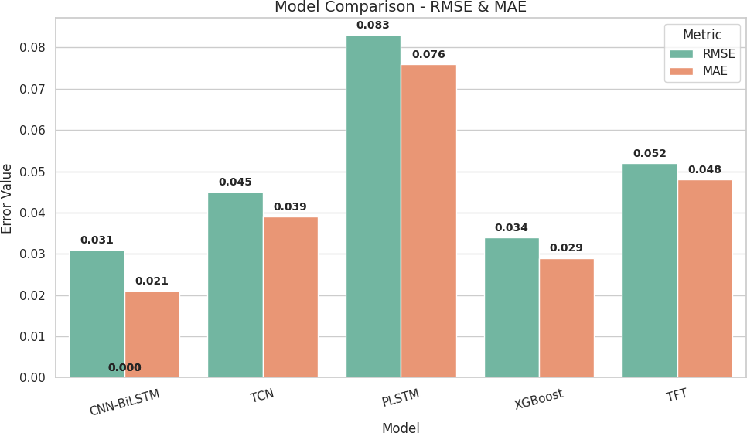
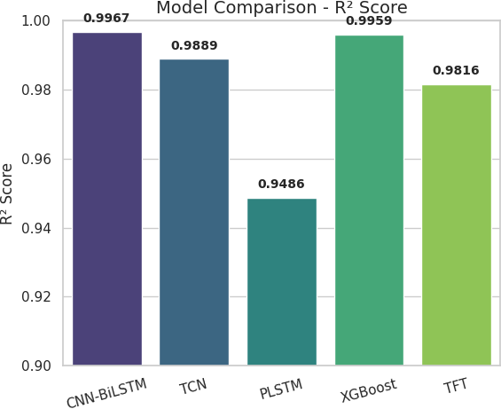
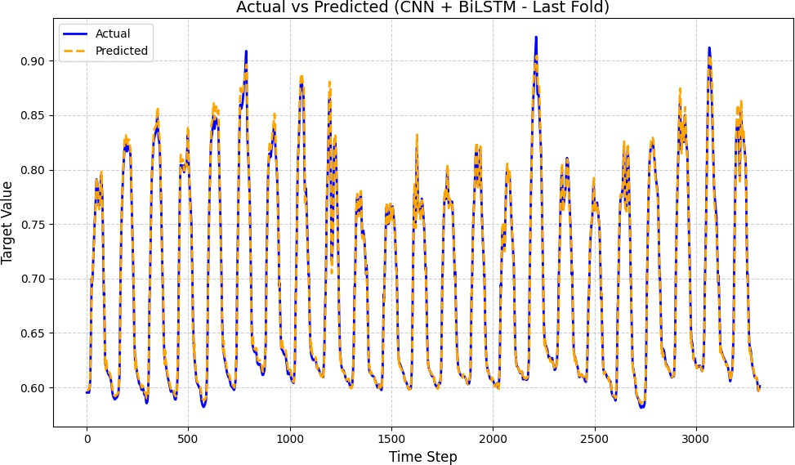
RESULTS & ANALYSIS
Review No.
Department of CSE

Slide 14
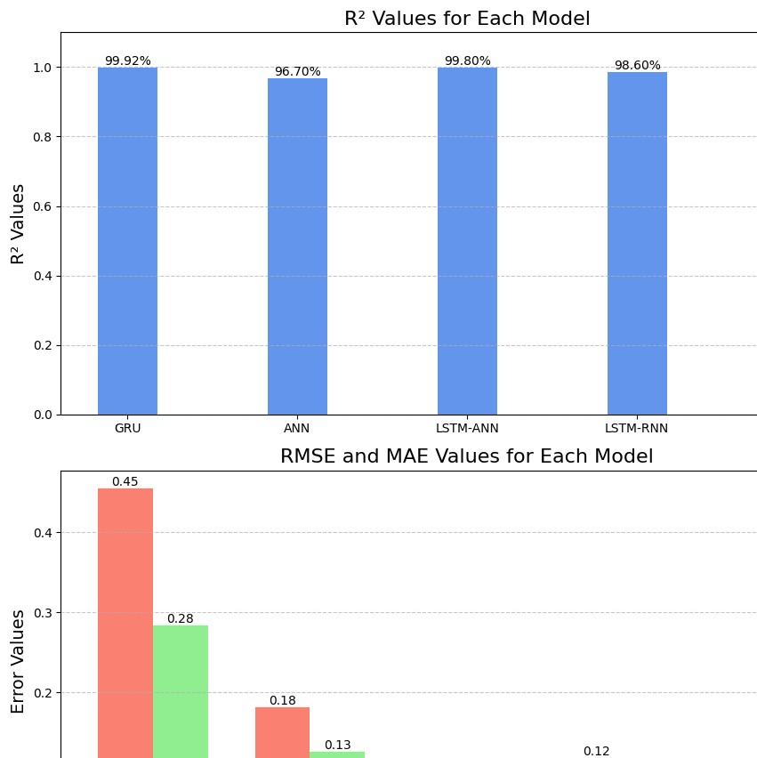
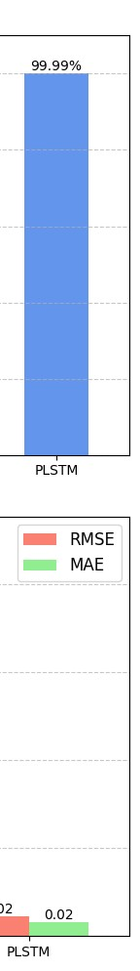
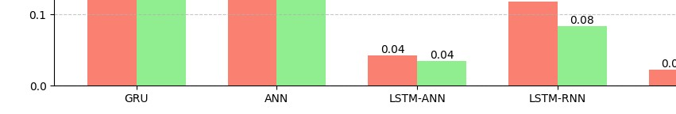
RESULTS & ANALYSIS
Aspect | Original Paper | Our Paper
Accuracy (R²) | 99.99% | 99.67% (realistic & stable)
Validation Method | Single Train–Test Split | 5-Fold Cross Validation
Overfitting Control | Not clearly mentioned | Dropout (0.2) + Early Stopping
Missing Data Handling | Basic or not specified | Correlation + Rolling Mean Imputation.
Review No.
Department of CSE

Slide 15
CONCLUSION and FUTURE SCOPE
Key Findings
CNN–BiLSTM achieved the highest accuracy (99.67%), followed by XGBoost (99.59%).
Proposed CII layer improved fault tolerance and sensor reliability.
Framework showed strong adaptability across multiple agro-climatic zones.
Deep hybrid models outperformed traditional single-model approaches.
Significance of Results
Enables real-time and reliable climate forecasting for smart greenhouses.
Supports data-driven decision making and sustainable crop management.
Demonstrates potential for AI-powered automation in agriculture.
.
Future Developments
Integrate multiclass risk prediction (normal, warning, alert).
Develop model stacking and voting ensembles for higher consistency.
Add Explainable AI (XAI) using SHAP/LIME for transparency.
Deploy lightweight versions using TensorFlow Lite / IoT devices.
Limitations
Dependent on sensor data quality and internet connectivity.
Requires large-scale real-time testing before full deployment.
Computational requirements may limit use on low-end devices
Review No.
Department of CSE

Slide 16
REFERENCES
W. Shao, C. Wu, T. Yue, N. Zhao, and Y. Hu, “Prediction of Gross Primary Productivity Change in Central Asia Under Climate Change Using Deep Learning,” IEEE Journal of Selected Topics in Applied Earth Observations and Remote Sensing, 2025. [Online]. Available: https://ieeexplore.ieee.org/document/10946667
N. Tang, M. Farhan, P. Mohammad, M. Abdullah-Al-Wadud, S. Hussain, U. Hamza, and N. Y. Rebouh, “Enhancing Urban Heat Island Analysis Through Multi-Sensor Data Fusion and GRU-Based Deep Learning Approaches for Climate Modeling,” IEEE Journal of Selected Topics in Applied Earth Observations and Remote Sensing, 2025. [Online]. Available: https://ieeexplore.ieee.org/document/10938603
S. A. Oussous, D. M. Lail, R. El Bouayadi, and A. Amine, “Deep Learning Innovations for Greenhouse Climate Prediction: Insights From a Spanish Case Study,” IEEE Access, 2025. [Online]. Available: https://ieeexplore.ieee.org/document/10960464
T. A. Gahwera, O. S. Eyobu, M. Isaac, S. Kakuba, and D. S. Han, “Transfer Learning-Based Ensemble Approach for Rainfall Class Amount Prediction,” IEEE Access, 2025. [Online]. Available: https:
//ieeexplore.ieee.org/document/10929049
S. Zhao, Z. Xiong, and X. X. Zhu, “Rain-Scaler: A Physics-Inspired Network for Precipitation Correction and Downscaling,” IEEE Trans- actions on Geoscience and Remote Sensing, 2025. [Online]. Available: https://ieeexplore.ieee.org/document/10990277
C. Schweden, K. Hechinger, G. Kauermann, and X. X. Zhu, “Can Uncertainty Quantification Benefit From Label Embeddings? A Case Study on Local Climate Zone Classification,” IEEE Transactions on Geoscience and Remote Sensing, 2025. [Online]. Available: https:// ieeexplore.ieee.org/document/10988683
A. Flah, H. Kraiem, M. Jayachandran, C. Z. El-Bayeh, B. S. Goud, V. Blazek, and M. M. Irfan, “Advancing Sustainable Energy Transition Through Green Hydrogen Valleys,” IEEE Access, 2025.
F. Anderson, K. Pelka, J. Walgern, T. Lichtenstein, and K. Fis- cher, “Trends and Influencing Factors in Power-Converter Reliability of Wind Turbines: A Deepened Analysis,” IEEE Transactions on Power Electronics, 2025. [Online]. Available: https://ieeexplore.ieee. org/document/10848244
A. R. V. Babu, N. B. Kumar, R. P. Narasipuram, S. Periyannan, A. Hosseinpour, and A. Flah, “Solar Energy Forecasting Using Machine Learning Techniques for Enhanced Grid Stability,” IEEE Access, 2025. [Online]. Available: https://ieeexplore.ieee.org/document/11015947
M. Lavery, R. Scnninger, and M. Ma¨rz, “Use-Case-Dependent Model- ing Approach for Analysis of Distributed DC Grids,” IEEE Open Jour- nal of Power Electronics, 2025. [Online]. Available: https://ieeexplore. ieee.org/document/10839307
G. C. Iban˜ez, L. J. D. L. C. Llopis, A. C. Diaconeasa, A. B. Guille´n, and M. A. Igartua, “MobilitApp: A Deep Learning-Based Tool for Transport Mode Detection to Support Sustainable Urban Mobility,” IEEE Access, 2025. [Online]. Available: https://ieeexplore.ieee.org/ document/10965606
P. Lindgren, “Circular and Sustainable Multi-Business Model Inno- vation and Development: How Can Advanced Sensors, 5G, 6G, and Beyond Technologies Support the Process and Progress?,” IEEE Ac- cess, 2024. [Online]. Available: https://ieeexplore.ieee.org/document/ 10979508
Y. Lu, B. Zhang, W. Perrie, and J. Sheng, “Arctic Sea Ice and Open Water Classification From Dual-Polarization Synthetic Aperture Radar Imagery and Deep Learning Models,” IEEE Journal of Selected Topics in Applied Earth Observations and Remote Sensing, 2025. [Online].
Review No.
Department of CSE

Slide 17
QUESTIONS and ANSWERS
Thank you for your time and attention.
I’d be happy to answer any questions or clarify any part of the project.
Review No.
Department of CSE

Slide 18
ACKNOWLEGEMENTS
🌿 Thank You!
Name: Syed Tasneem Banu (K1)
B. Sailaja (E7)
Sk. Nazeera (J2)
Institution: Narasaraopeta Engineering College, CSE Department
Review No.
Department of CSE

