Slide 1


CMT Paper ID: 133
Echoes of the Hidden Filter: Interpretable Ensemble Intelligence for Early CKD Prognosis
Authors Name
1. Dodda Venkata Reddy
2. Sura Venkata Siva Naga Lakshmi
3. Kolli Kaveri
4. Konda Pratyusha
5. V. Jyothi
6. Tummati Swapna
Affiliation
Dept. of Computer Science and Engineering,
Narasaraopeta Engineering College (1,2,3,4)
GRIET (5)
G.Narayanamma Institute of Technology Science (for women)(6)
Presented by
Sura Venkata Siva Naga Lakshmi
Department of Computer Science and Engineering
Narasaraopeta Engineering College
Narasaraopet,India
Notes:
1.7.2013
1.7.2013
1.7.2013
1.7.2013
‹#›
‹#›
‹#›
‹#›

Slide 2
Content
❖Introduction
❖Problem Statement
❖Objectives
Literature Review
❖Methodology
❖Result & Discussion
❖Conclusion & Future Scope
❖References
Notes:
1.7.2013
1.7.2013
1.7.2013
1.7.2013
‹#›
‹#›
‹#›
‹#›

Slide 3
Introduction:
Chronic Kidney Disease (CKD) is a major global health issue that often remains undetected in its early stages.
Traditional diagnostic methods detect CKD only after significant kidney damage, limiting early treatment.
The project uses machine learning models like Random Forest, XGBoost, SVM, and ANN for accurate early prediction.
Data preprocessing techniques like imputation and SMOTE are applied to handle missing values and class imbalance.
Explainable AI tools (SHAP & LIME) are integrated to make predictions transparent and clinically trustworthy.

Slide 4
Problem Statement:
Early detection of Chronic Kidney Disease (CKD) is difficult because symptoms appear only in advanced stages.
Traditional diagnostic methods like serum creatinine and eGFR detect CKD after major kidney damage.
Existing machine learning models lack interpretability, making them less trusted by clinicians.
Imbalanced and incomplete clinical data reduce prediction accuracy and model reliability.
There is a need for an accurate, interpretable, and scalable AI-based system for early CKD prediction.

Slide 5
Objectives:
To develop an ensemble-based machine learning model for early prediction of Chronic Kidney Disease (CKD).
To improve prediction accuracy we used different models such as Random Forest, XGBoost, SVM, and ANN.
To apply data preprocessing techniques like imputation and SMOTE for handling missing and imbalanced data.
To integrate Explainable AI methods (SHAP & LIME) for transparent and interpretable model predictions.
To design a scalable and clinically reliable system suitable for real-world healthcare environments.

Slide 6
Literature Review :
Kanasaki et al. (2024) – Highlighted the essential role of biomarkers like eGFR and albuminuria in diabetic nephropathy staging.
Souza et al. (2025) – Proposed a reagent-free microwave sensor as a low-cost, accurate tool for CKD screening.
Ghosh et al. (2025) – Enhanced CKD staging using classifier optimization and SHAP-based explainability.
Moreno-Sánchez et al. (2025) – Developed an interpretable tree-based ensemble AI model balancing accuracy and clinical transparency.
Sharen et al. (2024) – Introduced MSKd Net, a transformer-based deep learning model for accurate kidney disease stage classification.

Slide 7
Methodology:
Dataset Used:
Dataset used is Chronic Kidney Disease Dataset.
The dataset consists of 400–500 patient records .
Two classes: CKD vs. Non-CKD.
Key features: Age, Gender, eGFR, Serum creatinine, BUN, Albumin, BP, Diabetes.
Missing data handled; class imbalance corrected
Preprocessing Pipelines:
Data Cleaning → Handle missing values, remove duplicates, and standardize column names.
Feature Encoding → Convert categorical features (e.g., gender, diabetes, hypertension) using one-hot or label encoding.
Normalization → Scale numerical attributes (e.g., serum creatinine, urea, eGFR) using Min–Max or StandardScaler for uniform model input.
Data Splitting → Divide the dataset into train (70%), validation (15%), and test (15%) subsets to ensure fair model evaluation.
Imbalance Handling → Apply SMOTE or class-weight adjustment to balance CKD and non-CKD samples.

Slide 8
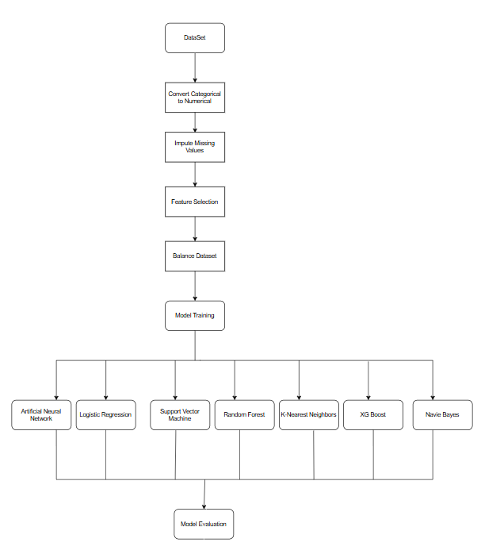
Architecture :
Dataset acquired and prepared for model development.
Categorical variables converted into numerical format.
Missing values handled using appropriate imputation methods.
Data consistency and quality ensured through preprocessing.
Important features selected and redundant attributes removed.
Dataset balanced using resampling techniques to handle class imbalance.
Optimized data used to train multiple classification models.
Models trained include ANN, Logistic Regression, SVM, Random Forest, KNN, XGBoost, and Naive Bayes.
Each model evaluated using standard performance metrics.
Model performances compared to identify the most effective classifier.

Slide 9
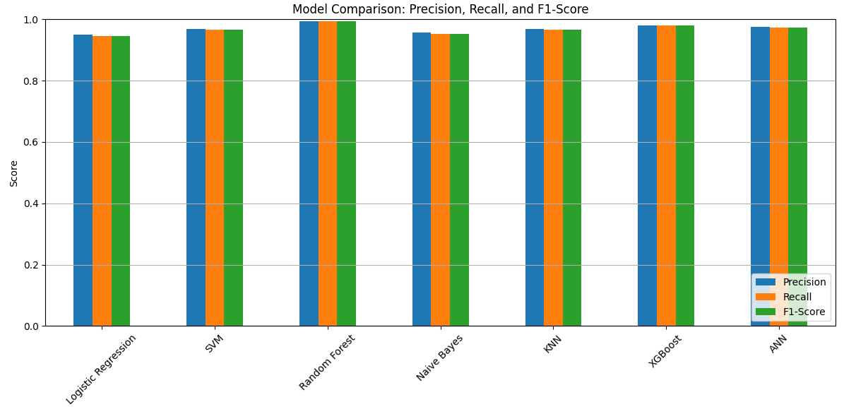
Results and Discussion :
Model Comparison:Precision,Recall,F1-score
Comparison made among seven ML models: Logistic Regression, SVM, Random Forest, Naive Bayes, KNN, XGBoost, and ANN.
Evaluation metrics used: Precision, Recall, and F1-Score.
These models demonstrate high reliability and robustness in clinical classification.
Minimal variation between precision, recall, and F1-score suggests balanced performance with fewer false positives and negatives.

Slide 10
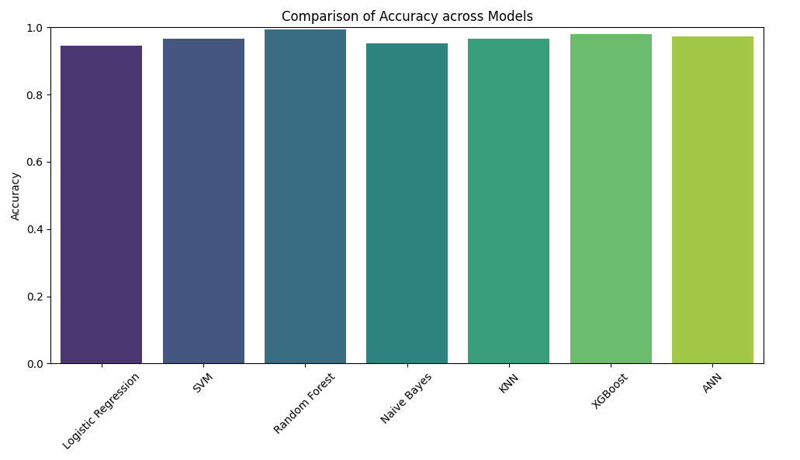
Performance Comparison of Proposed Model
All machine learning models achieved accuracy above 95%.
Random Forest attained the highest accuracy (~99%), showing strong pattern recognition capability.
XGBoost, ANN, and SVM also demonstrated excellent and stable performance.
KNN and Logistic Regression performed competitively, maintaining high accuracy despite their simplicity.
Naive Bayes achieved strong results due to effective preprocessing, feature selection, and SMOTE balancing.
Overall, robust preprocessing and class balancing significantly enhanced the accuracy of all models.

Slide 11
Conclusion
Achieved high diagnostic accuracy and strong interpretability using SHAP and LIME visual explanations.
Demonstrated robustness across heterogeneous patient datasets and multiple clinical biomarkers.
Ensured transparency in decision-making, improving clinician trust and model adoption.
Outperformed traditional classifiers and standalone deep models in both accuracy and explainability.
Future Scope
Integrate real-time clinical data streams (e.g., IoT-based patient monitoring) for continuous CKD risk assessment.
Extend the framework to multi-disease prediction, linking CKD with comorbidities such as diabetes and hypertension.
Incorporate advanced multimodal fusion (lab reports, imaging, and EHR text) for holistic patient evaluation.
Employ Neural Architecture Search (NAS) and attention-based fusion to further optimize model performance.

Slide 12
References
K. Kanasaki et al., J. Diabetes Complications, 38(5), 1073–1080, 2024.
O. C. Elcioglu et al., Kidney Int., 107(4), 745–752, 2025.
S. Jawad et al., IEEE Access, 13, 34567–34578, 2025
A. Moreno-Sánchez et al., IEEE J. Transl. Eng. Health Med., 13, 56789–56800, 2025.
V. Puri et al., Proc. IEEE Int. Conf. Blockchain and Cryptocurrency, 2025, pp. 1–8.
G. Bianchi et al., Int. Urol. Nephrol., 57(6), 1123–1130, 2025.
Y. Zhao et al., IEEE Access, 13, 12345–12356, 2025.

Slide 13
THANK YOU

