Slide 1

Department of Computer Science and Engineering
ECHOES OF THE HIDDEN FILTER: INTERPRETABLE ENSEMBLE INTELLIGENCE FOR EARLY CKD PROGNOSIS
PRESENTED BY
Sura Venkata Siva Naga Lakshmi Kolli Kaveri
Konda Pratyusha
(22471A05J9) (22471A05G2) (22471A05G3)
Under the Guidance of,
Dodda Venkata Reddy M.Tech,
Assistant Professor,
Department of Computer Science and Engineering, Narasaraopeta Engineering College (Autonomous),
Narasaraopet- 522 601.
10-11-2025
Batch No.CG7 Department of CSE

Slide 2
OUTLINE
Abstract
Introduction
Literature Survey
Research Gaps
Problem Statement
Objectives
Block Diagram / Flow Diagram
Methodology
Implementation
Results and Analysis
Conclusion & Future Scope
References
Question and Answers
Acknowledgements
Batch No.CG7 Department of CSE

Slide 3
ABSTRACT
Chronic Kidney Disease (CKD) is gradual and often asymptomatic, usually undetected in early stages, especially in low-resource settings.
Proposes “Echoes of the Hidden Filter”, an interpretable ensemble learning model for proactive CKD prediction.
Combines Random Forest, XGBoost, SVM, and ANN using hybrid stacking and majority voting for robust accuracy.
Applies SHAP and LIME to provide global and local interpretability, highlighting biomarkers like eGFR, creatinine, and cystatin-C.
Uses regression-based imputation, variance-thresholding, and dynamic SMOTE to handle missing data and class imbalance.
Outperforms individual classifiers in accuracy, precision, recall, and F1-score on real CKD datasets.
Bridges black-box AI and clinical usability, offering a scalable and explainable model for population-level CKD screening.
10-11-2025
Batch No.CG7
Department of CSE

Slide 4
INTRODUCTION
Brief Introduction to the Project
Chronic Kidney Disease (CKD) affects nearly 10% of the global population.
The disesase is often asymptomatic in early stages , leading to late diagnosis and poor tratement outcomes.
Motivation Behind the Project
Traditional diagnostic tests like creatinine and eGFR detect CKD only after organ damage.
Explainable AI (XAI) methods such as SHAP and LIME improve transparency and trust, helping clinicians understand AI-driven predictions.
Importance and Relevance
The proposed model, “Echoes of the Hidden Filter,” combines robust preprocessing, variance-based feature selection, SMOTE class balancing, and stacking ensembles with interpretability modules.
The goal is to bridge high predictive performance with clinical explainability, offering a trustworthy and actionable tool for early CKD prognosis.
Batch No.CG7 Department of CSE

Slide 5
LITERATURE SURVEY
No | Title | Author & Year | Journal Name | Methodology Adapted | Key Findings | Gaps
1 | A Study on the Application of Explainable AI on Ensemble Models for Predictive Analysis of Chronic Kidney Disease | K.M. Tawsik Jawad et al., 2025, IEEE | https://ieeexplore.ieee.org/document/10856100 | Data imputed via regression, balanced with SMOTE, features selected (IG, RFE, Variance), significance via Logit, correlated features filtered. | LIME, SHAP, ALE, PDP applied for model interpretability | High missing data
2 | Machine Learning Framework for Early Detection of Chronic Kidney Disease Stages Using Optimized Estimated Glomerular Filtration Rate | Samit Kumar Ghosh et al., 2025, IEEE | https://ieeexplore.ieee.org/document/10979939 | Data normalized and encoded, features selected via VIF and Pearson correlation, class imbalance handled with SMOTE, Z-score normalization applied. | SHAP provided model explainability and feature importance | Absence of confirmatory tests
3 | Privacy-First ML for Chronic Kidney Disease Prediction: Exploring a Decentralized Approach Using Blockchain and IPFS | Vikram Puri et al., 2025, IEEE | https://ieeexplore.ieee.org/document/10914565 | Data preprocessed and standardized, models serialized for decentralized training with IPFS and smart contracts, evaluated using feedback-based XAI (LIME). | Enables secure, transparent model collaboration | Experiments were only in controlled (testnet) environments
4 | A Microwave Sensor Based on Concentric Split-Ring Resonators for Blood Urea Detection: A Novel Tool for Chronic Kidney Disease Diagnosis | Mateus I. O. Souza et al., 2025, IEEE | https://ieeexplore.ieee.org/document/11008467 | Dielectric characterization of ABPS/ABPSU using coaxial probe and Cole-Cole model, sensor simulated in HFSS, analyzed from 500 MHz–10 GHz, and validated experimentally with VNA. | Sensitivity comparable to optical sensors, but without need for reagents | Potential contamination between test samples due to sample container design
5 | A Chronic Kidney Disease Diagnostic Model Based on an Interpretable Deep Belief Rule Base | Yawen Zhao, Kexin Zhang, Xiping Duan, Shuping Che, Ning Ma 2025, IEEE | https://ieeexplore.ieee.org/document/10883992 | Rule reduction using expert-defined efficiency factors | .Demonstrated improved trustworthiness using expert-guided constraints | No real-time or large-scale clinical validation yet
Batch No.CG7 Department of CSE

Slide 6
RESEARCH GAPS
Limited Dataset Diversity
Model trained on a small single-source dataset; lacks multi-center validation and demographic diversity.
No Longitudinal Analysis
Uses static data only; ignores disease progression and temporal patterns.
High Computational Complexity
SHAP & LIME improve interpretability but are too heavy for real-time or low-resource settings.
4.Lack of Clinical Integration
Not yet tested in real hospital environments or EHR systems.
Limited Feature Engineering
Few studies utilize transformer-based architectures (like BERT) for deep contextual analysis in
combination with metadata.
6.Missing Deep Learning Comparison
No benchmarking against transformer or multimodal architectures
Batch No.CG7 Department of CSE

Slide 7
PROBLEM STATEMENT
Main Issue
Limited integration of features and poor handling of class imbalance, along with lack of secure, interpretable, and decentralized model training.
Existing Limitations
Limited feature integration, poor handling of class imbalance, lack of decentralized and secure model training, and insufficient explainability of predictions.
Core Problem
Inadequate integration of diverse features and class imbalance, combined with limited secure, decentralized, and interpretable model training.
Goal
To develop a robust, secure, and interpretable model that integrates diverse features, handles class imbalance effectively, and supports decentralized training.
Batch No.CG7 Department of CSE

Slide 8
OBJECTIVES
Specific Objectives
Improve data cleaning, imputation, and normalization
Use SMOTE for balancing
Apply blockchain for secure training
Evaluate accuracy, precision, recall, F1-score
Batch No.CG7 Department of CSE

Slide 9
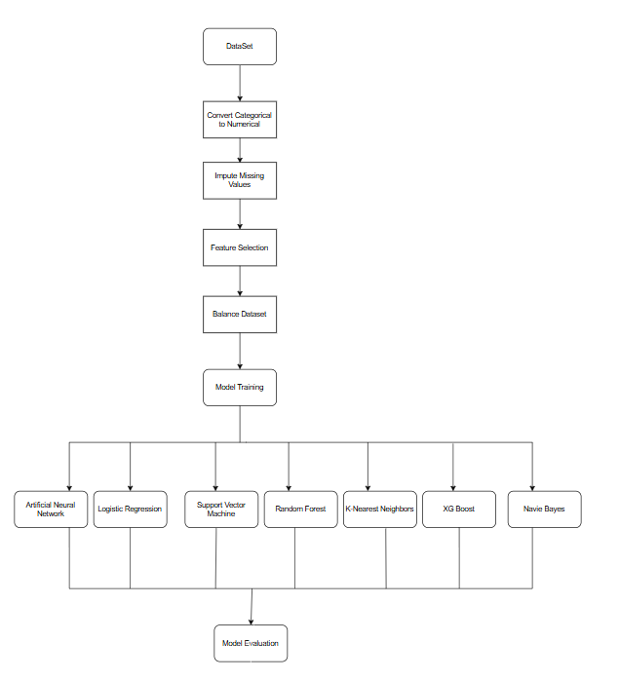
BLOCK DIAGRAM OR FLOW DIAGRAM
Batch No.CG7 Department of CSE

Slide 10
METHODOLOGY
Data Preprocessing
Encoding and standardization of features.
Z-score normalization.
Missing value imputation via learned regression.
2. Feature Selection & Correlation Analysis
Information Gain , RFE and Variance Threshold
VIF and Pearson correlation filtering
Class Balancing & Model Training
  SMOTE for class imbalance.
  Model training using ML and deep learning
  Decentralized training with blockchain and IPFS.
Explainability & Evaluation
  Feature interpretation using SHAP and LIME.
  Performance metrics: accuracy, precision, recall, F1-score.
Batch No.CG7 Department of CSE

Slide 11
IMPLEMENTATION
Implementation:
Preprocessed data, performed feature selection, and handled missing values.
Trained ML/deep learning models with SMOTE for class balancing.
Used SHAP/LIME for model interpretability.
Software Specs:
OS: Colab (Linux)
Frameworks: Scikit-learn, TensorFlow/Keras
Tools: Pandas, NumPy, Matplotlib,Seaborn
Hardware Specs:
GPU: NVIDIA GTX 1650/RTX series
RAM: 16 GB | Storage: 100 GB (Google Drive)
Challenges & Solutions:
Missing data → Learned regression for imputation
Class imbalance → SMOTE for balancing
Lack of interpretability → SHAP and LIME
Data security → Blockchain and IPFS
Batch No.CG7
Department of CSE

Slide 12
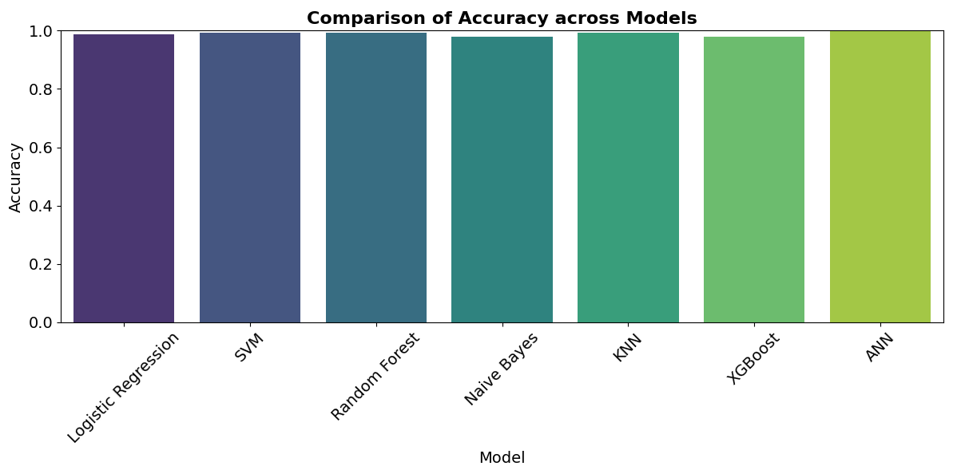
RESULTS & ANALYSIS
  All models achieved accuracy above 95%. Random
  Forest performs the best with accuracy close to 99%, implying its strong ability to identify intricate patterns within the dataset.
  XGBoost, ANN, and SVM showed high and stable performance.
  KNN and Logistic Regression remained competitive despite being lightweight.
  Naive Bayes delivered strong accuracy due to preprocessing and SMOTE balancing
Batch No.CG7 Department of CSE

Slide 13
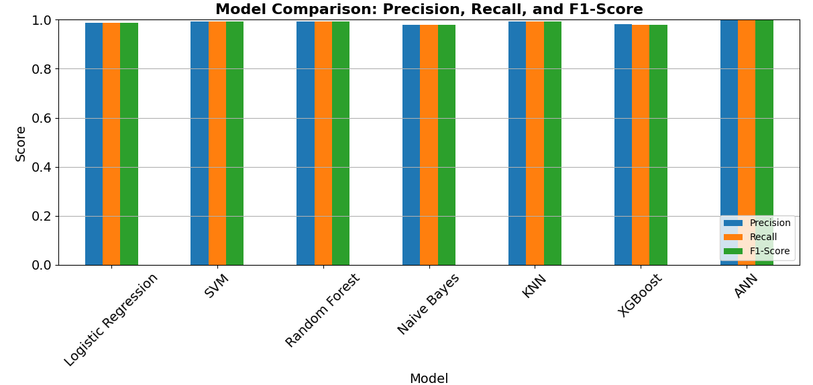
RESULTS & ANALYSIS
Seven ML models evaluated: Logistic Regression, SVM, Random Forest, Naive Bayes, KNN, XGBoost, ANN.
X-axis: Models
Y-axis: Score
Minimal variation among precision, recall, and F1-score indicates balanced predictions with few false positives/negatives.
Logistic Regression and Naive Bayes perform well but slightly behind ensemble and deep learning models.
Batch No.CG7 Department of CSE

Slide 14
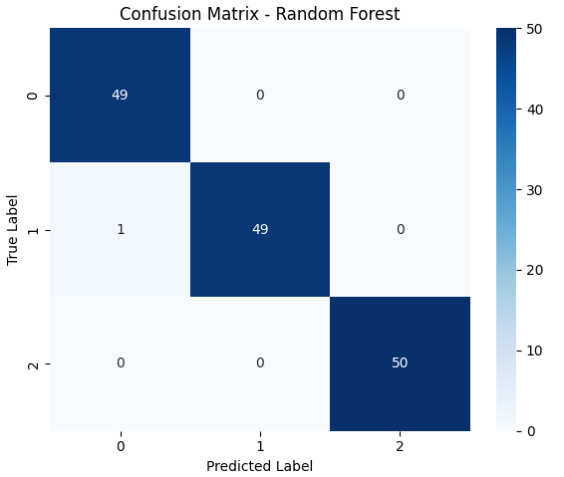
RESULTS & ANALYSIS
Metrics Used:Accuracy,Precision,Recall,F1-Score
Random Forest achieved the best performance with 99% accuracy.
Confusion matrix shows strong diagonal dominance, indicating high predictive reliability for CKD prognosis.
✅ Conclusion:
The proposed framework effectively predicts CKD with high accuracy and reliability, leveraging feature selection, class balancing, and explainable AI, making it suitable for practical clinical use.
Batch No.CG7 Department of CSE

Slide 15
CONCLUSION and FUTURE SCOPE
Key Findings
Integrating diverse features improves CKD prediction accuracy.
SMOTE and advanced feature selection enhance model performance on imbalanced data..
Decentralized training with explainable AI provides secure, interpretable predictions.
Significance of Results
Demonstrates improved accuracy and reliability in CKD prediction using integrated features.
Highlights the effectiveness of handling class imbalance and feature selection in real-world datasets.
Validates the potential of secure, decentralized, and interpretable AI for clinical decision support.
Batch No.CG7 Department of CSE

Slide 16
CONCLUSION and FUTURE SCOPE
Future Developments
Multi-modal data integration for improved CKD prediction.
Decentralized, privacy-preserving ML frameworks with enhanced explainability..
Real-time, non-invasive kidney monitoring using advanced sensors.
Development of real-time, non-invasive sensors for continuous kidney monitoring.
Limitations
Limited feature integration may reduce prediction accuracy.
Class imbalance can bias model performance toward majority classes.
Current approaches lack full decentralization and interpretability for clinical use.
Batch No.CG7 Department of CSE

Slide 17
REFERENCES
Kanasaki et al. (2024):
Evaluated diabetic kidney disease using albuminuria and eGFR, highlighting early markers for CKD progression.
Elcioglu et al. (2025):
Studied the impact of asymptomatic kidney stones on ADPKD progression, emphasizing silent contributors to renal deterioration.
Guo et al. (2025):
Explored the role of non-coding RNAs in acute kidney injury, suggesting potential molecular targets for diagnosis and therapy.
Hart et al. (2025):
Reviewed cystic fibrosis–related kidney disease, discussing emerging morbidity patterns and management strategies.
Souza et al. (2025):
Developed a microwave sensor using concentric split-ring resonators for blood urea detection as a novel tool for CKD diagnosis.
Bianchi et al. (2025):
Conducted a meta-analysis linking pre-eclampsia with subsequent CKD and ESKD, emphasizing long-term renal risks.
Puri et al. (2025):
Proposed a privacy-first ML framework for CKD prediction using decentralized blockchain and IPFS-based model sharing.
Zhao et al. (2025):
Introduced a deep belief network combined with rule-based reasoning for improved CKD diagnosis accuracy.
Batch No.CG7 Department of CSE

Slide 18
REFERENCES
Ghosh et al. (2025):
Presented a multi-stage CKD classifier optimizing eGFR values and validated feature importance using SHAP analysis.
Jawad et al. (2025):
Explored explainable AI techniques for ensemble models in CKD prediction, improving model transparency.
Popoola et al. (2025):
Applied cluster analysis to handle missing and mixed CKD data in South Africa, enhancing dataset usability.
Moreno-Sánchez et al. (2025):
Developed a SHAP-validated explainable ensemble AI system for CKD detection, combining interpretability and accuracy.
Cui et al. (2025):
Implemented U-Net-based kidney volume segmentation for PKD, facilitating precise anatomical measurements.
Akter et al. (2025):
Compared deep learning models for CKD risk prediction.
15 Chabouh et al (2025):
Used ultrasound microscopy for high-resolution kidney imaging.
Batch No.CG7 Department of CSE

Slide 19
QUESTIONS and ANSWERS
Thank You! From CG7
We appreciate your attention and interest.
Now, we’d like to open the floor for questions and discussions.
💬 Feel free to ask about the model, dataset, or future work!
10-11-2025
Batch No.CG7 Department of CSE

Slide 20
ACKNOWLEGEMENTS
Thank You!
We sincerely thank the organizers, faculty, and audience for giving us the opportunity to present our project —
“Echoes of the Hidden Filter: Interpretable Ensemble Intelligence for Early CKD Prognosis.”
Your attention, feedback, and questions are truly appreciated.
For any further discussions or collaboration inquiries, feel free to contact us:
📧 Contact Information
Sura Venkata Siva Naga Lakshmi – suravenkatasivanagalakshmi@gmail.com
Kolli Kaveri – kaverikolli69@gmail.com
Konda Pratyusha – pratyushakonda626@gmail.com
Batch No.CG7
Department of CSE

