Slide 1





2025 IEEE iSSSC
2025 IEEE 3rd International Symposium on Sustainable Energy, Signal Processing & CyberSecurity
Paper Title: Rethinking Artificial Empathy with Emotion-Calibrated Hate Detection Models
Paper ID: 625
Presenter Name: Shaik Khaja Mohiddin Basha
Authors: Shaik Khaja Mohiddin Basha,Chinmayee Guggilam, YagnaPriya Pichala, Karthika Yadavalli, V. Srilakshmi, Madhavi Latha Munagapati
Affiliation: JNTUK

Slide 2
Outline
Introduction:
Hate speech often hides behind emotional or indirect language, so this work proposes an emotion-calibrated framework that enhances detection accuracy and empathy in online moderation.
Motivation & Contributions:
This work is motivated by the need for emotionally aware systems that can detect subtle or implicit hate speech. It contributes a two-stage framework that integrates emotion recognition with hate detection, improving both accuracy and interpretability.
Proposed System Model:
The proposed system employs a two-stage framework where emotion recognition from GoEmotions guides hate detection on the Jigsaw dataset using emotion-calibrated features.
Results and Discussion:
The emotion-calibrated DistilRoBERTa model achieved the highest performance with 96.16% accuracy and a macro F1-score of 0.88, effectively detecting both explicit and implicit hate speech.
Conclusion:
The study demonstrates that integrating emotional context into hate detection significantly enhances accuracy, interpretability, and ethical moderation in online platforms.
Reference:
Key references include recent works on emotion-aware NLP and hate detection using datasets like GoEmotions and Jigsaw, supported by studies from Aubaid et al. (2024) and Ahmed et al. (2024).

Slide 3
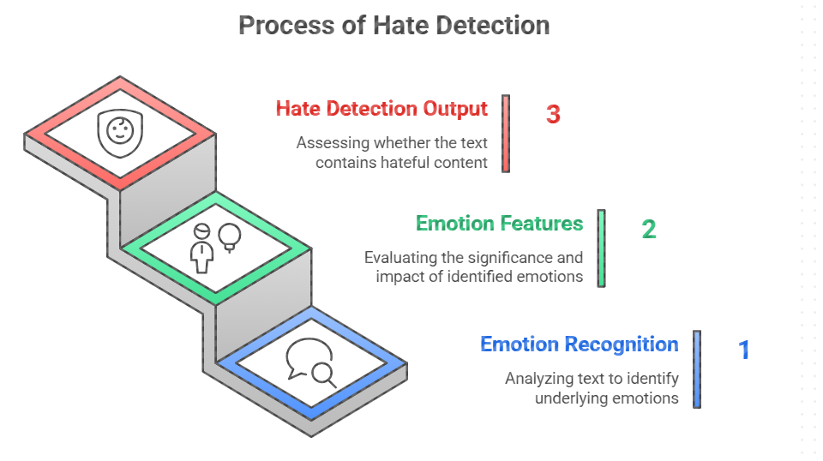
Introduction
With rising online toxicity, emotion-aware AI can make digital platforms more humane and responsible.
Hate speech online often hides behind emotions like anger, sarcasm, or frustration, making it hard to detect accurately.
Traditional models focus only on text and fail to understand emotional tone or subtle hate.
Our study integrates emotional intelligence into hate detection to recognize both direct and indirect hate speech.
This is important for building safer, more empathetic, and fair online environments.
With rising online toxicity, emotion-aware AI can make digital platforms more humane and responsible.

Slide 4
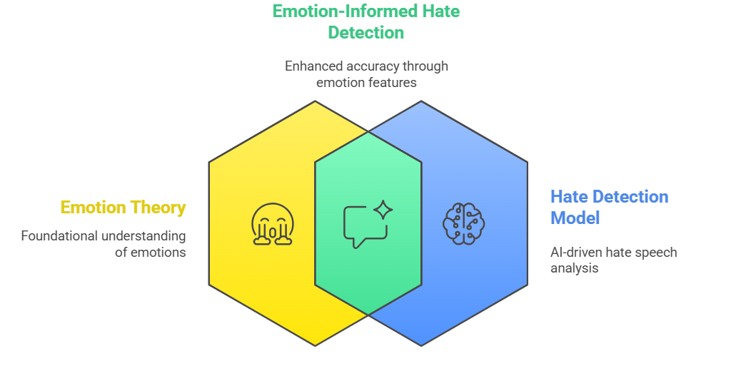
Motivation & Core Contribution
Motivation:
Existing hate detection models struggle to recognize indirect, emotional, or sarcastic hate speech.
Emotions carry hidden intent that traditional text-only models fail to capture.
There is a need for emotion-aware AI that understands both what is said and how it is expressed.
Core Contributions:
✅ Proposed a two-stage framework integrating emotion recognition with hate detection.
✅ Introduced emotion-calibrated features (logits & labels) to enhance contextual understanding.
✅ Achieved high accuracy (96.16%) and improved interpretability across datasets.
✅ Demonstrated how artificial empathy can make online moderation more human-centered and ethical.

Slide 5
Literature Review
Early studies relied on machine learning and rule-based models for detecting toxic or hateful text (Aubaid et al., 2024).
Recent research adopted deep learning and sentiment analysis to capture semantic and emotional context (Ahmed et al., 2024).
Works such as Naznin et al. (2024) and Paul et al. (2024) explored sentiment and context-aware hate detection, but lacked emotional depth.
Datasets like GoEmotions and Jigsaw enabled benchmarking, yet emotional signals were rarely integrated into hate classification.
Few studies addressed interpretability and ethical transparency, leaving a gap for emotion-driven, explainable models.
Approach | Key Focus | Limitation
ML & Rule-based | Text features | Miss emotional tone
Deep Learning | Context capture | Low interpretability
Proposed Model | Emotion + Hate | Explainable & empathetic

Slide 6
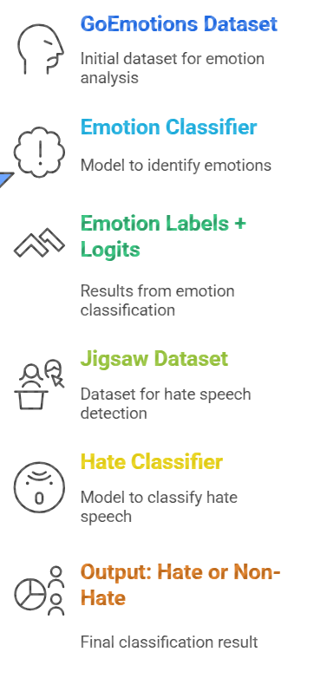
Proposed System Model
The proposed approach introduces a two-stage framework that blends emotion recognition and hate detection to enhance model understanding and interpretability.
Stage 1 – Emotion Classification:
  The GoEmotions dataset is used to train multiple models such as BERT, DistilBERT, DistilRoBERTa, LightGBM, and FastText.
  Each model predicts both emotion labels and emotion logits, capturing emotional intensity and category for every text.
Stage 2 – Hate Detection:
  These emotion features are merged with textual features from the Jigsaw Toxic Comment dataset.
  Models like LightGBM and Feedforward Neural Networks use these calibrated inputs to perform binary hate classification (Hate / Non-Hate).
The framework aims to detect implicit hate speech by leveraging emotional cues that reveal hidden aggression or sarcasm.
It provides an interpretable and emotion-aware system, improving both accuracy (up to 96.16%) and ethical transparency in online moderation.

Slide 7
Simulation Setup
All experiments were conducted on Google Colab Pro using a Tesla T4 GPU (16GB VRAM) with Python 3.10.
Key libraries used: PyTorch, Transformers, Scikit-learn, LightGBM, and FastText.
The GoEmotions dataset was used for emotion classification, and the Jigsaw Toxic Comments dataset for hate detection.
Data Split: 80% training and 20% validation, ensuring class balance through SMOTE oversampling.
Optimization: AdamW optimizer with learning rate = 2e-5, batch size = 16, and early stopping between 3–5 epochs.
Evaluation Metrics: Accuracy, Precision, Recall, Macro F1, and Weighted F1 scores were used for performance assessment.
Emotion logits and predicted labels were integrated into hate detection to test the effect of emotion calibration on performance.

Slide 8
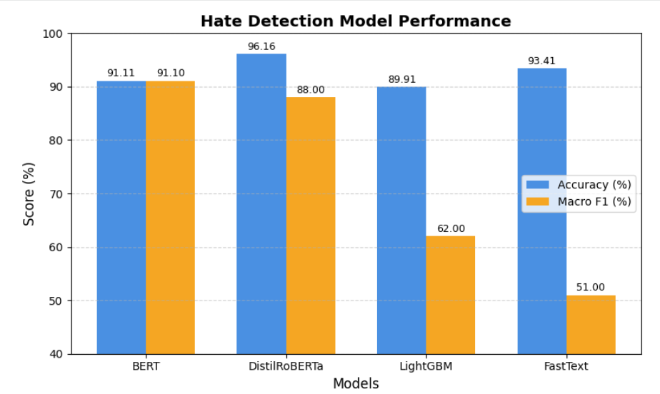
Result and Discussion
The emotion-calibrated DistilRoBERTa model achieved the best performance, with Accuracy: 96.16% and Macro F1-Score: 0.88.
Emotion features significantly improved detection of implicit or sarcastic hate speech.
The integration of emotional cues enhanced model interpretability, revealing links between hateful content and emotions such as anger, disgust, and contempt.
Statistical tests (paired t-test p < 0.01) confirmed the significance of emotion calibration over text-only baselines.
Models like BERT and DistilBERT also performed well, while LightGBM and FastText offered efficient, lightweight alternatives.

Slide 9
Conclusion & Future Work
Conclusion:
The proposed emotion-calibrated hate detection framework effectively integrates emotion recognition with text-based features for more accurate and empathetic moderation.
The DistilRoBERTa-based model achieved 96.16% accuracy and a Macro F1-score of 0.88, outperforming baseline models.
Emotional features enhanced both model interpretability and the ability to detect implicit or subtle hate speech.
This approach moves toward responsible and explainable AI in online content moderation.
Future Work:
Extend the framework to multilingual and cross-cultural contexts to handle diverse emotional expressions.
Incorporate multimodal features (e.g., emojis, tone, or facial cues) to enrich emotional context.
Implement a human-in-the-loop review system for fairness, bias reduction, and ethical decision-making.
Explore real-time deployment for social media moderation systems.

Slide 10
References
Aubaid, A. M., Mishra, A., & Mishra, A. (2024). Machine learning and rule-based embedding techniques for classifying text documents. Int. J. of System Assurance Engineering and Management.
Ahmed, N., et al. (2024). Deep learning-based NLP in human–agent interaction: Applications and challenges. Natural Language Processing Journal.
Naznin, F., Rahman, M. T., & Alve, S. R. (2024). Hierarchical Sentiment Analysis Framework for Hate Speech Detection. arXiv:2411.05819.
Paul, S., et al. (2024). Context-Aware Hate Speech Detection: A Comparative Study. IJCNIS, 16(3), 6703–6715.
Mathew, A., Saha, P., & Mukherjee, A. (2021). HateXplain: A Benchmark Dataset for Explainable Hate Speech Detection. Proc. AAAI.
Google Research. GoEmotions Dataset. [Online] Available: https://github.com/google-research/goemotions
Kaggle. Jigsaw Toxic Comment Classification Challenge. [Online] Available: https://www.kaggle.com/competitions/jigsaw-toxic-comment-classification-challenge

Slide 11
Reviewer Comments Addressed
Reviewer | Comments / Suggestions | Action / Revision Made
Reviewer 1 | Clearly position what is new (e.g., lightweight pipeline, interpretability, emotion logits). Ensure accuracy/F1 consistency across all results. Add cross-domain generalization (train on Jigsaw, test on Hate X plain). Improve figure captions and visual consistency. Fix naming inconsistencies. | Novelty clearly defined in Abstract & Introduction. Metrics standardized across tables & discussion. Added Cross-Domain Generalization using Hate X plain dataset. Figures replaced with high-resolution versions and unified captions. English grammar refined.
Reviewer 2 | Abstract too lengthy. Add references [13–20] to support work. Include statistical significance tests for improvements. Add ethical implications with real-world strategies. Improve grammar and figure quality. | Abstract rewritten concisely and humanized. Added latest 2024–2025 references. Introduced Statistical Significance Analysis section. Added Ethical Implications section (fairness, transparency, bias). Figures enhanced for clarity.
Reviewer 3 | Paper is well-written and technically sound. No modifications suggested. | Acknowledged positive feedback. Maintained structure and refined readability.

Slide 12
Thank You

