Slide 1

Department of Computer Science and Engineering
Learning Ridge Structures: Adaptive CNN-Based Local Orientation and Frequency Estimation for Fingerprints
PRESENTED BY
Atmakuri Jashwanth (22471A05L3)
Shaik Inkollu Farzan Basha (22471A05P1)
Yalagala Leela krishna (22471A05P2)
Under the Guidance of,
Syed Rizwana _{M.Tech, (Ph.D)}
Assistant Professor,
Department of Computer Science and Engineering,
Narasaraopeta Engineering College (Autonomous),
Narasaraopet- 522601.

Slide 2
OUTLINE
Abstract
Introduction
Literature Survey
Research Gaps
Problem Statement
Objectives
Block Diagram / Flow Diagram
Methodology
Implementation
Results and Analysis
Conclusion & Future Scope
References

Slide 3
ABSTRACT
Fingerprint identification is one of the most well-understood and widely used biometric methods for identifying individuals, relying on the accurate identification of ridge structures in fingerprint images. There has been significant work to date on estimating ridge information (i.e., orientation) in fingerprint images. However, estimating ridge quantity (i.e., ridge frequency) presents challenges, especially for noisy or low-quality images. In this work, we propose an end-to-end solution using Convolutional Neural Networks (CNNs) to simultaneously estimate both ridge frequency and ridge orientation from fingerprint images. The proposed method includes preliminary processing to extract the fingerprint area from an image and orientation encoding to facilitate the network’s learning process. The system has been trained with enhanced data and dense pixel-wise supervision to enhance noise and low contrast robustness. The system was evaluated on a typical fingerprint dataset and it yielded a mean absolute percentage error (MAPE) of 4.58 for frequency estimation leading to a substantial improvement over traditional image processing methodology. Additionally, this method is easily adaptable to real-time implementations. In this work, we illustrate how combining domain knowledge with modern machine learning approaches can lead to better accuracy and overall reliability in fingerprint analysis.

Slide 4
INTRODUCTION
Fingerprint recognition is a widely used and reliable biometric technique due to its uniqueness
and permanence.
Key structural features: Ridge Orientation and Ridge Frequency essential for enhancement,
minutiae extraction, and matching.
Traditional methods (gradient & Fourier-based) perform well on clean images but fail on noisy
or low-quality fingerprints.
Adaptive CNN-based model proposed to jointly estimate ridge orientation and frequency directly
from raw images.
Model includes XSFFE(Extended Synthetic Fingerprint Feature Extraction) and SNFFE (Synthetic Normalized Fingerprint Feature Extraction) preprocessing for noise reduction, normalization, and data consistency.

Slide 5
LITERATURE SURVEY
No | Title | Author | URL Link | Methodology Adapted | Key Findings | Gaps
1 | No Feature Left Behind: Filling the Gap in Fingerprint Frequency Estimation | Raffaele Cappelli. | https://ieeexplore.ieee.org/document/10719986 | The paper proposes a comprehensive fingerprint frequency estimation all ridge features. | 1.Introduction of the first publicly available benchmark (FFE benchmark) | Existing fingerprint frequency estimation methods .
2 | Latent fingerprint enhancement for accurate minutiae detection | Abdul Wahab, Tariq Mahmood Khan, Shahzaib Iqbal, | https://arxiv.org/abs/2409.11802 | The paper enhances latent fingerprints using image processing and deep learning. | Improved accuracy or Enhanced detection | Low clarity or Feature loss
3 | Recognition of Fingerprint Biometric Verification System Using Deep Learning | Rajora, M., Rathod, M., and Naik, N.S. | http://www.researchgate.net/publication/391989044_Recognition_of_Fingerprint | Deep learning-based fingerprint verification | Accurate fingerprint verification | Limited generalization or Feature sensitivity
4 | Advancements in Fingerprint Recognition Through Deep Learning | Leqian Yang. | https://doi.org/10.54254/2755‑2721/105/2024TJ0054 | Deep learning-based fingerprint feature extraction | Improved recognition performance | Algorithm complexity or Limited real-world testing
5 | Deep Learning Method for Multi-Attribute Analysis of Fingerprint | Diptadip Maiti, Madhuchhanda Basak | http://www.ivysci.com/articles/3797950 | Multi-attribute fingerprint analysis using deep learning | Enhanced feature extraction | Limited dataset diversity

Slide 6
RESEARCH GAPS
1. No Feature Left Behind – Raffaele Cappelli
- Misses subtle ridge features.
-Limited handling of noisy fingerprints.
2. Latent Fingerprint Enhancement – Abdul Wahab et al.
-Low clarity in latent fingerprints.
-Requires preprocessing; sensitive to noise and background artifacts.
3. Fingerprint Biometric Verification Using Deep Learning
-Limited generalization to new datasets or sensors.
-May struggle with distorted or rotated fingerprints.
4. Advancements in Fingerprint Recognition Through Deep Learning – Leqian Yang
-High algorithm complexity → computationally expensive.
-Limited testing on real-world datasets.
5. Deep Learning Method for Multi-Attribute Analysis – Diptadip Maiti et al.
-Limited dataset diversity affects generalization.
-May not capture rare or atypical fingerprint features.

Slide 7
PROBLEM STATEMENT
Existing methods fail on noisy and low-quality fingerprints.
Traditional filters lack adaptability to real-world variations.
CNN models trained on clean data show poor generalization.
No large ground-truth dataset for ridge frequency estimation.
Patch-based analysis loses global ridge structure information.
Need for an adaptive CNN that can accurately estimate ridge orientation and frequency in real time.

Slide 8
OBJECTIVES
To design an adaptive CNN model for ridge orientation and frequency estimation.
To improve fingerprint image quality using XSFFE and SNFFE preprocessing.
To achieve robust performance on noisy or low-quality fingerprints.
To ensure real-time execution with high accuracy.
To evaluate model performance using MAPE (Mean Absolute Precentage Error) and
benchmark comparisons.

Slide 9
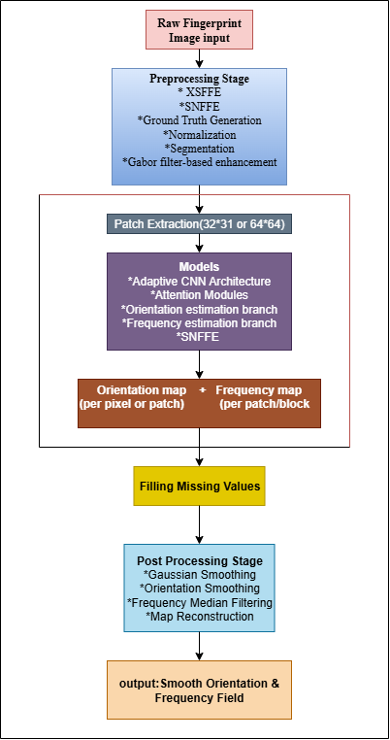
BLOCK DIAGRAM OR FLOW DIAGRAM

Slide 10
METHODOLOGY
Pipeline Overview :
1. Dataset:
Dataset Used – FFE Dataset
    The FFE (Fingerprint Feature Estimation) dataset is used for training and evaluation.
    Designed to support research on ridge orientation, ridge frequency, and foreground region detection.
Purpose of Dataset
    Enables benchmarking of fingerprint analysis models.
    Helps in validating adaptive CNN architectures for orientation and frequency field mapping.
    Supports comparison between traditional and CNN-based approaches.
Dataset Characteristics
    Contains classified fingerprint images categorized by quality (e.g., Good or Bad).
    Includes both clean and noisy fingerprint samples.

Slide 11
2. Data Preprocessing
1. Image Quality Enhancement
The preprocessing stage focuses on improving fingerprint clarity by removing noise, enhancing ridge
contrast, and preserving fine structural details for effective CNN learning.
2. XSFFE (Extended Synthetic Fingerprint Feature Extraction)
This module synthetically generates or sharpens ridge patterns, and performs distance transformation to produce a clean, noise-free fingerprint image suitable for feature extraction.
3. SNFFE (Synthetic Normalized Fingerprint Feature Extraction)
Responsible for normalizing brightness, contrast, and ridge sharpness, ensuring uniform data quality across the dataset.
It enhances consistency and stability in CNN-based training.
4. Segmentation
Segmentation isolates the fingerprint region from the background to ensure accurate ridge analysis and efficient feature extraction.
5. Ground Truth Generation
Ground truth generation creates accurate reference data for training and evaluating the model’s ridge orientation and frequency estimation.

Slide 12
3. Patch Extraction
1. Divides the fingerprint into small patches
➤ The fingerprint image is split into small regions (patches) for local analysis.
➤ Typical patch size: 16×16 or 32×32 pixels, depending on image resolution.
2. Focuses on local ridge details
➤ Each patch captures ridge direction and spacing in a small area.
➤ Helps in understanding local texture variations clearly.
3. Uses preprocessed images
➤ Patches are extracted after XSFFE and SNFFE preprocessing, ensuring clean and normalized inputs for
training.
4. Input for Adaptive CNN model
➤ The extracted patches are given to the Adaptive CNN for orientation and frequency estimation,
➤ Enabling dense pixel-wise supervision and higher accuracy.

Slide 13
Data Set
4. Models:
1. Adaptive CNN Model
➤ The core model that simultaneously estimates ridge orientation and frequency from fingerprint images.
➤ It adapts to local ridge structures, making it robust to noise and distortions.
2. SNFFE (Synthetic Normalized Fingerprint Feature Extraction)
➤ A specialized model that normalizes brightness, contrast, and ridge sharpness.
➤ Learns ridge frequency directly, outperforming traditional FFT-based methods.
3. Orientation Estimation Module
➤ Predicts the direction of ridges at each pixel using dense pixel-wise supervision.
➤ Improves the accuracy of orientation field mapping in both clean and noisy fingerprints.
4. Frequency Estimation Module
➤ Estimates ridge spacing (frequency) between consecutive ridges.
➤ Provides smooth frequency maps that are essential for enhancement and minutiae detection.

Slide 14
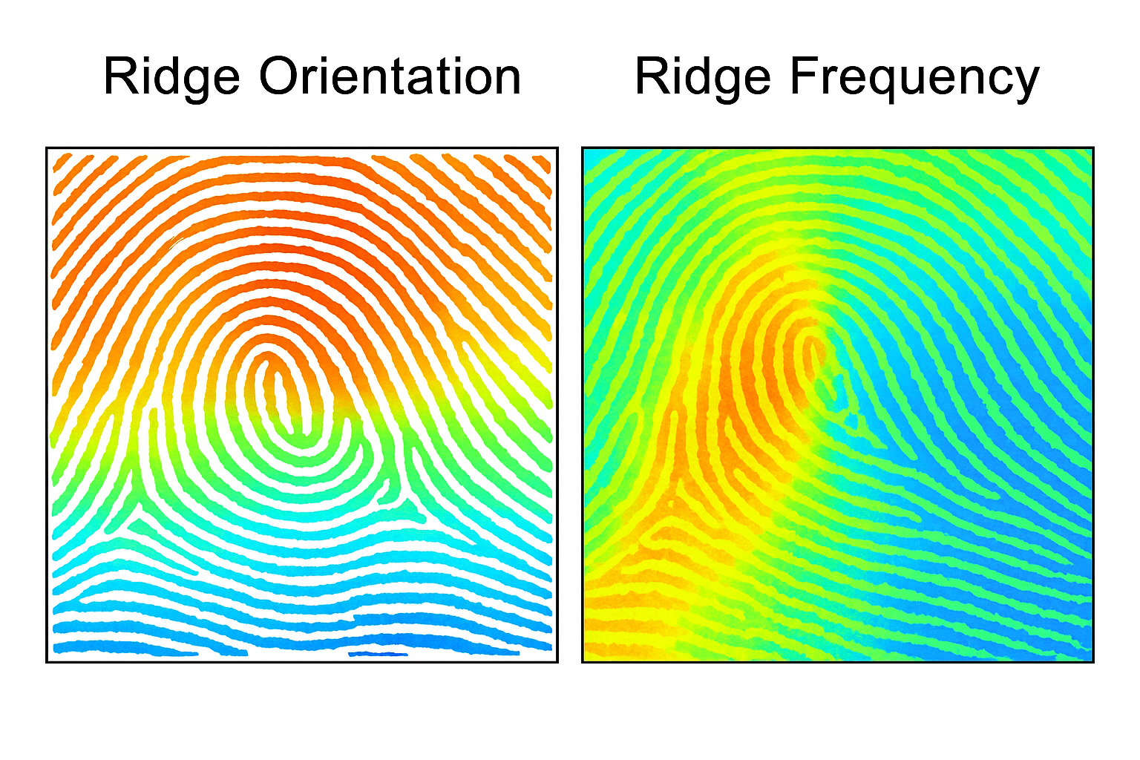
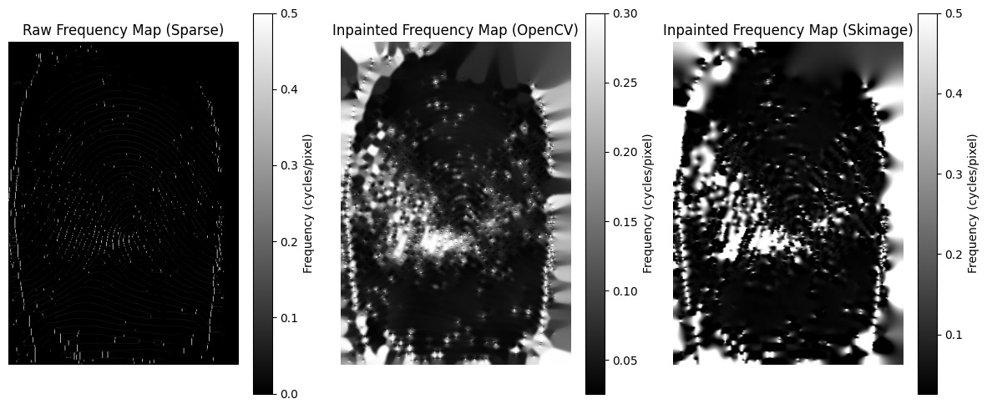
5. Orientation + Frequency : Orientation and frequency maps show ridge direction and spacing, helping the model analyze fingerprint patterns more accurately.
6. Filling Missing Values : Filling missing values restores incomplete or noisy ridge data, ensuring a smooth and continuous fingerprint pattern.
Grayscale Image

Slide 15
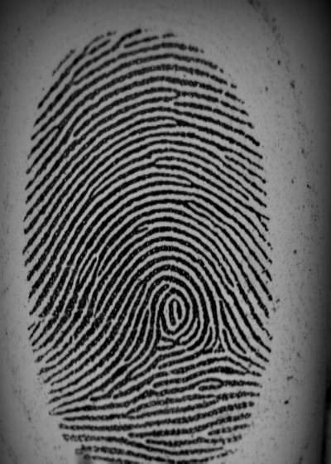
7. Post-processing: Gaussian smoothing, orientation smoothing, median filtering for frequency,
and map reconstruction.
8. Final output: smooth, robust orientation & frequency field ready for enhancement, minutiae
extraction, and matching.

Slide 16
Fingerprint Web Application Integration:
Data Set
Technologies Used:
Frontend: HTML, CSS, JavaScript (User interface for input and display)
Backend: Flask/Django (Handling model integration and data processing)
Deep Learning: Adaptive CNN Model, SNFFE ,Orientation,Frequency (Prediction models)

Slide 17
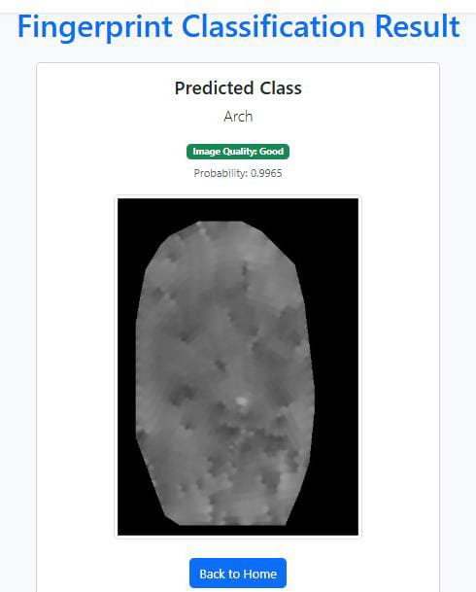

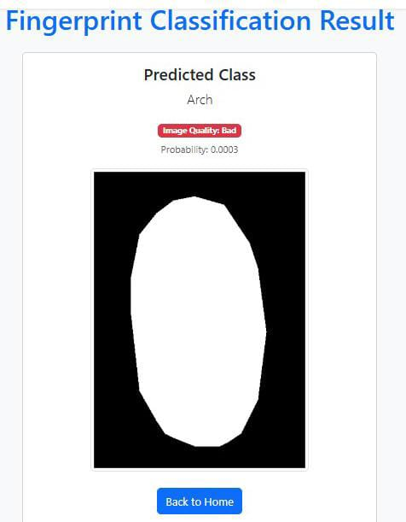
Data Set

Slide 18
IMPLEMENTATION
Software Specifications:
  Browser: Chrome
  Operating System: Windows11
  Python (COLAB)
  Flask
Hardware Specifications:
Processor: Intel® Dual Core
2.0GHz Hard Disk: 1TB
RAM: 8GB

Slide 19
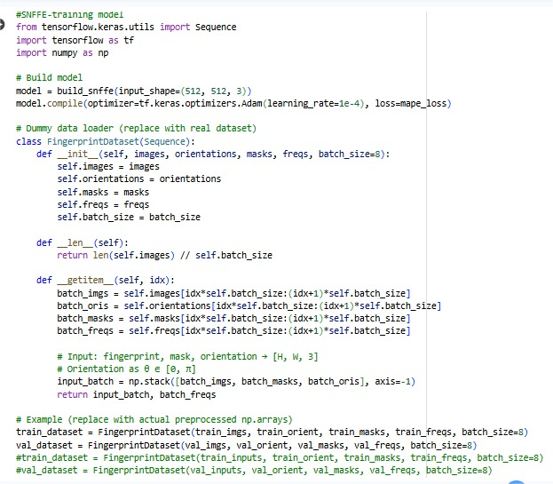
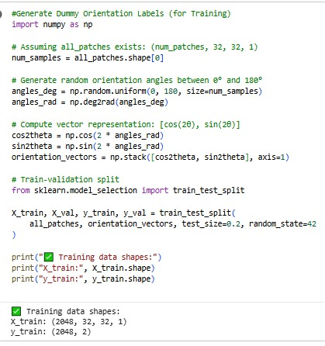
IMPLEMENTATION
SNFFE Model
Orientation Model

Slide 20
RESULTS & ANALYSIS
1. Proposed Adaptive CNN achieved MAPE of 4.58% (good) and 5.02% (degraded).
2. Outperformed baseline CNN and traditional frequency regression models.
3. Execution time: 0.012 seconds per image → suitable for real-time applications.
4. Enhanced ridge clarity and continuity in noisy or smudged fingerprints.
5. XSFFE + SNFFE preprocessing improved model learning and accuracy.
6. Demonstrated strong generalization across fingerprint variations.
7. Final output: smooth, accurate orientation and frequency fields for robust identification.

Slide 21
Table 1: Average MAPE on FFE Dataset (%)
Table 2: Average Execution Time on FFE Dataset (Seconds)
Method | Good Quality Images | Degraded Images
SNFFE (Proposed) | 4.58 | 5.02
Adaptive CNN (Orientation) | 10.5 | 9.8
Adaptive CNN (Frequency) | 12.2 | 10.5
Orientation Vector Model | 11.5 | 10.2
Frequency Regression Model | 11.8 | 12.9
CNN Classifier | 13.0 | 12.0
Method | Average Time (s)
SNFFE (Proposed) | 0.012
Adaptive CNN (Orientation) | 0.50
Adaptive CNN (Frequency) | 0.22
Orientation Vector Model | 0.35
Frequency Regression Model | 0.80
CNN Classifier | 0.37

Slide 22
CONCLUSION and FUTURE SCOPE
Proposed Adaptive CNN model accurately estimates ridge orientation and frequency.
XSFFE and SNFFE preprocessing improved ridge clarity and reduced noise.
Achieved high accuracy (MAPE 4.58%) and real-time performance (0.012 s).
Model shows strong robustness to smudges, distortions, and low contrast.
Future Scope:
-Integrate into complete fingerprint recognition systems.
-Test on multiple datasets and sensors for broader validation.
-Add adversarial robustness against spoofing attacks.

Slide 23
REFERENCES
[1] L. Ji et al., “Fingerprint Orientation Field Estimation Using Ridge Projection,” Pattern Recognition, vol. 41, no. 7,
pp. 1491–1500, 2008, doi:10.1016/j.patcog.2007.09.003.
[2] C. Gottschlich et al., “Curved Gabor Filters for Fingerprint Image En_x0002_hancement,” IEEE Trans. Image Process.,
vol. 21, no. 4, pp. 2220–2232, 2012, doi:10.48550/arXiv.1104.4298
[3] M. Ghafoor et al., “Fingerprint Frequency Normalisation and Enhance_x0002_ment Using 2D Short-Time Fourier
Transform Analysis,” IET Computer Vision, vol. 10, no. 5, 2016.
[4] S. Malathi et al., “Fingerprint Enhancement Based on Ridge Orientation and Ridge Frequency” Biometrics &
Bioinformatics, vol. 4, no. 2, 2020.
[5] J. Xu et al., “A New Path to Construct Parametric Orientation Field: Sparse FOMFE Model and Compressed Sparse
FOMFE Model” doi:10.48551/arXiv:1407.0342, 2014.
[6] A. Takahashi et al., “Fingerprint Feature Extraction by Combining Texture, Minutiae, and Frequency Spectrum
Using Multi-Task CNN,” doi:10.55841/arXiv:2008.11917, 2020.
[7] C. Chinnappan et al., “Fingerprint Recognition Technology Using Deep Learning: A Review,” SSRN Electronic
Journal, vol. 9, pp. 4647–4663, Jan. 2021.

Slide 24
REFERENCES
[8] R. Cappelli et al., “No Feature Left Behind: Filling the Gap in Finger_x0002_print Frequency Estimation,” IEEE
Access, vol. 12, pp. 153605–153617, 2024, doi: 10.1109/ACCESS.2024.3481507.
[9] E. Alibeigi et al., “Real-Time Ridge Orientation Estimation for Fingerprint Images” arXiv preprint,
arXiv:1710.05027, 2017, doi:10.48550/arXiv.1710.05027
[10] L. Hong, Y. Wan, and A. Jain, “Fingerprint Image Enhancement: Algorithm and Performance Evaluation,” IEEE
Trans. Pattern Anal. Mach. Intell., vol. 20, no. 8, pp. 777–789, 1998.
[11] R. Cappelli, D. Maio, D. Maltoni, J. Wayman, and A. Jain, “Performance Evaluation of Fingerprint Verification
Systems,” IEEE Trans. Pattern Anal. Mach. Intell., vol. 28, no. 1, pp. 3–18, 2006.
[12] A. Jain, L. Hong, and R. Bolle, “On-line Fingerprint Verification,” IEEE Trans. Pattern Anal. Mach. Intell., vol. 19,
no. 4, pp. 302–314, 1997.
[13] K. Cao, Y. Chen, J. Zhou, and R. Wang, “Deep Learning for Fingerprint Recognition: A Survey,” arXiv preprint,
doi:1905.02677, 2019.
[14] M. Hussain, R. Asghar, S. Anwar, and T. M. Anwar, “Deep Convo_x0002_lutional Neural Network for Fingerprint
Image Enhancement” Interna_x0002_tional Journal of Advanced Computer Science and Applications,
10/11/2025
Review No. 2 Batch No. DB1 Department of CSE

Slide 25


