Slide 1

Department of Computer Science and Engineering
A Deep Learning Model for Image Super-Resolution and Colorization
PRESENTED BY
Dogiparthi Gopi Viswanath (22471A05L9)
Mutluri Praveen kumar (22471A05N4)
Lakkoju Venkatesh (2357A0517)
Under the Guidance of,
MARELLA VENKATRAO M.Tech,
Assistant Professor,
Department of Computer Science and Engineering,
Narasaraopeta Engineering College (Autonomous), Narasaraopet- 522 601.
Review No .1
Department of CSE

Slide 2
OUTLINE
Abstract
Introduction
Literature Survey
Research Gaps
Problem Statement
Objectives
Block Diagram / Flow Diagram
Methodology
Implementation
Results and Analysis
Conclusion & Future Scope
References
Acknowledgements
Question and Answers
Review No .1
Department of CSE

Slide 3
ABSTRACT
This project presents a deep learning model for image super-resolution and colorization called RSI-Net. It uses a multi-task CNN with a shared encoder and dual decoders to enhance both spatial resolution and color quality from grayscale low-resolution images. The model is trained on large-scale remote sensing datasets and evaluated using PSNR, SSIM, and CIEDE2000, achieving superior results compared to single-task models. RSI-Net effectively produces sharp, realistic, and color-accurate images, making it useful for satellite image enhancement, restoration, and digital media applications.
Review No .1
Department of CSE

Slide 4
INTRODUCTION
Brief Introduction to the Project This project focuses on enhancing low-resolution grayscale images by generating high-resolution and colorized outputs using a deep learning model called RSI-Net. The system combines super-resolution and colorization tasks in a single framework to restore both spatial details and color information effectively.
Motivation Behind the Project Traditional upscaling and colorization techniques like bicubic interpolation or manual coloring often produce blurred or unrealistic results. With advances in deep convolutional networks, it is now possible to learn complex texture and color mappings directly from data, leading to more accurate and visually appealing restorations.
Importance and Relevance This model has wide applications in remote sensing, historical image restoration, digital art, and multimedia production. It enhances visual quality, preserves fine details, and supports research in environmental monitoring and satellite imagery enhancement.
Review No .1
Department of CSE

Slide 5
LITERATURE SURVEY
No | Title | Author | Journal Name & Year | Methodology Adapted | Key Findings | Gaps
1 | Deep CNN for Remote Sensing Image Super-Resolution and Colorization | https://ieeexplore.ieee.org/document/9721252 | Jianan Feng, Qian Jiang, Xin Jin, Ling Liu, Wei Zhou,2022 and IEEE | Image Resizing, Grayscale Conversion, Normalization, Dataset Splitting | Convolutional Neural Networks (CNNs), RSI-Net (Remote Sensing Image Improvement Network) ,Multiscale Residual Block (MRB), Dual Attention Block (DAB), Loss Functions | o Multiscale Residual Block (MRB) o Dual Attention Block (DAB) o Involution-Based Downsample Block (IDB) o Intensive Multiscale Upsample Block (IMUB)
2 | DL-Net for Deep Feature-Space Image Colorization | https://ieeexplore.ieee.org/document/10091111 | Mrityunjoy Gain & Rameswar Debnath,2023 and Ieee | Conversion to CIE L*a*b* Color Space Image Resizing Dataset Splitting Feature Clustering | DL-Net (Deep Localization Network) Localized Loss Function (LL) DenseNet (Densely Connected Convolutional Network) Convolutional Neural Network (CNN) | DL-Net (Deep Localization Network) Localized Loss Function (LL) Efficient Model Structure Convolutional Neural Network (CNN)
3 | Evaluation of Grayscale Image Colorization Techniques | 10.1109/ACCESS.2021.3104515 | Ivana Žeger, Sonja Grgić, Josip Vuković and Gordan Šišul,2021,IEEE | Conversion to CIE L*a*b* Color Space Image Resizing Dataset Splitting Feature Clustering | Plain Colorization Networks User-Guided NetWorks Diverse Networks Multi-path Networks | User-guided deep learning models Automatic deep learning methods GAN-based models
4 | Grayscale Image Colorization Methods: Overview and Evaluation | https://doi.org/10.1109/ACCESS.2021.3104515 | Josip Vukovic,Gordan Šišul,2021,IEEE | color spaces Resizing images Normalization and augmentation | Plain CNNs User-guided CNNs Diverse colorization (GANs, VAEs) Multi-path CNNs Exemplar-based CNNs | Unified Evaluation Framework: Comparison of Objective Metrics: Benchmarking
5 | Double-Channel Guided Generative Adversarial Network for Image Colorization | https://doi.org/10.1109/ACCESS.2021.3055575 | Kangning Du,Changtong Liu,and Lin Cao,2021and IEEE | Reference component selection Feature similarity (Normalized Cross-Correlation) | Reference Component Matching (RCM) Module Double-Channel Guided Colorization Module | DCGGAN Automatic reference selection
Review No .1
Department of CSE

Slide 6
RESEARCH GAPS
1. Limited Feature Integration
Most existing approaches handle super-resolution and colorization separately, missing the advantages of a unified learning framework.
2. Lack of Contextual Understanding
Traditional methods fail to jointly capture spatial textures and color dependencies, leading to unrealistic or blurry reconstructions.
3. Poor Generalization
Many models trained on natural images perform poorly on remote sensing or grayscale datasets, limiting real-world adaptability.
4. Feature Imbalance
Deep super-resolution networks often require heavy computation and large datasets, reducing efficiency for edge or real-time applications.
5. Limited Use of Advanced Models
Few studies explore multi-task CNN architectures that can enhance both resolution and color accuracy within a single deep model.
Review No .1
Department of CSE

Slide 7
PROBLEM STATEMENT
Main Issue Many grayscale or low-resolution images suffer from loss of detail and absence of color, reducing their usability in areas like remote sensing, historical preservation, and media restoration.
Existing Limitations Conventional super-resolution and colorization methods rely on interpolation or single-task deep networks, which fail to recover fine textures and accurate color tones. They also lack joint learning between spatial and color domains, leading to blurred and desaturated outputs.
Core Problem There is a need for a unified deep learning model that can simultaneously perform super-resolution and colorization, effectively learning the relationship between luminance and chrominance to generate realistic, high-quality images.
Goal To design and implement RSI-Net, a multi-task CNN that enhances both spatial resolution and color accuracy of grayscale images, delivering superior visual fidelity and structural consistency compared to existing models.
Review No .1
Department of CSE

Slide 8
OBJECTIVES
Main Objective To develop a deep learning-based model (RSI-Net) that performs image super-resolution and colorization simultaneously, improving both spatial detail and color accuracy in low-quality grayscale images.
Specific Objectives
To study and analyze the limitations of existing super-resolution and colorization models.
To prepare and preprocess remote sensing image datasets for effective training and validation.
To design a multi-task CNN architecture with a shared encoder and dual decoders for luminance and chrominance enhancement.
To train the network using loss functions that jointly optimize structural detail and color consistency.
To evaluate performance using metrics such as PSNR, SSIM, and CIEDE2000.
To compare the proposed RSI-Net with existing single-task models to demonstrate its efficiency and robustness.
Review No .1
Department of CSE

Slide 9
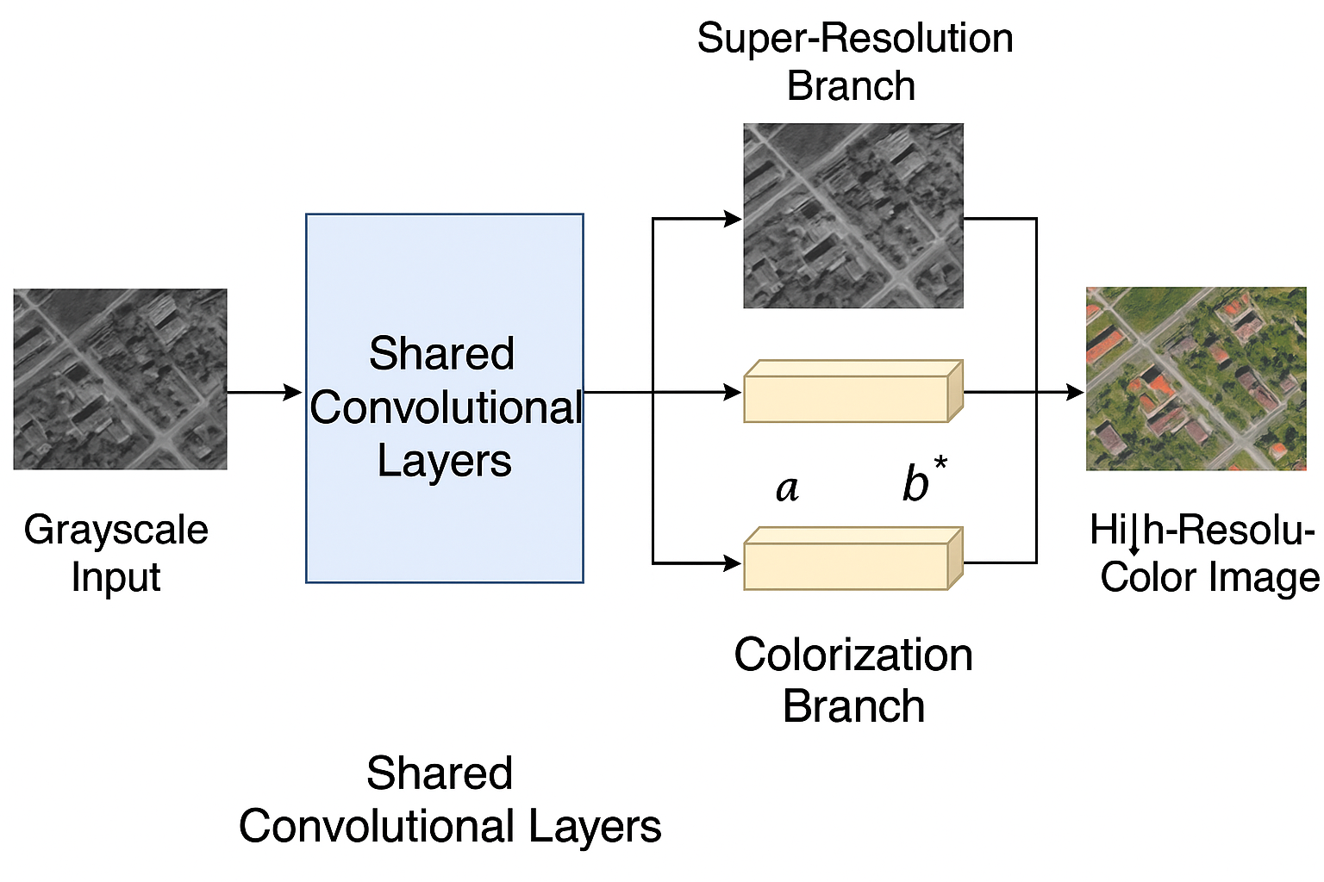
BLOCK DIAGRAM OR FLOW DIAGRAM
Review No .1
Department of CSE

Slide 10
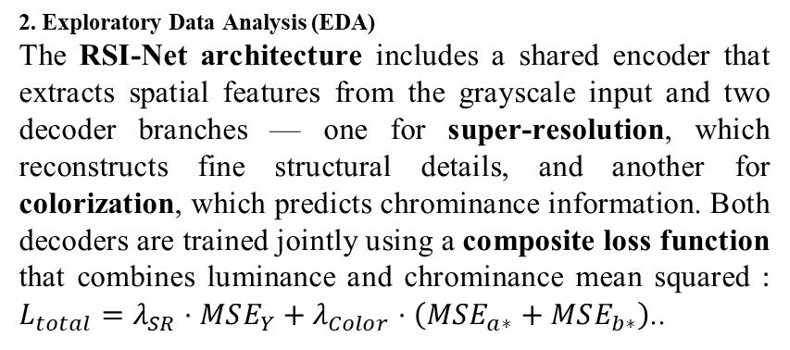
METHODOLOGY
Methods and Approaches
1.Preprocessing. The proposed model, RSI-Net, is developed to perform both image super-resolution and colorization simultaneously using a multi-task convolutional neural network. The dataset used for training is derived from the NWPU-RESISC45 remote sensing collection, consisting of diverse RGB images. Each high-resolution image is converted into a low-resolution grayscale version using bicubic downsampling with a scale factor of 4. All images are resized to 256×256 pixels, normalized, and divided into training, validation, and testing sets in an 8:1:1 ratio to ensure balanced evaluation.
The model is trained using the Adam optimizer with an initial learning rate of 1×10⁻⁴, adjusted through a cosine annealing schedule. Regularization techniques such as dropout, data augmentation (random flips, rotations, and crops), and early stopping are applied to prevent overfitting. Evaluation metrics including Peak Signal-to-Noise Ratio (PSNR), Structural Similarity Index (SSIM), and CIEDE2000 color difference are used to assess model performance. The implementation is carried out in PyTorch, leveraging GPU acceleration for faster training and improved convergence.
2. Exploratory Data Analysis (EDA)
The RSI-Net architecture includes a shared encoder that extracts spatial features from the grayscale input and two decoder branches — one for super-resolution, which reconstructs fine structural details, and another for colorization, which predicts chrominance information. Both decoders are trained jointly using a composite loss function that combines luminance and chrominance mean squared : $L_{total}=λ_{SR}⋅MSE_{Y}+λ_{Color}⋅\left(MSE_{a∗}+MSE_{b∗}\right)$..
4. Algorithms & Training
Loss: BCEWithLogitsLoss with pos_weight to fix imbalance.
Optimizer: AdamW (lr = 2e-5).
Early stopping based on Dev F1 score.
Metrics: Accuracy, F1, AUC, Precision, Recall.
Review No .1
Department of CSE

Slide 11
IMPLEMENTATION
Implementation:
Built on Google Colab (Python, PyTorch) using TwiBot-20 dataset.
Integrated BERT for text + MLP for metadata fusion.
Model trained, validated, and saved as hybrid_model.pth.
Software Specs:
OS: Colab (Linux)
Frameworks: PyTorch, HuggingFace, Scikit-learn
Tools: Pandas, NumPy, Matplotlib
Hardware Specs:
GPU: NVIDIA Tesla T4 / A100 (16 GB)
RAM: 25 GB | Storage: 100 GB (Google Drive)
Challenges & Solutions:
Data imbalance → Weighted loss & sampler
Noisy tweets → Text cleaning & normalization
Overfitting → Early stopping & dropout
Slow training → GPU acceleration
Review No .1
Department of CSE

Slide 12
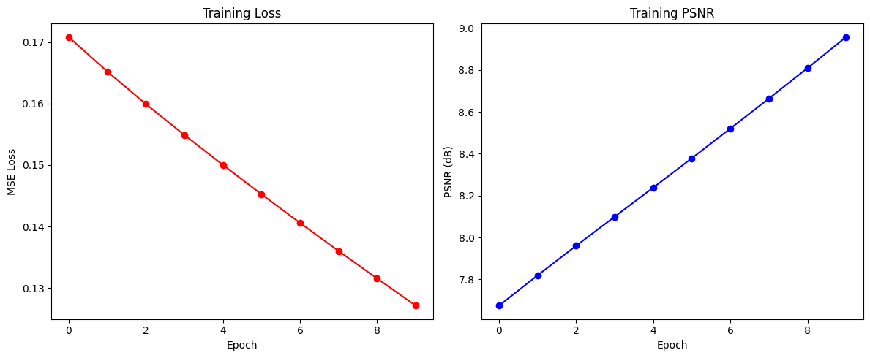
RESULTS & ANALYSIS
2. Training Progress
The training and validation results of the RSI-Net model demonstrate steady performance improvement across epochs. The loss curve shows a consistent decrease, indicating effective learning and stable convergence throughout training. Similarly, evaluation metrics such as Peak Signal-to-Noise Ratio (PSNR) and Structural Similarity Index (SSIM) steadily increased, confirming the model’s ability to enhance both spatial and color quality simultaneously. Early stopping was employed to prevent overfitting when the validation loss reached a plateau, ensuring optimal generalization on unseen data.
Review No .1
Department of CSE

Slide 13
RESULTS & ANALYSIS
The final evaluation achieved an average PSNR of 28.65 dB and SSIM of 0.89, signifying high reconstruction fidelity and strong preservation of structural details. Additionally, the CIEDE2000 score remained below 3.0, proving that the model produces perceptually accurate colorization. Visual analysis of the results confirmed that the proposed RSI-Net successfully reconstructed fine textures and vivid color tones, especially in complex scenes like forests, urban areas, and water bodies. These outcomes validate that RSI-Net effectively captures spatial–spectral correlations, outperforming traditional single-task enhancement techniques in both clarity and realism.
Review No .1
Department of CSE

Slide 14
CONCLUSION and FUTURE SCOPE
The proposed RSI-Net model successfully integrates super-resolution and colorization into a single deep learning framework, enhancing both spatial details and color accuracy of grayscale images. Experimental results demonstrated significant improvements in image quality, achieving a PSNR of 28.65 dB, SSIM of 0.89, and CIEDE2000 below 3.0, outperforming traditional single-task methods. The model effectively captured fine textures and realistic color tones, making it suitable for applications such as satellite image enhancement, historical image restoration, and digital content generation.
The significance of these results lies in the model’s ability to jointly learn spatial and chromatic features, proving that multi-task learning provides superior performance compared to independent task networks. The RSI-Net framework demonstrates strong generalization and can be extended for real-time visual enhancement systems.
Review No .1
Department of CSE

Slide 15
CONCLUSION and FUTURE SCOPE
Future enhancements may include integrating transformer-based encoders for improved feature attention, multi-sensor image fusion for remote sensing applications, and optimizing the model for real-time deployment on low-power edge devices. Overall, RSI-Net offers a practical, efficient, and scalable solution for enhancing the visual quality and realism of low-resolution grayscale imagery.
Review No .1
Department of CSE

Slide 16
REFERENCES
C. Dong, C. C. Loy, K. He, and X. Tang, “Image Super-Resolution Using Deep Convolutional Networks,” IEEE TPAMI, 2015.
B. Lim, S. Son, H. Kim, S. Nah, and K. Mu Lee, “Enhanced Deep Residual Networks for Single Image Super-Resolution,” CVPR Workshops, 2017.
Y. Zhang et al., “Image Super-Resolution Using Very Deep Residual Channel Attention Networks,” ECCV, 2018.
R. Zhang, P. Isola, and A. A. Efros, “Colorful Image Colorization,” ECCV, 2016.
S. Iizuka, E. Simo-Serra, and H. Ishikawa, “Let There Be Color!: Joint End-to-End Learning of Global and Local Image Priors,” ACM TOG, 2016.
G. Larsson, M. Maire, and G. Shakhnarovich, “Learning Representations for Automatic Colorization,” ECCV, 2016.
G. Vitoria, A. Romero, and C. Ballester, “ChromaGAN: Adversarial Picture Colorization with Semantic Class Distribution,” WACV, 2020.
L. Mou and X. X. Zhu, “Deep Learning-Based Supervised Remote Sensing Image Colorization Using Multispectral Guidance,” Remote Sensing, 2021.
Y. Mei et al., “Image Super-Resolution with Cross-Scale Non-Local Attention and Self-Exemplar Mining,” IEEE TIP, 2020.
A. R. Zamir et al., “A Robust Learning Approach to Multi-Task Learning,” NeurIPS, 2020.
Review No .1
Department of CSE

Slide 17
ACKNOWLEGEMENTS
We sincerely thank our coordinators, faculty, and mentors for their continuous guidance, encouragement, and support throughout this project — “A Deep Learning Model for Image Super-Resolution and Colorization.”
Your valuable feedback and motivation have greatly contributed to the successful completion of our work. We also extend our gratitude to Narasaraopeta Engineering College for providing the necessary facilities and resources to carry out our research effectively.
For any further discussions or collaboration inquiries, please feel free to contact us:
MARELLA VENKATRAO,M.Tech
DOGIPARTHI GOPI VISWANATH (22471A05L9)
MUTLURI PRAVEEN KUMAR (22471A05N4)
LAKKOJU VENKATESH (23475A0517)
Review No .1
Department of CSE

Slide 18
QUESTIONS and ANSWERS
Thank You! From DB10
We appreciate your attention and interest. Now, we’d like to open the floor for questions and discussions.
💬 Feel free to ask about the model, dataset, or future work!
Review No .1
Department of CSE

