Slide 1


2025 6th GLOBAL CONFERENCE FOR ADVANCEMENT IN TECHNOLOGY
(GCAT 2025)
Title : DeepFakeshield : Advanced image forgery detection with DeepLearning
Paper ID: 2314
PRESENTER NAME : Pothana Pavan Reddy
Affiliation: Narasaraopeta Engineering College JNTUK

Slide 2
OUTLINE
Abstract
Introduction
Research Gaps
Problem Statement
Objectives
Block Diagram / Flow Diagram
Methodology
Implementation
Results and Analysis
Conclusion & Future Scope
References
Acknowledgements

Slide 3
ABSTRACT
1.Objective : Develop an efficient image forgery detection system using Error Level Analysis (ELA) and Convolutional Neural Networks (CNN) with transfer learning.
2.Proposed Method : Evaluated eight pre-trained models for binary classification.EfficientNetV2 achieved 96% accuracy, excelling in efficiency and lightweight design.
3.Key Findings : Effective in detecting splicing, copy-move, and crack forgeries under conditions like noise, scaling, and rotation.
Outperformed existing state-of-the-art approaches.
4.Significance : Provides high accuracy with computational efficiency, making it suitable for resource-limited environments.
5.Future Scope : Expand to video forgery detection and address advanced real-world manipulation techniques.

Slide 4
INTRODUCTION
Aim: Leverage pre-trained models and transfer learning for efficient and accurate forgery detection. Importance and Relevance of the project
1.Introduction to the Project : Focuses on detecting digital image forgery prevalent in social media (e.g., Facebook, Twitter).Proposes the ELA-CNN model combining Error Level Analysis (ELA) and Convolutional Neural Networks (CNNs).
2.Detects various forgeries: splicing, copy-move, and crack, even under challenging conditions (noise, scaling, rotations).
3.Motivation Behind the Project : Rising challenge in identifying image authenticity due to advanced editing tools.Widespread use of manipulated images spreading misinformation and deception.

Slide 5
4.High Accuracy: Achieves 96% accuracy with lightweight EfficientNetV2.
5.Real-World Use: Handles diverse forgery types, ensuring reliability in various scenarios.
6.Technological Advancement: Sets a benchmark for future developments in image forgery detection.

Slide 6
6.Results Summary:
The Efficienetv2model achieved:
Training Accuracy: 96.5%.
Validation Accuracy: 95%.
Superior performance compared to ResNet50 and DenseNet121.

Slide 7
RESEARCH GAPS
1.Limited Generalization : Existing models struggle to generalize well across heterogeneous datasets and real-world scenarios.
2.Advanced Forgery Detection : Challenges in detecting sophisticated forgery techniques, such as Gaussian smoothing and adaptive compression.
3.Handling Low-Quality Images : Performance degrades significantly with highly compressed or low-resolution images.
4.Computational Complexity : High computational demands for models like GANs and Mask R-CNN, making them unsuitable for resource-constrained environments.
5.Multi-Class Detection Challenges : Difficulty in extending binary classification approaches to multi-class scenarios without overfitting.
6.Scalability Issues : Limited scalability of existing models to handle large-scale or high-resolution datasets effectively.

Slide 8
PROBLEM STATEMENT
*Problem Definition: Digital image manipulation has become widespread due to accessible editing tools.Forged images are often undetectable to the human eye.Existing detection methods focus narrowly on specific forgery types (e.g., splicing, copy-move).High computational complexity limits their applicability in real-world scenarios.
*Significance of the Problem:Impact on Society : Fake images fuel misinformation, undermining trust in media and institutions.
*Applications : Crucial for verifying authenticity in journalism, cybersecurity, and legal cases.Limitations of Current Methods : Dependence on large datasets for deep learning models.Inefficiency in resource-constrained environments.
Poor robustness against advanced forgery techniques like re-compression and smoothing.
*Need for Action :Develop a robust, efficient, and scalable image forgery detection system to address these challenges.

Slide 9
OBJECTIVES
1.Develop an Efficient Detection Model : Create a lightweight and scalable system for detecting various types of image forgeries.
2.Leverage Transfer Learning : Utilize pre-trained deep learning models to enhance detection accuracy while reducing computational complexity.
3.Address Advanced Forgery Techniques : Ensure robustness against sophisticated manipulations like re-compression and adaptive smoothing.
4.Improve Real-World Applicability : Design a solution that performs effectively in resource-constrained environments with minimal data and processing requirements.

Slide 10
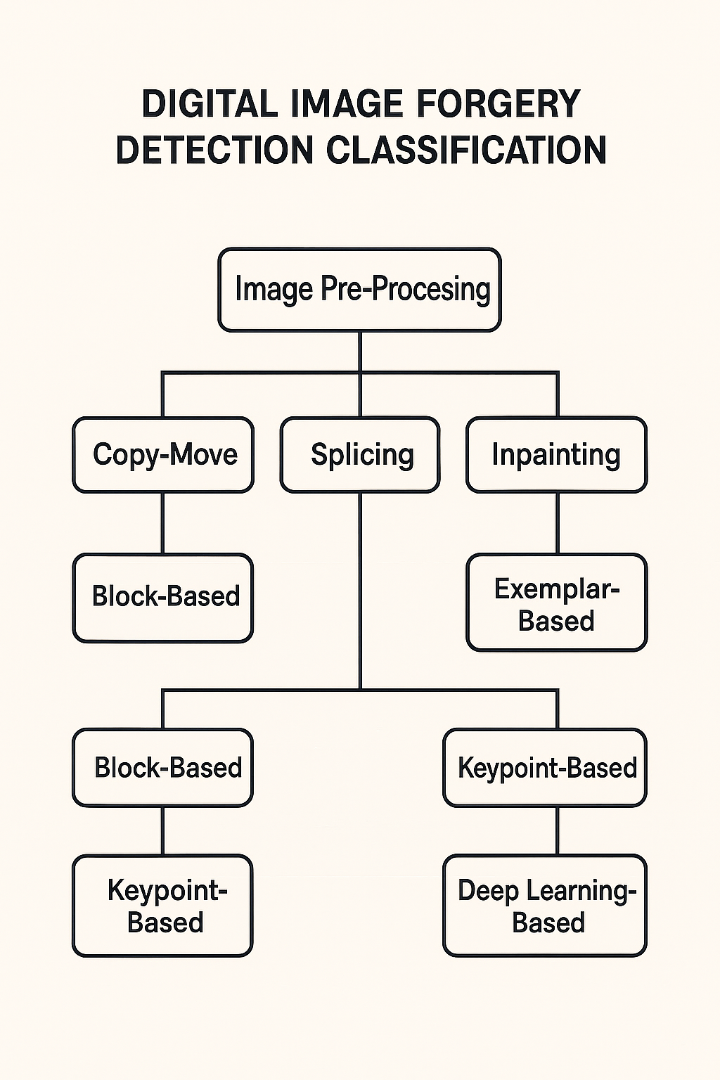
FLOW DIAGRAM

Slide 11
METHODOLOGY
1.Preprocessing
Error Level Analysis (ELA):
ELA highlights regions with different compression levels.
Steps involve resizing images to 224x224 pixels and normalizing pixel values to the range [0,1].
Data augmentation techniques (random rotations, flips, zoom, brightness alterations) are applied to enhance the dataset and minimize overfitting.
2. Exploratory Data Analysis (EDA)
Visualization of image differences before and after ELA.
Understanding dataset characteristics through class distribution and image quality levels.

Slide 12
3. Frameworks and Tools
Programming Environment: Google Colab (upgraded to T4 GPU for performance).
Frameworks: TensorFlow/Keras for deep learning model implementation.
Dataset: CASIA2 dataset for image forgery detection tasks.
4. Algorithms and Techniques
Model Architectures:
EfficientNetV2,MobileNetV2, ResNet50, DenseNet121 were employed with transfer learning.
Top layers of pre-trained models were customized for binary classification tasks.

Slide 13
5.Parameter Settings
Parameter | Value
Image Size | 224x224
Optimizer | Adam
Learning Rate | 0.001
Loss Function | Binary Cross-Entropy
Batch Size | 32
Epochs | 20(with early stopping)

Slide 14
6.Results Summary:
The Efficienetv2model achieved:
Training Accuracy: 96.5%.
Validation Accuracy: 95%.
Superior performance compared to ResNet50 and DenseNet121.

Slide 15
IMPLEMENTATION
Software Specifications
Programming Environment: Google Colab Pro with T4 GPU.
Programming Languages: Python 3.x.
Libraries/Frameworks:
TensorFlow, Keras (Model Development).
OpenCV, PIL (Image Preprocessing).
Matplotlib, Seaborn (Visualization).
Dataset: CASIA2 (Authentic and Tampered Images).
Hardware Specifications
Google Colab Pro (T4 GPU for faster training).
Local System:Intel Core i7, 16GB RAM, 500GB SSD.

Slide 16
Implementation Process
Data Preparation: Preprocessing with ELA, resizing, and augmentation.
Model Development:
Base Model: EfficienetNetV2
Optimizer: Adam (Learning Rate: 0.001).
Loss Function: Binary Cross-Entropy.
Training:
Early stopping after 5 epochs of no improvement.
Monitored accuracy/loss graphs for overfitting.
Evaluation:
Metrics: Precision, Recall, F1 Score, Accuracy.
Compared with MobileNet,
ResNet50 and DenseNet for validation

Slide 17
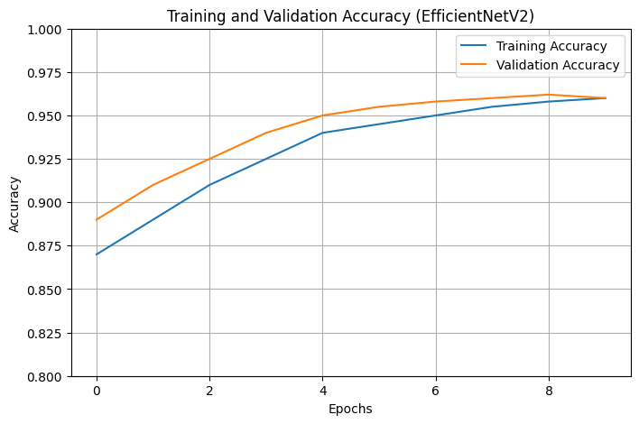
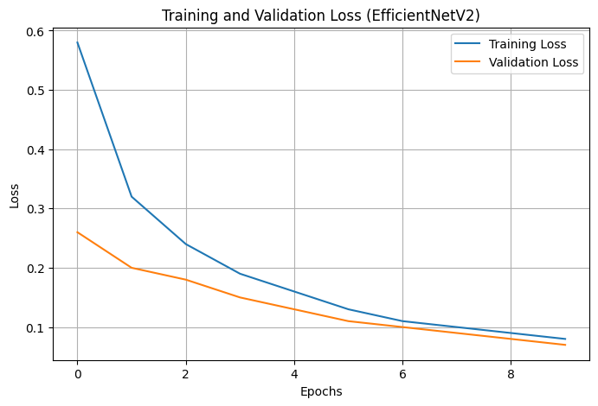
RESULT & ANALYSIS

Slide 18
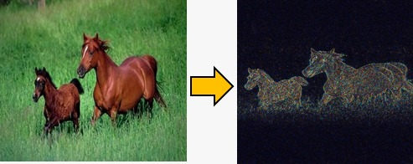

Slide 19
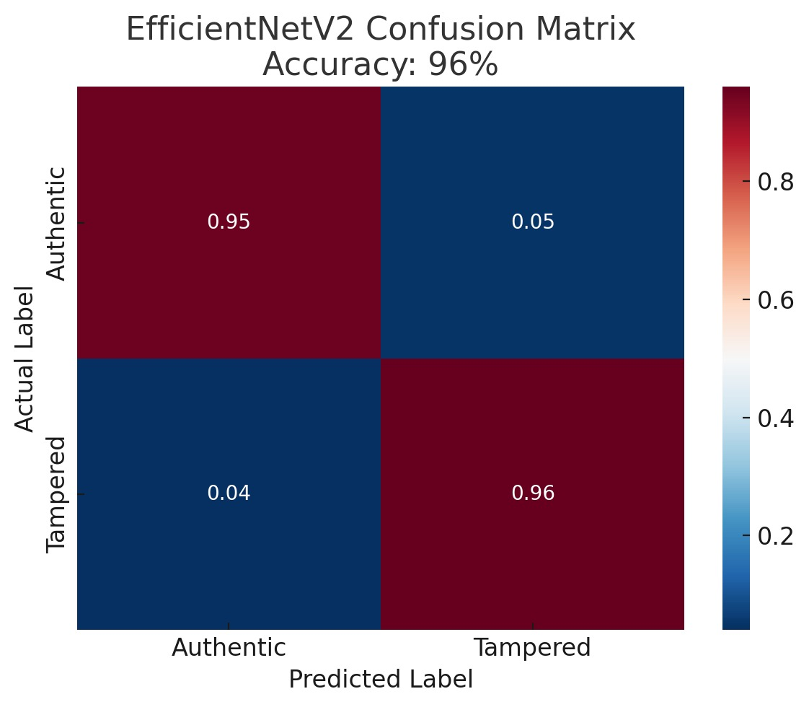

Slide 20
CONCLUSION and FEATURE SCOPE
Future Developments
Video Forgery Detection: Extend the model to analyze video sequences for manipulation.
Advanced Forgery Techniques: Enhance robustness against adaptive compression and Gaussian smoothing.
Real-Time Applications: Optimize the model for deployment on mobile and embedded systems.
Dataset Expansion: Incorporate larger, more diverse datasets for improved generalization across domains.
Limitations
Dependence on ELA: Limited effectiveness against forgeries involving uniform recompression or advanced smoothing techniques.
Dataset Size: Performance is constrained by the relatively small size and scope of the CASIA2 dataset.

Slide 21
Key Findings
Efficiency: ELA-CNN model demonstrated computational efficiency with faster training and fewer parameters, making it suitable for limited-resource environments.
Robust Preprocessing: The use of Error Level Analysis (ELA) effectively highlighted tampered regions, aiding in precise classification.
Significance of Results
Provides a scalable solution for image forgery detection in diverse applications, including social media moderation and digital forensics.
Demonstrates how transfer learning and lightweight architectures like EfficientNetV2 can enhance performance in resource-limited scenarios.
Offers a foundation for developing real-time and multimodal forgery detection systems.

