Slide 1

Department of Computer Science and Engineering
Ensemble Captioning of Images via Voting-Based Fusion Strategies
PRESENTED BY
Sk. Shajahan (23475A0519)
J.Surya Teja (22471A05M6)
N. V. C Sudheer (23475A0522)
Under the Guidance of,
K. RAJANI _{B Tech, M Tech},
Designation,
Department of Computer Science and Engineering,
Narasaraopeta Engineering College (Autonomous), Narasaraopet- 522 601.
Review No.1
Department of CSE

Slide 2
ABSTRACT
Satellite-based imagery presents significant challenges for automatic caption generation due to its complex visual content and varying spatial contexts. To address these issues, a modular captioning pipeline is proposed that integrates the Kosmos-2 and BLIP-base models. The system employs a voting-based fusion mechanism to select the most representative and contextually accurate caption. This approach demonstrates improved performance in both accuracy and semantic quality when evaluated on the RSICD dataset. The evaluation process utilizes several standard metrics, including BLEU, METEOR, ROUGE-L, CIDEr, and SPICE, to comprehensively assess the quality of the generated captions.
Review No.1
Department of CSE

Slide 3
INTRODUCTION
Remote sensing images are vital for analyzing land, environment, and urban areas.
Lack of visual cues like depth and perspective complicates captioning tasks
Traditional encoder–decoder models fail to capture spatial semantics.
Ensemble methods enhance caption accuracy and semantic richness.
New vision-language models bridge visual and textual representations.
This research applies ensemble captioning for satellite image understanding.
Review No.1
Department of CSE

Slide 4
LITERATURE SURVEY
No | Title | Author | Journal Name & Year | Methodology Adapted | Key Findings | Gaps
1 | NLP-Based Fusion Approach to Robust Image Captioning | Riccardo Ricci, Farid Melgani, José Marcato Junior | IEEE Journal of Selected Topics in Applied Earth Observations and Remote Sensing ( Volume: 17) | Feature extraction;NLPbased fusion | Combines visual features with NLPbased textual representationsfor improved RSIC captioning under noisy conditions | Needs further evaluation on multilingual datasets
2 | Retrieval Topic Recurrent Memory Network for Remote Sensing Image Captioning | Binqiang Wang, Xiangtao Zheng, BoQu, Xiaoqiang Lu | IEEE Journal of Selected Topics in Applied Earth Observations and Remote Sensing ( Volume: 13) | Retrieval of topics from image+text | created a memory network to improve caption quality by retrieving topics. | restricted to the variety of topics
3 | Medical ImageCaptioning Model to Convey More Details:MethodologicalComparison ofFeature DifferenceGeneration | Hyeryun Park,Kyungmo Kim,Seongkeun Park,Jinwook Choi,2024, IEEE | IEEE Access ( Volume: 9) | ResNet-152encoder;transformer/LSTMdecoders; featuredifferencevectors. | Developed a chest X-rayimage captioning modelusing feature differencesbetween patient andnormal images. | Difficulty in accurately describingall abnormal findings anddetailed causes.
4 | VAA: Visual Aligning Attention Model for Remote Sensing Image Captioning | Zhengyuan Zhang, Wenkai Zhang, Wenhui Diao, Menglong Yan | IEEE Access ( Volume: 7) | Attention model | Better performance on UCM/Sydney; increased attention to semantic regions | May ignore small/complex objects
5 | VLCA: vision language aligning model with crossmodal attention for bilingualremote sensing image captioning | Tingting Wei, Weilin Yuan, Junren Luo, Wanpeng Zhang | Journal of Systems Engineering and Electronics ( Volume: 34, Issue: 1, February 2023) | DIOR-Captions is a bilingual dataset, Cross-modal attention | Improved visual-language alignment and the first bilingual RS captioning | Limited language pairs/domain adaptation
Review No.1
Department of CSE

Slide 5
LITERATURE SURVEY
Early Works: Vinyals et al. (2015) and Xu et al. (2015) introduced neural image captioning using CNN-RNN and attention mechanisms, forming the foundation for visual-language modeling.
Remote Sensing Focus: Lu et al. (2017) created the RSICD dataset, enabling research in satellite image captioning, while Cheng et al. (2017) benchmarked remote sensing classification techniques.
Deep Learning Expansion: Zhu et al. (2017) and Li et al. (2022) provided comprehensive reviews of deep learning methods for remote sensing image analysis.
Fusion and Domain Adaptation: Zhang et al. (2021) and Chen et al. (2020) explored fusion-based and domain adaptation techniques to enhance caption accuracy across datasets.
Modern Vision-Language Models: Li et al. (2022) introduced BLIP and Huang et al. (2023) developed Kosmos-2, both leveraging large-scale pretraining to unify vision and language understanding.
Review No.1
Department of CSE

Slide 6
PROBLEM STATEMENT
Remote sensing images lack conventional visual cues found in ground-level photography
Individual captioning models generate inconsistent or vague descriptions.
There is a requirement for an ensemble strategy to merge multiple model outputs.
Aim to enhance caption accuracy, fluency, and semantic richness.
Develop a voting-based selection that identifies the best caption among alternatives.
Review No.1
Department of CSE

Slide 7
OBJECTIVES
Design an ensemble framework for satellite image captioning.
Combine BLIP-base and Kosmos-2 to leverage complementary strengths
Generate multiple captions per image for diversity.
Implement a voting-based fusion method to select optimal output.
Use RSICD dataset for evaluation and benchmarking.
Review No.1
Department of CSE

Slide 8
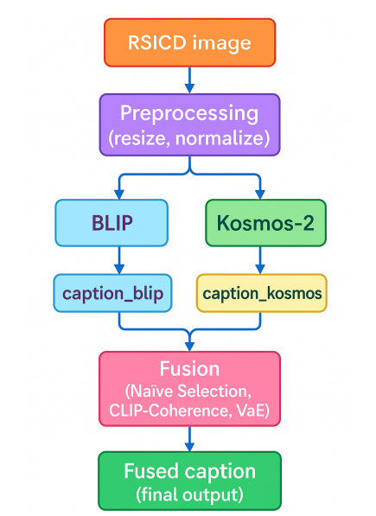
BLOCK DIAGRAM OR FLOW DIAGRAM
Review No.1
Department of CSE

Slide 9
METHODOLOGY
Built using PyTorch 2.x and HuggingFace Transformers framework.
Supported on both local GPU and cloud (Google Colab Pro+) environments.
Dataset: RSICD with 10 K images, 5 captions each, across 30 categories.
Preprocessing ensures consistent input dimensions and normalization.
Caption generation done independently by BLIP and Kosmos-2 models.
Token overlap and linguistic quality determine final caption.
Modular structure allows integration of additional models easily.
Review No.1
Department of CSE

Slide 10
IMPLEMENTATION
Data Collection
RSICD dataset with image–caption pairs divided into 70% train, 15% validation, and 15% test splits.
Image Preprocessing
All images resized to 224×224 pixels and normalized using ImageNet mean and standard deviation.
Text Preprocessing
Captions cleaned, tokenized, and encoded using BLIP and Kosmos-2 text tokenizers.
Model Loading
Pretrained BLIP and Kosmos-2 models loaded from Hugging Face and locally saved for efficient inference.
Fusion Strategy
Feature vectors from BLIP and Kosmos-2 fused using attention-based transformer fusion for robust caption
generation.
Evaluation
Generated captions evaluated using BLEU, ROUGE, CIDEr, and METEOR metrics for performance comparison.
Review No.1
Department of CSE

Slide 11
PREPROCESSING TECHNIQUES
Resize images to 224×224 pixels — all input images were rescaled to 224×224 to match the vision-transformer backbones used by the captioning models.
Pixel normalization using ImageNet statistics — image pixel values were normalized with the ImageNet mean and standard deviation (the same normalization used during model pretraining).
Convert images to tensors — after resizing and normalization, images were converted into PyTorch tensors suitable for model input pipelines.
Model-specific tokenization / text preprocessing — each model’s tokenizer was applied to prepare textual inputs/outputs (and captions were tokenized for downstream fusion/token-overlap operations).
Shared input flow for multi-model compatibility — the pipeline was designed so the same preprocessed image tensor can be fed into different pretrained models (BLIP, Kosmos-2, etc.) without altering the core input steps.
Dataset split for training/validation/testing — RSICD was partitioned using a 70:15:15 split (train : val : test) so preprocessing was applied consistently across each split before caption generation and evaluation.

Slide 12
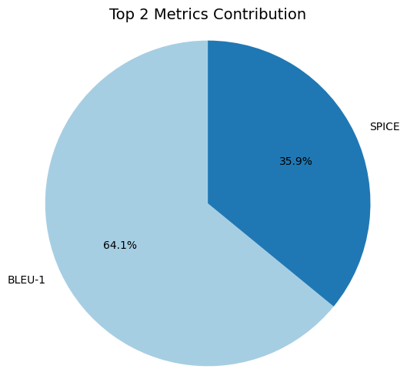
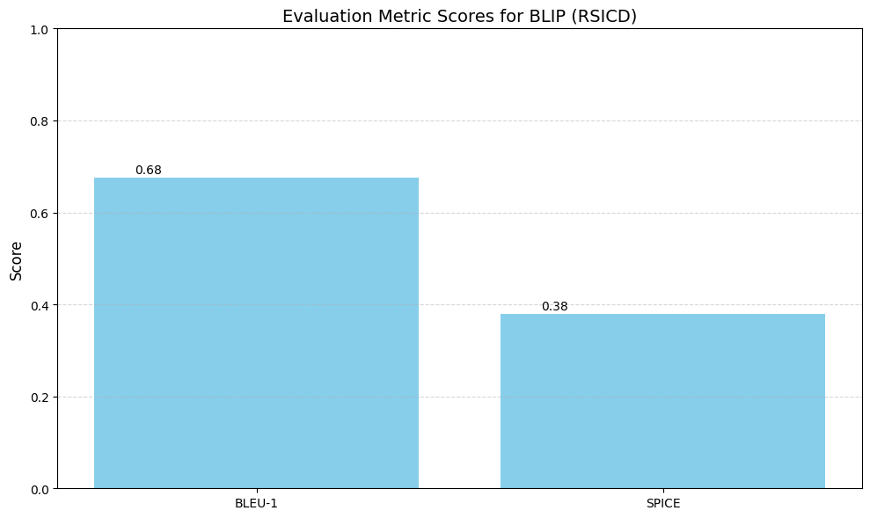
RESULTS & ANALYSIS
Ensemble model achieved BLEU-1 = 0.68 and SPICE = 0.38.
Outperformed BLIP (0.63) and Kosmos-2 (0.64) individually.
Higher scores in METEOR and CIDEr show better semantic alignment.
Visual results reveal smoother, more descriptive captions.
Captions maintained contextual meaning across varied scene categories.
BLEU improvements indicate better word-level fluency.
Ensemble approach proved stable and reliable for remote sensing.
Review No.1
Department of CSE

Slide 13
CONCLUSION and FUTURE SCOPE
Ensemble fusion enhances caption quality and context accuracy.
Modular and training-free design enables easy integration of new models.
Achieved improvements across all major evaluation metrics. Future work includes CLIP-based semantic scoring for fusion. Expansion to multilingual and temporal (video) captioning tasks.
Review No.1
Department of CSE

Slide 14
REFERENCES
X. Lu, Z. Wang, and X. Zheng, “RSICD: Remote sensing image caption dataset,” IEEE Journal of Selected Topics in Applied Earth Observations and Remote Sensing, vol. 10, no. 8, pp. 3718–3729, 2017.
G. Cheng, J. Han, and X. Lu, “Remote sensing image scene classification: Benchmark and state of the art,” Proceedings of the IEEE, vol. 105, no. 10, pp. 1865–1883, 2017.
X. X. Zhu, D. Tuia, L. Mou, G.-S. Xia, L. Zhang, F. Xu, and F. Fraundorfer, “Deep learning in remote sensing: A comprehensive review and list of resources,” IEEE Geoscience and Remote Sensing Magazine, vol. 5, no. 4, pp. 8–36, 2017.
W. Li, G. Wu, and B. Du, “Deep learning for remote sensing image analysis: A comprehensive review,” IEEE Transactions on Geoscience and Remote Sensing, vol. 60, pp. 1–42, 2022.
O. Vinyals, A. Toshev, S. Bengio, and D. Erhan, “Show and tell: A neural image caption generator,” in Proceedings of the IEEE Conference on Computer Vision and Pattern Recognition (CVPR), 2015, pp. 3156–3164.
Review No.1
Department of CSE

Slide 15
REFERENCES
K. Xu, J. Ba, R. Kiros, K. Cho, A. Courville, R. Salakhutdinov, R. Zemel, and Y. Bengio, “Show, attend and tell: Neural image caption generation with visual attention,” in International Conference on Machine Learning (ICML), 2015, pp. 2048–2057.
Y. Chen, F. Yang, and L. Wang, “Domain adaptation in remote sensing image captioning,” Remote Sensing, vol. 12, no. 3, p. 544, 2020.
L. Zhang, M. Wang, R. Zhao, et al., “Fusion-based captioning for enhanced image description,” IEEE Transactions on Multimedia, vol. 23, pp. 1234–1245, 2021.
X. Huang, Y. Wang, Y. Shen, X. Qi, et al., “Kosmos-2: Grounding multimodal large language models to the world,” arXiv preprint arXiv:2306.14824, 2023. [Online]. Available: https://arxiv.org/abs/2306.14824
J. Li, D. Li, C. Xiong, and S. C. Hoi, “BLIP: Bootstrapped language-image pretraining for unified vision-language understanding and generation,” arXiv preprint arXiv:2201.12086, 2022. [Online]. Available: https://arxiv.org/abs/2201.12086
Review No.1
Department of CSE

Slide 16
REFERENCES
X. Chen, H. Fang, T.-Y. Lin, et al., “Microsoft COCO caption evaluation tool,” 2015. [Online]. Available: https://github.com/tylin/coco-caption
R. Vedantam, C. L. Zitnick, and D. Parikh, “CIDEr: Consensus-based image description evaluation,” in Proceedings of the IEEE Conference on Computer Vision and Pattern Recognition (CVPR), 2015, pp. 4566–4575.
P. Anderson, B. Fernando, M. Johnson, and S. Gould, “SPICE: Semantic propositional image caption evaluation,” in European Conference on Computer Vision (ECCV). Springer, 2016, pp. 382–398.
X. Li, X. Yin, C. Li, X. Hu, P. Zhang, L. Zhang, L. Wang, H. Hu, L. Dong, F. Wei, et al., “OSCAR: Object-semantics aligned pre-training for vision-language tasks,” in European Conference on Computer Vision (ECCV). Springer, 2020, pp. 121–137.
J. Han, and X. Lu, “CIDEr: Content-based image description evaluation,” in Proceedings of the IEEE Conference on Computer Vision and Pattern Recognition (CVPR), 2015, pp. 4566–4575.
Review No.1
Department of CSE

Slide 17
QUESTIONS and ANSWERS
Q1: How does the voting-based fusion strategy improve caption accuracy?
A: It selects the most semantically consistent caption among model outputs, improving accuracy and context.
Q2: Why were BLIP and Kosmos-2 chosen for ensemble captioning?
A: They are advanced vision-language models offering complementary captioning strengths.
Q3: What dataset and metrics were used for evaluation?
A: The RSICD dataset was used with BLEU, METEOR, ROUGE-L, CIDEr, and SPICE metrics.
Review No.1
Department of CSE

Slide 18
ACKNOWLEGEMENTS
Grateful to our Chairman, Sri M. V. Koteswara Rao, B.Sc., for his continuous support and encouragement throughout the course.
Thankful to our Principal, Dr. S. Venkateswarlu, Ph.D., for his valuable guidance and motivation.
Sincere thanks to Dr. S. N. Tirumala Rao, M.Tech., Ph.D., HOD of CSE, and our Guide, K. Rajani, M.Tech., for their guidance and constant encouragement.
Appreciation to Syed Rizwana, M.Tech. (Ph.D.), Assistant Professor & Project Coordinator, for her support and inspiration.
Heartfelt gratitude to our parents, friends, and the CSE department staff for their cooperation, motivation, and continuous encouragement.
Review No.1
Department of CSE

Slide 19
THANK YOU
Contact:
jadamsuryateja@gmamil.com
Review No.1
Department of CSE

