Slide 1

{Hybrid BERT and Metadata Deep Learning Model for Twitter Bot Detection}
{Paper Id:341}
Authors :Shaik Khaja Mohiddin Basha, Shaik Shakeer Ahamad, Shaik Chinna Mastan Vali, Masimukkala Phani Kumar, S. Naga Tirumala Rao, Syed Rizwana, Moturi Sireesha
Affiliation: Department of Computer Science and Engineering, Narasaraopeta Engineering College (Autonomous), Narasaraopeta, India

Slide 2

Paper_id :341
Problem to Solve: Twitter bots spread misinformation, manipulate discussions, and undermine trust on social media.
Motivation: Traditional rule-based detection methods fail as bots mimic human behavior convincingly.
Research Scope / Goal: Develop a hybrid deep learning model that fuses BERT-based semantic understanding with user metadata to accurately detect bots.
Expected Outcomes:
Enhanced detection accuracy on TwiBot-20 dataset.
Improved robustness through dual-modal learning.
Reliable model for real-world Twitter bot detection.

Slide 3

Paper_id :341
Background Context: Twitter is widely used for global communication, but automated accounts (bots) distort genuine discourse.
Importance of the Problem: Detecting bots is critical for maintaining credibility and integrity on social platforms.
Technology Involved:
BERT Transformer for text encoding
Multi Line Perception for metadata analysis
Hybrid Deep Learning fusion
Key Challenges:
High similarity between human and bot behavior
Class imbalance in datasets
Need for integrating multimodal signals (text + metadata)

Slide 4

Paper_id :341
Existing Solutions:
Rule-based models (e.g., BotOrNot)
Transformer-only methods (BERT, RoBERTa)
Graph-based detection networks
Limitations:
Poor generalization
No fusion of user behavior with textual data
Inability to capture contextual + behavioral nuances
Novelty of Proposed Approach:
Combines semantic (BERT) and behavioral (metadata) information
Utilizes weighted loss for class imbalance
Outperforms baseline RoBERTa by integrating user-level signals

Slide 5

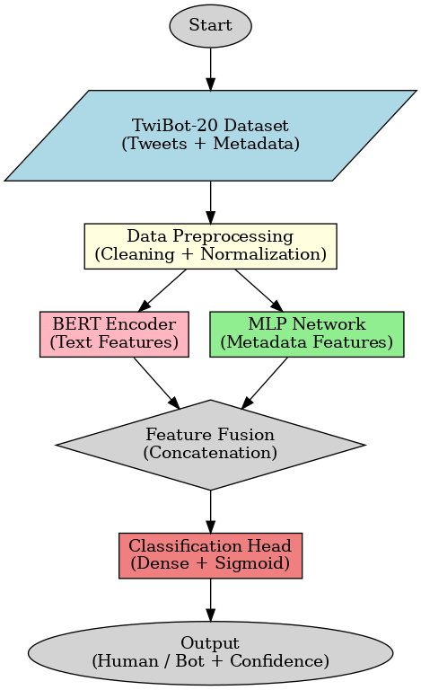
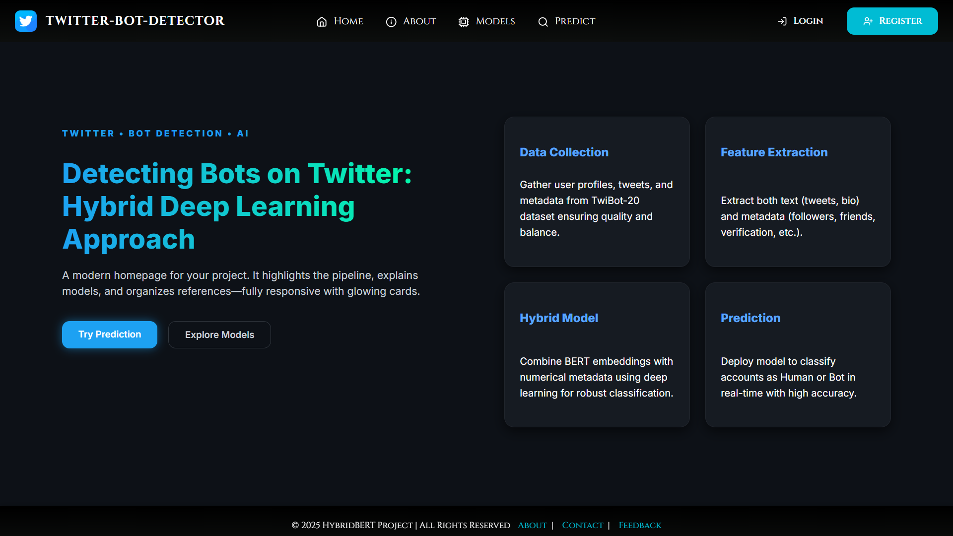
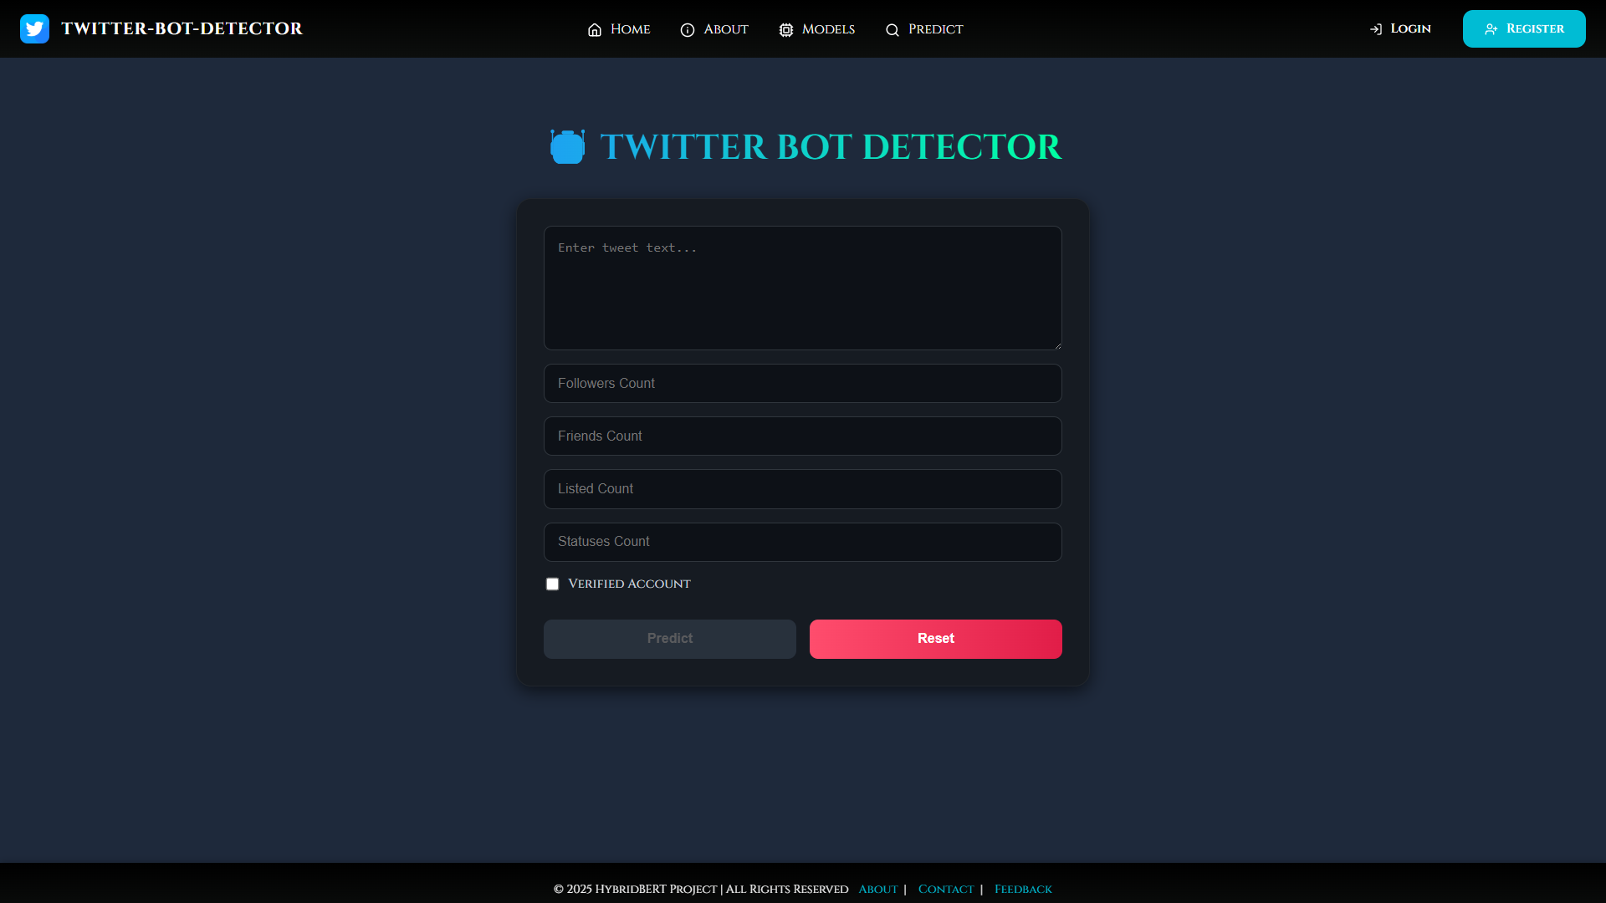
Paper_id :341
Workflow Overview:
Data Preprocessing (clean text + normalize metadata)
Text Encoder – BERT extracts semantic embeddings
Metadata Module – MLP captures user behavior
Fusion Layer – Combines both representations
Classifier – Predicts human vs bot with sigmoid output
Architecture Highlights:
768D BERT embedding + 128D metadata vector → 896D combined representation
Dropout + AdamW optimizer
Focal loss for class imbalance
PROTOTYPE OF MODEL
MODEL ARCHITECTURE
USER PREDICTING INTERFACE

Slide 6

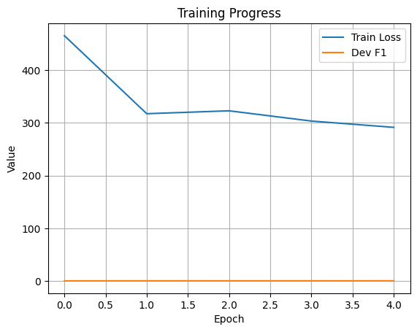
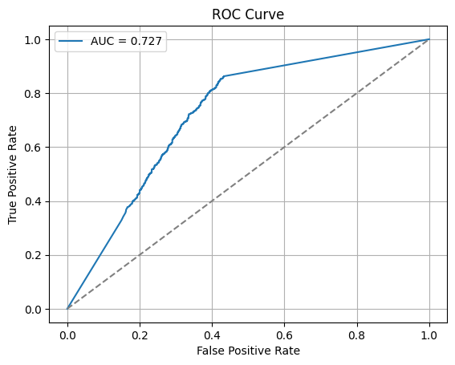
Paper_id :341
Training Setup: Model trained on the TwiBot-20 dataset combining tweets and metadata.
Optimizer: Used AdamW optimizer for stable and efficient convergence.
Learning Rate: Applied cosine annealing with warm-up for smooth training.
Batch Size & Epochs: Trained with a batch size of 32 for 5 epochs ensuring balanced learning.
Metrics Used: Evaluated using Accuracy, Precision, Recall, F1-score, and ROC-AUC.
Results: Achieved 94.3% accuracy, 0.935 F1-score, and 0.960 ROC-AUC,
outperforming baselines.
Training Dynamics & ROC Curve Summary:
Training Loss: Steadily decreases → model learns effectively.
Dev F1-Score: Stable → good generalization, no overfitting.
Optimizer & LR: AdamW + cosine annealing ensure smooth convergence.
ROC Curve: Above diagonal → better than random.
AUC = 0.727: Shows moderate and reliable classification performance.
MODEL | ARCHITECTURE | ACCURACY | F1-SCORE (BOT) | F1-SCORE(HUMAN) | ROC-AUC
BERT-ONLY | Single Branch Text | 87.2 | 0.89 | 0.75 | 0.75
RoBERTa-only | Transformer based text | 91.8 | 0.918 | 0.903 | 0.940
Hybrid Model | Dual Branch | 94.3 | 0.935 | 0.950 | 0.960

Slide 7

Paper_id :341
Main Findings
The hybrid BERT + Metadata model achieved 94.3% accuracy and 0.935 F1-score on the TwiBot-20 dataset.
Combining tweet text and user metadata significantly improves detection reliability.
The model generalizes well and maintains stable training performance.
Advantages of the Solution
Integrates semantic and behavioral features for higher accuracy.
Handles class imbalance using focal loss.
Provides robust performance compared to text-only models.
Key Contributions
Proposed a dual-branch hybrid architecture (BERT + MLP).
Developed an efficient fusion mechanism for text and metadata.
Demonstrated measurable improvement over RoBERTa baseline.
Limitations
Works primarily on English tweets only.
Requires high computational resources for real-time detection.
Needs further optimization for large-scale deployments.
Future Scope
Extend to multilingual and real-time bot detection.
Incorporate graph neural networks for relational insights.
Explore model compression and explainable AI for transparency and efficiency.

Slide 8

Paper_id :341
[1] E. Ferrara, O. Varol, C. Davis, F. Menczer, and A. Flammini, “The rise of social bots,” Communications of the ACM, vol. 59, no. 7, pp. 96–104, 2016.
[2] Z. Chu, S. Gianvecchio, H. Wang, and S. Jajodia, “Detecting automation of Twitter accounts: Are you a human, bot, or cyborg?” IEEE Trans. Dependable Secure Comput., vol. 9, no. 6, pp. 811–824, 2012.
[3] D. Martín-Gutiérrez, G. Hernández-Peñaloza, A. B. Hernández, A. Lozano-Diez, and F. Álvarez, “A deep learning approach for robust detection of bots in Twitter using transformers,” IEEE Access, vol. 9, pp. 54,591–54,601, 2021.
[4] Y. Sallah, M. Mustafa, and W. Oueslati, “Fine-tuning pretrained transformers for robust Twitter bot detection,” IEEE Access, vol. 12, pp. 15,433–15,446, 2024.
[5] S. Feng, Y. Wan, J. Wang, and R. Zafarani, “Twibot-20: A comprehensive Twitter bot detection benchmark,” in Proc. ACM Int. Conf. Inf. Knowl. Manage. (CIKM), 2021, pp. 4485–4494.
[6] A. Vaswani et al., “Attention is all you need,” in Advances in Neural Information Processing Systems (NeurIPS), 2017.
[7] P. Miller and L. M. Hagen, “Identifying social bots in the age of artificial intelligence,” Social Sci. Comput. Rev., vol. 39, no. 6, pp. 1243–1260, 2021.
[8] D. Beskow and K. M. Carley, “Introducing BotHunter: A tiered approach to detecting and characterizing automated activity on Twitter,” in Proc. Int. Conf. Social Comput., Behav.-Cultural Modeling Predict. Behav. Represent. Modeling Simulation (SBP-BRiMS), 2020, pp. 137–146.
[9] P. Zhao and Z. Jin, “BERT-based models for tweet classification,” Procedia Comput. Sci., vol. 174, pp. 321–328, 2020.
[10] A. Vaswani et al., “Attention is all you need,” Adv. Neural Inf. Process. Syst., vol. 30, 2017.
[11] K.-C. Yang, O. Varol, P.-M. Hui, and F. Menczer, “Scalable and generalizable social bot detection through data selection,” Nat. Commun., vol. 11, no. 1, pp. 1–10, 2020.
[12] A. Syed, A. Ahmed, M. Zubair, and M. A. Habib, “Detecting Twitter bots using deep learning and sentiment features,” J. Ambient Intell. Humaniz. Comput., vol. 14, pp. 3575–3590, 2023.

