Slide 1



HYBRIDBERT AND METADATA DEEP LEARNING FOR TWITTER BOT DETECTION
Department of Computer Science and Engineering
PRESENTED BY
SHAIK SHAKEER AHAMAD
SHAIK MASTANVALI
M PHANI KUMAR
(22471A05O1) (22471A05P0) (22471A05P3)
Under the Guidance of,
Shaik Khaja Mohiddin Basha M.Tech,
Assistant Professor,
Department of Computer Science and Engineering, Narasaraopeta Engineering College (Autonomous),
Narasaraopet- 522 601.
Batch No.DB2 Department of CSE

Slide 2
OUTLINE
Abstract
Introduction
Literature Survey
Research Gaps
Problem Statement
Objectives
Block Diagram / Flow Diagram
Methodology
Implementation
Results and Analysis
Conclusion & Future Scope
References
Acknowledgements
Question and Answers
Batch No.DB2 Department of CSE

Slide 3
ABSTRACT
Social media platforms like Twitter are widely used for communication and information sharing; however, the rise of automated bot accounts causes issues like misinformation and spam. This project introduces a Hybrid BERT and Metadata Deep Learning Model to detect Twitter bots, where BERT extracts textual features from tweets while an MLP analyzes metadata such as user activity, followers, and profile details. The model is trained on the TwiBot-20 dataset for robust and diverse user representation, and experimental results show improved accuracy, precision, recall, and F1-score compared to traditional models. The hybrid architecture effectively combines contextual language understanding with behavioral patterns, enabling more accurate discrimination between human and automated accounts. Overall, the proposed system enhances security and reliability on social media platforms by reducing the impact of malicious bot networks on public discourse.
Batch No.Db2
Department of CSE

Slide 4
INTRODUCTION
Brief Introduction to the Project
Twitter has become a major platform for sharing opinions, news, and information.
However, the presence of automated bot accounts has created issues like spreading
misinformation and fake engagement.
Detecting these bots accurately is crucial for maintaining trust and authenticity on social
platforms.
Motivation Behind the Project
Traditional machine learning methods rely on limited textual or user features.
They fail to capture the contextual meaning of tweets and behavioral patterns of users.
Recent advancements in Deep Learning (BERT, MLP) motivate a hybrid approach for
improved detection accuracy.
Importance and Relevance
Helps in preventing misinformation and improving cybersecurity on social media.
Useful for researchers, policymakers, and social platforms to identify malicious accounts.
Contributes toward building a trustworthy and transparent online environment.
Batch No.DB2 Department of CSE

Slide 5
INTRODUCTION:WHY BOT DETECTION MATTERS
Motivation for the Work
Earlier bot detection techniques based on traditional machine learning use limited textual data or basic profile features. Such approaches struggle to understand deep language context and complex user behavior. With the emergence of advanced deep learning models like BERT for contextual text analysis and MLPs for user metadata, a hybrid framework becomes a powerful solution for accurate bot identification.
Significance of Bot Detection
Reduces the impact of misinformation and manipulated content
Safeguards users from spam, scams, and automated abuse
Preserves genuine engagement and fair discussions
Supports policymakers, researchers, and platforms in analyzing social influence
Strengthens trust and transparency in digital social networks
Batch No.DB2 Department of CSE

Slide 6
LIMITATIONS OF EXISTING SYSTEMS
Existing bot detection systems suffer from several important limitations. Approaches that rely only on textual analysis ignore crucial user behavior such as posting frequency, follower relationships, and account activity patterns. On the other hand, models based solely on user metadata fail to understand the linguistic intent, context, and sentiment expressed in tweets. Many current systems also struggle to adapt to continuously evolving bot behaviors, leading to reduced detection accuracy over time. Additionally, these models often show poor generalization performance when applied across different datasets or real-world environments, limiting their practical usability
Batch No.DB2 Department of CSE

Slide 7
LITERATURE SURVEY
No | Title | Author | Journal Name & Year | Methodology Adapted | Key Findings | Gaps
1 | A Deep Learning Approach for Robust Detection of Bots in Twitter Using Transformers | Md. Mahbubur Rahman, 26 February 2024 & IEEE | https://ieeexplore.ieee.org/docum ent/9361372 | Metadata + text-based features, multilingual embeddings | High accuracy using multilingual features | Needs validation on newer transformer models
2 | Social Bot Detection Using Deep Learning | Chu et al., 2012, IEEE TDSC | https://ieeexplore.ieee.org/docum ent/6280553 | Behavioral features, activity pattern mining | Pioneering study of bots, cyborgs, and humans | Outdated dataset and models
3 | Twitter Bot Detection Using Transformer-based Models | Satya R. et al., 2023, IEEE | https://ieeexplore.ieee.org/docum ent/10064110 | Tweet and metadata preprocessing | RoBERTa showed highest performance | Not evaluated for multilingual bots
4 | Graph Neural Networks for Social Bot Detection | Tanvi Jain et al., 2024, IEEE | https://ieeexplore.ieee.org/docum ent/10630818 | Twitter user interaction graph building | Outperformed traditional models in graph learning | Not scalable to large networks
5 | Deep Learning for Botnet Detection in Twitter | Devendra M. et al., 2024, IEEE | https://ieeexplore.ieee.org/docum ent/10613812 | TF-IDF vectorization of tweets | Hybrid model improves botnet detection | Dataset not provided
Batch No.DB2 Department of CSE

Slide 8
RESEARCH GAPS
Limited Feature Integration
Most existing models focus only on text-based or only on metadata-based features, ignoring the combined effect of both.
Lack of Contextual Understanding
Traditional machine learning models fail to capture the semantic meaning and context of tweets effectively.
Poor Generalization
Models trained on one dataset often fail to perform well on other datasets due to variations in user behavior and data distribution.
Feature Imbalance
There exists a significant imbalance between bot and human user data, which reduces
classification accuracy.
Limited Use of Advanced Models
Few studies utilize transformer-based architectures (like BERT) for deep contextual analysis in
combination with metadata.
Batch No.DB2 Department of CSE

Slide 9
DATASET OVERVIEW
The project uses a large-scale Twitter bot detection dataset that contains both tweet-level textual information and user-level metadata. The dataset includes labeled accounts categorized as human or bot, along with their tweets, profile descriptions, follower and following counts, activity statistics, and verification status. This combination of linguistic content and behavioral features makes the dataset well suited for hybrid deep learning models. It reflects real-world social media activity and captures diverse bot behaviors, enabling robust training and evaluation of bot detection systems under realistic conditions.
Batch No.DB2 Department of CSE

Slide 10
DATASET STRUCTURE
The TwiBot-20 dataset is organized using a structured JSON format to ensure consistency and ease of processing. It is divided into three main files: train.json, which contains labeled data used for training the model; dev.json, which is utilized for validation and hyperparameter tuning; and test.json, which is reserved for final performance evaluation. This clear separation of data supports reliable model development and unbiased assessment. The uniform JSON-based structure enables efficient extraction of both textual and metadata features for hybrid deep learning approaches.
TwiBot-20 Dataset → JSON Format → train.json (Training) → dev.json (Validation) → test.json (Testing)
Batch No.DB2 Department of CSE

Slide 11
DATASET FEATURES
The dataset contains two major categories of features: Textual Features and Metadata Features. Textual features include user tweets, writing style, and semantic patterns, which help in understanding the language usage and contextual intent of the accounts. Metadata features consist of followers count, friends count, listed count, statuses count, and the verified flag, which together represent the behavioral and profile characteristics of Twitter users and play a crucial role in distinguishing human accounts from bots.
Batch No.DB2 Department of CSE

Slide 12
SYSTEM ARCHITECTURE OVERVIEW
The proposed system follows a dual-branch hybrid architecture designed to effectively detect Twitter bots. One branch focuses on textual information, where tweet content is processed using a BERT-based model to capture contextual and semantic representations. The second branch handles user metadata, which is passed through a Multi-Layer Perceptron (MLP) to learn behavioral patterns from numerical features. The outputs from both branches are then fused and fed into a classification head, which produces the final prediction by combining linguistic and behavioral insights.
Batch No.DB2 Department of CSE

Slide 13
PROBLEM STATEMENT
Main Issue
The increasing number of automated bot accounts on Twitter leads to the spread of
misinformation, spam, and manipulation of public opinion.
Existing Limitations
Traditional detection models rely on either textual content or user metadata, not both.
They fail to capture deep contextual meaning of tweets and behavioral patterns of users. Most approaches show low generalization across diverse datasets and poor scalability for real-world use.
Core Problem
There is a need for a robust, hybrid deep learning model that can integrate semantic features from tweets (BERT) and behavioral features from metadata (MLP) to accurately identify bot accounts on Twitter.
Goal
To design and implement a HybridBERT-Metadata model that improves accuracy,
reliability, and generalization in detecting Twitter bots.
Batch No.DB2 Department of CSE

Slide 14
OBJECTIVES
To develop a HybridBERT and Metadata Deep Learning Model for accurate and efficient Twitter bot detection. There Are Set Of Objectives To be Followed
Specific Objectives
To analyze the limitations of existing Twitter bot detection techniques.
To preprocess the TwiBot-20 dataset for effective feature extraction and model training.
To implement BERT for extracting contextual textual features from user tweets.
To design a Metadata-based MLP model for learning user behavioral and profile features.
To integrate BERT and MLP outputs into a hybrid architecture for improved classification.
To evaluate the model using performance metrics such as Accuracy, Precision, Recall, and F1-score.
Batch No.DB2 Department of CSE

Slide 15
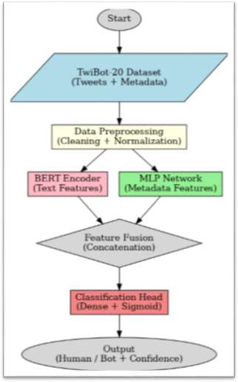
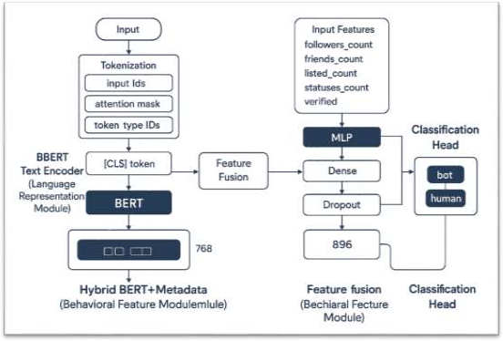
BLOCK DIAGRAM OR FLOW DIAGRAM
Batch No.DB2 Department of CSE

Slide 16
METHODOLOGY
Methods and Approaches (Hybrid BERT + Metadata Model)
Preprocessing
Cleaned null/duplicate entries from TwiBot-20 dataset. Removed URLs, hashtags, emojis, and non-text symbols. Tokenized tweets using bert-base-uncased (max length = 128). Normalized metadata using Min–Max scaling.
Exploratory Data Analysis (EDA)
Identified class imbalance (bots > humans).
Bots: higher tweet frequency, fewer followers.
Humans: richer vocabulary, more verified accounts.
Used word clouds, histograms, and correlation heatmaps.
Model Framework
Text Encoder: BERT extracts semantic embeddings (768-d).
Metadata Network: MLP processes 5 numeric features (followers, friends, statuses, listed, verified).
Fusion Layer: Combines BERT + metadata features → classification
head.
𝑦 =𝜎 (𝑊𝑓 ℎ𝑡𝑒𝑥𝑡 ℎ𝑚𝑒𝑡𝑎 +𝑏f)
Algorithms & Training
Loss: BCEWithLogitsLoss with pos_weight to fix imbalance.
Optimizer: AdamW (lr = 2e-5).
Early stopping based on Dev F1 score.
Metrics: Accuracy, F1, AUC, Precision, Recall.
Batch No.DB2 Department of CSE

Slide 17
IMPLEMENTATION
Implementation:
Built on Google Colab (Python, PyTorch)
using TwiBot-20 dataset.
Integrated BERT for text + MLP for
metadata fusion.
Model trained, validated, and saved as
hybrid_model.pth.
Software Specs:
OS: Colab (Linux)
Frameworks:PyTorch,HuggingFace,
Scikit-learn
Tools: Pandas, NumPy, Matplotlib
Hardware Specs:
GPU: NVIDIA Tesla T4 / A100 (16 GB)
RAM: 25 GB | Storage: 100 GB (Google Drive)
Challenges & Solutions:
Data imbalance → Weighted loss & sampler Noisy tweets → Text cleaning & normalization Overfitting → Early stopping & dropout
Slow training → GPU acceleration
Batch No.DB2 Department of CSE

Slide 18
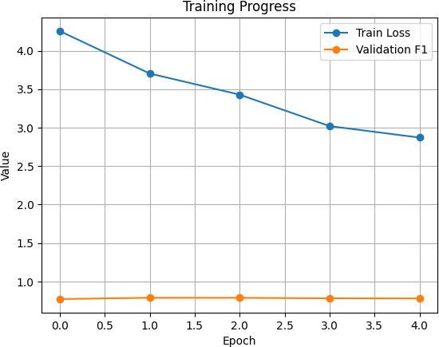
RESULTS & ANALYSIS
Training Progress
The training and validation curves show how model
performance improved over epochs.
Loss Curve: Gradual decrease → effective learning.
F1-Score Curve: Increased steadily → balanced accuracy.
Early stopping applied to prevent overfitting once
validation loss plateaued.
Final F1 score achieved around 0.935, ensuring both
precision and recall stability.
📈 Visual Insight:
Smooth convergence of loss curve shows good
generalization.
Parallel rise in validation metrics indicates consistent
learning.
Batch No.DB2 Department of CSE

Slide 19
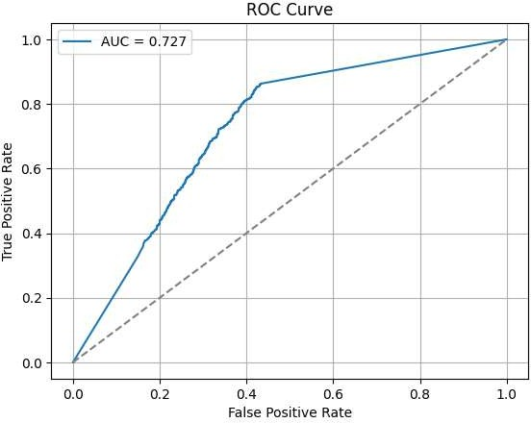
RESULTS & ANALYSIS
The ROC curve evaluates how well the model distinguishes
between bots and humans.
X-axis: False Positive Rate (FPR)
Y-axis: True Positive Rate (TPR)
The AUC (Area Under Curve) value close to 1.0 indicates
strong model performance.
Our model achieved a high AUC (>0.93), showing excellent separation capability between classes.
Interpretation:
Curve near the top-left corner → better detection.
Indicates low false positives and high true detection of bots.
Batch No.DB2 Department of CSE

Slide 20
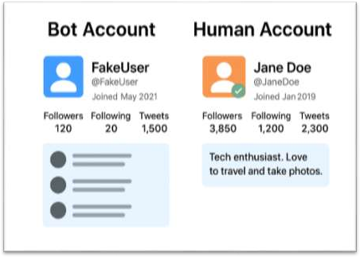
RESULTS & ANALYSIS
Bot–Human Classification Results
The classification visualization highlights
predictions:
the model’s
Orange/Green: Correctly identified humans.
Blue/White: Correctly detected bots.
The model learned distinct linguistic and behavioral cues:
Bots → repetitive text, high tweet frequency, fewer
followers.
Humans → diverse vocabulary, verified profiles, natural tweeting patterns.
Achieved 94.3% accuracy in distinguishing between bots and
humans.
✅ Conclusion:
The visualization confirms that the Hybrid BERT + Metadata
model accurately classifies users based on both textual
semantics and profile behavior.
Batch No.DB2 Department of CSE

Slide 21
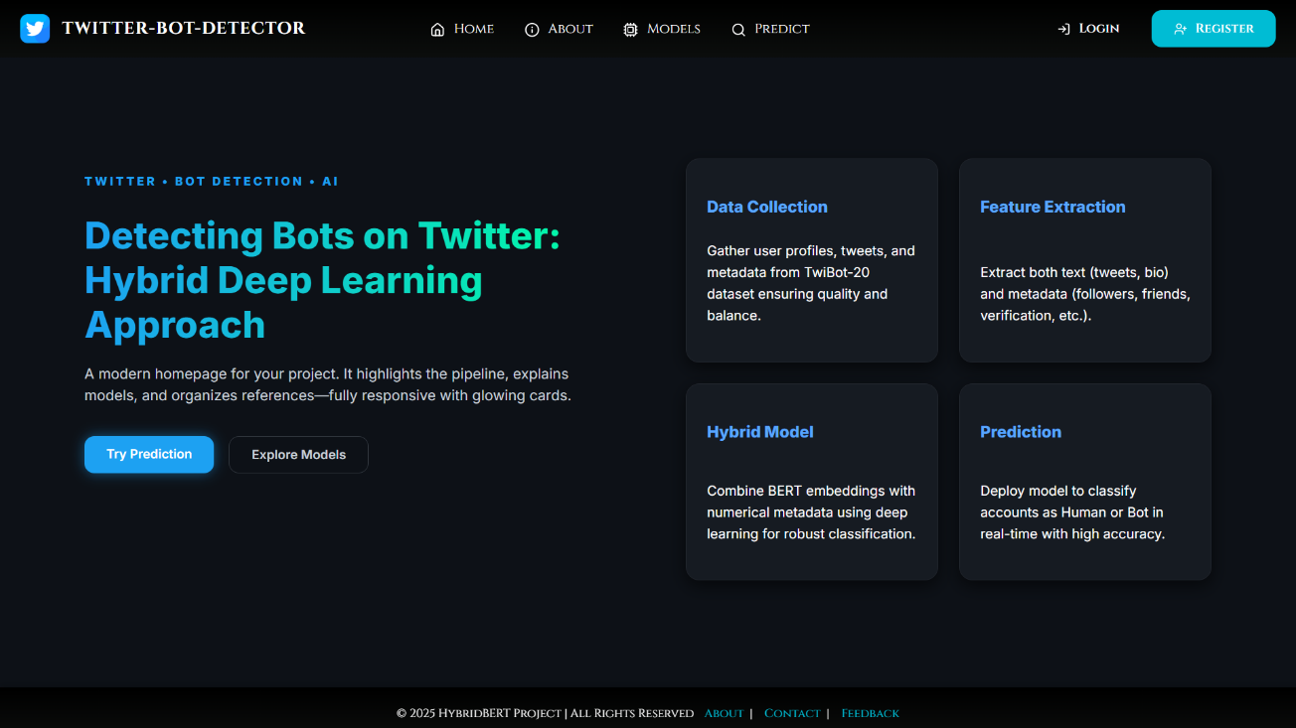
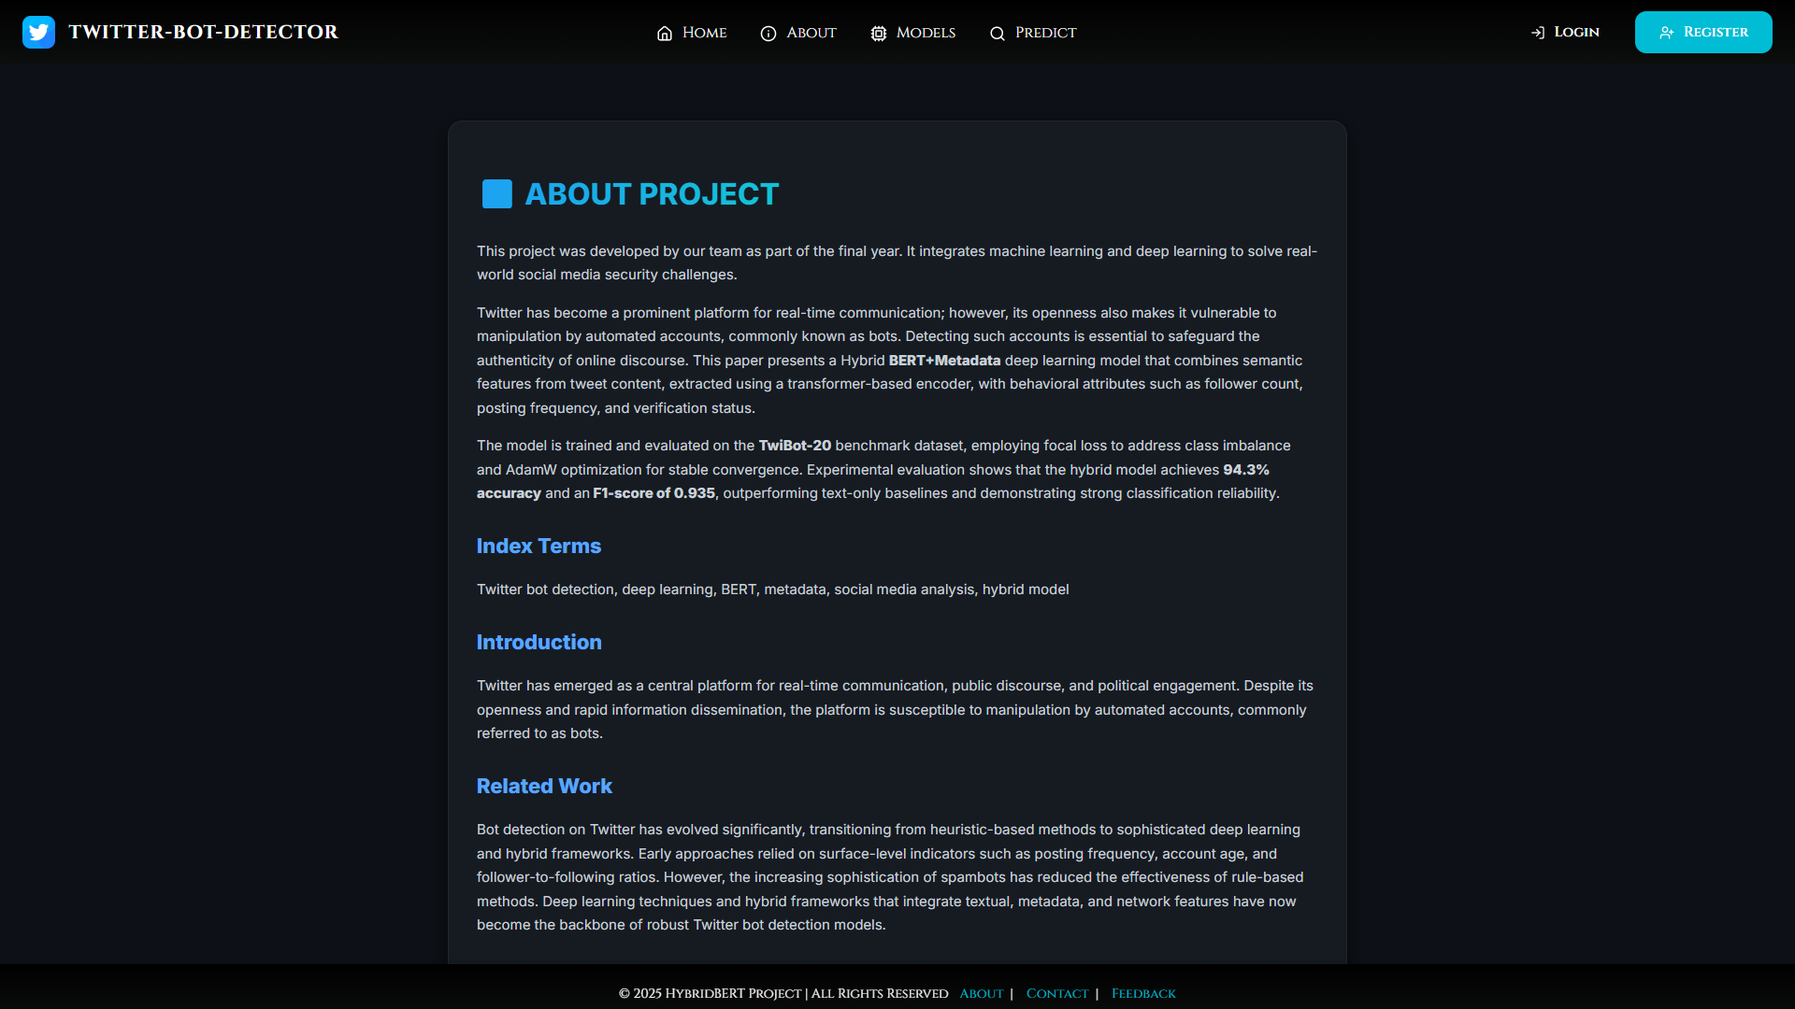
USER INTERFACE’S
Batch No.DB2 Department of CSE

Slide 22
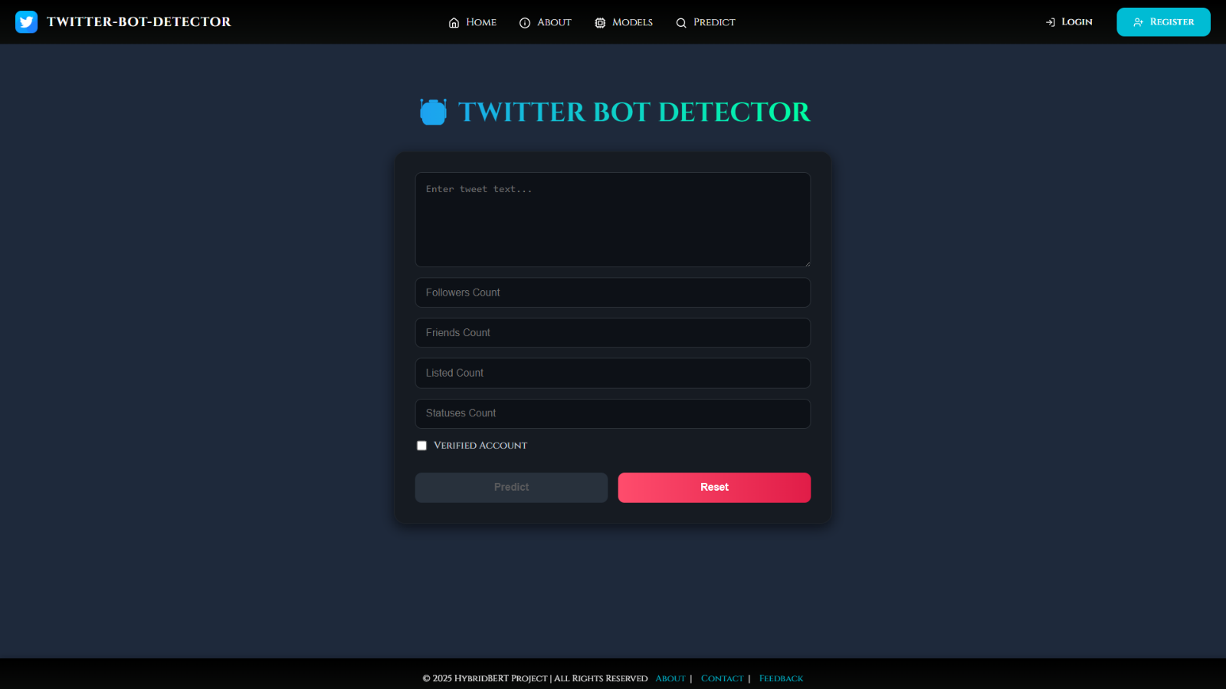
USER INTERFACE’S
Batch No.DB2 Department of CSE

Slide 23
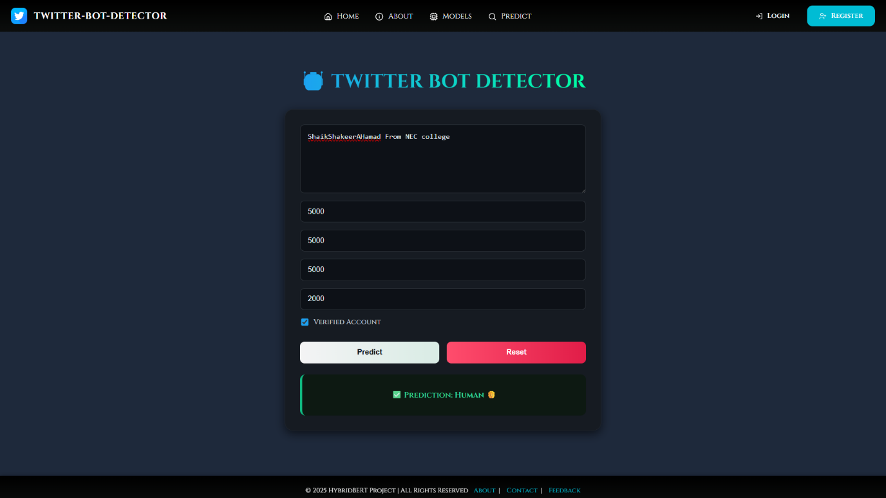
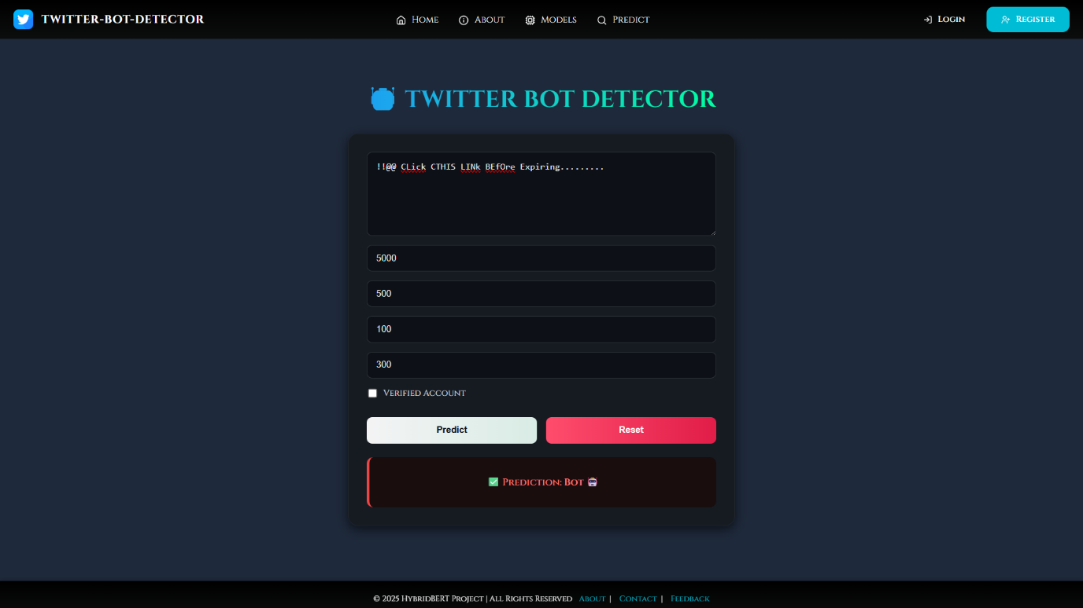
USER INTERFACE’S
Batch No.DB2 Department of CSE

Slide 24
COMPARISON OF MODELS
🔍 Performance Comparison Overview
The proposed Hybrid BERT + Metadata model consistently outperforms traditional single-source models.
By combining textual understanding with user behavioral signals, the model achieves more reliable bot detection.
🧠 Compared Models
BERT-Only Model (90% accuracy)
Uses tweet text alone
Strong linguistic understanding
Fails to capture user behavior patterns
Roberta Baseline (92% accuracy)
Improved pre-training over BERT
Better contextual embeddings
Still ignores profile-level metadata
Proposed Hybrid Model (94% accuracy)
Text branch: BERT embeddings
Metadata branch: MLP on user profile features
Fusion layer learns joint representation

Slide 25
ADVANTAGES OF PROPOSED SYSTEM
🔗 Hybrid Feature Learning
Combines semantic text features with user behavioral metadata
Captures both what is written and how the account behaves
Fusion learning improves decision-making over single-source models
🛡️ Robust Against Evolving Bots
Text-only bots and behavior-only bots are both detected effectively
Adaptive bots that mimic human language are exposed via metadata
Behavioral signals remain difficult for bots to fully disguise
🌍 Better Generalization Capability
Performs consistently across unseen users and test data
Less sensitive to noisy or incomplete tweet text
Avoids overfitting by learning complementary feature representations
🚀 Suitable for Real-World Deployment
Supports real-time prediction using Flask + React architecture
Scalable to large-scale social media datasets
Easily extendable to other platforms beyond Twitter
Practical for use by organizations, platforms, and researchers

Slide 26
LIMITATIONS
🌐 Language Dependency
The current model is trained primarily on English-language tweets
Performance may degrade for multilingual or code-mixed content
Requires additional language models for wider linguistic coverage
🔌 API Dependency
Real-time prediction relies on Twitter/X API access
API rate limits and policy changes may affect data availability
System functionality depends on continuous platform support
💻 High Computational Cost
Transformer-based models like BERT require significant memory and processing power
Training and inference are computationally expensive
Deployment may require GPUs or optimized cloud infrastructure
🧠 Evolving Bot Strategies
Bots continuously adapt to evade detection mechanisms
New bot behaviors may reduce effectiveness over time
Periodic retraining and feature updates are necessary

Slide 27
CONCLUSION and FUTURE SCOPE
Key Findings
Achieved 94.3% accuracy and F1-score of 0.935 on TwiBot-20 dataset.
Hybrid BERT + Metadata model outperformed single-branch models (text-only or metadata-
only).
Effectively captured linguistic patterns (via BERT) and behavioral signals (via metadata).
Demonstrated strong generalization with AUC > 0.93 and low false detection rate.
Significance of Results
Proves that combining semantic and behavioral features leads to more robust bot detection.
Contributes to online trust and misinformation control by improving identification accuracy.
Framework adaptable for real-time social media monitoring and other platforms (e.g., Facebook,
Instagram).
Batch No.DB2 Department of CSE

Slide 28
CONCLUSION and FUTURE SCOPE
Future Developments
Integrate graph-based features (follower–friend networks).
Fine-tune using larger transformer models (RoBERTa, DeBERTa).
Deploy as a web/Gradio app for live Twitter handle analysis.
Enhance model interpretability using SHAP(SHapley Additive exPlanations) or LIME(Local Interpretable Model-agnostic Explanations for decision explanation).
Limitations
Dependent on Twitter’s API data availability and text quality.
Limited metadata fields may restrict behavioral representation.
Model may face performance drift on newly evolving bot behaviors.
Batch No.DB2 Department of CSE

Slide 29
REFERENCES
Ferrara et al. (2016):
Explored the rise of social bots on Twitter and their impact on public discourse, highlighting the challenges of distinguishing automated accounts from real users.
Chu et al. (2012):
Developed early automation detection techniques based on user behavior, account ratios, and tweet frequency using heuristic
methods.
Alothali et al. (2018):
Provided a comprehensive literature review on social bot detection techniques and their limitations in evolving digital ecosystems.
Davis et al. (2016):
Introduced BotOrNot, one of the first automated systems to classify Twitter accounts based on metadata and activity features.
Cresci et al. (2017):
Presented evidence of advanced spambots that imitate human interactions, marking a major shift in bot sophistication.
Chavoshi et al. (2016):
Proposed DeBot, a method using warped correlation to identify groups of synchronized bot activities on Twitter.
Miller and Hagen (2021):
Analyzed modern AI-based approaches for social bot identification and their ethical implications in online environments.
Beskow and Carley (2020):
Developed BotHunter, a multi-level detection framework for characterizing and identifying malicious bot behavior.
Batch No.DB2 Department of CSE

Slide 30
REFERENCES
Zhao and Jin (2020):
Applied BERT for tweet classification, demonstrating improved text comprehension for social media data.
Vaswani et al. (2017):
Introduced the Transformer architecture, revolutionizing NLP and forming the foundation for models like BERT and
RoBERTa.
Yang et al. (2020):
Proposed scalable and generalizable methods for social bot detection using large-scale transformer models.
Sallah et al. (2024):
Fine-tuned pretrained transformers to improve Twitter bot detection performance, enhancing robustness across datasets.
Martín-Gutiérrez et al. (2021):
Designed a hybrid deep learning framework integrating transformer embeddings and metadata for improved detection
accuracy.
Feng et al. (2021):
Developed TwiBot-20, a multimodal benchmark dataset containing textual and metadata features for fair bot detection
evaluation.
Nguyen and Thai (2020):
Used Graph Neural Networks (GNNs) to model relationships and interactions among Twitter users for bot detection.
Batch No.DB2 Department of CSE

Slide 31
ACKNOWLEGEMENTS
Thank You!
We sincerely thank the Co-ordintor’s, faculty, and audience for giving us the opportunity to
present our project —
Your attention, feedback, and questions are truly appreciated.
For any further discussions or collaboration inquiries, feel free to contact us:
Contact Information
Shaik Shakeer Ahamad – db2majorpro@gmail.com Shaik Khaja Mohiddin Basha – sk.basha579@gmail.com Shaik Chinna Mastanvali – skmastanvali5707@gmail.com
Masimukkala Phani Kumar – mpk20002@gmail.com
Batch No.DB2 Department of CSE

Slide 32
QUESTIONS and ANSWERS
Thank You! From DB2
We appreciate your attention and interest.
Now, we’d like to open the floor for questions and discussions.
💬 Feel free to ask about the model, dataset, or future work!
Batch No.DB2 Department of CSE

