Slide 1


CMT ID : 208
ARTICLE TITLE : A COMPARATIVE STUDY OF CNN ARCHITECTURES FOR
MONKEYPOX DETECTION
NAME OF THE PRESENTING AUTHOR : SHAIK SUBHANI
AFFILIATION OF THE PRESENTING AUTHOR : DEPARTMENT OF COMPUTER SCIENCE AND ENGINEERING,
NARASARAOPETA ENGINEERING COLLEGE (AUTONOMOUS),
NARASARAOPET, INDIA
PAPER ID, TITLE AND AUTHOR DETAILS
Notes:
1.7.2013
1.7.2013
1.7.2013
1.7.2013
‹#›
‹#›
‹#›
‹#›

Slide 2
With Monkeypox increasingly becoming a rising public health concern, the demand for rapid, accurate, and convenient diagnostic tools is greater than ever. This paper evaluates the deep learning methods can play in facilitating the early diagnosis of Monkeypox via skin lesion image analysis. We fine-tuned three popular convolutional neural network (CNN) models—EfficientNetV2-S, DenseNet121, and InceptionV3—on a binary classification dataset of Monkeypox and normal skin images. To enhance generalization of models, we employed a variety of data augmentation techniques while training. Further, to provide insight into the predictions of the models, we employed LIME to plot the most mandatory regions of the images that can be used to give to the output.he dataset utilized within this work was selected with care to mimic real-world clinical conditions such that the models could learn from varied visual patterns. Explainability is also a focus of our approach, which is essential in developing trust in AI-influenced medical aids. The models are only need image inputs, and thus they are deployable for mobile or remote healthcare use.
ABSTRACT
Notes:
1.7.2013
1.7.2013
1.7.2013
1.7.2013
‹#›
‹#›
‹#›
‹#›

Slide 3
INTRODUCTION
Monkeypox detection through skin lesion images is a fast, non-invasive, and accessible diagnostic approach.
A CNN-based transfer learning model is proposed to automatically extract discriminative features for Monkeypox diagnosis.
The model integrates data augmentation, fine-tuning, and LIME explainability to enhance accuracy, robustness, and interpretability.
In this study, we examine and contrast the effectiveness of three top-performing CNN architectures for the binary classification of monkeypox versus normal skin: InceptionV3, DenseNet121, and EfficientNetV2-S.
Key features: lesion color, texture, and shape are vital for accurate classification and feature extraction.
Notes:
1.7.2013
1.7.2013
1.7.2013
1.7.2013
‹#›
‹#›
‹#›
‹#›

Slide 4
PROBLEM STATEMENT
Existing models are trained on small, non-clinical Monkeypox datasets, limiting their ability to generalize across different skin tones and lesion types.
Most studies are retrospective, without validation on independent or real-world clinical images.
GAN-generated or augmented images are heavily used to compensate for limited data, which may not accurately represent true lesion characteristics.
The lack of large, clinically verified datasets restricts robustness and scalability for deployment in healthcare environments.
Current deep learning models often struggle under variable lighting, noise, and real clinical image quality.
There is a need for an interpretable and efficient CNN-based system capable of accurately detecting Monkeypox from diverse skin images in real time.
Notes:
1.7.2013
1.7.2013
1.7.2013
1.7.2013
‹#›
‹#›
‹#›
‹#›

Slide 5
OBJECTIVES
Our Research work aims to :
Develop CNN-based deep learning models (EfficientNetV2-S, DenseNet121, InceptionV3) for accurate Monkeypox detection from skin lesion images.
Enhance model generalization using advanced data augmentation and transfer learning techniques.
Incorporate LIME-based explainability to highlight lesion regions influencing model predictions, ensuring interpretability and clinical trust.
Compare model performance using metrics such as Accuracy, Precision, Recall, and F1-Score.
Design a lightweight and deployable solution suitable for mobile or remote healthcare environments.
Notes:
1.7.2013
1.7.2013
1.7.2013
1.7.2013
‹#›
‹#›
‹#›
‹#›

Slide 6
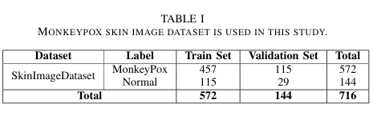
METHODOLOGY
1. Dataset :
We used a publicly accessible dataset of images of monkeypox that was divided into two categories: normal and monkeypox. The dataset was divided in an 80/20 ratio between train and validation sets. Prior to training, all images were normalized to scale pixel values to 0 and 1 and resized to the input size each model requires (e.g., 224×224 pixels).
The dataset can be used for valuable benchmark for monkeypox detection, it’s in small size (716 images) may limit the generalizability of the models to larger clinical scenarios. Future work will be focused on expanding the dataset through collaboration with medical institutions or public health repositories, and incorporating external validation to strengthen the robustness of the findings.
Notes:
1.7.2013
1.7.2013
1.7.2013
1.7.2013
‹#›
‹#›
‹#›
‹#›

Slide 7
2. Data Preprocessing :
Before training, all images were preprocessed to ensure uniformity and compatibility across models.
This step prepares raw input data for efficient learning and stable model convergence.
Preprocessing Steps Applied:
Image Resizing:
All images resized to 224 × 224 pixels to match the input dimensions required by EfficientNetV2-S, DenseNet121, and InceptionV3.
2) Normalization:
Pixel values scaled between 0 and 1 to standardize input intensity and speed up training.
3) Dataset Splitting:
Images divided into 80% training and 20% validation sets for balanced evaluation.
4) Label Encoding:
Classes converted into binary labels → Monkeypox (1) and Normal (0).
Notes:
1.7.2013
1.7.2013
1.7.2013
1.7.2013
‹#›
‹#›
‹#›
‹#›

Slide 8
3. Data Augmentation :
For this project, we didn’t reinvent the wheel. Instead, we fired up Keras Image Data Generator—think of it as Photoshop on autopilot, dicing up your images with new looks on the fly. So as the model trains, it’s getting hit with a parade of fresh, slightly tweaked pictures. Keeps things interesting, keeps the model on its toes. Here’s the menu of augmentations we served up:
1) RESCALING: Input img pixel values were all rescaled to [0, 1] by dividing each value by 255.
2) RANDOM ROTATIONS: The Images are rotated in a random manner so that it is clear to identify the image.
3) ZOOMING: A 20 percent zoom was imposed to mimic differences in the distance or closeness the lesion is viewed in each photo so that patterns at various scales can be identified by the model.
4) HORIZONTAL FLIPPING: Horizontal random flips were applied in order to incorporate more variability and make the model understand that the side of a lesion (left or right) should not influence the prediction. These above steps were only implemented in the training data only keeping the validation set not changes . The utilization of augmentation greatly improved the generalization capability of the model, especially on a small or slightly unbalanced dataset. By enlarging the variety of inputs, the models were more capable of dealing with unknown skin lesion images during test and deployment.
Notes:
1.7.2013
1.7.2013
1.7.2013
1.7.2013
‹#›
‹#›
‹#›
‹#›

Slide 9
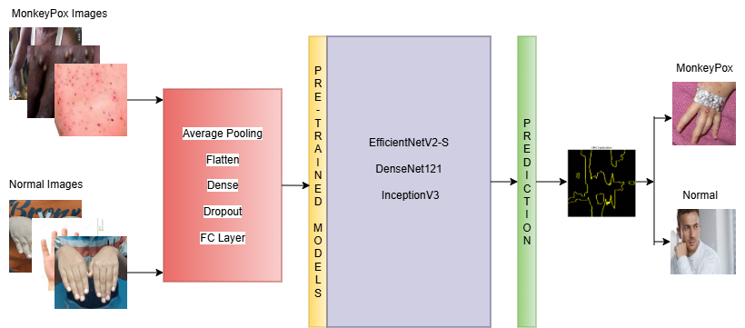
4. Model Architecture :
This diagram shows the complete pipeline — from input images, through custom layers and pre-trained CNN models, to the final
Monkeypox prediction.
LIME
Notes:
1.7.2013
1.7.2013
1.7.2013
1.7.2013
‹#›
‹#›
‹#›
‹#›

Slide 10
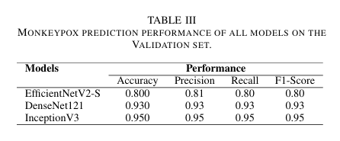
RESULTS AND ANALYSIS
MODELS AND PERFORMANCE :
1. EfficientNetV2-S
Purpose: A compact and efficient CNN architecture used for image classification and transfer learning.
2. DenseNet121
Purpose: A densely connected CNN where each layer receives inputs from all previous layers, promoting feature reuse.
3.InceptionV3
Purpose: A deep CNN model optimized for multi-scale feature extraction using parallel convolution filters.
Notes:
1.7.2013
1.7.2013
1.7.2013
1.7.2013
‹#›
‹#›
‹#›
‹#›

Slide 11
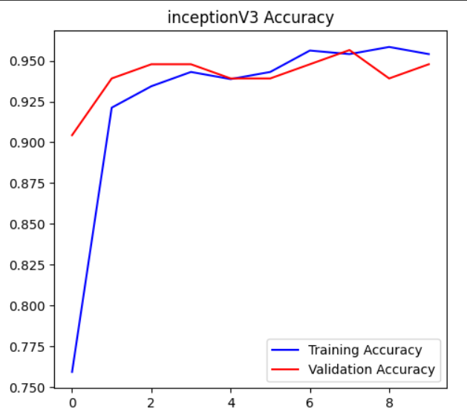
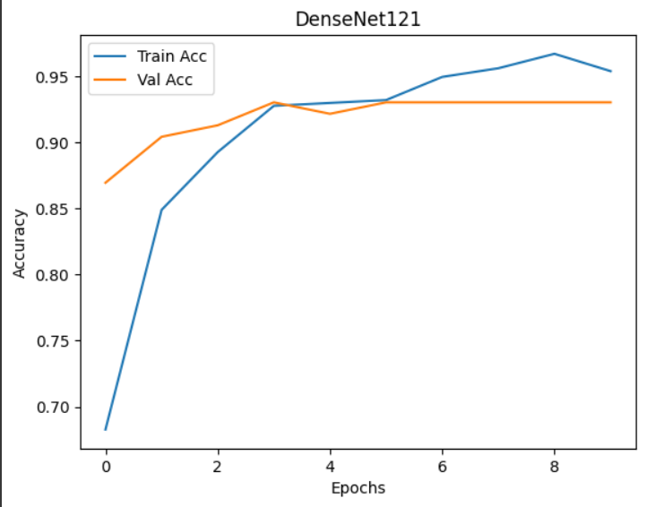
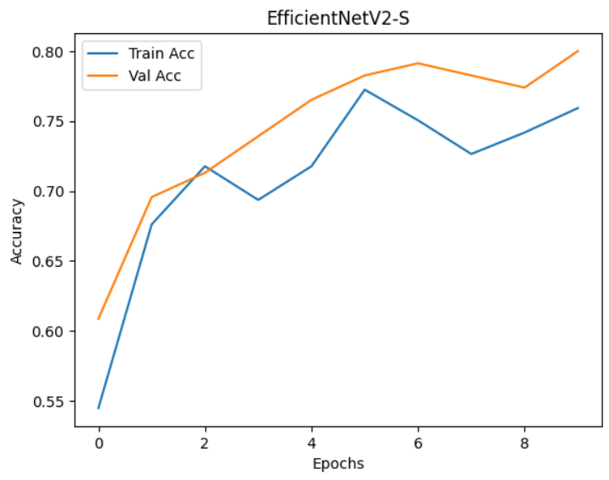
1. InceptionV3 : Achieved 95.0 % accuracy, 0.95 F1-score — top performer among all evaluated architectures.
2. DenseNet121 : Achieved 93.0 % accuracy, 0.93 F1-score — highly reliable model for clinical-grade detection.
3. EfficientNetV2-S : Achieved 80.0 % accuracy, 0.81 F1-score — lightweight and ideal for mobile deployment.
Notes:
1.7.2013
1.7.2013
1.7.2013
1.7.2013
‹#›
‹#›
‹#›
‹#›

Slide 12
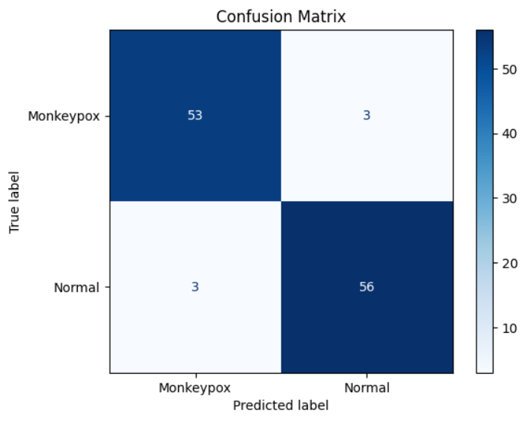
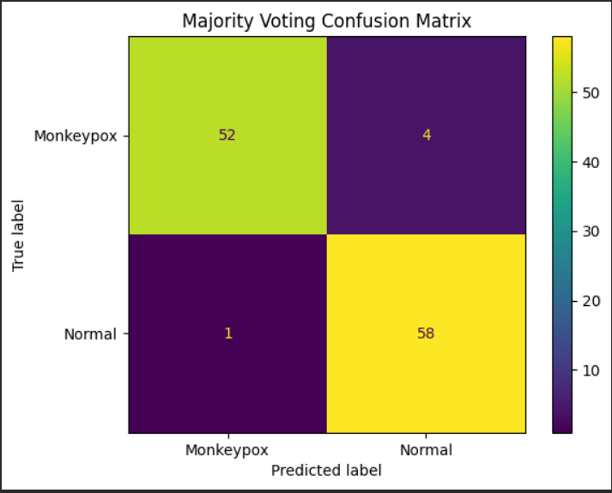
Out of 115 test images, our model correctly predicted 109. It identifies Monkeypox and Normal cases with very high accuracy, making only six minor errors.
Confusion Matrix of Majority Voting Predicted well.
Notes:
1.7.2013
1.7.2013
1.7.2013
1.7.2013
‹#›
‹#›
‹#›
‹#›

Slide 13
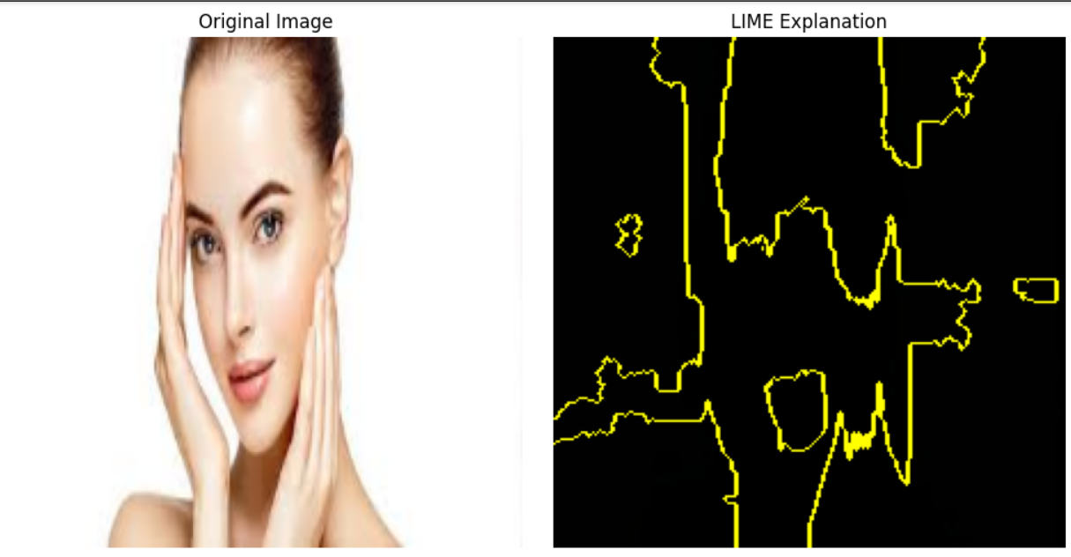
LIME :
LIME (Local Interpretable Model-agnostic Explanations) explains why a model made a specific decision for an individual case.
Why it matters:
Gives us a simple, understandable explanation for each prediction.
Explains individual predictions (one image at a time) rather than the model as a whole.
Divides an image into small regions (called superpixels) and studies how each region affects the prediction.
Notes:
1.7.2013
1.7.2013
1.7.2013
1.7.2013
‹#›
‹#›
‹#›
‹#›

Slide 14
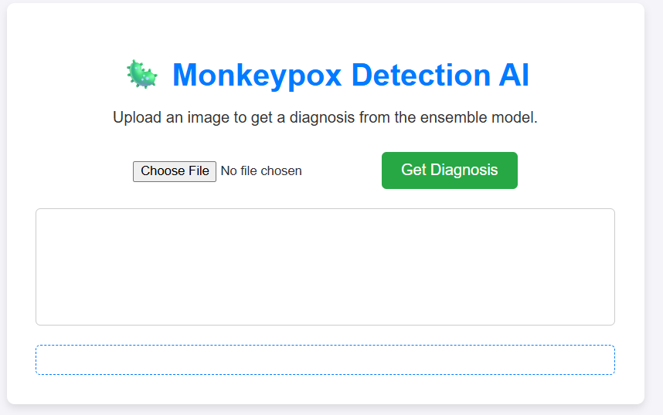
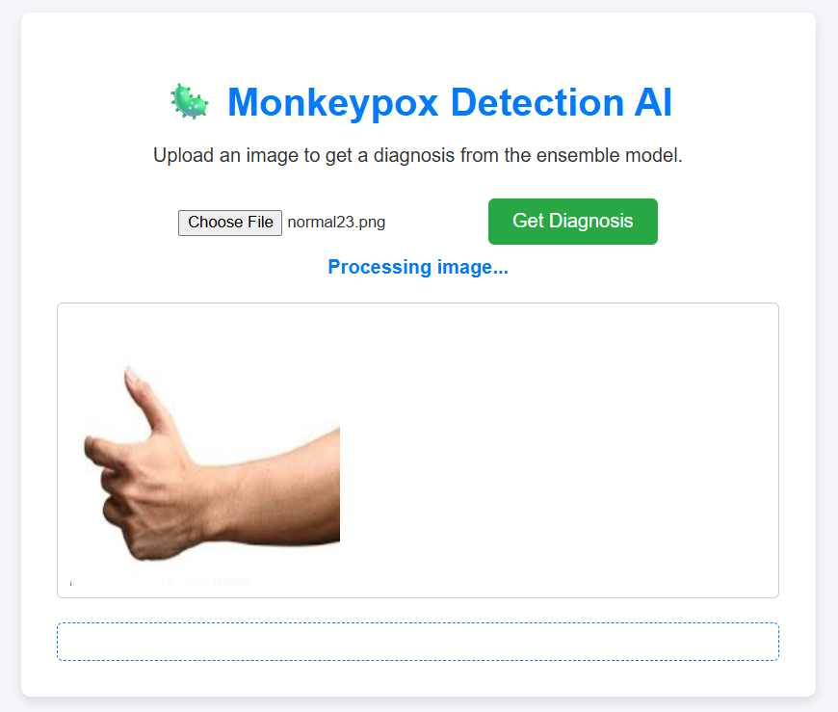
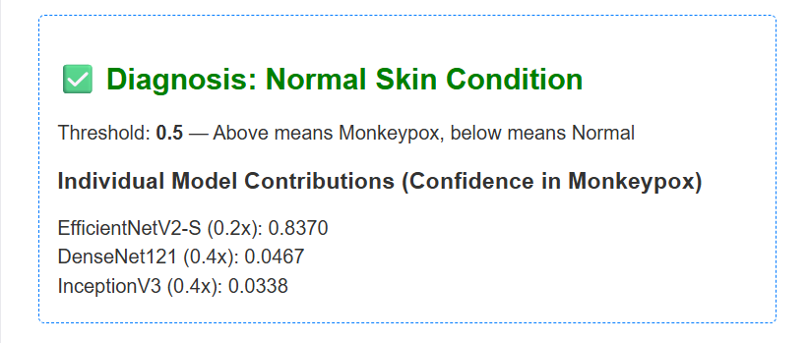
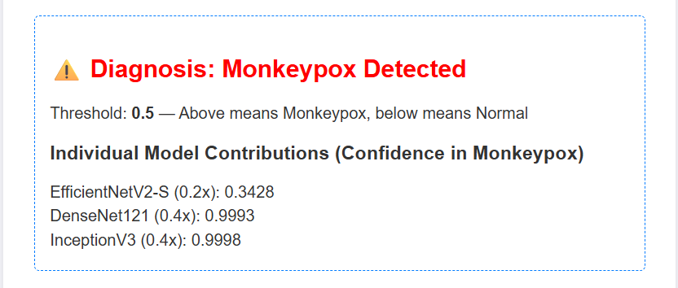
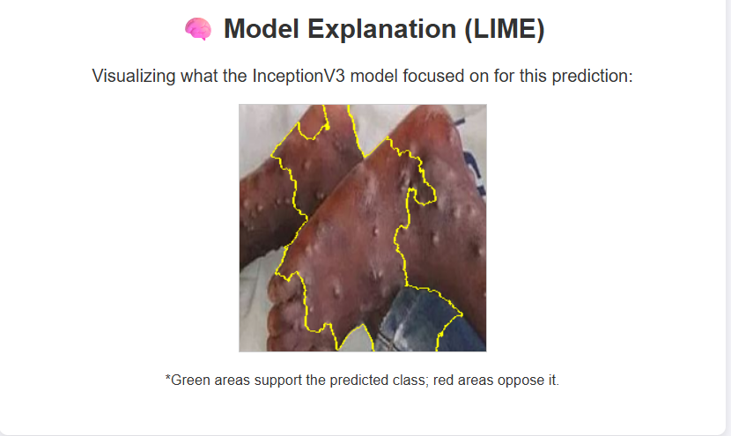
OUTPUT SCREENS :
Notes:
1.7.2013
1.7.2013
1.7.2013
1.7.2013
‹#›
‹#›
‹#›
‹#›

Slide 15
CONCLUSION AND FUTURE SCOPE
Conclusion:
The study successfully implemented three CNN architectures — EfficientNetV2-S, DenseNet121, and InceptionV3 — for Monkeypox detection using skin lesion images.
Among the models, InceptionV3 achieved the highest accuracy (95%), followed closely by DenseNet121 (93%), proving their strong diagnostic capability.
LIME explainability provided clear visualization of lesion regions influencing predictions, enhancing clinical trust and transparency.
The proposed approach demonstrates that AI-driven models can serve as reliable decision-support tools for early Monkeypox screening, especially in low-resource or remote areas.
Future Work:
Expand dataset size with diverse, clinically verified Monkeypox and Normal images to improve generalization.
Integrate real clinical testing through collaboration with hospitals and medical professionals.
Develop a mobile or web-based diagnostic app for real-time skin lesion analysis.
Notes:
1.7.2013
1.7.2013
1.7.2013
1.7.2013
‹#›
‹#›
‹#›
‹#›

Slide 16
We express our heartfelt gratitude to our project guide, Mr. Mothe Sathyam Reddy, for his continuous guidance, motivation, and
valuable insights throughout the course of this research work.
We also extend our sincere thanks to our project co-ordinators, Dr. Syed Rizwana and Dr. Moturi Sireesha, for their constant
support and encouragement.
We are grateful to the Department of Computer Science and Engineering, Narasaraopeta Engineering College
(Autonomous), for providing the necessary facilities and resources to successfully complete this study.
We would also like to acknowledge our team members — Kotte Naresh Babu, V. Manasa, and Ambidi Naveena — for their
contributions and collaborative effort.
Finally, we thank the organizers of INCOWOCO for providing us the opportunity to present our work at this prestigious
conference.
ACKNOWLEDGMENT
Notes:
1.7.2013
1.7.2013
1.7.2013
1.7.2013
‹#›
‹#›
‹#›
‹#›

Slide 17
REFERENCES :
[1] D. Kundu et al., ”Federated DL for Monkeypox Disease Detection on GAN-Augmented Dataset,” IEEE Access, vol. 12, pp. 32819–32829, 2024, doi: 10.1109/ACCESS.2024.3370838.
[2] Deepa, P. R. Shetty, P. S. Shetty, S. Namita and Sahana, ”Au tomated Classification of Monkeypox Disease based on DL,” in Proc. 8th Int. Conf. on Electronics, Communication and Aerospace Technology (ICECA), Coimbatore, India, 2024, pp. 1186–1190, doi: 10.1109/ICECA63461.2024.10801171.
[3] M. E. Haque, M. R. Ahmed, R. S. Nila and S. Islam, ”Human Monkeypox Disease Detection Using DL and Attention Mechanisms,” in Proc. 25th Int. Conf. on Computer and Information Technology (IC CIT), Cox’s Bazar, Bangladesh, 2022, pp. 1069–1073, doi: 10.1109/IC CIT57492.2022.10055870.
[4] R. Dhiman et al., ”Deep Learning Based Monkeypox Virus De tection Model Using Skin Lesion Images,” in Proc. 4th Int. Conf. on Technological Advancements in Computational Sciences (IC TACS), Tashkent, Uzbekistan, 2024, pp. 1362–1366, doi: 10.1109/IC TACS62700.2024.10840698.
[5] A. V. Kottath and M. Malarvel, ”Comparison Of Deep Learn ing Models for Monkeypox Disease Detection,” in Proc. 1st Int. Conf. on Advances in Electrical, Electronics and Computational Intelligence (ICAEECI), Tiruchengode, India, 2023, pp. 1–8, doi: 10.1109/ICAEECI58247.2023.10370981.
Notes:
1.7.2013
1.7.2013
1.7.2013
1.7.2013
‹#›
‹#›
‹#›
‹#›

