Slide 1

Department of Computer Science and Engineering
A Comparative Study of CNN Architectures for Monkeypox Detection
PRESENTED BY
Shaik Subhani Kotte Naresh Babu
(23475A0503) (23475A0505)
Under the Guidance of,
Mothe Sathyam Reddy _{B.Tech, M.Tech}
Assistant Professor,
Department of Computer Science and Engineering,
Narasaraopeta Engineering College (Autonomous), Narasaraopet- 522601.
11/11/2025
Review No.1
Batch No.DB4
Department of CSE
1

Slide 2
OUTLINE
Abstract
Introduction
Literature Survey
Research Gaps
Problem Statement
Objectives
Block Diagram / Flow Diagram
Methodology
Implementation
Results and Analysis
Conclusion & Future Scope
References
Question and Answers
Acknowledgements
Review No. 1

Slide 3
ABSTRACT
With Monkeypox increasingly becoming a rising public health concern, the demand for rapid, accurate, and convenient diagnostic tools is greater than ever. This paper evaluates the deep learning methods can play in facilitating the early diagnosis of Monkeypox via skin lesion image analysis. We fine-tuned three popular convolutional neural network (CNN) models—EfficientNetV2-S, DenseNet121, and InceptionV3—on a binary classification dataset of Monkeypox and normal skin images. To enhance generalization of models, we employed a variety of data augmentation techniques while training. Further, to provide insight into the predictions of the models, we employed LIME to plot the most mandatory regions of the images that can be used to give to the output. InceptionV3 showed the best accuracy and F1-score among the models examined, with good performance in the dif ferentiation of Monkeypox-infected lesions. The dataset utilized within this work was selected with care to mimic real-world clinical conditions such that the models could learn from varied visual patterns. Explainability is also a focus of our approach, which is essential in developing trust in AI-influenced medical aids. The models are only need image inputs, and thus they are deployable for mobile or remote healthcare use.
Review No. 1

Slide 4
INTRODUCTION
Monkeypox detection through skin lesion images is a fast, non-invasive, and accessible diagnostic approach.
Key features: lesion color, texture, and shape are vital for accurate classification and feature extraction.
Traditional methods (manual or rule-based image analysis) perform well on simple cases but fail under noise, lighting variation, and skin diversity.
A CNN-based transfer learning model is proposed to automatically extract discriminative features for Monkeypox diagnosis.
The model integrates data augmentation, fine-tuning, and LIME explainability to enhance accuracy, robustness, and interpretability.
In this study, we examine and contrast the eﬀectiveness of three top-performing CNN architectures for the binary classification of monkeypox versus normal skin: InceptionV3, DenseNet121, and EﬃcientNetV2-S.
Review No. 1
4

Slide 5
LITERATURE SURVEY
No | Title | Author | Journal Name & Year | Methodology Adapted | Key Findings | Gaps
1 | Automated Classification of Monkeypox Disease based on Deep Learning | Prajna S Shetty, S Namita. | https://ieeexplore.ieee.org/ document/10801171 | Images were resized and normalized. Augmentation techniques like rotation. | Evaluated the performance of ResNet50, and VGG16 on the dataset. | Dataset was small and may not generalize well to all skin tones and lesion variations.
2 | Detection Of Monkeypox Disease Using Deep Learning Techniques | G. Arun, Ss Tharun Vikas. | https://ieeexplore.ieee.org/ document/10688010 | Data Augmentation Techniques, Balanced Dataset Creation. | Explainable AI (LIME & Grad-CAM) were integrated | Non-clinical dataset with limited size
3 | Mpoxnet: Detection of Monkeypox using Deep Learning in Digital Skin Images | Vandana, Chetna Sharma. | https://ieeexplore.ieee.org/ document/10984329 | Standard Cleaning and Augmentation. | High Accuracy with MobileNetV2. | Most evaluations are retrospective.
4 | Systematic Study of Deep Learning Models for Image-Based Detection of Monkeypox Virus | Vanessa Melencian | https://ieeexplore.ieee.org/ document/10528817 | Hybrid CNN–LSTM Model | Improved Skin lesion dataset. | no testing on clinical or independently sourced images.
5 | Federated Deep Learning for Monkeypox Disease Detection | Md. Mahbubur Rahman, | https://ieeexplore.ieee.org/ document/10445472 | Image Resizing & color Format Standardization. | ViT-B32 + FL + GAN combo achieved the highest accuracy of 97.90%. | Real monkeypox images heavily reliant on GAN-generated data. ⁵
Review No. 1
Batch No. DB4
Department of CSE

Slide 6
LITERATURE SURVEY
★ “Automated Classification of Monkeypox Disease Based on Deep Learning” –
CNN-based system for automatic skin lesion classification; gap: limited testing on diverse real-world images.
★ “Detection of Monkeypox Disease Using Deep Learning Techniques” –
Comparative evaluation of pre-trained CNNs; gap: lacks model interpretability and explainability.
★ “MpoxNet: Detection of Monkeypox Using Deep Learning in Digital Skin Images” –
Lightweight CNN optimized for mobile deployment; gap: lower accuracy on complex lesion patterns.
★ “Systematic Study of Deep Learning Models for Image-Based Detection of Monkeypox Virus” – Benchmarking of multiple CNNs for Monkeypox classification; gap: models struggle with small dataset variability.
★ “Federated Deep Learning for Monkeypox Disease Detection” –
Distributed model training approach ensuring data privacy; gap: high communication cost and lower convergence speed.
Review No. 1
Batch No.DB4
Department of CSE
6

Slide 7
RESEARCH GAPS
Automated Classification of Monkeypox Disease Based on Deep Learning – Deepa et al.
  Dataset small and non-clinical; limited representation of diverse skin tones.
  May not generalize well to real-world lesion variations.
Detection of Monkeypox Disease Using Deep Learning Techniques – Arumugam et al.
  Evaluation limited to retrospective datasets.
  No testing on independent or clinical image sources.
MpoxNet: Detection of Monkeypox Using Deep Learning in Digital Skin Images – Vandana et al.
  Relies heavily on GAN-generated and augmented images.
  Lightweight model trades accuracy for computational eﬃciency.
Systematic Study of Deep Learning Models for Image-Based Detection of Monkeypox Virus – Llamas et al.
  Focused on benchmark comparison; lacks real-world validation.
  Models struggle with variations in lighting, skin tone, and lesion type.
Federated Deep Learning for Monkeypox Disease Detection – Kundu et al.
  Communication overhead and slow convergence in distributed settings.
  Performance dependent on data quality and device heterogeneity.
7
Review No.1
Batch No. DB4
Department of CSE

Slide 8
PROBLEM STATEMENT
Existing models are trained on small, non-clinical Monkeypox datasets, limiting their ability to generalize across diﬀerent skin tones and lesion types.
Most studies are retrospective, without validation on independent or real-world clinical images.
GAN-generated or augmented images are heavily used to compensate for limited data, which may not accurately represent true lesion characteristics.
The lack of large, clinically verified datasets restricts robustness and scalability for deployment in healthcare environments.
Current deep learning models often struggle under variable lighting, noise, and real clinical image quality.
There is a need for an interpretable and eﬃcient CNN-based system capable of accurately detecting Monkeypox from diverse skin images in real time.
Review No. 1

Slide 9
OBJECTIVES
Our Research work aims to :
Develop CNN-based deep learning models (EﬃcientNetV2-S, DenseNet121, InceptionV3) for accurate Monkeypox detection from skin lesion images.
Enhance model generalization using advanced data augmentation and transfer learning techniques.
Incorporate LIME-based explainability to highlight lesion regions influencing model predictions, ensuring interpretability and clinical trust.
Compare model performance using metrics such as Accuracy, Precision, Recall, and F1-Score.
Design a lightweight and deployable solution suitable for mobile or remote healthcare environments.
Review No. 1

Slide 10
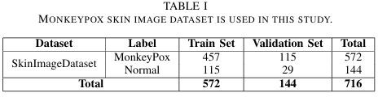
Dataset :
We used a publicly accessible dataset of images of monkeypox that was divided into two categories: normal and monkeypox. The dataset was divided in an 80/20 ratio between train and validation sets. Prior to training, all images were normalized to scale pixel values to 0 and 1 and resized to the input size each model requires (e.g., 224×224 pixels).
The dataset can be used for valuable benchmark for monkeypox detection, it’s in small size (716 images) may limit the generalizability of the models to larger clinical scenarios. Future work will be focused on expanding the dataset through collaboration with medical institutions or public health repositories, and incorporating external validation to strengthen the robustness of the findings.
Review No. 1

Slide 11
Data Augmentation (Happens during Training) :
For this project, we didn’t reinvent the wheel. Instead, we fired up Keras Image Data Generator—think of it as Photoshop on autopilot, dicing up your images with new looks on the fly. So as the model trains, it’s getting hit with a parade of fresh, slightly tweaked pictures. Keeps things interesting, keeps the model on its toes. Here’s the menu of augmentations we served up:
RESCALING: Input img pixel values were all rescaled to [0, 1] by dividing each value by 255.
RANDOM ROTATIONS: The Images are rotated in a random manner so that it is clear to identify the image.
ZOOMING: A 20 percent zoom was imposed to mimic diﬀerences in the distance or closeness the lesion is viewed in each photo so that patterns at various scales can be identified by the model.
HORIZONTAL FLIPPING: Horizontal random flips were applied in order to incorporate more variability and make the model understand that the side of a lesion (left or right) should not influence the prediction. These above steps were only implemented in the training data only keeping the validation set not changes . The utilization of augmentation greatly improved the generalization capability of the model, especially on a small or slightly unbalanced dataset. By enlarging the variety of inputs, the models were more capable of dealing with unknown skin lesion images during test and deployment.
Review No. 1

Slide 12
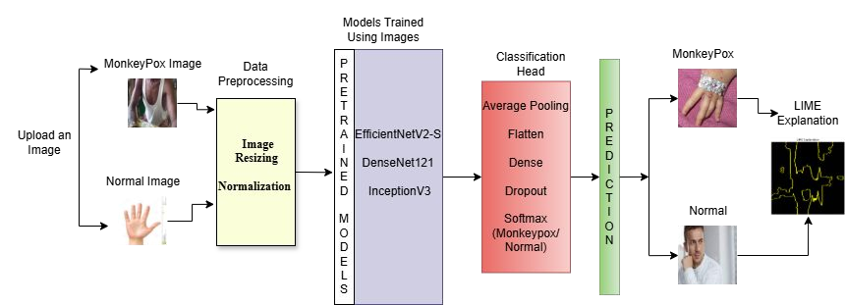
BLOCK DIAGRAM OR FLOW DIAGRAM
Review No.1
Batch No.DB4
Department of CSE
12

Slide 13
METHODOLOGY
Overview :
Data Preprocessing :
Before training, all images were preprocessed to ensure uniformity and compatibility across models. This step prepares raw input data for eﬃcient learning and stable model convergence.
Preprocessing Steps Applied:
  Image Resizing:
    All images resized to 224 × 224 pixels to match the input dimensions required by EﬃcientNetV2-S, DenseNet121, and InceptionV3.
Normalization:
  Pixel values scaled between 0 and 1 to standardize input intensity and speed up training.
Review No.1
Batch No. DB4
Department of CSE
13

Slide 14
2. Model Selection and Development :
EﬃcientNetV2-S
  Purpose: A compact and eﬃcient CNN architecture used for image classification and transfer learning.
  Strength: Balances accuracy and speed; suitable for mobile or low-power devices while maintaining strong performance.
  Training Details: Pretrained on ImageNet and fine-tuned on Monkeypox dataset.
  Result: Achieved 80.0 % accuracy, 0.81 F1-score — lightweight and ideal for mobile deployment.
DenseNet121
□ Purpose: A densely connected CNN where each layer receives inputs from all previous layers, promoting feature reuse.
  Strength: Excellent feature extraction and gradient flow, prevents vanishing gradients in deep networks.
  Training Details: Fine-tuned with transfer learning using same preprocessing pipeline.
  Result: Achieved 93.0 % accuracy, 0.93 F1-score — highly reliable model for clinical-grade detection.
Review No. 1

Slide 15
InceptionV3
  Purpose: A deep CNN model optimized for multi-scale feature extraction using parallel convolution filters.
  Strength: Captures both fine and coarse lesion features; strong generalization on unseen data.
  Training Details: Transfer learning with fine-tuning on Monkeypox dataset.
  Result: Achieved 95.0 % accuracy, 0.95 F1-score — top performer among all evaluated architectures.
Review No. 1

Slide 16
3. Classification Head :
AveragePooling2D
  Reduces spatial dimensions of feature maps
  Keeps most important visual information
  Helps prevent overfitting
Flatten Layer
  Converts pooled feature maps into a 1-D vector
  Makes data compatible with Dense layers
Dense Layer
  Learns task-specific lesion patterns
  Extracts high-level features for classification
Review No.1
Batch No. DB4
Department of CSE
16

Slide 17
Dropout (0.5)
  Randomly drops 50% neurons during training
  Prevents overfitting
  Improves generalization
Output Dense Layer (Softmax)
  Produces two probabilities:
    Monkeypox
    Normal
  Chooses the class with highest probability
  Ensures output sums to 1
Review No. 1

Slide 18
4. Prediction :
Decision Threshold :
Threshold = 0.5
If final score > 0.5 → Monkeypox
If final score ≤ 0.5 → Normal
Ensemble Decision :
The final prediction is based on weighted outputs from three models
Combined weighted confidence indicates Monkeypox
Review No. 1

Slide 19
How the Ensemble Works :
Each model produces its Monkeypox probability
A weighted average is calculated:
  EﬃcientNet = 0.2
  DenseNet = 0.4
  Inception = 0.4
Final combined score > threshold → Monkeypox
Review No. 1

Slide 20
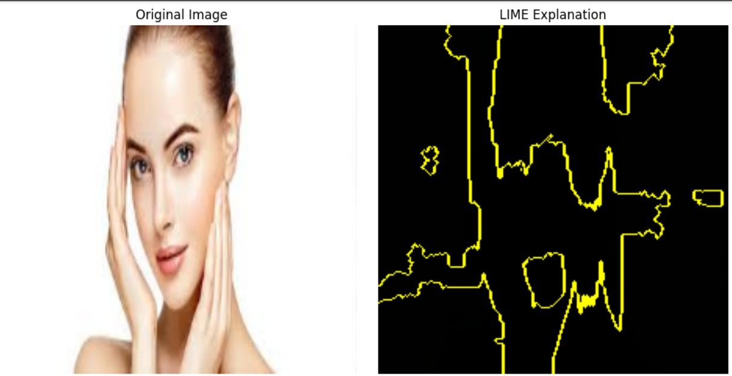
5. LIME :
LIME (Local Interpretable Model-agnostic Explanations) explains why a model made a specific decision for an individual case.
Why it matters:
Gives us a simple, understandable explanation for each prediction.
Explains individual predictions (one image at a time) rather than the model as a whole.
Divides an image into small regions (called superpixels) and studies how each region aﬀects the prediction.
Review No.1
20

Slide 21
MonkeyPox Prediction Web Application Integration:
Technologies Used:
Frontend: HTML, CSS, JavaScript (User interface for input and display)
Backend: Flask (Handling model integration and data processing)
DeepLearning: InceptionV3, DenseNet121, and EﬃcientNetV2-S (Prediction models)
Interpretability Tools: LIME (Explaining predictions)
How It Works:
User uploads a skin image (Monkeypox or Normal).
Preprocessing & Data Augmentation steps resize, normalize, and enhance the image for model compatibility.
The image is passed through the trained CNN model (EﬃcientNetV2-S, DenseNet121, or InceptionV3).
The model predicts whether the lesion indicates Monkeypox or Normal skin.
LIME generates an explainability heatmap, showing which regions of the image influenced the model’s decision.
Clinicians or users can visually verify that the prediction focuses on relevant lesion areas — improving trust and transparency in AI-based diagnosis.
Review No. 1
21

Slide 22
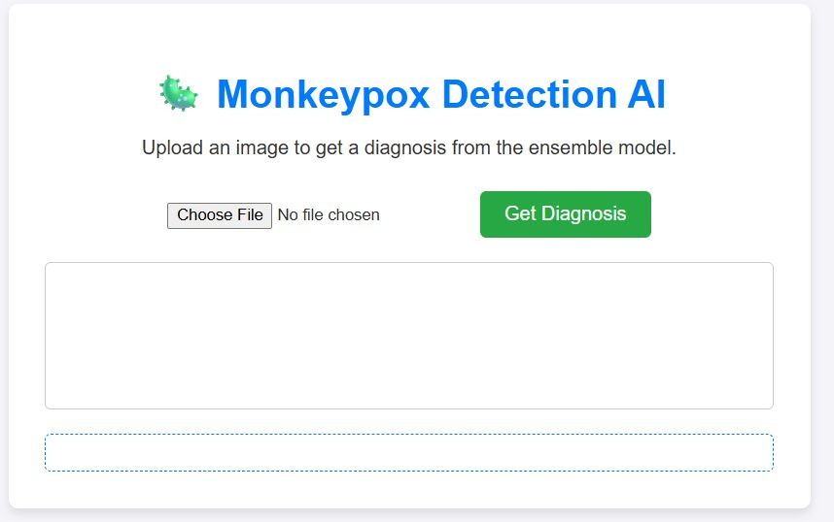
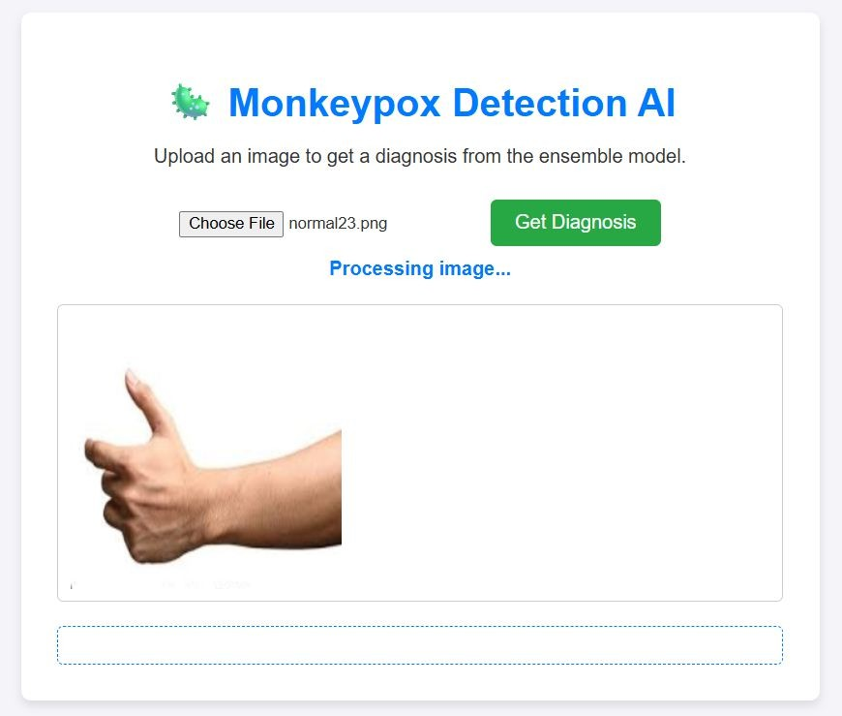
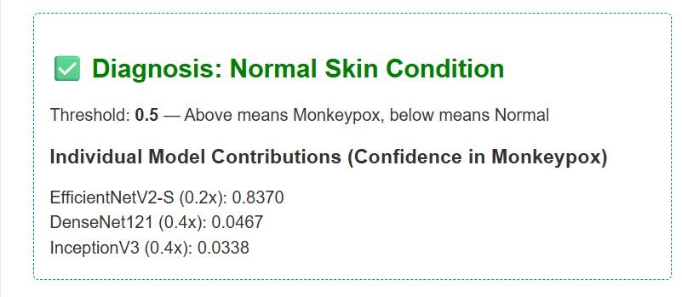
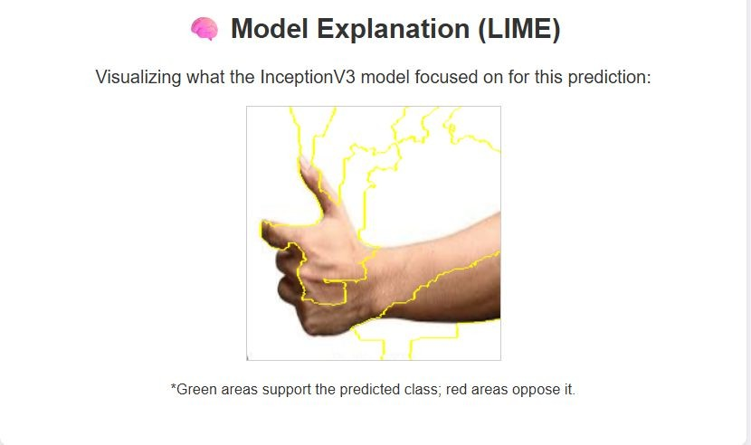
Review No. 1
Batch No. DB4
Department of CSE
22

Slide 23
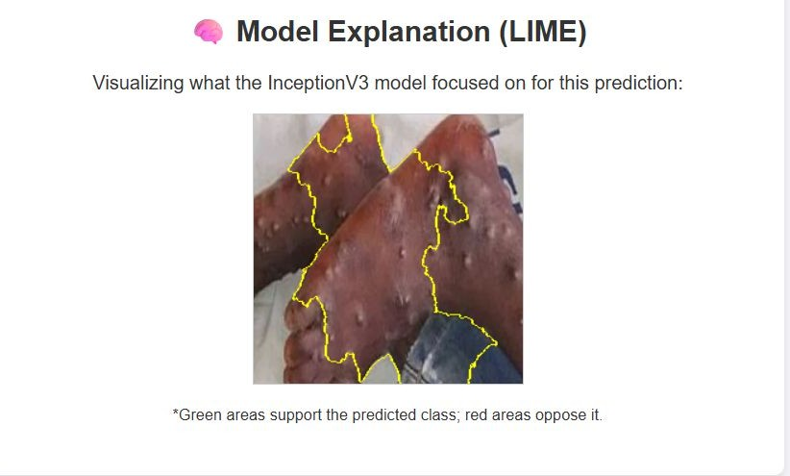
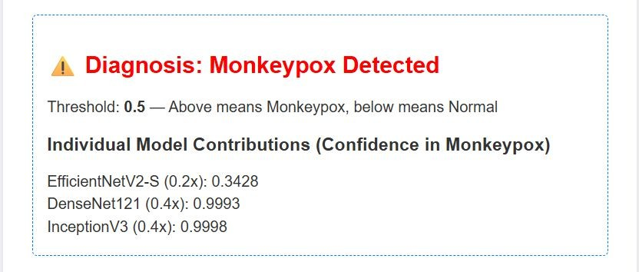
MONKEYPOX DETECTED OUTPUT :
Review No.1

Slide 24
IMPLEMENTATION
Software Specifications:
Browser: Chrome
Operating System: Windows 10/11
Python (COLAB)
Flask
Visualization Tools : LIME for model interpretability, Matplotlib for graphs
Hardware Specifications:
Processor : Intel Core i5 or Higher
RAM : 8 GB minimum (recommended 16 GB for local training)
Storage : ≥ 50 GB free space for dataset and models
GPU : NVIDIA Tesla T4 / P100 (via Google Colab) or equivalent CUDA-enabled GPU
Review No.1

Slide 25
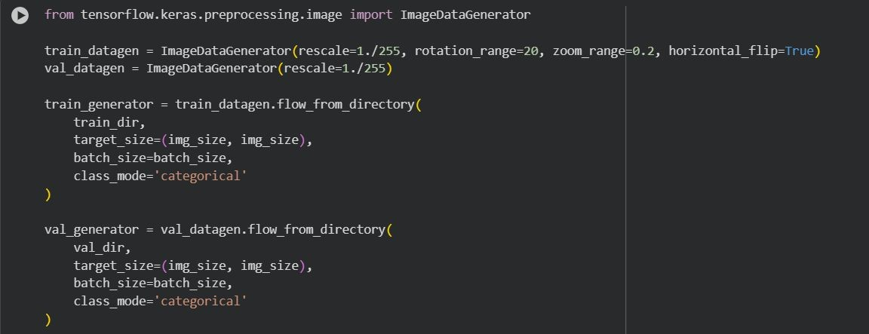
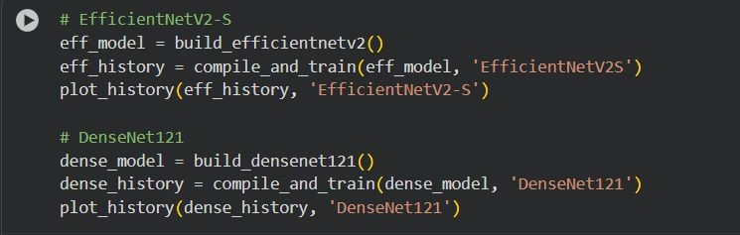
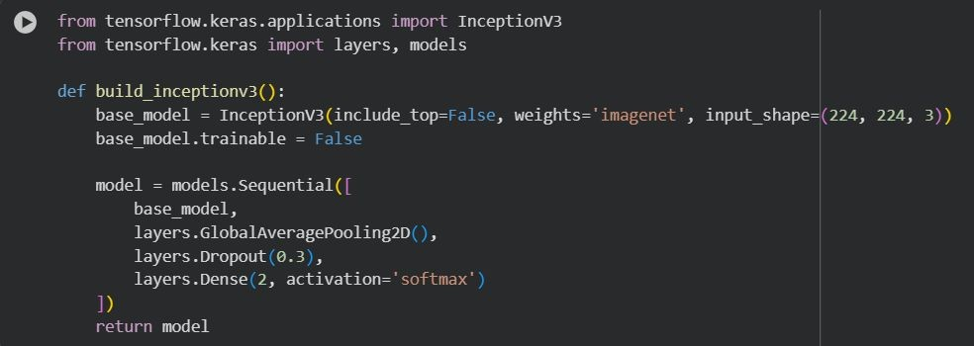
IMPLEMENTATION
Review No.1

Slide 26
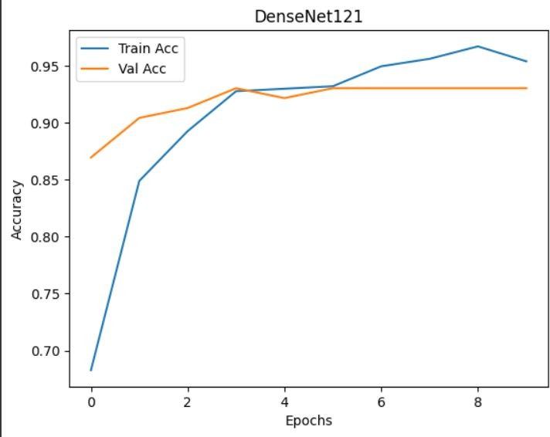
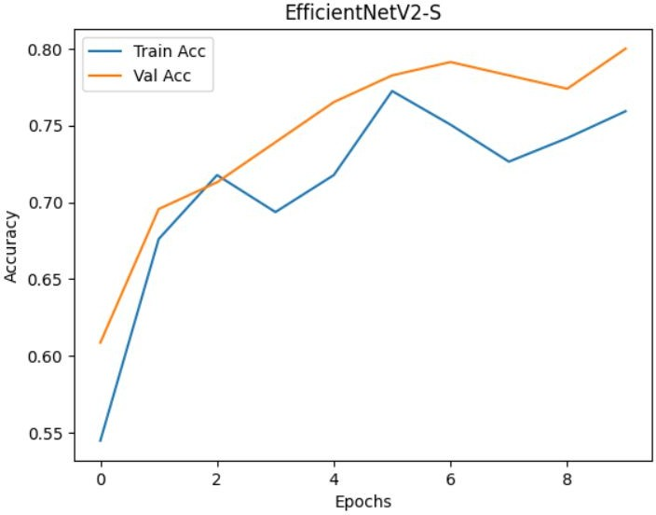
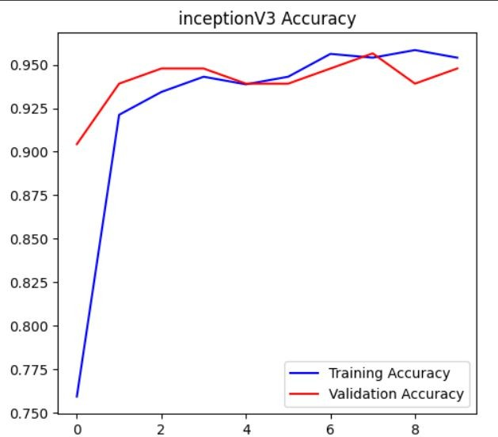
RESULTS & ANALYSIS
Review No.1

Slide 27
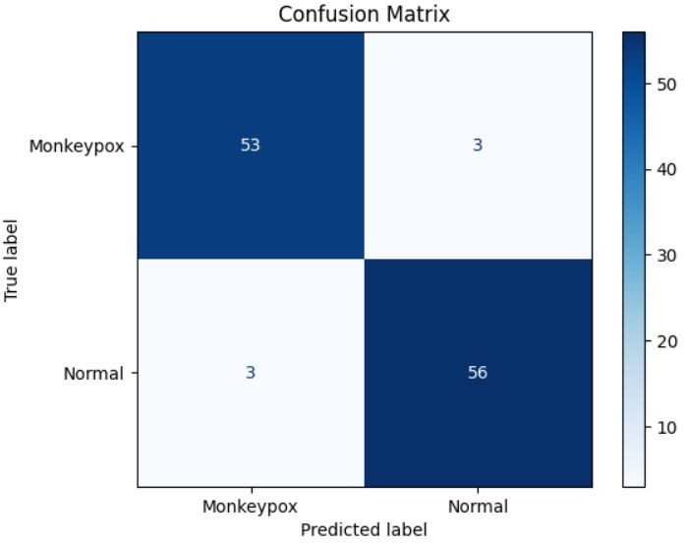
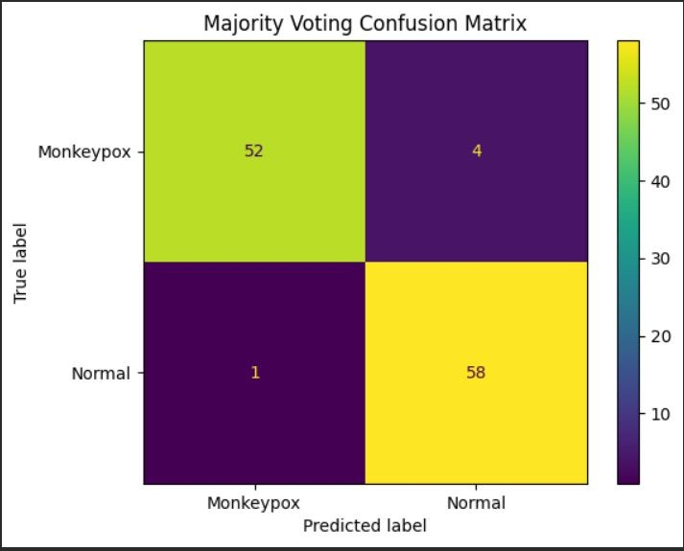
RESULTS & ANALYSIS
Review No.1

Slide 28
CONCLUSION and FUTURE SCOPE
Conclusion:
The study successfully implemented three CNN architectures — EﬃcientNetV2-S, DenseNet121, and InceptionV3 — for Monkeypox detection using skin lesion images.
Among the models, InceptionV3 achieved the highest accuracy (95%), followed closely by DenseNet121 (93%), proving their strong diagnostic capability.
LIME explainability provided clear visualization of lesion regions influencing predictions, enhancing clinical trust and transparency.
The proposed approach demonstrates that AI-driven models can serve as reliable decision-support tools for early Monkeypox screening, especially in low-resource or remote areas.
Future Work:
Expand dataset size with diverse, clinically verified Monkeypox and Normal images to improve generalization.
Integrate real clinical testing through collaboration with hospitals and medical professionals.
Develop a mobile or web-based diagnostic app for real-time skin lesion analysis.
Review No.1

Slide 29
REFERENCES
[1] D. Kundu et al., ”Federated DL for Monkeypox Disease Detection on GAN-Augmented Dataset,” IEEE Access, vol. 12, pp. 32819–32829, 2024, doi: 10.1109/ACCESS.2024.3370838.
[2] Deepa, P. R. Shetty, P. S. Shetty, S. Namita and Sahana, ”Au tomated Classification of Monkeypox Disease based on DL,” in Proc. 8th Int. Conf. on Electronics, Communication and Aerospace Technology (ICECA), Coimbatore, India, 2024, pp. 1186–1190, doi: 10.1109/ICECA63461.2024.10801171.
[3] M. E. Haque, M. R. Ahmed, R. S. Nila and S. Islam, ”Human Monkeypox Disease Detection Using DL and Attention Mechanisms,” in Proc. 25th Int. Conf. on Computer and Information Technology (IC CIT), Cox’s Bazar, Bangladesh, 2022, pp. 1069–1073, doi: 10.1109/IC CIT57492.2022.10055870.
[4] R. Dhiman et al., ”Deep Learning Based Monkeypox Virus De tection Model Using Skin Lesion Images,” in Proc. 4th Int. Conf. on Technological Advancements in Computational Sciences (IC TACS), Tashkent, Uzbekistan, 2024, pp. 1362–1366, doi: 10.1109/IC TACS62700.2024.10840698.
[5] A. V. Kottath and M. Malarvel, ”Comparison Of Deep Learn ing Models for Monkeypox Disease Detection,” in Proc. 1st Int. Conf. on Advances in Electrical, Electronics and Computational Intelligence (ICAEECI), Tiruchengode, India, 2023, pp. 1–8, doi: 10.1109/ICAEECI58247.2023.10370981.
[6] M. Arumugam, G. Arun and S. Tharun Vikas, ”Detection Of Mon keypox Disease Using Deep Learning Techniques,” in Proc. OPJU Int. Technology Conf. (OTCON), Raigarh, India, 2024, pp. 1–6, doi: 10.1109/OTCON60325.2024.10688010.
[7] V. M. Llamas et al., ”Systematic Study of Deep Learning Models for Image-Based Detection of Monkeypox Virus,” in Proc. 12th Int. Conf. on Software Process Improvement (CIMPS), Cuernavaca, Mexico, 2023, pp. 225–233, doi: 10.1109/CIMPS61323.2023.10528817.
Review No. 1

Slide 30
[8] K. Arora et al., ”Using DL Algorithms for Accurate Diagnosis and Out break Prediction of Monkeypox,” in Proc. 4th Int. Conf. on Innovative Practices in Technology and Management (ICIPTM), Noida, India, 2024, pp. 1–5, doi: 10.1109/ICIPTM59628.2024.10563418.
[9] A. A, J. Anitha, G. P and S. J. D, ”Monkeypox Detection us ing Skin Lesion Images: A Comparative Analysis of Deep Learn ing Models,” in Proc. 5th Int. Conf. on Pervasive Computing and Social Networking (ICPCSN), Salem, India, 2025, pp. 482–487, doi: 10.1109/ICPCSN65854.2025.11035422.
[10] Vandana, C. Sharma and V. Kant, ”Mpoxnet: Fast Detection of Mon keypox using Deep Learning in Digital Skin Images,” in Proc. 8th Int. Conf. on Parallel, Distributed and Grid Computing (PDGC), Waknaghat, India, 2024,
pp. 409–415, doi: 10.1109/PDGC64653.2024.10984329.
[11] M. Ahsan et al., “Enhancing Monkeypox Diagnosis and Explanation through Deep Transfer Learning Approaches,” Journal of Biomedical Informatics, 2024.
[12] A. Shateri, N. Nourani, M. Dorrigiv and H. Nasiri, “An Explain able Nature-Inspired Framework for Monkeypox Diagnosis: Xception Features Combined with NGBoost and African Vultures Optimization Algorithm,” arXiv, Apr. 2025.
[13] N. Soe et al., “Explainable AI-Driven Detection of Human Mon keypox from Skin Lesions: Vision Transformer vs CNNs,” J. Med. Internet Res., vol. 26, e52490, 2024, doi:10.2196/52490. :contentRef erence[oaicite:1]index=1
[14] J. Chen, Z. Lu and S. Kang, “Monkeypox Disease Recognition Model based on Improved SE-InceptionV3,” arXiv, Mar. 2024.
[15] M. Pal et al., “Early Detection of Human Mpox: A Comparative Study of ML/DL Ensemble Models,” Digital Health, 2025. :contentRefer ence[oaicite:2]index=2
Review No. 1

Slide 31

Review No. 1
Batch No. DB4
Department of CSE
31

