Slide 1

Department of Computer Science and Engineering
A Dual-Function Image System for Multimodal Interface
PRESENTED BY
Y. KRUPA CHAITANYA (22471A05O7)
Sk. A. ABDUL KAREEM (22471A05N8)
G. L. VARA PRASAD (23475A0507)
Under the Guidance of,
Y. CHANDANA _{B Tech, M Tech},
Assistant Professor,
Department of Computer Science and Engineering,
Narasaraopeta Engineering College (Autonomous), Narasaraopet- 522 601.
Review No.1
Department of CSE

Slide 2
ABSTRACT
In a dual-function image system that combines image-to-image semantic retrieval and text-to-image generation into a single framework is presented in this work. Using the WANG dataset and ImageCLEF, the system is made to handle both content-based search tasks and creative generation tasks. For text-to-image generation, we synthesize high-quality 512×512 images from user-provided prompts using the Stable Diffusion v1.5 model. The system uses OpenAI’s CLIP (ViT-B/32) to extract high-dimensional semantic embeddings and YOLOv8 for object detection in image retrieval. FAISS is used to index these embeddings for a quick and effective similarity search. With high precision and recall across several categories, the system is evaluated using standard classification metrics and achieves a Top-1 accuracy of 90.38% and a macro-average ROC AUC of 0.9267. Strong multi-modal interaction is made possible by this dual functionality, which supports a variety of applications in design, surveillance, and content discovery by enabling users to produce original visual content and retrieve semantically related images based on visual features.
Review No.1
Department of CSE

Slide 3
INTRODUCTION
This work presents a dual-function image system that combines two key capabilities into a single framework.
Function 1: Semantic Image Retrieval: Allows users to retrieve semantically related images based on visual features. This addresses content-based search tasks.
Function 2: Text-to-Image Generation: Enables users to produce original visual content by synthesizing high-quality 512x512 images from user-provided text prompts.
This dual functionality supports strong multi-modal interaction for diverse applications in design, surveillance, and content discovery.
Review No.1
Department of CSE

Slide 4
LITERATURE SURVEY
No | Title | Author | Journal Name & Year | Methodology Adapted | Key Findings | Gaps
1 | Improving the Efficiency of Semantic Image Retrieval Using a Combined Graph and SOM Model | Nguyen Minh Hai | November 2023 & IEEE | Feature Extraction, Hierarchical Clustering | GP-Tree, Graph-GPTree | classification accuracy and retrieval performance for WANG ImageCLEF datasets.
2 | Text-Image Matching for Cross-Modal Remote Sensing Image Retrieval via Graph Neural Network | Yunyan Xing | IEEE Journal of Selected Topics in Applied Earth Observations and Remote Sensing ( Volume: 13) | Retrieval of topics from image+text | Nearest Neighbor Search (brute force) for image retrieval | Improved both accuracy and interpretability, critical for clinical acceptance
3 | Deep Semantic Feature Reduction for Efficient Remote Sensing Image Retrieval | Saeed Iqbal | IEEE Access ( Volume: 9) | Image Resizing, Feature Extraction | Haralick Features (GLCM-based) | Achieved higher retrieval performance compared to only CNN-based models.
4 | VAA: Visual Aligning Attention Model for Remote Sensing Image Captioning | Rajesh Yelchuri,Yan | IEEE Access ( Volume: 7) | Attention model | Modified ResNet50 (MRSI) CNN, Transfer Learning | May ignore small/complex objects
5 | VLCA: vision language aligning model for bilingualremote sensing image captioning | Tingting Wei, Weilin Yuan, Junren Luo, Wanpeng Zhang | Journal of Systems Engineering and Electronics ( Volume: 34, Issue: 1, February 2023) | Image Resizing, Text Processing | CMMFN-Net (Cross-modal Feature Matching Network) | Limited language pairs/domain adaptation
Review No.1
Department of CSE

Slide 5
LITERATURE SURVEY
Nguyen Minh Hai et al. [2]: Developed a hybrid image retrieval model using GP-Tree, Graph-GPTree, and SOM to enhance semantic organization and retrieval precision, though scalability was limited by computational demands.
Yunyan Xing et al. [18]: Proposed a deep learning approach for medical image retrieval, demonstrating that deep semantic features improve retrieval accuracy in domain-specific datasets.
Saeed Iqbal [19]: Created a fusion-based framework combining handcrafted texture features (GLCM-Haralick) with CNN-based semantic features for more robust image retrieval.
Rajesh Yelchuri et al. [20]: Introduced a deep semantic feature reduction model using Modified ResNet50 (MR50) to improve retrieval efficiency while reducing memory usage.
Rombach et al. (Stable Diffusion, 2022): Presented a latent diffusion model capable of generating high-quality images from text prompts, forming the foundation for the text-to-image component of this project.
Review No.1
Department of CSE

Slide 6
PROBLEM STATEMENT
Conventional Content-Based Image Retrieval (CBIR) methods focus on low-level visual features.
Core Problem: Such methods often fail to capture the high-level semantics or contextual understanding of an image.
This discrepancy between machine-extracted characteristics and human interpretation is known as the "semantic gap".
Review No.1
Department of CSE

Slide 7
OBJECTIVES
Models are often static; the SOM component must be retrained for new data, reducing real-time applicability.
To overcome these challenges, this work proposes a Dual Function Image System within a single unified framework.
The system is designed to be dynamic by eliminating the reliance on static ontologies.
It leverages zero-shot CLIP embeddings and automatic label extraction to ensure both semantic depth and scalability.
Review No.1
Department of CSE

Slide 8
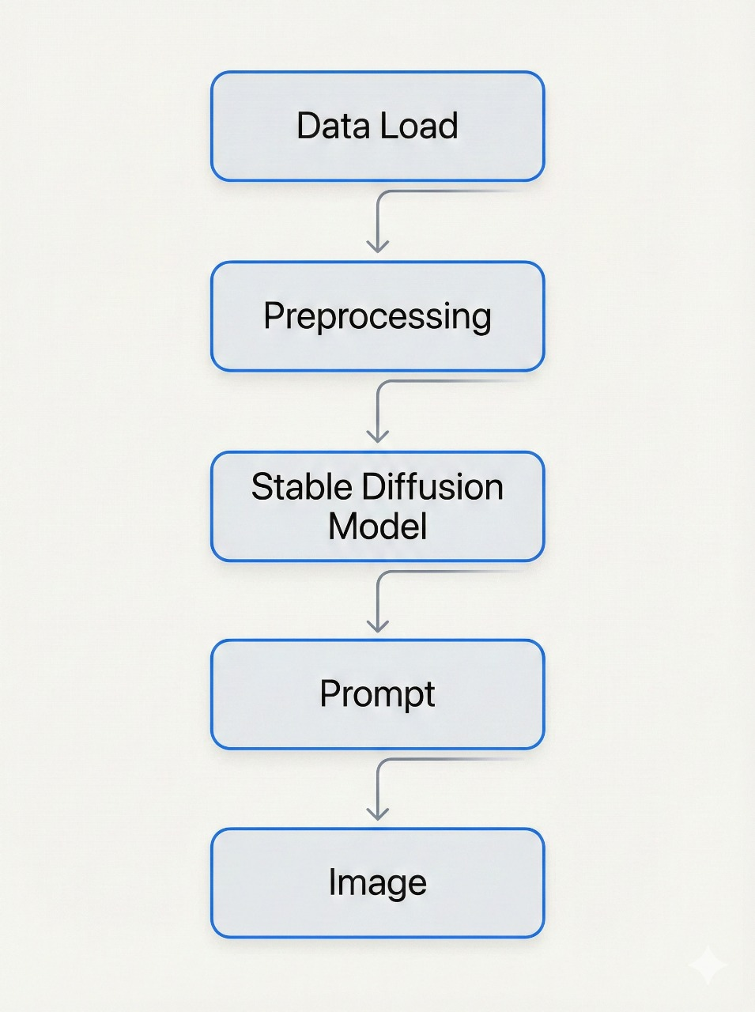
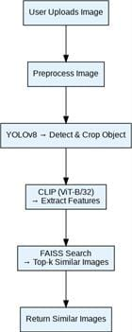
BLOCK DIAGRAM OR FLOW DIAGRAM
TEXT TO IMAGE :
IMAGE TO IMAGE :
Review No.1
Department of CSE

Slide 9
METHODOLOGY
A user uploads an image.
The image is preprocessed (normalized, resized to 512x512).
YOLOv8 detects and crops semantic objects from the image.
CLIP (ViT-B/32) extracts high-dimensional semantic features from the cropped objects.
FAISS indexes these features and conducts a high-speed similarity search to find the top-k matching images.
The system returns the semantically similar images.
Review No.1
Department of CSE

Slide 10
IMPLEMENTATION
Programming Environment: Implemented using Python 3.10 with libraries such as OpenCV, Matplotlib, and Scikit-learn for image handling, visualization, and analysis.
Development Platforms: Project executed on both a local system and Google Colab to leverage GPU acceleration for faster processing.
Hardware Setup: Used Intel Core i5-12450H (12th Gen) CPU, 8 GB RAM, and NVIDIA Tesla T4 GPU (16 GB VRAM) accessed via Google Colab.
Operating System: The implementation was carried out on Windows 11 (64-bit, x64 architecture) environment.
Review No.1
Department of CSE

Slide 11
RESULTS & ANALYSIS
The system demonstrates robust performance and real-time capability across both structured (WANG) and unstructured (ImageCLEF) domains
WANG Dataset Performance :
Top-1 Classification Accuracy: 87.25%
Top-5 Retrieval Accuracy: 94.38%
Macro F1-Score: 91.45%
Average Query Duration: 0.09 sec (9ms)
ImageCLEF Dataset Performance :
Top-1 Classification Accuracy: 90.38%
Top-5 Retrieval Accuracy: 91.62%
Macro F1-Score: 91.45%
Average Search Latency: 0.12 sec (12ms)
Review No.1
Department of CSE

Slide 12
CONCLUSION and FUTURE SCOPE
We successfully developed a unified, dual-function system for semantic retrieval (YOLOv8, CLIP, FAISS) and text-to-image generation (Stable Diffusion v1.5).
The system is robust, scalable, and achieves high performance, with a 94.38% Top-5 accuracy on the WANG dataset and query times under 0.1 seconds.
Expand functionality to support text-to-image retrieval (using a text query to find existing images) via CLIP's textual embeddings.
Integrate real-time user feedback mechanisms to refine retrieval relevance.
Review No.1
Department of CSE

Slide 13
REFERENCES
[1] G. Pass and R. Zabih, “Comparing images using joint histograms,” Multimedia Systems, vol. 7, no. 3, pp. 234–240, 1999.
[2] N. M. Hai et al., “Improving the efficiency of semantic image retrieval using a combined graph and SOM model,” IEEE Access, vol. 11, pp. 140647–140650, 2023. [Online]. Available: https://ieeexplore.ieee.org/document/10289012
[3] S. Jabeen, Z. Mehmood, T. Mahmood, T. Saba, A. Rehman, and M. T. Mahmood, “An effective content-based image retrieval technique for image visuals representation based on the bag-of-visual-words model,” PLoS One, vol. 13, no. 4, 2018.
[4] X.-Y. Wang, Y.-W. Li, and H.-Y. Yang, “An image retrieval scheme with relevance feedback using feature reconstruction and SVM reclassification,” Neurocomputing, vol. 127, pp. 214–230, 2014.
[5] Y. LeCun, L. Bottou, Y. Bengio, and P. Haffner, “Gradient-based learning applied to document recognition,” Proceedings of the IEEE, vol. 86, no. 11, pp. 2278–2324, 1998.
Review No.1
Department of CSE

Slide 14
REFERENCES
[6] X. Wang, Z. Huang, and F. van Harmelen, “Ontology-based semantic similarity approach for biomedical dataset retrieval,” Health Information Science, 2020.
[7] C. S. Wickramasinghe, K. Amarasinghe, and M. Manic, “Parallelizable deep self-organizing maps for image classification,” in IEEE Symposium Series on Computational Intelligence (SSCI), 2017, pp. 1–7.
[8] J. Z. Wang, J. Li, and G. Wiederhold, “Simplicity: Semantics-sensitive integrated matching for picture libraries,” IEEE Transactions on Pattern Analysis and Machine Intelligence, vol. 23, no. 9, pp. 947–963, 2001.
[9] B. Ionescu, H. Müller, M. Villegas et al., “Overview of ImageCLEF 2018: Challenges, datasets and evaluation,” in Proc. International Conference of the Cross-Language Evaluation Forum for European Languages, Springer, 2018, pp. 309–334.
[10] T. Berners-Lee, J. Hendler, and O. Lassila, “The semantic web,” Scientific American, vol. 284, no. 5, pp. 34–43, 2001.
Review No.1
Department of CSE

Slide 15
REFERENCES
[11] G. Jocher, A. Chaurasia et al., “YOLOv8: Ultralytics official implementation,” 2023. [Online]. Available: https://github.com/ultralytics/ultralytics
[12] A. Radford, J. W. Kim, J. Hallacy et al., “Learning transferable visual models from natural language supervision,” in Proc. 38th International Conference on Machine Learning (ICML), 2021. [Online]. Available: https://openai.com/research/clip
[13] J. Johnson, M. Douze, and H. Jégou, “Billion-scale similarity search with GPUs,” arXiv preprint arXiv:1702.08734, 2019. [Online]. Available: https://github.com/facebookresearch/faiss
[14] K. V. N. Reddy, Y. Narendra, M. A. N. Reddy, A. Ramu, D. V. Reddy, and S. Moturi, “CNN deep learning,” Social Innovation (IATMSI), IEEE, 2025. [Online]. Available: http://www.scopus.com/inward/record.url?eid=2-s2.0-105007441024&partnerID=MN8TOARS
[15] S. L. Jagannadham, K. Lakshmi Nadh, and M. Sireesha, “Brain tumour detection using CNN,” in Proc. 5th International Conference on I-SMAC (IoT in Social, Mobile, Analytics and Cloud), IEEE, 2021. [Online]. Available: http://www.scopus.com/inward/record.url?eid=2-s2.0-85124198074&partnerID=MN8TOARS
Review No.1
Department of CSE

Slide 16
QUESTIONS and ANSWERS
Q1: What are the datasets used?
A: I used two datasets — WANG and ImageCLEF
Q2: Do you use both datasets together?
A: No, I used the datasets separately for training and evaluation.
Q3: What is the main objective of this project?
A: The main objective is to develop a dual-function image system that can perform both image-to-image semantic retrieval and text-to-image generation using advanced deep learning models.
Review No.1
Department of CSE

Slide 17
ACKNOWLEGEMENTS
Grateful to our Chairman, Sri M. V. Koteswara Rao, B.Sc., for his continuous support and encouragement throughout the course.
Thankful to our Principal, Dr. S. Venkateswarlu, Ph.D., for his valuable guidance and motivation.
Sincere thanks to Dr. S. N. Tirumala Rao, M.Tech., Ph.D., HOD of CSE, and our Guide, Y. Chandana, M.Tech., for their guidance and constant encouragement.
Appreciation to Syed Rizwana, M.Tech. (Ph.D.), Assistant Professor & Project Coordinator, for her support and inspiration.
Heartfelt gratitude to our parents, friends, and the CSE department staff for their cooperation, motivation, and continuous encouragement.
Review No.1
Department of CSE

Slide 18
THANK YOU
Contact:
chaitu25113@gmamil.com
Review No.1
Department of CSE

