Slide 1








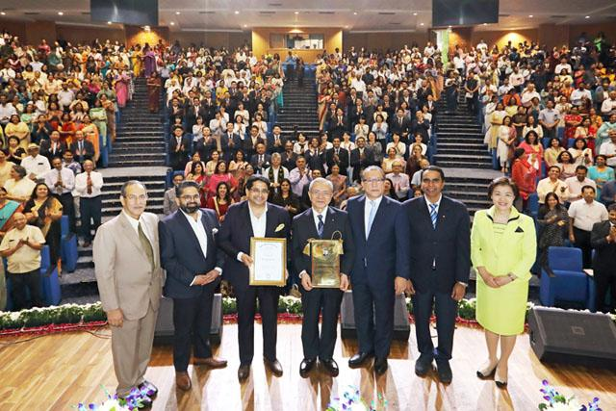
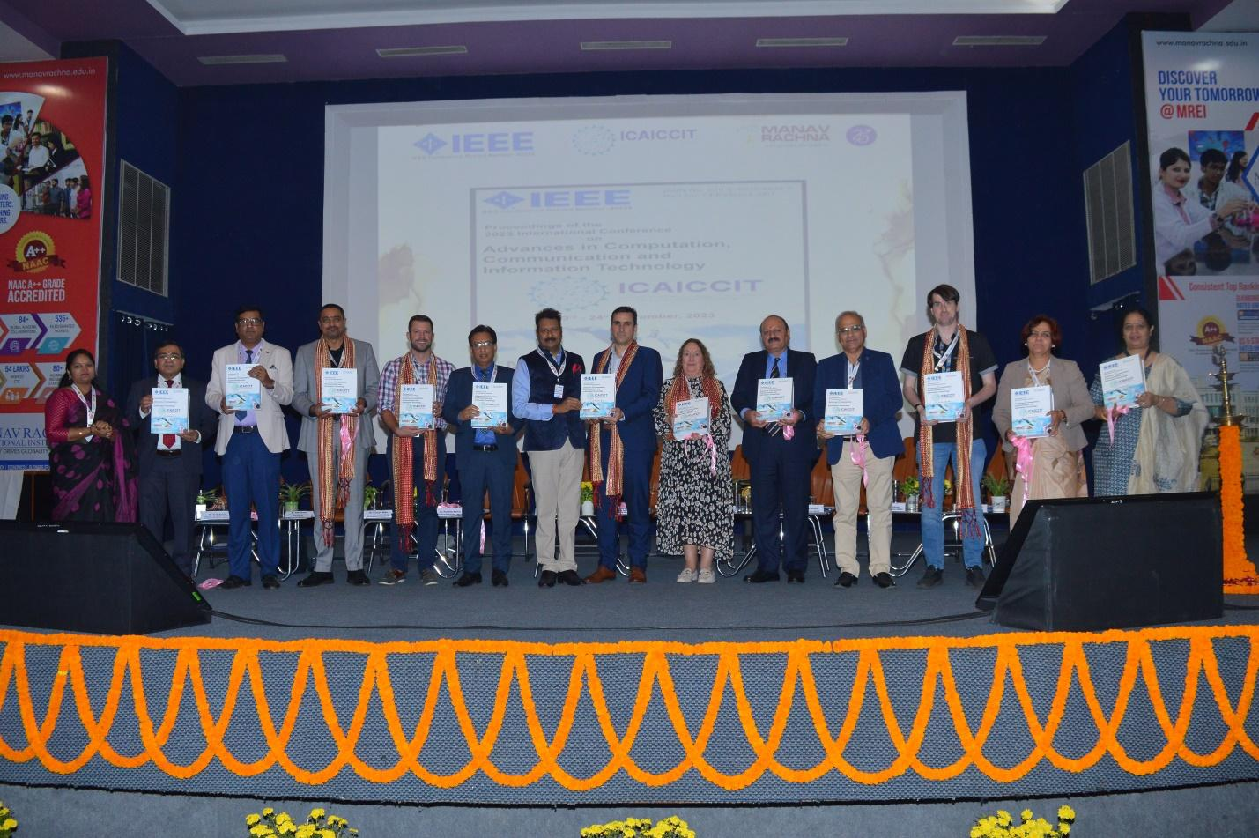

ICAICCIT-2025, 3rd International conference on Advances in Computing, Communication and Information Technology, technically Co-Sponsored by IEEE Delhi SECTION (IEEE record no # 68829)
on 31st Oct & 1st Nov. 2025

Slide 2
Title of Paper
A Dual-Function Image System for Multimodal Interface
Paper id
ICAICCIT_ 0237
Authors Name
Chandana .Y
Krupa Chaitanya .Y
Sk.A.Abdul Kareem
G.L.Vara Prasad
Anuradha .K
Ramalinga Reddy .K
Syed Rizwana
Affiliation
Dept. of CSE, Narasaraopet Engineering College (1,2,3,4,7)
Dept. of CSE, GRIET (5)
Dept. of ETM, GNITS (6)
Presented by
YELLAMELLI KRUPA CHAITANYA
Team members details
Sk. A. ADUL KAREEM
G. L. VARA PRASAD

Slide 3
Content
Introduction
Problem Statements
Objectives
Literature Review
Methodology
Result & Discussion
Conclusion & Future Scope
References

Slide 4
Introduction
This work presents a dual-function image system that combines two key capabilities into a single framework.
Function 1: Semantic Image Retrieval: Allows users to retrieve semantically related images based on visual features. This addresses content-based search tasks.
Function 2: Text-to-Image Generation: Enables users to produce original visual content by synthesizing high-quality 512x512 images from user-provided text prompts.
This dual functionality supports strong multi-modal interaction for diverse applications in design, surveillance, and content discovery.

Slide 5
Problem Statements
Conventional Content-Based Image Retrieval (CBIR) methods focus on low-level visual features.
Core Problem: Such methods often fail to capture the high-level semantics or contextual understanding of an image.
This discrepancy between machine-extracted characteristics and human interpretation is known as the "semantic gap".

Slide 6
Objectives
Models are often static; the SOM component must be retrained for new data, reducing real-time applicability.
To overcome these challenges, this work proposes a Dual Function Image System within a single unified framework.
The system is designed to be dynamic by eliminating the reliance on static ontologies.
It leverages zero-shot CLIP embeddings and automatic label extraction to ensure both semantic depth and scalability.

Slide 7
Literature Review
Nguyen Minh Hai et al. [2] , Methodology: Proposed a hybrid image retrieval model integrating a GP-Tree (hierarchical indexing), a Graph-GPTree (semantic learning), and a Self-Organizing Map (SOM) for unsupervised clustering.
Saeed Iqbal [19] , Methodology: Developed a fusion-based retrieval framework combining handcrafted statistical descriptors with deep learning-based visual features.
Rajesh Yelchuri et al. [20] ,
Methodology: Proposed a deep semantic feature reduction framework for remote sensing image retrieval.

Slide 8
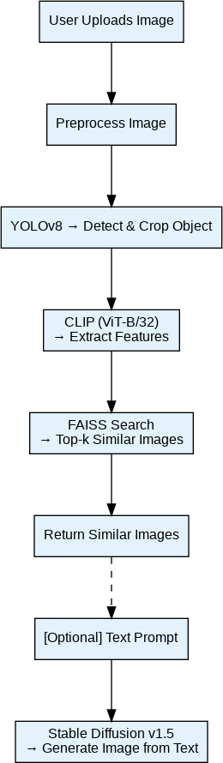
Methodology
A user uploads an image.
The image is preprocessed (normalized, resized to 512x512).
YOLOv8 detects and crops semantic objects from the image.
CLIP (ViT-B/32) extracts high-dimensional semantic features from the cropped objects.
FAISS indexes these features and conducts a high-speed similarity search to find the top-k matching images.
The system returns the semantically similar images.

Slide 9
Result & Discussion
The system demonstrates robust performance and real-time capability across both structured (WANG) and unstructured (ImageCLEF) domains
WANG Dataset Performance :
Top-1 Classification Accuracy: 87.25%
Top-5 Retrieval Accuracy: 94.38%
Macro F1-Score: 91.45%
Average Query Duration: 0.09 sec (9ms)
ImageCLEF Dataset Performance :
Top-1 Classification Accuracy: 90.38%
Top-5 Retrieval Accuracy: 91.62%
Macro F1-Score: 91.45%
Average Search Latency: 0.12 sec (12ms)

Slide 10
Conclusion & Future Scope
We successfully developed a unified, dual-function system for semantic retrieval (YOLOv8, CLIP, FAISS) and text-to-image generation (Stable Diffusion v1.5).
The system is robust, scalable, and achieves high performance, with a 94.38% Top-5 accuracy on the WANG dataset and query times under 0.1 seconds.
Expand functionality to support text-to-image retrieval (using a text query to find existing images) via CLIP's textual embeddings.
Integrate real-time user feedback mechanisms to refine retrieval relevance.

Slide 11
References
G. Pass and R. Zabih, "Comparing images using joint histograms," Multimedia Systems, vol. 7, no. 3, pp. 234-240, 1999.
N. M. Hai et al., "Improving the efficiency of semantic image retrieval using a combined graph and som model." IEEE Access, vol. 11, pp. 140 647-140 650, 2023. [Online]. Available: https://ieeexplore.ieee.org/document/10289012 .
X.-Y. Wang, Y.-W. Li, and H.-Y. Yang, "An image retrieval scheme with relevance feedback using feature reconstruction and svm reclassification," Neurocomputing, vol. 127, pp. 214-230, 2014.

Slide 12
THANK YOU
Questions?
Contact – formystudiesbtech@gmail.com

