Slide 1

Grammar Correction Using Deep Learning BART Model
PRESENTED BY
G.Sagarbabu (22471A05M2)
N.Vinay (22471A05N5)
P.Venkatesh (23475A0514)
Under the Esteemed Guidance of
G.Saranya _{M. Tech.}
Assistant Professor,
Department of Computer Science and Engineering,
Narasaraopeta Engineering College (Autonomous),
Narasaraopet - 522 601.

Slide 2
OUTLINE
Abstract
Introduction
Literature Survey
Research Gaps
Problem Statement
Objectives
Block Diagram
Methodology
Implementation
Results and Analysis
Conclusion & Future Scope
References

Slide 3
ABSTRACT
This work presents a transformer-based framework for Grammatical Error Correction (GEC) that integrates lightweight error detection with fluent and accurate correction. Unlike traditional single-stage models, the proposed system uses pre-classifiers such as DistilBERT, RoBERTa, and DeBERTa to identify potential grammatical errors, followed by a BART-based corrector enhanced with a supervised copy mechanism. This approach ensures that only erroneous segments are modified, minimizing overcorrection and preserving the natural fluency of the sentence. The novelty of this work lies in its two-stage architecture, which effectively balances accuracy and efficiency while remaining scalable for real-world applications. Experimental results on benchmark datasets such as Lang-8 and JFLEG demonstrate that the system outperforms baseline models across BLEU, F1, and MCC metrics. These outcomes confirm that the proposed model delivers high-quality corrections with strong computational efficiency, making it a promising solution for practical grammar assistance systems.
Index Terms— Grammatical Error Correction, Deep Learning, Transformers, BART, Lang-8, BLEU, MCC, Natural Language Processing, Neural Networks, Educational AI.

Slide 4
INTRODUCTION
Written communication is an essential part of everyday life, especially in academic and professional settings.
Many users—particularly students and non-native English speakers—struggle to write grammatically correct sentences.
Even small grammatical mistakes can reduce clarity and affect the quality of written communication.
This creates a strong need for intelligent systems that can automatically detect and correct grammatical errors.
Earlier grammar correction systems were rule-based, making them difficult to update and ineffective for complex or informal language.
Later, statistical and translation-based models improved performance but often made unnecessary changes and produced unnatural corrections.
To overcome these issues, the proposed work introduces a deep learning–based Grammatical Error Correction (GEC) model.
The system uses BART, a transformer-based sequence-to-sequence model, for fluent and accurate sentence correction.

Slide 5
INTRODUCTION
Before correction, the system detects error-prone tokens using lightweight transformer classifiers such as:
  DistilBERT
  RoBERTa
  DeBERTa
The BART corrector is enhanced with a supervised copy mechanism, ensuring that only incorrect segments of the sentence are modified.
This prevents overcorrection and preserves the natural fluency of the sentence.
The model is trained and evaluated on large-scale datasets such as:
  Lang-8 Learner Corpus
  JFLEG Corpus

Slide 6
S.No | Title | Author | Journal Name & Year | Methodology Adapted | Key Findings | Gaps
1 | Enhancing Grammatical Error Correction Systems with Explanations | Fei et al. | ACL, 2023 | Tokenization, POS tagging, Error evidence extraction, Transformer with explanation-aware fine-tuning | Introduces EXPECT dataset with error evidence and explanation; improves model interpretability | Needs evaluation on multilingual scenarios
2 | Type-Driven Multi-Turn Corrections for Grammatical Error Correction | Lai et al. | NAACL, 2022 | Error type labeling, Sentence augmentation, Multi-turn Seq2Seq model | correction by error type; improves precision on complex sentences | Complex training pipeline
3 | TemplateGEC: Improving GEC with Detection Templates | Li et al. | ACL, 2023 | POS tagging, Error region detection, Seq2Edit + Template-Aware Seq2Seq | Achieved improved accuracy and classification rates in distributed environments. | Less effective on informal text

Slide 7
S.no | Title | Author | Journal Name & Year | Methodology Adapted | Key Findings | Gaps
4 | FlaCGEC: A Chinese GEC Dataset with Fine-grained Annotations | Du et al | CIKM, 2023 | Linguistic error tagging, Token normalization, Transformer with error type classification | First Chinese dataset with 78 linguistic error types; supports fine-grained correction | Limited to Chinese text only
5 | MuCGEC: Multi-Reference Chinese GEC Dataset | Zhang et al. | Manual annotation, Normalization, Seq2Seq, Seq2Edit | Seq2Edit + Template-Aware Seq2Seq | Provides multi-reference corrections for 7k sentences; enhances evaluation diversity | Doesn’t support English

Slide 8
RESEARCH GAPS
Most existing GEC systems use single-stage architectures, which often struggle to balance accuracy with computational efficiency.
Many models tend to overcorrect sentences, altering even the correct parts and reducing fluency.
Traditional rule-based and statistical approaches lack adaptability to informal, diverse, or complex sentence structures.
Detection and correction are usually treated as separate tasks, creating inefficiencies and limiting real-time deployment.
Existing transformer-based models do not consistently preserve correct tokens due to the absence of controlled copying mechanisms.

Slide 9
RESEARCH GAPS
Pre-classifiers used in earlier research are often limited and do not leverage multiple lightweight transformers for robust token-level error detection.
Several models show strong BLEU or fluency scores but perform poorly on token-level accuracy metrics such as MCC.
There is limited exploration of integrated pipelines that combine error detection and fluent correction in a unified system.
Many GEC systems lack scalability when applied to large datasets or real-time applications.
Few studies systematically evaluate both fluency and error detection accuracy using diverse benchmark datasets like Lang-8 and JFLEG.

Slide 10
PROBLEM STATEMENT
Many individuals, especially students and non-native English speakers, struggle to write grammatically correct sentences, leading to unclear communication.
Traditional rule-based grammar correction systems are rigid, difficult to maintain, and fail to handle complex or informal language.
Existing statistical and translation-based GEC models often make unnecessary edits, resulting in overcorrection and unnatural sentence outputs.
Single-stage deep learning models lack an effective mechanism to distinguish between correct and incorrect tokens, reducing correction accuracy.

Slide 11
PROBLEM STATEMENT
Current GEC systems rarely integrate error detection and correction into a unified, efficient pipeline suitable for real-time use.
Most transformer-based correctors modify the entire sentence instead of focusing only on erroneous parts, causing loss of fluency.
Many existing models do not perform well across multiple evaluation metrics such as BLEU, F1, and MCC, limiting their reliability.
There is a need for a scalable and computationally efficient grammar correction architecture that can be deployed in real-world writing tools.

Slide 12
OBJECTIVES
To develop an accurate and efficient system for detecting and correcting grammatical errors in English sentences.
To integrate lightweight transformer models for fast and reliable error detection.
To use a BART-based correction model that produces fluent and natural sentence outputs.
To implement a supervised copy mechanism that edits only incorrect tokens and avoids overcorrection.
To create a unified two-stage pipeline that combines both detection and correction for real-time usability.

Slide 13
OBJECTIVES
To train and evaluate the system on benchmark datasets such as Lang-8 and JFLEG to ensure high performance.
To improve fluency and accuracy scores across key evaluation metrics like BLEU, F1, and MCC.
To build a scalable grammar correction framework suitable for educational and practical writing applications.

Slide 14
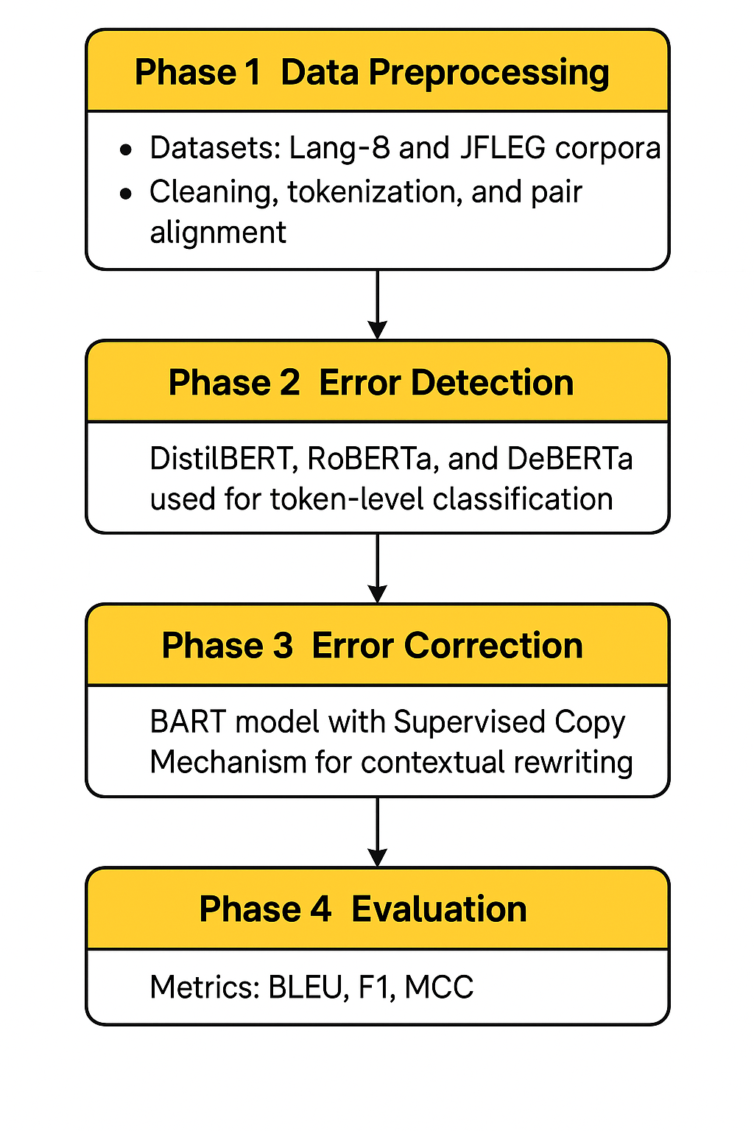
FLOW DIAGRAM

Slide 15
METHODOLOGY
Phase 1: Data Preprocessing
  Use Lang-8 and JFLEG learner corpora as the primary datasets.
  Perform cleaning to remove noisy, empty, or misaligned sentence pairs.
  \Apply tokenization and prepare input–output aligned pairs for training.
Phase 2: Error Detection
  Utilize lightweight transformer models: DistilBERT, RoBERTa, and DeBERTa.
  Perform token-level classification to identify and mark potential grammatical errors.
  Pass only the error-prone tokens forward to minimize unnecessary corrections.

Slide 16
METHODOLOGY
Phase 3: Error Correction
  Apply a BART-based sequence-to-sequence model for sentence rewriting.
  Integrate a Supervised Copy Mechanism to preserve correct tokens.
  Modify only the erroneous segments to ensure fluent and natural corrections.
Phase 4: Evaluation
  Evaluate the system using standard GEC metrics:
  BLEU for sentence fluency.
  F1-score for correction accuracy.
  MCC for reliable token-level error detection.
  Compare performance with existing baseline models to validate improvements.

Slide 17
System Requirements
Hardware Requirements
Processor : intel Core i5
Cache memory : 4MB(Megabyte)
RAM : 12.7GB (gigabyte)
Hard Disk : 166.8GB
Compute Engine : T4 GPU
Software Requirements
Operating System : Windows 10, 64-bit OS
Coding Language : Python
Python distribution : Google Colab Pro , Flask
Browser : Any Latest Browser like Chrome

Slide 18
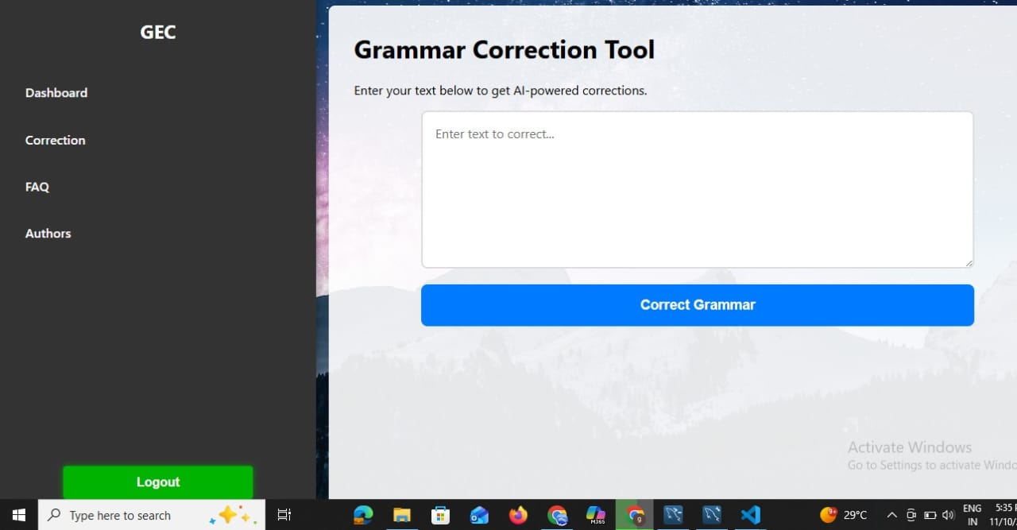
Correction Page

Slide 19
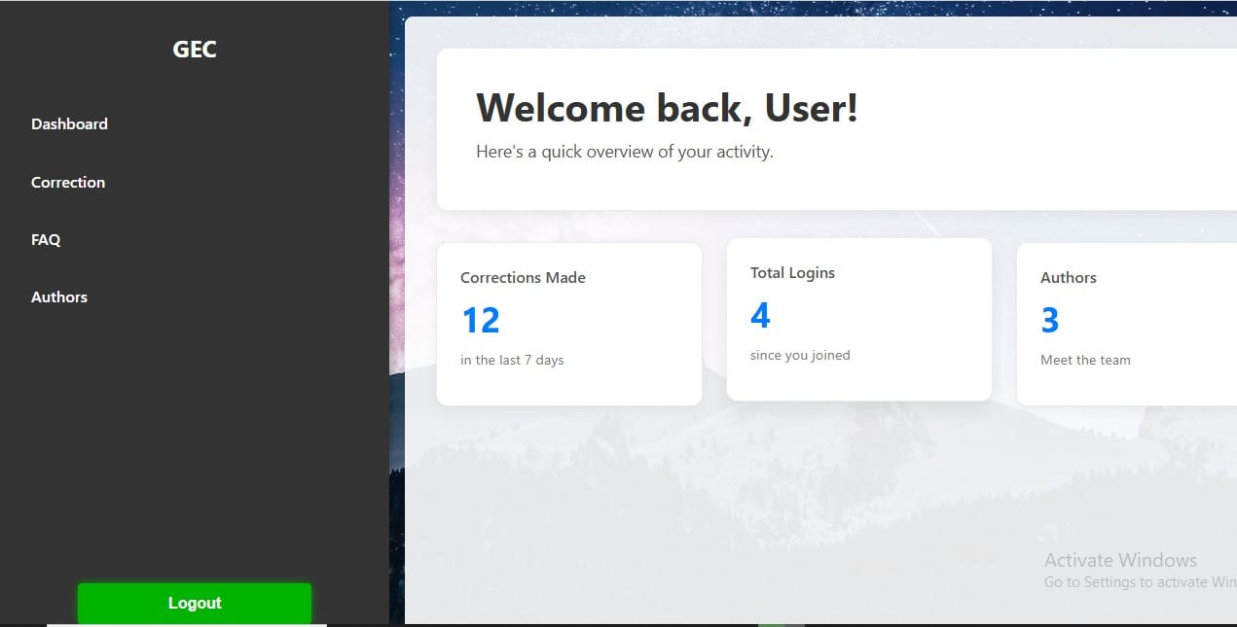
Dashboard

Slide 20
RESULTS & ANALYSIS
The error detection stage using DistilBERT, RoBERTa, and DeBERTa achieved consistent accuracy of 0.953, showing reliable token-level classification across models.
F1-scores for detection ranged between 0.928 and 0.933, indicating strong precision and recall in identifying grammatical errors.
The BART-based correction model achieved a BLEU score of 95.15, demonstrating highly fluent and human-like sentence generation.
The overall correction performance reached an F1-score of 0.945, showing accurate modification of erroneous tokens while preserving correct ones.
Comparative evaluation showed that the proposed hybrid system outperformed existing baseline models across BLEU, F1, and MCC metrics.

Slide 21
CONCLUSION and FUTURE SCOPE
Conclusion
❖ The proposed two-stage transformer-based GEC system effectively detects and corrects
grammar errors.
❖ The Supervised Copy Mechanism prevents unnecessary edits, ensuring fluent and natural
text.
❖ Future Scope:
  Extend to multilingual grammar correction.
  Integrate into educational tools or chatbots.
  Explore large language models (LLMs) like GPT or T5 for enhanced performance.

Slide 22
REFERENCES
Lichtarge et al., 2019 – Data-driven GEC
Neupane, 2023 – Error analysis in student writing
Zhao et al., 2019 – Copy-based correction
Al-Sabahi & Yang, 2023 – Supervised copy mechanism
Lewis et al., 2020 – BART model
Sanh et al., 2019 – DistilBERTERT

Slide 23
REFERENCES
7. Liu et al., 2019 – RoBERTa
8. He et al., 2021 – DeBERTa

