Slide 1

Department of Computer Science and Engineering
ADAPTIVE INTRUSION DETECTION USING HYBRID DEEP LEARNING MODELS AND FEATURE SELECTION
PRESENTED BY
T. DurgaBhavani (22471A05O6)
G. Kavya (22471A05M4)
SK. Y.Khajabi (22471A05O3)
A.Deepthi Priya (23475A0513)
Under the Guidance of,
Dr.K.Suresh Babu Ph.D,
Associate Professor,
Department of Computer Science and Engineering,
Narasaraopeta Engineering College (Autonomous), Narasaraopet- 522 601.
Review No.
Department of CSE

Slide 2
OUTLINE
Abstract
Introduction
Literature Survey
Research Gaps
Problem Statement
Objectives
Block Diagram / Flow Diagram
Methodology
Implementation
Results and Analysis
Conclusion & Future Scope
References
Question and Answers
Acknowledgements
Review No.
Department of CSE

Slide 3
ABSTRACT
      The project focuses on building an adaptive deep learning-based Intrusion Detection System (IDS) to handle complex and large-scale cyberattacks. The CICIDS2017 dataset is used,
      and preprocessing is done using data cleaning, Min–Max normalization,and SMOTE-ENN
      to balance the data. Boruta feature selection is applied to choose only the most important
      features for training the models. Four deep learning models - Autoencoder,GRU,AlexNet,
      and Mini VGGNet are used, and the hybrid approach gives better performance.The Auto-
      encoder model achieved the best results with 99.67% accuracy, proving that combining preprocessing, feature selection, and deep learning improves IDS performance.
Review No.
Department of CSE

Slide 4
INTRODUCTION
We choose this topic because cyberattacks are increasing every day,and many existing systems fail to detect new or rare attacks correctly.
Intrusion Detection Systems (IDS)play an important role in protecting networks,but traditional methods often show low accuracy and high false alarms.
To overcome these problems , our work focuses on developing an adaptive intrusion detection system that can automatically learn and adjust to new types of attacks.
We used a hybrid deep learning approach that combines multiple models - Autoencoder GRU, AlexNet, and MiniVGGNet - along with advanced preprocessing and feature selection methods.
The goal of our paper is to improve detection accuracy , reduce false alarms, and make the IDS system more reliable and adaptive to real-time network threats.
Review No.
Department of CSE

Slide 5
LITERATURE SURVEY
No | Title | Author | Journal Name & Year | Methodology Adapted | Key Findings | Gaps
1 | Intrusion Detection of Imbalanced Network Traffic Based on Machine Learning and Deep Learning | Lan Liu, Pengcheng Wang, Jun Lin, Langzhou Liu, 2020,IEEE | https://ieeexplore.ieee.org/document/10555151 | Proposed Difficult Set Sampling Technique (DSSTE) with Edited Nearest Neighbor (ENN) and KMeans; used RF, SVM, XGBoost, LSTM, AlexNet, MiniVGGNet | DSSTE reduces imbalance, improves learning, and outperforms 24 other methods on NSL-KDD and CSE-CIC-IDS2018 datasets | Hard to ensure both accuracy and timeliness; malicious traffic can hide in large normal data
2 | Balanced Multi-Class Network Intrusion Detection Using Machine Learning | Faraz Ahmad Khan et al,2024,IEEE | https://ieeexplore.ieee.org/document/8995813 | Used SMOTE- Tomek Links for balancing CICIDS2017 data; trained models like DT, RF, XGBoost, NB, LR, AdaBoost | Achieved 96.37% accuracy and 96.33% F1-score; 99.96% accuracy for binary classification | Signature-based tools still fail for new attacks; algorithms need higher accuracy and lower false alarms
3 | Intrusion Detection Systems Using Long Short-Term Memory (LSTM) | Fatima Ezzahra Laghrissi et al,2021, Springer | https://ieeexplore.ieee.org/document/9961235 | Implemented LSTM with PCA and Mutual Information (MI) for feature selection; tested on KDD99 dataset | Deep learning with PCA gives high accuracy for binary and multiclass detection | Dataset is outdated (KDD99) and unsuitable for real-time large-scale data
4 | An Improved Algorithm for Network Intrusion Detection Based on Deep Residual Networks | Xuntao Hu et al,2024,IEEE | https://ieeexplore.ieee.org/document/8995813 | Added Hybrid Attention Mechanism to Deep Residual Networks (DRN) and Bi-LSTM; tested on UNSW-NB15, CICIDS2017/2018 | Achieved 100% binary accuracy, 99.06% multiclass; strong generalization | Needs improved accuracy and generalization for complex attacks
5 | An Attention-Based Convolutional Neural Network for Intrusion Detection Model | Prerna Tyagi, Pratibha et al,2022,IEEE | https://ieeexplore.ieee.org/document/9714367 | Used Transformer models (BERT, RoBERTa, XLNet, ALBERT) with text preprocessing | RoBERTa achieved highest accuracy; better than traditional ML methods | Limited testing on multilingual, real-time data; lacks model explainability
Review No.
Department of CSE

Slide 6
RESEARCH GAPS
Imbalanced Datasets:
Most existing intrusion detection systems (IDS) face data imbalance, where normal traffic dominates attack data. This leads to poor detection of minority or rare attack types.
High False Alarm Rate:
Many traditional and machine learning-based IDS generate too many false positives,
reducing system reliability.
Lack of Feature Optimization:
Several works ignored proper feature selection or extraction, which results in redundant data and longer training time.
Limited Adaptability:
Models trained on specific datasets like NSL-KDD or CICIDS2017 often fail to adapt to new or evolving attacks in real-time environments.
Insufficient Hybrid Techniques:
Many studies used only one deep learning model, instead of combining multiple models that could enhance both feature learning and classification accuracy.
Review No.
Department of CSE

Slide 7
PROBLEM STATEMENT
Detecting Unbalanced Network Traffic Intrusions with Deep Learning (Reference Base Paper)
Problems Identified:
Suffered from imbalanced network data, causing biased model results.
Contained irrelevant and redundant features that lowered accuracy.
Deep learning models were not optimized for spatial or temporal attack patterns.
Could detect only known attacks, failing to identify zero-day or new threats.
No hybrid feature selection or preprocessing methods were used to enhance performance.
Adaptive Intrusion Detection Using Hybrid Deep Learning Models and Feature Selection(Proposed Base Paper)
Problems Solved:
Used SMOTE-ENN to balance the dataset and improve model learning.
Applied Boruta algorithm for selecting significant features and removing noise.
Integrated multiple deep models (Autoencoder, GRU, AlexNet,
MiniVGGNet) for hybrid detection.
Achieved high detection accuracy (99.67%) with lower false positives.
Enhanced capability to detect new and complex network attacks efficiently.
date
Review No.
BatchNo.DG2
Department of CSE

Slide 8
OBJECTIVES
To design an adaptive Intrusion Detection System (IDS) using hybrid deep learning models.
To handle class imbalance effectively using the SMOTE-ENN technique.
To improve model performance byapplying the Boruta algorithm for feature selection.
To develop and compare multiple deep learning models - Autoencoder,GRU,Alexnet
and MiniVGGNet.
To achieve high detection accuracy and reduce false positives in identifying network attacks.
To build a system that can detect both known and unknown (zero-day) attacks efficiently
Review No.
Department of CSE

Slide 9
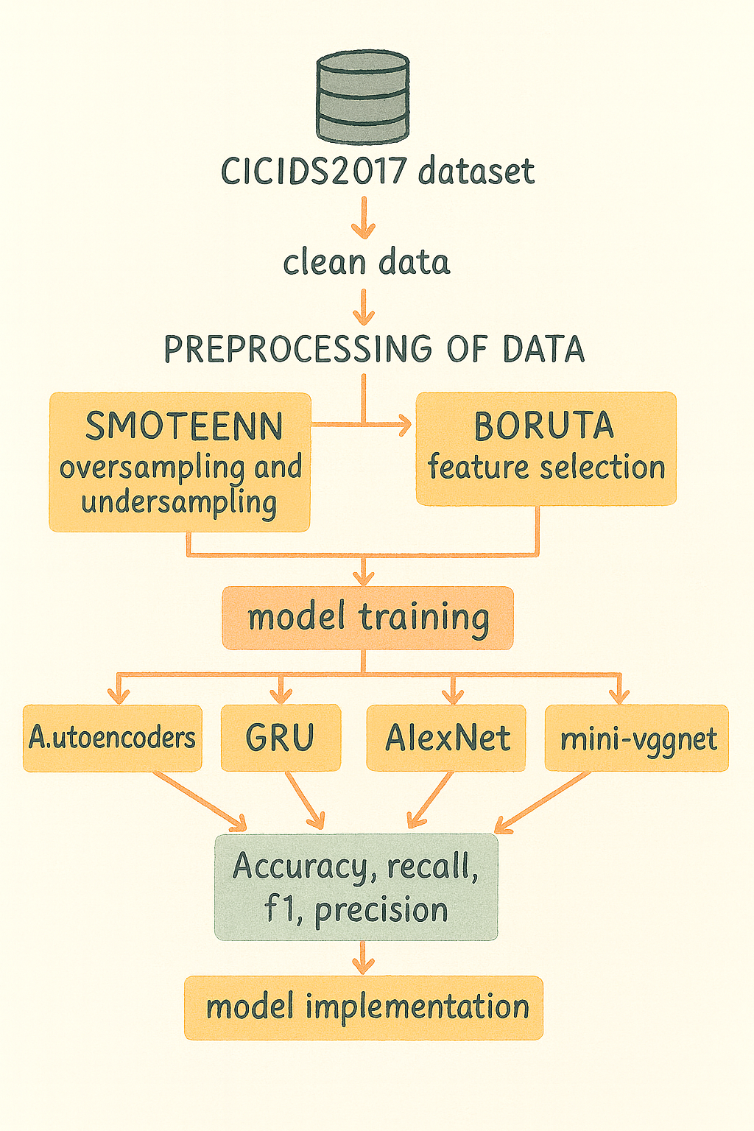
BLOCK DIAGRAM OR FLOW DIAGRAM
Model architecture of the proposed hybrid intrusion detection system
Data Preprocessing:
The CICIDS2017 dataset is first cleaned and preprocessed using SMOTE-ENN for data balancing (over- and under-sampling) and Boruta for selecting only the most important features.
Model Training:
The processed data is then used to train four deep learning models — Autoencoder, GRU, AlexNet, and Mini-VGGNet — to learn and classify normal and attack traffic patterns.
Model Evaluation and Implementation:
The models are evaluated using accuracy, F1-score, precision, and recall, and the best-performing model is selected for implementation in the intrusion detection system.
Review No.
Department of CSE

Slide 10
METHODOLOGY
1.Dataset Selection:
Utilized CICIDS2017 dataset containing real-world normal and attack traffic.
Data Preprocessing:
Performed data cleaning and Min–Max normalization.
Encoded categorical values and removed irrelevant fields
3.Model Development:
Built and trained four deep learning models:
Autoencoder: showed strong detection ability by identifying abnormal data accurately using reconstruction errors.
GRU: model performed well in handling time-based data, learning sequential patterns effectively.
AlexNet and MiniVGGNet: which are CNN-based models, also gave good results in spatial feature extraction, helping to detect various attack types.
2.Class Imbalance Handling:
Used SMOTE-ENN to balance minority and majority classes by oversampling and noise removal.
Feature Selection:
Implemented Boruta algorithm to identify and retain only the most significant features.
Integrated them into a hybrid IDS framework for improved accuracy and efficiency.
4.Evaluation Metrics:
Accuracy, Precision, Recall, and F1-Score were used to evaluate model performance
Review No.
Department of CSE

Slide 11
IMPLEMENTATION
Implementation:
The model was developed and trained on Google Colab using Python and TensorFlow/Keras frameworks.
The CICIDS2017 dataset was used for training and testing after preprocessing (cleaning, normalization, balancing).
Four deep learning models — Autoencoder, GRU, AlexNet, and MiniVGGNet — were trained and evaluated.
The best-performing model (Autoencoder) was saved and used for final intrusion detection implementation.
Software Specifications:
Operating System: Google Colab (Linux)
Frameworks & Libraries: TensorFlow, Keras, Scikit-learn, Pandas, NumPy, Matplotlib
Tools Used: Google Drive for dataset storage and result saving
Hardware Specifications:
GPU: NVIDIA Tesla T4 / A100 (16 GB VRAM)
RAM: 25 GB
Storage: 100 GB (Google Drive cloud storage)
Challenges & Solutions:
Data imbalance -- Used SMOTE-ENN for balancing normal and attack data
Overfitting during training – Applied dropout andearly stopping techniques
Feature redundancy – used boruta algorithm for feature selection to keep only relevant data
Review No.
Department of CSE

Slide 12
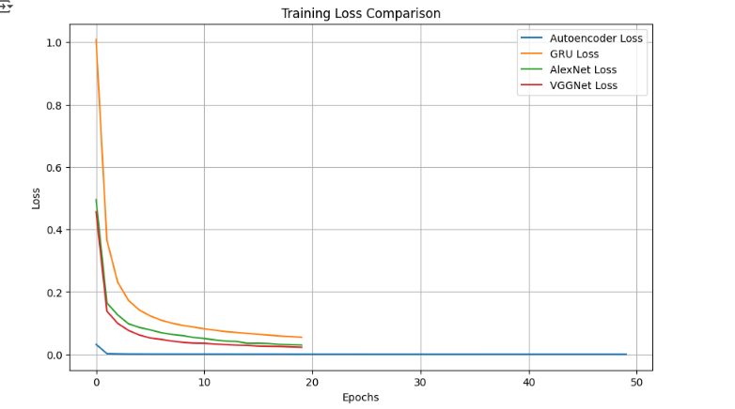
RESULTS & ANALYSIS
Training Loss Comparison of Autoencoder, GRU, AlexNet, and VGGNet models
This graph shows the training loss of our model over multiple epochs.
We can see that the loss value keeps decreasing as the training progresses, which means the model is learning correctly and reducing errors.
A lower training loss indicates that the model is predicting more accurately on the training data and not making large mistakes.
This shows our deep learning models especially GRU and Autoencoder are well-trained and stable.
Review No.
Department of CSE

Slide 13
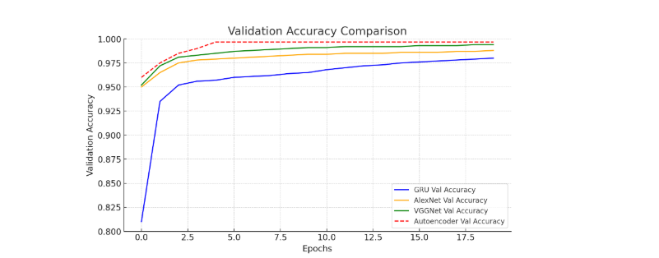
RESULTS & ANALYSIS
Validation Accuracy Comparison across Models
This graph shows the validation accuracy, which measures how well our model performs on new, unseen data.
The accuracy increases steadily and becomes stable, meaning the model is generalizing well and not overfitting.
It proves that our hybrid model maintains high performance on both training and testing data, which is important for real-time intrusion detection.
Review No.
Department of CSE

Slide 14
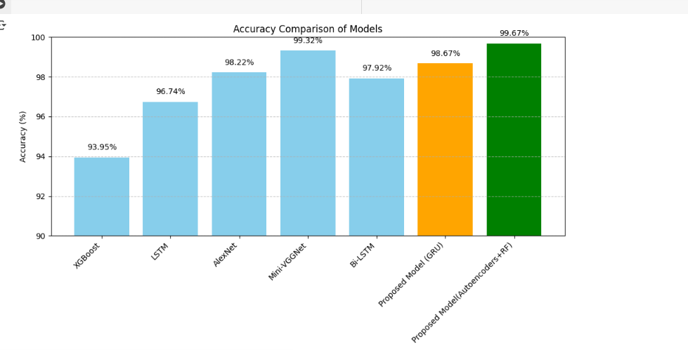
RESULTS & ANALYSIS
Comparison Table
This table shows the numerical comparison of each model’s performance.
You can see the Accuracy, Precision, Recall, and F1-score values for every model listed here.
These models performed better because GRU efficiently learns time-based patterns, and Autoencoder detects abnormal data through reconstruction errors.
Overall, the table confirms that our proposed models outperform the base paper models (XGBoost and LSTM) in all evaluation metrics, proving that our method gives more accurate and reliable intrusion detection.
date
Review No.
BatchNo.DG2
Department of CSE

Slide 15
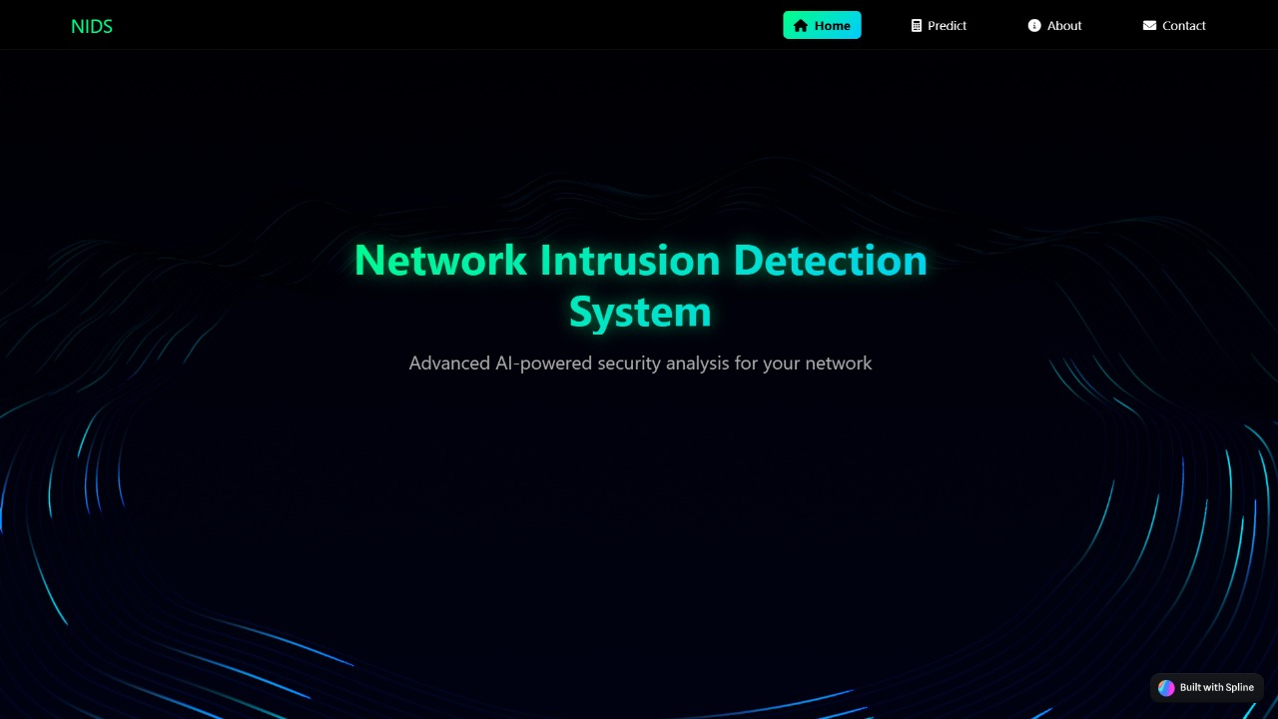

WEBSITE PAGES
date
Review No.
BatchNo.DG2
Department of CSE

Slide 16
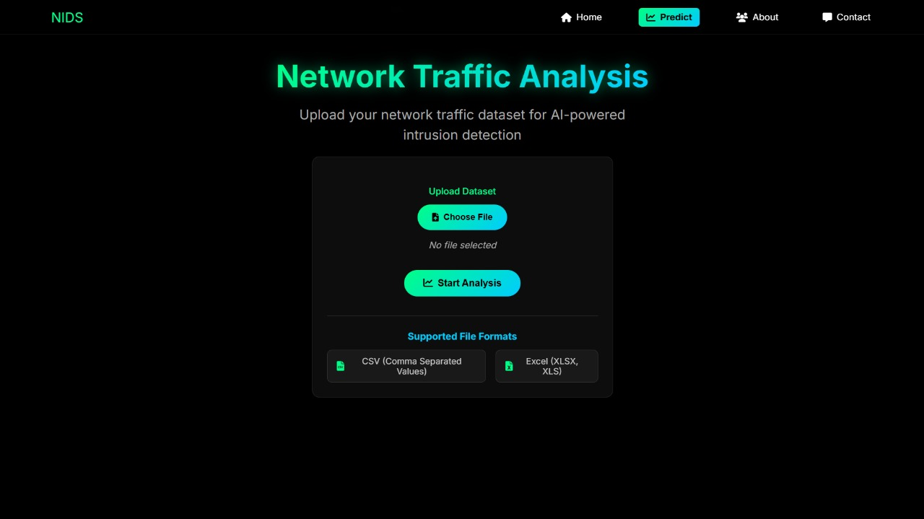
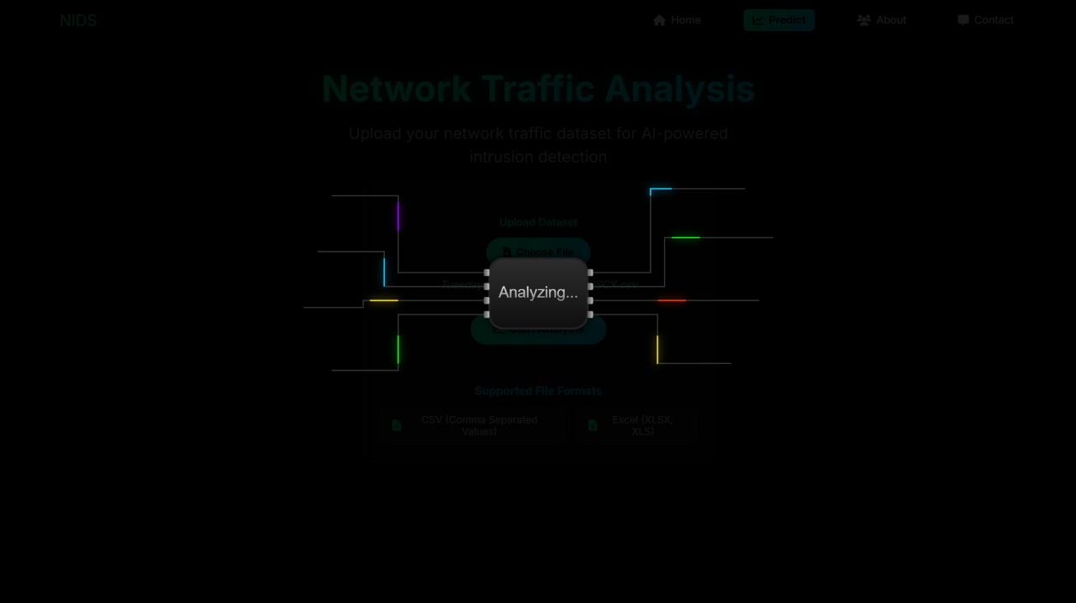
WEBSITE PAGES
date
Review No.
BatchNo.DG2
Department of CSE

Slide 17
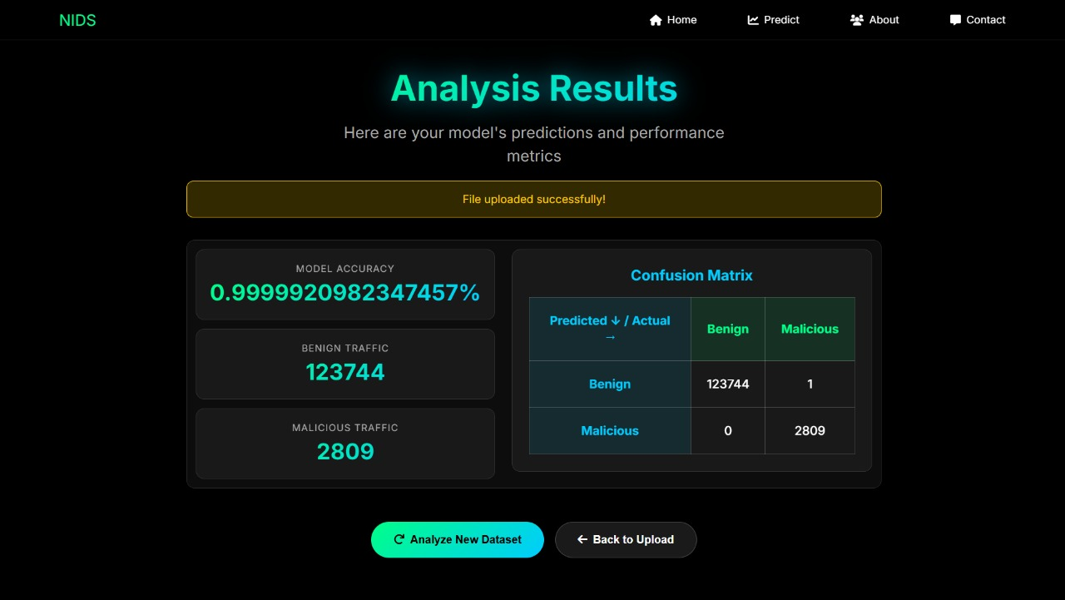
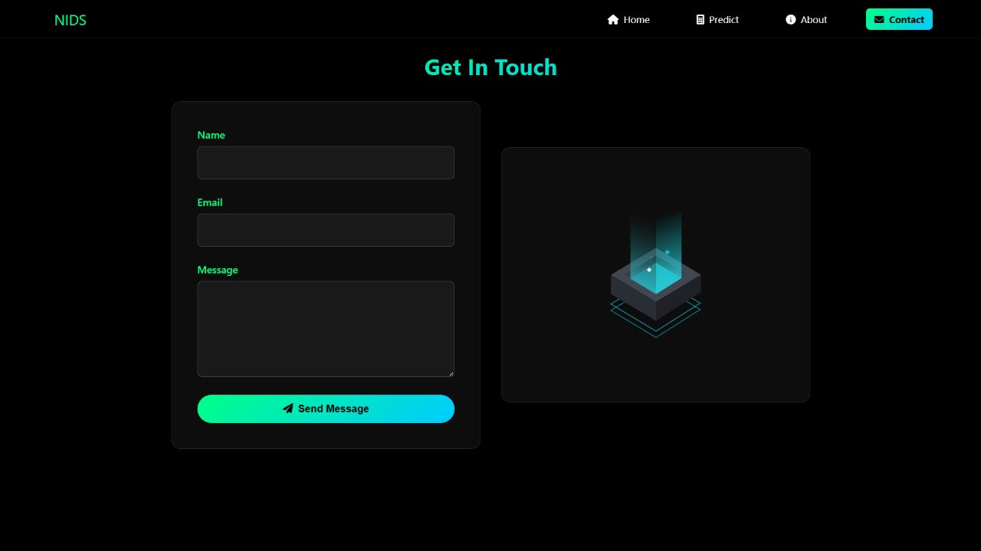
WEBSITE PAGES
date
Review No.
BatchNo.DG2
Department of CSE

Slide 18
CONCLUSION
Our adaptive hybrid intrusion detection system improves network security by combining intelligent preprocessing with deep learning. SMOTE-ENN balanced the dataset , and
Boruta selected t he most important features, leading to more efficient training. Using Autoencoder, GRU, AlexNet, and MiniVGGNet together enabled strong detection of
various attacks, including unknown and zero-day attacks. The model achieved 99.67% accuracy, proving that balanced data, optimized features, and hybrid deep learning significantly enhance IDS performance.
Review No.
Department of CSE

Slide 19
FUTURE SCOPE
Future Developments:
In the future, this system can be extended for real-time intrusion detection and automatic model updates for new attack patterns. It can also be optimized for IoT, cloud environments, and enhanced with explainable AI for better transparency.
Review No.
Department of CSE

Slide 20
REFERENCES
S. Aljawarneh, M. Aldwairi, and M. Yassein, ―Anomaly-based intrusion detection system through feature selection analysis and building hybrid efficient model,‖ Journal of Computer Science, vol. 25, pp. 152–160, 2018.
N. Shone, T. N. Ngoc, V. D. Phai, and Q. Shi, ―A deep learning approach to network intrusion detection,‖ IEEE Transactions on Emerging Topics in Computational Intelligence, vol. 2, no. 1, pp. 41–50, 2018
N. V. Chawla, K. W. Bowyer, L. O. Hall, and W. P. Kegelmeyer, ―SMOTE: Synthetic minority over-sampling technique,‖ Journal of Artificial Intelligence Research, vol. 16, pp. 321–357, 2002.
M. B. Kursa and W. R. Rudnicki, ―Feature selection with the Boruta package,‖ Journal of Statistical Software, vol. 36, no. 11, pp. 1–13, 2010.
K. S. Babu and Y. N. Rao, ―MCGAN: Modified Conditional Generative Adversarial Network for class imbalance problems in network intrusion detection system,‖ Applied Sciences, vol. 13, no. 4, p. 2576, 2023
I. Sharafaldin, A. Habibi Lashkari, and A. Ghorbani, ―Toward generating a new intrusion detection dataset and intrusion traffic characterization,‖ Proceedings of ICISSP, 2018.
Review No.
Department of CSE

Slide 21
QUESTIONS and ANSWERS
Thank You for Your Attention!
We’re open to your questions and suggestions.
— Presented by Team DB2
Review No.
Department of CSE

Slide 22
ACKNOWLEGEMENTS
We would like to express our sincere gratitude to our guide and faculty members for their valuable guidance, constant encouragement, and continuous support throughout this project.
We are also thankful to our institution for providing the facilities and resources that made this work possible.
Finally, we thank all our team members of DB2 for their cooperation, teamwork, and dedication in successfully completing this project titled “Adaptive Intrusion Detection Using Hybrid Deep Learning Models.”
Review No.
Department of CSE

